Slide 1

QUANTIC MSBA PROJECT APPENDIX
Predictive Retention & Deposit Framework
A Data-Driven Strategy for NovaBank Margin Recovery
Standardized Decision Rules, Model Trade-offs, and Governance
Reproducible Repository: https://github.com/popicu/novabank-retention-framework

Slide 2
Executive Challenge
Business context:
NovaBank's margins are under pressure from untargeted outbound campaigns. Only 11.27% of contacted customers historically subscribed to a term deposit.
Decision:
Should NovaBank replace mass outreach with model-based targeting to concentrate limited calling capacity where conversion is most likely?
Analytical reframing:
The supplied dataset does not contain a customer-churn outcome. We therefore use term-deposit engagement as a proxy for the broader retention objective, predicting which customers are most likely to respond to a deposit campaign.
Proposed action:
Rank customers using pre-call information by predicted response probability and target the top 20%, balancing conversion capture, outreach cost, and customer contact fatigue.
Success measures: Precision@20% • Conversion capture (Recall) • Net campaign profit

Slide 3
Data Readiness & Hygiene
1. Raw Data Ingestion
41,188 banking contacts across 20 social, financial & economic indicators.
•
Dataset Scope: 41,188 candidate contacts evaluated across 20 demographic, financial, relationship, campaign, and macro indicators.
2. Leakage Elimination
Stripped 'duration' to prevent post-call look-ahead bias (ensures real-world auditability).
•
Data Leakage Prevention: Stripped duration prior to training to ensure realistic pre-call operational forecasting.
•
Target Definition: Binary target y mapped to deposit conversion (11.27% baseline rate).
3. Feature Transformation
One-hot dummy encoding on 10 categoricals; engineered 'previously_contacted' indicator.
•
Train-Test Protocol: Stratified 80/20 train/test split to preserve minority class distribution.
4. Stratified Split (80/20)
Preserves 11.27% baseline conversion distribution across train & test partitions.

Slide 4
Model Diagnostics & Comparison
Metric | Legacy Mass Outreach | Baseline (Logistic Reg.) | Recommended (Gradient Boost)
Test ROC-AUC | 0.5000 | 0.8008 | 0.8142
Contacts Targeted | 41,188 (100%) | 8,238 (Top 20%) | 8,238 (Top 20%)
Precision@20% | 11.27% | 36.55% | 37.77%
Recall (Conversions Captured) | 100.0% | 64.9% | 67.03%
Net Campaign Profit | €542,180 | €628,930 | €653,930 (+20.6%)

Slide 5
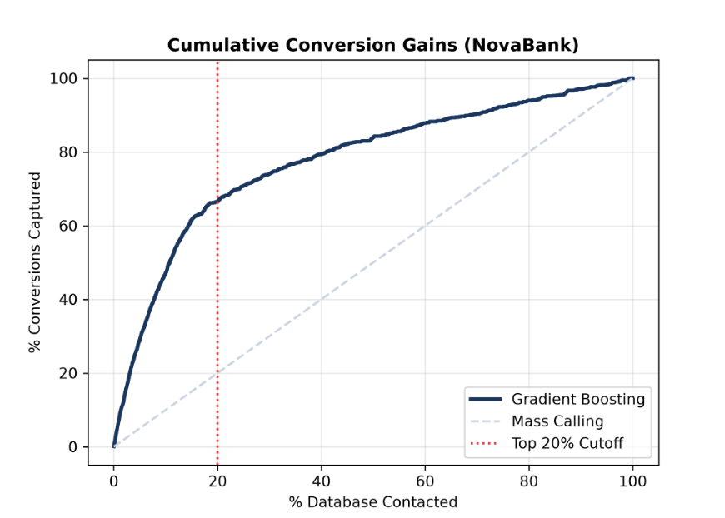

Cumulative Gains & Conversion Precision
Top-20% trade-off: ~5,128 non-converters contacted vs. ~1,530 historical converters missed
At the 20% population cutoff, the Gradient Boosting policy captures 67.03% of all deposit conversions, delivering 3.34x conversion density over mass calling.

Slide 6

Financial Impact Summary
Key Financial Takeaways
Call Spend Slashed: Operating cost drops from €617,820 to €123,570 (-80.0% cost reduction).
+20.6%
Captured Conversions: Retains 3,110 term-deposit subscriptions using an illustrative €250 assumed campaign value.
Net Profit Expansion (+€111,750)
Customer Experience: Prevents over 32,900 unnecessary cold calls, preserving brand equity.

Slide 7






Permutation Importance & Ethical Governance
Macro Indicators
Relationship History
Demographic Fairness
Age, marital status, and education are monitored through subgroup selection-rate and historical conversion-rate audits; small groups require cautious interpretation.
Permutation importance is concentrated in macro indicators, led by nr.employed, emp.var.rate, cons.price.idx, and euribor3m.
Contact channel, campaign activity, and relationship-history variables also contribute to the predictive ranking.

Slide 8

Macro Stress Testing
Interest Rate Sensitivity
An illustrative 100 bps reduction in Euribor is modeled as an 8.5% conversion reduction; this scenario supports ongoing model monitoring and recalibration.
CLV Erosion Buffer: Even if the illustrative campaign value compresses by 20% (from €250 to €200), the top-20% policy remains substantially more profitable than mass outreach, generating approximately €498k vs. €310k in net campaign profit under the stated assumptions.

Slide 9



60-Day Pilot Implementation Plan
Weeks 3–6: A/B Trial
Run randomized trial across 4,000 clients (2,000 model vs. 2,000 control).
Weeks 1–2: Setup
Weeks 7–8: Scale
Integrate scoring pipeline into CRM; route the top 20% of scored contacts to the outbound team
Scale only if the randomized pilot demonstrates positive incremental conversion lift versus control; monitor Precision@20% ≥ 35% and Return on Campaign Spend ≥ 5x as supporting operating metrics.

Slide 10
Questions & Governance
Audit Defensibility, Human-in-the-Loop AI Attribution, and Continuous Operational Oversight
🤖 AI Copilot Attribution & Governance
• Assistance Scope: Generative AI copilots supported scikit-learn syntax boilerplate, Matplotlib chart formatting, and Markdown scaffolding.
• Human Direction: Core decision logic, target engineering, business objective function (€15/call vs €250 CLV), and decile policy rules were designed by the project author.
• Data Leakage Remediation: Independently identified and audited the 'duration' feature trap, mandating its drop to preserve pre-call operational validity.
🛡️ Model Governance & Operational Controls
• Macro Drift Monitoring: Macro indicators are prominent in permutation-importance results, so performance and calibration should be reviewed periodically as economic conditions change.
• Fairness & Demographic Monitoring: Monitor subgroup selection rates and historical conversion rates across age, marital status, and education; investigate material disparities before scale-up.
• Contact Saturation Guardrail: Historical conversion rates decline as campaign contacts accumulate; use contact frequency as an operational guardrail and treat the observed relationship as descriptive, not causal.
🔗 Reproducible Codebase & Auditable Submission Files
Public GitHub Repository: https://github.com/popicu/novabank-retention-framework | Includes main.py, reproducible notebook, requirements.txt, and diagnostic charts.

