Slide 1
sRNA pipeline
niko.popitsch@univie.ac.at

Slide 2
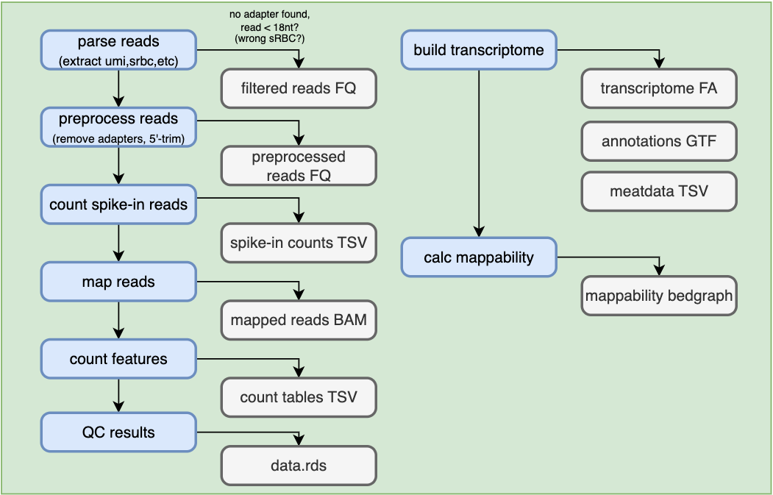
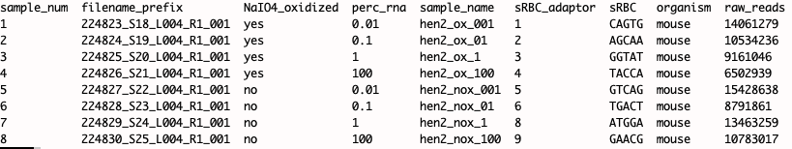
Currently supported read layout
sRNA nextflow pipeline overview
Example sample sheet

Slide 3
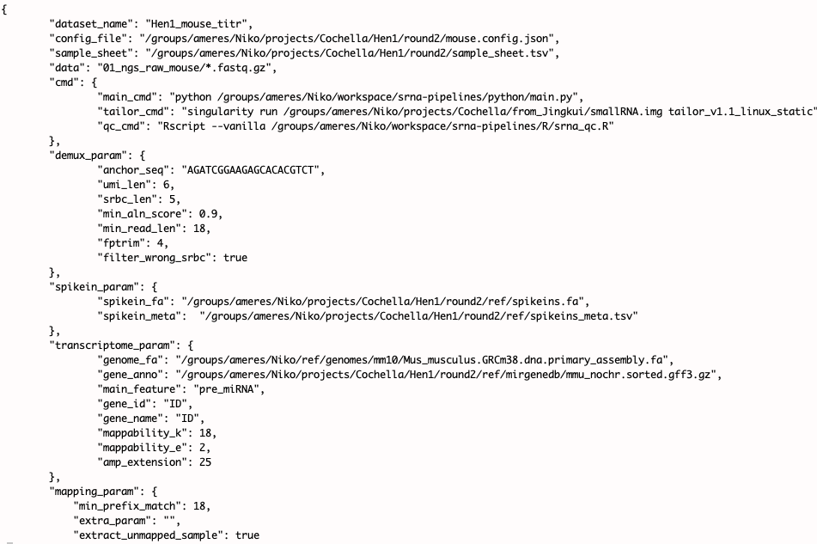
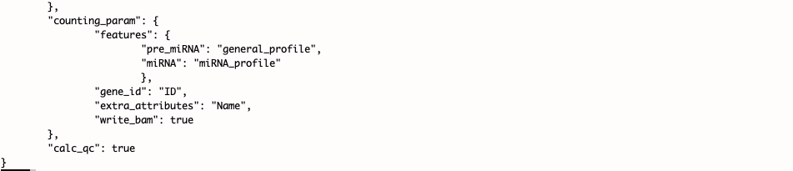
Example configuration
Filter short remaining fragments
Automatically created transcriptome from genome + annotation set
Currently using tailor (prefix-matcher)
Pre-defined filters for pre-miRNA and mature miRNAs

Slide 4

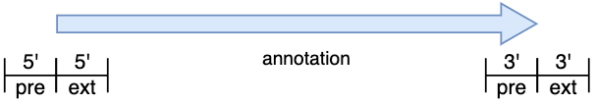
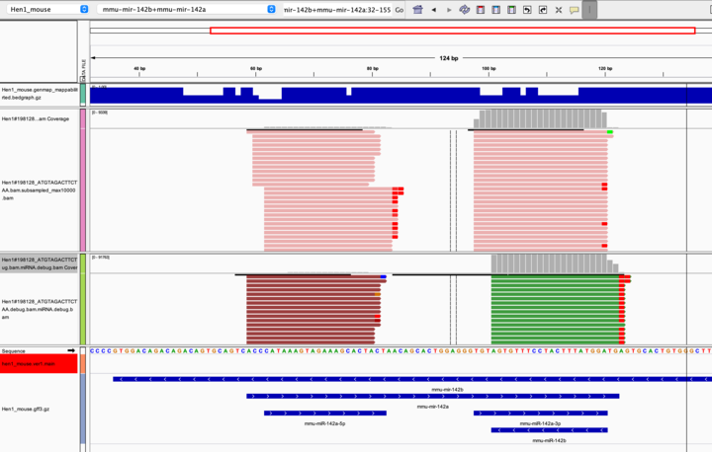
3’-pre unconstrained
Debugging output shows what reads were filtered for what reason

Slide 5
Integration with Brian’s pipeline?
Read pre-processing should be similar
We also support sRBCs and spike-ins which is beneficial for normalization
Todo: check support for pre-trimmed reads
Annotations:
Currently i am using annotations from mirgenedb (https://mirgenedb.org/) containing pre-miRNA and mature mir/mir* annotations
According to Luisa those are far better than miRBase.
For Dmel: Don’t know how they compare to flybase annotations
Mapping:
Using those I create a transcriptome and map using the prefix mapper ‘tailor’ (https://github.com/jhhung/Tailor/tree/master)
This would have to be adapted to use bowtie, NextGenMap or possibly srnaMapper (Zytnicki, 2022)
Counting:
Needs to be adapted to include T/C conversions

