Slide 1
sRNA pipeline
niko.popitsch@univie.ac.at

Slide 2
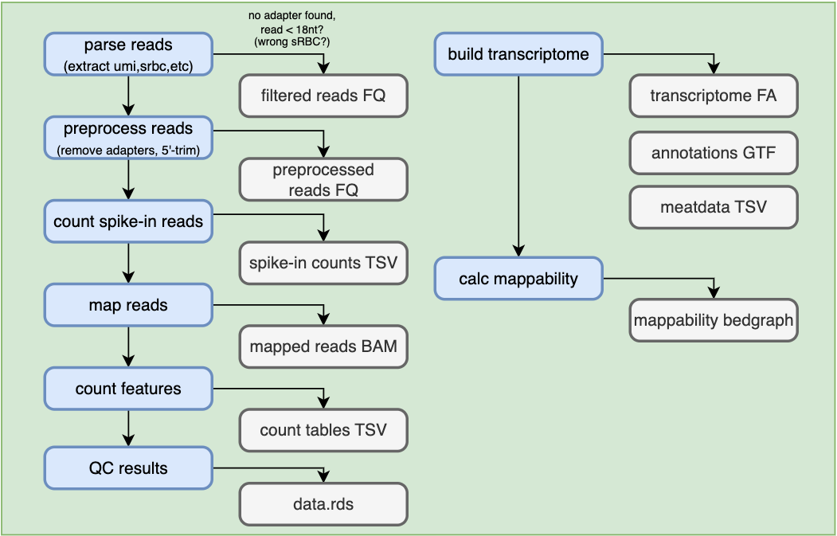
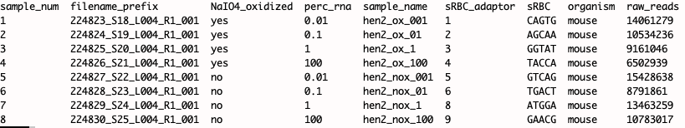
Currently supported read layout
sRNA nextflow pipeline overview
Example sample sheet

Slide 3
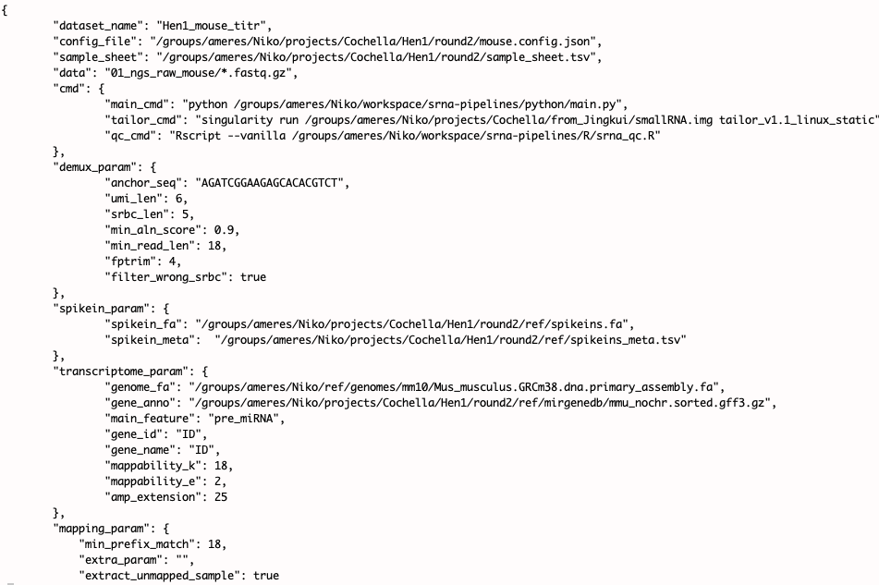
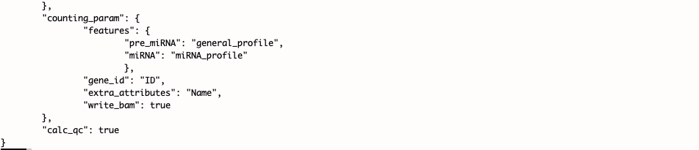
Example configuration
Filter short remaining fragments
Automatically created transcriptome from genome + annotation set
Currently using tailor (prefix-matcher)
Pre-defined filters for pre-miRNA and mature miRNAs

Slide 4

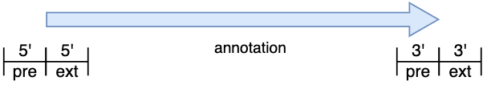
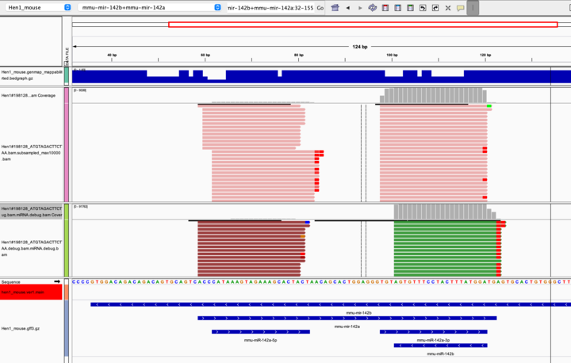
3’-pre unconstrained
Debugging output shows what reads were filtered for what reason

Slide 5
Integration with Brian’s pipeline?
Read pre-processing should be similar
We also support sRBCs and spike-ins which is beneficial for normalization
Todo: check support for pre-trimmed reads
Annotations:
Currently i am using annotations from mirgenedb (https://mirgenedb.org/) containing pre-miRNA and mature mir/mir* annotations
According to Luisa those are far better than miRBase.
For Dmel: Don’t know how they compare to flybase annotations
Mapping:
Using those I create a transcriptome and map using the prefix mapper ‘tailor’ (https://github.com/jhhung/Tailor/tree/master)
This would have to be adapted to use bowtie, NextGenMap or possibly srnaMapper (Zytnicki, 2022)
Counting:
Needs to be adapted to include T/C conversions

Slide 6
Mapper comparison for T/C aware mapping
Tailor –l 18
NextGenMap 0.5.5 --very-sensitive -n 3 --strata -k 10
srnaMapper –e 3
HISAT-3N --base-change T,C
Bowtie v1.2.2 -v 3 -m 1 -k 3 --best --strata -p 1

Slide 7
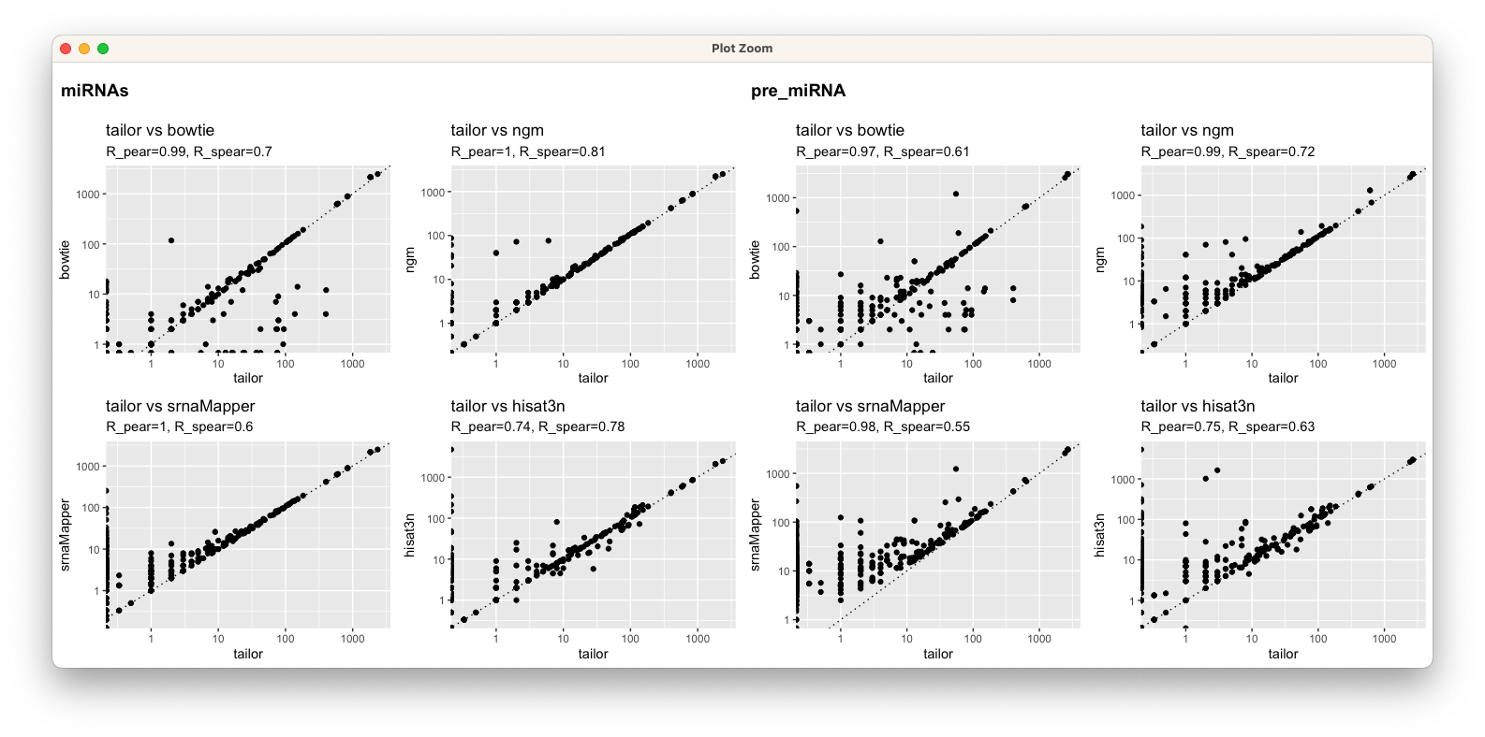
Good correlation but some outliers ?
High pearson but low spearman?

Slide 8
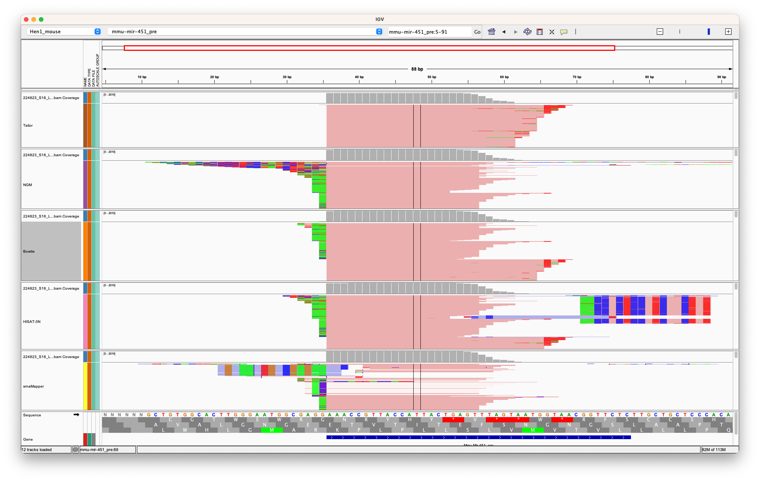
Tailor: baseline
NextGenMap: good best rc correlation with tailor
Bowtie 1.2.2: good rc correlation
HISAT-3N with T/C index: some false alignment due to unpunished T/C mm
srnaMapper:
Some weird (wrong) alignments but good readcount coorelation

