Slide 1
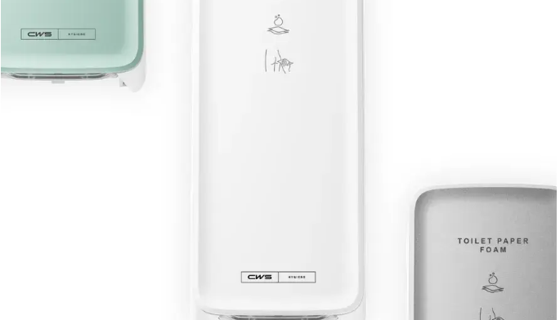
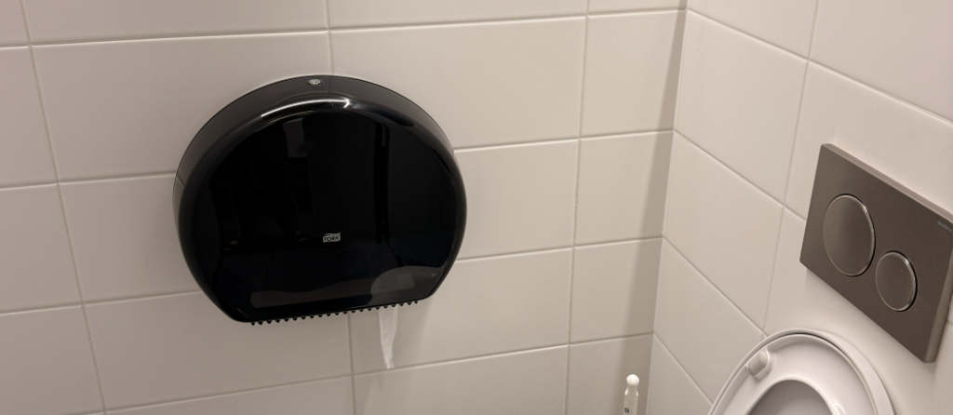
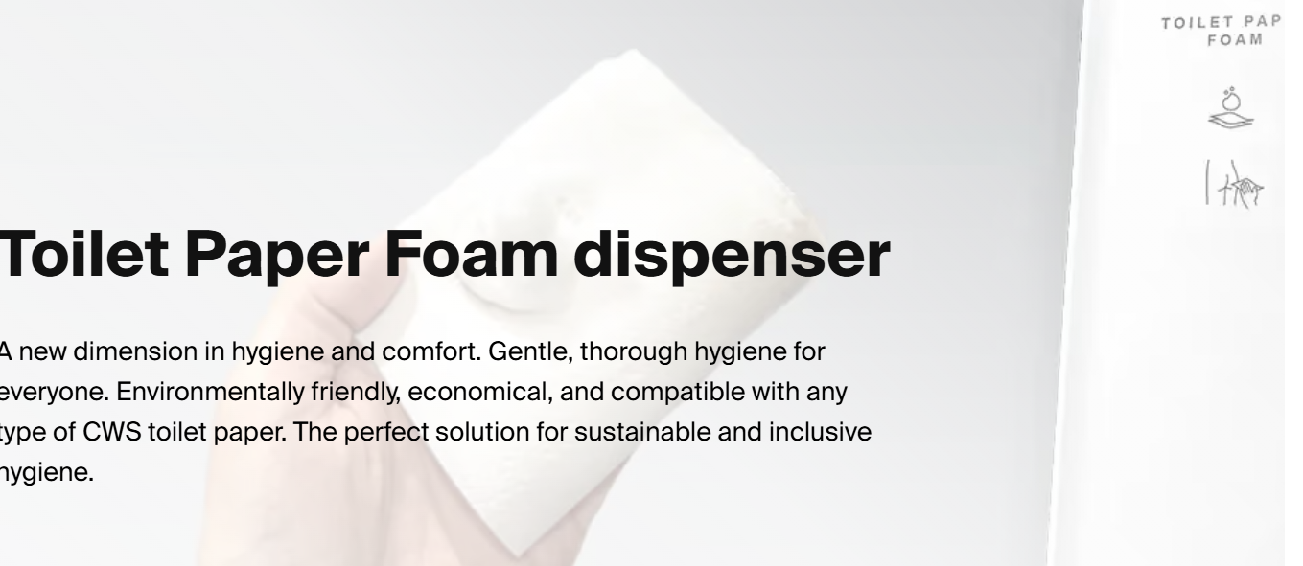
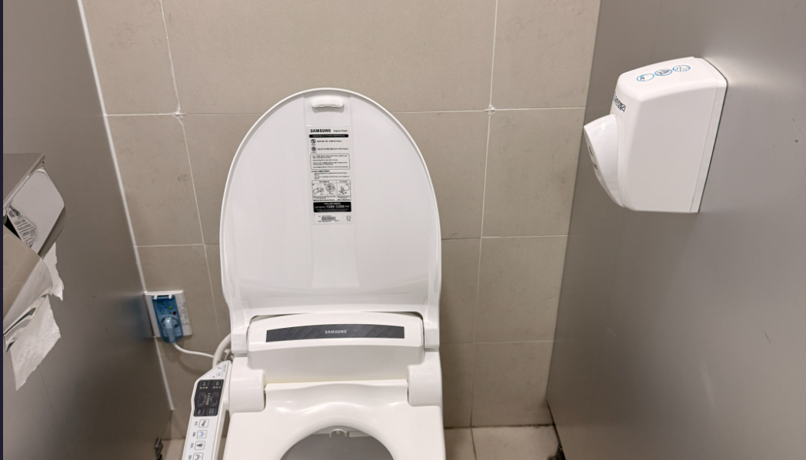

Slide 2
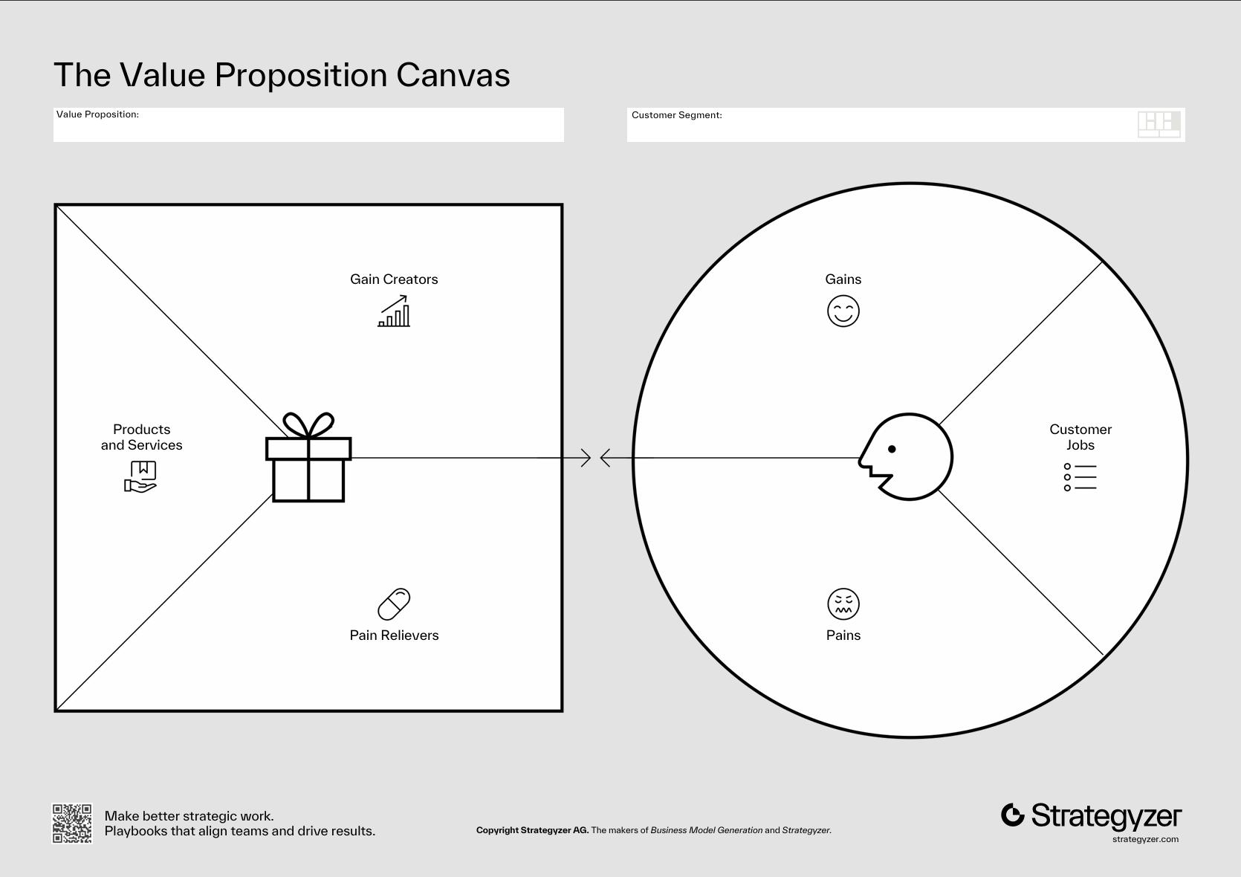
FoamFit — Cleaner tissue experience
백화점 (Department Store)
Better hygiene
Easy refill
User satisfaction
Maintenance
Cost down
Foam module
Cleaner feeling
Clean restrooms
No electricity
Refill cartridge
Reduce complaints
Better hygiene
Uncomfortable
Control cost
Less wipe waste
Lower clogging
Bidet cost
Wet-wipe clogs

