Slide 1
Chapter 7: advanced sql
Modern Database Management
12th Edition
Global Edition
Jeff Hoffer, Ramesh Venkataraman,
Heikki Topi
授課老師：楊立偉教授，台灣大學工管系

Slide 2
Processing Multiple Tables
Join–a relational operation that causes two or more tables with a common domain to be combined into a single table or view 連接2或多個表格成為單一表格
Equi-join–a join in which the joining condition is based on equality between values in the common columns; common columns appear redundantly in the result table 以共通欄位相等值作連接 (會有重複資料欄)
Natural join–an equi-join in which one of the duplicate columns is eliminated in the result table (同上，但去掉重複的資料欄)
The common columns in joined tables are usually the primary key of the dominant table and the foreign key of the dependent table in 1:M relationships.
Notes:
Very often the data we want to see from a query needs to come from multiple tables. Most of the time these tables are linked in relationships via primary and foreign keys. The vast majority of joins involve matching primary and foreign keys, but there can also be other kinds of joins as well.

Slide 3
Processing Multiple Tables
Outer join–a join in which rows that do not have matching values in common columns are nonetheless included in the result table (as opposed to inner join, in which rows must have matching values in order to appear in the result table) 以共通欄位未有符合值者作連接 (剛好相反)
Union join–includes all data from each table that was joined
Notes:
Unions are not literally joins, and the syntax for expressing a union is not the same as the syntax for expressing a join. Nevertheless, unions also combine data from different tables.

Slide 4
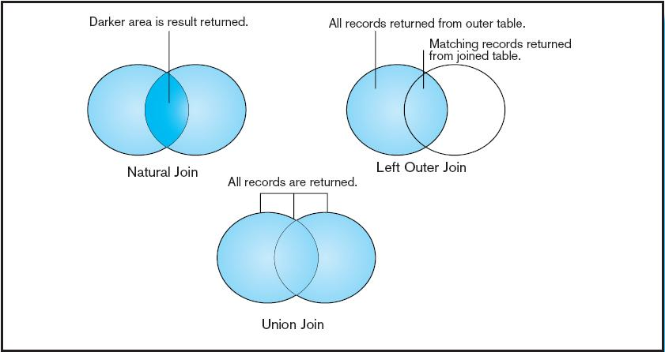
Figure 7-2 Visualization of different join types with results returned in shaded area
Notes:
In this Venn diagram, the data from each table is represented as a circle. Natural joins will only return the records from each table that have a match in the join condition with the other table. This is also called an inner join. By contrast, with an outer join, the records from one table will be included even if there are no corresponding records from the other. With a union join, all records from both tables are returned. This can also be accomplished via a full outer join.

Slide 5
SELECT Order.*, Customer.*, Product.*
FROM Order
JOIN Customer ON Order.c_id=Customer.id
JOIN Product ON Order.p_id=Product.id
Equi-join的結果
最原始, 由等號連結
Natural join的結果
其中必有部份欄位之值
完全相同 (Join條件)
將之剔除不顯示

Slide 6
SELECT Emp.*, Dept.*
FROM Emp
JOIN Dept ON Emp.dep_no=Dept.no
←注意這筆
Equi-join的結果
最原始, 由等號連結
Left outer join的結果
Left : 以左邊為主
Outer : 不管是否有關聯到, 均列出
SELECT Emp.*, Dept.*
FROM Emp LEFT OUTER JOIN Dept ON Emp.dep_no=Dept.no

Slide 7
SELECT Emp.*, Dept.*
FROM Emp
JOIN Dept ON Emp.dep_no=Dept.no
←注意這筆
Left inner join的結果
Left : 以左邊為主
Inner : 有關聯到的才列出
→結果又等同Equi-join
SELECT Emp.*, Dept.*
FROM Emp LEFT INNER JOIN Dept ON Emp.dep_no=Dept.no
預設就是inner
不需特別指定

Slide 8
SELECT *
FROM Customer_TPE
SELECT *
FROM Customer_HKG
Union-join的結果
垂直合併
兩張表格必需聯集相容 Union Compatible
→兩張表格有相同之欄位，
且相對應之欄位有相同值域
合併後的結果必需符合表格特徵
→任兩筆完全相同紀錄的會被合併
(若不想作重複檢查，可改用UNION ALL語法)
SELECT *
FROM Customer_TPE
UNION
SELECT *
FROM Customer_HKG

Slide 9
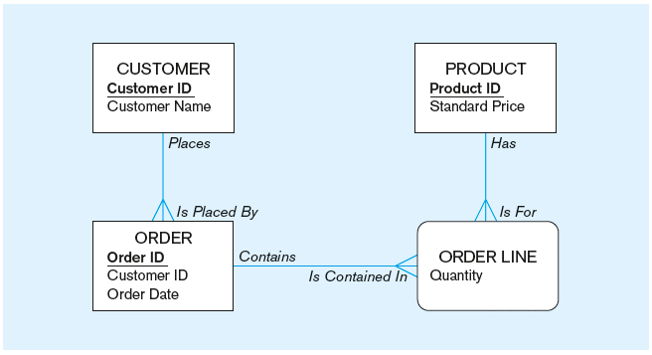
The following slides Involve queries operating on tables from this enterprise data model
(from Chapter 1, Figure 1-3)
Notes:
We’ve looked at these entities several times throughout the course. Each of these entities is implemented in a table. A customer may have several orders, each of which contains one or more order lines. Each order line is associated with a product. Of course, each product could be associated with several orders (through the order line associative entity).
We’ll look at several examples involving tables generated from these entities.

Slide 10
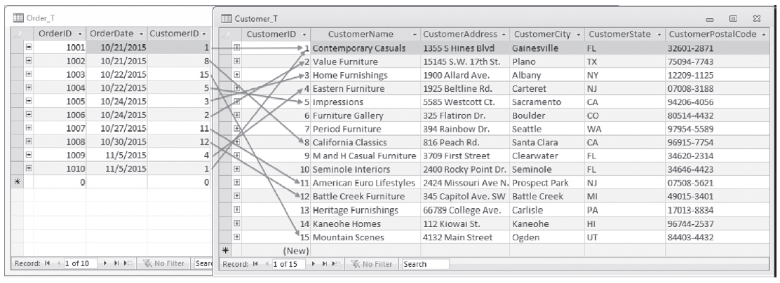
Figure 7-1 Pine Valley Furniture Company Customer_T and Order_T tables with pointers from customers to their orders
有10筆訂單
有15個客戶 (9個客戶下過訂單; 其中1位下過2張訂單)
These tables are used in queries that follow
Notes:
Customer_T and Order_T have a 1:N relationship, as you can see from the CustomerID foreign key in Order_T. These are two of the tables; the others are OrderLine_T and Product_T.

Slide 11
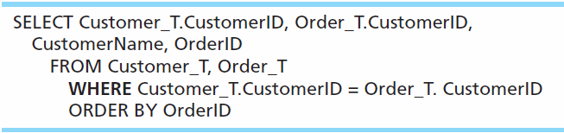
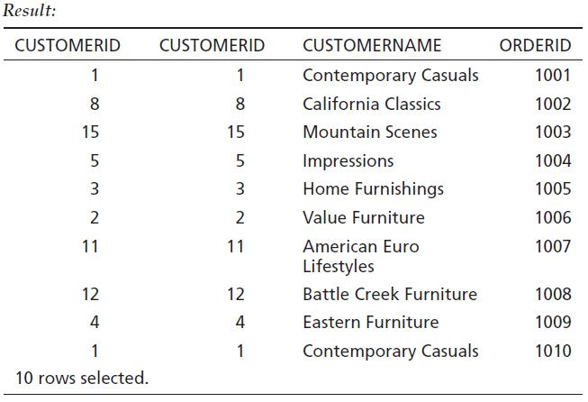
Equi-Join Example (用WHERE)
For each customer who placed an order, what is the customer’s name and order number?
Customer ID appears twice in the result
Notes:
This is an equi-join. Notice that the CustomerID is showing from both tables. It’s probably not necessary to see this, because they are always matched.
Notice also that 10 rows are returned in this query. There are 10 rows in the Order_T table, and only those rows from the Customer_T table with corresponding orders will be included. That’s because equi-joins are inner join by default.

Slide 12
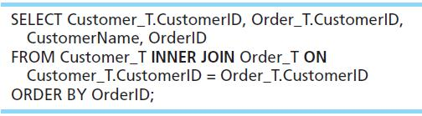
Equi-Join Example – alternative syntax (用join)
INNER JOIN clause is an alternative to WHERE clause, and is used to match primary and foreign keys.
An INNER join will ONLY return rows from each table that have matching rows in the other. 找不到符合的不會包含顯在結果中
This query produces same results as previous equi-join example.
Notes:
For join conditions, sometimes this syntax is used instead of the WHERE clause. This way you can distinguish between conditions that are used for matching records between tables vs. conditions used for selecting which rows to return (as we learned about in Chapter 6).

Slide 13
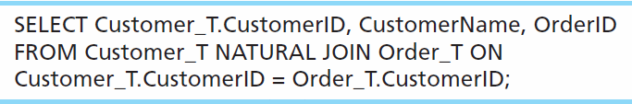
Natural Join Example
For each customer who placed an order, what is the customer’s name and order number?
Join involves multiple tables in FROM clause
ON clause performs the equality check for common columns of the two tables
Note: From Fig. 7-1, you see that only 10 Customers have links with orders.
➔ Only 10 rows will be returned from this INNER join
通常直接寫JOIN, 較少使用NATURAL JOIN

Slide 14
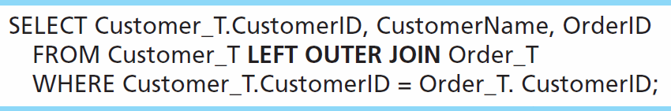
Outer Join Example
List the customer name, ID number, and order number for all customers. Include customer information even for customers that do NOT have an order.
LEFT OUTER JOIN clause causes customer data to appear even if there is no corresponding order data
會回傳15筆
Unlike INNER join, this will include customer rows with no matching order rows

Slide 15
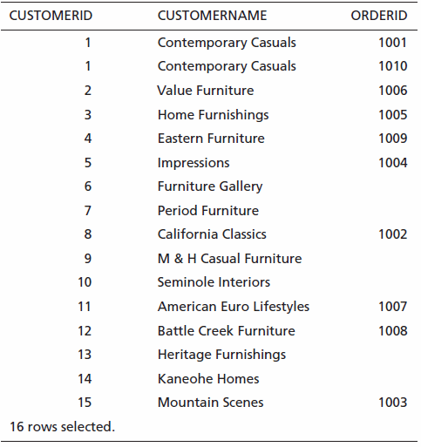
Outer Join Results
Unlike INNER join, this will include customer rows with no matching order rows
符合多筆訂單的仍會出現多次 (例如客戶1)
未符合的紀錄，訂單值則留空(以null表達)
Notes:
There are 15 records in the Customer_T table, so all of these are returned, even if there are no matching records in the Order_T table. Also, one of the customers has two orders, as you can see. Therefore there are total of 16 rows returned here. That’s one for each order, plus one for each unmatched customer.
This is what distinguishes an outer join from an inner join.

Slide 16
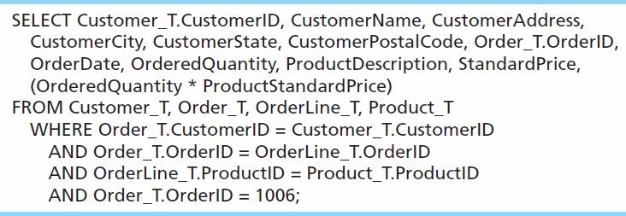
Multiple Table Join Example
Assemble all information necessary to create an invoice for order number 1006
Four tables involved in this join
Each pair of tables requires an equality-check condition in the WHERE clause, matching primary keys against foreign keys. 全部4張表(至少)需有3個連接條件
Notes:
There are four tables involved in this join. Therefore there are three join conditions. In general, if there are n tables, there will be n-1 join conditions.
The final condition (OrderID = 1006) is not a join condition. This is a condition that restricts the number of rows returned, not one that connects tables.

Slide 17
Multiple Table Join Example
SELECT C.CustomerID, CustomerName, CustomerAddress, CustomerCity, CustomerState, CustomerPostalCode, O.OrderID, OrderDate, OrderQuantity AS Q, ProductDescription, ProductStandardPrice AS P, (Q * P) AS Amount
FROM CUSTOMER_T AS C, ORDER_T AS O, ORDER_LINE_T AS L, PRODUCT_T AS T
WHERE C.CustomerID = O.CustomerID
AND O.OrderID = L.OrderID
AND L.ProductID = P.ProductID
AND O.OrderID = 1006;
不模糊的情況下不用指定表格名稱
改用別名易於閱讀
共三個連接條件，一個過濾條件
改用JOIN寫有同樣效果
SELECT …
FROM CUSTOMER_T AS C
JOIN ORDER_T AS O ON C.CustomerID = O.CustomerID
JOIN ORDER_LINE_T AS L ON O.OrderID = L.OrderID
JOIN PRODUCT_T AS P ON L.ProductID = P.roductID
WHERE O.OrderID = 1006;
17

Slide 18
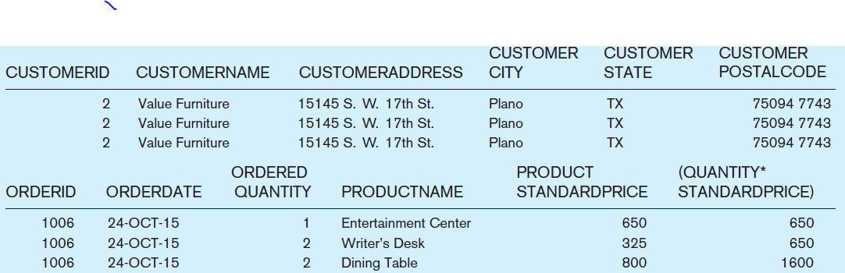
Figure 7-4 Results from a four-table join (edited for readability)
From CUSTOMER_T table
From ORDER_T table
From ORDERLINE_T table
From PRODUCT_T table
Notes:
Obviously, all rows returned from this query will pertain to OrderID 1006.
Note that the full query results include columns from four different tables.

Slide 19
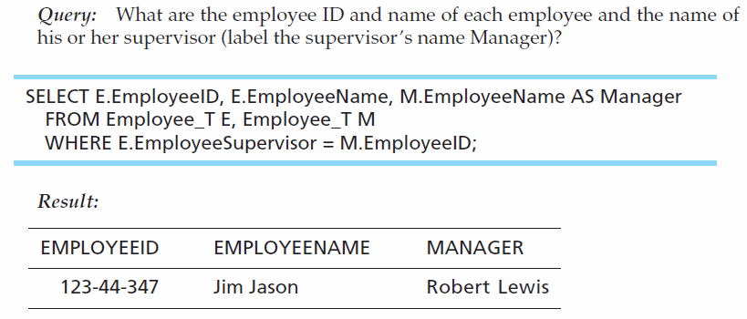
Self-Join Example
The same table is used on both sides of the join; distinguished using table aliases
用不同別名來區別
Self-joins are usually used on tables with unary relationships.

Slide 20
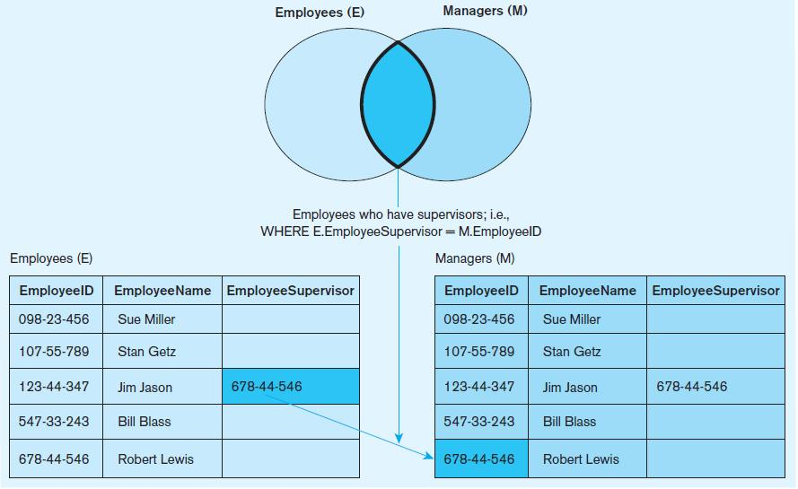
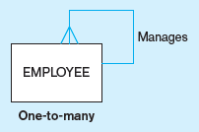
Figure 7-5 Example of a self-join
From Chapter 2
Unary 1:N
Notes:
Suppose you have a table of five employees as shown here. Only one of these employees has a supervisor. The EmployeeSupervisor column would be a foreign key in the Employees table which is associated the primary key EmployeeID. We saw an ER diagram showing the same sort of thing in chapter 2. So, a self join is associated with a unary relationship.

Slide 21
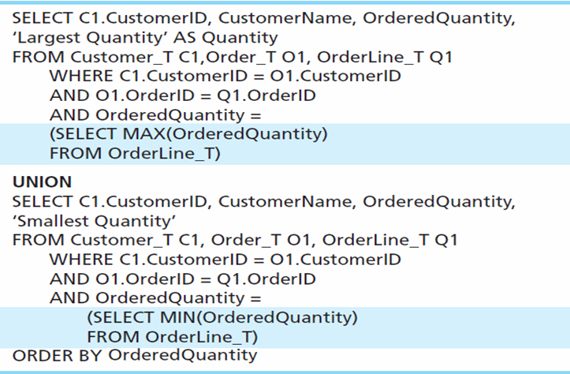
Union Queries
Ex.找出訂購數量最多及最少的客戶
Combine the output (union of multiple queries) together into a single result table
以常數字串
增加一欄作為
說明文字
First query
Combine
Second query
Notes:
This query determines the customer(s) who has in a given line item purchased the largest quantity of any Pine Valley product and the customer(s) who has in a given line item purchased the smallest quantity and returns the results in one table.
To use the UNION clause, each query involved must output the same number of columns, and they must be UNION compatible. This means that the output from each query for each column should be of compatible data types.
Note: although these queries involve subqueries, this is not necessary for unions. It just so happens we’re doing it in this example.
In general a UNION is structured like this:
SELECT statement
UNION
SELECT statement
It is possible to UNION many different SELECT statements together. He we perform a single UNION operation combining two of them.

Slide 22
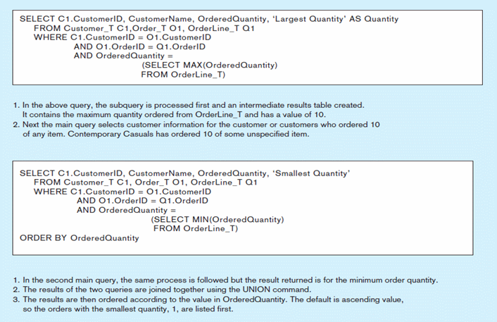
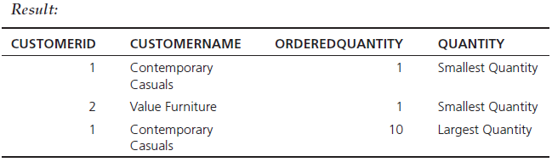
Figure 7-9 Combining queries using UNION
Note: With UNION queries, the quantity and data types of the attributes in the SELECT clauses of both queries must be identical.
Notes:
This figure explains the processing of this UNION query.
Note another feature of this example. It is possible for the SELECT clause to include literal values in its returned column list. See the words ‘Smallest Quantity’ and ‘Largest Quantity’. These are not values in the tables, but can still be shown in the results.

Slide 23
Processing Multiple Tables Using Subqueries
Subquery
因為查詢的結果還是表格，因此可對結果再查詢
placing an inner query (SELECT statement) inside an outer query
Options:
In a condition of the WHERE clause 在WHERE子句使用
As a “table” of the FROM clause 在FROM當新來源
Within the HAVING clause 在HAVING子句使用
Subqueries can be:
Noncorrelated–executed once for the entire outer query
Correlated–executed once for each row returned by the outer query 每行資料都得執行一次子查詢
Notes:
Subqueries are usually placed in the WHERE or HAVING clause of the outer query, and its results are often used as conditions for the WHERE or HAVING. It is also possible to put subqueries into the FROM clause.
When using multiple tables, sometimes you need a subquery, sometimes you need a join. Other times, the problem can be solved by either a subquery or a join. It is also possible to combine joins and subqueries together.

Slide 24
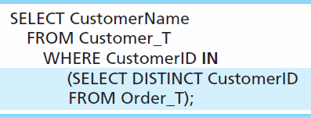
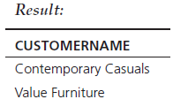
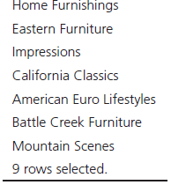
Subquery Example
Show all customers who have placed an order
The IN operator will test to see if the CUSTOMER_ID value of a row is included in the list returned from the subquery
Subquery is embedded in parentheses. In this case it returns a list that will be used in the WHERE clause of the outer query
在這個例子DISTINCT可加可不加，為什麼?
Notes:
Here, the subquery returns all the DISTINCT customer IDs. In other words, if the same customer ID appears twice in the Order_T table, the DISTINCT operator ensures that it only appears once in the final result. This is often useful in queries.
This could also have been accomplished using an inner join.

Slide 25
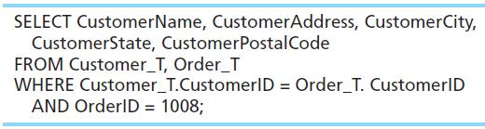
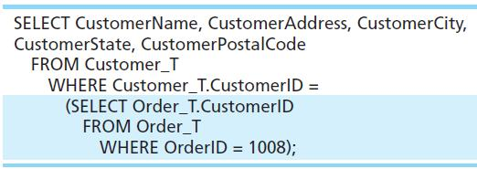
Join vs. Subquery
Some queries could be accomplished by either a join or a subquery
Join version
Subquery version
Notes:
Here is another example where either a join or a subquery would work.
But the subquery would not work if you needed to display data from the Order table. The results from the subquery are not actually displayed to the user; rather they are only used by the outer query. So, none of the data from the query looking at ORDER_T will be displayed.

Slide 26
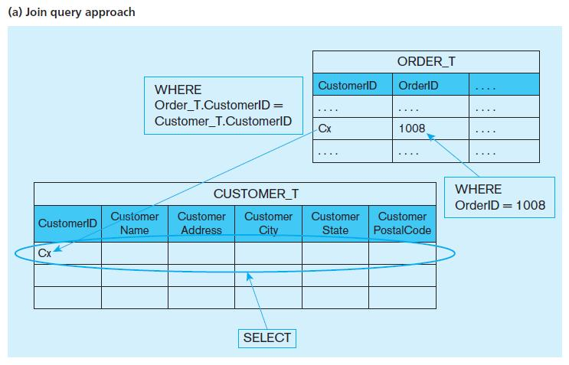
Figure 7-6 Graphical depiction of two ways to answer a query with different types of joins
Notes:
The joining technique is useful when data from several relations are to be retrieved and displayed, and the relationships are not necessarily nested, whereas the subquery technique allows you to display data from only the tables mentioned in the outer query. For example with the join we could see the Oder ID, but not with the subquery.
A join involves a cross product which combines all combinations of rows from each of the tables, followed by removing the rows that don’t match according to the conditions of the join.

Slide 27
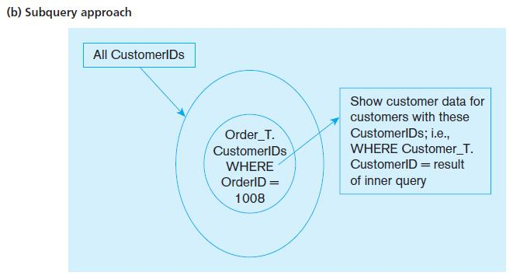
Figure 7-6 Graphical depiction of two ways to answer a query with different types of joins
Subquery寫法指示了DBMS運算順序；Join寫法將運算細節交給DBMS自行決定
Notes:
A subquery operates differently from a join. First, the subquery executes, which returns a result. Then that result is used in the outer query.
So, for these examples, although the results are the same, the execution that gave the results are quite different.

Slide 28
請見補充講義

Slide 29
Correlated vs. Noncorrelated Subqueries
Noncorrelated subqueries:
Do not depend on data from the outer query
Execute once for the entire outer query
Correlated subqueries:
Make use of data from the outer query
Execute once for each row of the outer query
Can use the EXISTS operator
可配合EXISTS使用，判斷子查詢是否有結果
Notes:
Correlated subqueries use the result of the outer query to determine the processing of the inner query. That is, the inner query is somewhat different for each row referenced in the outer query. In this case, the inner query must be computed for each outer row, whereas in the earlier examples, the inner query was computed only once for all rows processed in the outer query.

Slide 30
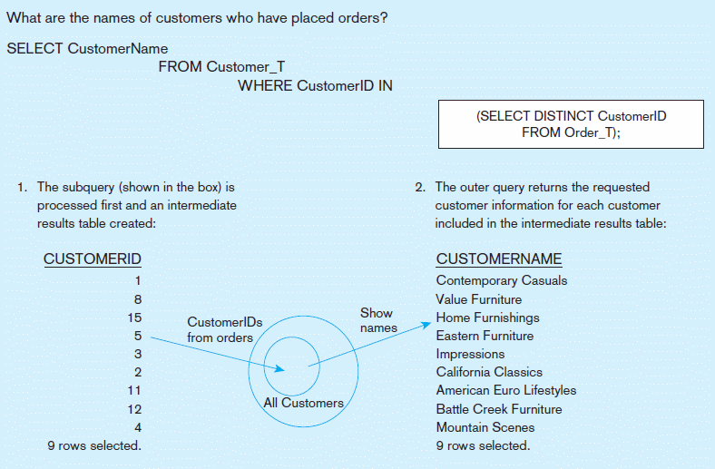
Figure 7-8a Processing a noncorrelated subquery
No reference to data in outer query, so subquery executes once only
A noncorrelated subquery processes completely before the outer query begins.
Notes:
This is a non-correlated subquery. In this case all customer IDs are obtained from the Order_T table. Then this list is applied to the IN clause in the outer query. So, in this case we executed the inner query once, and then the outer query once.

Slide 31
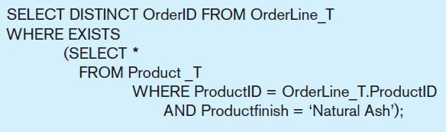
Correlated Subquery Example
Show all orders that include furniture finished in natural ash.
The EXISTS operator will return a TRUE value if the subquery resulted in a non-empty set, otherwise it returns a FALSE
➔ A correlated subquery always refers to an attribute from a table referenced in the outer query
The subquery is testing for a value that comes from the outer query
Notes:
The key feature that identifies a correlated subquery is the fact that the subquery makes reference to a column from the outer query. Note that OrderLine_T is a table used in the FROM clause of the outer query, but is not a table in the FROM clause of the inner query. Yet, the WHERE clause of the inner query does refer to a column from OrderLine_T, specifically the product ID.
If your subquery has a reference to a table in the outer query, that makes it a correlated subquery. If it does not have such a reference, then it is a noncorrelated subquery.

Slide 32
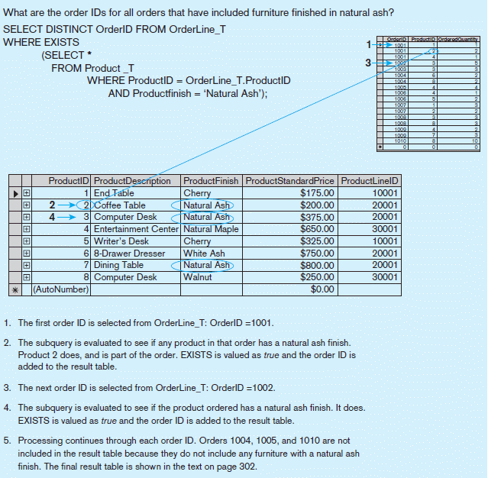
Figure 7-8b Processing a correlated subquery
Subquery refers to outer-query data, so executes once for each row of outer query (需花相較很多的執行時間)
Note: Only the orders that involve products with Natural Ash will be included in the final results.
Notes:
So, in this case the subquery will execute once for each row of the outer query. In this example, the outer query goes through each row of the OrderLine_T table. Each time it gets to a row, that particular row’s product ID is used in the subquery to get the product of that particular order line. There are 17 order line records, so the subquery will execute 17 times, one for each order line record.
So, you can see the difference in behaviors of correlated vs. noncorrelated queries. With a non-correlated query, the inner query executes once, and then the outer query executes. For a correlated subquery, the outer query executes, and for each row of the outer query the inner query will execute once.

Slide 33
改用join的寫法
Q. What are the order IDs for all orders that have included furniture finished in natural ash ?
SELECT DISTINCT L.OrderID
FROM OrderLine_T AS L, Product_T AS P
WHERE L.ProductID=P.ProductID
AND P.ProductFinish=‘Natural Ash’

Slide 34
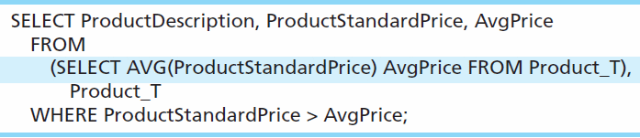
Another Subquery Example /(Derived Table)
Show all products whose standard price is higher than the average price
One column of the subquery is an aggregate function that has an alias name. That alias can then be referred to in the outer query.
Subquery forms the derived table used in the FROM clause of the outer query 產生新的臨時表 (只有一欄)
The WHERE clause normally cannot include aggregate functions, but because the aggregate is performed in the subquery its result can be used in the outer query’s WHERE clause.
Notes:
Here we have a case where the subquery is in the FROM clause of the outer query. This is often called a “derived table”, because normally you see tables in the FROM clause. Derived tables are discussed in chapter 6.
Because aggregate functions cannot be done in the WHERE clause, it is often useful to use subqueries when you want your conditions to include aggregate results.
For example, this query would not have worked, so instead we do what the slide is showing:
SELECT ProductDescription, ProductStandardPrice FROM Product_T
WHERE ProductStandardPrice > AVG(ProductStandardPrice);

Slide 35
更直覺的寫法
SELECT PRODUCT_DESCRIPTION, STANDARD_PRICE
FROM PRODUCT_T
WHERE STANDARD_PRICE >
(SELECT AVG(STANDARD_PRICE) AVGPRICE FROM PRODUCT_T)

Slide 36
Tips for Developing Queries
Be familiar with the data model (entities and relationships) 寫SQL的時後才不用一直查Schema
Understand the desired results
Know the attributes desired in results i.e SELECT子句
Identify the entities that contain desired attributes
Review ERD
Construct a WHERE equality for each link 知道去哪查表
Fine tune with GROUP BY and HAVING clauses if needed
Consider the effect on unusual data
Notes:
It is important to test your query against a set of test data that includes unusual data, missing data, impossible values, etc.

Slide 37
Guidelines for Better Query Design
Understand how indexes are used in query processing
Keep optimizer statistics up-to-date (現今DBMS會保持索引更新)
Use compatible data types for fields and literals (避免DBMS內部自動多作過多的型別轉換)
Write simple queries
Break complex queries into multiple simple parts 把複雜查詢做拆解 (同下，少用巢狀查詢)
Don’t nest one query inside another query; Don’t combine a query with itself (if possible avoid self-joins)
Notes:
Note that if you have indexed fields and want to take advantage of them, the WHERE clause should test for equality. For example, in the Product_T table, suppose Finish is indexed. If so, the query will run more efficiently if you are doing something like this: WHERE Finish = ‘Birch’ OR ‘Walnut’ instead of this: WHERE Finish NOT = ‘Walnut’.

Slide 38
Guidelines for Better Query Design (cont.)
Create temporary tables for groups of queries
Combine update operations
Retrieve only the data you need 不取多餘的欄位或資料
Don’t have the DBMS sort without an index
Learn! 對複雜查詢多試不同的寫法; 查閱各DBMS之技術手冊
Consider the total query processing time for ad hoc queries 考量一次性查詢(及經常性查詢)所需之時間
Notes:
All options are not available with every DBMS, and each DBMS has unique options due to its underlying design. You should refer to reference manuals for your DBMS to know which specific tuning options are available to you.

Slide 39
More Complicated SQL Queries
Production databases contain hundreds or even thousands of tables, and tables could include hundreds of columns.
So, sometimes query requirements can be very complex.
Sometimes it’s useful to combine queries, through the use of Views
If you use a view (which is a query), you could have another query that uses the view as if it were a table.
Notes:
Views were discussed in Chapter 6. These are objects stored in the database, like tables. But they are dynamically generated “virtual” tables, which are really implemented as queries. So, you could have a query that uses the view, which is another query.

Slide 40
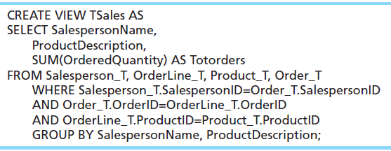
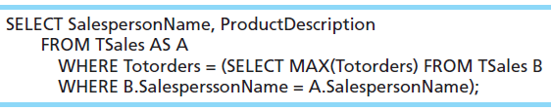
Example of Query Using a View
查詢各銷售人員對各產品的總訂單數量
基於之上，查詢總訂單數量最多的銷售人員
Notes:
The view is called TSales, and consists of an aggregate query involving a join of three tables. TSales, returns the total sales of each product sold by each salesperson.
The query below it uses TSales as if it were a table. Note that this query involves a correlated subquery. What this query does is show the biggest selling product for each salesperson.

Slide 41
Query Efficiency Considerations
Instead of SELECT *, identify the specific attributes in the SELECT clause; this helps reduce network traffic of result set i.e.不取多餘的欄位或資料
Limit the number of subqueries; try to make everything done in a single query if possible
i.e. 少用子(巢狀)查詢
If data is to be used many times, make a separate query and store it as a view
Notes:
Subqueries can be very useful, but can also cause computational overload. This is especially true for correlated subqueries. Suppose for example, you had a correlated subquery where the outer query was processing through 10,000 rows. This means the subquery would execute 10,000 times! So, in effect, that one overall query involves 10,001 real queries.
This is another reason it is important to test your queries. Not only must they be able to execute, but they should produce valid results and also do it in a reasonable amount of time.

Slide 42
Routines and Triggers
Routines Ex. 預先寫好的常用SQL指令
Program modules that execute on demand
Functions–routines that return values and take input parameters i.e.可視為有回傳值及輸入變數的routine
Procedures–routines that do not return values and can take input or output parameters 無回傳值
Triggers–
routines that execute in response to a database event (INSERT, UPDATE, or DELETE)
Ex. 當INSERT至ORDER表格時，
自動也INSERT至ORDER_LOG表格

Slide 43
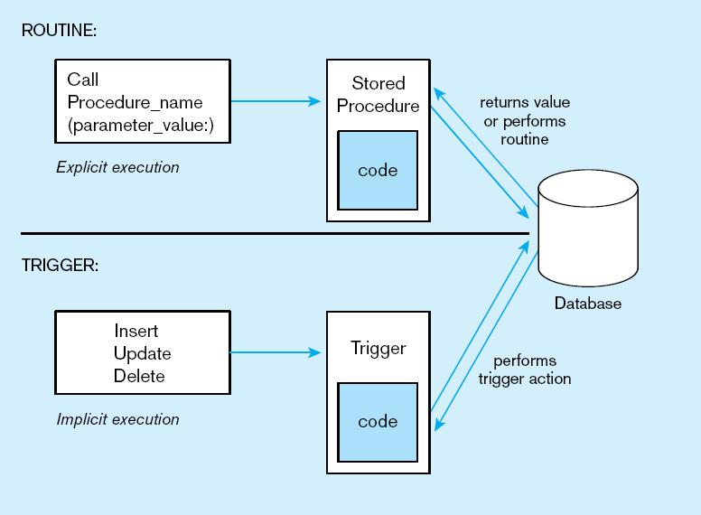
Figure7-13 Triggers contrasted with stored procedures (based on Mullins 1995)
Procedures are called explicitly
Triggers are event-driven
Source: adapted from Mullins, 1995.
Notes:
Procedures and Functions are called explicitly by the user of the database (for example an application program). When calling a procedure or function, you may pass it parameters. Functions, unlike procedures, will actually return a value. In both cases, there could be several queries or updates done to the database.
Triggers are not called explicitly. Instead, they are invoked as a result of some sort of database action, such as inserting a new record, modifying an existing record, or deleting a record. They could also be invoked as a result of a DDL statement to ALTER a table.

Slide 44
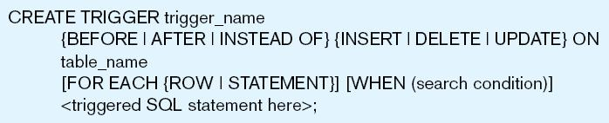
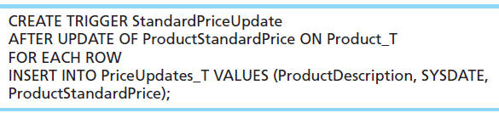
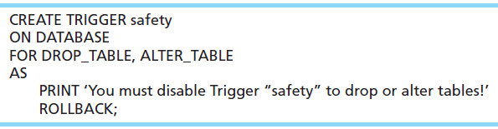
Figure 7-14 Simplified trigger syntax, SQL:2008
Example DML Trigger
Example DDL Trigger
Notes:
Triggers may occur either before, after, or instead of the statement that aroused the trigger is executed. DML triggers may occur on INSERT, UPDATE, or DELETE commands.
Question: Remember what DML stands for?
Answer: Data Manipulation Language.
Question: Remember what DDL stands for?
Answer: Data Definition Language
SQL = DDL + DML
This sample DML trigger will execute after an update of the ProductStandardPrice column of the Product_T table. It will add a new row to the PriceUpdates_T table, and use the new values of the product description and price (from the update) for this new row.
DDL triggers are generally most useful to database administrators.

Slide 45
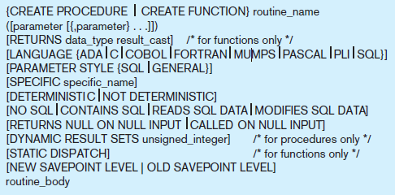
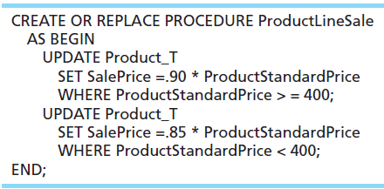

Figure 7-15 Syntax for creating a routine, SQL:2011
Example stored procedure
400元以上產品打9折,
未滿400元產品打8折; 一同執行
Calling the procedure
Notes:
As we said earlier, routines, which can be either Procedures or Functions, are explicitly called and can take parameters. In this sense they are a lot like the types of program modules you find in procedural programming languages like Java or C. These will often make use of SQL extensions that enable flow control, such as IF-THEN statements or loops. These extensions are called Persistent Stored Modules.

Slide 46
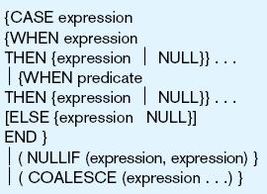
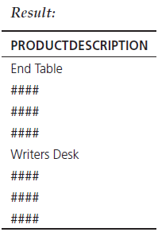
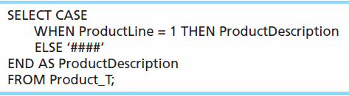
Conditional Expressions Using Case Keyword
This is available with newer
versions of SQL, previously not part
of the standard
Figure 7-10
Notes:
SQL does not include an IF-ELSE statement, unlike procedural programming languages. The CASE keyword was introduced to accommodate this need.
The CASE syntax has four possible forms.
The CASE form can be constructed using either an expression that equates to a value or a predicate. The predicate form is based on threevalue logic (true, false, don’t know) but allows for more complex operations. The value expression form requires a match to the value expression. So, these are the first two forms.
NULLIF and COALESCE are the keywords associated with the other two forms of the CASE expression.

Slide 47
假設Customer_T.gender性別欄為原先以M及F值作代表，
在查詢時利用CASE子句作立即轉換 (不影響原儲存之值)
SELECT CASE
WHEN gender=‘M’ THEN ‘男’
WHEN gender=‘F’ THEN ‘女’
ELSE ‘不詳’
END
FROM Customer_T

Slide 48
Embedded and Dynamic SQL
Embedded SQL
Including hard-coded SQL statements in a program written in another language such as C or Java i.e.將SQL指令放在C或Java程式內一起使用
Dynamic SQL
Ability for an application program to generate SQL code on the fly, as the application is running 於程式內即時產生所需的SQL指令
Ex. 輸入客戶名稱檢查是否存在 (0表示不存在)
SELECT COUNT(Name)
FROM Customer_T
WHERE Name=$var_customer_name
Notes:
We’ll learn more about embedded and dynamic SQL in chapter 8, when we talk about database applications.

Slide 49
Reasons to Embed SQL in 3GL
Can create a more flexible, accessible interface for the user
Possible performance improvement
Database security improvement; grant access only to the application instead of users
只授權程式能存取資料，而非使用者

Slide 50
Ensuring Transaction Integrity
Transaction = A discrete unit of work that must be completely processed or not processed at all
確保動作完成不被中斷分割
May involve multiple updates
If any update fails, then all other updates must be cancelled
SQL commands for transactions
BEGIN TRANSACTION/END TRANSACTION
Marks boundaries of a transaction
COMMIT
Makes all updates permanent
ROLLBACK
Cancels updates since the last COMMIT
在MySQL中可設
SET AutoCommit=0或1
Notes:
Transactions should be atomic. This means that either the entire transaction should complete, or none of it should complete.
Atomicity is discussed in more detail in chapter 12 (database administration). DBMSs are supposed to guarantee ACID (atomic, consistent, isolated, durable) transactions.
For example, consider processing a customer’s sales order in the Pine Valley Furniture database. This requires creating an Order_T record, and a few OrderLine_T records. .
If the Product_T table also includes inventory on hand attribute, it could also mean changing this value. So, several updates need to be done. If any of these fail, then all the others should be cancelled.

Slide 51
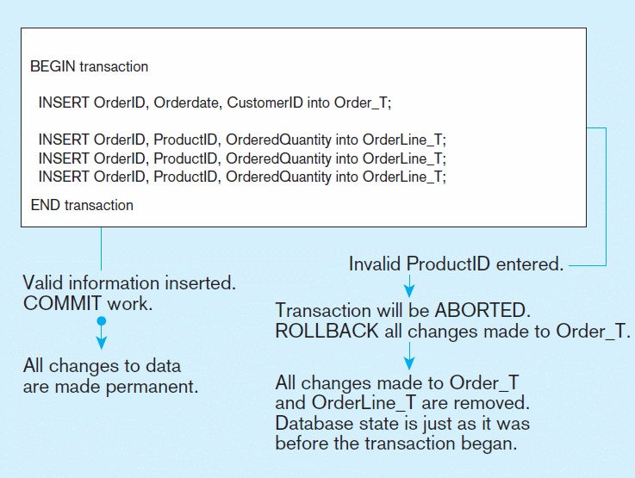
Figure 7-12 An SQL Transaction sequence (in pseudocode)
Notes:
So, none of the inserts actually take place until the transaction have been COMMITTED. If there is any error, then all previous updates will be ROLLED BACK.
This helps to ensure that the transaction is atomic. Either the whole thing happens, or none of it happens.

Slide 52
Why do we need transaction
When multiple users access the database…
Query the total balance
SELECT sum(amount) FROM account WHERE id=‘001’
Transfer $100 from bank A to B
UPDATE account SET amount=amount-100 WHERE id=‘001’ and bank=‘A’
UPDATE account SET amount=amount+100 WHERE id=‘001’ and bank=‘B’
A tentative value will be retrieved
Timeline

Slide 53
Transaction ACID properties
4 properties that guarantee that database transactions are processed reliably
Atomicity 不可分割性
Transaction cannot be subdivided; each transaction be "all or nothing“
Consistency 一致性
Constraints don't change from before transaction to after transaction. i.e. database integrity remains.
Isolation 隔離性
Database changes not revealed to users until after transaction has completed; tentative data can't be accessed.
Durability 持續性
Database changes are permanent; once a transaction has been committed, it will remain so, even in the event of power loss, crashes, or errors

