Slide 1
Chapter 2: Modeling Data in the Organization
Modern Database Management
12th Edition
Global Edition
Jeff Hoffer, Ramesh Venkataraman,
Heikki Topi
授課老師：楊立偉教授，台灣大學工管系

Slide 2
E-R Model Constructs
Entities: 個體
Entity instance–person, place, object, event, concept (often corresponds to a row in a table)
Entity Type–collection of entities (often corresponds to a table)
Relationships: 關係
Relationship instance–link between entities (corresponds to primary key-foreign key equivalencies in related tables)
Relationship type–category of relationship…link between entity types
Attributes: 屬性
Properties or characteristics of an entity or relationship type (often corresponds to a field in a table)
Notes:
2

Slide 3
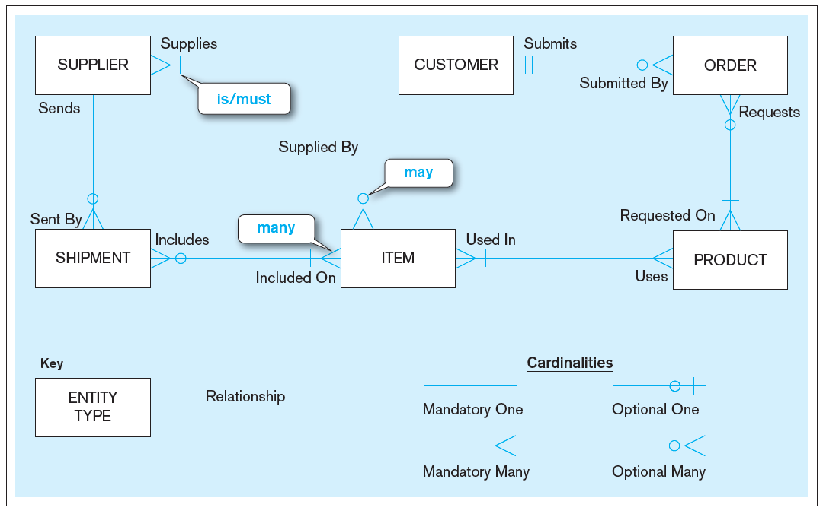
Sample E-R Diagram (Figure 2-1)
1
0 or 1
1…N
0…N
Notes:
3
Entity relationship (ER) diagrams include rectangles representing entities, and lines between the entities representing relationships. Relationships have cardinalities, which can be one-to-one, one-to-many, or many-to-many. In addition, on each side of the relationship you can specify that it is mandatory or optional.

Slide 4
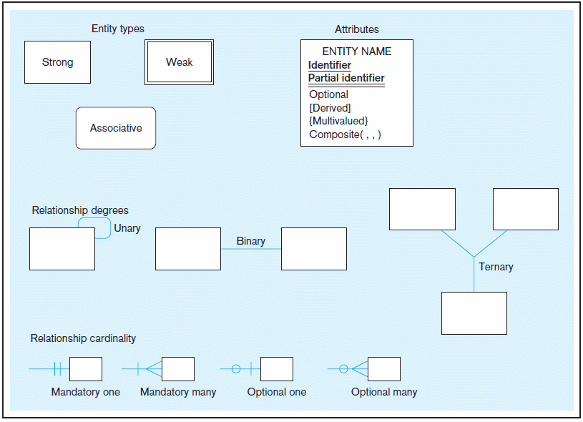
Basic E-R notation (Figure 2-2)
Entity symbols
Attribute symbols
A special entity that is also a relationship
Relationship symbols
Relationship degrees specify number of entity types involved
Relationship cardinalities specify how many of each entity type is allowed
Notes:
8
Entities can be strong, weak, or associative. This will be explained later.
In addition to cardinalities, relationships also have degrees. A unary degree represents a relationship between entities of the same entity type. A binary degree represents a relationship between entities of two different entity types. A ternary degree represents a relationship between entities of three different entity types. In principle you can have relationships between any number of entity types, so the term for this degree is “n-ary”.

Slide 5
Business Rules
Are statements that define or constrain some aspect of the business 用來定義或限制 : Ex. 每人每學期修課總學分上限為30學分
Are derived from policies, procedures, events, functions; Assert business structure 定出商業結構
Control/influence business behavior 控制或影響行為 Ex. 避免學生超修行為
Are expressed in terms familiar to end users 以使用者熟悉的語言來表達
Are automated through DBMS software 例如修課系統應自動擋掉超修行為
Notes:
A business rule is a statement that defines or constrains some aspect of the business. It is intended to assert business structure or to control or influence the behavior of the
business.
Not all business rules are implemented in a database, and it is the responsibility of the database analyst to determine which business rules can be expressed through ER models and which cannot.

Slide 6
A Good Business Rule Is:
Declarative–what, not how 做什麼(而非如何做)
Precise–clear, agreed-upon meaning 精確
Atomic–one statement 不可分割
Consistent–internally and externally 一致
Expressible–structured, natural language 可被結構化的口語表達
Distinct–non-redundant 非贅述的
Business-oriented–understood by business people 可被該領域的人了解
Notes:
Business rules appear (possibly implicitly) in descriptions of business functions, events, policies, units, stakeholders, and other objects. These descriptions can be found in interview notes from individual and group information systems requirements collection sessions, organizational documents (e.g., personnel manuals, policies, contracts, marketing brochures, and technical instructions), and other sources. Rules are identified by asking questions about the who, what, when, where, why, and how of the organization.
Gathering business rules requires good interviewing and listening skills. As a database analyst, you will ask questions about the who, what, when, where, why, and how of the organization. You’ll need to be persistent in clarifying initial statements of rules because initial statements may be vague or imprecise, so this is an iterative inquiry process.

Slide 7
作業範例
圖書館的商業規則

Slide 8
A Good Data Name Is:
Related to business, not technical, characteristics 非技術詞
Meaningful and self-documenting 看了就懂
Unique 獨一
Readable 可讀性高(非只是一堆代號)
Composed of words from an approved list 是可用列表中的語詞
Repeatable 適用多種狀況
Written in standard syntax 有固定命名方式 (例如英文動名詞加名詞，全小寫，不用複數等)
Notes:
Data objects must be named and defined before they can be used unambiguously in a model of organizational data. Data names refer to the names of entities, their attributes, and their relationships, which are the data objects. These names should be meaningful to the business interests and operations. In a sense, data names should be “self-documenting”, which means they should “obviously” capture the essence of the data object.

Slide 9
Entities
先找出 Entity
Entity – a person, a place, an object, an event, or a concept in the user environment about which the organization wishes to maintain data
Entity type – a collection of entities that share common properties or characteristics
Entity instance – A single occurrence of an entity type
Notes:
It is important to distinguish an entity instance from an entity type. For example, an entity may be John Doe, a particular person. But the entity type is “Person” as a concept. When you develop ER diagrams, the boxes represent entity types, not entity instances. Although we use the word “entity” when describing ER diagrams, what we are really talking about is “entity types”.

Slide 10
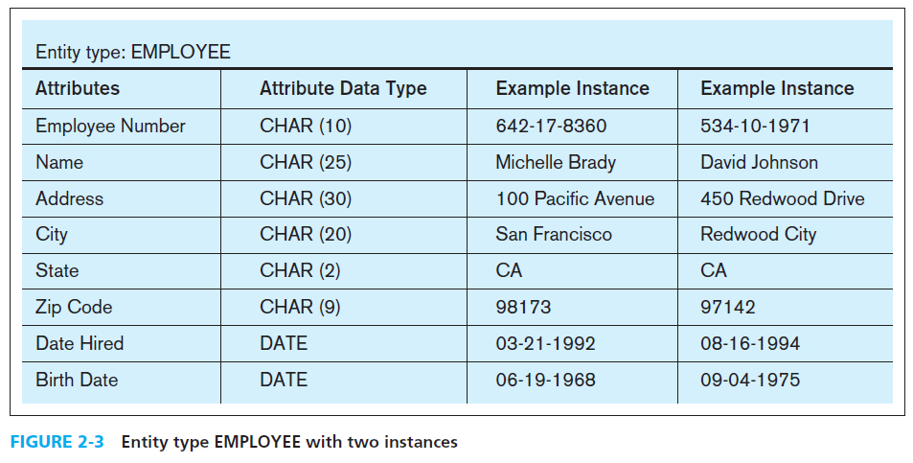
Entity Type and Entity Instances
Notes:
Here we see the distinction between an entity type and an entity instance. The entity type is represented in the first two columns of this figure. It includes the names of the various attributes (remember what we talked about regarding data names), as well as the types of data. By contrast, the third and fourth columns represent two entity instances. These would be actual records (or rows) in the final database table that implements this entity type.

Slide 11
An Entity…
SHOULD BE:
An object that will have many instances in the database
An object that will be composed of multiple attributes
An object that we are trying to model
SHOULD NOT BE:
A user of the database system
An output of the database system (e.g., a report)
Notes:
A common mistake people make when they are learning to draw E-R diagrams, especially if they are already familiar with data process modeling (such as data flow diagramming), is to confuse data entities with other elements of an overall information systems model. A simple rule to avoid such confusion is that a true data entity will have many possible instances, each with a distinguishing characteristic, as well as one or more other descriptive pieces of data.

Slide 12
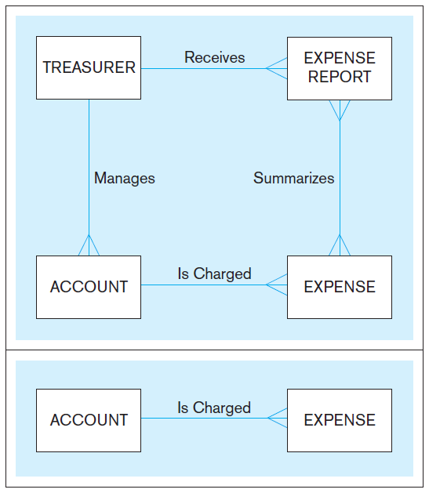
Figure 2-4 Example of inappropriate entities
System
user
System output
Inappropriate entities
X 會計出納員
這是操作的人
不在系統範圍內
(除非含用戶管理)
X 費用報告
這是運算後的結果
不在系統範圍內
(除非含報表管理)
Appropriate entities
Notes:
This figure illustrates a mistake many novices will make. The treasurer is a user of the system, and the expense report is an output of the system. Neither of these are entities that should be represented in the database or the ER model. The ER model should represent the objects that are of interest to the user and that will be displayed in the system output.

Slide 13
Guidelines for Naming and Defining Entities
Names: 命名
Singular noun 取名用單數
Specific to organization
Concise, or abbreviation
For event entities, the result not the process
(例如訂購單, 而非訂購)
Name consistent for all diagrams
Definitions: 舉例說明
“An X is…”
Describe unique characteristics of each instance
Explicit about what is and is not the entity
When an instance is created or destroyed
Changes to other entity types
History that should be kept
Notes:
5
In addition to general guidelines about naming and defining data objects, there are some specific guidelines for naming entity types. These are listed here.

Slide 14
Attributes
Attribute–Property or Characteristic of an entity or relationship type. i.e. Field
Classifications of attributes:
Required versus Optional Attributes 是否必填
Simple versus Composite Attribute 複合屬性 Ex. 姓名 vs 姓+名
Single-Valued versus Multivalued Attribute 是否有多值
Stored versus Derived Attributes 是否為衍生屬性 Ex. 出生年 vs 年齡
Identifier Attributes 是否可供識別用 Ex. 學號
Notes:
5
In naming attributes, we use an initial capital letter followed by lowercase letters. If an attribute name consists of more than one word, we use a space between the words
and we start each word with a capital letter, for example, Employee Name or Student Home Address. In E-R diagrams, we represent an attribute by placing its name in the
entity it describes.

Slide 15
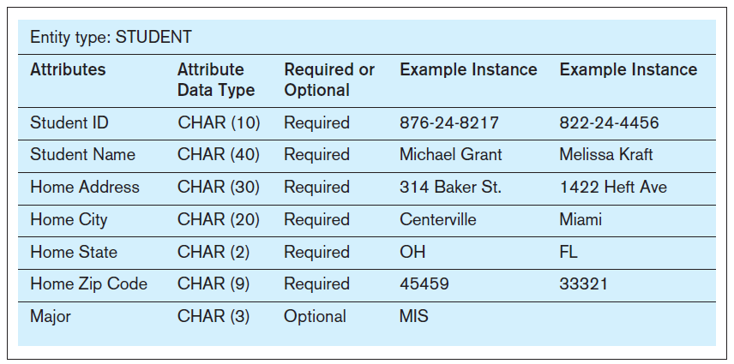
Required vs. Optional Attributes
Required – must have a value for every entity (or relationship) instance with which it is associated
Optional – may not have a value for every entity (or relationship) instance with which it is associated
Notes:
5
This figure illustrates the various properties of an entity’s attributes. Required attributes must have a value, whereas optional attributes could be null. Note that the identifier is ALWAYS required.
In this case, the student’s major is optional because a student may not yet have declared a major. All the other attributes, however, are required.

Slide 16
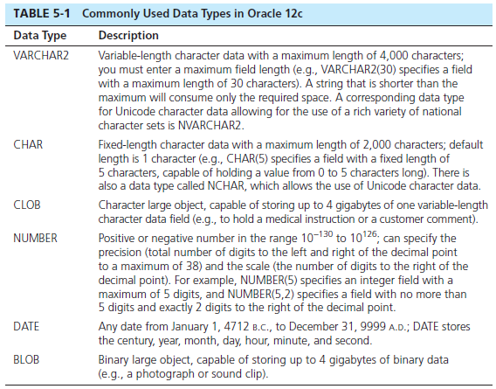
Choosing Data Types
from Ch.5
Notes:
A data type is a detailed coding scheme recognized by system software, such as a DBMS, for representing organizational data. The data type specifies the bit pattern of data stored in that coding scheme. There are many ways in which data could be physically represented. For data used in mathematical calculations, numeric fields should be used. For text displays, there are a variety of character based representations, some of which are fixed length and some of variable length. Other data types include dates, binary representations for images or audio, and even specialized types for XML and other representations.

Slide 17
Field Data Integrity
from Ch.5
Default value–assumed value if no explicit value 給定預設值
Range control–allowable value limitations (constraints or validation rules) 允許值之限制
Null value control–allowing or prohibiting empty fields 是否允許無值(未曾填過)或空值(填了留白)
Referential integrity–range control (and null value allowances) for foreign-key to primary-key match-ups 外鍵查表的對應檢查
Note: Sarbanes-Oxley Act (SOX) legislates importance of financial data integrity
沙賓法案其中規範了財務性資料的完整性檢查
Notes:
In most DBMSs, data integrity controls can be built into the physical structure of the fields and controls enforced by the DBMS on those fields. SQL has constructs to enforce these rules, as we will see in chapter 6.
The data type enforces one form of data integrity control because it may limit the type of data (numeric or character) and the length of a field value. Others include default values, allowable ranges of values, whether or not a value is required (null value controls), and enforcing relationships and their cardinality constraints via primary-to-foreign key matchups.

Slide 18
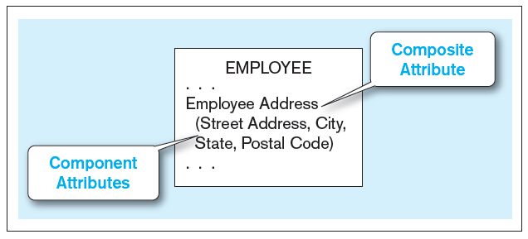
Simple vs. Composite Attributes
Composite attribute – An attribute that has meaningful component parts (attributes)
The address is broken into component parts
地址
Figure 2-7 A composite attribute
Notes:
6
Sometimes many attributes are related to each other, such as the elements of an address. In this case they can be grouped into a composite attribute. For simplicity, we can refer to the “employee address”, but if we want more detail we can break it into street, city, state, and postal code. So, this way we have the option to describe the attribute at a macro or at a micro level. Note the use of parentheses for encompassing the components of a composite attribute.

Slide 19
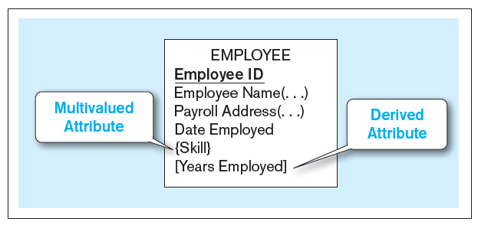
Multi-valued and Derived Attributes
Multivalued – may take on more than one value for a given entity (or relationship) instance
Derived – values can be calculated from related attribute values (not physically stored in the database)
Figure 2-8 Entity with multivalued attribute (Skill) and derived attribute (Years Employed)
技能
年資
Multivalued
an employee can have more than one skill
Derived
Calculated from date employed and current date
Notes:
12
A multivalued attribute is not the same as a composite attribute, although novices may confuse these terms. A composite attribute is one that has many parts, such as an address composed of street, city, state, and zip. By contrast, a multivalued attribute is one that can have many different values, such as an employee being able to do many things.
Note that a derived attribute is not one that is physically stored in the database, but rather one that is calculated based on the value of another. The length of time employed, or a person’s age, are classic examples, as they are calculated based on a fixed starting point (date hired or birthdate).
Attributes could be both composite and multivalued, and even also derived. So these are distinct concepts.

Slide 20
Identifiers (Keys)
Identifier (Key)–an attribute (or combination of attributes) that uniquely identifies individual instances of an entity type Ex. 學號 or 系所+姓名
Simple versus Composite Identifier
Candidate Identifier–an attribute that could be an identifier…satisfies the requirements for being an identifier
Notes:
6
Every entity type should have an identifier attribute. No two instances of the entity type may have the same value for the identifier attribute. For example, a person (employee, student, etc.) cannot rely on the first and last name to be an identifier, because many people could have the same name. Rather, the identifier should be something like an employee ID, a social security number, or some other absolutely unique value.

Slide 21
Criteria for Identifiers
Choose Identifiers that
Will not change in value 不會更改
Will not be null 不會無值
Avoid intelligent identifiers (e.g., containing locations or people that might change) 不要包含可能更改的欄位 ex. 戶口所在縣市之代碼 (遷戶口怎麼辦)
Substitute new, simple keys for long, composite keys 簡短單一最好 Ex. 流水號是不錯的選擇
Notes:
7
An identifier in he ER model will eventually become a primary key in the resulting database table. We’ll see this in a later chapter. Identifiers are required, so cannot be devoid of value. And it should be constant. Consider an employee ID or a social security number. These do not change. A person’s name or home address, however, could change. Also, identifiers must be unique. Several people could have the same name.

Slide 22
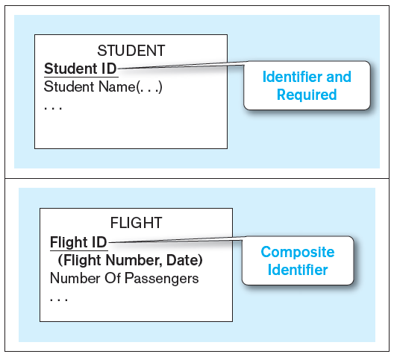


Figure 2-9 Simple and composite identifier attributes
ID欄位
(或稱 Key鍵值)
The identifier is boldfaced and underlined
Notes:
14
In the ER diagram, and identifier will be underlined. Note also that required attributes are typically boldfaced, so all identifiers will be boldfaced as well. If an identifier is composite, then all its component parts are required.

Slide 23
Naming Attributes
Name should be a singular noun or noun phrase 用單數名詞或名詞片語
Name should be unique 獨一
Name should follow a standard format
e.g. [Entity type name { [ Qualifier ] } ] Class 例如 Student_ID、Student_Name、Student_Address
Similar attributes of different entity types should use the same qualifiers and classes
例如Student_ID、Professor_ID
Notes:
7
As with all other data objects, there are guidelines for naming and defining attributes. These are listed in this slide and the next.
A common naming format is [Entity type name { [ Qualifier ] } ] Class, where [ . . . ] is an optional clause, and { . . . } indicates that the clause may repeat. Entity type
name is the name of the entity with which the attribute is associated. The entity type name may be used to make the attribute name explicit. It is almost always
used for the identifier attribute (e.g., Customer ID) of each entity type. Class is a phrase from a list of phrases defined by the organization that are the permissible
characteristics or properties of entities (or abbreviations of these characteristics). For example, permissible values (and associated approved abbreviations)
for Class might be Name (Nm), Identifier (ID), Date (Dt), or Amount (Amt). Class is required. Qualifier (optional) is a phrase from a list of phrases defined by the
organization that are used to place constraints on classes.

Slide 24
Defining Attributes
State what the attribute is and possibly why it is important 試著說明這屬性是什麼，為什麼需要
Make it clear what is and is not included in the attribute’s value 合法值的範圍，並給一些範例
Include aliases in documentation 若有別稱要一併說明
State source of values 說明值的來源 (有哪些值)
State whether attribute value can change once set 是否可修改
Specify required vs. optional 是否必填
State min and max number of occurrences allowed 是否有出現次數的下限或上限 (例如全班成績只可以有10個A)
Indicate relationships with other attributes 試著說明與其他屬性的關係
Notes:
7

Slide 25
Modeling Relationships
Relationship Types vs. Relationship Instances
The relationship type is modeled as lines between entity types…the instance is between specific entity instances
Relationships can have attributes
These describe features pertaining to the association between the entities in the relationship
Two entities can have more than one type of relationship between them (multiple relationships)
Associative Entity–combination of relationship and entity

Slide 26
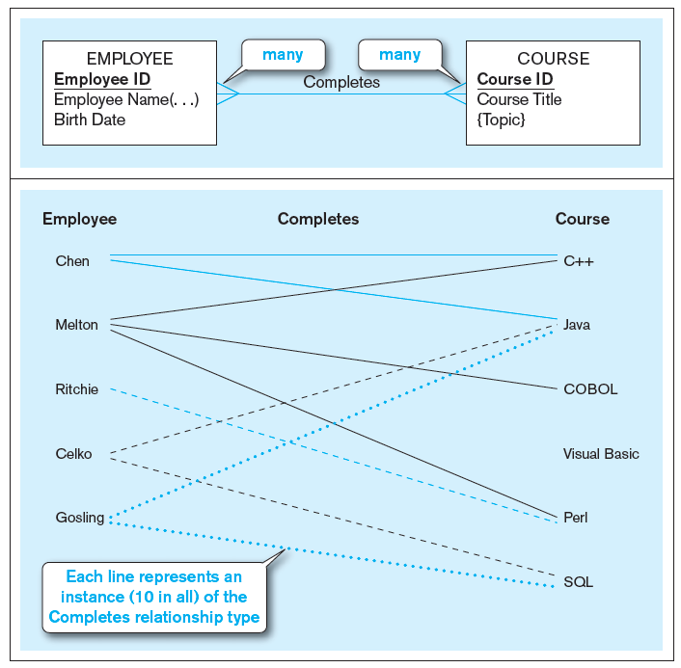
Figure 2-10 Relationship types and instances
a) Relationship type (Completes)
b) Relationship instances
Notes:
17
This figure illustrates the difference between relationship types and relationship instances. The ER diagram depicts types. It depicts both entity types and relationship types. The actual data that would be in the database constitutes instances, both relationship and entity instances.

Slide 27
Degree of Relationships
Degree of a relationship is the number of entity types that participate in it
(1) Unary Relationship
A relationship between different instances of the same entity is called a recursive relationship
(2) Binary Relationship
(3) Ternary Relationship
建議少用更多n-ary的關係；可轉換成多個binary關係；或用associative entity表達
Dey, Debabrata, Veda C. Storey, and Terence M. Barron. "Improving database design through the analysis of relationships." ACM Transactions on Database Systems (TODS)24.4 (1999): 453-486.
Notes:
16
Most relationships are of binary degree. But it is possible to have any number of entities involved in a relationship “Ternary” refers to three. If you have more than that, it is sometimes referred to generically as an “n-ary” relationship.

Slide 28
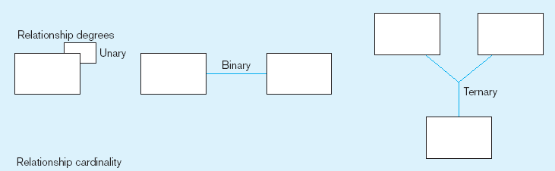
Degree of relationships – from Figure 2-2
Entities of two different types related to each other
One entity related to another of the same entity type
Entities of three different types related to each other
Ex. 修課關係
Ex. 朋友關係
Ex. 工作分派關係
Notes:
8
One example of unary relationships would be supervisor-subordinate relationships, which exists between employees.

Slide 29
Cardinality of Relationships
One-to-One
Each entity in the relationship will have exactly one related entity
One-to-Many
An entity on one side of the relationship can have many related entities, but an entity on the other side will have a maximum of one related entity
Many-to-Many
Entities on both sides of the relationship can have many related entities on the other side

Slide 30
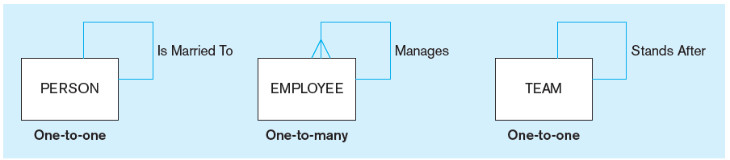
Figure 2-12 Examples of relationships of different degrees
a) Unary relationships
Notes:
22
Although this figure of unary relationships shows only one-to-one and one-to-many cardinalities, it is also possible to have many-to-many unary relationships. For example consider a Person entity with a “friend” relationship. A particular person can have many friends, and each friend could in turn have other friends. This is different from the one-to-many relationship of employees. Although a supervisor could manage many subordinates, typically a subordinate only reports to one supervisor.

Slide 31
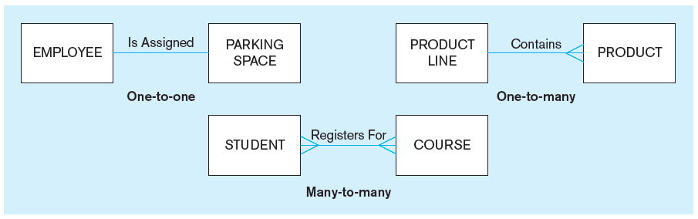
Figure 2-12 Examples of relationships of different degrees (cont.)
b) Binary relationships
Notes:
22
Here are binary degree relationships with all he different possible cardinalities.

Slide 32
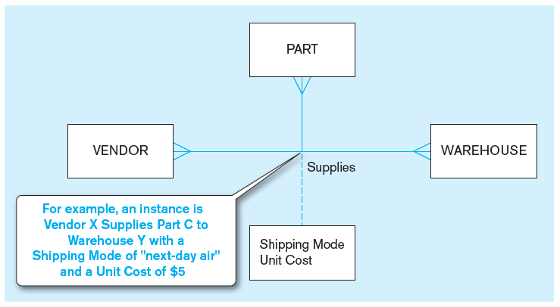
Figure 2-12 Examples of relationships of different degrees (cont.)
c) Ternary relationship
零件
廠商
倉庫
供應出貨關係
Note: a relationship can have attributes of its own
Notes:
22
The cardinality of this ternary relationship is many-to-many-to-many. In other words, each vendor could supply many parts to many warehouses. Each part could come from many vendors and housed in many warehouses. Each warehouse could have many parts from many vendors.
The dashed line is a way of representing the attributes of the relationship. For a given vendor supplying a given part to a given warehouse, here is a shipping mode and a unit cost. Each of these ternary relationship instances could have its own shipping mode and unit cost.

Slide 33
Cardinality Constraints
Cardinality Constraints—the number of instances of one entity that can or must be associated with each instance of another entity
Minimum Cardinality 最小值
If zero, then optional
If one or more, then mandatory
Maximum Cardinality 最大值
The maximum number
Notes:
29
Sometimes it is required for an entity to have its related entity, and sometimes not. Also, it is possible for there to be a limit to how many related entities a given entity could be related to.

Slide 34
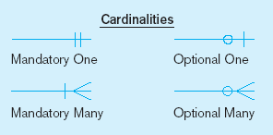
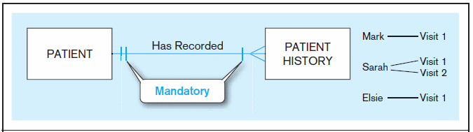
Figure 2-17 Examples of cardinality constraints
a) Mandatory cardinalities
A patient history is recorded for one and only one patient
A patient must have recorded at least one history, and can have many
Notes:
1
Note the hatch mark vs. the circle. The hatch mark illustrated mandatory cardinalities, whereas the circle represents optional cardinalities. This figure indicates that each patient must have had at least one visit (mandatory), and could have many more (many). By contrast, each patient history (visit) record must be associated with exactly one patient.
Note that in all these ER diagrams cardinality is represented using something called “crow’s-feet” notation. The three prongs on the many side of the relationship is called a “crow’s foot”. There are other possible notations in ER diagram. For example, Microsoft Visio by default shows an arrow from the many side to the one side, although you can change it to crow’s feet notation.

Slide 35
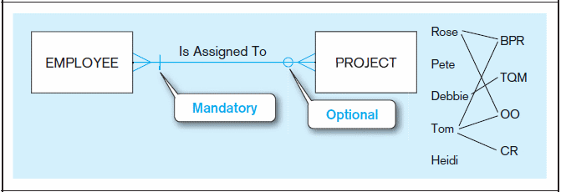
Figure 2-17 Examples of cardinality constraints (cont.)
b) One optional, one mandatory
A project must be assigned to at least one employee, and may be assigned to many
An employee can be assigned to any number of projects, or may not be assigned to any at all
Notes:
1
This figure shows a binary many-to-many relationship. In this case one side is mandatory and the other is optional. Here every project must have at least one employee assigned to it, but an employee could possibly not be assigned to any projects.

Slide 36
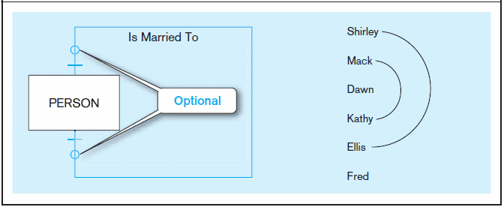
Figure 2-17 Examples of cardinality constraints (cont.)
c) Optional cardinalities
A person is married to at most one other person, or may not be married at all
Notes:
1
This is a unary one-to-one relationship. According to this, a person could be married to one or no other person. This figure rules out polygamy. Can you see why? How would we be able to allow polygamy in this ER diagram? (Answer: make it many-to-many).
Dawn and Fred are single. Shirley is married to Ellis and Mack is married to Kathy.

Slide 37
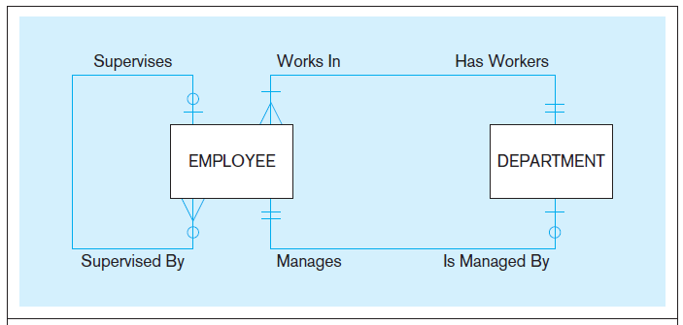
Figure 2-21 Examples of multiple relationships
a) Employees and departments
Entities can be related to one another in more than one way
Notes:
40
Here, we see a one-to-many unary relationship between employees. It shows that a given employee MUST have exactly one supervisor and could supervise any number of other employees (or none at all).
We also see two binary relationships between employees and departments. First, each department must have at least one, and possibly many, employees. Each employee must work in exactly one department. Also, each department has exactly one employee as a manager, and each employee can manage at most one department, or possible none at all.
The figure illustrates that there could be multiple types of relationships between entities.

Slide 38
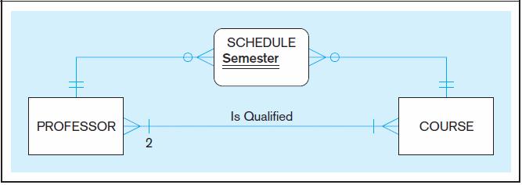
Figure 2-21 Examples of multiple relationships (cont.)
b) Professors and courses (fixed lower limit constraint)
Here, min cardinality constraint is 2. At least two professors must be qualified to teach each course. Each professor must be qualified to teach at least one course.
Notes:
40
Again, we see multiple relationships between two entities, this time between professors and courses. The “Is Qualified” relationship is of binary degree and mandatory many-to-many cardinality. A professor must be qualified to teach at least one course. And a course must have at least two qualified professors.
The other relationship is actually implemented via what is called an “associative entity” called Schedule, which has an identifier attribute called Semester. We will shortly talk about associative entities in more detail. This associative entity is implementing a many to many relationship between professors and courses, indicating that a particular professor may be scheduled during a particular semester to many courses, and vice versa.

Slide 39
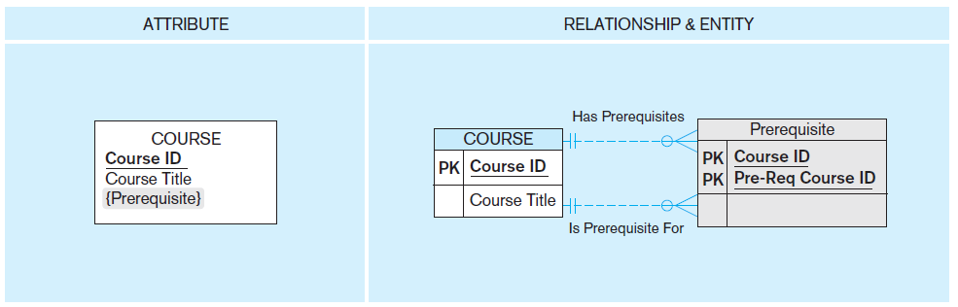
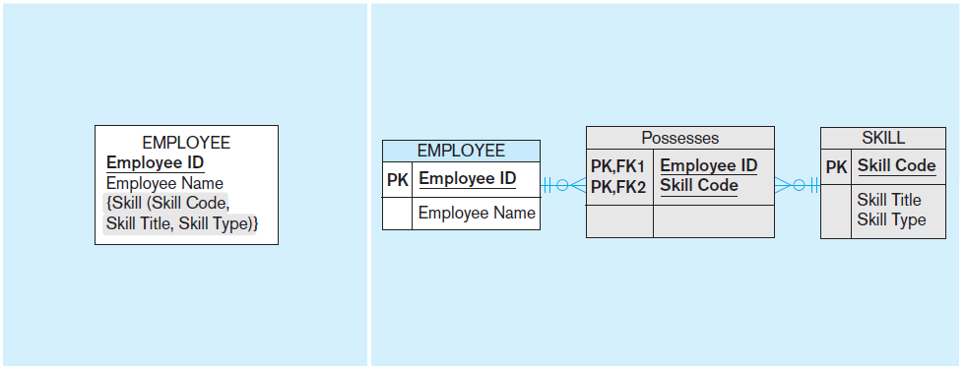
Figure 2-15a and 2-15b Multivalued attributes can be represented as relationships
simple
Ch4. First Normal Form時會教
composite
Notes:
In this figure we see two examples of multivalued attributes on the left. On the right we see instead separate entities with relationships.
The top figure shows a simple multivalued attribute, whereas the bottom figure shows a composite multivalued attribute. Note that on the right, it is explicit that there are many to many relationships. For example, although the left side shows that a course can have many prerequisites, there is nothing explicit showing that a course could itself be a prerequisite for multiple other courses. Similarly, on the left it is explicitly shown that an employee can many many skills, but it is not explicitly shown that many employees can share the same skill. The figures on the right, however, do make these facts explicit.
The right side of each figure is in Microsoft Visio notation.

Slide 40
Associative Entities
An entity–has attributes
A relationship–links entities together
When should a relationship with attributes instead be an associative entity?
All relationships for the associative entity should be many (tips: 多對多關係)
The associative entity could have meaning independent of the other entities 有獨立意義時
The associative entity preferably has a unique identifier, and should also have other attributes 自己有獨立id時
The associative entity may participate in other relationships other than the entities of the associated relationship (理由類同下條)
Ternary relationships should be converted to associative entities

Slide 41
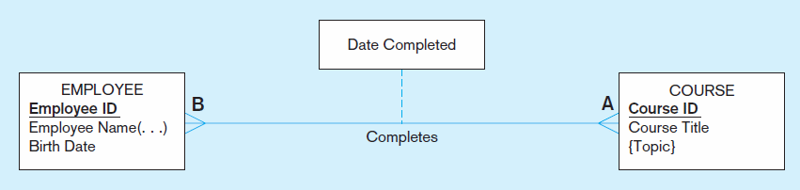
Figure 2-11a A binary relationship with an attribute
Here, the date completed attribute pertains specifically to the employee’s completion of a course…it is an attribute of the relationship.
Notes:
20
Here, the relationship simply states that an employee completed a course on a particular date. The completion is represented as a relationship, and is not an entity unto itself.

Slide 42
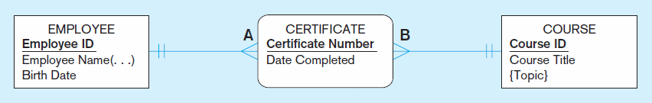
Figure 2-11b An associative entity (CERTIFICATE)
轉成一張表
Associative entity is like a relationship with an attribute, but it is also considered to be an entity in its own right.
Note that the many-to-many cardinality between entities in Figure 2-11a has been replaced by two one-to-many relationships with the associative entity.
Notes:
21
Here, the simple relationship has been replaced with an associative entity. A certificate is considered to be an entity unto itself, and in fact even has a unique identifier attribute.

Slide 43
原圖及改以Associative Entity表示後之比較
1個多對多關係分成兩個1對多關係，且意思上正確
1個員工可修1到多門課；1門課可被1到多個員工修
1個員工可得1到多張證書，每張證書必歸1個員工
1門課可發1到多張證書，每張證書必載1門課

Slide 44
原圖及改以Associative Entity表示後之比較
速算法
移至
移至
必為||
必為||

Slide 45
原圖及改以Associative Entity表示後之比較
為何需要
E_ID | E_NAME
1 | John
2 | Mary
3 | Bob
CNO | E_ID | C_ID | CDate
001 | 1 | A | 10/1
002 | 1 | B | 10/5
003 | 2 | A | 10/1
004 | 2 | C | 10/9
005 | 3 | B | 10/5
C_ID | C_Title
A | 會計
B | 行銷
C | 管理
每1列代表1位員工
每1列代表1門課
每1列代表1張證書

Slide 46
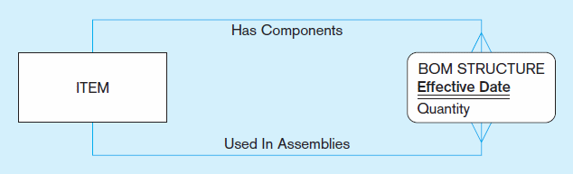
Figure 2-13c An associative entity – bill of materials structure
This could just be a relationship with attributes…it’s a judgment call.
Notes:
27
Here we see another example of an associative entity representing a bill of materials structure. If not for an associative entity, the BOM structure would be represented as a unary many-to-many relationship between items.

Slide 47
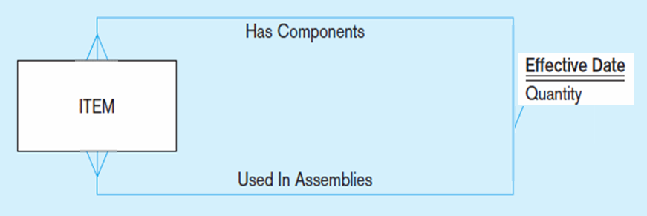
對比原圖
用Associative Entity表示
Notes:
27
Here we see another example of an associative entity representing a bill of materials structure. If not for an associative entity, the BOM structure would be represented as a unary many-to-many relationship between items.

Slide 48
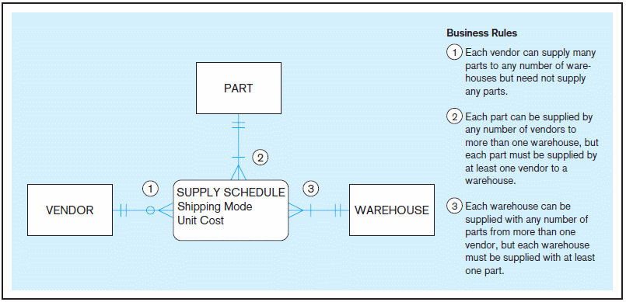
Figure 2-18 Cardinality constraints in a ternary relationship
Notes:
36
Here is another example of an associative entity, this time as the center of a ternary relationship.

Slide 49
對比原圖
(有associative entity的cardinality可以表達更細；不能用速算法)
零件
廠商
倉庫
供應出貨關係
Notes:
22
The cardinality of this ternary relationship is many-to-many-to-many. In other words, each vendor could supply many parts to many warehouses. Each part could come from many vendors and housed in many warehouses. Each warehouse could have many parts from many vendors.
The dashed line is a way of representing the attributes of the relationship. For a given vendor supplying a given part to a given warehouse, here is a shipping mode and a unit cost. Each of these ternary relationship instances could have its own shipping mode and unit cost.

Slide 50
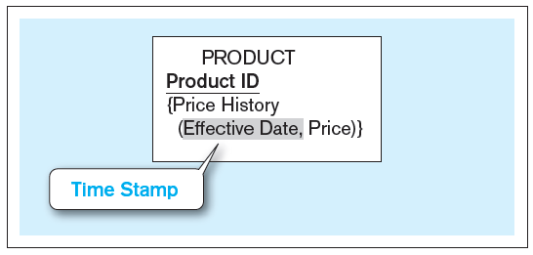
Figure 2-19 Simple example of time-stamping
歷史價格
注意大括號與小括號
The Price History attribute is both multivalued and composite.
Time stamp – a time value that is associated with a data value, often indicating when some event occurred that affected the data value
Notes:
37
Time stamps are useful for keeping historical data. In this case, we see a way of keeping track of price changes over time for products.
Can you think of how the price history could be represented as a separate entity instead of a multivalued attribute? What would be the cardinality of the relationship between product and price history? (Answer: one-to-many).

Slide 51
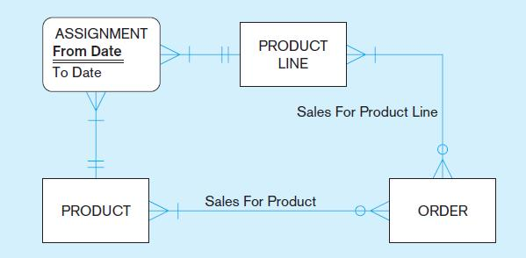
Figure 2-20c E-R diagram with associative entity for product assignment to product line over time
The Assignment associative entity shows the date range of a product’s assignment to a particular product line.
Modeling time-dependent data has become more important due to regulations such as HIPAA 健康保險可攜性及責任法案 and Sarbanes-Oxley 沙賓法案.
Notes:
37

Slide 52
Strong vs. Weak Entities, and Identifying Relationships
Strong entity
exists independently of other types of entities
has its own unique identifier
identifier underlined with single line
Weak entity
dependent on a strong entity (identifying owner)…cannot exist on its own
does not have a unique identifier (only a partial identifier)
entity box and partial identifier have double lines
Identifying relationship
links strong entities to weak entities
Notes:
Most of the basic entity types to identify in an organization are classified as strong entity types. A strong entity type is one that exists independently of other entity types, so sometimes these are called “independent” entity types. In contrast, a weak entity type is an entity type whose existence depends on some other entity type, so these are sometimes called “dependent” entity types.

Slide 53
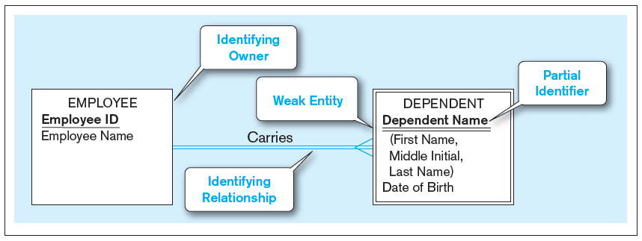
Figure 2-5 Example of a weak identity and its identifying relationship
扶養親屬
Strong entity
Weak entity
Notes:
This figure shows an ER diagram depicting an identifying relationship between an identifying owner (the employee) and a weak entity (the employer’s dependent). Note that the dependent’s identifier is only a partial identifier. The full identification requires the identifying owner’s identifier as well. Also note the double lines that distinguish the weak entity and the identifying relationship.

Slide 54
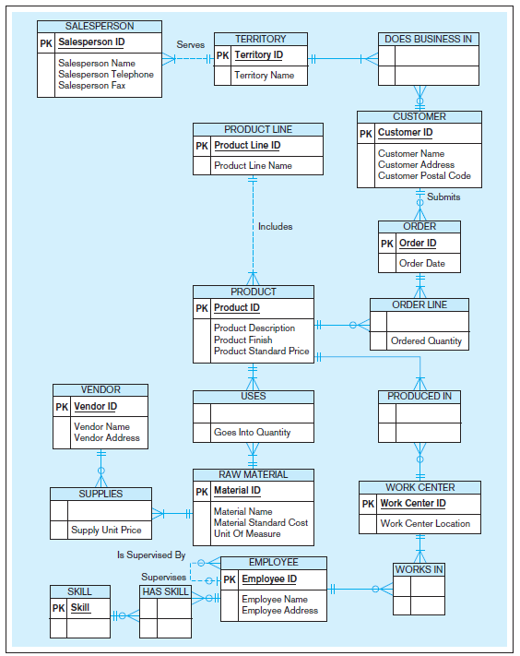
Figure 2-22
Data model for Pine Valley Furniture Company in Microsoft Visio notation
Different modeling software tools may have different notation for the same constructs.
不同工具之圖例表達
可能略有不同
Notes:
As you can see, data models can be quite comprehensive, including many different entities and relationships.

Slide 55
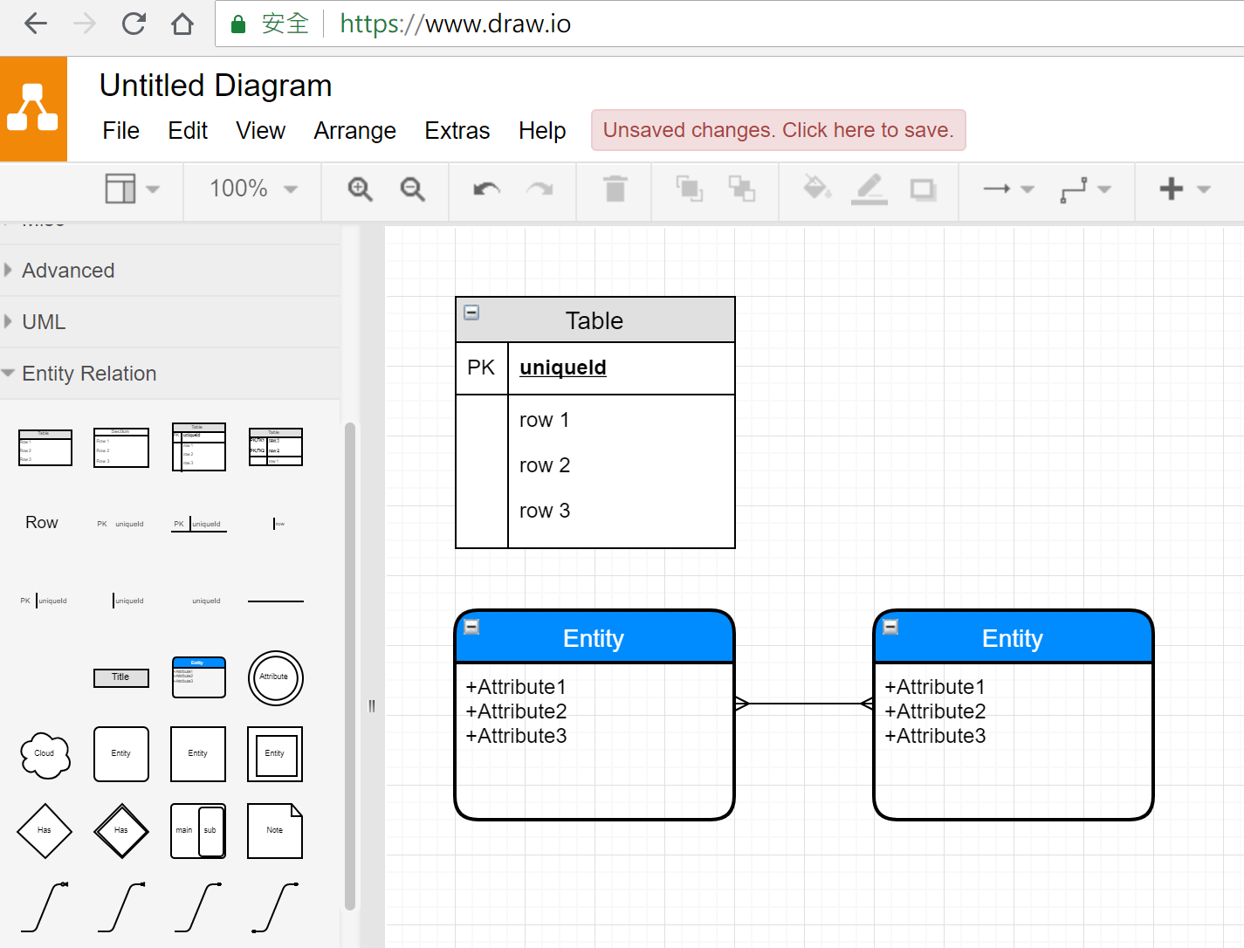
http://draw.io

