Slide 1
Chapter 6: Introduction to SQL
Modern Database Management
12th Edition
Global Edition
Jeff Hoffer, Ramesh Venkataraman,
Heikki Topi
授課老師：楊立偉教授，台灣大學工管系

Slide 2
SQL Overview
Structured Query Language – 結構式查詢語言often pronounced “Sequel”
The standard for relational database management systems (RDBMS)
1986成為ANSI標準, 1987成為ISO標準
各家廠商的實作可能略有不同
RDBMS: A database management system that manages data as a collection of tables in which all relationships are represented by common values in related tables

Slide 3
History of SQL
1970–E. F. Codd develops relational database concept
1974-1979–System R with Sequel (later SQL) created at IBM Research Lab
1979–Oracle markets first relational DB with SQL
1981 – SQL/DS first available RDBMS system on DOS/VSE
Others followed: INGRES (1981), IDM (1982), DG/SGL (1984), Sybase (1986)
1986–ANSI SQL standard released
1989, 1992, 1999, 2003, 2006, 2008, 2011–Major ANSI standard updates
Current–SQL is supported by most major database vendors
Oracle, Microsoft SQL Server, IBM DB2, MySQL, Postgre SQL, etc.
Notes:
The concepts of relational database technology were first articulated in 1970, in E. F. Codd’s classic paper “A Relational Model of Data for Large Shared Data Banks.” System R was project at IBM Research Laboratory in San Jose, California, which demonstrated the feasibility of implementing the relational model in a database management system. They used a language they called “sequel”. It’s later been named SQL, but “sequel” is still often how it is pronounced.
SQL-92 was a major revision and was structured into three levels: Entry, Intermediate, and Full. SQL:1999 established the core-level conformance, which must be met before any other level of conformance can be achieved; core-level conformance requirements are unchanged in SQL:2011. In addition to fixes and enhancements of SQL:1999, SQL:2003 introduced a new set of SQL/XML standards, three new data types, various new built-in functions, and improved methods for generating values automatically. SQL:2006 refined these additions and made them more compatible with XQuery, the XML query language published by the World Wide Web Consortium (W3C). SQL:2008 improved analytics query capabilities and enchanged MERGE for combining tables. The most important new additions to SQL:2011 are related to temporal databases, that is, databases that are able to capture the change in the data values over time. At the time of this writing, most database management systems claim SQL-92 compliance and partial compliance with SQL:1999 and SQL:2011.

Slide 4
Purpose of SQL Standard
Specify syntax/semantics for data definition and manipulation 資料定義與操作的語法
Define data structures and basic operations 定義了資料結構及基本操作
Enable portability of database definition and application modules 實現了可攜性
Specify minimal (level 1) and complete (level 2) standards
Allow for later growth/enhancement to standard (referential integrity, transaction management, user-defined functions, extended join operations, national character sets) 允許日後做擴充

Slide 5
Benefits of a Standardized Relational Language
Reduced training costs降低學習成本
Productivity提高生產力
Application portability應用程式可攜性
Application longevity應用程式長久性
Reduced dependence on a single vendor減少依賴單一廠商
Cross-system communication有助跨系統溝通
Notes:
These are all benefits of standardization. Keep in mind, though, that different database vendors may use different constructs in their SQL versions, so the standards are not perfectly applied.
Standards are good, but they also have disadvantages. A standard can stifle creativity and innovation. One standard is never enough to meet all needs, and an industry standard can be far from ideal because it may be the offspring of compromises among many parties. Standard may be difficult to change (because so many vendors have a vested interest in it), so fixing deficiencies may take considerable effort. Since vendors typically extend standards with proprietary features, application portability isn’t complete; you may need to change SQL statements when migrating from one vendor to another (for example, switching from Oracle to Microsoft SSL Server or vice versa).

Slide 6
SQL Environment
Catalog
A set of schemas that constitute the description of a database
Schema
The structure that contains descriptions of objects created by a user (base tables, views, constraints)
Data Definition Language (DDL)
Commands that define a database, including creating, altering, and dropping tables and establishing constraints
Data Manipulation Language (DML)
Commands that maintain and query a database
Data Control Language (DCL)
Commands that control a database, including administering privileges and committing data

Slide 7
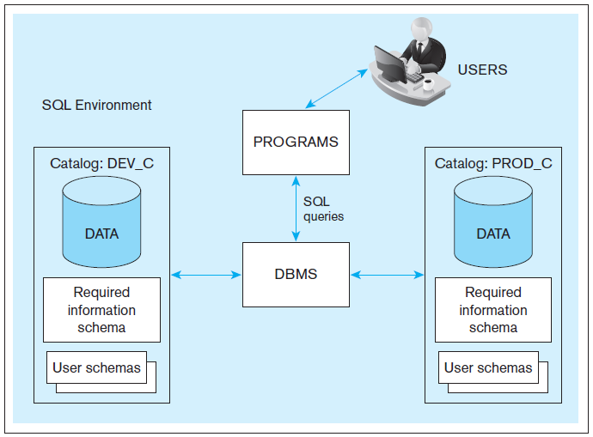
Figure 6-1
A simplified schematic of a typical SQL environment, as described by the SQL: 2011 standard
不同的Environment
(或稱Space)
開發用
正式用
Notes:
A database instance, also called a database server, is a set of memory structure and software processes that manage the access to a set of database files. Each instance maintains one or more databases, organized into catalogs consisting of schemas.
Here we see an instance of a DBMS along with two databases (PROD and DEV). The Production database contains its own data indexed by the catalog PROD_C. It is the actual database being used for business operations. The Development database is used for making application changes and testing. Usually, organizations have two separate databases, one for production and one for development.

Slide 8
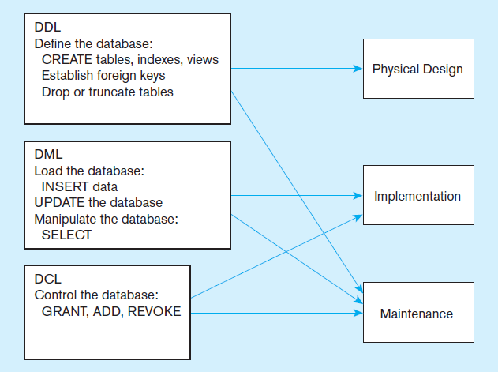
Figure 6-4
DDL, DML, DCL, and the database development process
DDL :
CREATE TABLE
ALTER TABLE
DROP TABLE
(SHOW TABLES)
(DESC table-name)
DML :
INSERT
UPDATE
DELETE
SELECT
Notes:
SQL is composed of three sub-languages, DDL, DML, and DCL.
DDL is Data Definition Language. This is used to actually create the metadata of the database, including all tables, attributes and their data types, indexes, primary and foreign keys, etc. The DDL implements the logical design into actual physical databases. This is the language that database designers will use to create the database.
DML is Data Manipulation Language. This includes all query, update, insert, and delete statements. This is the language that allows users and applications interact with and manipulate the data in the database.
DCL is Data Control Language. This is used by database administrators to specify who can access the data and the types of data and operations these users are authorized to do.

Slide 9
For Database
新增 CREATE Database dbname
刪除 DROP Database dbname
使用 USE dbname
For Table
新增 CREATE TABLE tablename …
刪除 DROP TABLE tablename …
修改 ALTER TABLE tablename …
查詢 SHOW TABLES / DESC tablename
For Record
新增 INSERT INTO tablename …
刪除 DELETE FROM tablename …
修改 UPDATE tablename …
查詢 SELECT FROM tablename …

Slide 10
SQL Database Definition
Data Definition Language (DDL)
Major CREATE statements:
CREATE SCHEMA–defines a portion of the database owned by a particular user
CREATE TABLE–defines a new table and its columns
CREATE VIEW–defines a logical table from one or more tables or views 由一至多張表格所構成的虛擬表格 (視界)

Slide 11
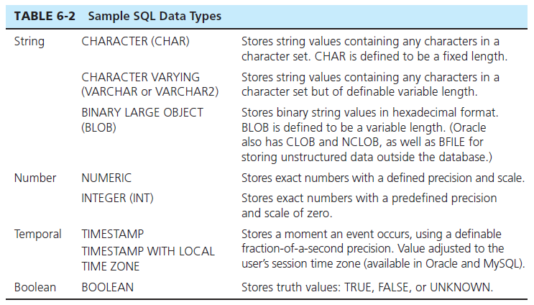
SQL Data Types
資料型別可依廠商別而略有不同或自有擴充
Notes:
One of the purposes of DDL is to specify data types of each of the attributes (columns, fields) of a table. This table shows some of the common data types, but there are many others.

Slide 12
Steps in Table Creation
Identify data types for attributes 決定欄位型別
Identify columns that can and cannot be null 可否無值
Identify columns that must be unique (candidate keys) 該欄位之值是否不可重複
Identify primary key–foreign key mates 主鍵及外鍵
Determine default values 有預設值嗎
Identify constraints on columns (domain specifications) 有任何限制嗎
Create the table and associated indexes 是否建索引
Notes:
DDL is used for table creation. It allows you to implement all of the items listed here.

Slide 13
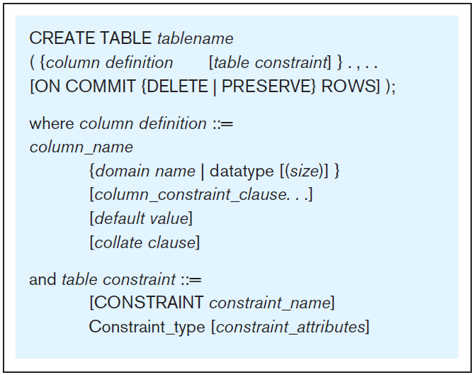
Figure 6-5 General syntax for CREATE TABLE statement used in data definition language
語法表示 [ ] 表選項, 可填可不填
{ } 表重複多次, 至少一次
Notes:
This shows the overall structure of a CREATE TABLE statement. This shows that the table will have a name, and some number of column definitions and table constraints. In the following slides, we see several examples, related to the Pine Valley Furniture database.

Slide 14
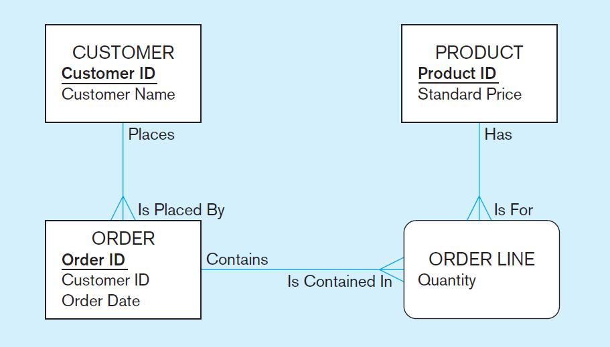
The following slides create tables for this enterprise data model
(from Chapter 1, Figure 1-3)
Notes:
This is the E-R diagram from chapter 1. Each of these entities, including the associative entity, is implemented as a table in the database.

Slide 15
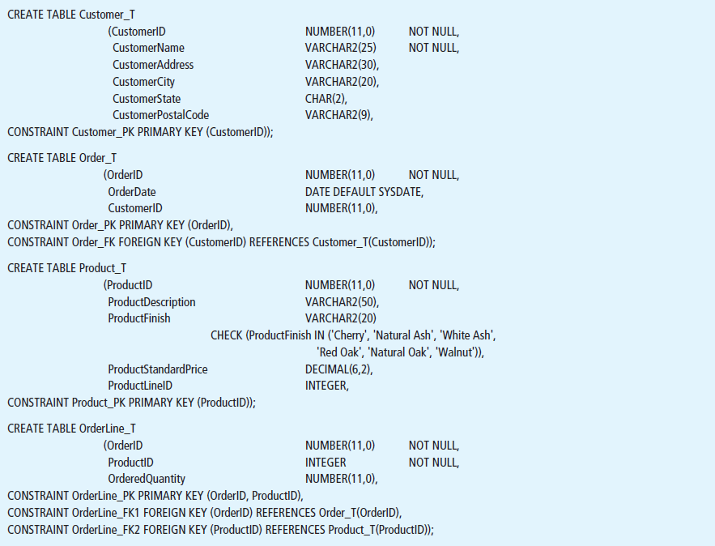
Figure 6-6 SQL database definition commands for PVF Company
(Oracle 12c)
Overall table definitions
Notes:
Here we see the SQL DDL commands for creating four tables, one each for customer, order, product, and order line. Note that for each of these, there is some number of column definitions, and some number of constraints.

Slide 16
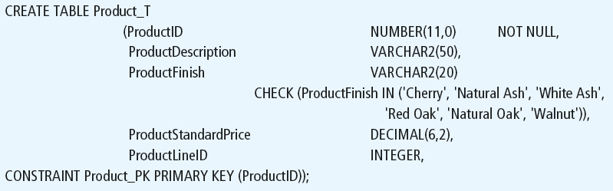
Defining attributes and their data types
decimal [(p[, s])] 和 number [(p[ , s])]
p 固定有效位數，小數點左右兩側都包括在內
s 小數位數的數字。
number 與 decimal 的功能相同。
為 key 取一個名字
語法及測試 https://www.w3schools.com/sql/sql_create_table.asp
Notes:
Each column has a data type. In this case, some are numeric, and some are character (text). You can also specify column sizes. For numeric columns, you can specify whether they will be integer (which ProductID is) or allow decimal values (such as ProductStandardPrice.

Slide 17
Non-nullable specification
Primary keys can never have NULL values
Identifying primary key
Notes:
The constraint above specifies the primary key. There are other ways of doing this as well.
Note that primary keys must have a value; they can never be null.

Slide 18
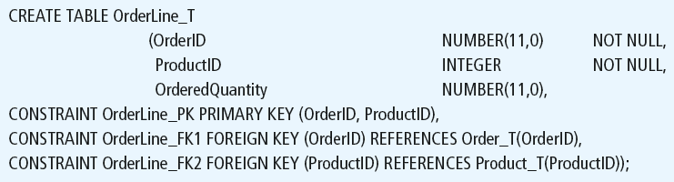
Non-nullable specifications
Primary key
為 key 取一個名字
Some primary keys are composite– composed of multiple attributes
注意PK為複合欄位時的寫法
Notes:
For this table, we see a composite primary key.
Remember that OrderLine is an associative entity, between Product and Order. Therefore it has two foreign keys, one to each of these tables.

Slide 19
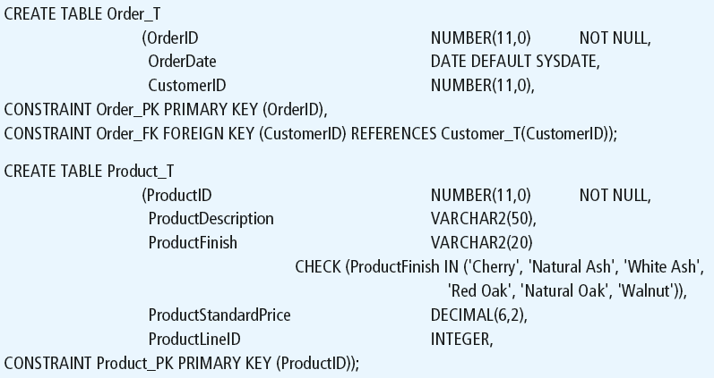
Controlling the values in attributes
DEFAULT value
指定預設值
SYSDATE是
系統日期變數
Domain constraint
Notes:
Here we see a domain constraint that limits the number of allowable values for the ProductFinish column. The CHECK operator always ensures that update and insert attampts to this table will only allow the values listed. However, because ProductFinish does not prohibit null values, it is possible to insert a record while leaving ProductFinish without a value at all.

Slide 20
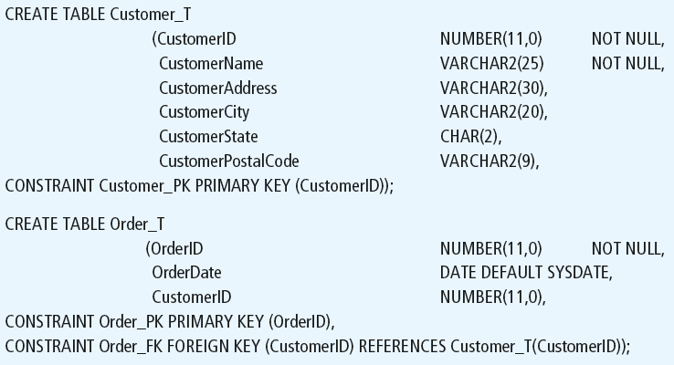
Identifying foreign keys and establishing relationships
Primary key of parent table
Foreign key of dependent table
Notes:
Here we see that the Order table has a foreign key. This CONSTRAINT statement creates a foreign key constraint, referencing the Customer table’s primary key.

Slide 21
Data Integrity Controls
Referential integrity–constraint that ensures that foreign key values of a table must match primary key values of a related table in 1:M relationships
Restricting:
Deletes of primary records
Updates of primary records
Inserts of dependent records

Slide 22
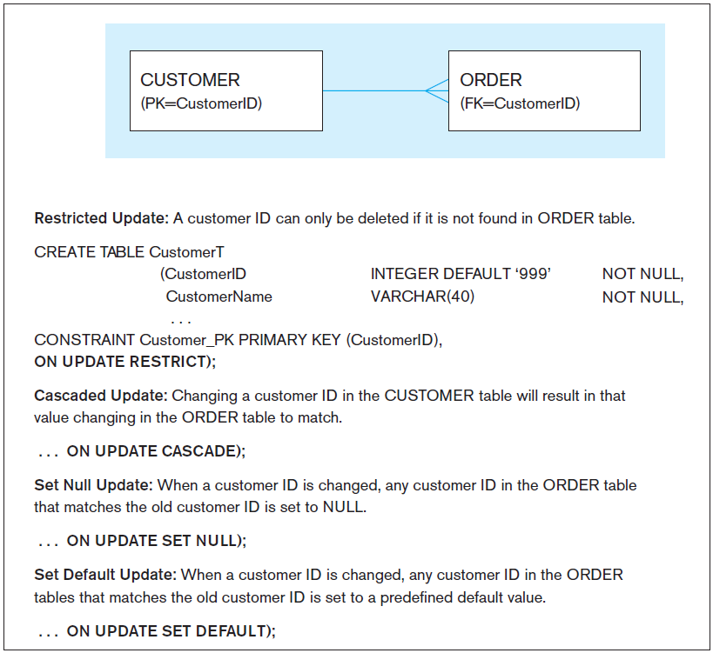
Figure 6-7 Ensuring data integrity through updates
Relational integrity is enforced via the primary-key to foreign-key match
1
2
自動檢查完整性
有四種指定方法
註 : 有些較簡易的
RDBMS可能未支援
3
4
Notes:
The CREATE TABLE statement includes a clause to specify how updates and deletes are processed when there are dependent tables. If a DELETE request comes for a record with dependent records in another table, The DBMS could restrict the delete, which means to disallow it. Or, it could cascade the delete, so that dependent records with matching foreign keys will also be deleted. Or it could set null, which means that deleting the primary key record will result in setting all corresponding foreign keys to be set to null (this would imply an optional one cardinality in the relationship).

Slide 23

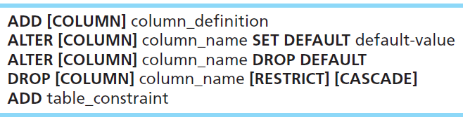

Changing Tables
ALTER TABLE statement allows you to change column specifications:
Table Actions:
Example (adding a new column with a default value):
Notes:
The ALTER command will be done after tables have already been created. For example, if you have an existing database, even one with actual data in it, you can modify tables by adding or changing columns, removing columns adding constraints, etc. If data in the tables violate the constraints, you will be prevented from setting these constraints until after changing the data.
So, whereas CREATE TABLE is mostly a process that takes place during implementation, ALTER TABLE often takes place during maintenance.

Slide 24
More examples
ALTER TABLE Customer_T ADD (Gender VARCHAR(2))
ALTER TABLE Customer_T DROP Gender
尚包含改名、改型別等功能；其它請參考語法

Slide 25
Removing Tables
DROP TABLE statement allows you to remove tables from your schema:
DROP TABLE Customer_T
Notes:
Tables will not be dropped if there are other tables that depend on them. This means that if any table has a foreign key to the table being dropped, the drop will fail. Therefore, it makes a difference which order you drop the tables in.

Slide 26



Insert Statement
Adds one or more rows to a table 開始加入資料至表格內
Inserting into a table
Inserting a record that has some null attributes requires identifying the fields that actually get data
Inserting from another table 直接將查詢結果加入
Notes:
As the last statement shows, it is possible to insert data into one table based on a query from another table. We’ll talk more about the SELECT statement shortly.

Slide 27
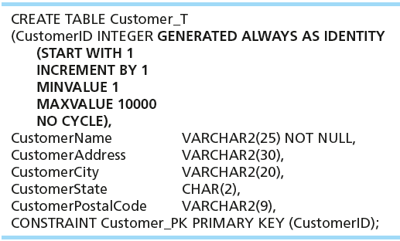
Creating Tables with Identity Columns
自動編號欄位型別
Introduced with SQL:2008
Inserting into a table does not require explicit customer ID entry or field list
INSERT INTO Customer_T VALUES ( 'Contemporary Casuals', '1355 S. Himes Blvd.', 'Gainesville', 'FL', 32601);
往後加入資料時就不需指定該欄位之值(會自動編號)
Notes:
Identity columns are columns whose value automatically increment with each new INSERT. So, an INSERT statement does not explicitly give a value for an identity column; this is handled automatically. Often primary keys are identity columns, but not always.

Slide 28
Delete Statement
Removes rows from a table 將表格內(符合條件的部份)資料刪除
Delete certain rows
DELETE FROM Customer_T WHERE CustomerState = 'HI';
使用WHERE條件子句
Delete all rows
DELETE FROM Customer_T;
Notes:
Remember, referential integrity rules will control whether a delete actually happens. The RESTRICT, CASCADE, and SET NULL constraints will determine how to handle the orders for a deleted customer.

Slide 29
WHERE bool_expression
WHERE (field operator value) bool_operator (field operator value) …
operator 例如 =, >, <, !=, >=, <=
bool_operator 例如 AND, OR, NOT 可加括號
C_ID | C_NAME | C_ADDR | C_STATE
1 | John | … | HI
2 | Mary | … | CA
3 | Bob | … | TX
4 | Peter | … | HI
5 | Sue | … | NY
6 | Leo | … | CA
WHERE 像是表格的水平定位器 (或過濾器)
rows是無順序的，
故要透過WHERE來指定作用的對象
DELETE FROM Customer_T 可接範例例如
WHERE C_STATE=‘HI’ OR C_STATE=‘NY’ 刪掉住HI或NY的客戶
WHERE C_ID>3 AND C_STATE=‘HI’ 刪掉編號大於3且住HI的客戶
WHERE C_ID>3 AND NOT C_STATE=‘HI’ 刪掉編號大於3且不是住HI的客戶

Slide 30

Update Statement
Modifies data in existing rows修改表格內(符合條件的部份)資料之值
使用WHERE條件子句 (欄位條件的布林邏輯組合)
Notes:
For this UPDATE, we know that it will affect only one record in the table. How do we know this?
Answer: Because ProductID is the primary key, which must be unique. So, there can be only one product with ProductID = 7.
However, many times updates and deletes affect many records. For example,
DELETE FROM CUSTOMER_T WHERE CUSTOMERSTATE = 'HI'; affects all customers from Hawaii.

Slide 31
Delete a lot of rows 小心使用！
UPDATE PRODUCT_T SET PRODUCT_DESCRIPTION=“”; 未指定WHERE子句，故作用在全部rows→清空欄位
UPDATE PRODUCT_T SET UNIT_PRICE = 775; 何意? (因為漏打WHERE子句，誤將全產品資料都設錯價格)

Slide 32
Create column index
Speed up in specific columns
替某個或某些欄位建立索引
Example
CREATE INDEX indexname ON Customer_T(CustomerName)
This makes an index for the CUSTOMER_NAME field of the CUSTOMER_T table
該欄位的查詢速度會大幅增加 (由線性時間下降成 log 時間)
Every key field (PK or FK) is suggested to add index
加快跨表關聯
WHERE子句中常作為篩選條件的欄位，也應建索引以加快查詢

Slide 33
SELECT Statement
Used for queries on single or multiple tables
Clauses of the SELECT statement:
SELECT 要取出哪些欄位
List the columns (and expressions) to be returned from the query
FROM 從哪張表
Indicate the table(s) or view(s) from which data will be obtained
WHERE 要取出哪些筆紀錄 (條件子句)
Indicate the conditions under which a row will be included in the result
GROUP BY 紀錄是否要合併, 用哪些欄位合併
Indicate categorization of results
HAVING 若紀錄有合併, 是否要再做篩選 (條件子句)
Indicate the conditions under which a category (group) will be included
ORDER BY 依哪些欄位做排序
Sorts the result according to specified criteria
Notes:
The SELECT statement includes many features that allow you to perform sophisticated queries. You can specify the conditions for rows to be included in the results, and you can choose which columns from these rows should be included. You can either get detailed data, or get aggregate results such as sums and averages. You also have many options in how to sort and format the results.

Slide 34
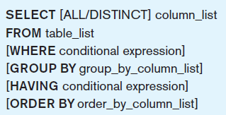
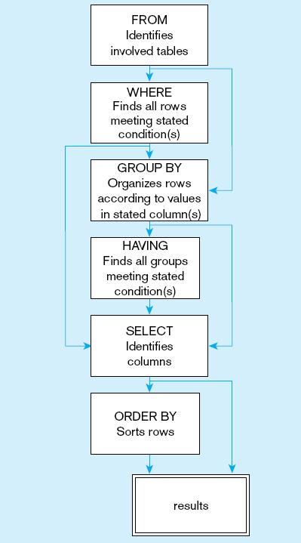
Figure 6-2
General syntax of the SELECT statement used in DML
內部RDBMS在解釋
這句命令時的處理順序
Figure 6-10
SQL statement processing order (based on van der Lans, 2006 p.100)
Notes:
The SELECT clause specifies which columns to return. The FROM clause specifies which tables these come from. The WHERE clause specifies conditions that determine whether a row is returned in the results. GROUP BY and HAVING are used for aggregate queries and ORDER BY determines sorting. Note that queries can also include subqueries, so you may see a SELECT inside another SELECT.

Slide 35
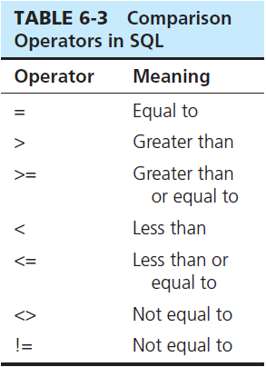
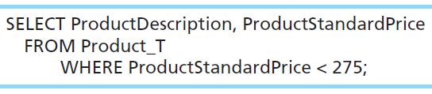
SELECT Example (1)
Find products with standard price less than $275
SELECT像是垂直定位器，指定取出哪些欄位
WHERE像是水平定位器，指定取出哪些紀錄
兩者合用，就可以取出2維表格中任何想取的區塊
Table 6-3: Comparison Operators in SQL
Notes:
The WHERE clause includes one or more conditions. A condition is a test that for each row in the table is either true or false. Only those with true results are permitted in the result set of the query.

Slide 36
SELECT Example (2) Using Alias
Alias is an alternative column or table name
SELECT Customer_T.CustomerName, Customer_T.CustomerAddress
FROM Customer_T
WHERE Customer_T.CustomerName = ‘Home Furnishings’;
SELECT C.CustomerName, C.CustomerAddress
FROM Customer_T AS C
WHERE C.CustomerName = ‘Home Furnishings’;
SELECT C.CustomerName AS NAME, C.CustomerAddress
FROM Customer_T AS C
WHERE NAME = ‘Home Furnishings’;
原句
(完整欄位的寫法是 tablename.fieldname，在不混淆的情況下tablename可以省略)
為表格
取別名
為欄位
取別名
取個別名, 比較方便指定, 也可省去重複打字
Notes:
Aliases are useful. They can often save on typing time when writing a query.

Slide 37
SELECT Example (3) Using a Function
可以使用函數對欄位做運算
例如 COUNT(), MAX(), MIN(), SUM(), AVG()…等
依RDBMS不同另有許多擴充函數
Using the COUNT aggregate function to find totals
找出總筆數
SELECT COUNT(*) FROM ORDERLINE_T
WHERE ORDERID = 1004;
* 是 "所有欄位" 的簡寫
改以特定欄位亦可
Note: With aggregate functions you can’t have single-valued columns included in the SELECT clause, unless they are included in the GROUP BY clause.
Notes:
The most common aggregate functions are COUNT, SUM, and AVERAGE.
What the above query gives is a number indicating the total number of order line records associated with order number 1004.

Slide 38
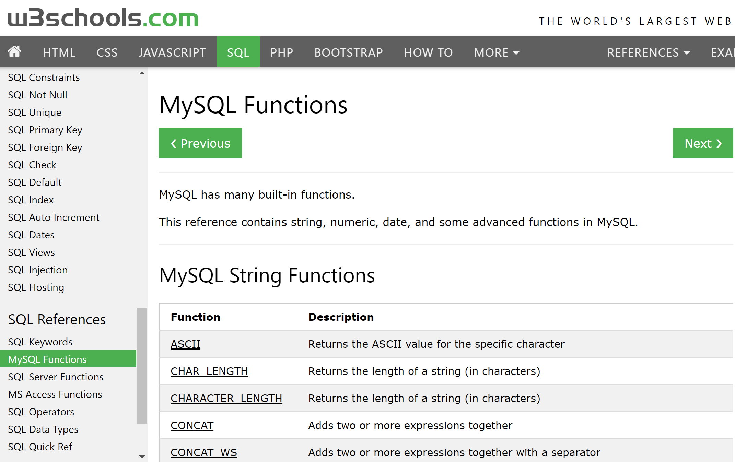
https://www.w3schools.com/sql/sql_ref_mysql.asp 可查MySQL特殊函數或其他語法

Slide 39
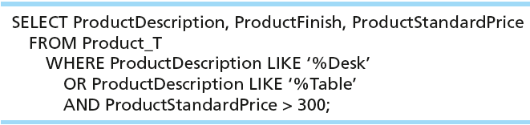
SELECT Example (4) Boolean Operators
AND, OR, and NOT Operators for customizing conditions in WHERE clause
Note: The LIKE operator allows you to compare strings using wildcards. For example, the % wildcard in ‘%Desk’ indicates that all strings that have any number of characters preceding the word “Desk” will be allowed.
LIKE 是做字串比對用的, 支援萬用字元%或_ (或以*與?表示)
Notes:
The WHERE clause in this query has tests for three conditions. It lists product name, finish, and standard price for all desks, and all tables that cost more than $300 in the Product table.

Slide 40
LIKE operator and wildcards
% or * : zero to many of any characters
_ or ? : one of any characters
Example
Mic* matches Mickey, Michael, Michelle, etc.
*son matches Dickson, Jackson, Bobson, etc.
s?n matches sun, son, san, sin, etc.
可以多個混合使用 例 c??p* matches computer, camp

Slide 41
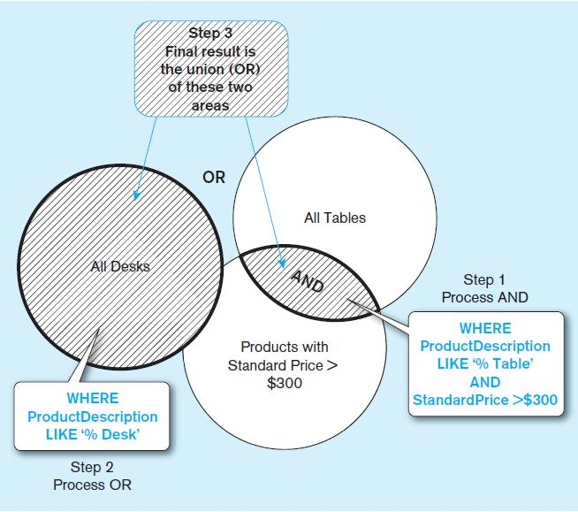
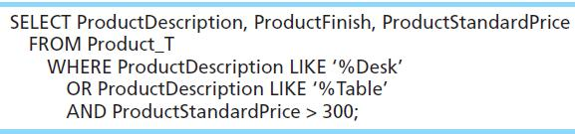
Figure 6-8 Boolean query A without use of parentheses
By default, processing order of Boolean operators is NOT, then AND, then OR
Notes:
By default, the AND operation takes place before the OR. So, only tables over $3000 are included (via the AND). These are then combined with all desks (no matter what price) via the OR.

Slide 42
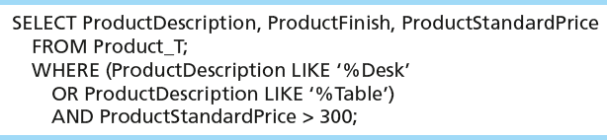
With parentheses… these override the normal precedence of Boolean operators 用括號改變優先順序
With parentheses, you can override normal precedence rules. In this case parentheses make the OR take place before the AND.

Slide 43
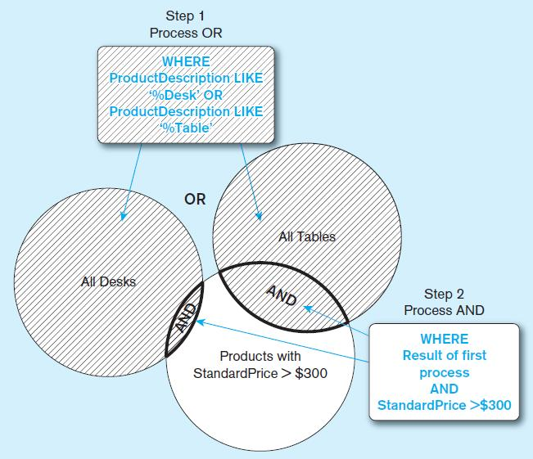
Figure 6-9 Boolean query B with use of parentheses
Notes:
The parentheses cause the OR to take place before the AND. Therefore, first desks and tables are combined (via the OR), and then this entire set is subjected to the $300 price limit via the AND.

Slide 44
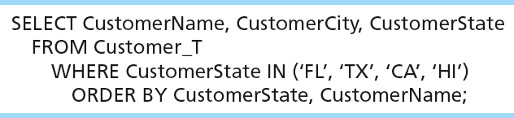
SELECT Example (5) Sorting Results with ORDER BY Clause 將查詢結果做排序
Sort the results first by STATE, and within a state by the CUSTOMER NAME
Note: The IN operator in this example allows you to include rows whose CustomerState value is either FL, TX, CA, or HI. It is more efficient than separate OR conditions. 跟寫 STATE=‘FL’ OR STATE=‘TX’ OR … 是一樣的效果
ORDER BY field1 [ASC|DESC] [,field2 [ASC|DESC]…]
可用ASC或DESC來指定升冪或降冪排列
Notes:
You can order by any number of fields from the originating table.
Question: How would you have done the WHERE clause if you used OR conditions instead of the IN operator?
Answer: WHERE CustomerState = ‘FL’ OR CustomerState = ‘TX’ OR CustomerState = ‘CA’ OR CustomerState = ‘HI’

Slide 45

SELECT Example (6) Categorizing Results Using GROUP BY Clause
For use with aggregate functions需配合集合函數使用
Scalar aggregate: single value returned from SQL query with aggregate function 若單只使用集合函數, 只傳回單筆紀錄, 如count(*)
Vector aggregate: multiple values returned from SQL query with aggregate function (via GROUP BY) 若配合GROUP BY將傳回多筆
You can use single-value fields with aggregate functions if they are included in the GROUP BY clause
在GROUP BY子句出現過的欄位才可以調用；
其他欄位都被合併計算了
Notes:
This is an example of vector aggregate. It will return the number of customers from each state. This query will return the name and count of customers from all states that actually have customers.
If all we wanted was the total number of customers (across all states), we could do this scalar aggregate query”
SELECT COUNT(*) from Customer_T
This query will return a single value, which is the total number of customers. That would be the sum of all the individual numbers returned from the aggregate query displayed in this slide.

Slide 46
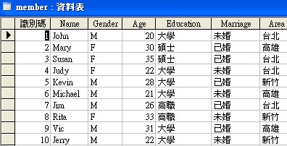


原始表格
SELECT gender, count(*)
FROM member
GROUP BY gender;
SELECT area, count(*)
FROM member
GROUP BY area;
46

Slide 47
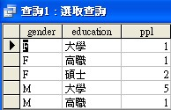
原始表格
SELECT gender, education, count(*) AS ppl
FROM member
GROUP BY gender, education;
47

Slide 48
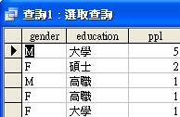
原始表格
SELECT gender, education, count(*) AS ppl
FROM member
GROUP BY gender, education
ORDER BY count(*) DESC;
48

Slide 49
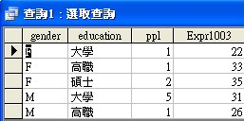
原始表格
SELECT gender, education, count(*) AS ppl,
max(age)
FROM member
GROUP BY gender, education;
使用不同的函數
49

Slide 50
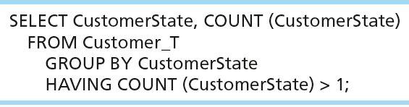
SELECT Example (7) Qualifying Results by Categories Using the HAVING Clause
For use with GROUP BY
將GROUP BY後的結果再用條件過濾的意思
HAVING語法與WHERE一樣
(HAVING在GROUP BY之後做，WHERE在GROUP BY之前做)
Like a WHERE clause, but it operates on groups (categories), not on individual rows.
Here, only those groups with total numbers greater than 1 will be included in final result.
Notes:
The HAVING clause restricts which groups will be returned in an vector aggregate query. It’s like a WHERE clause, but operates on groups, not individual rows.

Slide 51
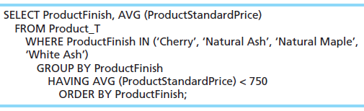
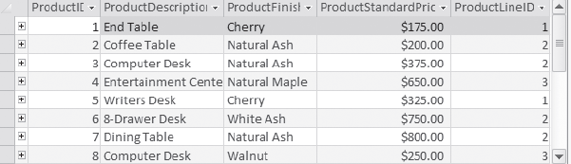
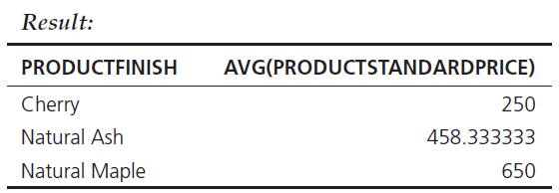
A Query with both WHERE and HAVING
Notes:
First, the WHERE clause restricts us to only products with certain types of Product Finish. Then, after that they are grouped by the product finish and average prices calculated for each group. Only the groups with average price less than 750 are included in the final result, via the HAVING clause. After all this is done, they are ORDERed alphabetically by ProductFinish.
So, the WHERE clause operated to restrict the number of rows, and then the HAVING was used to restrict the number of groups.

Slide 52

SELECT gender, education, count(*) AS ppl
FROM member
GROUP BY gender, education;
SELECT gender, education, count(*) AS ppl
FROM member
GROUP BY gender, education
HAVING education='大學';
HAVING可以想成是GROUP BY後的WHERE
52

Slide 53
Using and Defining Views
Views provide users controlled access to tables
Ex. 限制只可看到某些欄位, 或建立某些常用查詢 (為了方便)
Base Table–table containing the raw data
Dynamic View
A “virtual table” created dynamically upon request by a user
No data actually stored; instead data from base table made available to user
Based on SQL SELECT statement on base tables or other views
Materialized View
Copy or replication of data
Data actually stored
Must be refreshed periodically to match corresponding base tables 需資料更新以維持一致性, 故較少用

Slide 54
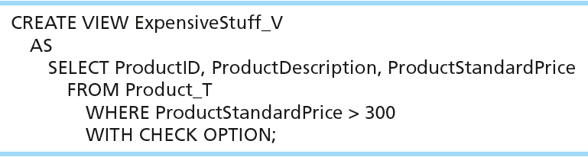
Sample CREATE VIEW
View has a name.
View is based on a SELECT statement.
可分為 read-only view 或 updateable view (較少使用)
若為updateable view，CHECK_OPTION prevents updates that would create rows not included in the view.

Slide 55
Advantages of Views
Simplify query commands
Provide customized view for user
常用查詢可建立為view
善用view可簡化複雜查詢
Disadvantages of Views
Use processing time each time view is referenced
May or may not be directly updateable
處理速度可能稍慢
有些RDBMS不支援updateable view

