Slide 1
Chapter 1: The Database Environment and Development Process
Modern Database Management
12th Edition
Global Edition
Jeff Hoffer, Ramesh Venkataraman,
Heikki Topi
授課老師：楊立偉教授，台灣大學工管系

Slide 2
Definitions
Database: organized collection of logically related data
Data: stored representations of meaningful objects and events
Structured: numbers, text, dates 結構性
Unstructured: images, video, documents 非結構性
Information: data processed to increase knowledge in the person using the data
Metadata: data that describes the properties and context of user data 描述資料用的註記
Notes:
描述不同: 每日氣溫, 每周平均, 每周一特別熱, 3天高溫後下雨機率倍增
Data by itself is not very useful. It is only after the data has been processed, summarized, and organized that it becomes useful for decision makers and knowledge workers. Processed data becomes information, which is often made available to users in the form of reports or graphical displays.
Metadata really pertains to the underlying structure of the data. When you design a database, you are specifying its metadata. When you populate the database, you are putting data into it.

Slide 3
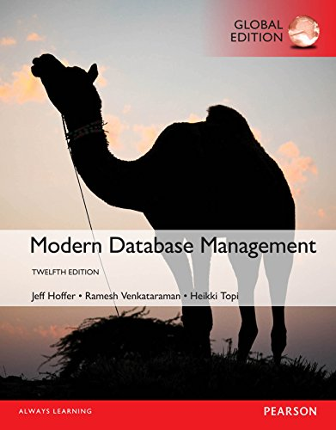
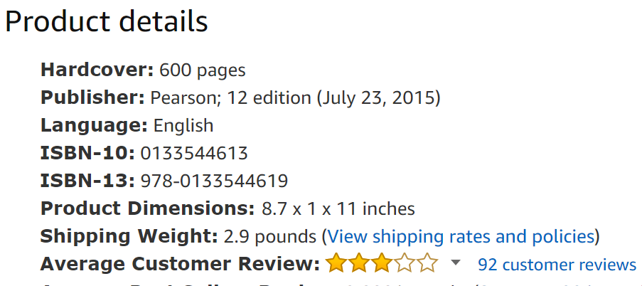
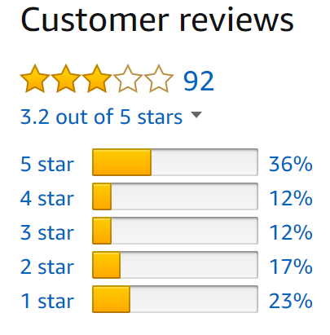
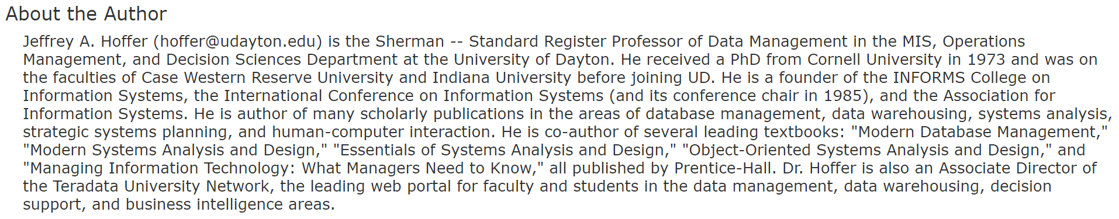
補充 : Structured, Semi-, and Unstructured
是否有欄位、結構、規則可循

Slide 4
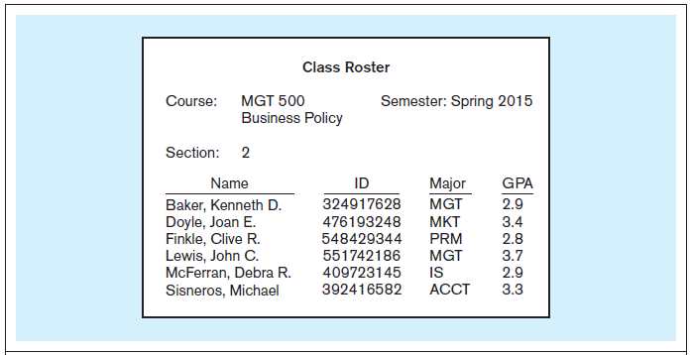
Figure 1-1a Data in context 範例 – 修課清單
有哪些種類的資料？
有哪些欄位？
Context helps users understand data
Notes:
Here we see a report that indicates several types of data entities. We have courses and sections of these courses, and we also have the students that are enrolled in a section. Thus, we have gone from just raw data to some type of useful information by organizing the data.
The concept of an entity is something we will discuss in detail later on.

Slide 5
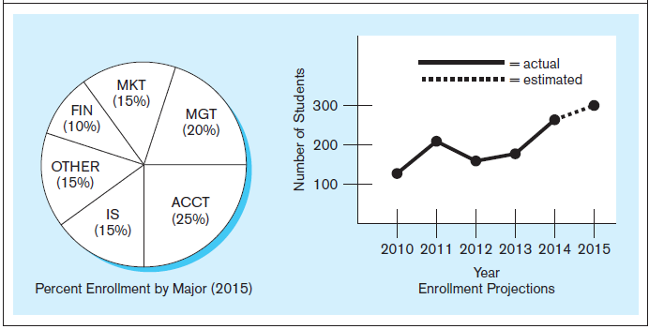
Figure 1-1b Summarized data
Graphical displays turn data into useful information that managers can use for decision making and interpretation
提供決策與解釋之用
Notes:
Here we see summaries of the data. Rather than individual data units, the data has been processed into aggregates and categories. Sums and averages are typical forms of aggregated data, and this is another way of turning raw data into useful and actionable information.

Slide 6
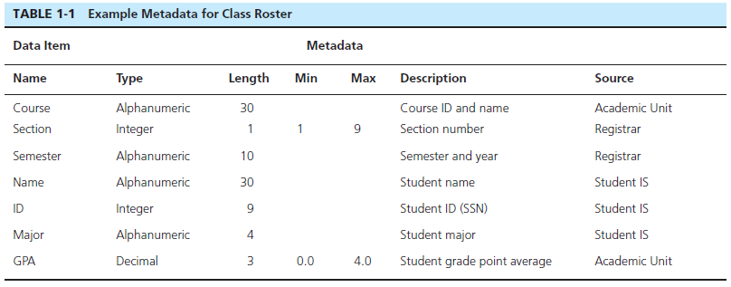
Descriptions of the properties or characteristics of the data, including data types 資料型別, field sizes 欄位長度, allowable values 合法值, and data context 資料來源與描述
Notes:
Metadata is not data per se. Instead it is a description of how data is to be stored and organized into a database.

Slide 7
Disadvantages of File Processing
如果不存在資料庫，就只能存在個別應用程式(檔案)中，缺點是…
Program-Data Dependence 程式與資料相依
All programs maintain metadata for each file they use
Duplication of Data
Different systems/programs have separate copies of the same data
Limited Data Sharing
No centralized control of data
Lengthy Development Times
Programmers must design their own file formats 欠缺統一格式
Excessive Program Maintenance
80% of information systems budget
Notes:
以從前的通訊錄APP為例: 程式加資料, 重複, 不共用
之後才有集中雲端資料庫
Prior to the advent of databases, data was stored in individual files, each being used by a separate program. This was the traditional file processing approach to data storage. As business applications became more complex, it became evident that traditional file processing systems had a number of shortcomings and limitations. Database systems were developed to overcome these shortcomings. However, there is still a lot of data that is stored in traditional file systems. Legacy systems still abound with traditional files. Even Excel spreadsheets, which are relatively modern, would be considered to fall within the same category as file systems. Many companies store their important data in myriad spreadsheets, and as their businesses become more complex they run up against the limitations of these storage methods.

Slide 8
Problems with Data Dependency
若不將資料分離開，而程式與資料是相依的話…
(想像有2個資料不相通的應用程式App - 通訊錄A及通訊錄B)
Each application programmer must maintain his/her own data 不同人(或系統)得維護自己的資料
Each application program needs to include code for the metadata of each file 得在程式中自己定義資料
Each application program must have its own processing routines for reading, inserting, updating, and deleting data 在程式中自己處理各項資料操作
Lack of coordination and central control 欠缺控管
Non-standard file formats 沒有標準格式
Notes:
想像以通訊錄APP1與APP2為例子

Slide 9
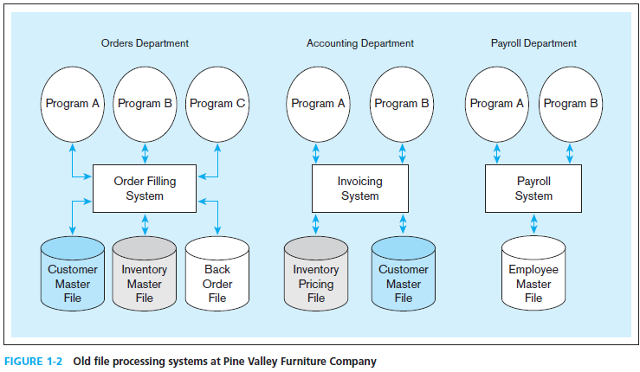
Duplicate Data
某大傢俱公司的三個部門 (系統)
Notes:
If the invoicing system and the order filing system each have their own copy of customer data, then this could lead to inconsistencies. What if one file changes the address or account valance of a customer, but the other one does not? In this case, we would have inconsistent data, which is not good for the organization. Data duplication is one of the biggest problems in data management, and databases are designed to eliminate or reduce duplication.
The Pine Valley Furniture (PVF) company will be an ongoing case in this textbook. You will become very familiar with PVF over time.

Slide 10
Problems with Data Redundancy
問題核心 : 重複多餘的資料
Waste of space to have duplicate data 浪費儲存空間
Causes more maintenance headaches 需更多維護成本
The biggest problem:
Data changes in one file could cause inconsistencies 造成資料不一致性
Compromises in data integrity 破壞資料整體性
Notes:
例如用email協作的問題: 附件檔案版本控制
Although wasted space is an issue with data redundancy, it has become less of a problem over time. Storage media is increasingly becoming less and less expensive.
The real problem, as mentioned earlier, is with data inconsistencies. The term “data integrity” refers to ensuring the validity, security, and availability of a company’s data. Traditional file processing systems have a difficult time ensuring data integrity.

Slide 11
SOLUTION: The DATABASE Approach
Central repository of shared data (將需共享的資料)集中儲存
Data is managed by a controlling agent (透過單一的代理程式)統一管理
Stored in a standardized, convenient form 標準並方便處理的格式
Requires a Database Management System (DBMS)
Notes:
解決方法: 集中 統一 標準

Slide 12
Database Management System (DBMS)
A software system that is used to create, maintain, and provide controlled access to user databases
不同系統
集中儲存
Order Filing
System
Central database
Contains employee,
order, inventory,
pricing, and
customer data
Invoicing
System
DBMS
存取統一控制
Payroll
System
DBMS manages data resources like an operating system manages hardware resources
Notes:
舉例類比為Web Service的概念
The database management system (DBMS) is a software system that is used to create, maintain, and provide controlled access to user databases.
Most current DBMSs are in the form of relational databases, which represent data as a collection of tables in which all data relationships are represented by common values in related tables. We will explore relational databases in detail throughout this course.
Note that because all the data is shared in a central database, there is no longer the need for separate systems and programs to maintain their own copy of the data. This reduces duplication and increases integrity.

Slide 13
Advantages of the Database Approach
(想像有2個資料可相通的應用程式App - 通訊錄A及通訊錄B)
Program-data independence 程式與資料獨立切開
Planned data redundancy 避免資料重複
Improved data consistency 改善資料一致性
Improved data sharing 讓資料可共用
Increased application development productivity
加快應用程式開發
Enforcement of standards 標準的資料格式
Improved data quality 改善資料品質
Improved data accessibility and responsiveness
更好的資料存取性與回應
Reduced program maintenance 減少維護成本

Slide 14
Costs and Risks of the Database Approach
New, specialized personnel 需要專人處理
Installation and management cost and complexity 資料庫安裝與管理成本
Conversion costs 轉換資料或系統的成本
Need for explicit backup and recovery
需要確實備份與復原 (ex. 注意成為單一弱點)
Organizational conflict
可能會造成組織衝突 (ex. 資料/資源不共享)

Slide 15
Elements of the Database Approach
Data models 資料模型
Graphical diagram capturing nature and relationship of data
Enterprise Data Model–high-level entities and relationships for the organization
Project Data Model–more detailed view, matching data structure in database or data warehouse
Entities
Noun form describing a person, place, object, event, or concept
Composed of attributes
Relationships
Between entities
Usually one-to-many (1:M) or many-to-many (M:N), but could also be one-to-one (1:1)
Relational Databases 關聯式資料庫
Database technology involving tables (relations) representing entities and primary/foreign keys representing relationships

Slide 16
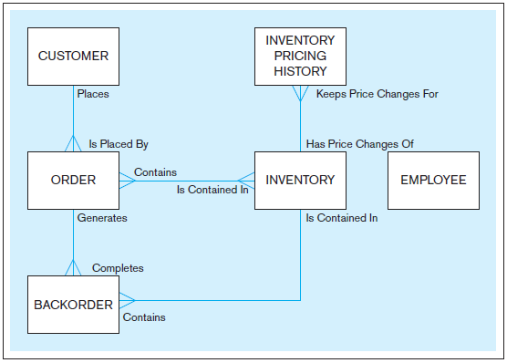

此稱為Entity
此稱為Relationship
此稱為Entity-Relationship
Model (E-R model)
Notes:
Note that the enterprise model doesn’t contain some details, including the attributes of the entities, as well as the associative entities. In this sense it is a more summarized view, and simpler to look at. This is in contrast to the project-level model which is much more detailed.

Slide 17
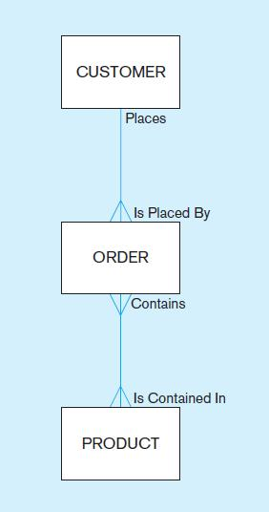
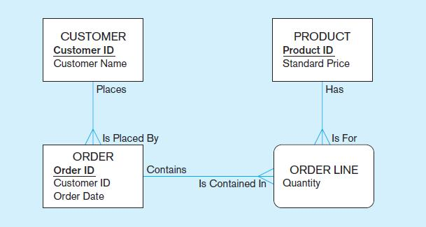
Figure 1-3 Comparison of enterprise and project level data models
Segment of an enterprise data model
Segment of a project-level data model
Notes:
Here we see the distinction between an enterprise data model and a project data model. The enterprise-level model is more of a bird’s eye view, and less detailed than a project-level model.
Entities are represented by boxes. Relationships are represented by lines between the boxes. Attributes, which describe the important characteristics of an entity, are represented by the verbiage within the boxes.

Slide 18
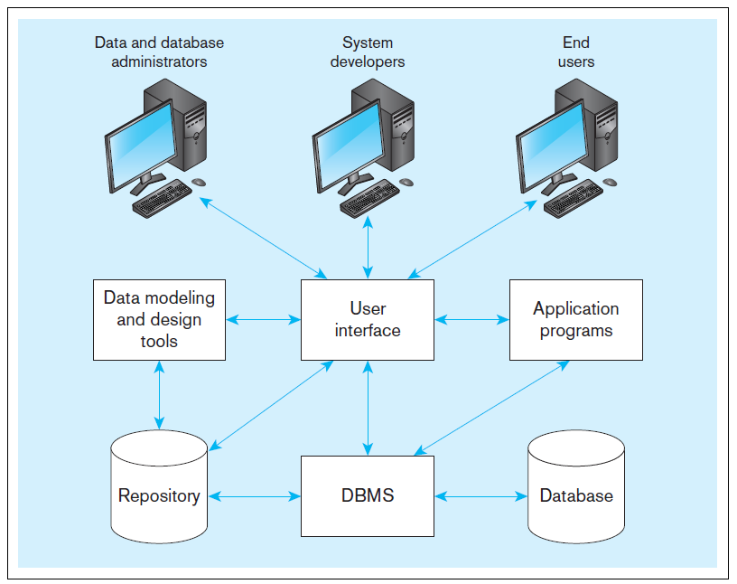
Figure 1-5 Components of the database environment
Notes:
Data modeling and design tools are automated tools used to design databases and application programs. These tools help with creation of data models and in some cases can also help automatically generate the “code” needed to create the database.
A repository is a centralized knowledge base for all data definitions, data relationships, screen and report formats, and other system components. In other words, the metadata resides in the repository.
DBMS is a software system that is used to create, maintain, and provide controlled access to databases. A database is an organized collection of logically related data, usually designed to meet the information needs of multiple users in an organization. A database is not the same as a repository. The database contains data, whereas the repository contains metadata. In other words, the repository defines the structure of the data.
Application programs interact with the database to provide functionality of use for the company. Relating this to figure 1-2, the application programs fulfill the order processing, invoicing, and payroll functions.
The user interface includes languages, menus, and other facilities by which users interact with various system components. Most application programs will involve user interfaces, because they will be directly used by people (users). However, not all applications involve user interfaces; some are run as batch programs in the background. For example, a program that prints paychecks may not include a user interface.
Different types of users include data and database administrators, system developers, and end users. The data administrators manage the data and database. The developers create the application programs. The end users are peope who use the systems for various business functions. These can include accountants, sales people, managers, etc. Database administrators and system developers are IT people, and their principal clientele involve end users.

Slide 19
Components of the Database Environment
Data modeling and design tools -- automated tools used to design databases and application programs
Repository–centralized storehouse of metadata
Database Management System (DBMS) –software for managing the database
Database–storehouse of the data
Application Programs–software using the data
User Interface–text, graphical displays, menus, etc. for user
角色 Data/Database Administrators–personnel responsible for maintaining the database
角色 System Developers–personnel responsible for designing databases and software
角色 End Users–people who use the applications and databases

Slide 20

Enterprise Data Model 企業的資料模型
First step in the database development process
Specifies scope and general content
Overall picture of organizational data at high level of abstraction 先概略地盤點有哪些資料要納入範圍
Entity-relationship diagram 建立ER圖並慢慢補足細節
Descriptions of entity types
Relationships between entities
Business rules

Slide 21
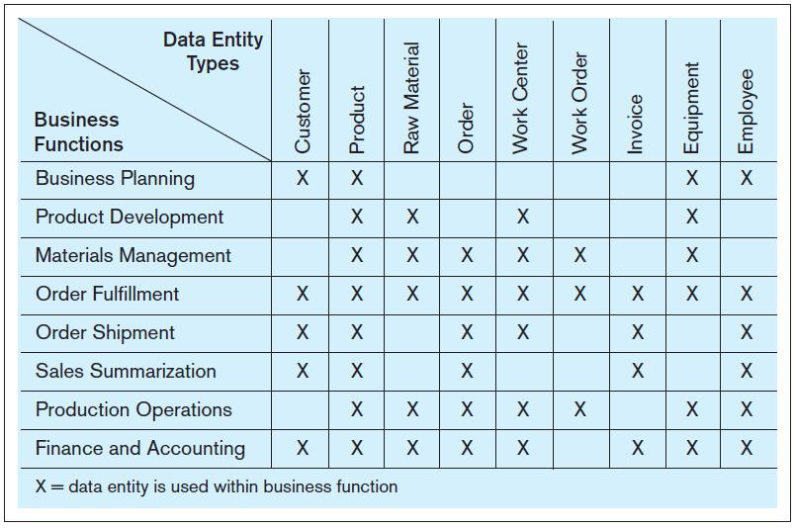
FIGURE 1-6 Example business function-to-data entity matrix
Notes:
How do we determine the type of data that is required and who within the organization needs what data? Often this is done using matrixes. One type of matrix matches business functions with the data entity types they need; this is called a function-to-data-entity matrix.

Slide 22
Two Approaches to Database and IS Development
SDLC
System Development Life Cycle 系統開發生命週期法
Detailed, well-planned development process
Time-consuming, but comprehensive
Long development cycle
Prototyping 雛型法
Rapid application development (RAD) 為快速應用開發之一種
Cursory attempt at conceptual data modeling (ex. 打草稿)
Define database during development of initial prototype
Repeat implementation and maintenance activities with new prototype versions
Notes:
The traditional SDLC came from the days before advanced technologies made rapid application development possible. Prototyping and its variants (such as agile, scrum, and extreme programming) came about much later in the history of information technology. Many projects combine various elements from SDLC and prototyping. In the next set of slides we’ll look at the steps in each approach.

Slide 23
Systems Development Life Cycle (see also Figure 1-7)
Planning
Analysis
Logical Design
Physical Design
Implementation
Maintenance
常又稱為瀑布法 (waterfall)
Notes:
The SDLC is sometimes called a “waterfall” approach. The outputs from one phase flow down to the next. But as you can see it is also a cycle. At any stage in the process, it is possible and sometimes necessary to return to a prior stage.

Slide 24
 |  | Purpose | Deliverable | Database activity
1 | Planning | preliminary understanding | request for study | enterprise modeling and early conceptual data modeling
2 | Analysis | thorough requirements analysis and structuring | functional system specifications | thorough and integrated conceptual data modeling
3 | Logical Design | information requirements elicitation and structure | detailed design specifications | logical database design (transactions, forms, displays, views, data integrity and security)
4 | Physical Design | develop technology and organizational specifications | program/data structures, technology purchases, organization redesigns | physical database design (define database to DBMS, physical data organization, database processing programs)
5 | Implementation | programming, testing, training, installation, documenting | operational programs, documentation, training materials | database implementation, including coded programs, documentation, installation and conversion
6 | Maintenance | monitor, repair, enhance | periodic audits | database maintenance, performance analysis and tuning, error corrections

Slide 25
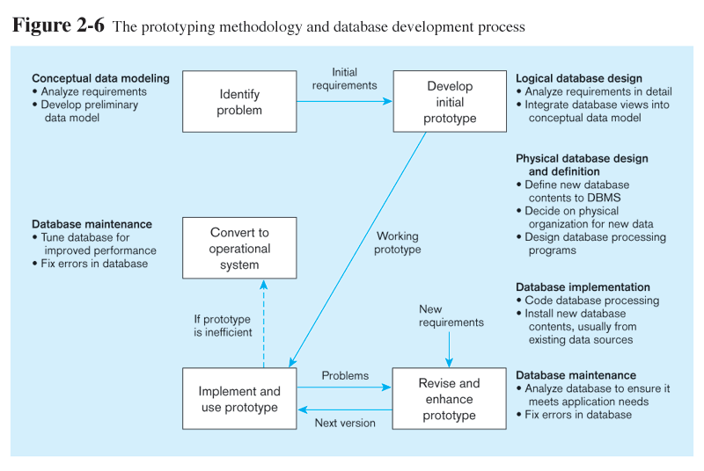
Prototyping Database Methodology (Figure 1-8)
Notes:
Database maintenance will occur throughout the operational lifetime of the system, just like in the SDLC methodology.

Slide 26
Other Rapid Application (RAD) Approaches
認為軟體需求的不斷變化是很自然的現象，是軟體專案開發中不可避免的、也是應該欣然接受的現象，重點在適應需求而非預測需求
Agile – emphasizes “individuals and interactions over processes and tools, working software over comprehensive documentation, customer collaboration over contract negotiation, and response to change over following a plan.” (The Agile Manifesto) 敏捷開發方法
Examples of agile programming methodologies
eXtreme programming 極限編程
Scrum “爭球”
DSDM Consortium (Dynamic Systems Development Method)
Feature-driven development
Notes:
Prototyping led to many RAD approaches. The “Agile Manifesto” was a statement that espoused a radical free-flowing and flexible approach to systems development. Here is a list of some of the methodologies.

Slide 27
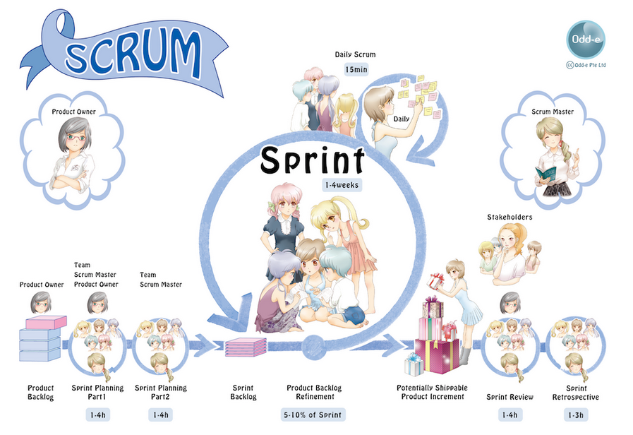

Slide 28
Database Schema
Conceptual Schema
E-R models–covered in Chapters 2 and 3
Internal Schema
Logical structures–covered in Chapter 4
Physical structures–covered in Chapter 5
External Schema
User Views
Subsets of Conceptual Schema
Can be determined from business-function/data entity matrices
DBA determines schema for different users
Notes:
The term “schema” here refers to the view you have of the system being developed. Users of a system have one view, based on the reports, forms, and interactions they have with the system. Designers have s view of the entities, attributes, and relationships involved in the world being modeled (the conceptual schema), as well as a view of tables, fields, primary and foreign keys, together with an understanding of what makes a database well structured and efficient (the internal schema).

Slide 29
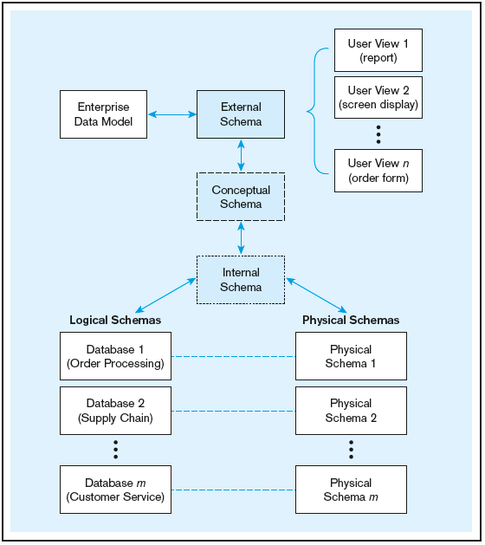
Figure 1-9 Three-schema architecture
Different people have different views of the database…these are the external schema
The internal schema is the underlying design and implementation
Notes:
If you are a database designer, you will be extensively involved in the conceptual schema logical and physical pieces of the internal schema. You will be particularly involved in the physical schema if you are a database administrator (DBA). If you are a user, these schemas don’t matter much to you; rather you will be involved in the external schema.

Slide 30
Managing People and Projects
Project–a planned undertaking of related activities to reach an objective that has a beginning and an end 專案一定有開始、有結束、有目標
Initiated and planned in planning stage of SDLC
Executed during analysis, design, and implementation
Closed at the end of implementation
Notes:
Project management is an important skill in any information systems project, and managing the database design and implementation tasks is part of project management.
Projects often are organized into tasks and subtasks, each of which is scheduled for an expected time period, and assigned to various people involved in the project. It is up to the project manager to monitor the progress and cost of the project.

Slide 31
Managing Projects: People Involved
Business analysts 商業分析師 (商業規則)
Systems analysts 系統分析師 (需求到規格)
Database analysts and data modelers 資料庫分析師及資料建模師
Users 使用者
Programmers 程式人員
Database architects 資料庫架構師 (資料庫部署)
Data administrators (DBA) 資料庫管理師 (資料庫內部配置)
Project managers 專案經理
Other technical experts, and Data Scientist 資料科學家 (實驗/推論)
Notes:
There are many different people, each with different perspectives, skills, and needs, involved in a systems development project.

Slide 32
Evolution of Database Systems
Driven by four main objectives:
Need for program-data independence ➔ reduced maintenance 更好維護
Desire to manage more complex data types and structures 可處理更多種資料
Ease of data access for less technical personnel 易於使用而不要太多技術細節
Need for more powerful decision support platforms 提供更多決策支援之用
Notes:
Here are some of the motivations that led to the evolution of database systems.

Slide 33
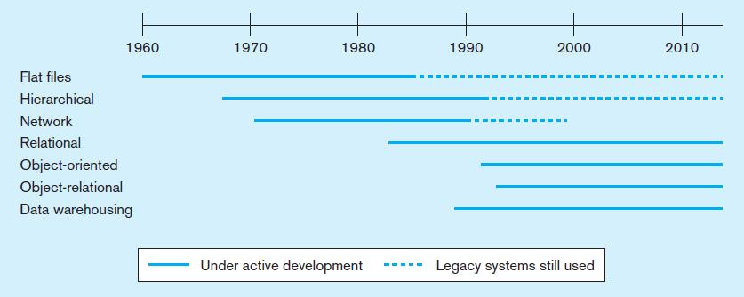
Figure 1-10a Evolution of database technologies
Notes:
Over the years since the advent of computer data processing systems in business, there have been many approaches to database technology. We already discussed flat files and their problems. Early attempts to solve these problems led to hierarchical and network databases. Legacy systems, those initially created in the 1950s and 1960s sometimes still use these earlier technologies.
The relational database is the most common form, especially for business applications. However, others also exist, including object-oriented and object-relational. Data warehousing is commonly used for managerial decision making.

Slide 34
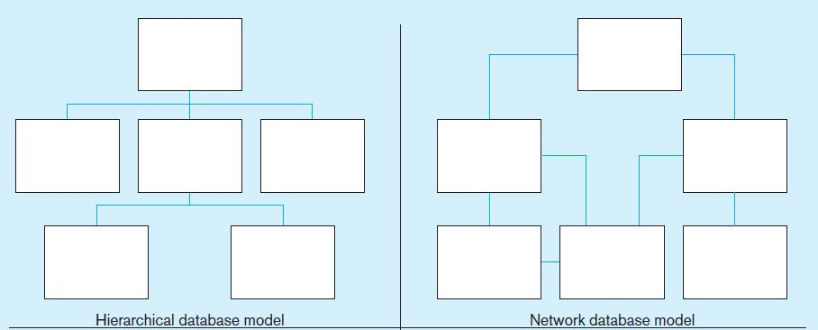
Figure 1-10b Database architectures
對應到程式設計中常用的
tree資料結構
對應到程式設計中常用的
graph資料結構
Notes:
The hierarchical and network database models was the first attempt to structure data according to relationships between entities. But they fell short because they were very inflexible. For example, many-to-many relationships are impossible in hierarchical databases, and although they are possible in network models they are difficult to modify in these structures.

Slide 35
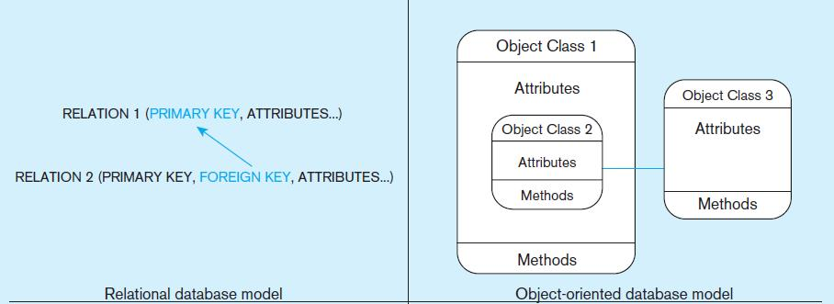
Figure 1-10b Database architectures (cont.)
易懂且表達能力強
(也可儲存tree及graph)
物件導向設計 (資料及動作一同封裝，
減少複雜度及出錯的可能，並提供繼承)
Notes:
The relational model is the most ubiquitous, and represents relationships as primary-to-foreign key associations in different “relations”. Here we see some confusing terminology. There is the concept of “relationship”, which was shown as lines between boxes in figure 1-3. And there is another concept of “relation”, which is really like a database table. We’ll see this distinction later in the semester.
Object-oriented databases are interesting in that they allow for a sort of inheritance between classes and subclasses. Also, unlike relations (tables) in relational databases, objects in object-oriented databases are capable of behaviors (program code) in the form of “methods”. If you take a course in Java or another object-oriented language, you will become familiar with these ideas.

Slide 36
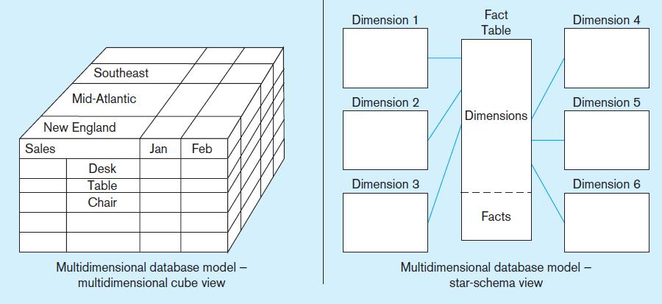
Figure 1-10b Database architectures (cont.)
基於Relational data model之上
常用於線上分析(OLAP)之設計
基於Relational data model之上
常用於資料倉儲之設計
Notes:
Multidimensional models are typically based on data warehouses, and are used for decision support purposes. The term Online Analytical Processing (OLAP) refers to the types of systems that use multidimensional data.

Slide 37
用表格表達階層資料 (生物資料為例)
Life
生物
Micro-organisms微生物界
Animalia
動物界
Plantae
植物界
Invertebrate
無脊椎動物
Chordata
脊椎動物
名稱 | 上層
Life生物 | (無)
Animalia動物界 | Life生物
Plantae植物界 | Life生物
Micro-organism微生物界 | Life生物
Invertebrate無脊椎動物 | Animalia動物界
Chordata脊椎動物 | Animalia動物界

Slide 38
用表格表達網路資料 (匯款關係為例)
Name
John
Bob
Mary
Michael
John
Bob
Mary
From | To
John | Mary
John | Michael
Bob | Mary
Mary | Michael
Michael

Slide 39
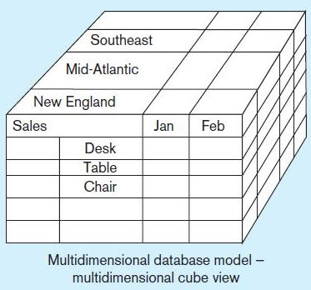
用表格表達多維度資料 (銷售資料為例)
OR

Slide 40
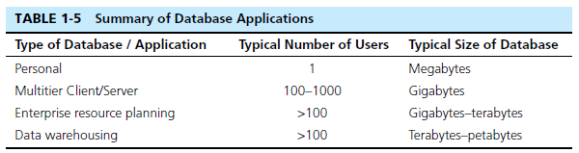
The Range of Database Applications
各種資料庫應用系統 –
會用到資料庫的程式 (非常多)
Personal databases
Two-tier and N-tier Client/Server databases
Enterprise applications
Enterprise resource planning (ERP) systems
Data warehousing implementations
Notes:
依使用者做分類
Here are some size ranges of typical database applications. Personal databases are often done in Microsoft Access. Multitier client/server and ERP systems are typical for the normal operational activities of most companies. Data warehouses tend to be large because they collect and maintain historical data over time.

Slide 41
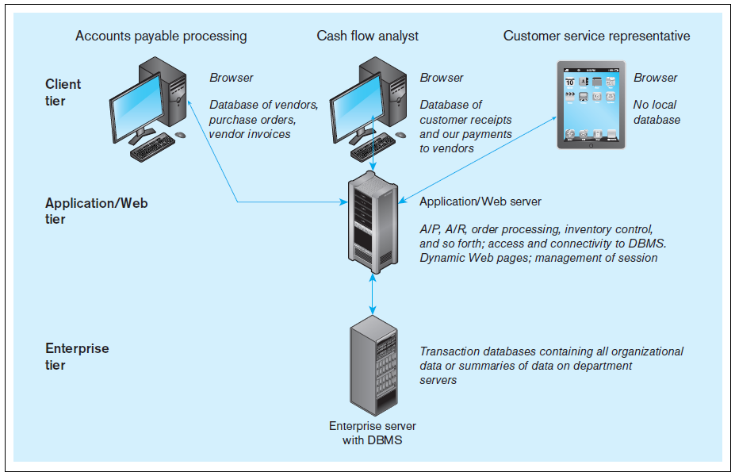
Figure 1-11 Multi-tiered client/server database architecture (see Ch.8)
Notes:
When we get to chapter 8, we will see how databases are used in applications. Most web applications follow the 3-tier approach. Databases are typically at an enterprise tier, application program code is at an application/Web tier, and user interfaces for different users are at the client tier.

Slide 42
Enterprise Database Applications
Enterprise Resource Planning (ERP)
Integrate all enterprise functions (manufacturing, finance, sales, marketing, inventory, accounting, human resources)
相當於產進銷存+財會+人資總務
支援前台各種線上/行動及應用
Data Warehouse 資料倉儲
Integrated decision support system derived from various operational databases

Slide 43
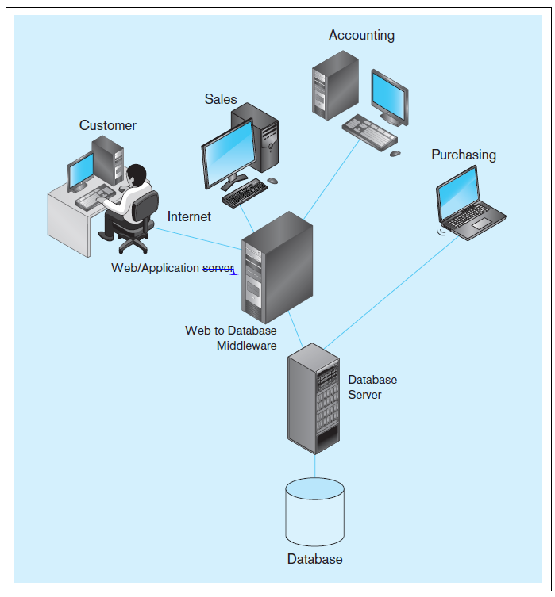
FIGURE 1-13 Computer
System for Pine Valley
Furniture Company
Notes:
Throughout the textbook, you will see many descriptions of Pine Valley Furniture. This figure shows a typical system configuration. Note the 3-tier architecture, with a database server, an application server, and client workstations for customers and employees in different departments.

Slide 44
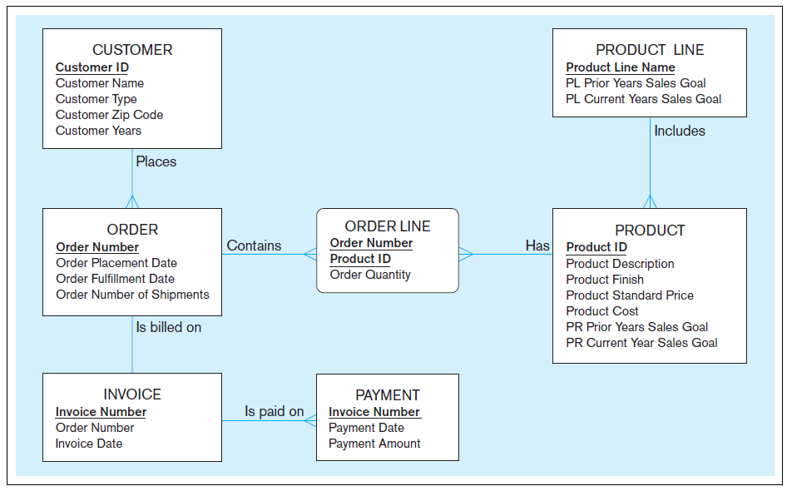
FIGURE 1-15 Project data model for Home Office product line marketing support system
Notes:
This data model shows some of the main entities for PVF, as well as their attributes and relationships. Over time you will see many other diagrams and descriptions of PVF.

