Slide 1
Chapter 8: database application development
Modern Database Management
12th Edition
Global Edition
Jeff Hoffer, Ramesh Venkataraman,
Heikki Topi
授課老師：楊立偉教授，台灣大學工管系

Slide 2
Client/Server architectures
Networked computing model網路運算模型
Processes distributed between clients and servers 將要處理的工作散在Client與Server
Client–Workstation (PC, smartphone, tablet) that requests and uses a service
Server– Powerful computer (PC/mini/mainframe) that provides a service
For DBMS, server is a database server
For the Internet, server is a web server
Notes:
Client/server applications began with the advent of networked computing, and are the dominant paradigm for computing applications for the past 25 years. Prior to that, mainframe computers with “dumb terminals” (and later “smart terminals”) was the dominant mode. These still exist, but they are usually also somehow connected C/S networks.
Every time you use the Web you are operating in a client/server environment. The idea is that the requests some sort of resource, and the server provides it. Each server will service many clients, maybe even millions (for example Amazon’s web servers.
Servers can be file servers, print servers, database servers, web servers, or in general servers providing any shared resource to clients in the network. For example, your school’s computer lab has a shared printer that you can use, and this is done by a print server in a client/server environment. The computer you work on is a client in that network. This is typically called a local area network (LAN).
Web servers operate in the Internet, which is a wide are network (WAN).
Advances in personal computing, smartphone, and tablet technology and the corresponding rapid evolution of graphical user interfaces (GUIs), networking, and communications have changed the way businesses use computing systems to meet ever more demanding business needs. Electronic commerce requires that clients (PCs or smartphones) be able to access dynamic Web pages attached to databases that provide real-time information. Mainframe applications have been rewritten to run in client/server environments and take advantage of the greater cost-effectiveness of advances in networking, personal computers, smartphones, and tablets.

Slide 3
Application Logic in C/S Systems
Presentation Logic 呈現邏輯
Input–keyboard/mouse
Output–monitor/printer
GUI Interface
(Graphic User Interface)
Processing Logic 處理邏輯
I/O processing
Business rules
Data management
Procedures, functions,
programs
Storage Logic 儲存邏輯
Data storage/retrieval
DBMS activities
Notes:
As you can see here, there are three main layers in an application, and they serve different purposes. The presentation layer is what you the user directly interact with. The processing logic involves the software doing all the computation for the application. And the storage logic involves the activities of the DBMS. Different types of C/S systems will distribute these three in different ways.

Slide 4
Application Partitioning
Placing portions of the application code in different locations (client vs. server) after it is written 重新切分程式執行的位置
Advantages
Improved performance
Improved interoperability
Balanced workloads
Notes:
We’re going to see different types of application partitioning. This involves distributing the presentation, processing and storage logic to different computers in the client server network. Of course, presentation is always at the client.

Slide 5
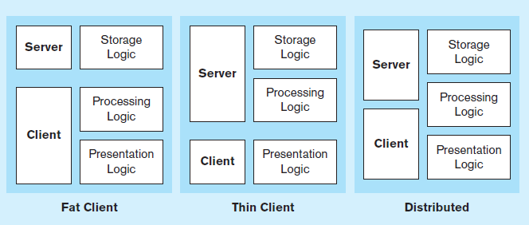
Figure 8-2 Common Logic Distributions
a) Two-tier client-server environments
Processing logic could be at client (fat client), server (thin client), or both (distributed environment).
Notes:
Local area networks are typically implemented as a 2-tier system. Here, the presentation layer always does presentation logic, and the server always does storage logic. Processing logic could take place in either. This is what you are using when you work within an office’s local network, or your school’s computer lab’s.

Slide 6
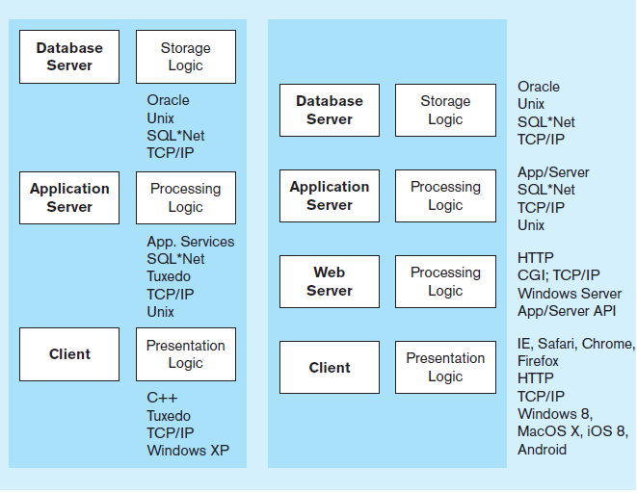
Figure 8-2 Common Logic Distributions
b) Three-tier and n-tier client-server environments
Processing logic will be at application server or Web server.
Notes:
This is how it’s done on the web. There are at least three tiers, with each tier doing one of the three logics. The client is you on your PC or mobile device. Application logic takes place on the application server and the DBMS is on the database server. We’ll see in later slides some code you’ll typically see in application logic.
Notice that sometimes the processing logic is split. The underlying business logic is done on one server and the control of Internet processing is done on the web server.

Slide 7
3 types of Client/Server Architectures
Client does extensive processing
1.File Server Architecture
2.Database Server Architecture
3.Three-tier Architecture
Client does little processing

Slide 8
1. File Server Architecture
All processing is done at the PC that requested the data
Entire files are transferred from the server to the client for processing Ex. 利用網路芳鄰分享mysql/data資料目錄
Problems:
Huge amount of data transfer on the network
Each client must contain full DBMS
Heavy resource demand on clients
Client DBMSs must recognize shared locks, integrity checks, etc.

Slide 9
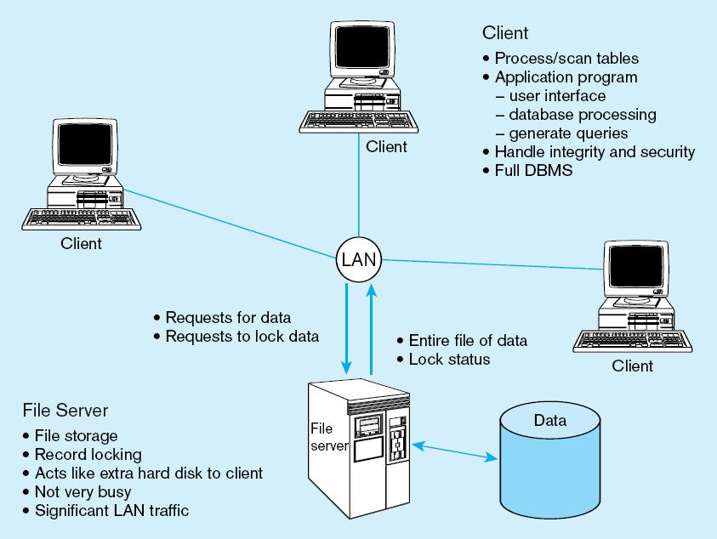
FAT CLIENT

Slide 10
2. Two-Tier Database Server Architectures
Client workstation is responsible for
Presentation logic
Data processing logic
Business rules logic
Server performs all data storage, access, and processing
Typically called a database server
➔ DBMS is only on server

Slide 11
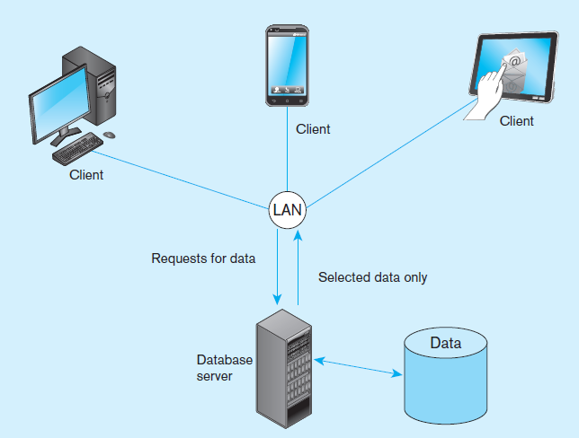
Figure 8-3 Database server architecture (two-tier architecture)
Front-end programs
(Ex. MySQLWorkbench)
Back-end functions
Notes:
Here is a picture of a 2-tier system with a database server and clients. LANs tend to be small without a huge amount of network traffic. The server is in charge of all control to the database, and also handles all the DBMS activities like user authorization, integrity checking, data dictionary maintenance, and query and update processing.
The only people directly using the server are typical system administrators and database administrators. We talk about database administration in chapter 12.

Slide 12
Advantages of Two-Tier Approach
Clients do not have to be as powerful
Greatly reduces data traffic on the network
Improved data integrity since it is all processed centrally
Stored procedures : performs some business rules done on server
把較常用或重要的程序預先寫好放在DBMS內

Slide 13
Advantages And Disadvantages of Stored Procedures
Advantages
Performance improves for compiled SQL statements 改進效能
Reduced network traffic佔較少的網路流量
Improved security 安全性較高
Improved data integrity資料完整性較高
Thinner clients前端運算量較少
Disadvantages
Proprietary, so algorithms are not portable, and programming takes more time 專屬不相通

Slide 14
Three-Tier Architectures
GUI interface
(I/O processing)
Browser, Mobile App
Client
Application server
Web(+AP) Server
Business rules
Database server
Data storage
DBMS
Thin Client
PC just for user interface and a little application processing. Limited or no data storage (sometimes no hard drive) 例如: Web Browser
Notes:
We’ve been talking about 2-tier client server architectures, and now we’ll start talking about three-tier and n-tier systems. In these types of C/S architectures, the client is typically a browser like Internet Explorer or Google Chrome sitting on your desktop, or perhaps a mobile app. These interact with a Web server, which includes in addition to HTTP processing, the application framework like ASP .NET, PHP, or JSP. At this level, programs written in these languages interact with DBMSs such as Oracle, SQL Server, or mySql through a variety of middleware components via the APIs of these particular frameworks.

Slide 15
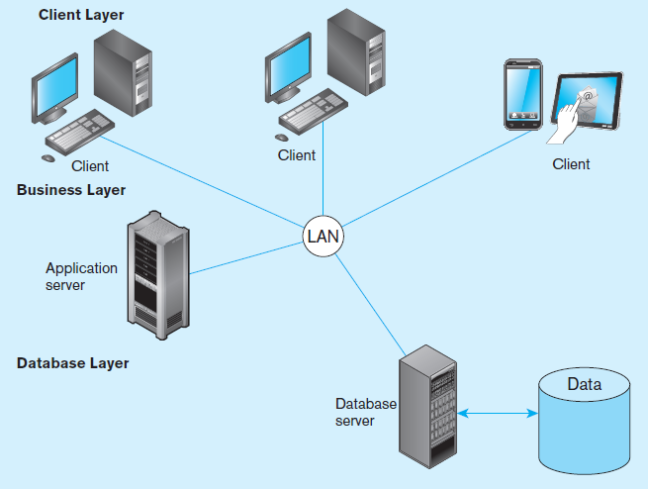
Figure 8-6a Generic three-tier architecture
Thin clients
Business rules on separate server
DBMS only on DB server
Business rules on application
server
Notes:
Here, notice the separation of the two different servers. That’s why it’s 3-tier.
This distributes the processing demand across servers, increasing performance and scalability. Also, experts at different levels concentrate on the code on different tiers. For example, user interface designers concentrate on the code of the presentation layer. Applications developers’ code resides on the application server. And database designers and administrators concentrate on the database server.

Slide 16
Advantages of Three-Tier Architectures
Scalability (在佈署與效能上) 具擴充性
Technological flexibility 具技術彈性
Long-term cost reduction 長期低本降低
Better match of systems to business needs 較符合企業所需
Reduced risk 風險降低

Slide 17
Benefits of Moving to Client/Server Architecture
Staged delivery of functionality speeds deployment 功能可分階段完成
GUI ease application use 將使用者界面與應用分離
Flexibility and scalability facilitates business process reengineering 更容易擴充 具有彈性
Reduced network traffic 只傳處理過的資料
Facilitation of Web-enabled applications
易於轉為Web或行動應用

Slide 18
Middleware 中介軟體 / API 應用程式介面
Middleware – software that allows an application to interoperate with other software without requiring user to understand and code low-level operations
Application Program Interface (API) – routines that an application uses to direct the performance of procedures by the computer’s operating system
Common database APIs – ODBC, ADO .NET, JDBC
The “glue” that holds client/server applications together
Notes:
No matter what C/S architecture you use, you will encounter middleware and APIs. There are many kinds of APIs, and database APIs is only one type. For example, there are API’s for the presentation layer stuff (forms, buttons, list boxes, and all the user interface processing). There are also APIs for working with different web services; often these are in the form of REST and XML.
Computer programmers and application developers will use APIs for interacting with the database, and these APIs invoke middleware to provide the connection to the DBMS.
ODBC and ADO .NET are the most common database APIs for the Microsoft platform. ODBC is older, and ADO .NET is more modern. ADO .NET is the most common database API in web applications.

Slide 19
ODBC–Open Database Connectivity
Most DB vendors support this
JDBC–Java Database Connectivity
可視為Java版的ODBC
Special Java classes that allow Java applications/applets to connect to databases
ADO.NET
Microsoft data access services 微軟的資料庫存取元件

Slide 20
Using ODBC to Link External Databases Stored on a Database Server
Open Database Connectivity (ODBC)
API provides a common language for application programs to access and process SQL databases independent of the particular RDBMS that is accessed
Required parameters:
ODBC driver
Back-end server name
Database name
User id and password
Additional information:
Data source name (DSN)
Windows client computer name
Client application program’s executable name

Slide 21
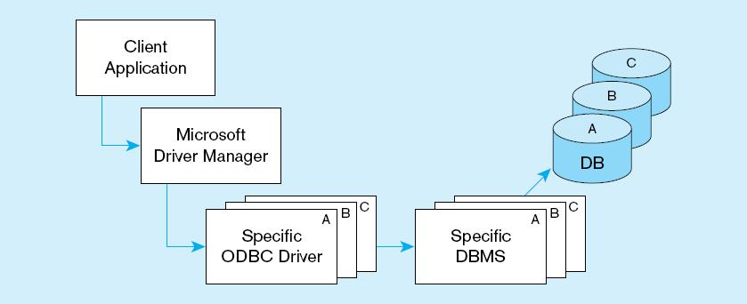
ODBC Architecture
Client does not need to know anything about the DBMS
Application Program Interface (API) provides common interface to all DBMSs
Each DBMS has its own ODBC-compliant driver

Slide 22
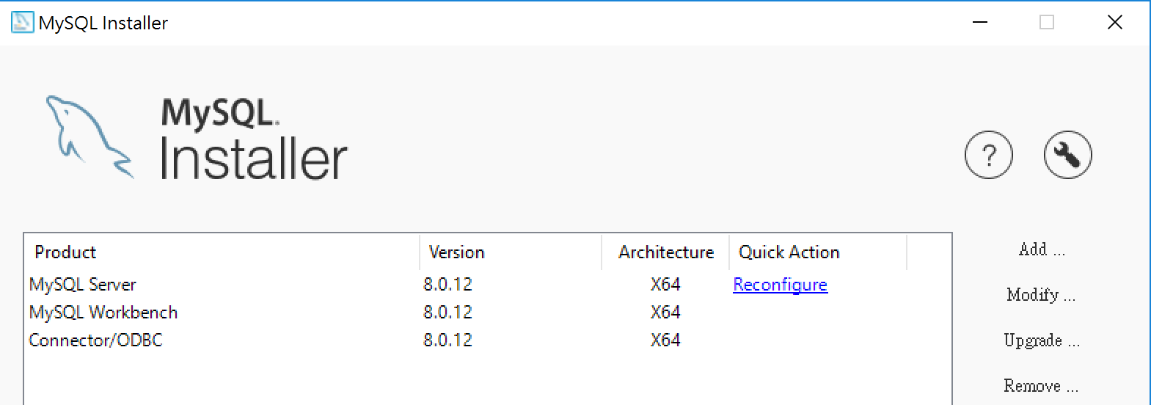
實作: 實際設定一個DSN (以Windows為例)
先確認有安裝MySQL Connector/ODBC
以64位元版本為例

Slide 23
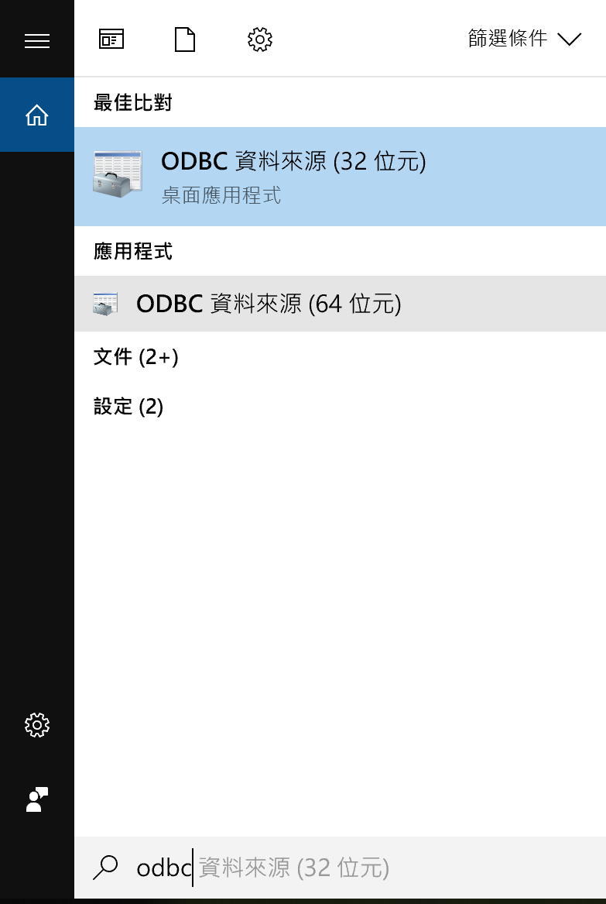
在Windows搜尋ODBC資料來源，啟動ODBC管理員

Slide 24
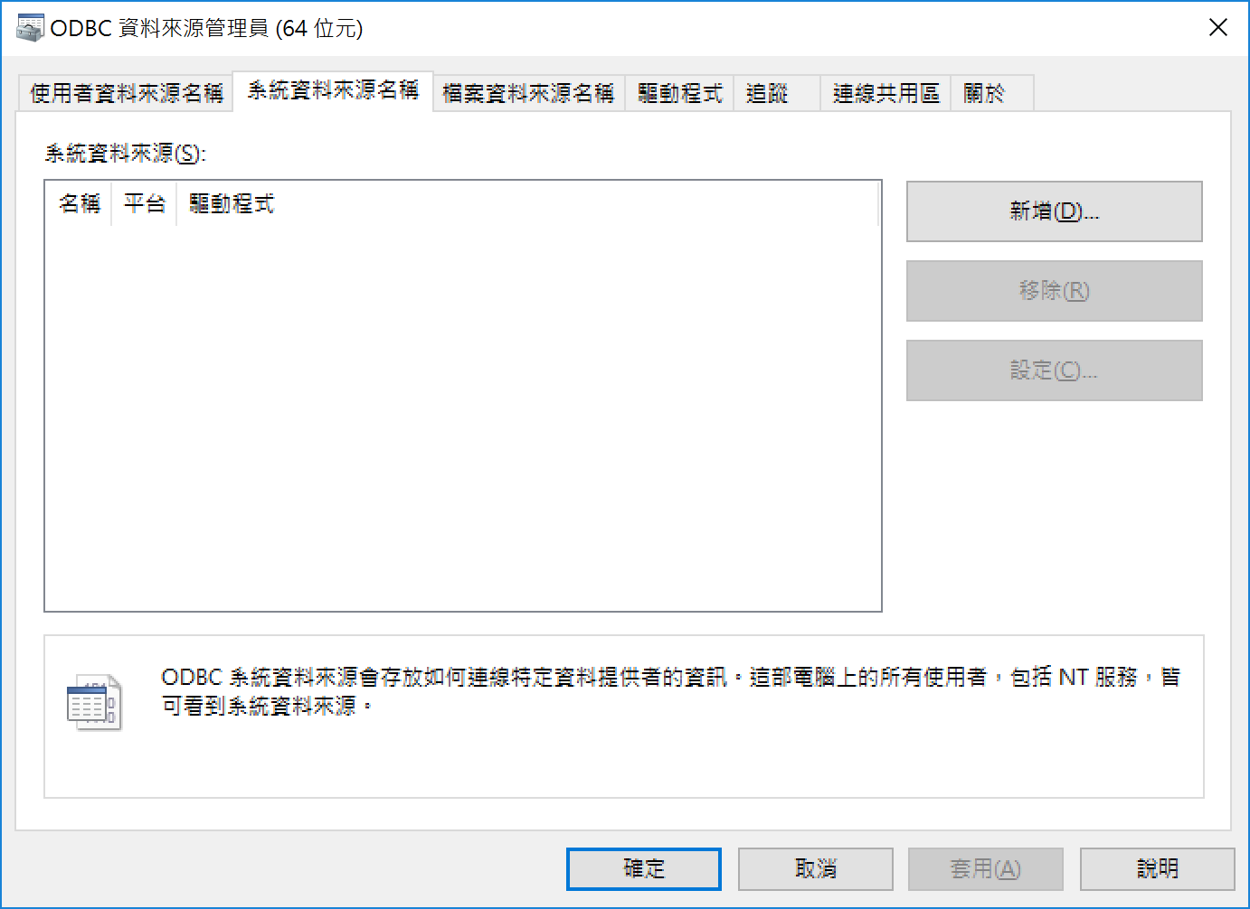
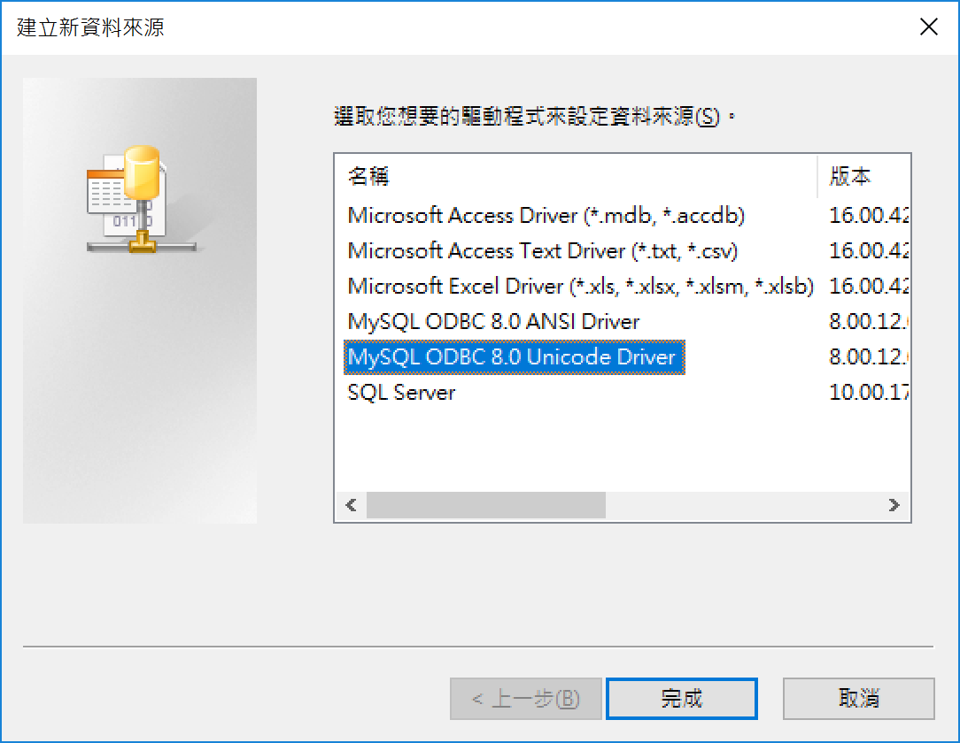
選擇系統資料來源名稱，點選新增
選取正確的資料庫驅動程式 (MySQL ODBC Unicode Driver)

Slide 25
選擇系統資料來源名稱，點選新增
選取正確的資料庫驅動程式 (MySQL ODBC Unicode Driver)

Slide 26
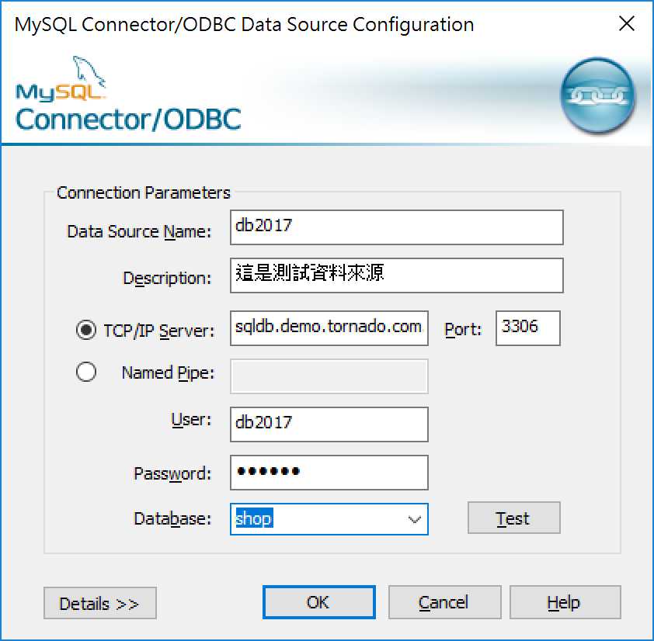
取一個Data Source Name，輸入描述
指定Server位置 (IP或hostname)，指定Port埠號
指定登入的帳號及密碼
點選Test，測試是否連通
選擇使用的Database
設定完成

Slide 27
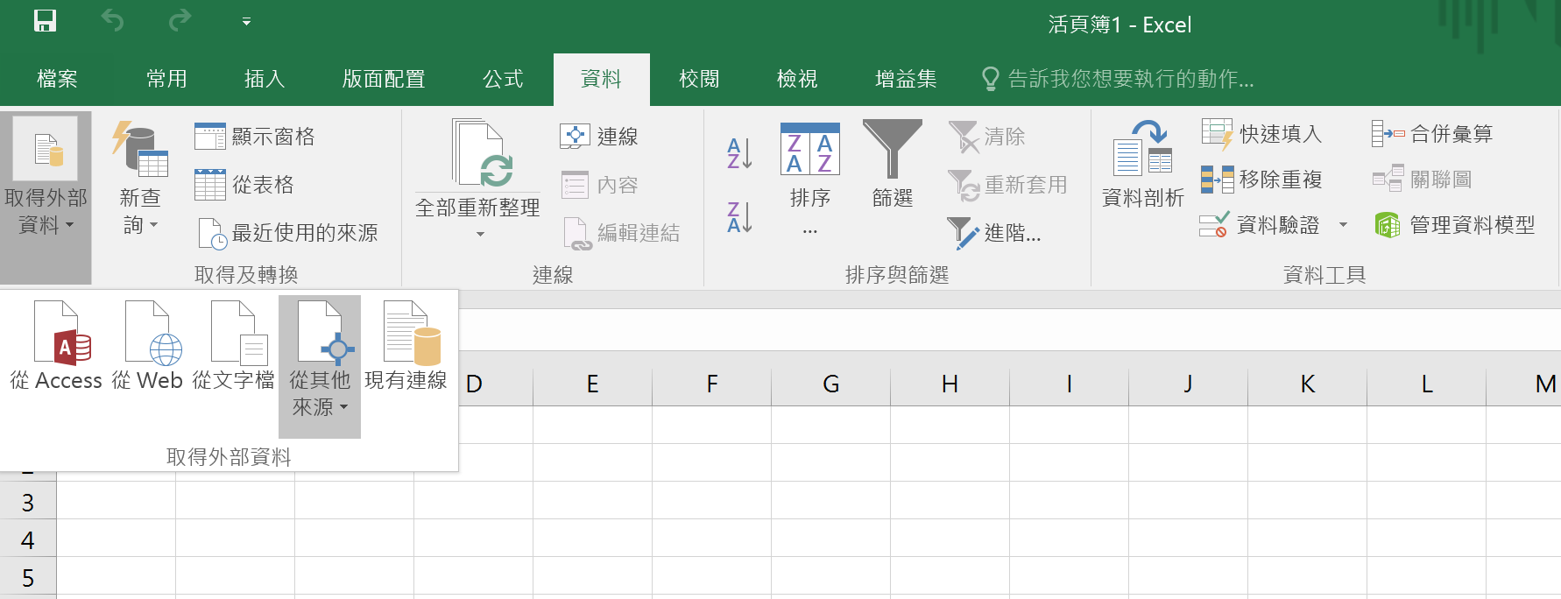
如何連結資料庫 – 以MS Excel 2016/ODBC為例
啟動Excel，選取資料 > 取得外部資料 > 從其他來源

Slide 28
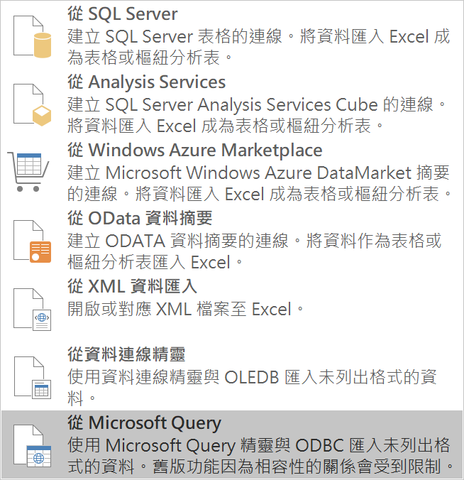
選取MS Query取得ODBC來源

Slide 29
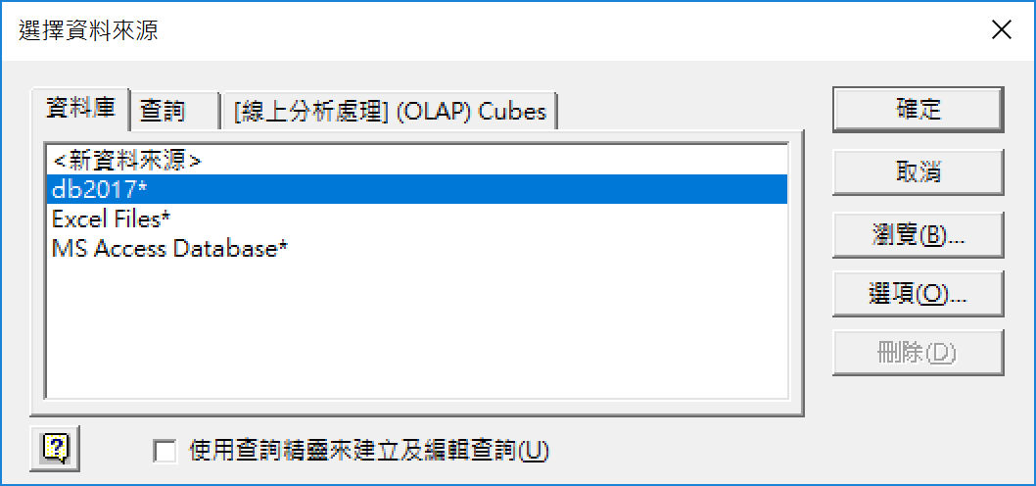
選取之前設定的DSN (db2017)
不要勾選使用查詢精靈

Slide 30
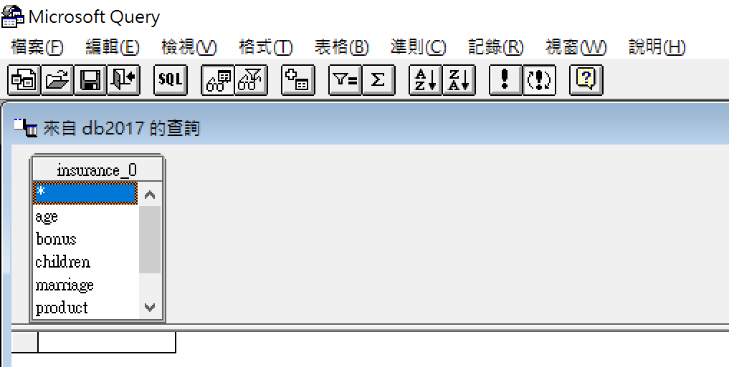
會列出該DSN下的表格，選取任一要使用的表格 (之後用命令自行指定)。點選SQL進入命令視窗

Slide 31
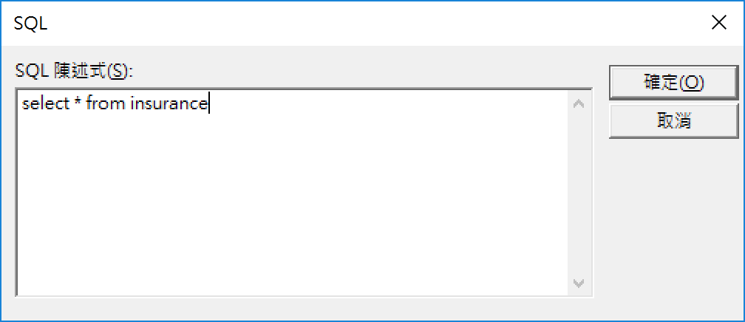
在SQL命令視窗輸入取得資料之指令，預覽結果 (若有亂碼沒關係)
結束MS Qquery，將結果傳回MS Excel

Slide 32
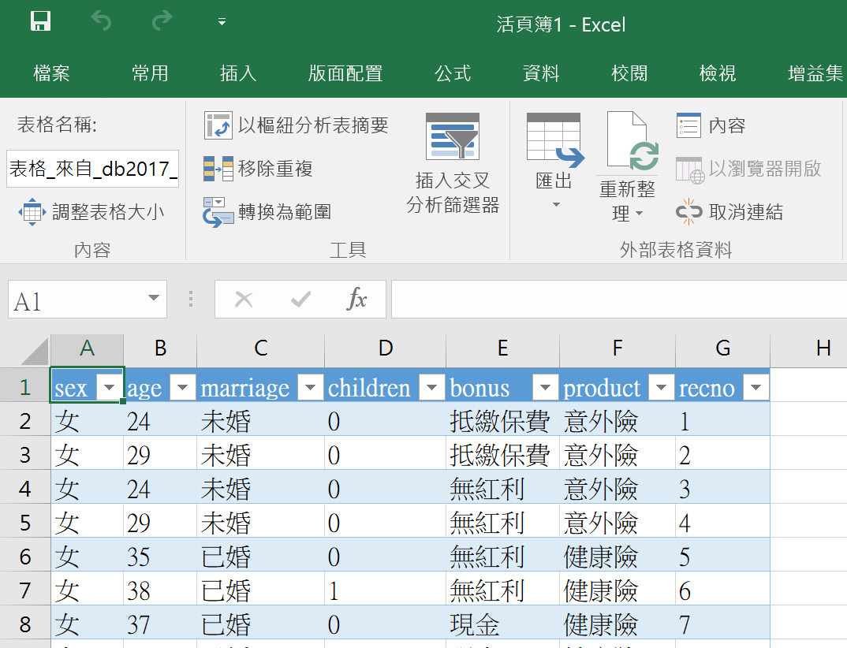
在Excel中即可連結資料庫

Slide 33
補充說明
若資料仍為亂碼，請確認資料庫欄位編碼、資料庫編碼、ODBC編碼，是否設定一致 (均為unicode)
Mac OS用戶除了安裝MySQL Connector/ODBC外，需另外安裝ODBC管理員，手動設定DSN
server=要連線的MySQL主機位置
port=連線埠號
database=要使用的資料庫名稱
username及password會有彈出視窗詢問

Slide 34
Steps for Using Databases via Middleware APIs 在程式中存取資料庫的方式
Identify and register a database driver.
Open a connection to a database.
Execute a query against the database.
Process the results of the query.
Repeat steps 3–4 as necessary.
Close the connection to the database.
Notes:
When you’re writing a program that interacts with a database, you will need to do all these things in the code. Different programming languages have different syntax and we’ll see a couple examples.

Slide 35
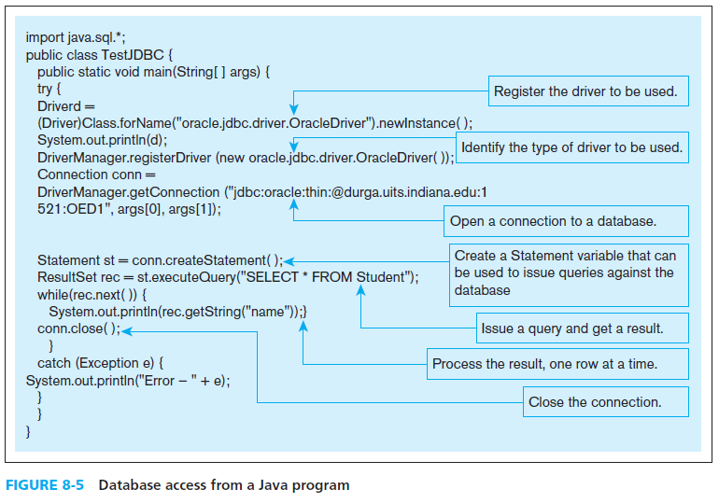
Notes:
Here’s the Java code for doing these steps. The “driver” is the middleware program that provides the link to the DBMS. At the “open a connection” step you can see the connection string. And further down, you see the query. The data returned from the query is in a “result set”, and your program can loop through this result set to obtain that data.
The three JDBC classes that you will likely use in a Java database program are DriverManager, Connection, Statement, and ResultSet. Each of these are classes in the Java JDBC API.
The textbook also shows a VB .NET example, which you’d typically have in a Microsoft operating system. There are similar classes in the .NET API (for establishing connections, creating commands and queries, and processing the results of queries).

Slide 36
Thin Client
An application where the client accessing the application primarily provides the user interfaces and some application processing, usually with no or limited local data storage.
Usually, thin client application is a Web browser and the 3-tier architecture involves a Web application.
Notes:
Your browser is a good example of a thin client. This displays HTML and responds to users’ menu choices and button clicks. It also includes a little more processing in the form of JavaScript and JSON. But the deep application processing is done at the server level. This is where the .NET, PHP, or JSP code resides and executes. Clients will typically store very little permanent data, which usually goes to a database server. Often the permanent client-saved data is in the form of cookies.

Slide 37
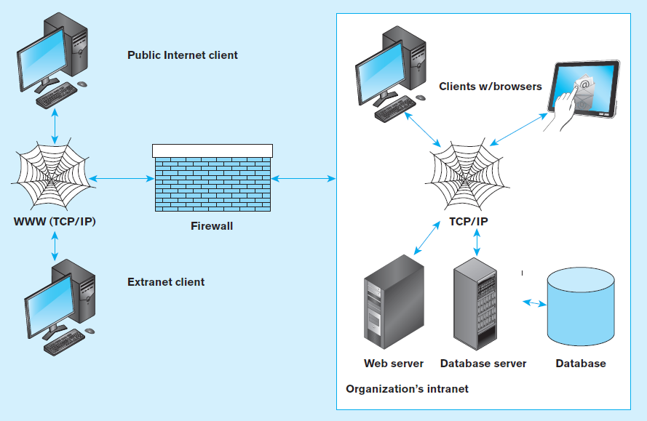
Figure 8-7 A database-enabled intranet/Internet environment
Notes:
The network protocol for Internet-bound traffic is TCP/IP, which stands for Transmission Control Protocol – Internet Protocol. The notion of an extranet is what we usually think of when we use a Web site like Amazon. Companies interact with the public via extranets. An intranet also uses 3-tier internet technology (web servers, TCP/IP protocol) but is limited to access from within an organizations control. This is hidden from the external internet by a firewall, providing security for the organization’s resources.

Slide 38
Web Application Components
Database server – hosts the DBMS
e.g. Oracle, SQL Server, Informix, MS Access, MySql
Web server – receives and responds to browser requests using HTTP protocol
e.g. Apache, Internet Information Services (IIS)
Application server – software building blocks for creating dynamic web sites
e.g. MS ASP .NET framework, Java EE, ColdFusion, PHP
Web browser – client program that sends web requests and receives web pages
e.g. Internet Explorer, Firefox, Safari, Google Chrome

Slide 39
Processing in 3-Tier Applications
Static page requests
.htm or .html requests handled by the Web server
Dynamic page requests
.jsp, .aspx, and .php requests are routed to the application server
Server-side processing by JSP servlet (Java), ASP .NET application (C# or VB), ColdFusion, or PHP
Database access via JDBC, ADO .NET, or other database middleware

Slide 40
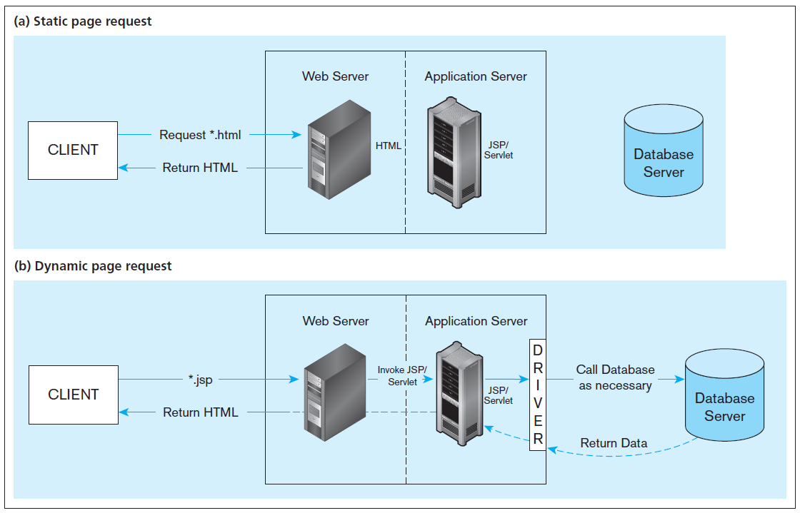
Figure 8-9 Information flow in a three-tier architecture
No server side processing, just a page return
Server side processing, including database access
…also *.aspx or *.php
Notes:
This shows the difference between static and dynamic page requests. Any web request to a .html or .shtml file is a static request. No application processing takes place on the application server. Basically, the file retrieved has all the HTML, CSS, and JavaScript code in it.
URLs with .jsp, .php, and .aspx are dynamic page requests. Here, the application server is invoked and interacts with the database to dynamically generate the HTML, CSS, and JavaScript that gets sent to the browser.

Slide 41
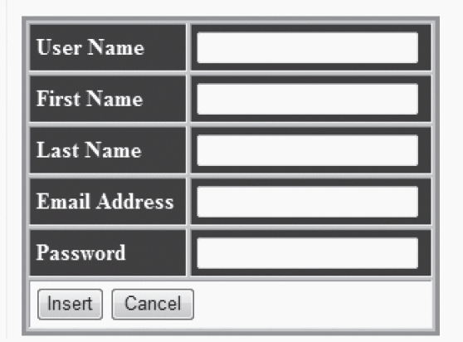
Figure 8-12 A registration page written in ASP .NET
b) Form for the ASP .NET application
Notes:
This web page has a DetailsView. A DetailsView displays as a table consisting of two columns. The first column consists of the field name of the bound field in the .aspx file. The second column will contain the values of these fields from the query results. A DetailsView can also allow for update, insert, or delete.
Remember the earlier Java example. In that example, setting up connections and doing queries and updates is coded in the procedural language. But in this case, we did it in the markup HTML. This is often much simpler. However, you can’t do everything in the markup language. Sometimes you need procedural code for database processing. In this case you’d do that in the C# or VB procedural code associated with the .aspx file.

Slide 42
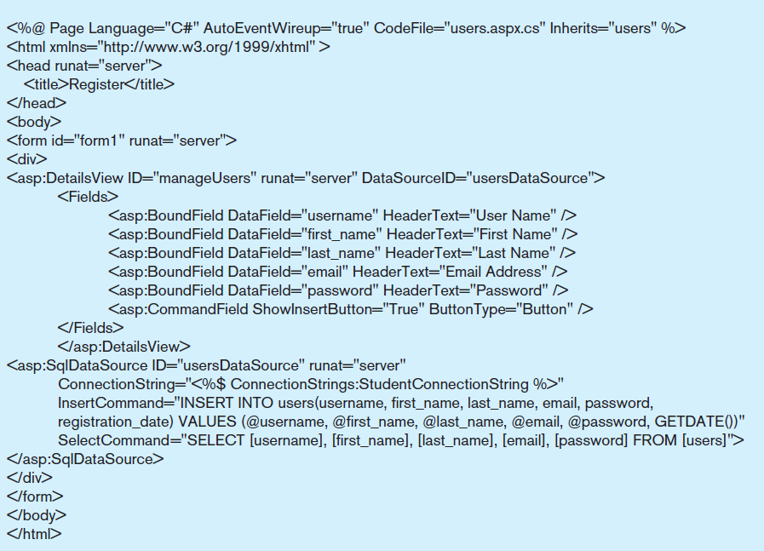
Figure 8-12 A registration page written in ASP .NET
a) Sample ASP .NET code for user registration
A DetailsView is a type of Web control
Web controls can be databound to data sources, including SqlDataSource.
Notes:
The textbook also shows PHP and JSP examples, but we’ll focus on an ASP .NET example here. This is an example Web page that you would see in a .aspx file. You see some HTML, but you also see some special asp tags. These are the objects that are part of the ASP .NET API.
Web controls are often databound to query results from the SqlDataSource web control. There are lots of different web controls in ASP .NET, including FormViews, ListBoxes, GridViews, Charts, to name a few.
The <asp:> tags run at the server to create Web controls that dynamically generate HTML which gets sent to the browser.
Note that this Page has a C# as its underlying procedural code. But code you see here is all markup language (HTML with .ASP NET extensions).

Slide 43
Cloud computing
A model for creating ubiquitous, convenient, on-demand access to network services
Characteristics: on-demand, broad network access, resource pooling, rapid elasticity, measured service
Types of cloud computing: 由下至上通常分成三層
Software-as-a-service (SaaS) 應用服務層
Platform-as-a-service (PaaS) 作業系統層 (通常DB在這)
Infrastructure-as-a-service (IaaS) 虛擬主機層
Notes:
Cloud computing and 3-tier architectures go hand in hand.

Slide 44
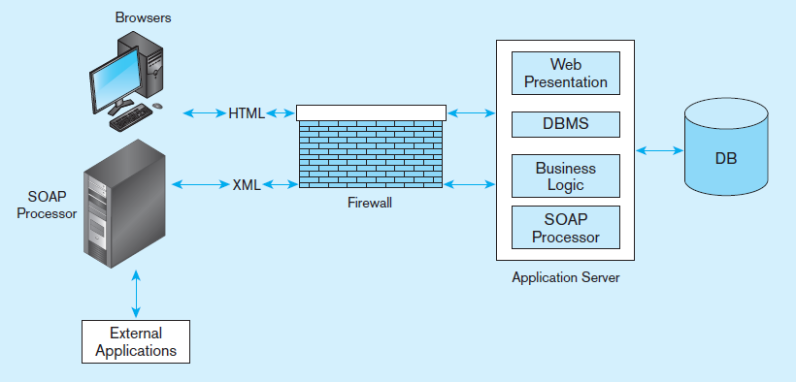
Figure 8-18 Web services deployment
Source: Based on Newcomer (2002).
透過Web services可實現Service Oriented Architecture (SOA)
Notes:
As a transaction flows from one business to another or from a customer to a business, a SOAP processor creates a message envelope that allows the exchange of formatted XML data across the Web. Note that within a company’s 3-tier architecture, the SOAP processor logic is housed in the application server. Note also that this exchange of XML data is happening between SOAP processors.

