Slide 1
Chapter 4:
Logical Database Design and the Relational Model
Modern Database Management
12th Edition
Global Edition
Jeff Hoffer, Ramesh Venkataraman,
Heikki Topi
授課老師：楊立偉教授，台灣大學工管系

Slide 2
Components of relational model
Data structure
  Tables (relations), rows, columns
Data manipulation
  Powerful SQL operations for retrieving and modifying data
Data integrity
  Mechanisms for implementing business rules that maintain integrity of manipulated data

Slide 3
Relation
A relation is a named, two-dimensional table of data. 二維的表格
A table consists of rows 列 (records 紀錄) and columns 欄 (attribute 屬性 or field 欄位).
Requirements for a table to qualify as a relation:
  It must have a unique name.
  Every attribute value must be atomic (not multivalued, not composite).
  Every row must be unique (can’t have two rows with exactly the same values for all their fields). 不可以有兩列是完全一樣的
  Attributes (columns) in tables must have unique names.
  The order of the columns must be irrelevant. 欄位順序不重要
  The order of the rows must be irrelevant. 紀錄順序不重要
NOTE: All relations are in 1st Normal form.
Notes:
All relations are tables, but not all tables are relations. Think of a “table” as simply being a grid with rows and columns. In this sense, a spreadsheet could be a “table”. To qualify as a relation, each row would need to be unique, which implies that each row needs to have a primary key.

Slide 4
Correspondence with E-R Model
從E-R model來建立表格的對應方法
Relations (tables) correspond with entity types and with many-to-many relationship types.
個體或多對多關係，應該轉成Table
Rows correspond with entity instances and with many-to-many relationship instances.
Columns correspond with attributes.
NOTE: The word relation (in relational database) is NOT the same as the word relationship (in E-R model).
Notes:
People often confuse the term “relation” with the term “relationship”. A relation is a table that follows certain rules, and refers to actual relational database architecture. A relationship is a conceptual term that refers to how entities relate to each other. The ER concept of relationship will be implemented by primary and foreign keys connecting the database’s relations.

Slide 5
Key Fields
Keys are special fields that serve two main purposes:
  Primary keys 主鍵 are unique identifiers of the relation. Examples include employee numbers, social security numbers, etc. This guarantees that all rows are unique.
  Foreign keys 外鍵 are identifiers that enable a dependent relation (on the many side of a relationship) to refer to its parent relation (on the one side of the relationship).
Keys can be simple (a single field) or composite (more than one field).
Keys usually are used as indexes to speed up the response to user queries (more on this in Chapter 5).
Notes:
Keys are to databases as identifiers are to E-R models.

Slide 6
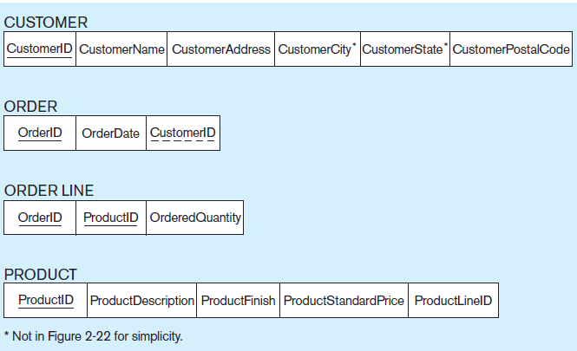
E-R model 可參考課本 Figure 1-3 or 2-22
Figure 4-3 Schema for four relations (Pine Valley Furniture Company)
Primary Key
Foreign Key (implements 1:N relationship between customer and order)
Combined, these are a composite primary key (uniquely identifies the order line)…individually they are foreign keys (implement M:N relationship between order and product)
Notes:
The relation on the many side of a 1:N relationship will have a foreign key that corresponds with the primary key of the relation on the 1 side.
Any time you have a M:N relationship between entities, this must be implemented via a separate relation, often called an “intersection table” or a “junction table”. The Order Line table is an example of a relation that implements a many-to-many relationship between orders and products. Each order may involve several products, and likewise each product could be involved in many orders.

Slide 7
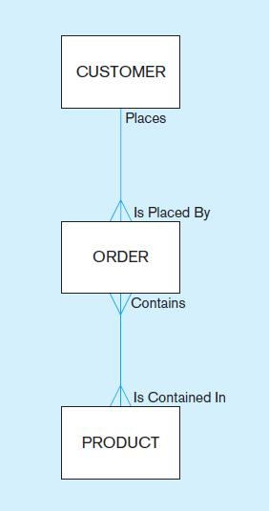
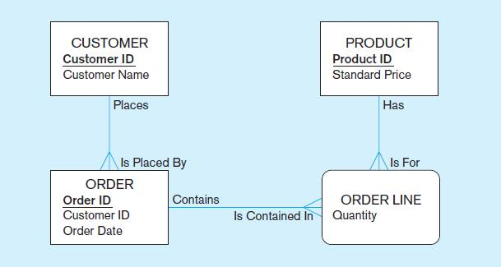
對應下列 E-R model (欄位有增加)
←原始ER圖
將多對多關係轉成Associative Entity後之ER圖↓

Slide 8
Integrity Constraints
Domain Constraints
  Allowable values for an attribute (See Table 4-1)
Entity Integrity
  No primary key attribute may be null. All primary key fields MUST contain data values.
  主鍵一定要有值

Slide 9
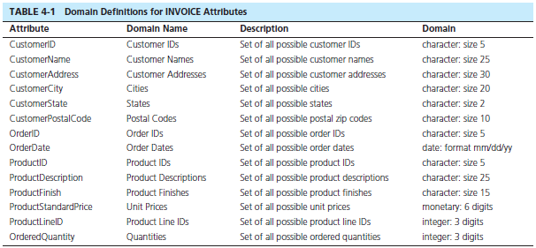
Domain definitions enforce domain integrity constraints.
Notes:
A domain definition usually consists of the following components: domain name, meaning, data type, size (or length), and allowable values or allowable range (if applicable).
There are many ways to enforce domain constraints. One way is in the SQL for creating tables, as we will see in later chapters. Another way is for applications to enforce this prior to inserting data into the database.
For example, in Table 4-1, you can verify that an entered date is legitimate (e.g. not Feb. 29, 2015). Or, you can verify that the unit price is a positive number.

Slide 10
Integrity Constraints
Referential Integrity 參照完整性 rule states that any foreign key value (on the relation of the many side) MUST match a primary key value in the relation of the one side. (Or the foreign key can be null) 外鍵一定指向某筆紀錄或者為無值
  For example: Delete Rules
  在刪除資料時，為了保持參照完整性的三種做法
    Restrict–don’t allow delete of “parent” side if related rows exist in “dependent” side
    Cascade–automatically delete “dependent” side rows that correspond with the “parent” side row to be deleted
    Set-to-Null–set the foreign key in the dependent side to null if deleting from the parent side → not allowed for weak entities
Notes:
Because some tables are dependent on others, it is important to control how data is to be deleted. Referential integrity rules prevent data from being deleted when there is other data dependent on it. For example, a customer will not be deleted from the database if there are existing orders that were generated by that customer. The delete rules specify how such deletions can be controlled within the database.

Slide 11
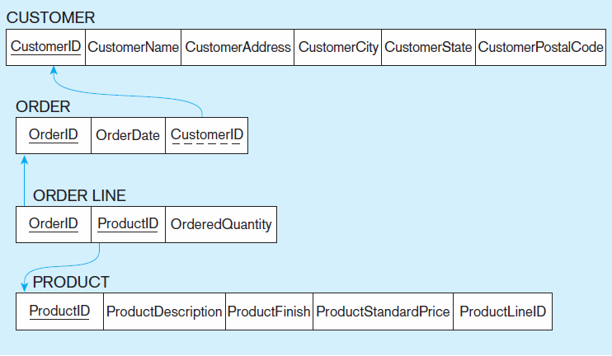
Figure 4-5
Referential integrity constraints (Pine Valley Furniture)
Referential integrity constraints are drawn via arrows from dependent to parent table
(箭號指向parent)
Notes:
In the relation diagrams of this chapter, arrows between foreign and primary keys depict referential integrity constraints.

Slide 12
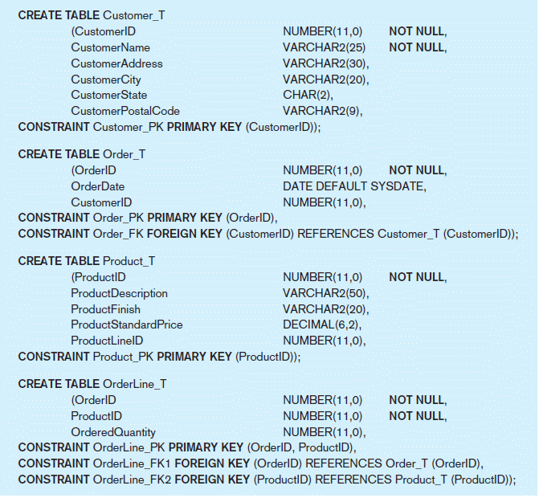
Figure 4-6 SQL table definitions
SQL 四大指令之一 (語法之後會教)
Referential integrity constraints are implemented with foreign key to primary key references.
Notes:
This is an example of CREATE TABLE statements in SQL. Here we can see how a dependent table references its dominant table through creation of a foreign key. We will learn more about CREATE TABLE in chapter 6.

Slide 13
Transforming E-R Diagrams into Relations (1)
Mapping Regular Entities to Relations
  Simple attributes: E-R attributes map directly onto the relation
  Composite attributes: Use only their simple, component attributes 複合屬性應個別建立對應欄位
  Multivalued Attribute: Becomes a separate relation with a foreign key taken from the superior entity 多值屬性應獨立成Table，以外鍵連結
Notes:
The next several slides show the mechanics of designing relational databases based on E-R and EER data models. As we saw in chapter 1, the database development life cycle often involves first constructing a conceptual model (E-R or EER) and then using this to create the logical model (relational database design). If you do a thorough job of developing the conceptual model, it should be a fairly simple matter to convert this to a well-structured relational database.
However, if you just start by creating tables, you could wind up with a database that is not well-structured, which required you to fix these mistakes. This is the process of normalization, which will be discussed later.

Slide 14

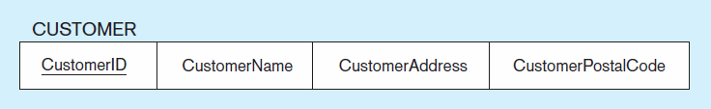
Figure 4-8 Mapping a regular entity
(a) CUSTOMER entity type with simple attributes
(b) CUSTOMER relation
Notes:
Very simple. Each attribute of the entity becomes a column (field) of the resulting relation. The identifier of the entity becomes a primary key in the relation.

Slide 15
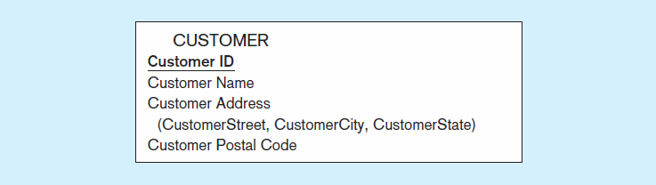

Figure 4-9 Mapping a composite attribute
(a) CUSTOMER entity type with composite attribute
(b) CUSTOMER relation with address detail
Notes:
A bit more complex. Although conceptually you can have a composite attribute, there is no such thing as a “composite column” or “composite field” in relational databases. So, the component attributes become individual columns. As you can see, there is no field called “Customer Address” in the relation, just its components.

Slide 16

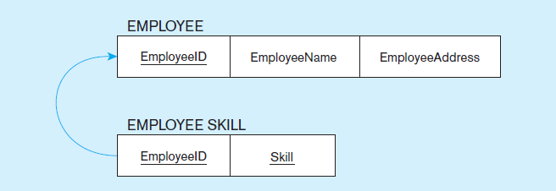
Figure 4-10 Mapping an entity with a multivalued attribute
(a)
Multivalued attribute becomes a separate relation with foreign key
(b)
One–to–many relationship between original entity and new relation
Notes:
Multivalued attributes in E-R models must be converted to separate relations in the logical database design. This is because there is no such thing as a multivalued attribute in relational databases. Remember the rules for 1st normal form.
In this case, there is a one-to-many relationship in the final database structure. The Employee Skill relation has a composite primary key (EmployeeID and Skill). The EmployeeID portion of this composite primary key is also a foreign key to the Employee table.

Slide 17
E_ID | E_Name | E_Address | E_Skill
A | John | Taipei | Java
B | Mary | Hsinchu | Python
C | Bob | Taichung | PHP, Java
由multi-valued attribute
轉換成1對多關係的新table
以符合relation之定義
也滿足1st normal form
→這樣的表達方式，優點是什麼 ?
E_ID | E_Name | E_Address
A | John | Taipei
B | Mary | Hsinchu
C | Bob | Taichung
E_ID | E_Skill
A | Java
B | Python
C | PHP
C | Java

Slide 18
Transforming E-R Diagrams into Relations (2)
Mapping Weak Entities
  Becomes a separate relation with a foreign key taken from the superior entity
  Primary key composed of:
    Partial identifier of weak entity 部分自己的ID欄位
    Primary key of identifying relation (strong entity) 加上Parent的主鍵欄位

Slide 19
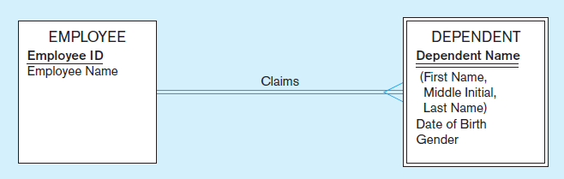
Figure 4-11 Example of mapping a weak entity
a) Weak entity DEPENDENT
扶養親屬
Notes:
Recall that double lines depict weak entities and identifying relationships.

Slide 20
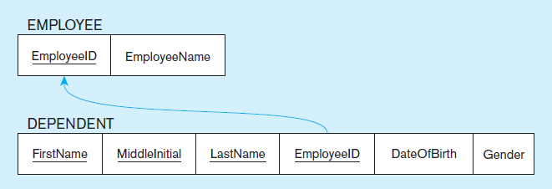
Figure 4-11 Example of mapping a weak entity (cont.)
b) Relations resulting from weak entity
NOTE: the domain constraint for the foreign key should NOT allow null value if DEPENDENT is a weak entity
Foreign key
Composite primary key
Notes:
If a foreign key is null, this implies an “optional one” in the 1:N relationship. But for weak entities this will never be the case. The weak entity cannot exist without its corresponding strong entity.
Note the assumption above. We assume that each dependent of an employee must have a unique name (first, middle, and last). Otherwise the fields comprising the composite primary key would not be unique, violating the rules of a relation.

Slide 21
E_ID | E_Name
A | John
B | Mary
D_FName | D_MName | D_LName | DOB | Gender
Dad | Sr | Lin | 8/10 | M
Dad | Sr | Lin | 1/10 | M
Mom | Sr | Lin | 6/10 | F
由weak entity
轉換成1對多關係的新table
補強primary key之表達
E_ID | E_Name
A | John
B | Mary
D_FName | D_MName | D_LName | E_ID | DOB | Gender
Dad | Sr | Lin | A | 8/10 | M
Dad | Sr | Lin | B | 1/10 | M
Mom | Sr | Lin | B | 6/10 | F

Slide 22
Transforming E-R Diagrams into Relations (3)
Mapping Binary Relationships
  One-to-Many–Primary key on the one side becomes a foreign key on the many side
  Many-to-Many–Create a new relation with the primary keys of the two entities as its primary key
  One-to-One–Primary key on mandatory side becomes a foreign key on optional side

Slide 23
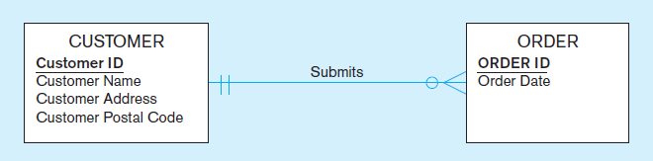
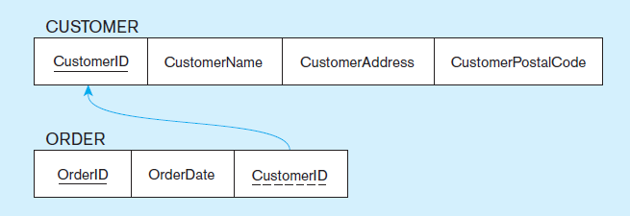
Figure 4-12 Example of mapping a 1:M relationship
a) Relationship between customers and orders
Note the mandatory one
b) Mapping the relationship
Again, no null value in the foreign key…this is because of the mandatory minimum cardinality.
Foreign key
Notes:
Because of the mandatory one in the relationship, we could have modelled ORDER as a weak entity and Submits as an identifying relationship.
In E-R diagrams, we generally don’t depict the idea of a “foreign key”. This is because the only purpose of a foreign key is to implement the relationship; it is not a meaningful piece of data in itself.

Slide 24
C_ID | C_Name | C_Address | C_Postal
A | John | Taipei | 106
B | Mary | Hsinchu | 300
C | Bob | Taichung | 400
兩種表達方式，
哪一種比較好
O_ID | OrderDate | C_ID
001 | 7/5 | A
002 | 10/6 | B
003 | 11/3 | A
C_ID | C_Name | C_Address | C_Postal | O_ID
A | John | Taipei | 106 | 001, 003
B | Mary | Hsinchu | 300 | 002
C | Bob | Taichung | 400 | null
O_ID | OrderDate
001 | 7/5
002 | 10/6
003 | 11/3

Slide 25
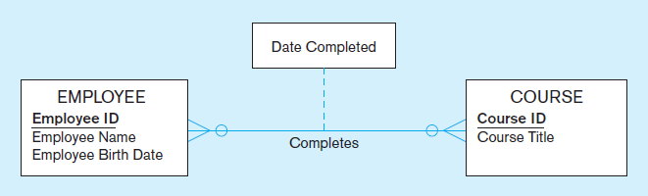
Figure 4-13 Example of mapping an M:N relationship
a) Completes relationship (M:N)
The Completes relationship will need to become a separate relation.
多對多關係需要新開一個Table (假設取名為 Certificate 結業證書)

Slide 26
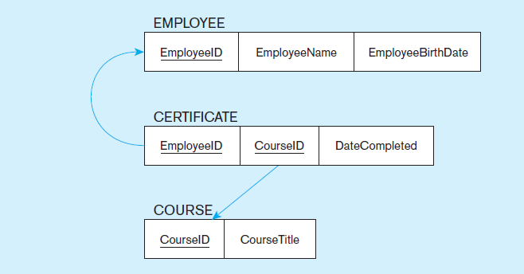
Figure 4-13 Example of mapping an M:N relationship (cont.)
b) Three resulting relations
Composite primary key
Foreign key
new intersection relation
Foreign key
Notes:
Note that any time you have a many-to-many relationship, whether or not it contains its own attributes, it must be implemented as a separate relation (table). Often this is called an intersection table or junction table.
In this example, the new table’s primary key is a composite, formed by two foreign keys, one to each of the entities comprising the M:N relationship (Employee and Course).

Slide 27
E_ID | E_Name | E_DOB | C_Completed
1 | John | 1/10 | (A,10/1), (B,10/5)
2 | Mary | 2/10 | (A,10/1), (C,10/9)
3 | Bob | 6/20 | (B,10/5)
C_ID | C_Title
A | 會計
B | 行銷
C | 管理
由多對多關係 (轉成Associative Entity後)
轉換成1張新table
以2邊的primary key作為foreign key
→這樣的表達方式，優點是什麼 ?
E_ID | E_Name | E_DOB
1 | John | 1/10
2 | Mary | 2/10
3 | Bob | 6/20
E_ID | C_ID | CDate
1 | A | 10/1
1 | B | 10/5
2 | A | 10/1
2 | C | 10/9
3 | B | 10/5
C_ID | C_Title
A | 會計
B | 行銷
C | 管理
每1列代表1位員工
每1列代表1門課
每1列代表1張證書

Slide 28
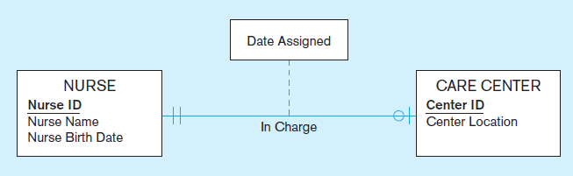
Figure 4-14 Example of mapping a binary 1:1 relationship
a) In charge relationship (binary 1:1)
Often in 1:1 relationships, one direction is optional
Notes:
Although 1 – to - 1 relationships are less common than 1:N or M:N, they still can occur. This E-R diagram shows that a nurse could be in charge of at most one care center, and that each care center must have exactly one nurse in charge.

Slide 29
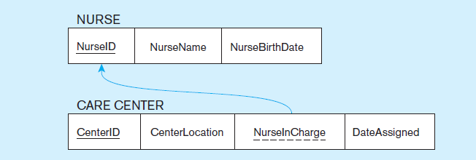
Figure 4-14 Example of mapping a binary 1:1 relationship (cont.)
b) Resulting relations
通常 1:1 關係，在其中一張Table 加上外鍵欄位即可
→挑哪一張Table 較佳 ?
Foreign key goes in the relation on the optional side,
matching the primary key on the mandatory side
為什麼 ?
Notes:
So, since the care center must have a charge nurse, this means the foreign key in this relationship goes into the Care Center table. Also, because of the mandatory one in the relationship, this must mean that the NurseInCharge field can never have a null value.

Slide 30
NurseID | NurseName | NurseBirthDate
A | Mary | 7/1
B | Sue | 5/1
C | Belle | 4/8
兩種表達方式，
哪一種比較好
CenterID | CenterLocation | NurseInCharge | DateAssigned
001 | Taipei | A | 7/8
002 | Hsinchu | B | 6/5
NurseID | NurseName | NurseBirthDate | ToCenter | DateAssigned
A | Mary | 7/1 | 001 | 7/8
B | Sue | 5/1 | 002 | 6/5
C | Belle | 4/8 | null | null
CenterID | CenterLocation
001 | Taipei
002 | Hsinchu

Slide 31
Transforming E-R Diagrams into Relations (4)
Mapping Associative Entities
  Identifier Not Assigned 未特別給定id者
    Default primary key for the association relation is composed of the primary keys of the two entities (as in M:N relationship)
  Identifier Assigned 另給定id者
    It is natural and familiar to end-users
    Default identifier may not be unique
Notes:
As we saw in chapter 2, M:N relationships can also be modeled as associative entities. Sometimes this is preferable. Associative entities will map onto intersection tables in the resulting logical database design.

Slide 32
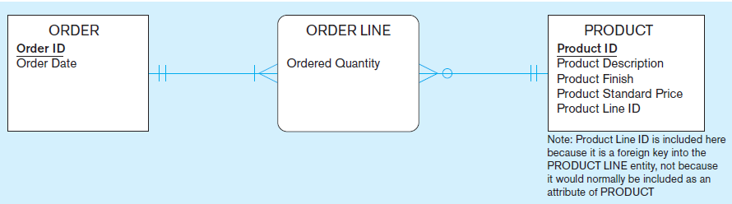
Figure 4-15 Example of mapping an associative entity
a) An associative entity
Notes:
Here, Order Line, which implements a M:N relationship between Order and Product, is explicitly modelled as an associative entity.

Slide 33
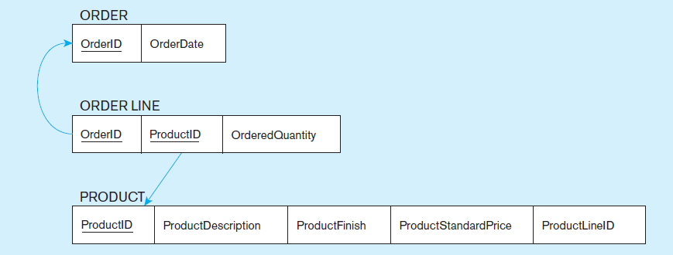
Figure 4-15 Example of mapping an associative entity (cont.)
b) Three resulting relations
Composite primary key formed from the two foreign keys
Notes:
The resulting intersection table connects orders to products. The same would have been true if there was just a M:N relationship (instead of an associative entity) in the E-R model.
So, mapping associative entities to relational databases is essentially identical to mapping M:N relationships to relational databases.

Slide 34
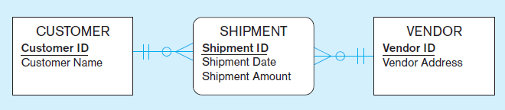
Figure 4-16 Example of mapping an associative entity with
an identifier
a) SHIPMENT associative entity
Notes:
In this case, the associative entity has its own identifier…..

Slide 35
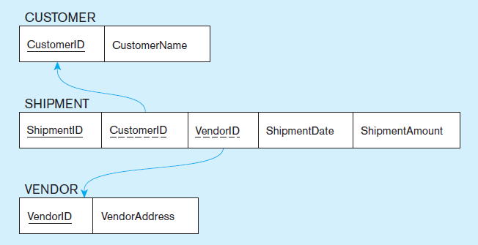
Figure 4-16 Example of mapping an associative entity with
an identifier (cont.)
b) Three resulting relations
Primary key differs from foreign keys
Notes:
…thus, the foreign keys of the resulting intersection relation are not part of the primary key.

Slide 36
E_ID | E_Name | E_DOB | C_Completed
1 | John | 1/10 | (A,10/1), (B,10/5)
2 | Mary | 2/10 | (A,10/1), (C,10/9)
3 | Bob | 6/20 | (B,10/5)
C_ID | C_Title
A | 會計
B | 行銷
C | 管理
(請比較之前的例子)
不使用2邊的foreign key當組合主鍵
新增加CNO證書編號當作primary key
E_ID | E_Name | E_DOB
1 | John | 1/10
2 | Mary | 2/10
3 | Bob | 6/20
CNO | E_ID | C_ID | CDate
001 | 1 | A | 10/1
002 | 1 | B | 10/5
003 | 2 | A | 10/1
004 | 2 | C | 10/9
005 | 3 | B | 10/5
C_ID | C_Title
A | 會計
B | 行銷
C | 管理
每1列代表1位員工
每1列代表1門課
每1列代表1張證書，多加了證書編號

Slide 37
Transforming E-R Diagrams into Relations (5)
Mapping Unary Relationships
  One-to-Many–Recursive foreign key in the same relation 直接加外鍵欄位即可
  Many-to-Many–Two relations: 要多開一張Table
    One for the entity type
    One for an associative relation in which the primary key has two attributes, both taken from the primary key of the entity

Slide 38
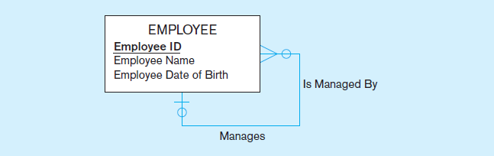
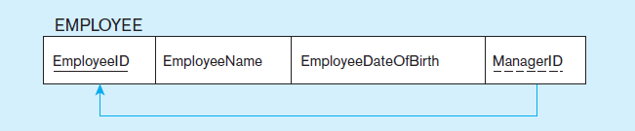
Figure 4-17 Mapping a unary 1:N relationship
(a) EMPLOYEE entity with unary relationship
(b) EMPLOYEE relation with recursive foreign key
Notes:
The E-R diagram involves a one-to-many relationship. Thus, the foreign ley is in the same table as the primary key. This is often called a “recursive” key because it points at records in the same table.
Because of the optional relationship, it is possible for an employee not to have any supervisor. Therefore, the ManagerID field could be null.
This structure is an example of storing hierarchies. It enables the representation of a supervisor who has subordinates, and these subordinates could in turn manage other subordinates, etc.

Slide 39
Peter
John
Mary
Bob
Sue
Emp_ID | E_Name | E_DOB | Mgr_ID
1 | John | 1/10 | 4
2 | Mary | 2/10 | 4
3 | Bob | 6/20 | 1
4 | Peter | 3/20 | null
5 | Sue | 9/20 | 4
每1列代表1位員工
主管關係 (組織圖)
把自身primary key再拿來參照一次成為foreign key
但同table不可有同名欄位，故取名為Mgr_id

Slide 40
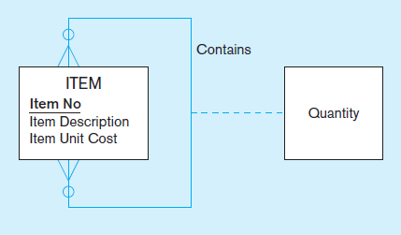
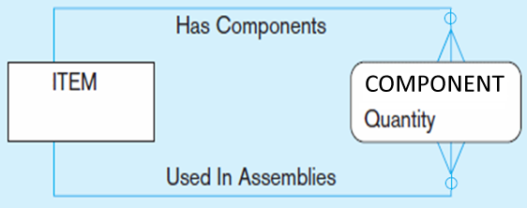
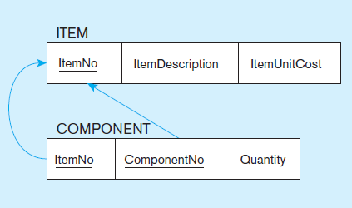
Figure 4-18 Mapping a unary M:N relationship
(a) Bill-of-materials relationships (unary M:N)
先轉為Associative Entity
(b) ITEM and COMPONENT relations
成為新的table
拿2邊的主鍵
來成為外鍵
(取不同名字)
Notes:
As always, any many-to-many relationship requires a separate table (relation).
Bill-of-materials is another classic example of representing hierarchies in a database. An item may have sub-items, which could in turn have other sub-items, etc. However, there is a difference between this and the employees example from earlier. A given employee can have only one direct manager (1:N). But a component could conceivable be part of many other items (M:N).

Slide 41
記憶體
ItemNo | Desc | UCost
1 | 電腦 | 800
2 | 處理器 | 100
3 | 顯示卡 | 200
4 | 記憶體 | 20
2
8
處理器
顯示卡
1
2
電腦
1
ItemNo | ComponentNo | Quantity
1 | 2 | 2
1 | 3 | 1
1 | 4 | 8
3 | 2 | 1
3 | 4 | 2
元件組成關係
拿2邊的primary key來 (需取不同名字)
成為foreign key，同時也是composite primary key

Slide 42
Transforming E-R Diagrams into Relations (6)
Mapping Ternary (and n-ary) Relationships
  One relation for each entity and one for the associative entity
  Associative entity has foreign keys to each entity in the relationship

Slide 43
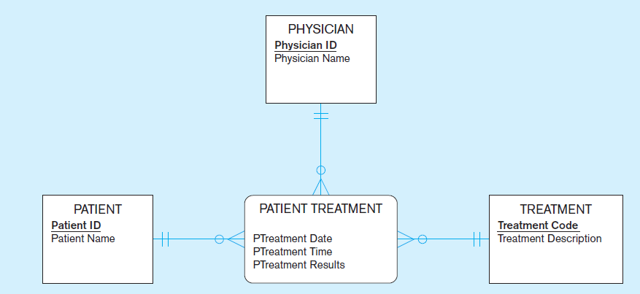
Figure 4-19 Mapping a ternary relationship
a) PATIENT TREATMENT Ternary relationship with associative entity
內科醫師
病患
看病紀錄
處方
Notes:
Note that this ER diagram shows that a given physician can give a particular treatment to a particular patient, and that this could happen more than once.

Slide 44
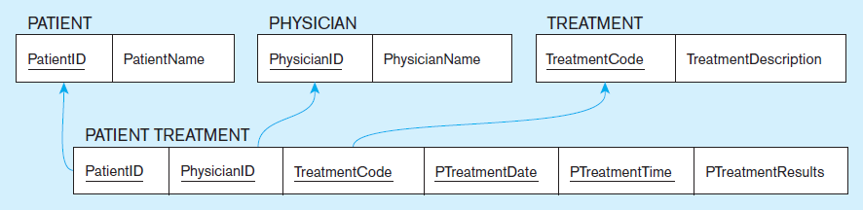
Figure 4-19 Mapping a ternary relationship (cont.)
b) Mapping the ternary relationship PATIENT TREATMENT
Remember that the primary key MUST be unique.
This is why treatment date and time are included in the composite primary key.
But this makes a very cumbersome key…
It would be better to create a surrogate key like Treatment#.
主鍵是複合欄位而且又很長時
考慮直接給一個編號當主鍵
Notes:
This is why the primary key of the Patient Treatment table needs more than just the three foreign keys to Physician, Treatment, and Patient. This is why date and time are part of the primary key. But this creates a primary key consisting of five separate columns.
Suppose later we were to create a table that depends on patient treatment. If we did this, then that table would have a five-field foreign key! Very cumbersome.
So, the solution would be to have a surrogate primary key. If you have large composite primary keys, this is an indicator that a surrogate key is preferable.

Slide 45
Data Normalization 正規化
Primarily a tool to validate and improve a logical design so that it satisfies certain constraints that avoid unnecessary duplication of data
避免資料重複與各種異象
The process of decomposing relations with anomalies to produce smaller, well-structured relations
切成較小, 結構較好的表
Notes:
The previous slides showed how to map an E-R model to a relational database design. If you follow these mappings, then your result will be a well-structured database. But if you just start by creating tables without considering the ER rules, then you will likely get a database that is not well-structured. These databases could cause anomalies because of data duplication. In the next several slides we’ll see how to correct these anomalies through a process called “normalization”.

Slide 46
Well-Structured Relations
A relation that contains minimal data redundancy and allows users to insert, delete, and update rows without causing data inconsistencies
Goal is to avoid anomalies 為了避免異象
  Insertion Anomaly–adding new rows forces user to create duplicate data
  Deletion Anomaly–deleting rows may cause a loss of data that would be needed for other future rows
  Modification Anomaly–changing data in a row forces changes to other rows because of duplication
General rule of thumb: A table should not pertain to more than one entity type. 一張表不該表示超過一個entity

Slide 47

Example–Figure 4-2b
Question–Is this a relation?
Answer–Yes: Unique rows and no multivalued attributes
Question–What’s the primary key?
Answer–Composite: EmpID, CourseTitle
Notes:
This is a relation. But it is not a well-structured relation.

Slide 48
Anomalies in this Table
問題出在這「一張大表」 企圖同時表示多個 entity
Insertion–can’t enter a new employee without having the employee take a class (or at least empty fields of class information)
Deletion–if we remove employee 140, we lose information about the existence of a Tax Acc class
Modification–giving a salary increase to employee 100 forces us to update multiple records
Why do these anomalies exist?
  Because there are two themes (entity types) in this one relation. This results in data duplication and an unnecessary dependency between the entities.
「一張大表」造成了不必要的資料重複與相依性

Slide 49
Functional Dependencies and Keys
Functional Dependency: The value of one attribute (the determinant) determines the value of another attribute
相依: 一個欄位是受另一個欄位所決定
Candidate Key:
  A unique identifier. One of the candidate keys will become the primary key
    E.g., perhaps there is both credit card number and SS# in a table…in this case both are candidate keys.
  Each non-key field is functionally dependent on every candidate key.

Slide 50
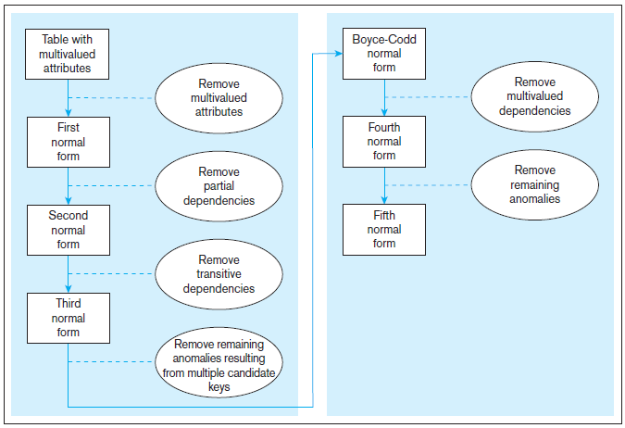
Figure 4.22 Steps in normalization
3rd normal form is generally considered sufficient
一般要滿足第三正規化即可
Notes:
It is important that a database reach third normal form. Boyce-Codd, fourth, and fifth are of theoretical interest, but not generally considered vital for qualifying as a set of well-structured relations.

Slide 51
First Normal Form 第一正規化
No multivalued attributes 不可有多值的欄位
Every attribute value is atomic
Fig. 4-25 is not in 1st Normal Form (multivalued attributes) ➔ it is not a relation.
Fig. 4-26 is in 1st Normal form.
All relations are in 1st Normal Form.

Slide 52
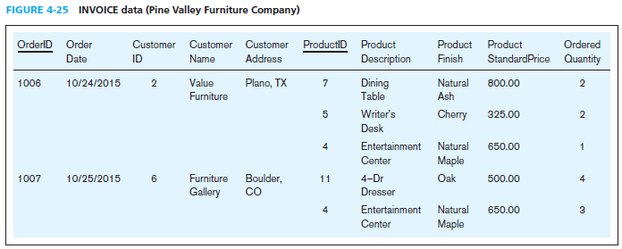
Table with multivalued attributes, not in 1st normal form
多值放在同一筆發票紀錄中
Note: This is NOT a relation.
Notes:
This table is not a relation. Note the blank OrderID field. Also, we don’t explicitly see the customer or order date for the second, third, and fifth rows. You can imagine seeing something like this in a spreadsheet and inferring that the second and third rows correspond with order 1006. But this is not sufficient for a database.
Basically, we here are violating the principle of “no multivalued attributes”. It’s as if OrderID 1006 has “ProductID” equaling 7, 5, and 4. You can’t have that in a true relation.

Slide 53
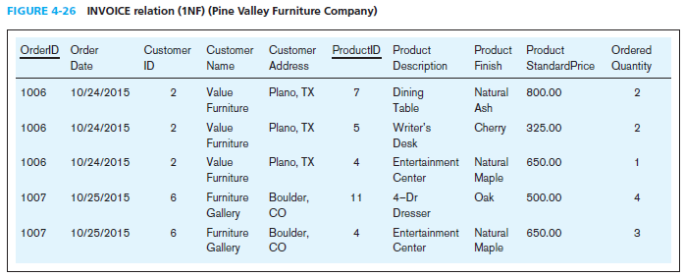
Table with no multivalued attributes and unique rows, in 1st normal form
Note: This is a relation, but not a well-structured one.
Notes:
Now we have a true relation. It is in first normal form. But note the data duplication. This will cause anomalies.

Slide 54
Anomalies in this Table
Insertion–if new product is ordered for order 1007 of existing customer, customer data must be re-entered, causing duplication
Deletion–if we delete the Dining Table from Order 1006, we lose information concerning this item’s finish and price
Update–changing the price of product ID 4 requires update in multiple records
Why do these anomalies exist?
  Because there are multiple themes (entity types) in one relation. This results in duplication and an unnecessary dependency between the entities.

Slide 55
Second Normal Form 第二正規化
1NF PLUS every non-key attribute is fully functionally dependent on the ENTIRE primary key
  Every non-key attribute must be defined by the entire key, not by only part of the key 每個非鍵值欄位只能與整個主鍵相依
  No partial functional dependencies 不能只與部份主鍵相依

Slide 56
Third Normal Form 第三正規化
2NF PLUS no transitive dependencies (functional dependencies on non-primary-key attributes)
每個非鍵值欄位, 不能與任何非鍵值欄位相依 (反面再講一次, 語氣更強)
Note: This is called transitive, because the primary key is a determinant for another attribute, which in turn is a determinant for a third
Solution: Non-key determinant with transitive dependencies go into a new table; non-key determinant becomes primary key in the new table and stays as foreign key in the old table

Slide 57
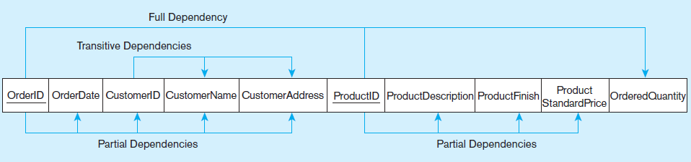
Figure 4-27 Functional dependency diagram for INVOICE
OrderID ➔ OrderDate, CustomerID, CustomerName, CustomerAddress
CustomerID ➔ CustomerName, CustomerAddress
ProductID ➔ ProductDescription, ProductFinish, ProductStandardPrice
OrderID, ProductID ➔ OrderQuantity
Therefore, NOT in 2nd Normal Form
Notes:
So, in this one relation, there are both partial and transitive dependencies. Because of partial dependencies, the relation is not in 2nd normal form. So, our first step is to remove the partial dependencies by splitting the table into three, one for orders, one for products, and one for order line.

Slide 58
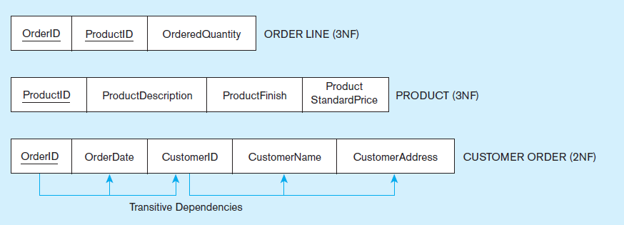
Figure 4-28 Removing partial dependencies
Getting it into Second Normal Form
Partial dependencies are removed, but there are still transitive dependencies
Notes:
So, now we have three separate relations. There is no partial dependency. But we still have a transitive dependency. We will fix this next by splitting customers from orders.

Slide 59
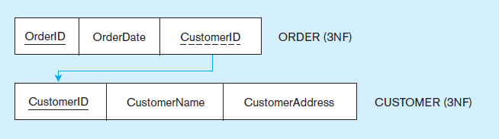
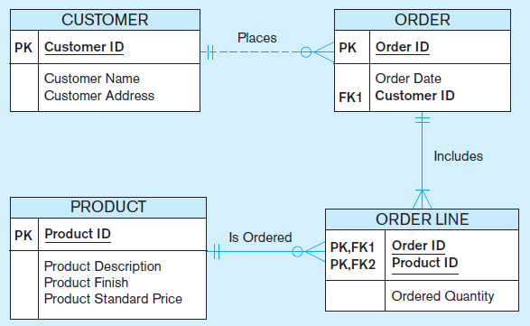
Figure 4-29 Removing partial dependencies
Getting it into Third Normal Form
Transitive dependencies are removed.
Figure 4-30 shows the result of normalization, yielding four separate relations where initially there was only one.
Notes:
Finally we are at third normal form. At this point we have a well-structured database.
Note that if we had started with a thorough ER model, we would not have wound up with one big table containing multiple themes. The original table basically had three separate entities all wrapped into a single relation (customer, product, and order). Furthermore, it hid the fact of a many-to-many relationship between orders and products.
This illustrates the danger of going straight to the logical database design without first performing the conceptual model analysis. But this sort of thing happens all to often.

Slide 60
實務技巧
正規化
  優點：更新方便、不會有不一致的怪現象
  只是之後跨表查詢需重新連接 JOIN，效能會較差
    主鍵及外鍵要記得建索引
何時該切表格
  「有些欄位是跟隨某個欄位的」

Slide 61
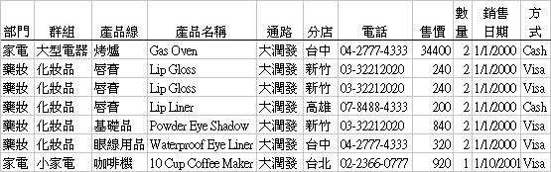
練習範例
大賣場的銷售紀錄表
有哪些欄位彼此相依？
只要留哪些必要欄位？

Slide 62
Merging Relations
View Integration–Combining entities from multiple ER models into common relations
合併多個E-R models成一組表格
Issues to watch out for when merging entities from different ER models: 合併要注意的事
  Synonyms 異名同義詞 two or more attributes with different names but same meaning. Ex. Author, Creator
  Homonyms 同名異義詞 attributes with same name but different meanings. Ex. Price (unit price or total price?)
  Transitive dependencies–even if relations are in 3NF prior to merging, they may not be after merging 合併之後要再檢查第三正規化
Notes:
Most medium-to-large organizations have many reasonably independent systems development activities that at some point may need to come together to create a shared database. The result is that some of the relations generated from these various processes may be redundant. This is where view integration comes in handy. But you need to be cautious about the problems that stem from these redundancies.

Slide 63
Enterprise Keys
Primary keys that are unique in the whole database, not just within a single relation 整個資料庫內都可用的主鍵
Corresponds with the concept of an object ID in object-oriented systems

Slide 64
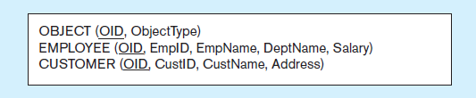
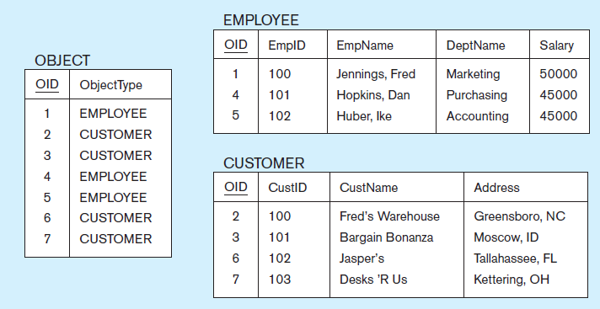
Figure 4-31 Enterprise keys
a) Relations with enterprise key
b) Sample data with enterprise key
Notes:
Enterprise keys are primary keys that are unique in the whole database, not just within a single relation. This corresponds with the concept of an object ID in object-oriented systems

