Slide 1
Optimization
Or “Making code go ‘brrrrrr’”

Slide 2
Why does it matter
2 examples from my research

Slide 3
Example 1: Cognitive modeling and EEG

Slide 4
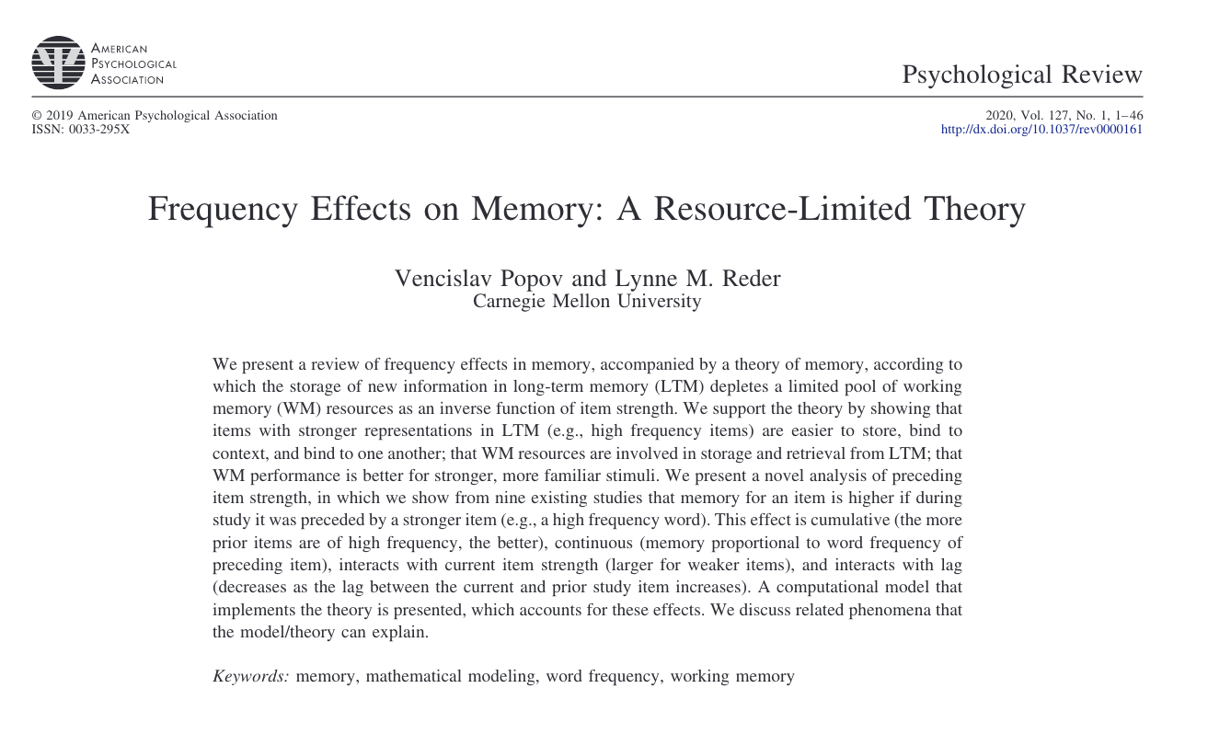

Slide 5
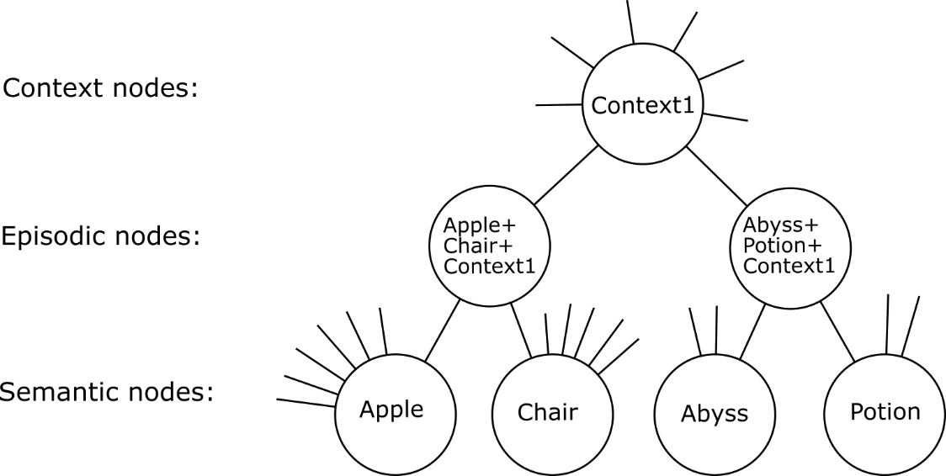
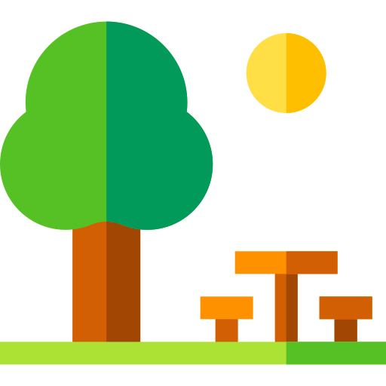




SAC model - representation

Slide 6
SAC model - representation

Slide 7
SAC model - representation

Slide 8
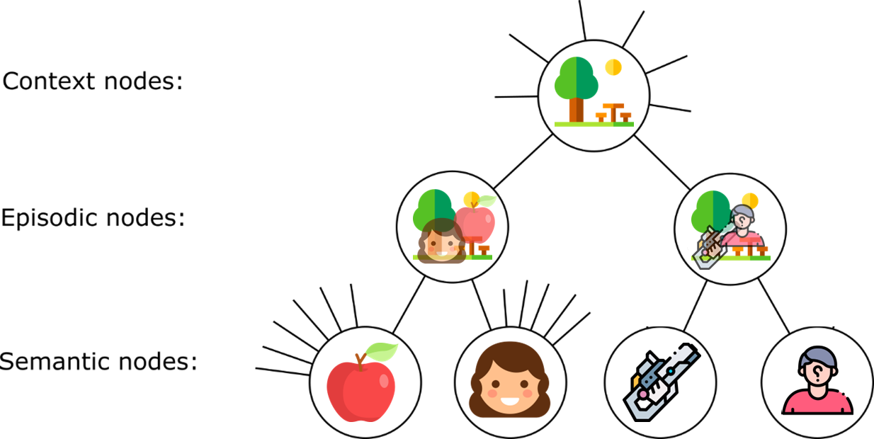
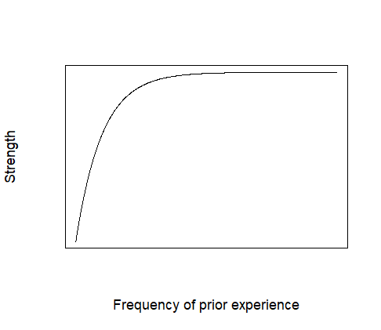

SAC model - Assumptions
1 ) Prior strength
$$B_{0}=0.4 −0.2 e^{−Freq}$$

Slide 9


SAC model - Assumptions
1) Prior strength
2) Memory formation
$$boost=δ\left(1−B_{0}\right)$$
$$B=B_{0}+boost×{time}^{−d}$$

Slide 10

1) Prior strength
2) Memory formation
3) Resource depletion and recovery
L
L
L
Max = 1
$Depletion: \text{s} \text{∝}$ $\left(1−B_{0}\right) W$
$$Remaining: W_{a}=W−s$$
$$W$$
$$Recovery: W_{a}+RecoveryRate ∗Time$$
Min = 0
Time

Slide 11
1) Prior strength
2) Memory formation
3) Resource depletion and recovery
L
L
L
H
H
H
Max = 1
Max = 1
Min = 0
Min = 0
Time
Time

Slide 12

4) Retrieval
What happened at the picnic?
Did you see Ann yesterday?
Did Ann eat an apple at the picnic?
Current activation:
$A=B×A_{boost} × e^{−γt}$
Spreading activation (boost):
$A_{boost, r}=\sum_{s=1}^{n}{\left(A_{s}×\frac{S_{s,r}}{\sum_{i=1}^{k}{S_{s,i}}}\right)}$
Context diversity:
$\sum_{i=1}^{k}{S_{s,i}}= S_{newlinks}+ 0.2−0.2 ×e^{−0.1 CD}$

Slide 13
1. How can we measure resource availability? 2. What is this resource? 3. Can we measure individual differences?

Slide 14
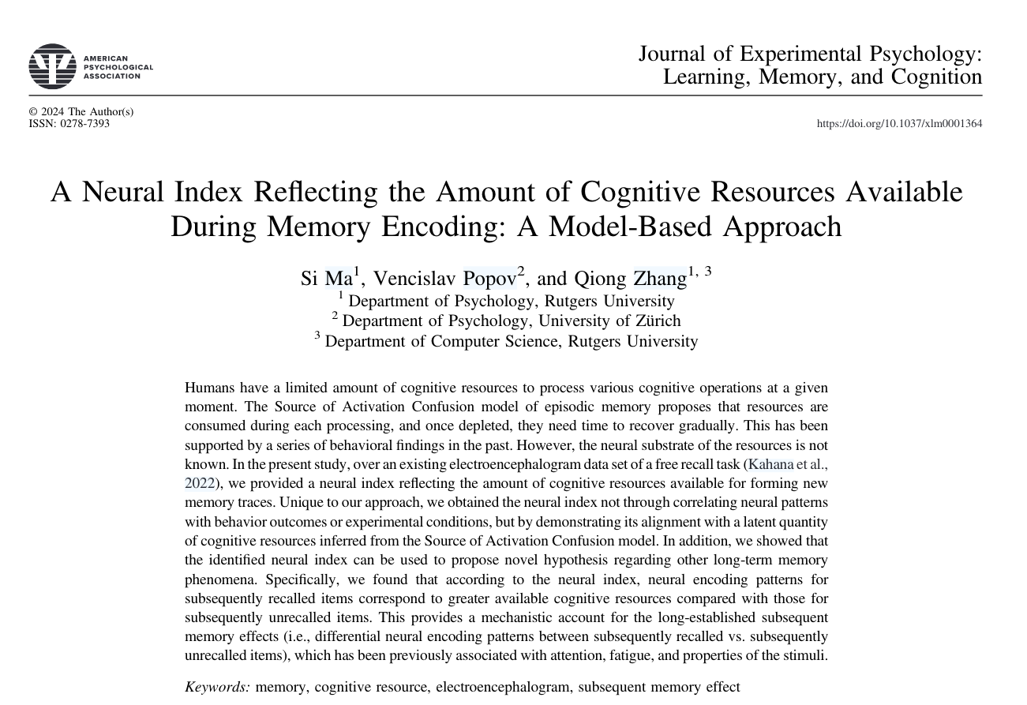

Slide 15

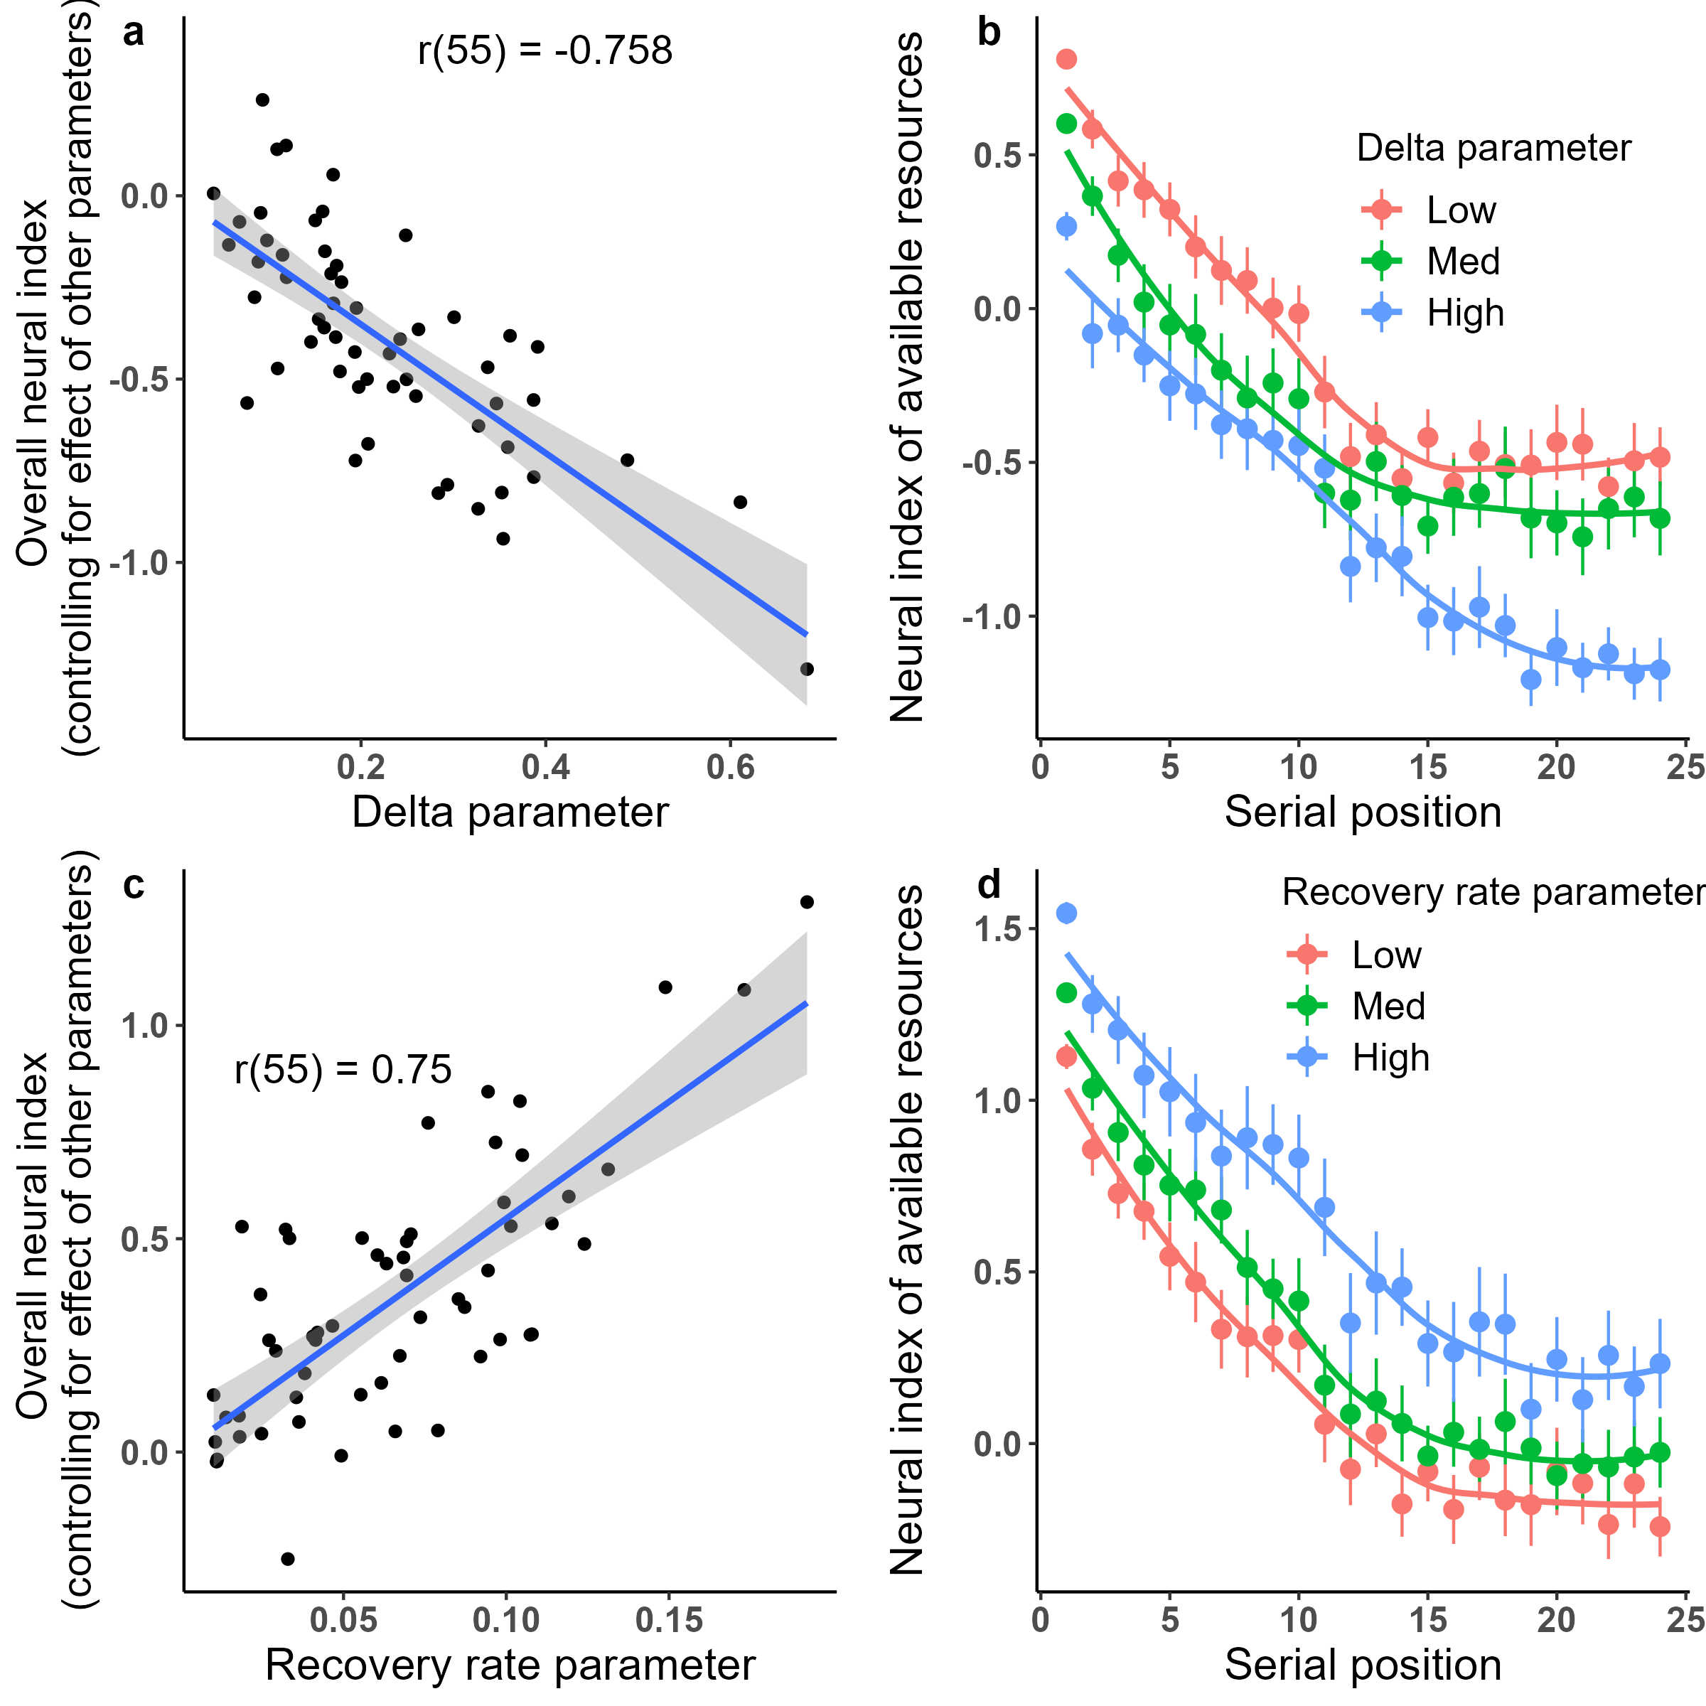
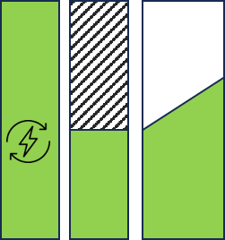
Ma, Popov & Zhang (Under Revision) JEP:LMC
STUDY SESSION
EEG resource index
EEG resource index
TEST SESSION
Depletion parameter

Slide 16
Example 2 – Bayesian modeling

Slide 17


Slide 18
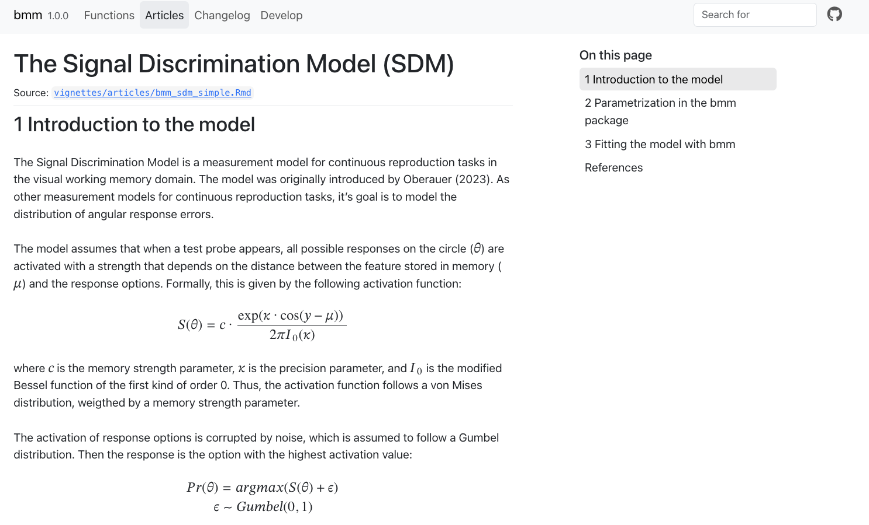

Slide 19
Write a function to calculate the sum of all positive integers smaller or equal to N which are divisible by 3 or 5
For example, if N = 20, then the answer is 3+5+6+9+10+12+15+18+20 = 98

Slide 20
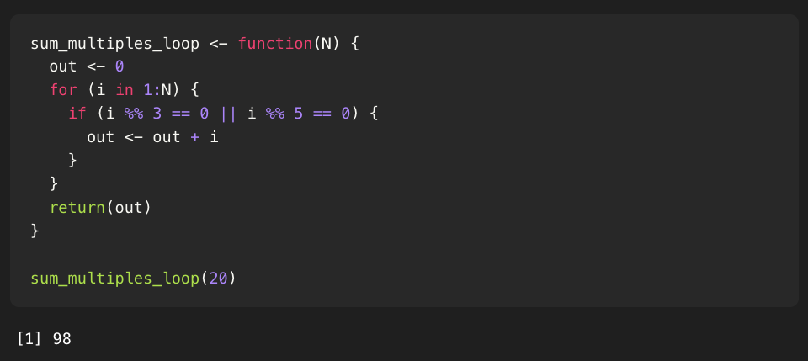

Slide 21
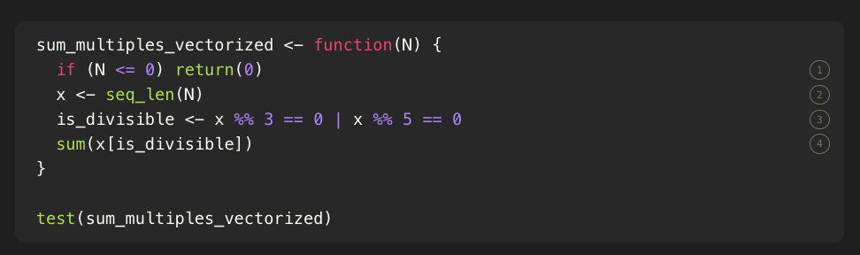

Slide 22
