Slide 1




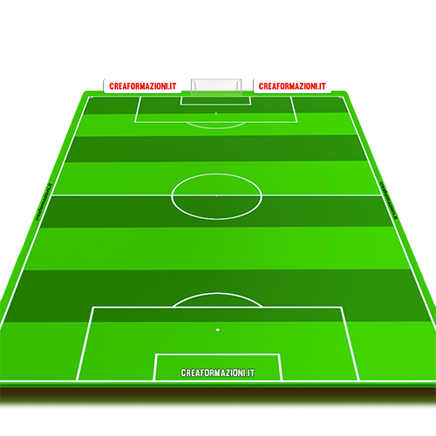



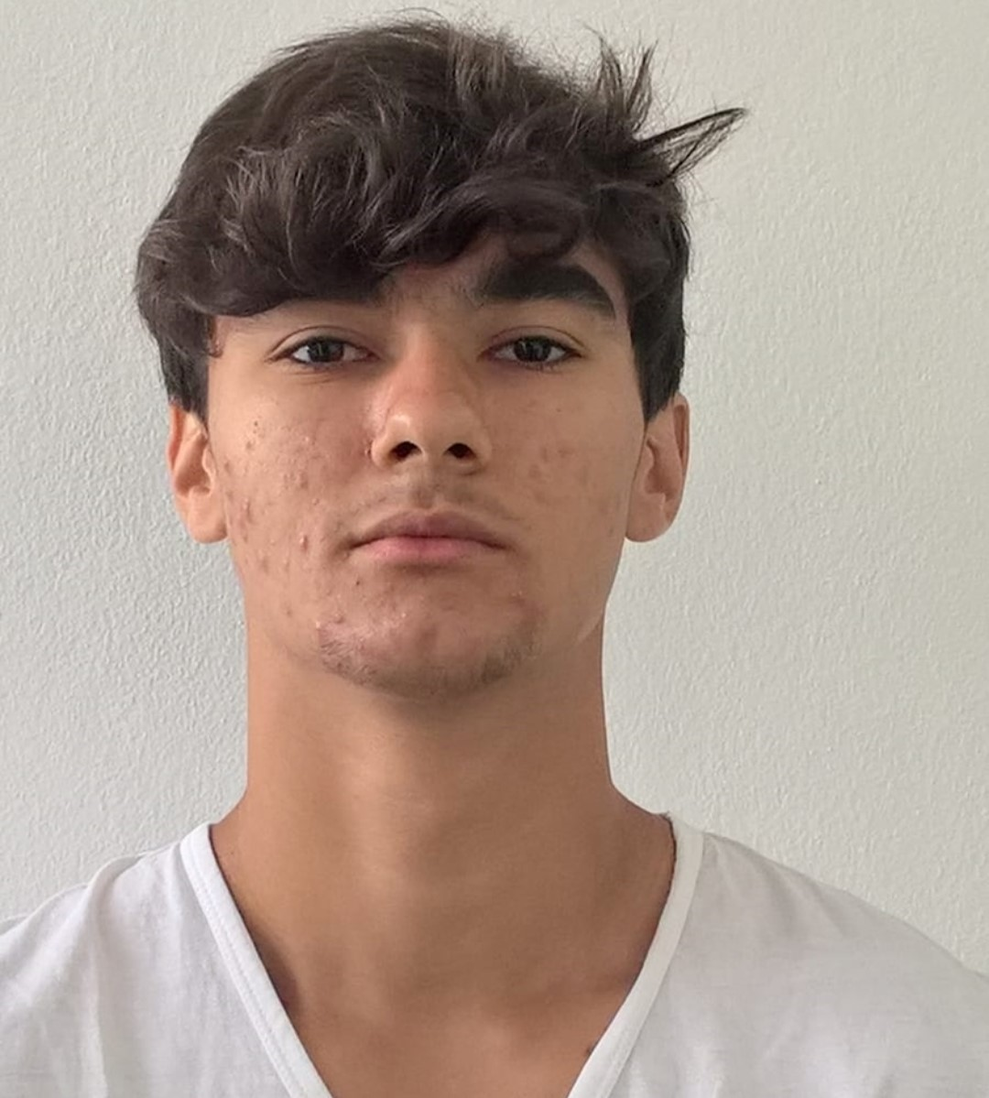


Department of Information Engineering Academic Year 2023/2024
Web Applications Project
“Awesome Tournaments”
Alberto Basaglia
Andrea Bruttomesso
Alessandro Corrò
Milica Popovic
Davide Seghetto
Andrea Stocco

Slide 2
Developing a web application to provide a comprehensive platform for organizing football tournaments and following them
Project objectives
Organizers can take care of tournaments management by:
Creating and setting up tournaments
Scheduling matches
Managing teams and players
Basic users can view:
Match schedules and results
Tournament statistics
Information about the players
2

Slide 3
Creation of a new tournament
Edit/deletion of a tournament
Creation/edit/deletion of a team for the tournament
Addition/edit/deletion of players
Creation of the draw
Updating the info of a tournament’s matches
Following the tournament’s matches
Main features
3

Slide 4
The server uses a SQL database
Implemented the different java classes needed from scratch:
DAO
Filter
Resource
REST
Servlet
4
Back-end

Slide 5
Our system accommodates three distinct user types:
Guest: a non-logged-in user.
Team Administrator: a registered user responsible for managing his own teams.
Tournament Administrator: a registered user responsible for managing his own tournaments.
Additionally, tournament administrators can manage the teams enrolled in their tournaments. A registered user may hold ownership of both tournaments and teams. Every of those users can view past and present tournaments along with their related match schedules, team standings, and other statistics
5
Authentication

Slide 6
When the user login a session is created
The session is used by the application filters to validate the access to the certain functionalities, such as editing a team
Application filter
6

Slide 7
The DAO classes are used to access the database and perform the different operations
The methods are implemented using the Prepared Statement to avoid SQL injection and increase safety
7
Dao

Slide 8
The resources classes are used by the REST services
The services that are implemented using REST are:
manage of members
manage of conferences
reservation of the seats
All the REST requests are served by the RestMatcherServlet
Resources and REST
8

Slide 9
Demo
Let’s a demo!
9

