Slide 1
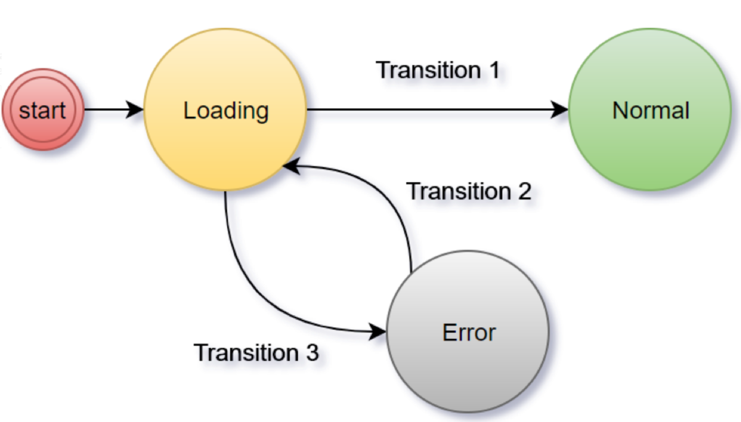
Modeling software applications with Spring Statemachine (SSM)
Host: Popovici Gabriel
Division: Domains
Hub: Bucharest,Romania

Slide 2
Workshop Agenda
Prerequisites
Using SSM 3.0.0.M1
Java with JDK 8
Spring Framework 5.2.0.RC1
Toolchain: Maven 3.5.x
Clone https://github.com/popovici-gabriel/contact-service
IDE plugins: lombok, java micro harness(jmh)
Context
Types of systems modeling
Workflow engine vs Statemachine
Building blocks of Statemachine
SSM Concepts
What?
Why?
Hands-on: Modeling RESTfull APIs using SSM
Benchmark

Slide 3
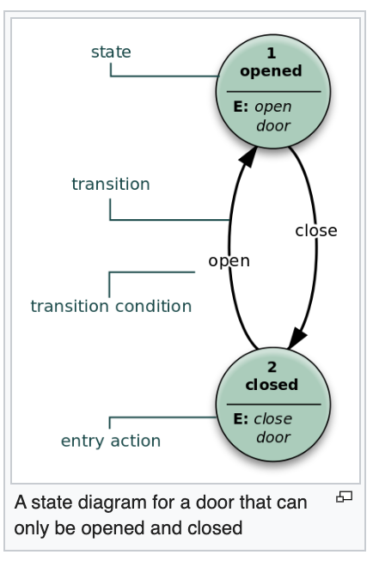
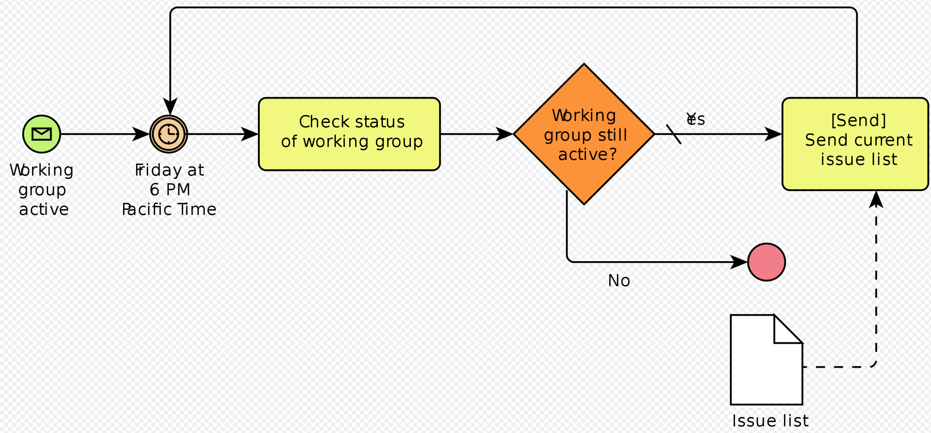
Types of system modeling
In business and IT development systems are modeled with different scopes and scales of complexity, such as:
Functional modeling
Systems architecture
Business process modeling
Enterprise modeling
(Source: https://en.wikipedia.org/wiki/Systems_modeling)
Specific types of modeling languages[edit]
Framework-specific modeling language
Systems Modeling Language
SysML includes 9 types of diagram, some of which are taken from UML.
Block definition diagram
Internal block diagram
Package diagram
Use case diagram
Requirement Diagram
Activity diagram
Sequence diagram
State machine diagram
Parametric diagram
Business Process Model and Notation (BPMN) is a graphical representation for specifying business processes in a workflow. BPMN was developed by Business Process Management Initiative (BPMI), and is currently maintained by the Object Management Group since the two organizations merged in 2005. The current version of BPMN is 2.0.^{[29]}

Slide 4
Workflow engine vs. Statemachine
Category | Workflow Engine | Statemachine
Flexibility | sequential pattern | unordered
Understandability | complex and appropriate for large systems | easy but complicated to implement in large systems
Readability | easy to read in large systems | hard to read in large systems
Predictability | predictable and predefined | randomly as it depends on external events
When to use? | complex systems | small systems
Standard | BPMN 2.x | None
Graphical representation | BPMN components | Represented through UML state diagrams
Source: https://workflowengine.io/blog/workflow-engine-vs-state-machine/

Slide 5
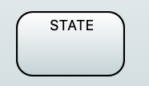
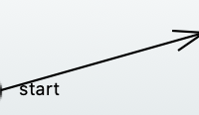








Building blocks of Statemachine
Item | Description | UML Representation
State | model of the system
Transition | relationship between a source state and a target state
Internal transition | the source state and the target state are always the same
Event | the impulse/signal which triggers a state change
Initial state | the initial state of the machine(mandatory)
End state | final state(mandatory)
History state | pseudo state linking previous state
Choice state | pseudo state allowing a transition choice based on some input (similar to if/elseif/else structure )
Junction state | similar to choice state but has multiple incoming transitions
Region | composite state or sub state machine
Action | behavior run during state transition | usually specified on the transition arrow
Guard | an expression evaluated dynamically based on variables and parameters
Entry point | pseudo state when entering into submachine
Exit point | pseudo state when exiting submachine

Slide 6
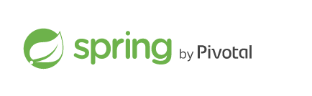
What?
SSM:
Implements the traditional state machine
Integration with Spring IoC and Spring Boot
Hierarchical state machine structure
Support for regions, sub-machines
Support for Eclipse modeling framework (Papyrus)
Supports distributed states through the use of Zookeeper
Testing support
3rd party modules: https://docs.spring.io/spring-statemachine/docs/3.0.0.M1/reference/#modules

Slide 7
Why?
Traditionally, state machines are added to an existing project when developers realize that the code base is starting to look like a plate full of spaghetti. Spaghetti code looks like a never ending, hierarchical structure of IF, ELSE, and BREAK clauses, and compilers should probably ask developers to go home when things are starting to look too complex.
You are already trying to implement a state machine when you:
Use boolean flags or enums to model situations.
Have variables that have meaning only for some part of your application lifecycle.
Loop through an if-else structure (or, worse, multiple such structures), check whether a particular flag or enum is set, and then make further exceptions about what to do when certain combinations of your flags and enums exist or do not exist.

Slide 8
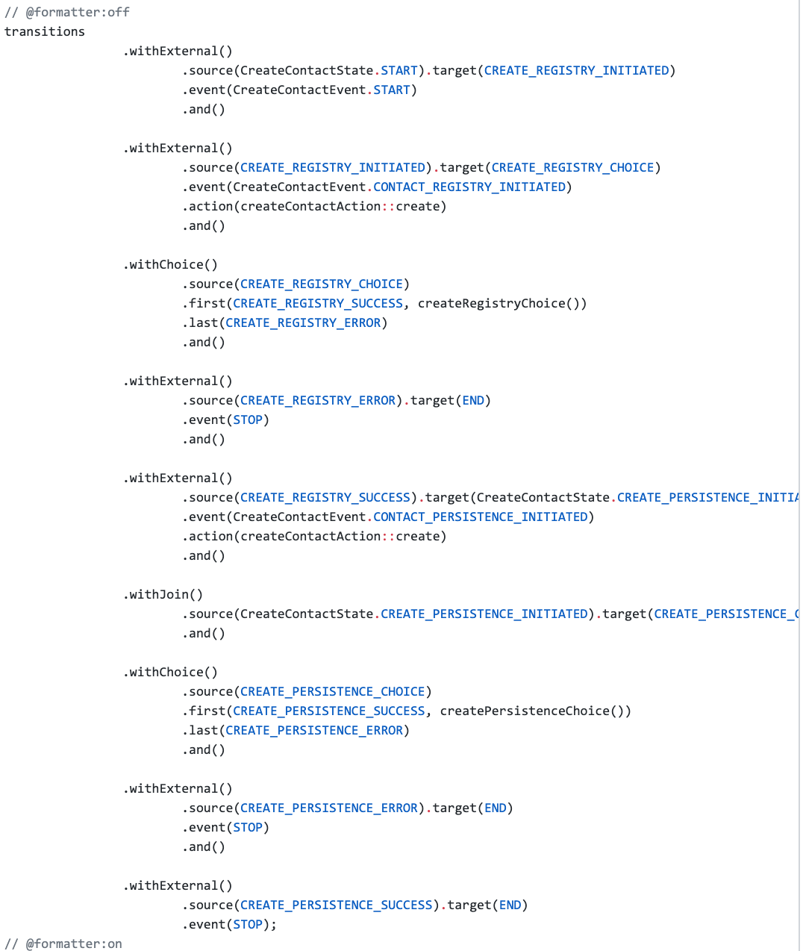
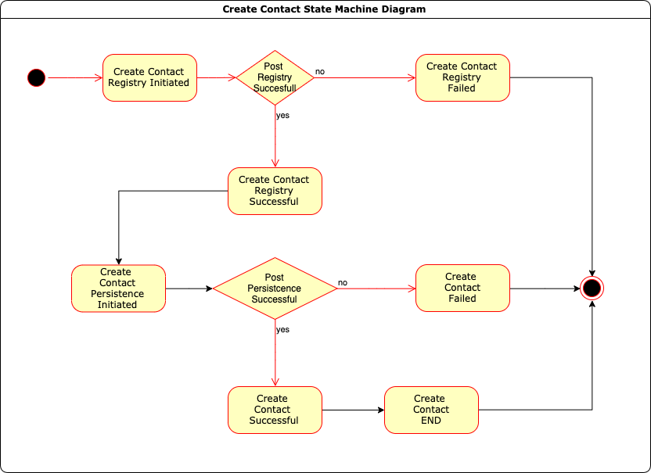
Hands-on: Modeling RESTfull APIs using SSM
Create Contact

Slide 9
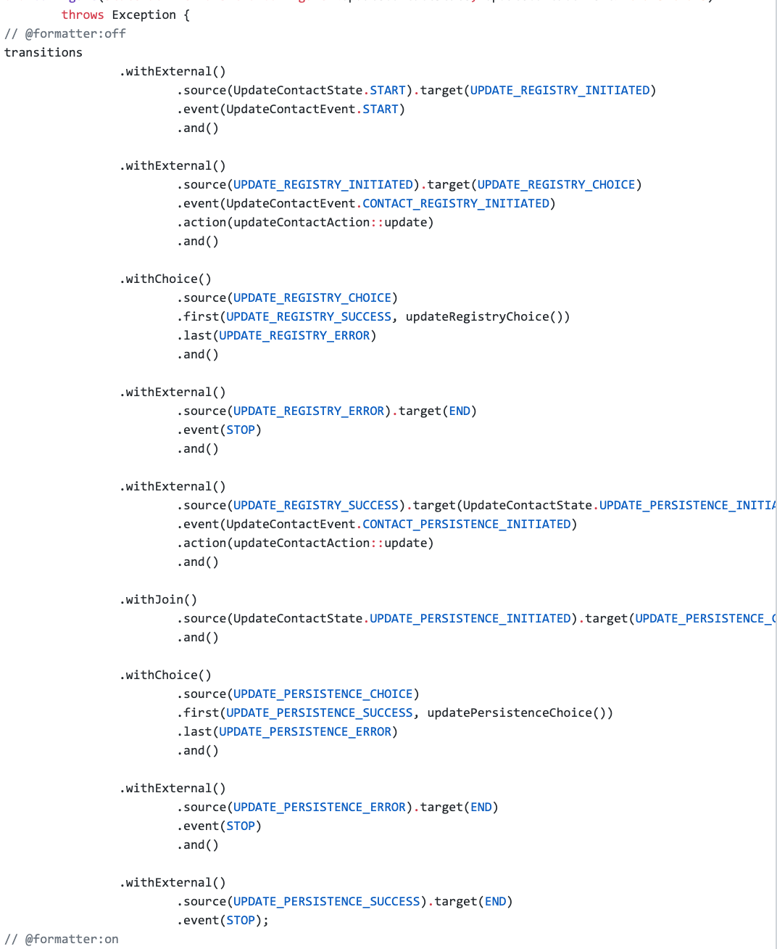
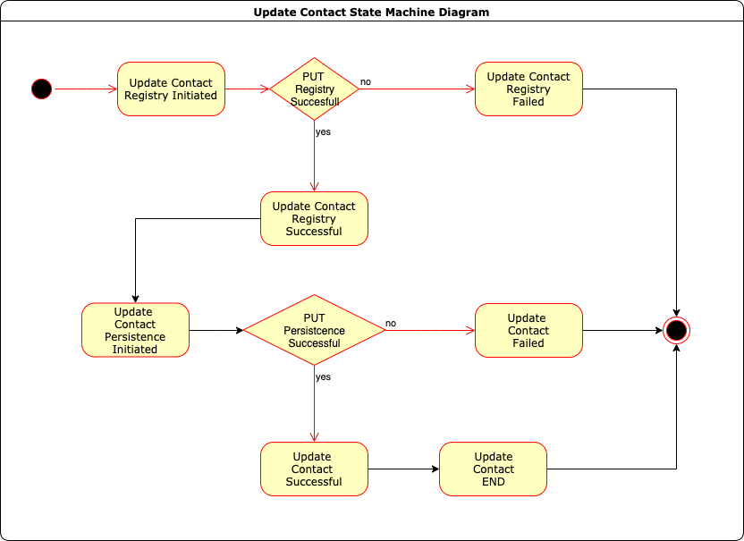
Update Contact

Slide 10
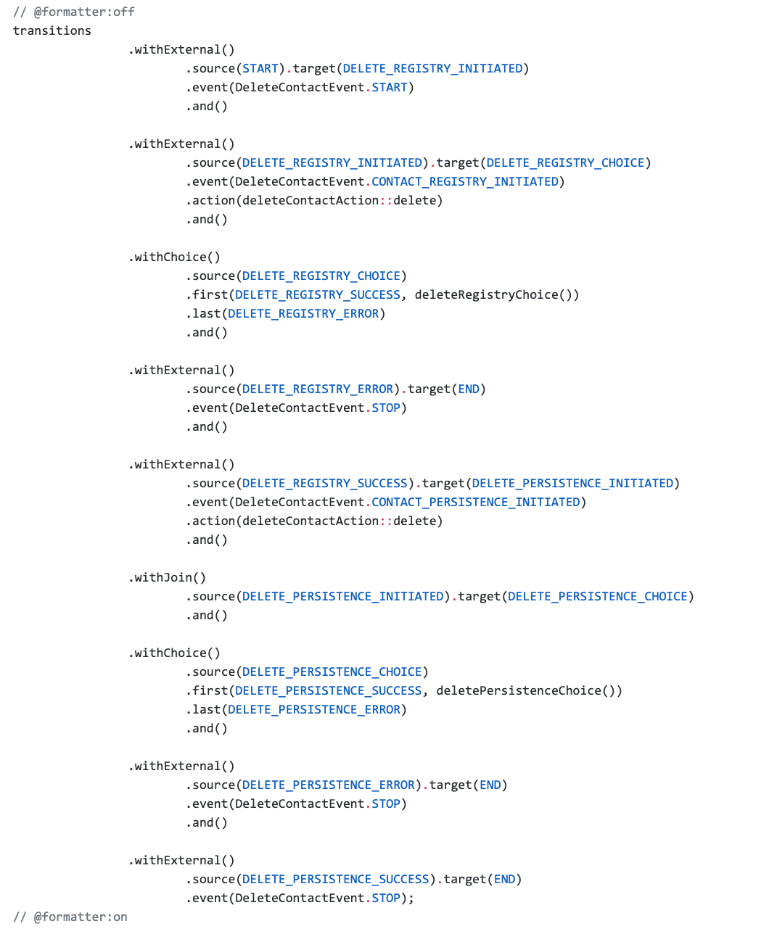

Delete Contact

Slide 11
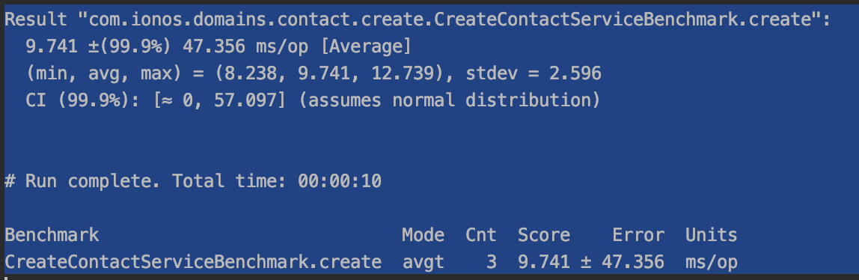
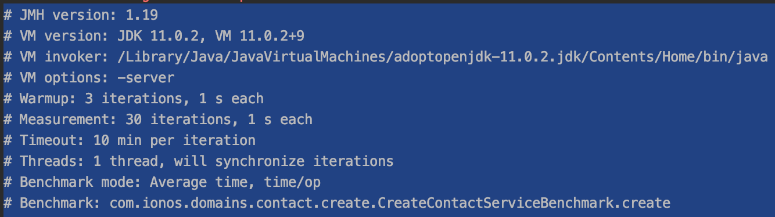
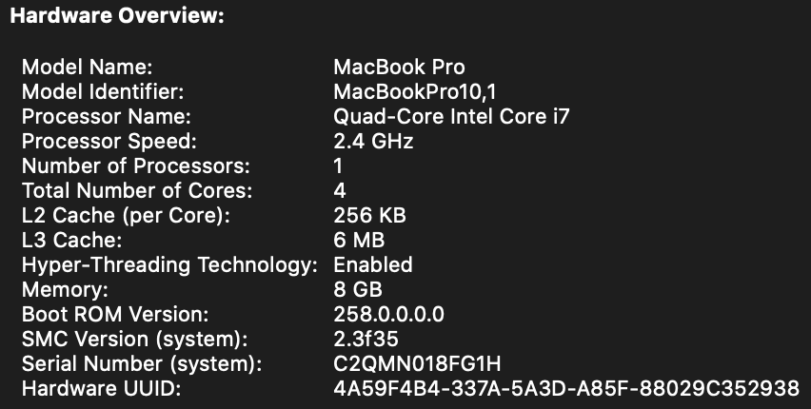
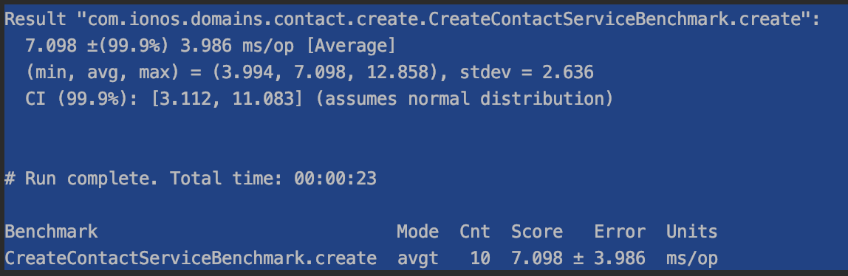
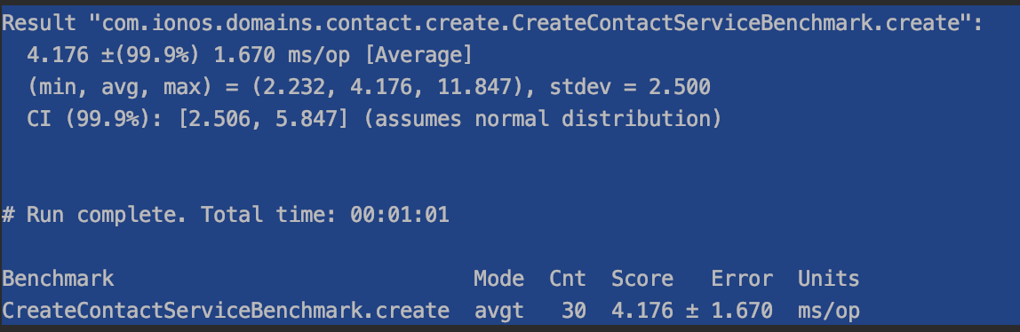
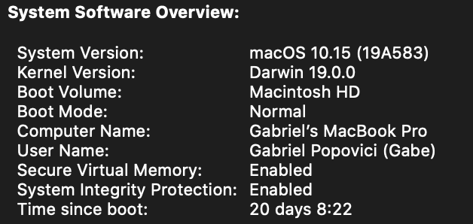
Benchmark Results

Slide 12
Q&A

