Slide 1
Flask? No thanks!
by Alexey Popravka

Slide 2
About me
6+ years of Python
Python developer / Tech Lead at Prom.ua
Contributor of github.com/aio-libs
github.com/popravich

Slide 3
What this talk is about?
What is Flask
What Flask is not (what is wrong)
Alternatives
Questions

Slide 4
What is Flask
“Flask is a microframework for Python based on Werkzeug, Jinja 2 and good intentions.”

Slide 5
What is Flask
“Flask is a microframework for Python based on Werkzeug, Jinja 2 and good intentions.”
from flask import Flask
app = Flask(__name__)
@app.route('/')
def hello_world():
return 'Hello World!'
if __name__ == '__main__':
app.run()

Slide 6
What is Flask
Jinja2 templates out of the box
from flask import render_template
@app.route('/hello/')
@app.route('/hello/<name>')
def hello(name=None):
return render_template('hello.html', name=name)
<!doctype html>
<title>Hello from Flask</title>
{% if name %}
<h1>Hello {{ name }}!</h1>
{% else %}
<h1>Hello World!</h1>
{% endif %}

Slide 7
What is Flask
Jinja2 templates
Sessions
from flask import Flask, session, escape
app = Flask(__name__)
@app.route('/')
def index():
if 'username' in session:
return 'Logged in as %s' % escape(session['username'])
return 'You are not logged in'

Slide 8
What is Flask
Jinja2 templates
Sessions
Static files serving
url_for('static', filename='style.css')

Slide 9
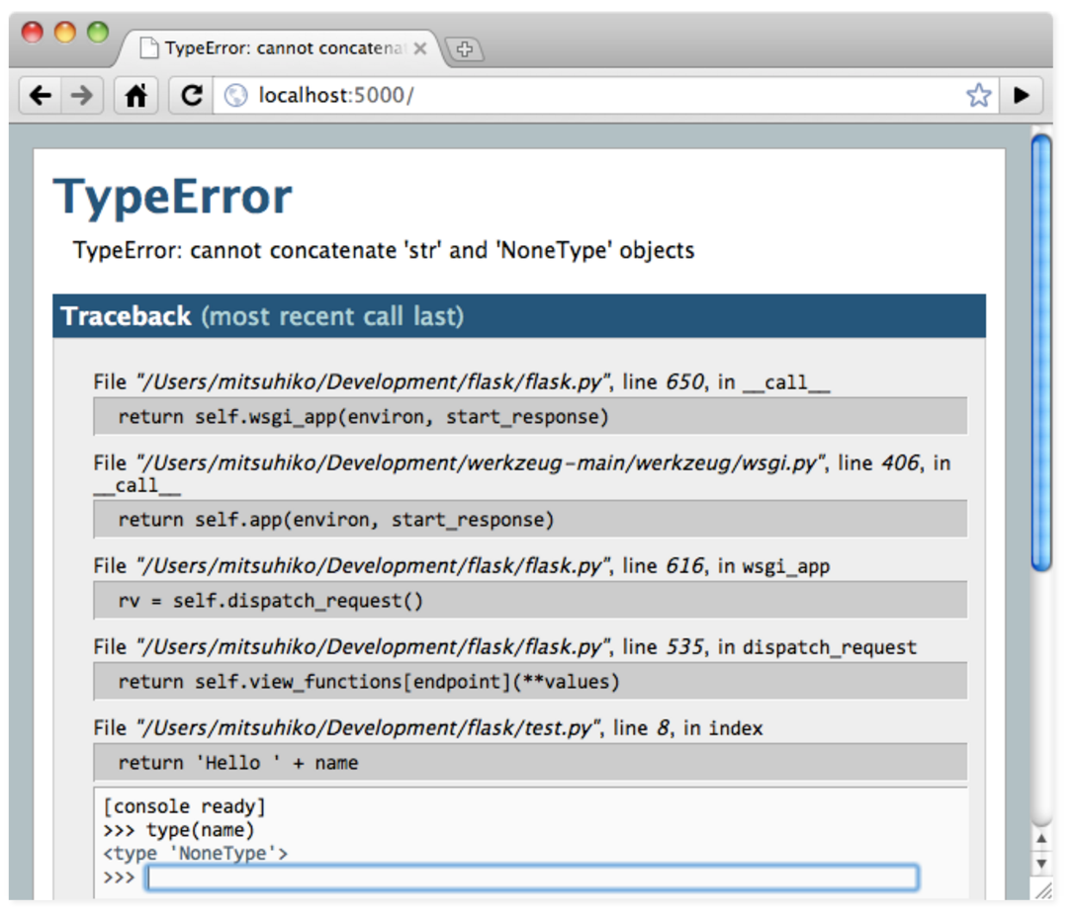
What is Flask
Jinja2 templates
Sessions
Static files serving
Debugger
app.run(debug=True)

Slide 10
What is Flask
Jinja2 templates
Sessions
Static files serving
Debugger
Many extensions
$ pip search flask | wc -l
1020

Slide 11
What is wrong with: routes
Preferred way – using decorator
# app/view.py
@app.route('/')
def index():
return “Hello world”
bp = Blueprint()
@bp.route('/')
def hello():
return “Hello world”

Slide 12
What is wrong with: routes
Preferred way – using decorator
# proj/view.py
from proj import app
@app.route('/')
def index():
return “Hello world”
Must have application instance ->
# proj/__init__.py
from flask import Flask
app = Flask('proj')
We begin with already runnable app.
But, wait!
* Did we have time to configure it?
* Did we have time to configure something else (DB, etc)?

Slide 13
What is wrong with: routes
Preferred way – using decorator?
# proj/view.py
from proj import app
if app.debug:
@app.route('/docs/')
def show_some_docs():
pass
How to control? ->

Slide 14
What is wrong with: composite apps
Say you need several apps not messing their code:
# proj/app/__init__.py
from flask import Flask
app = Flask('proj.app')
@app.route('/')
def index():
return render_template(
'index.html')
# proj/admin/__init__.py
from flask import Flask
app = Flask('proj.admin')
@app.route('/')
def index():
return render_template(
'admin_index.html')

Slide 15
What is wrong with: composite apps
How to reuse apps' URLs?
# proj/admin/__init__.py
from flask import Flask
from flask import url_for
app = Flask('proj.admin')
@app.route('/')
def index():
url_for('app.index') #???
return render_template(
'admin_index.html')
??? ->
* Blueprints can help, but application must be only one

Slide 16
What is wrong with: jinja
Abused!
from celery import Celery
from flask import render_template
celery_app = Celery()
@celery_app.task
def send_periodic_email():
to = get_address()
html_body = render_template('mails/annoy.html')
send_mail(to, html_body)
Web Worker == Celery Worker

Slide 17
What is wrong with: global vars
Magical request object
  thread-local proxy object
from celery import Celery
from flask import render_template, session
celery_app = Celery()
@celery_app.task
def send_periodic_email():
to = get_address()
user_name = session['user_name']
html_body = render_template(
'mails/annoy.html',
{user_name: user_name})
send_mail(to, html_body)
Need request instance ->

Slide 18
What is wrong with: global vars
Magical request object
from flask import Flask, request
from proj.db import session
from proj.redis import redis
# ... import other global instance
app = Flask()
@app.route('/')
def index():
uid = redis.get(request.cookies.get('cid'))
user_row = session.execute(“select * from ...”)
# ...

Slide 19
Alternatives
Enough using WSGI, start using asyncio/aiohttp

Slide 20
Alternatives
Can't cope asyncio? At least try using Flask less self-destructive:
  Get rid of app.route decorator
def index():
return “Hello world”
# ... more views
def setup_routes(app):
app.add_url_rule('/', 'index', index)
app.add_url_rule(...)
from flask import Flask
from . import views
def main():
app = Flask()
views.setup_routes(app)
# more configuration

Slide 21
Alternatives
Can't cope asyncio? At least try using Flask less self-destructive:
  Use any kind of dependencies instead of global (thread-local proxy) variables:
from flask import Flask, current_app
class MyApp:
def __init__(self, *args, redis, db_conn **kw):
super().__init__(*args, **kw)
self.redis = redis
self.db_conn = db_conn
def get_user_view():
redis = current_app.redis
....

Slide 22
Alternatives
Still want to use Flask — use Werkzeug!

Slide 23
The End
Questions?
What Flask is not — it is not “micro framework” it is a “Werkzeug wrapper”

