Slide 1
Ember
Where does a wildfire go next?
Forecasting fire-edge spread with a 5-qubit quantum reservoir
Qiskit Fall Fest Waterloo 2026
Notes:
Ember forecasts how far a wildfire edge moves in the next one and three days, in eight directions, using a small quantum reservoir. I will show the task, the circuit, an honest test on 2023 fires, and a run on real IBM hardware.

Slide 2
2023 was Canada's worst fire season
17.2 M ha
Where will the fire edge be in 24 h and in 72 h?
burned in Canada in 2023, a national record
Source: CIFFC, Canada Report 2023
Ember forecasts the edge advance in 8 directions, starting on day 3 of a fire.
~20,000
people ordered out of Yellowknife on 16 Aug 2023
Source: CBS News, 16 Aug 2023
Notes:
2023 burned 17.2 million hectares, more than double the previous record. In August, the whole city of Yellowknife, about 20,000 people, was told to leave as fire ZF015 approached. Decisions like that need to know where the edge goes next, so that is our target.

Slide 3
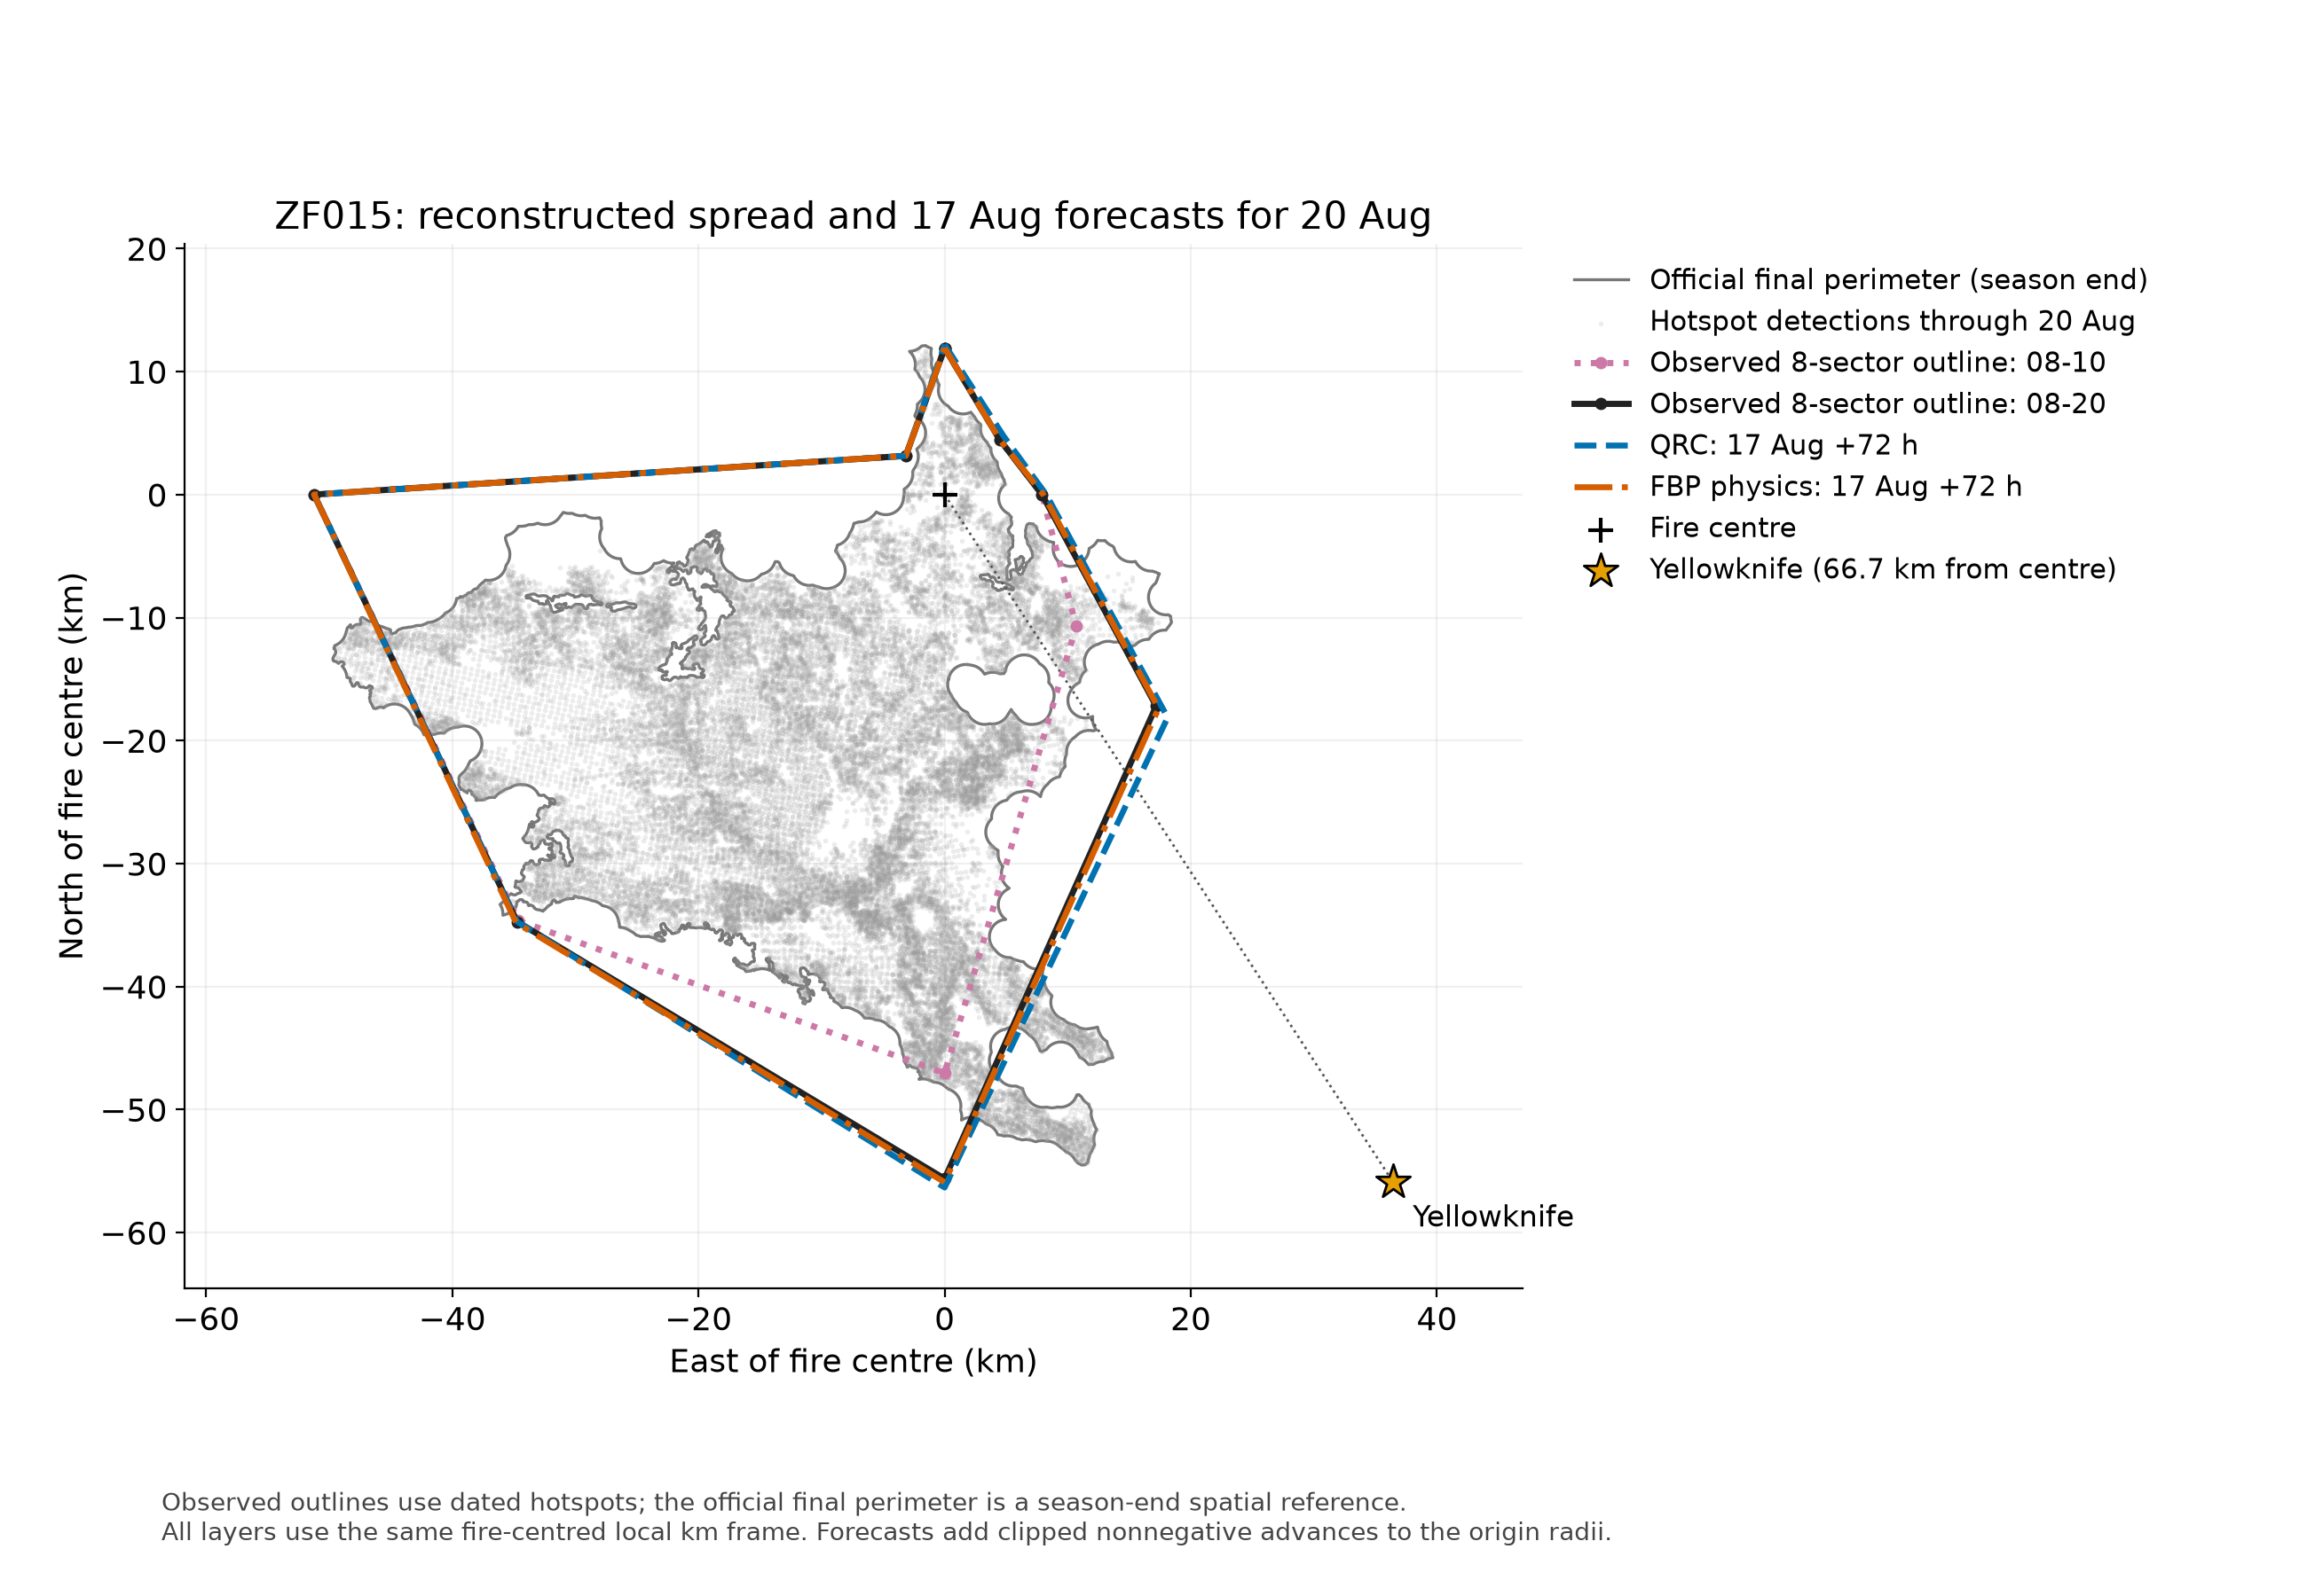
We rebuild each fire's daily outline from satellites
1
Hotspots to fires
CWFIS satellite detections, grouped by each fire's final perimeter
2
Daily outline in 8 sectors
Edge distance from the day-1 centre; growth through 2 km chains, at most 30 km a day
3
Forecast
Edge advance in each sector at +24 h and +72 h, from day 3
Train 2018–21: 378 fires
Choose settings 2022: 102 · Test 2023: 392, scored once
Yellowknife fire ZF015: rebuilt outlines and 17 Aug forecasts for 20 Aug
Notes:
There are no daily fire outlines in the public data, only one final perimeter per fire. So we rebuild them from dated satellite hotspots: measure the edge distance in eight compass sectors every day. The task is to forecast how far each sector moves in one day and in three days. We train on 2018 to 2021, choose settings on 2022, and score 2023 once.

Slide 4
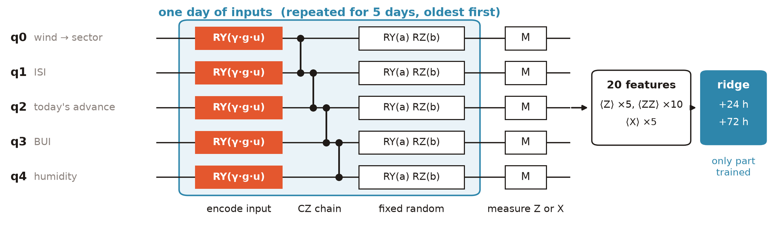
5 qubits turn 5 days of inputs into 20 features
One qubit per input
Fixed circuit
Chosen on 2022 only
Wind toward the sector, ISI, today's advance, BUI, humidity
20 CZ gates. Nothing quantum is trained; only the ridge read-out
5 days, γ = π/4, ridge λ = 10⁻⁶, locked before testing
Builds on the PronoiaQ reservoir (Quantathon 2026)
Notes:
Each qubit carries one input. Every day we rotate each qubit by its input, entangle the chain with CZ gates, then apply fixed random rotations. Five days in a row, then we measure 20 expectation values. Only the linear ridge read-out is trained. Settings were chosen on 2022 and locked before we looked at 2023.

Slide 5
Test 2023: quantum ties classical models
About level with classical
Quantum 0.360 / 0.943 km; ESN 0.350 / 0.934; random circuit 0.361 / 0.946
Physics wins on mean error
FBP 0.262 / 0.694 km. It uses a fuel-based spread rate our inputs lack
No model wins everything
Persistence has the best outline overlap. On growing sectors, learned models beat FBP
392 test fires, scored once. Values at +24 h / +72 h. No quantum advantage is claimed.
Notes:
This is the honest result. The quantum reservoir is level with a classical echo state network and with a random circuit, and slightly behind ridge on the raw inputs. It beats persistence only at three days. FBP, the Canadian physics model, has the lowest mean error because it uses fuel type. No model wins everything: persistence draws the best outline because most sectors do not move, while on growing sectors the learned models beat FBP.

Slide 6
On ibm_fez, the forecasts survive the noise
238 s
QPU time for all 88 circuits
10,000
shots per circuit
20 CZ
per circuit, no SWAP gates
88 correlated sector windows from one fire; descriptive only. The same frozen read-out is applied to every source.
Notes:
We ran the Yellowknife case on ibm_fez: 88 circuits, 10,000 shots each, 238 seconds of QPU time. The read-out was trained on exact simulation and applied unchanged to hardware features. Hardware error is within about 0.02 km of exact simulation. Hardware being slightly lower is not a real gain: one fire, correlated windows.

Slide 7
Takeaways
What we showed
Limits
Next
Daily fire outlines rebuilt from satellite hotspots
An honest test: the quantum reservoir ties classical reservoirs
Forecasts hold up on real IBM hardware
Only one fire run on hardware
Inputs lack fuel type, which FBP uses
The 30 km/day cap can let merged fires creep
Give the reservoir fuel type and spread rate
Run more fires on hardware, with intervals
Rank nearby towns by forecast closest approach
Quantum features match classical ones on real fire data, and they survive real hardware.
Notes:
To sum up: we rebuilt daily fire outlines from satellites, tested a quantum reservoir honestly, and found it ties classical models, with no advantage claimed. It does survive real hardware noise. The clearest next step is to give it the fuel information that makes FBP strong. Thank you.

