Slide 1

Emerging Trends
Chris Papadopoulos

Slide 2



OUTLINE
Executive Summary
Introduction
Methodology
Results
Visualization – Charts
Dashboard
Discussion
Findings & Implications
Conclusion
Appendix

Slide 3

EXECUTIVE SUMMARY
Web based languages/technologies are most used
Easy to use languages are more desired than complicated ones

Slide 4

INTRODUCTION
Stack overflow
Developers paradise
Problem
Languages are changing often
Questions
What are the world demands?
Be on the lookout for…
What do the developers want

Slide 5

METHODOLOGY
Data collection / wrangling
Modified GitHub Jobs API
Programming language salaries from Web Scraping²
Modified Stack Overflow Survey Results
Data analysis / visualization
Exploring through visualization
Creating dashboards

Slide 6
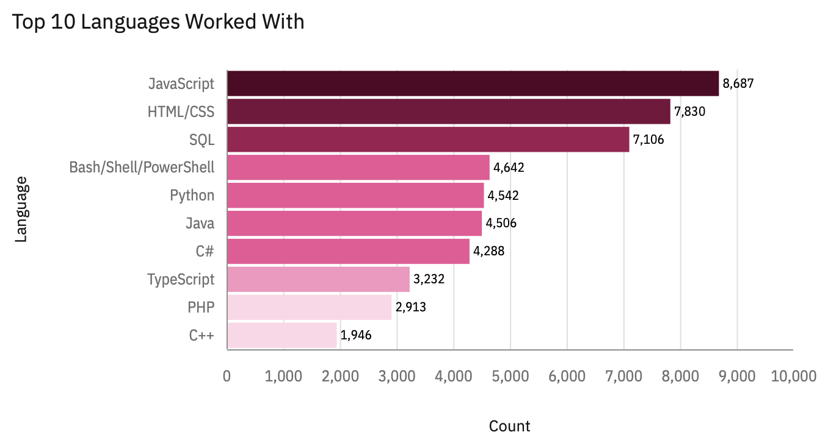
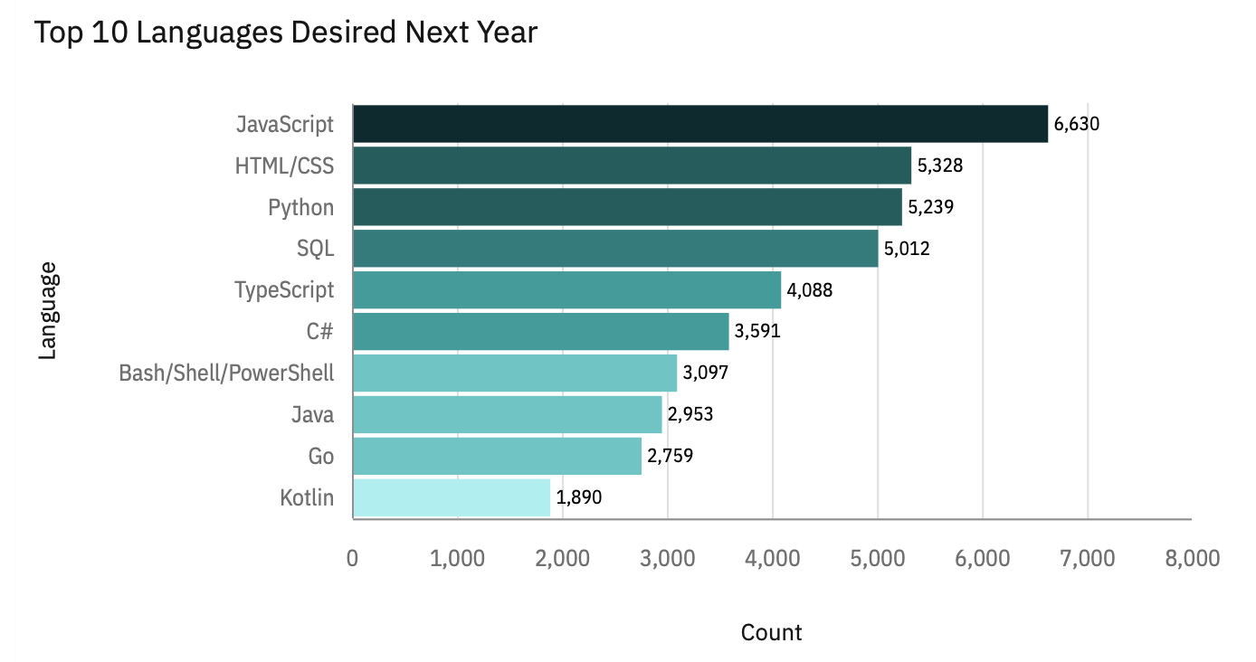
PROGRAMMING LANGUAGE TRENDS
Current Year
Next Year

Slide 7
PROGRAMMING LANGUAGE TRENDS - FINDINGS & IMPLICATIONS
Findings
JavaScript is the most used and most desired language and Python demand is increasing fast
Lost interest in Bash and Shell scripting
Implications
Since the web is such a prominent aspect of the tech world it makes sense that web languages are at the top
JavaScript is being continually upgraded and made more easy to use, a large complaint is the lack of typing
Go & Kotlin are languages that are also contain Typing and have simple syntaxes

Slide 8
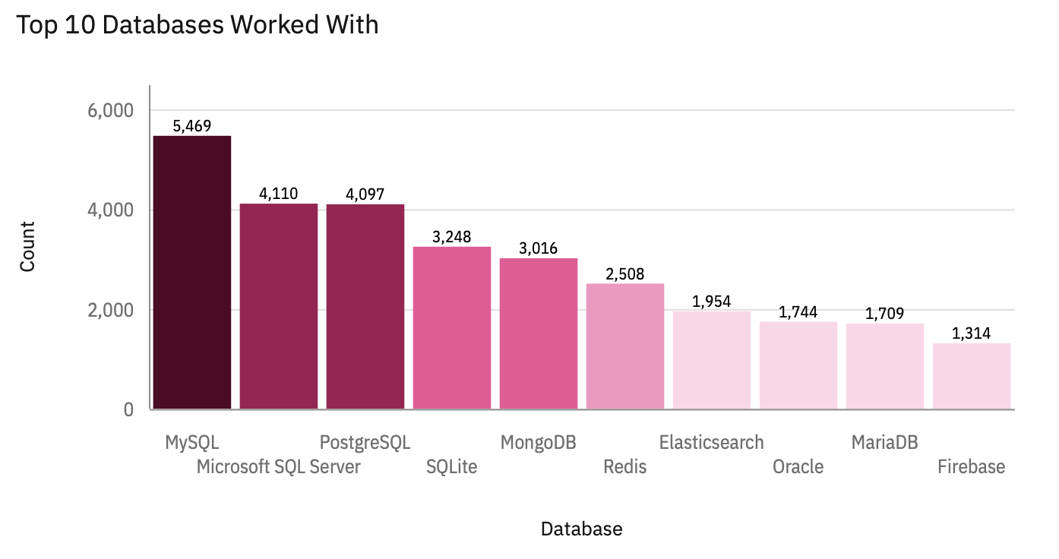
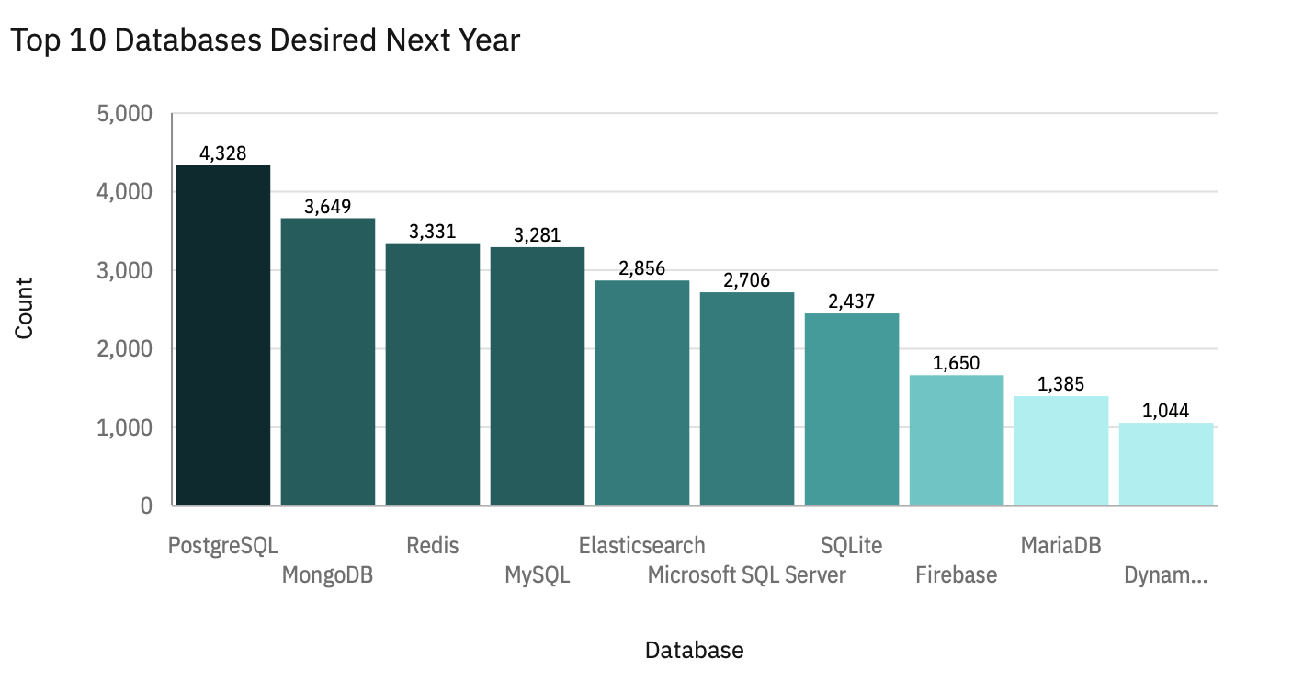
DATABASE TRENDS
Current Year
Next Year

Slide 9
DATABASE TRENDS - FINDINGS & IMPLICATIONS
Findings
Oracle is not in the top 10 most desired
Relational Databases are still popular
Developers losing interest in Microsoft SQL Server
Implications
As data becomes more prevalent and valuable storing it becomes more important, thus explaining the increase in data stores
PaaS tools are gaining in popularity

Slide 10

DASHBOARD
Can be found in GutHub Repo

Slide 11
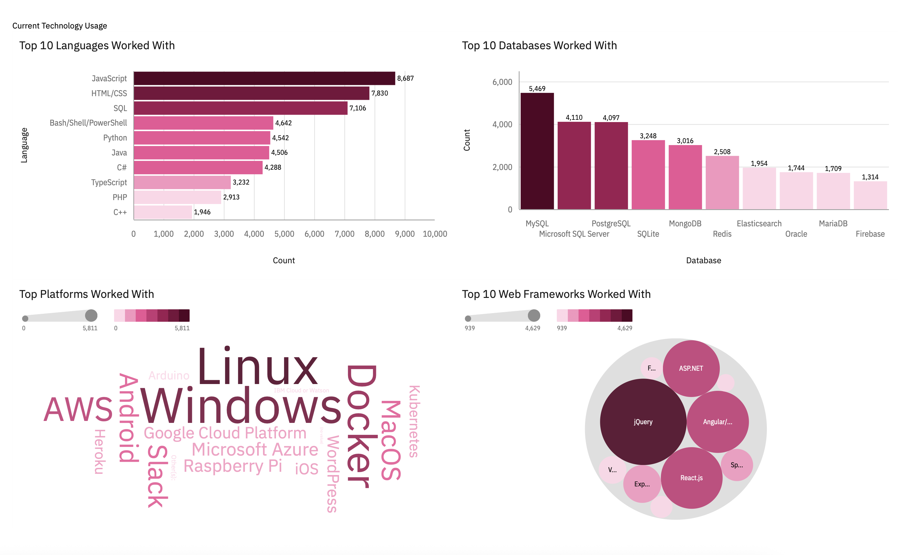
DASHBOARD TAB 1

Slide 12
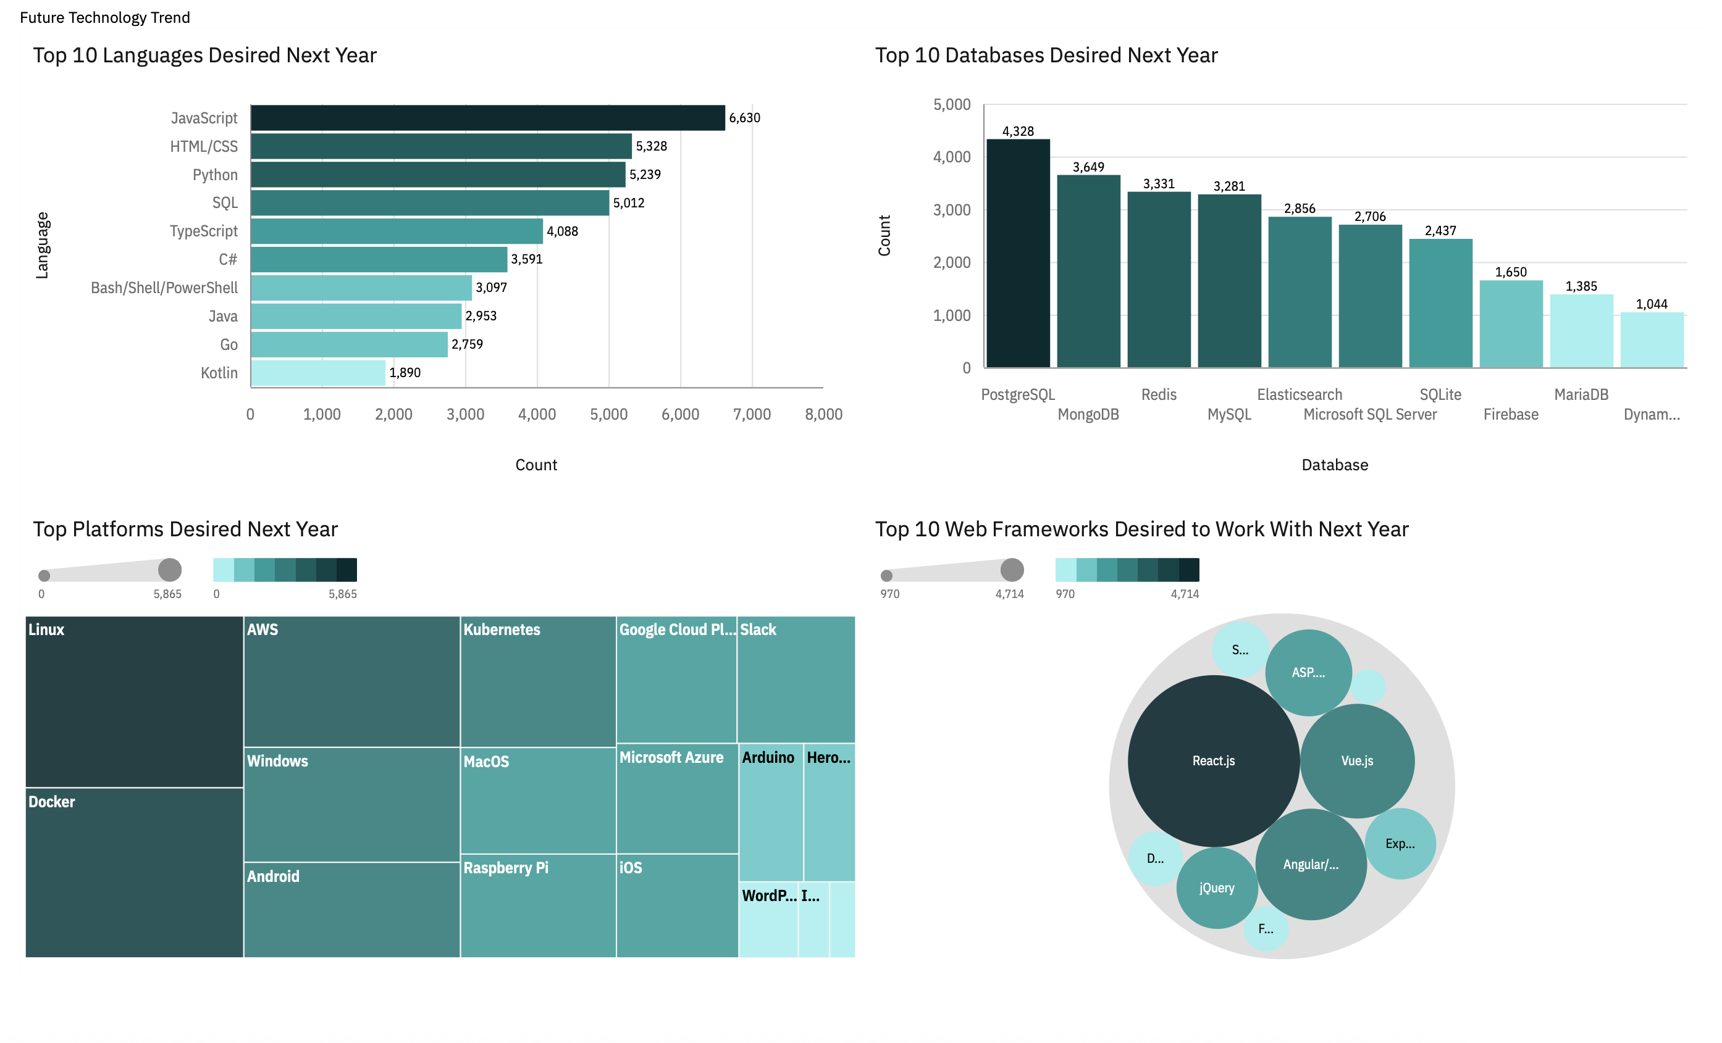
DASHBOARD TAB 2

Slide 13
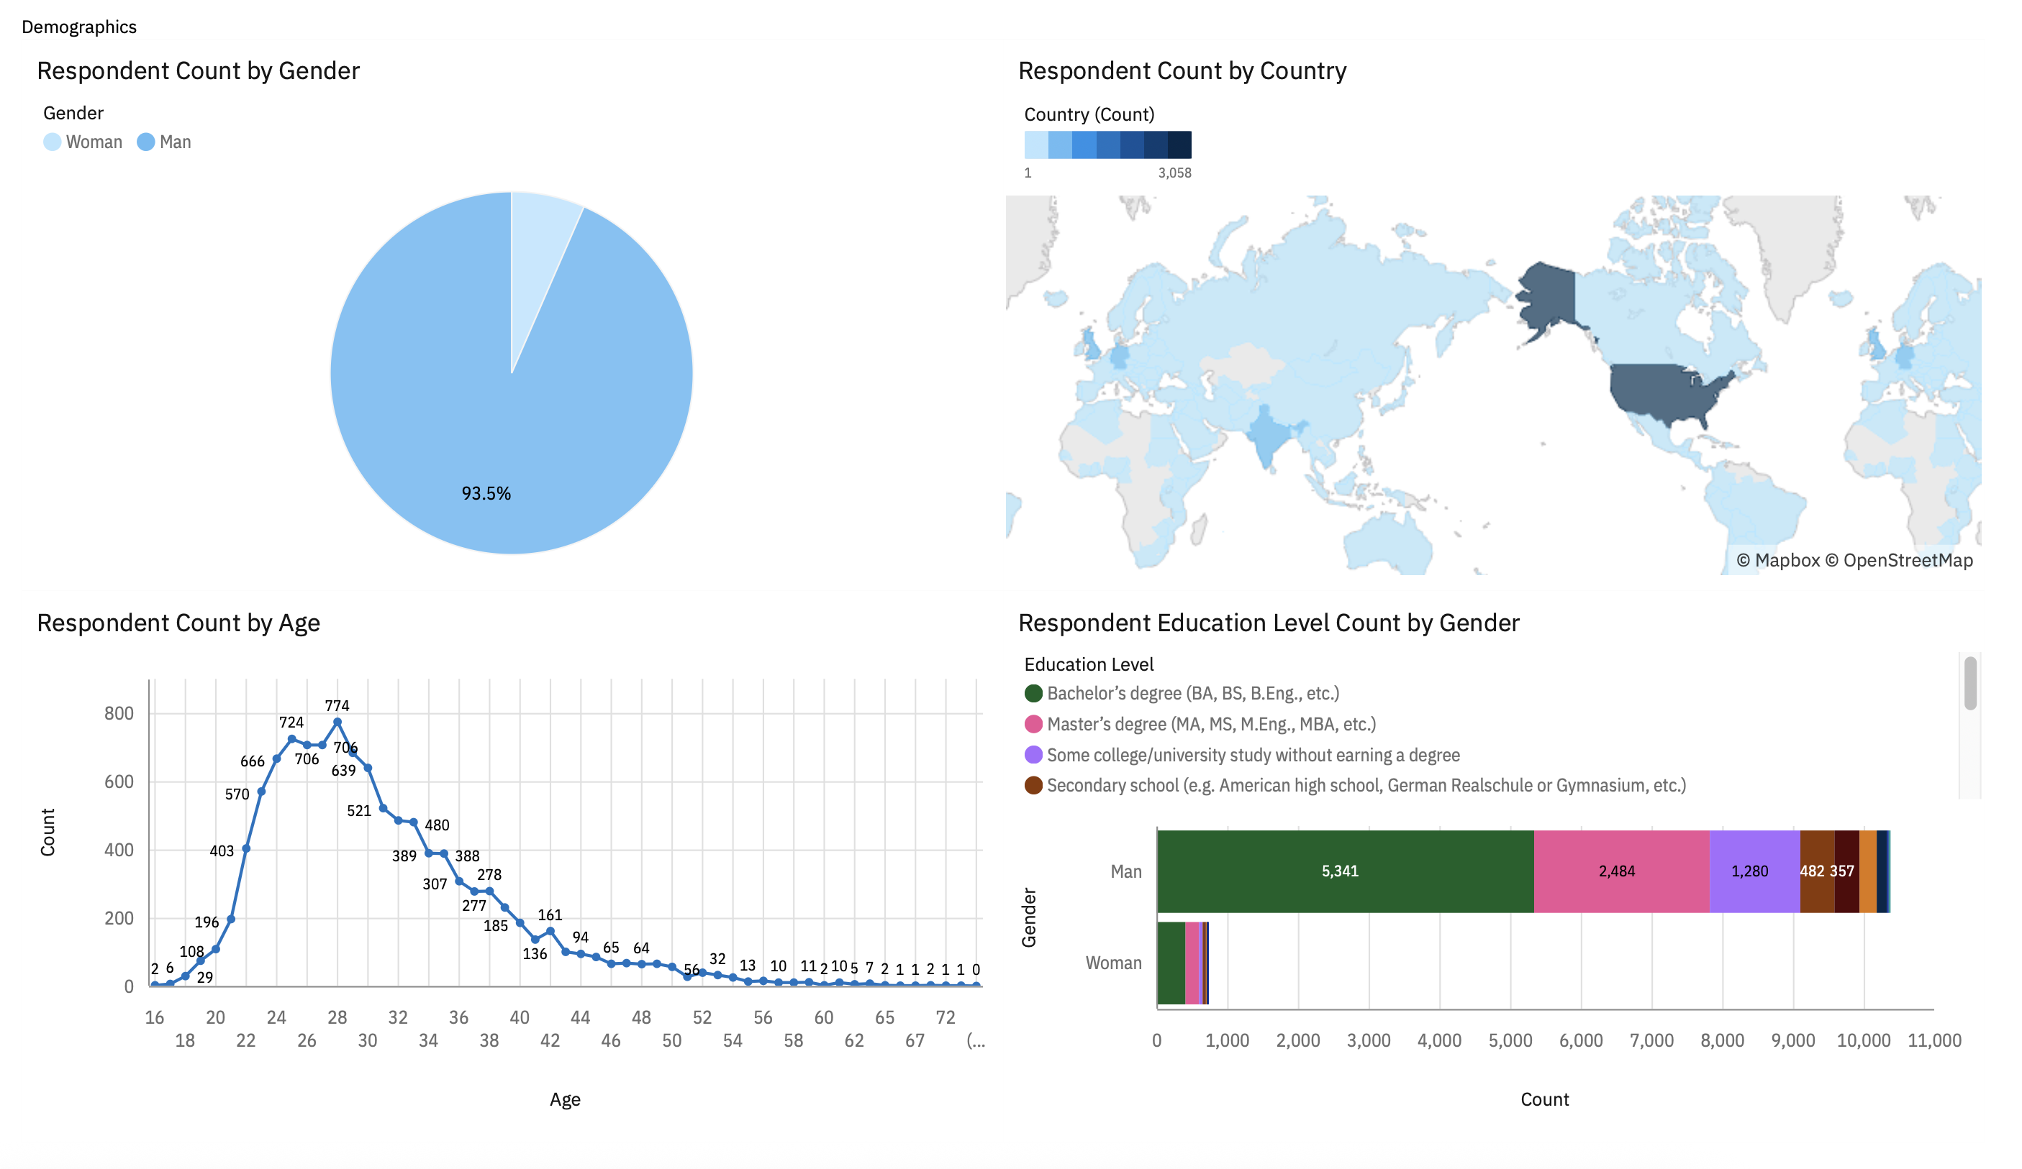
DASHBOARD TAB 3

Slide 14
DISCUSSION

Slide 15
OVERALL FINDINGS & IMPLICATIONS
Findings
JavaScript widely used and TypeScript getting popular.
Over 90% young male developers.
Developers mostly located in developed countries.
Implications
JavaScript and TypeScript web frames gaining followers.
Global polarization of developers location and gender.
Young developers without postgrad studies on its majority.

Slide 16

CONCLUSION
Developers look for the following key points for choice of language and technology:
Syntactically simple languages
Tools with less overhead
Tools that are less error prone

Slide 17
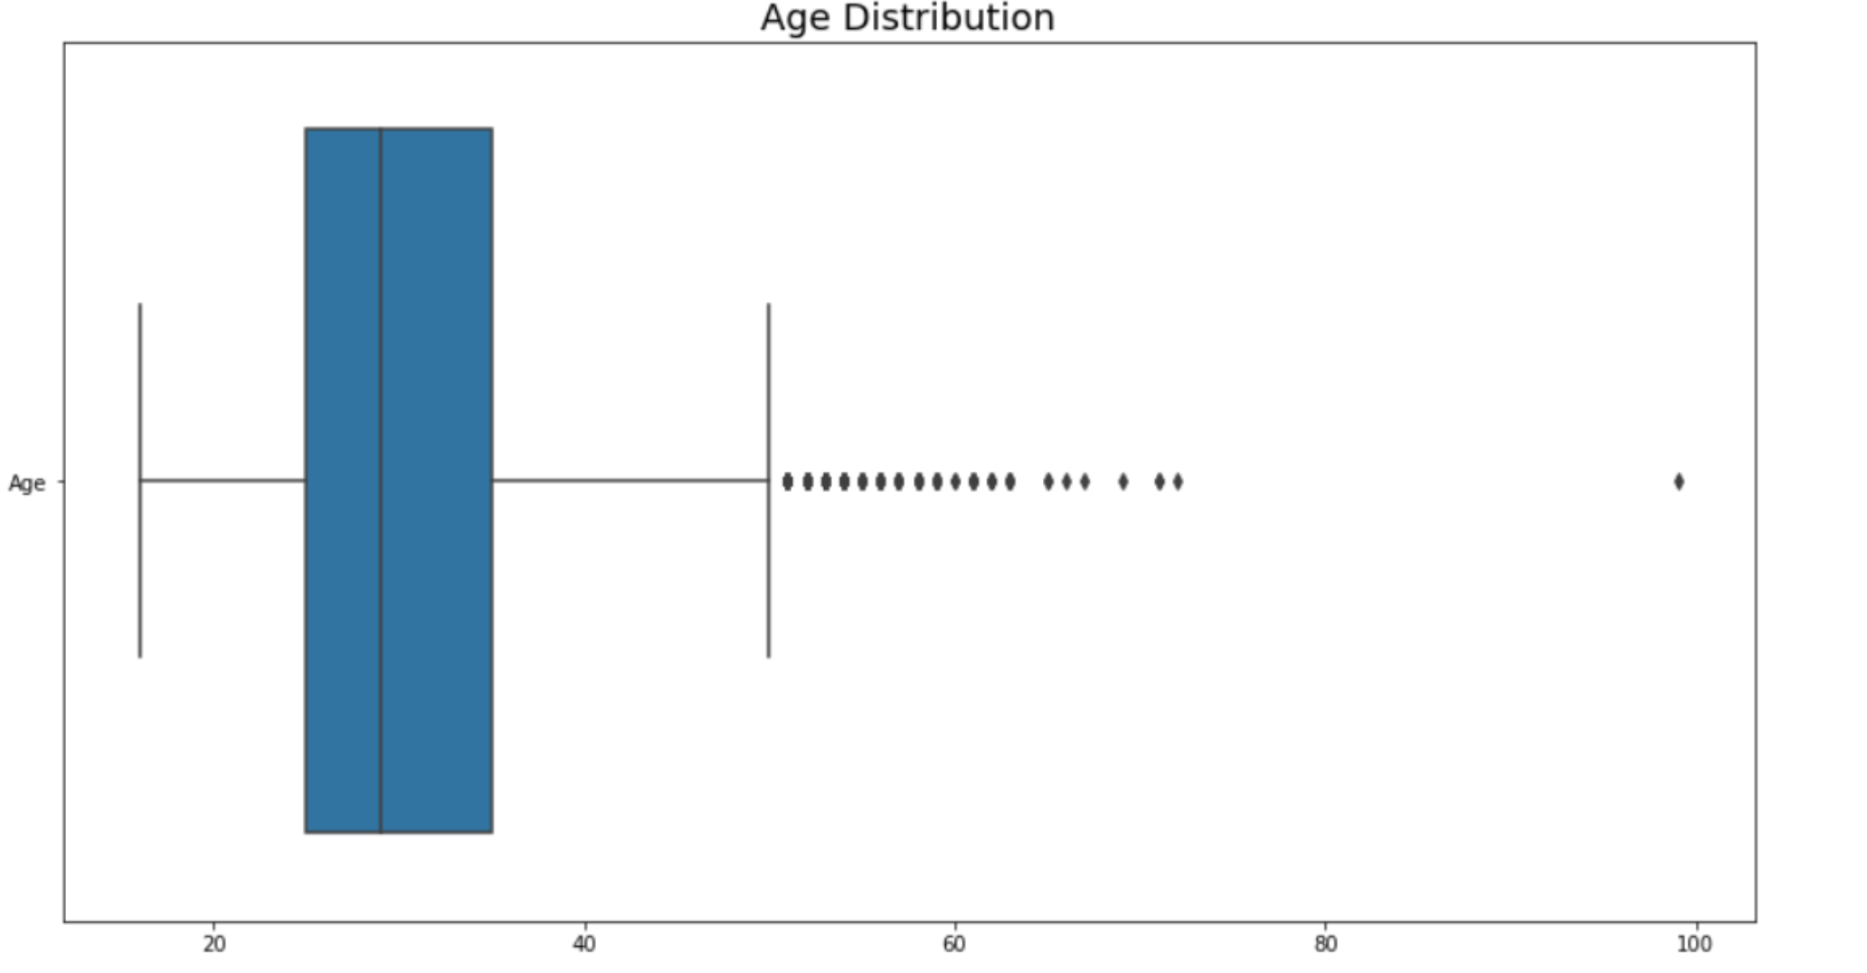

APPENDIX

Slide 18
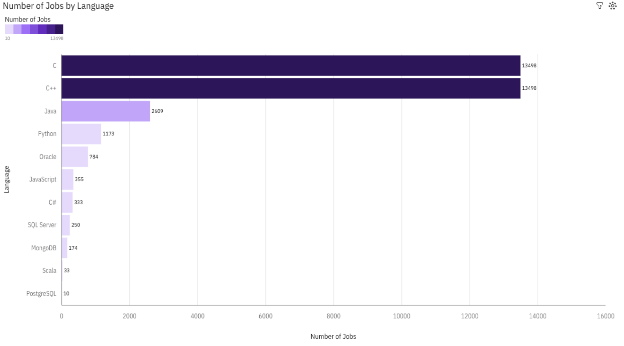
JOB POSTINGS

Slide 19
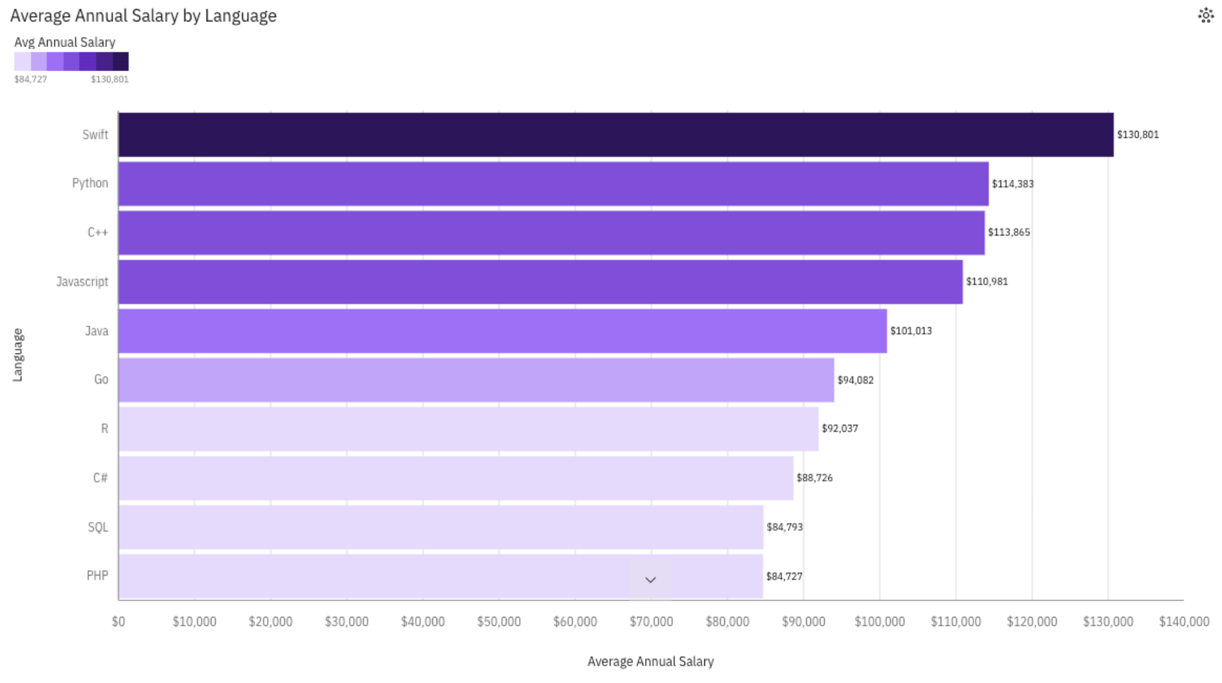
POPULAR LANGUAGES

