Slide 1







Variant annotation workflow
Variant filtering
and prioritization workflow
Review and reporting
Pipeline inputs
Static Annotation Resources
Dynamic Annotation Resources
Potential Diagnoses
Result Return
ClinVar (via ClinvArbitration)
PanelApp Australia
Variant data
SNV/indel calls
SV calls
CNV calls
Family and phenotype
Pedigree with affected status
Phenotype data (optional)
Variant Logic Modules
Phenotype and Family Logic
Gene-to-phenotype associations
gnomAD population allele frequencies
In silico missense variant effect prediction
ClinVar P/LP
De novo
PM5
Monthly iterative cycles
Manual review
Clinician notified
Assessment and reporting by clinical laboratory
Filtering by pedigree data and affected status
Filtering by
HPO terms
High Impact
SV LOF
In silico
Variant annotation workflow
Variant filtering
and prioritization workflow
Review and reporting
Pipeline inputs
Static Annotation Resources
Dynamic Annotation Resources
Potential Diagnoses
Result Return
ClinVar (via ClinvArbitration)
PanelApp Australia
Variant data
SNV/indel calls
SV calls
CNV calls
Family and phenotype
Pedigree with affected status
Phenotype data (optional)
Variant Logic Modules
Phenotype and Family Logic
Gene-to-phenotype associations
gnomAD population allele frequencies
In silico missense variant effect prediction
De novo
ClinVar P/LP or PM5
Monthly iterative cycles
Manual review
Clinician notified
Assessment and reporting by clinical laboratory
Filtering by pedigree data and affected status
Filtering by
HPO terms
SV LOF or High Impact
In silico

Slide 2
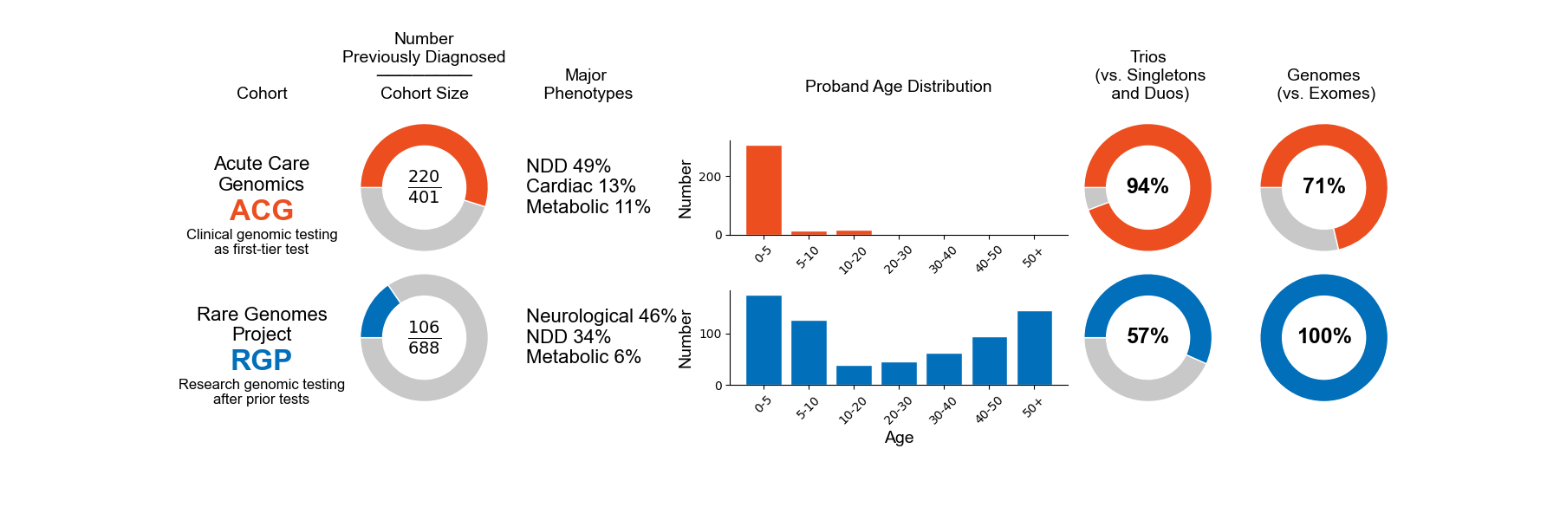
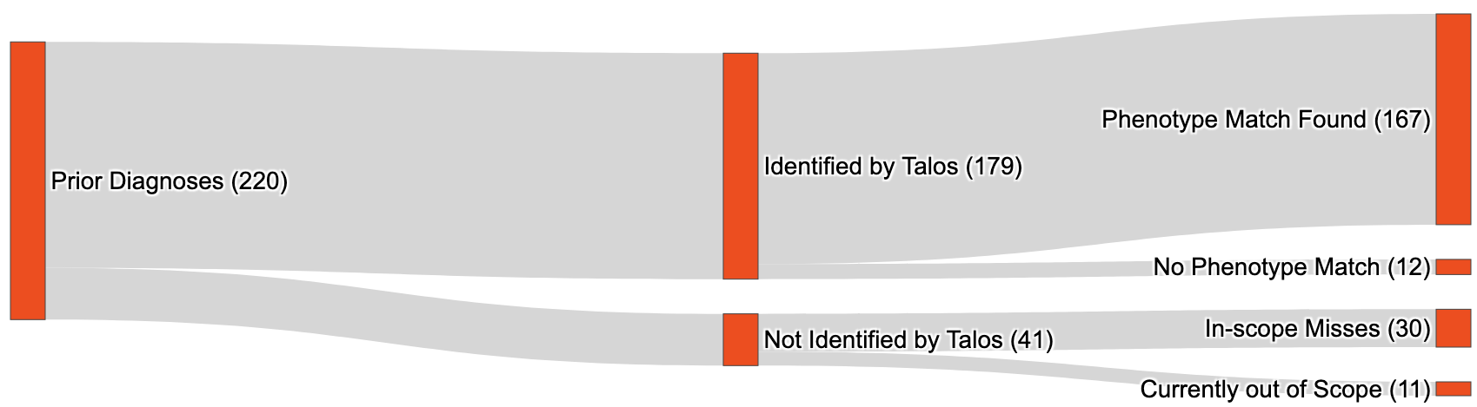
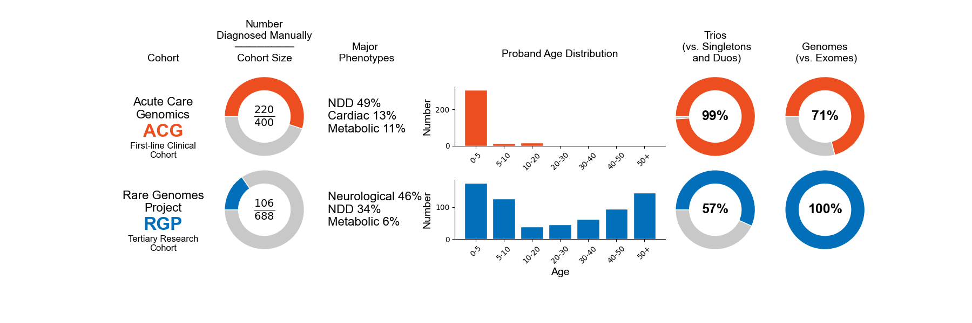
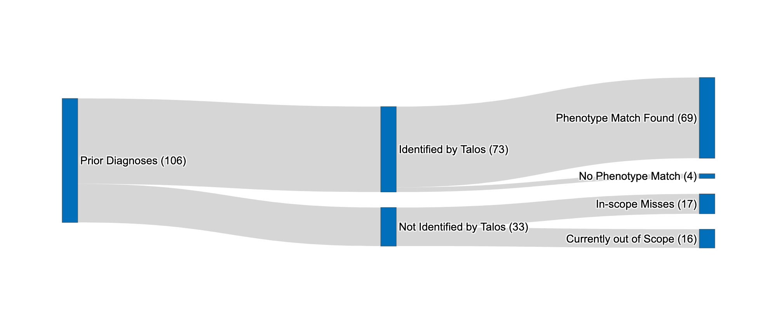
A
B

Slide 3
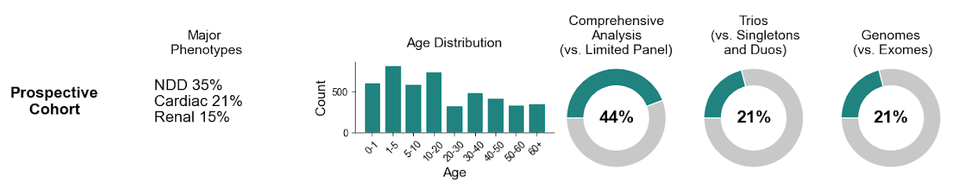
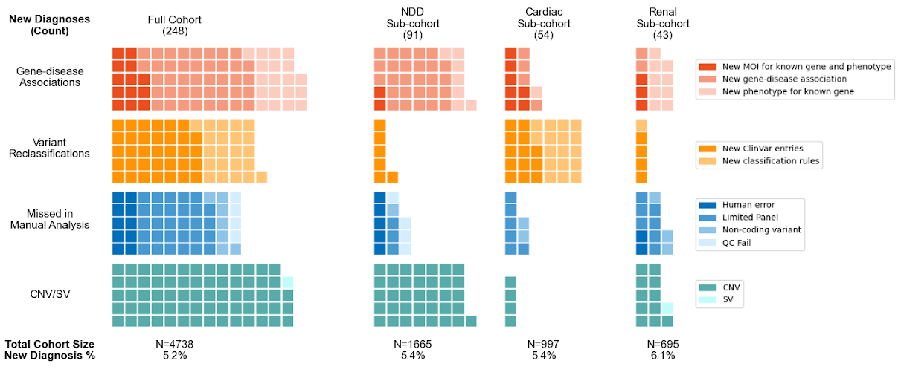
A
B

Slide 4
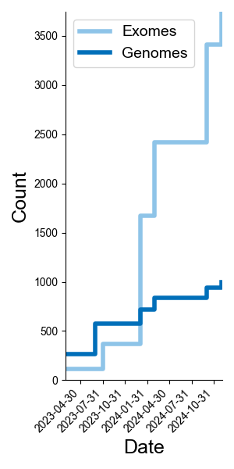
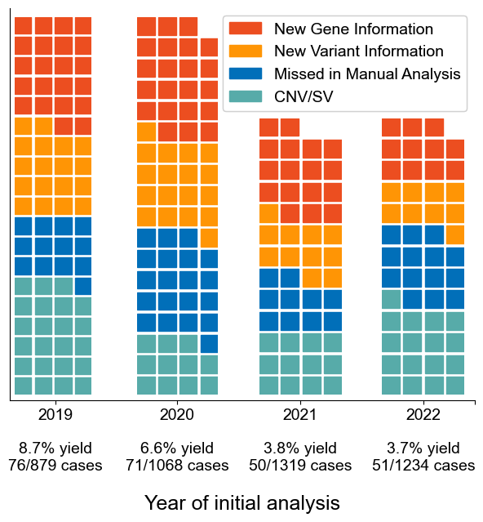
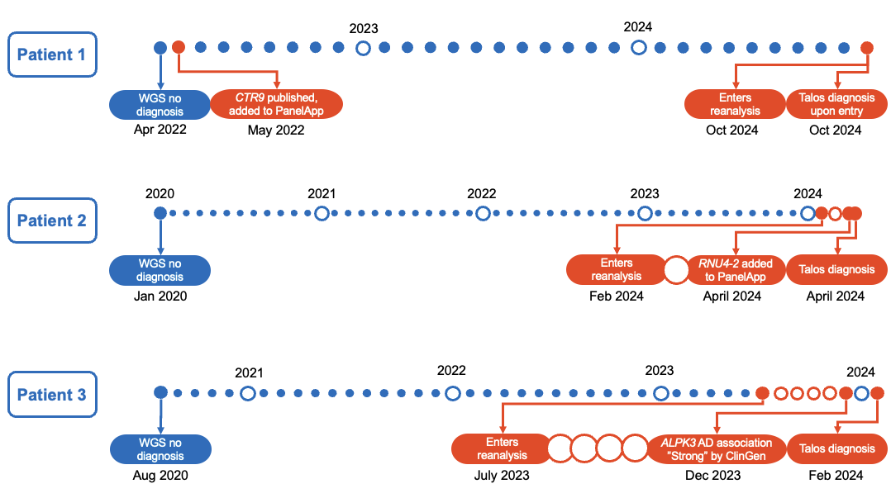
A
B
C

Slide 5
Variant annotation workflow
Variant filtering
and prioritization workflow
Review and reporting
Pipeline inputs
Annotation Resources
Variant Logic Modules
Phenotype and Family Logic
Potential Diagnoses
Result Return
Variant data
SNV/indel calls
SV calls
CNV calls
Family and phenotype
Pedigree with affected status
Phenotype data (optional)
ClinVar (via ClinvArbitration)
PanelApp Australia
Gene-to-phenotype associations
gnomAD population allele frequencies
In silico missense variant effect prediction
Frequently updating resource
ClinVar P/LP
High Impact
Filtering by pedigree data and affected status
De novo
PM5
Monthly iterative cycles
Manual review
Clinician notified
Assessment and reporting by clinical laboratory
SV LOF
In silico
Filtering by
HPO terms
Variant annotation workflow
Variant filtering
and prioritization workflow
Review and reporting
Pipeline inputs
Static Annotation Resources
Dynamic Annotation Resources
Potential Diagnoses
Result Return
ClinVar (via ClinvArbitration)
PanelApp Australia
Variant data
SNV/indel calls
SV calls
CNV calls
Family and phenotype
Pedigree with affected status
Phenotype data (optional)
Variant Logic Modules
Phenotype and Family Logic
Gene-to-phenotype associations
gnomAD population allele frequencies
In silico missense variant effect prediction
ClinVar P/LP
De novo
PM5
Monthly iterative cycles
Manual review
Clinician notified
Assessment and reporting by clinical laboratory
Filtering by pedigree data and affected status
Filtering by
HPO terms
High Impact
SV LOF
In silico

