Slide 1
Principles of Robot Autonomy I
Camera models and camera calibration

Slide 2

Attendance Form

Slide 3
Agenda
Agenda
Perspective projections
Camera calibration
Basic concepts in 3D reconstruction
Readings:
Chapter 7, sections 7.1 – 7.4 in D. Gammelli, J. Lorenzetti, K. Luo, G. Zardini, M. Pavone. Principles of Robot Autonomy. 2026.

Slide 4
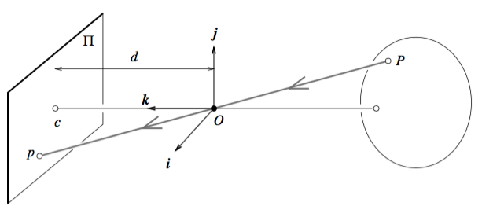


Perspective projection
Goal: find how world points map in the camera image
Assumption: pinhole camera model (all results also hold under thin lens model, assuming camera is focused at $∞$)
P in camera frame
Roadmap:
Map $P_{c}$ into p (image plane)
Map p into (u,v) (pixel coordinates)
Transform $P_{w}$ into $P_{c}$
Camera frame
P in world frame
Image plane
World frame

Slide 5

Step 1
Task: Map $P_{c}=(X_{C},Y_{C},Z_{C})$ into $p=(x,y)$ (image plane)
From before

Slide 6
Step 2.a
Actual origin of the camera coordinate system is usually at a corner (e.g., top left, bottom left)

Slide 7
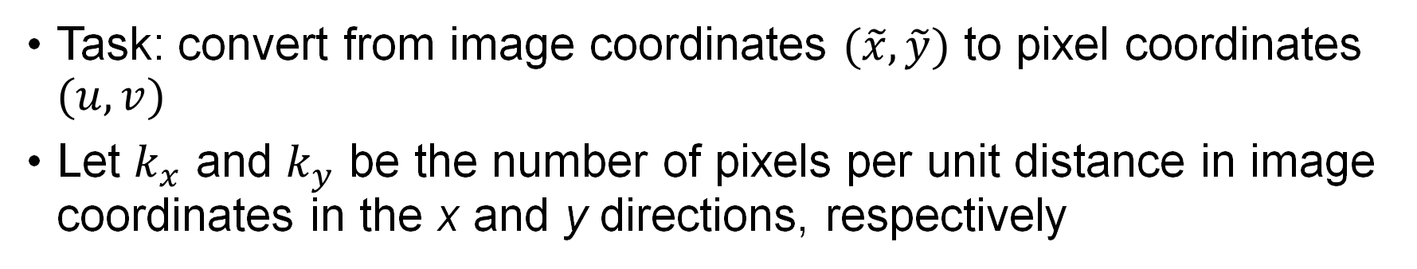
Step 2.b
Task: convert from image coordinates $(\tilde{x},\tilde{y})$ to pixel coordinates $(u,v)$
Let $k_{x}$ and $k_{y}$ be the number of pixels per unit distance in image coordinates in the x and y directions, respectively
Nonlinear transformation

Slide 8
Homogeneous coordinates
Goal: represent the transformation as a linear mapping
Key idea: introduce homogeneous coordinates
Inhomogenous -> homogeneous
Homogenous -> inhomogeneous

Slide 9
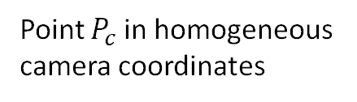
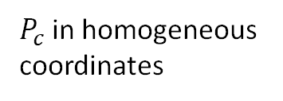
Perspective projection in homogeneous coordinates
Projection can be equivalently written in homogeneous coordinates
In homogeneous coordinates, the mapping is linear:
Camera matrix/
Matrix of intrinsic parameters
$P_{c}$ in homogeneous coordinates
Homogeneous pixel coordinates
Point p in homogeneous pixel coordinates
Point $P_{c}$ in homogeneous camera coordinates

Slide 10
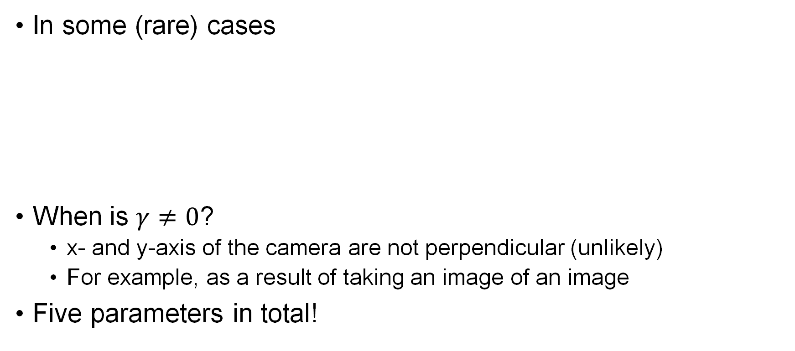
Skewness
In some (rare) cases
When is $γ≠0$?
x- and y-axis of the camera are not perpendicular (unlikely)
For example, as a result of taking an image of an image
Five parameters in total!
Skew parameter

Slide 11
Step 3
So far, we have derived a mapping between a point P in the 3D camera reference frame to a point p in the 2D image plane
Last step is to include in our mapping an additional transformation to account for the difference between the world frame and the 3D camera reference frame

Slide 12
Rigid transformations
where R is the rotation matrix relating camera and world frames

Slide 13
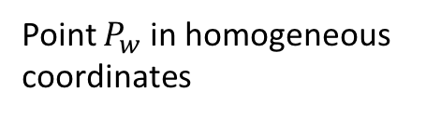
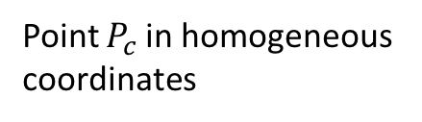
Rigid transformations in homogeneous coordinates
Point $P_{c}$ in homogeneous coordinates
Point $P_{w}$ in homogeneous coordinates

Slide 14
Perspective projection equation
Collecting all results
Hence
Degrees of freedom: 4 for K (or 5 if we also include skewness), 3 for R, and 3 for t. Total is 10 (or 11 if we include skewness)
Projection matrix M
Intrinsic parameters
Extrinsic parameters

Slide 15
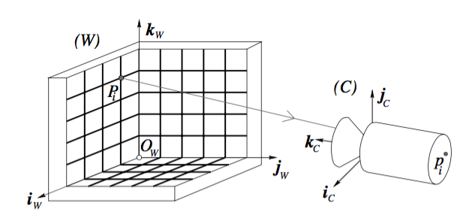

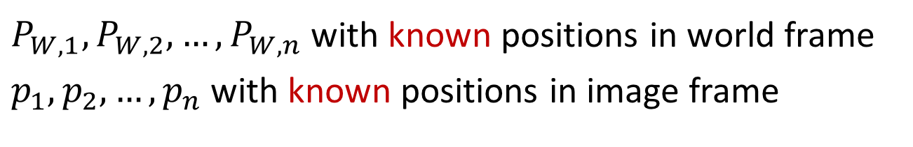
Camera calibration: direct linear transformation method
Goal: find the intrinsic and extrinsic parameters of the camera
Strategy: given known correspondences $p_{i} ↔P_{W,i}$, compute unknown parameters K, R, t by applying perspective projection
Credit: FP Chapter 1
$P_{W,1},P_{W,2},…,P_{W,n}$ with known positions in world frame
$p_{1},p_{2},…,p_{n}$ with known positions in image frame

Slide 16


Step 1
$1×4$ vector
First consider combined parameters
This gives rise to $2n$ component-wise equations, for $i=1,…, n$

Slide 17

Calibration problem
Stacking all equations together
$\tilde{P}$ contains in block form the known coefficients stemming from the given correspondences
To estimate 11 coefficients, we need at least 6 correspondences
2n x 12 matrix of known coefficients
12 x 1 vector of unknown coefficients
12 x 1

Slide 18
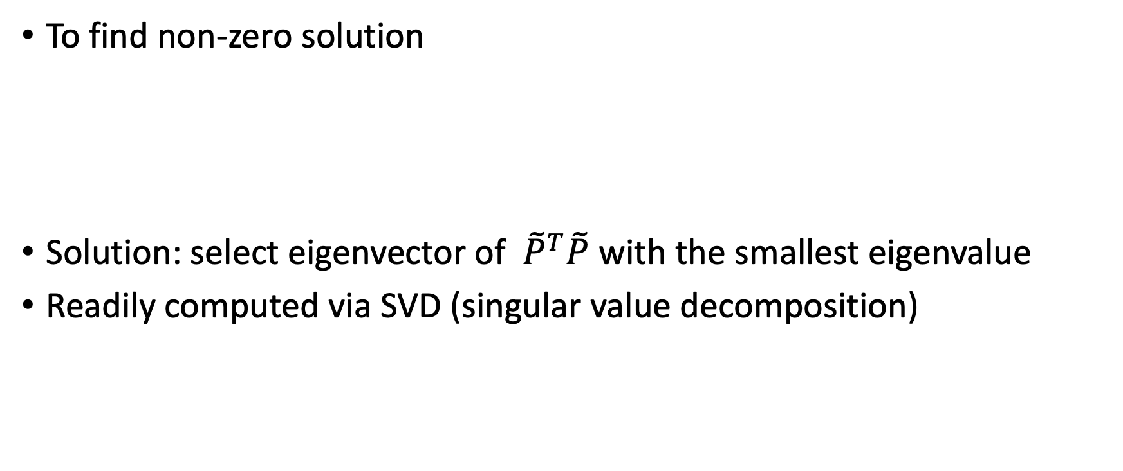
Solution
To find non-zero solution
Solution: select eigenvector of ${ \tilde{P}}^{T}\tilde{P}$ with the smallest eigenvalue
Readily computed via SVD (singular value decomposition)

Slide 19
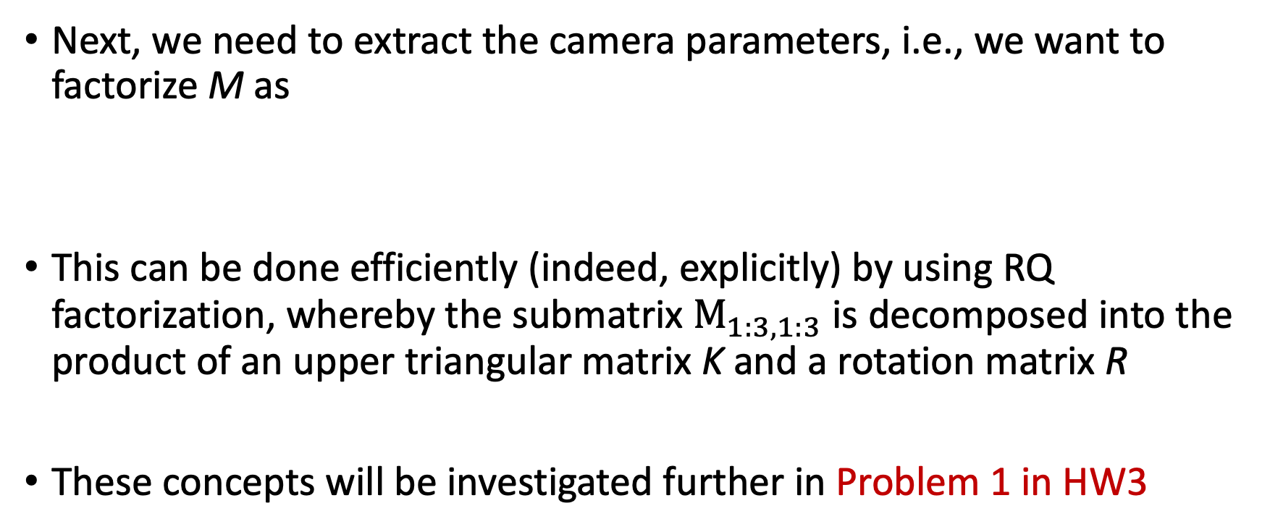
Step 2
Next, we need to extract the camera parameters, i.e., we want to factorize M as
This can be done efficiently (indeed, explicitly) by using RQ factorization, whereby the submatrix $M_{1:3,1:3}$ is decomposed into the product of an upper triangular matrix K and a rotation matrix R
These concepts will be investigated further in Problem 1 in HW3

Slide 20
Measuring depth
Line of sight
Homogeneous coordinates
Once the camera is calibrated, can we measure the location of a point P in 3D given its known observation p?
No: one can only say that P is located somewhere along the line joining p and O!

Slide 21
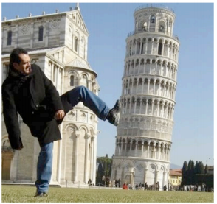
Issues with recovering structure

Slide 22
Recovering structure
Structure: 3D scene to be reconstructed by having access to 2D images
Common methods
Through recognition of landmarks (e.g., orthogonal walls)
Depth from focus: determines distance to one point by taking multiple images with better and better focus
Stereo vision: processes two distinct images taken at the same time and assumes that the relative pose between the two cameras is known
Structure from motion: processes two images taken with the same or different cameras at different times and from different unknown positions

Slide 23
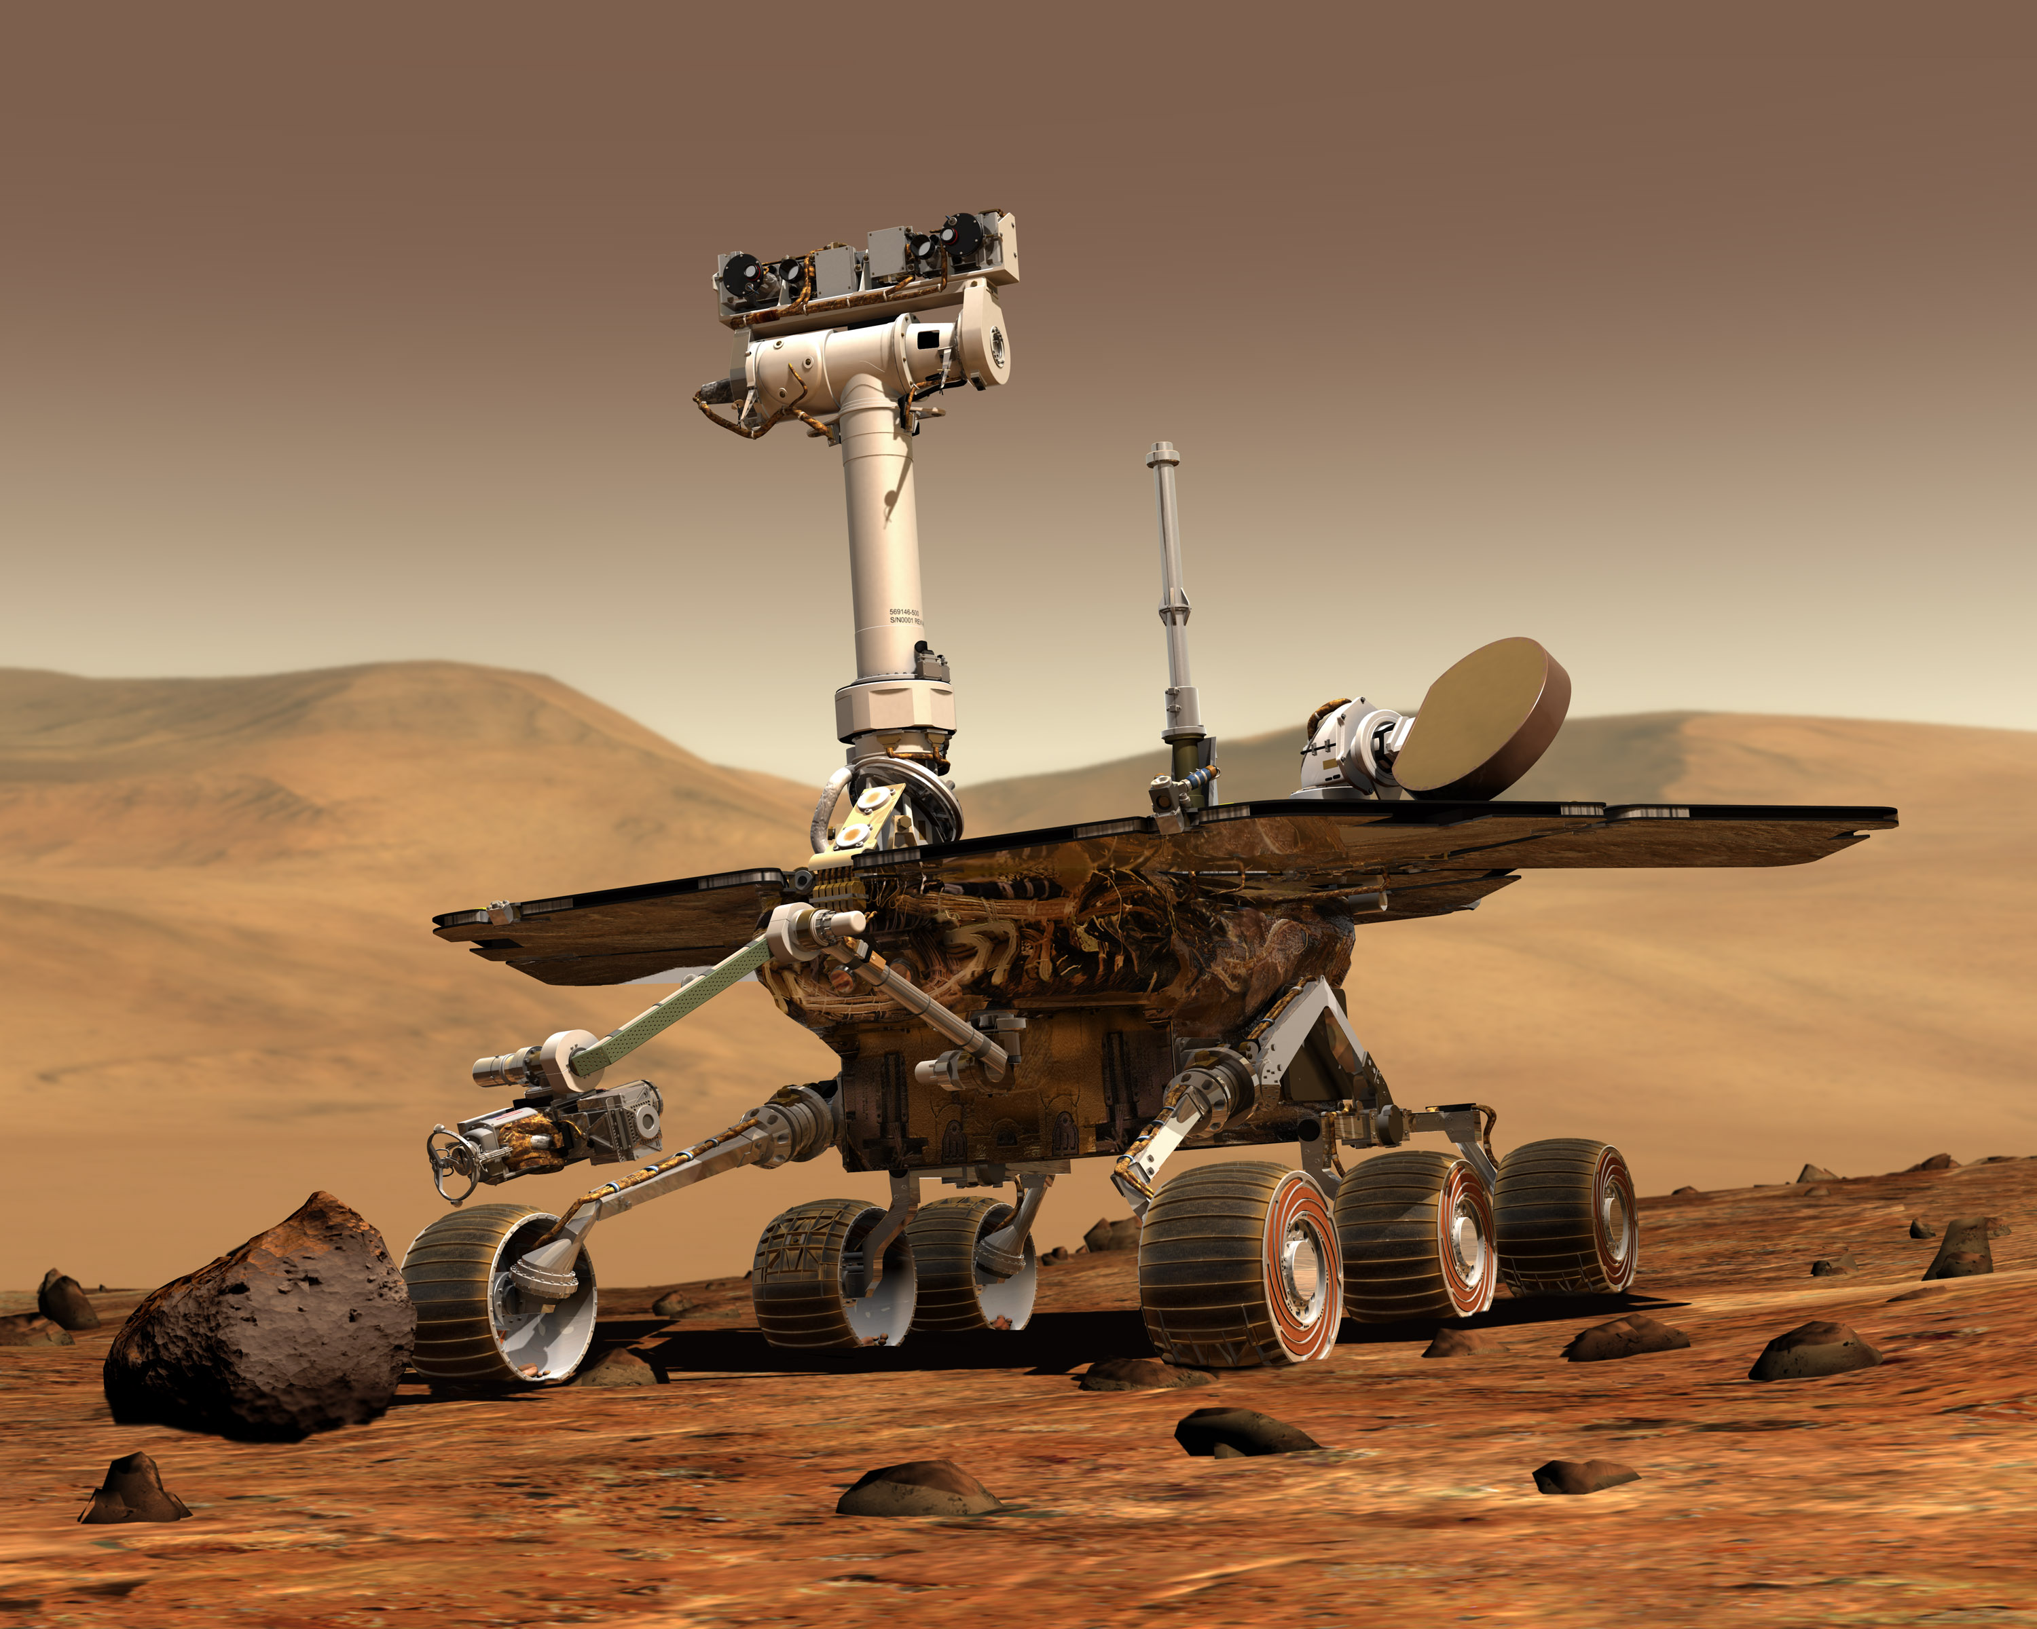
Stereopsis, or why we have two eyes

Slide 24
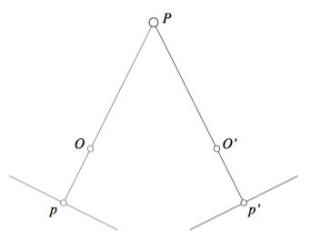
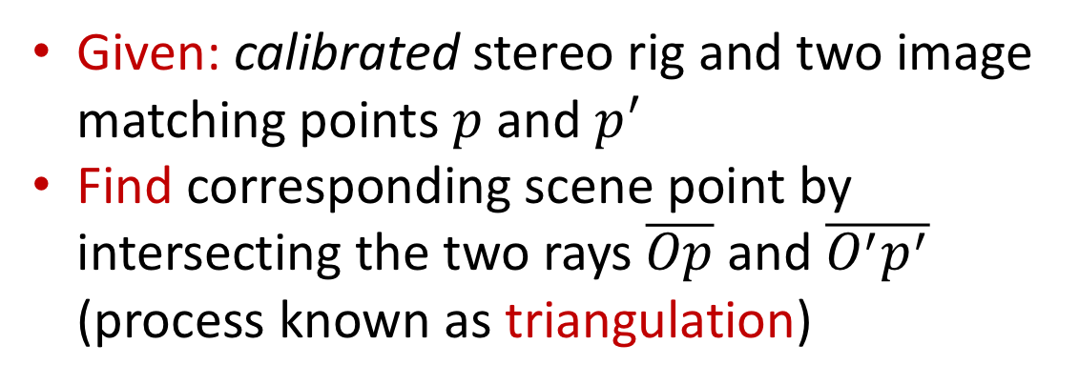
Binocular reconstruction
Given: calibrated stereo rig and two image matching points $p$ and $p^{′}$
Find corresponding scene point by intersecting the two rays$\overline{Op}$ and $\overline{O^{′}p^{′}}$ (process known as triangulation)

Slide 25
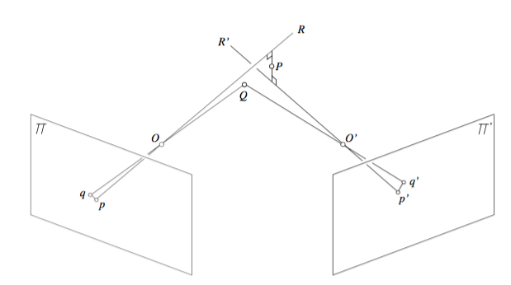
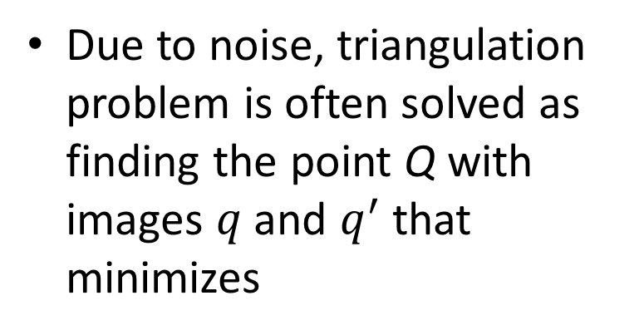
Approximate triangulation
Due to noise, triangulation problem is often solved as finding the point Q with images $q$ and $q^{′}$ that minimizes
Re-projection error

Slide 26
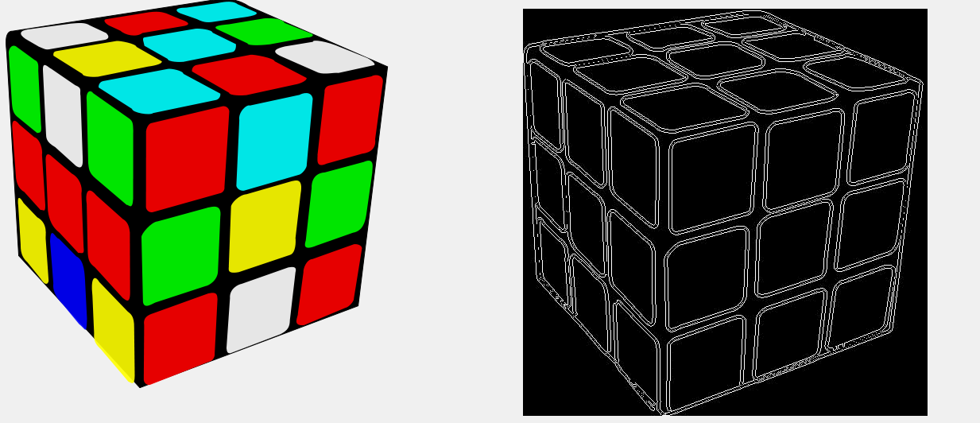
Next time: image processing, feature detection & description

