Slide 1
Principles of Robot Autonomy I
Markov localization and EKF-localization

Slide 2

Attendance Form

Slide 3
Agenda
Aim
Markov localization, with an emphasis on EKF localization
Readings
Chapter 15, sections 15.1 – 15.4 in D. Gammelli, J. Lorenzetti, K. Luo, G. Zardini, M. Pavone. Principles of Robot Autonomy. 2026.

Slide 4
Mobile robot localization
Problem: determine pose of a robot relative to a given map
Localization can be interpreted as the problem of establishing correspondence between the map coordinate system and the robot’s local coordinate frame
This process requires integration of data over time

Slide 5
Local versus global localization
Position tracking assumes that the initial pose is known -> local problem well-addressed via Gaussian filters
In global localization, the initial pose is unknown -> global problem best addressed via non-parametric, multi-hypothesis filters
In kidnapped robot localization, initial pose is unknown and during operation robot can be “kidnapped” and “teleported” to some other location -> global problem best addressed via non-parametric, multi-hypothesis filters

Slide 6
Static versus dynamic environments
Static environments are environments where the only variable quantity is the pose of the robot
Dynamic environments possess objects (e.g., people) other than the robot whose locations change over time -> addressed via either state augmentation or outlier rejection

Slide 7
Passive versus active localization
In passive localization, localization module only observes the robot; i.e., robot’s motion is not aimed at facilitating localization
In active localization, robot’s actions are aimed at minimizing the localization error
Hybrid approaches are possible

Slide 8
Single-robot versus multi-robot
In single-robot localization, a single, individual robot is involved in the localization process
In multi-robot localization, a team of robots is engaged with localization, possibly cooperatively
In this class we will focus on local, static (or quasi-static), passive, single-robot localization problems

Slide 9

Casting the localization problem within a Bayesian filtering framework
State $x_{t},$control $u_{t}$ and measurements $z_{t}$ have the same meaning as in the general filtering context
For a differential drive robot equipped with a laser range-finder (returning a set of range $r_{i}$ and bearing $φ_{i}$ measurements)

Slide 10
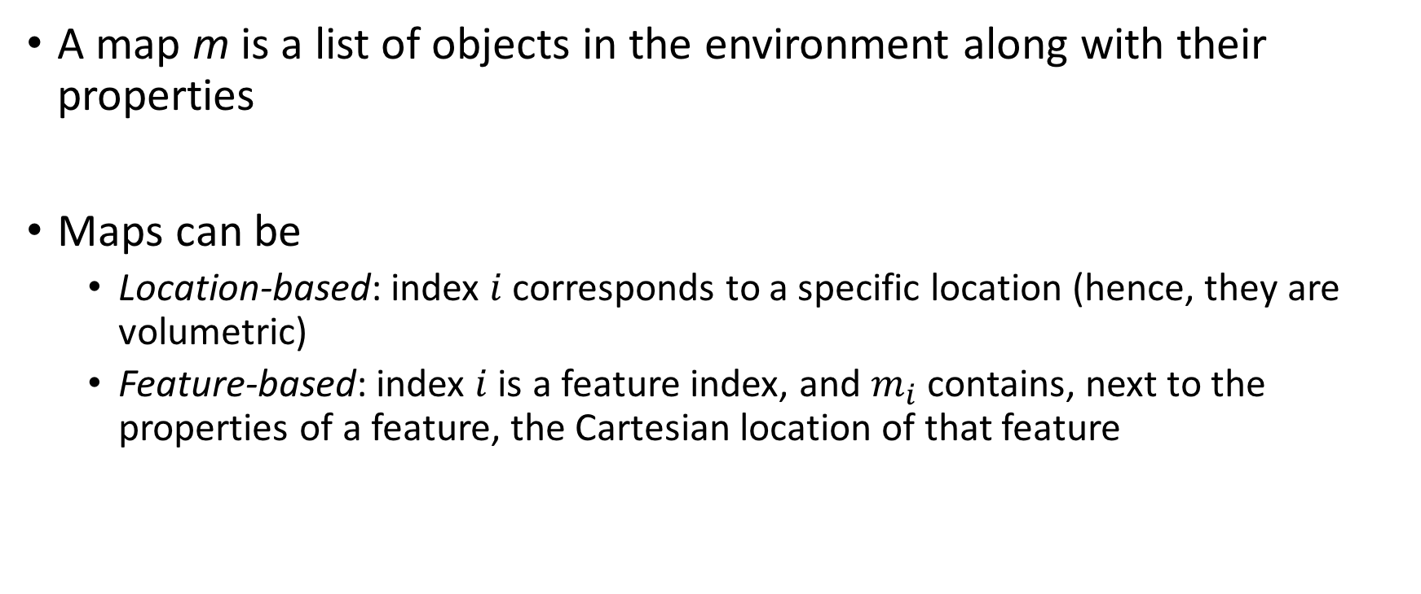
Casting the localization problem within a Bayesian filtering framework
A map m is a list of objects in the environment along with their properties
Maps can be
Location-based: index $i$ corresponds to a specific location (hence, they are volumetric)
Feature-based: index $i$ is a feature index, and $m_{i}$ contains, next to the properties of a feature, the Cartesian location of that feature

Slide 11
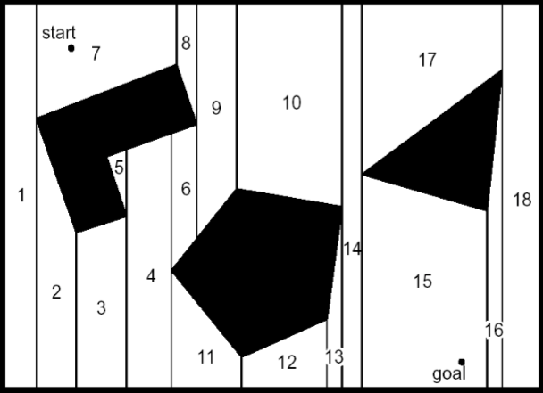
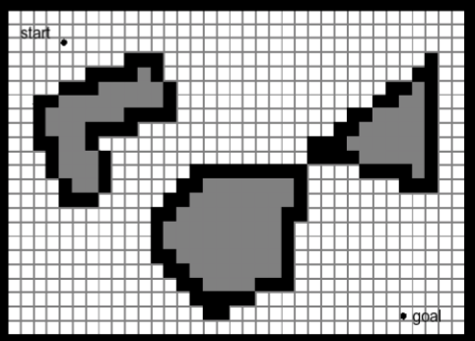
Location-based maps
Vertical cell decomposition
Fixed cell decomposition (occupancy grid)

Slide 12
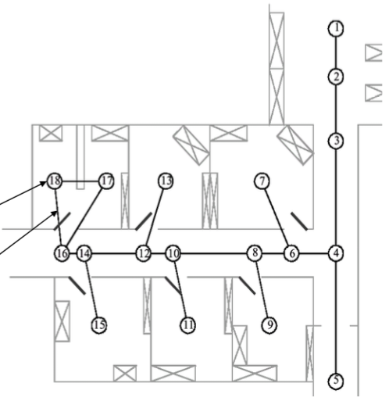
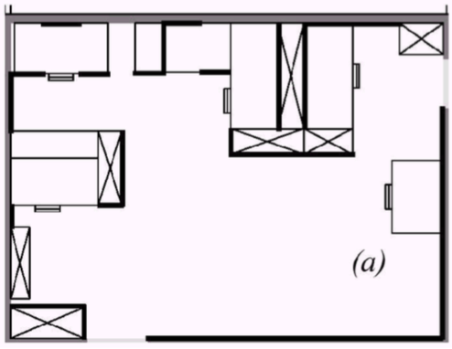
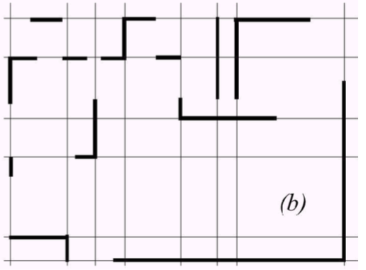
Feature-based maps
Line-based map
Topological map
node
edge

Slide 13

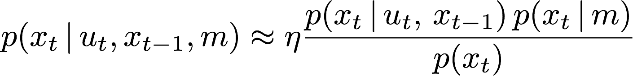
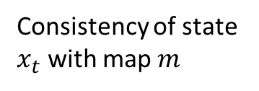
Casting the localization problem within a Bayesian filtering framework
Motion model is probabilistic
Key fact:
Useful approximation (tight at high update rates)
Consistency of state $x_{t}$ with map $m$
Uses approximation

Slide 14
Casting the localization problem within a Bayesian filtering framework
Measurement model is probabilistic
Sensors usually generate more than one measurement when queried
Typically, independence assumption is made

Slide 15
Markov localization
Straightforward application of Bayes filter
Requires a map m as input
Addresses:
Position tracking
Global localization
Kidnapped robot problem

Slide 16
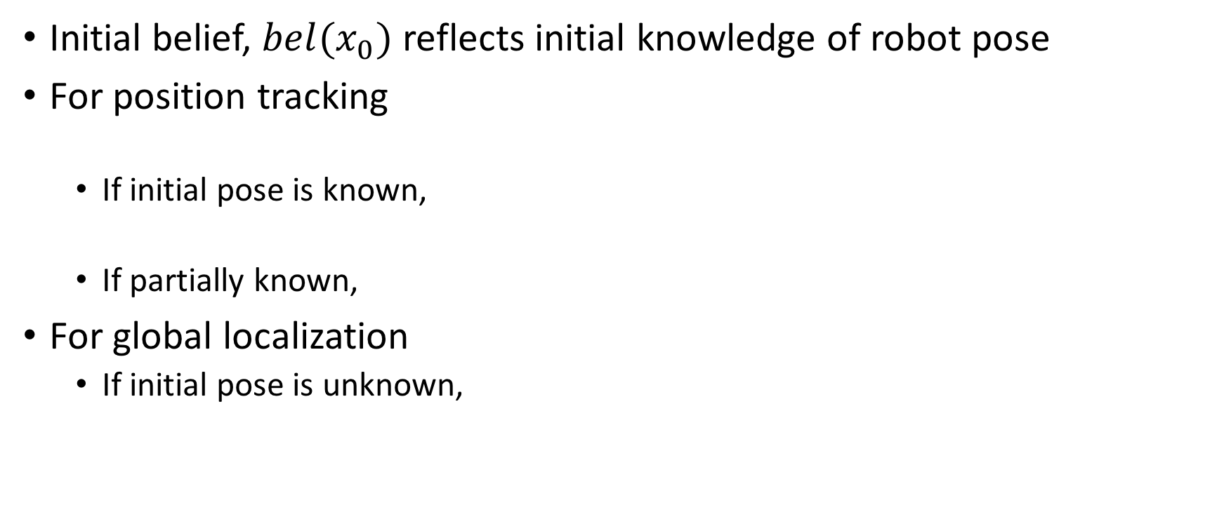
Markov localization: typical choices for initial belief
Initial belief, $bel(x_{0})$ reflects initial knowledge of robot pose
For position tracking
If initial pose is known,
If partially known,
For global localization
If initial pose is unknown,

Slide 17
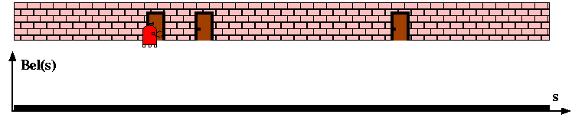
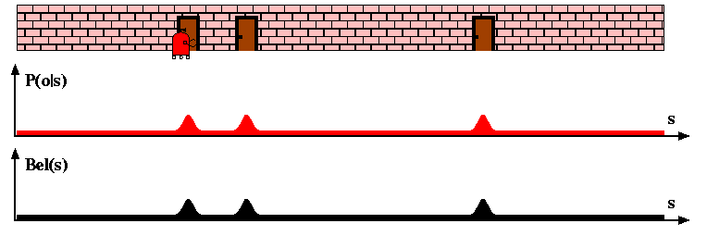
Markov localization: example

Slide 18
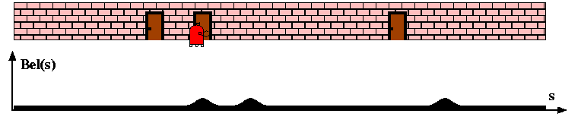
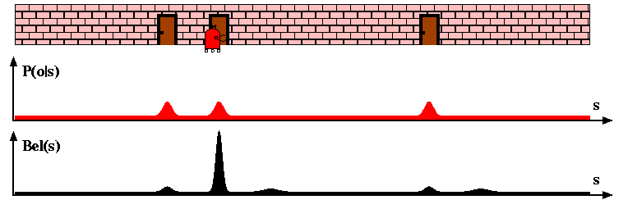
Markov localization: example

Slide 19
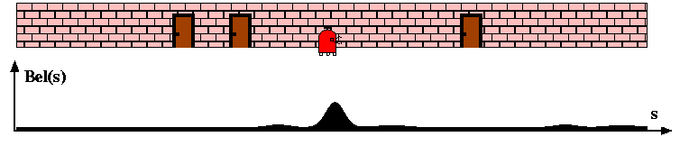
Markov localization: example

Slide 20

Instantiation of Markov localization
To make algorithm tractable, we need to add some structure to the representation of $bel(x_{t})$; examples:
Gaussian representation <- focus of the rest of this lecture
Particle filter representation

Slide 21
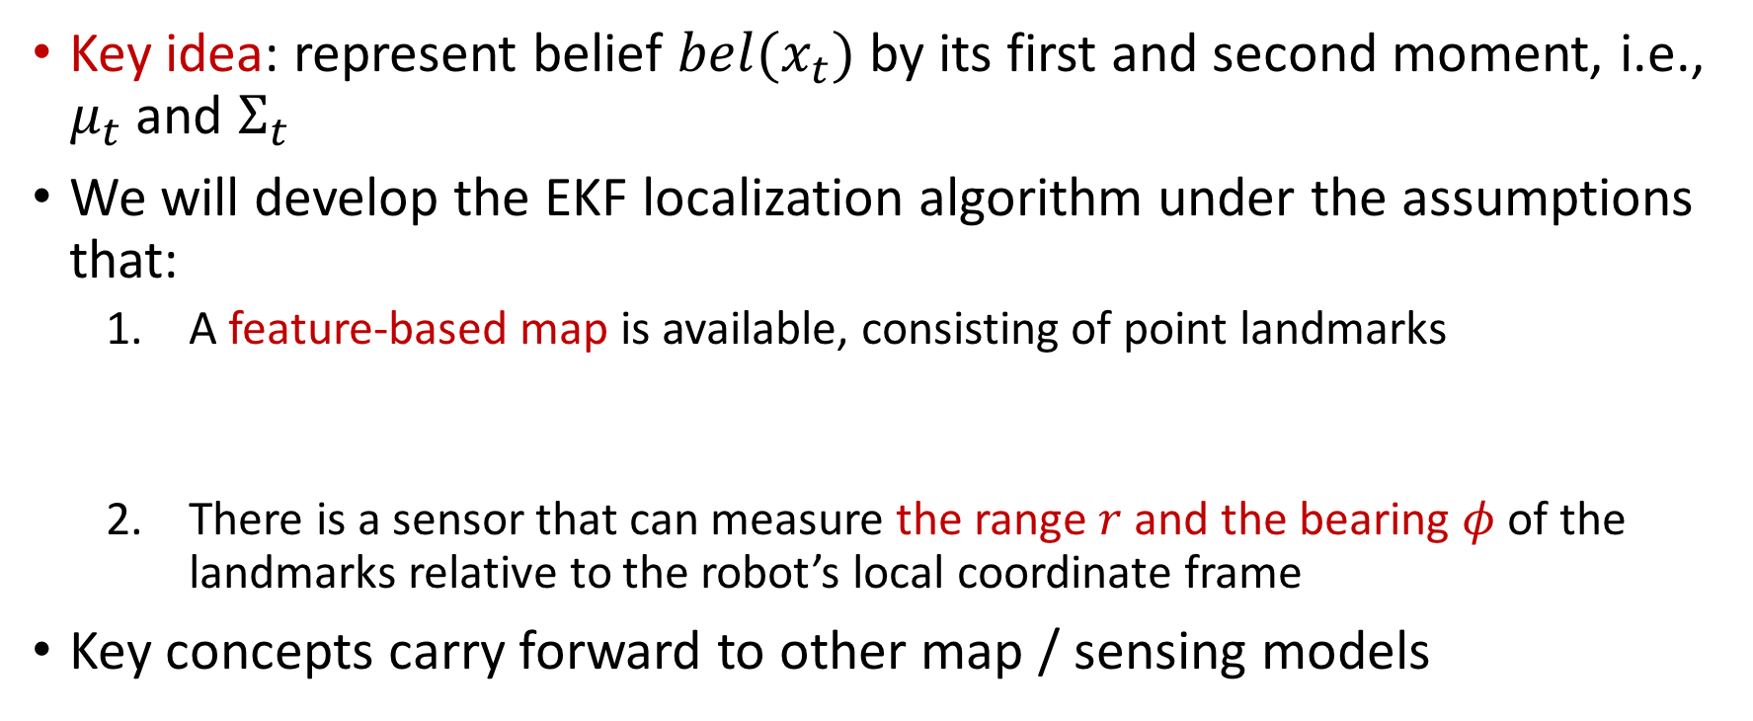
Extended Kalman filter (EKF) localization
Key idea: represent belief $bel(x_{t})$ by its first and second moment, i.e., $μ_{t}$ and $Σ_{t}$
We will develop the EKF localization algorithm under the assumptions that:
A feature-based map is available, consisting of point landmarks
There is a sensor that can measure the range $r$ and the bearing $φ$ of the landmarks relative to the robot’s local coordinate frame
Key concepts carry forward to other map / sensing models
Location of the landmark in the global coordinate frame

Slide 22
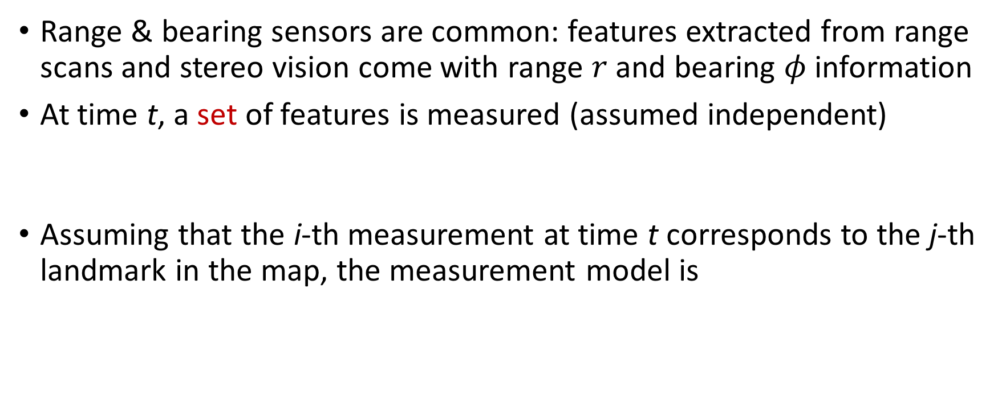
Range and bearing sensors
Range & bearing sensors are common: features extracted from range scans and stereo vision come with range $r$ and bearing $φ$ information
At time t, a set of features is measured (assumed independent)
Assuming that the i-th measurement at time t corresponds to the j-th landmark in the map, the measurement model is
Gaussian noise

Slide 23
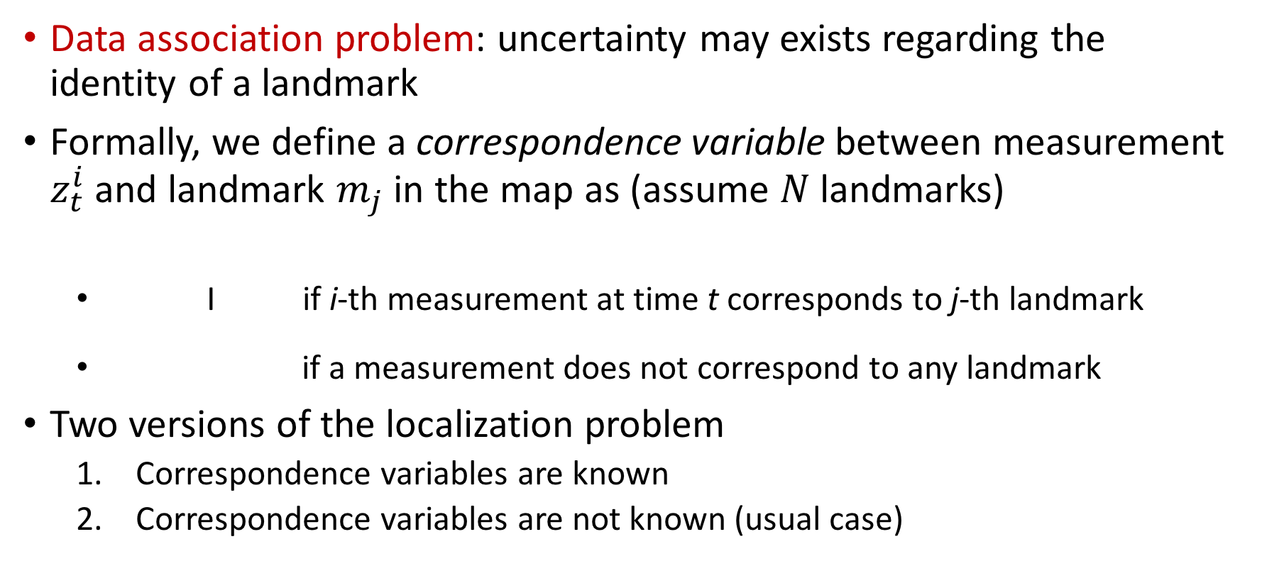
The issue of data association
Data association problem: uncertainty may exists regarding the identity of a landmark
Formally, we define a correspondence variable between measurement $z_{t}^{i}$ and landmark $m_{j}$ in the map as (assume $N$landmarks)
I if i-th measurement at time t corresponds to j-th landmark
if a measurement does not correspond to any landmark
Two versions of the localization problem
Correspondence variables are known
Correspondence variables are not known (usual case)

Slide 24
EKF localization with known correspondences
Algorithm is derived from EKF filter
Assume motion model (in our case, differential drive robot)
Assume range and bearing measurement model

Slide 25
EKF localization with known correspondences
Main difference with EKF filter: multiple measurements are processed at the same time
We exploit conditional independence assumption
Such assumption allows us to incrementally add the information, as if there was zero motion in between measurements
Innovation covariance

Slide 26
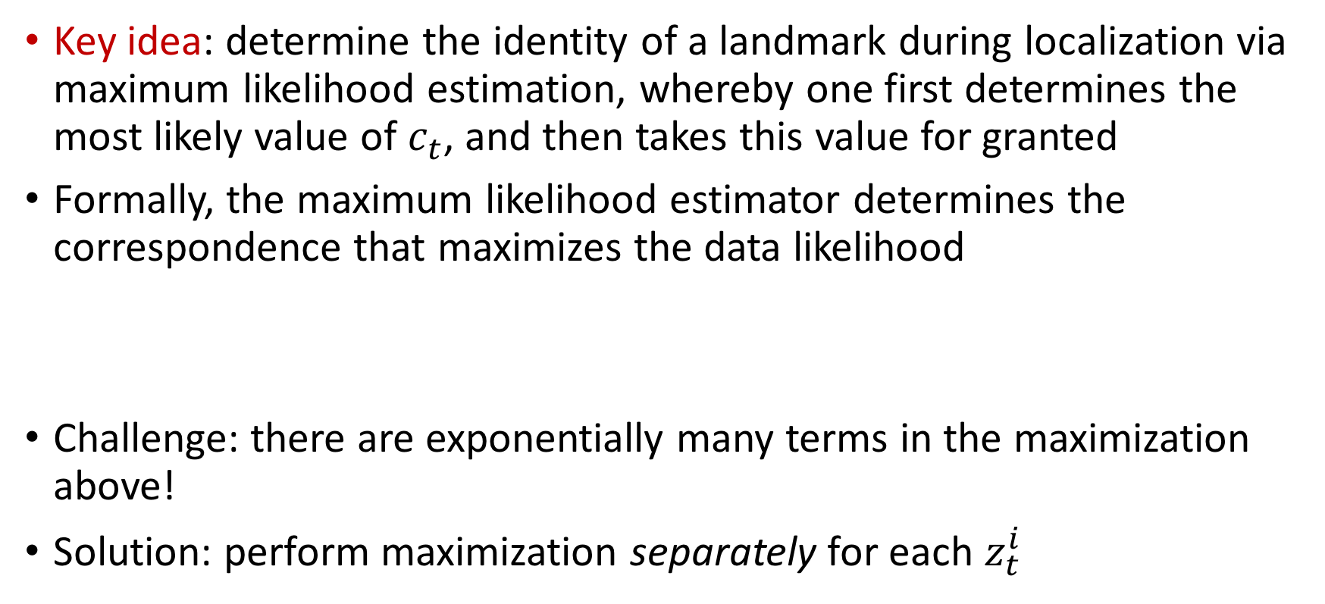
EKF localization with unknown correspondences
Key idea: determine the identity of a landmark during localization via maximum likelihood estimation, whereby one first determines the most likely value of $c_{t}$, and then takes this value for granted
Formally, the maximum likelihood estimator determines the correspondence that maximizes the data likelihood
Challenge: there are exponentially many terms in the maximization above!
Solution: perform maximization separately for each $z_{t}^{i}$

Slide 27
Estimating the correspondence variables
Step #1: find
Derivation (sketch)

Slide 28
Estimating the correspondence variables
Performing the algebraic calculations
Step #2: estimate correspondence as

Slide 29
EKF localization with unknown correspondences
Same as before, plus the inclusion of a maximum likelihood estimator for the correspondence variables
Correspondence estimation

Slide 30
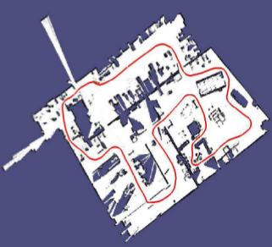
Next time

