Slide 1
Principles of Robot Autonomy I
Simultaneous Localization and Mapping (SLAM)

Slide 2
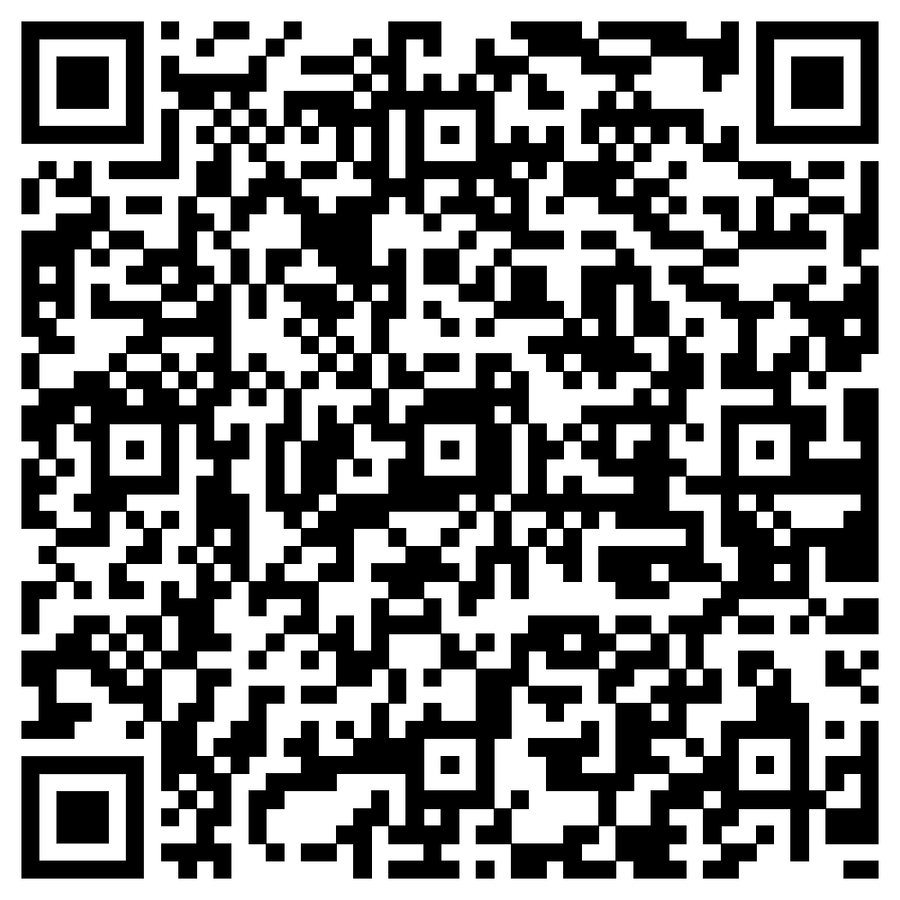
Attendance Form

Slide 3
Agenda
Aim
General SLAM problem
EKF SLAM
Readings
Chapter 16, sections 16.1 – 16.4 in D. Gammelli, J. Lorenzetti, K. Luo, G. Zardini, M. Pavone. Principles of Robot Autonomy. 2026.

Slide 4
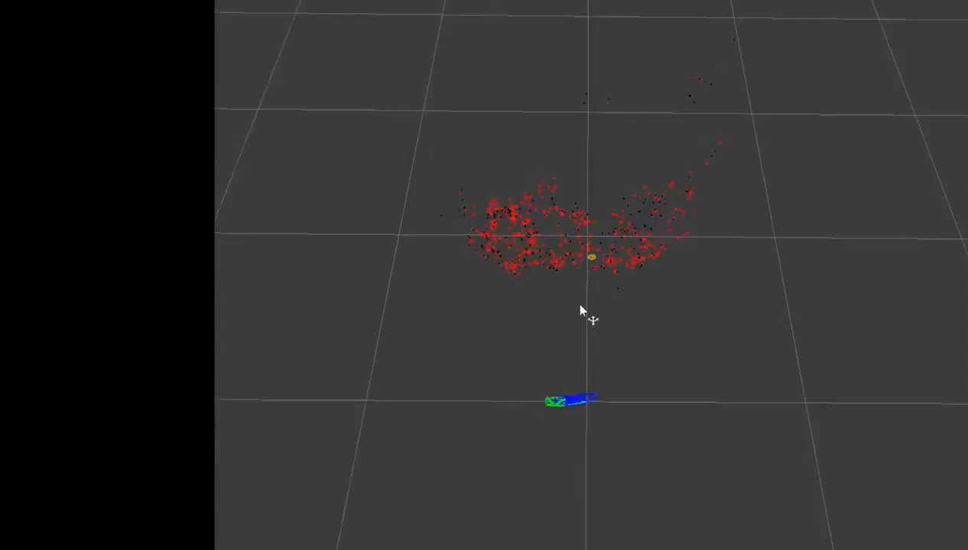
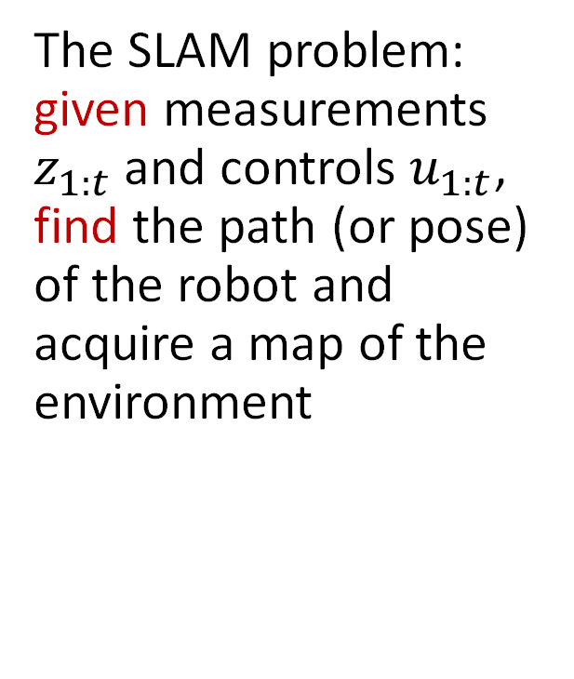
Simultaneous Localization and Mapping
The SLAM problem: given measurements $z_{1:t}$ and controls $u_{1:t}$, find the path (or pose) of the robot and acquire a map of the environment

Slide 5
Forms of SLAM
Online SLAM problem: estimate the posterior over the momentary pose along with the map
Full SLAM problem: estimate posterior over the entire path along with the map
or
or

Slide 6
Graphical models of SLAM
Online SLAM
Full SLAM

Slide 7
EKF SLAM
Historically the earliest SLAM algorithm
Key idea: apply EKF to online SLAM using maximum likelihood data association
Assumptions:
Gaussian assumption for motion and perception noise, and Gaussian approximation for belief (essential)
Feature-based maps (essential)
Two versions of the problem
Correspondence variables are known
Correspondence variables are not known (usual case)

Slide 8
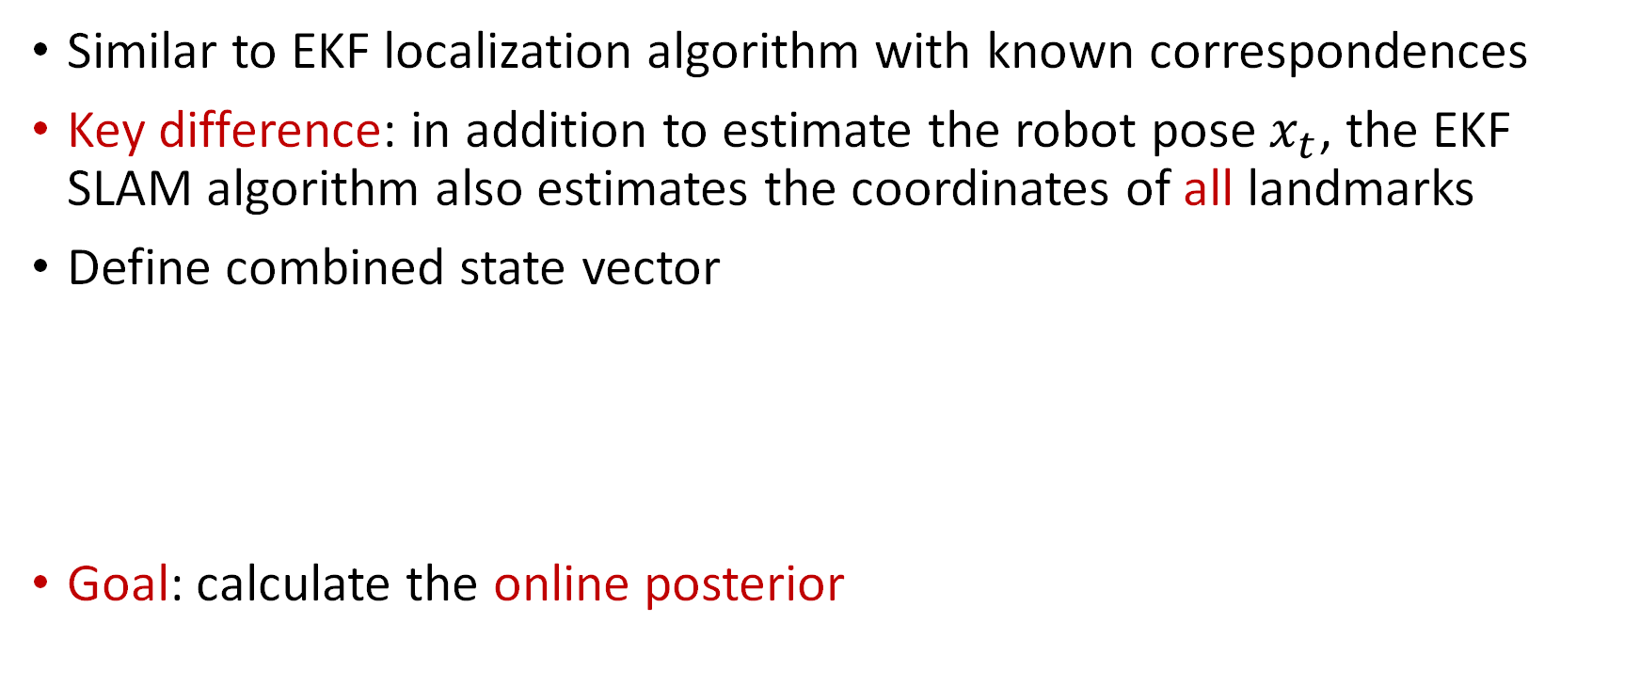
EKF SLAM with known correspondences
Similar to EKF localization algorithm with known correspondences
Key difference: in addition to estimate the robot pose $x_{t}$, the EKF SLAM algorithm also estimates the coordinates of all landmarks
Define combined state vector
Goal: calculate the online posterior
3 + 2N vector

Slide 9
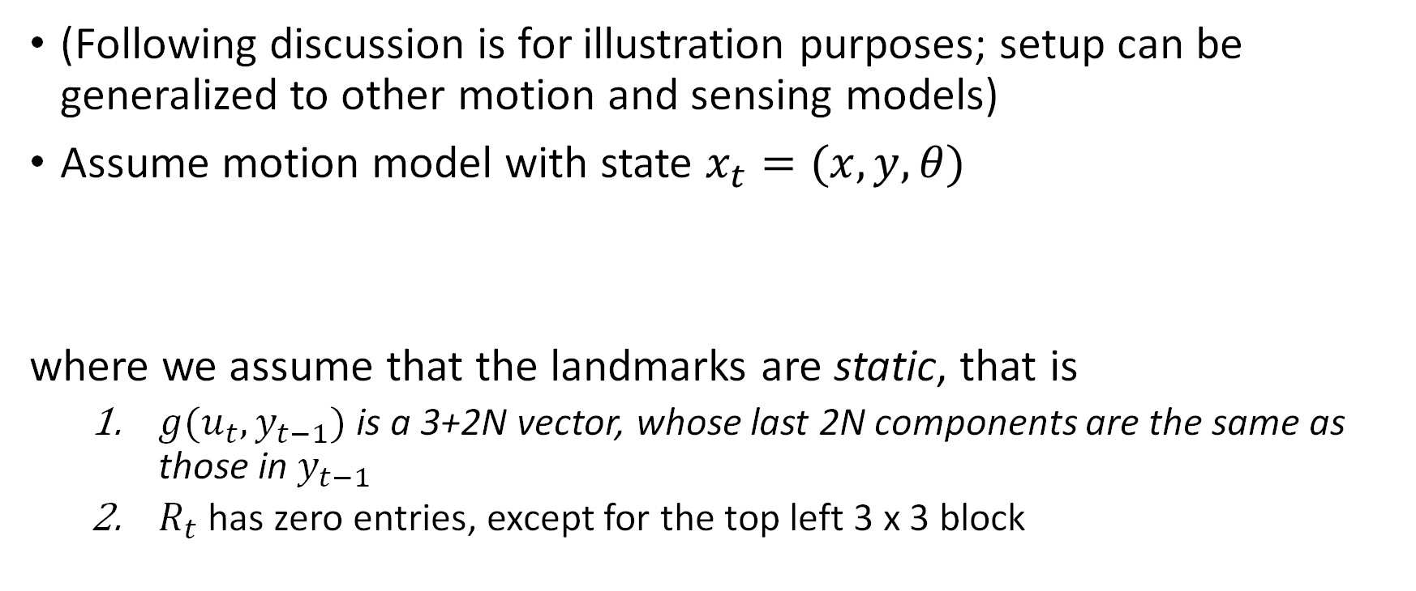
Motion and sensing model
(Following discussion is for illustration purposes; setup can be generalized to other motion and sensing models)
Assume motion model with state $x_{t}=(x,y, θ)$
where we assume that the landmarks are static, that is
$g(u_{t}, y_{t−1})$ is a 3+2N vector, whose last 2N components are the same as those in $y_{t−1}$
$R_{t}$ has zero entries, except for the top left 3 x 3 block

Slide 10

Motion and sensing model
Assume range and bearing measurement model
Usual linear approximation for sensing model (with $j=c_{t}^{i}$)
Since $h$ depends only on $x_{t}$ and $m_{j}$, $H_{t}^{i}$ can be factored as

Slide 11

Motion and sensing model
First term, a 2 x 5 matrix, is the Jacobian of $h(y_{t}, j)$ at ${\overline{μ}}_{t}$ w.r.t. $x_{t}$ and $m_{j}$:
Second term, a 5 x (3+2N) matrix, maps $h_{t}^{i}$ into $H_{t}^{i}$:
where

Slide 12
Initialization
Initial belief expressed as
Initialization for pose variables
(3+2N) x (3+2N)

Slide 13

Initialization
When a landmark is observed for the first time, the landmark estimate ${\left({\overline{μ}}_{j,x},{\overline{μ}}_{j,y}\right)}^{T}$ is initialized with the expected position, that is

Slide 14
EKF SLAM algorithm
Similar to EKF localization; main differences:
Augmented state vector
Augmented dynamics (with trivial dynamics for the landmarks)
Initialization of unseen landmarks
Augmented measurement Jacobian

Slide 15
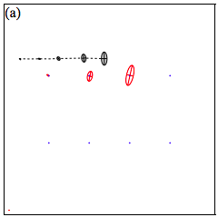
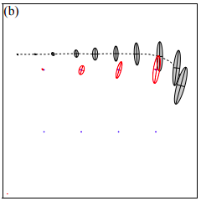
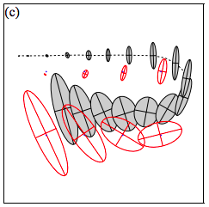
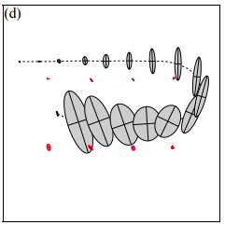
Example

Slide 16
EKF SLAM with unknown correspondences
Key idea: use an incremental maximum likelihood estimator to determine correspondences
Similar to EKF localization with unknown correspondences, but now we also need to create hypotheses for new landmarks
Caveat: maximum likelihood data association often makes the algorithm brittle, as it is not possible to revise past data associations

Slide 17
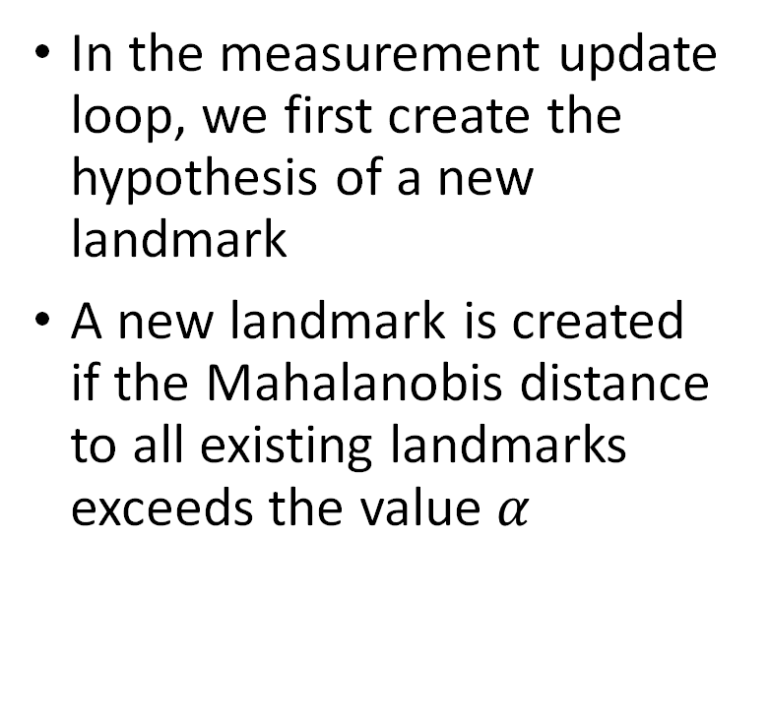
EKF SLAM with unknown correspondences
Hypothesis for new landmark
In the measurement update loop, we first create the hypothesis of a new landmark
A new landmark is created if the Mahalanobis distance to all existing landmarks exceeds the value $α$
Mahalanobis distance
Hypothesis test

Slide 18
Making EKF SLAM robust
A key issue is represented by the fact that fake landmarks might be created; furthermore, EKF can diverge if nonlinearities are large
Several techniques exist to mitigate such issues
Outlier rejection schemes, for example via provisional landmark lists
Strategies to enhance the distinctiveness of landmarks
Spatial arrangement
Signatures
Enforcing geometric constraints
Dilemma of EKF SLAM: accurate localization typically requires dense maps, but EKF requires sparse maps due to quadratic update complexity

Slide 19
Summary: Gaussian filtering
Key ideas:
Represent a belief with a Gaussian distribution
Assume all uncertainty sources are Gaussian
Pros:
Runs online
Well understood
Works well when uncertainty is low
Cons:
Unimodal estimate
States must be well approximated by a Gaussian
Works poorly when uncertainty is high

Slide 20
Final considerations
A quite recent overview of SLAM (with strong focus on graph SLAM): C. Cadena, L. Carlone, H. Carrillo, Y. Latif, D. Scaramuzza, J. Neira, I. Reid, and J. J. Leonard. "Past, present, and future of simultaneous localization and mapping: Toward the robust-perception age." IEEE Transactions on Robotics 32, no. 6 (2016): 1309-1332.
Popular software packages
https://www.openslam.org/: comprehensive list of open-source SLAM software
https://github.com/pamela-project/slambench: popular benchmark framework
Commercial SDKs: ARCore/ARKit from Google/Apple, Oculus Insight

Slide 21
Thanks for a great quarter!

