Slide 1
Principles of Robot Autonomy I
Introduction to ROS
Jakob Thumm

Slide 2
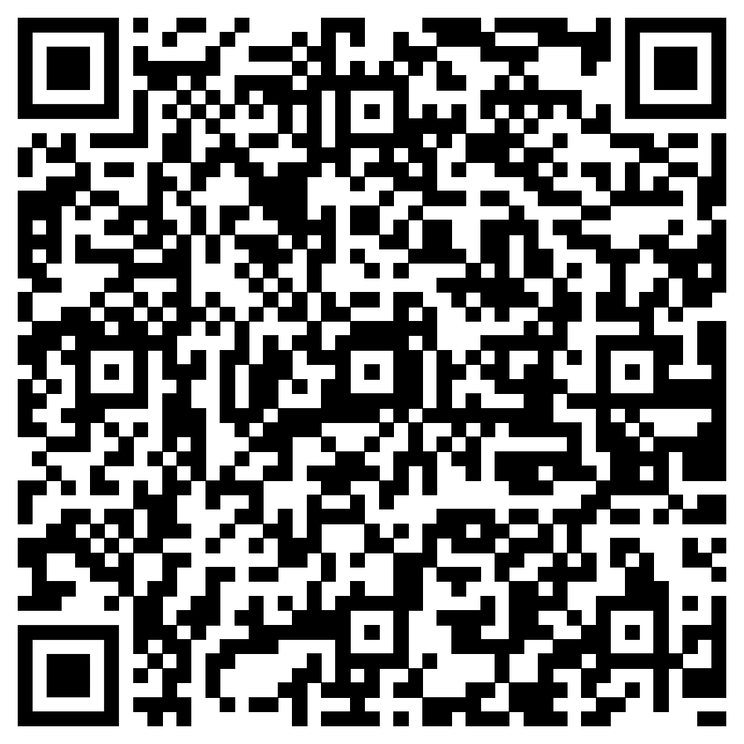
Attendance

Slide 3
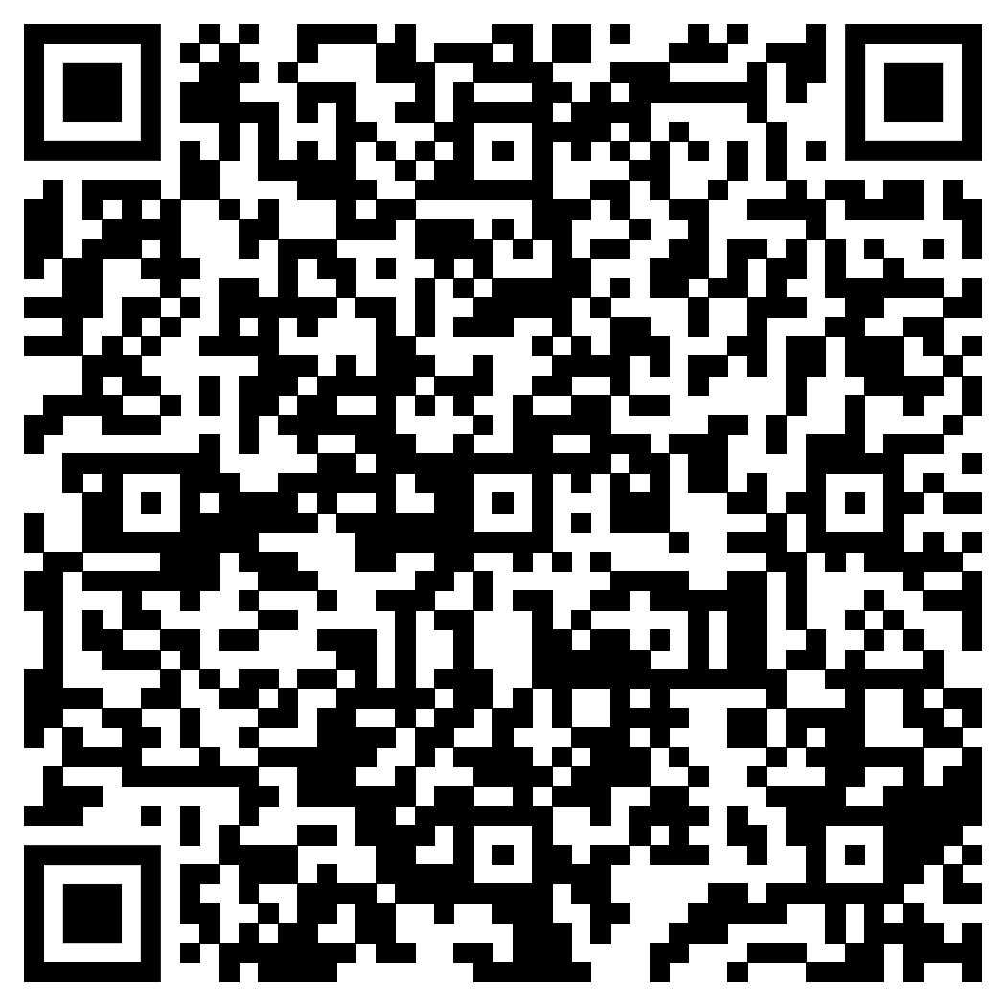
Section Sign Up Today Afternoon

Slide 4
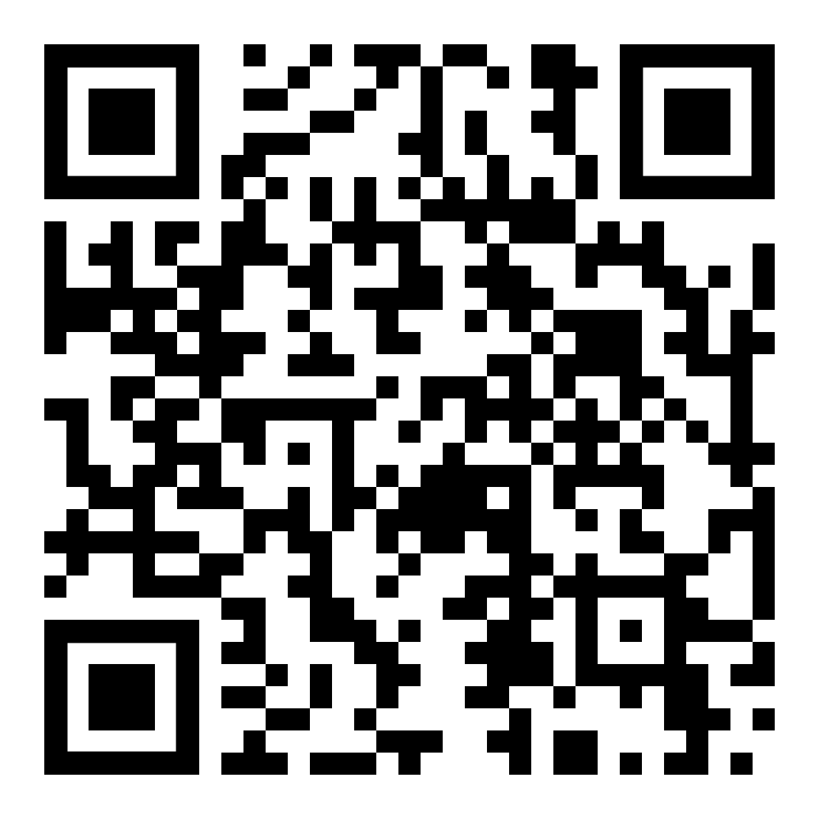
Follow along
IF you have a laptop running a Linux distro with you:
https://github.com/JakobThumm/simple-ros2-package
Otherwise
No problem!
You will have enough time to learn the basics of Linux and ROS in the sections.

Slide 5
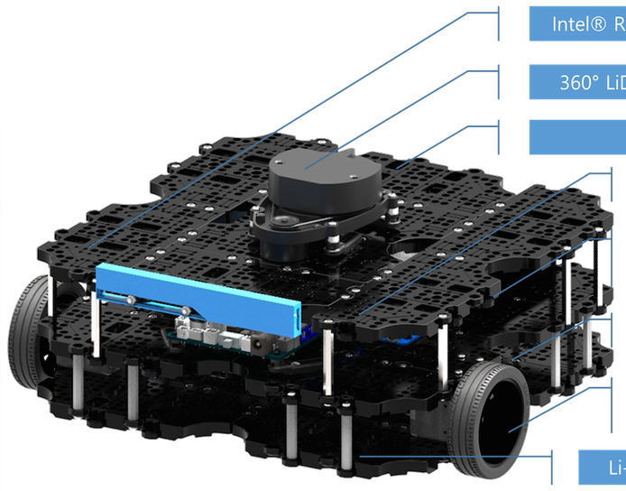
Brain Teaser
What components does this robot have?
Which components need to communicate with each other?
Remember: See, Think, Act

Slide 6
Learning goals
Understand the structure of a ROS workspace
Understand how to solve problems in ROS
Listing available packages, nodes, topics, and parameters
Manually starting nodes
Getting information about topics
Send and print messages to and from topics
Understand communication between ROS nodes
Internalize tab completion

