Slide 1
Principles of Robot Autonomy I
State space dynamics – definitions and modeling

Slide 2

Attendance Form

Slide 3
For urgent questions
aa174a-aut2526-staff@lists.stanford.edu
Please do not email Prof. Pavone or the CAs individually unless there is a specific reason!

Slide 4
Agenda
State space dynamics
Definitions
Modeling (kinematic and dynamic models)
Special case: LTI systems and linearization
Readings
Chapter 1, sections 1.1 – 1.3 in D. Gammelli, J. Lorenzetti, K. Luo, G. Zardini, M. Pavone. Principles of Robot Autonomy. 2026.

Slide 5
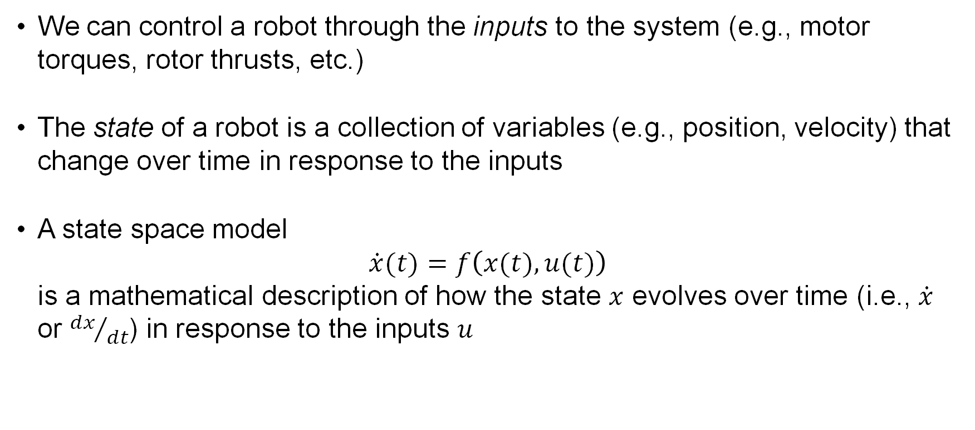
State space models
We can control a robot through the inputs to the system (e.g., motor torques, rotor thrusts, etc.)
The state of a robot is a collection of variables (e.g., position, velocity) that change over time in response to the inputs
A state space model $\dot{x}(t)=f\left(x(t), u(t)\right)$ is a mathematical description of how the state $x$ evolves over time (i.e., $\dot{x}$ or ${dx}/{dt}$) in response to the inputs $u$

Slide 6
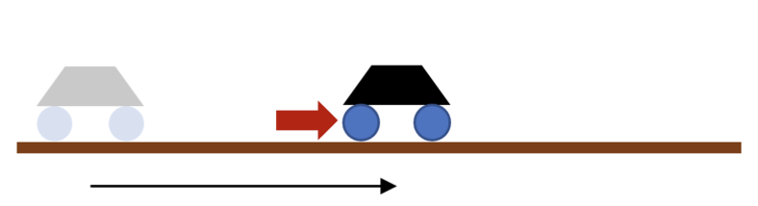
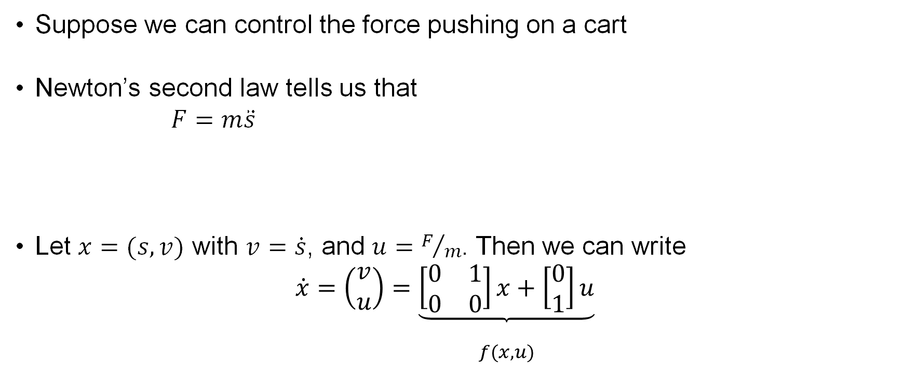



Example: double-integrator
Suppose we can control the force pushing on a cart
Newton’s second law tells us that $F=m\ddot{s}$
Let $x=(s,v)$ with $v=\dot{s}$, and $u=F/m$. Then we can write $\dot{x}=\left(\begin{matrix}v \\ u\end{matrix}\right)=\underset{\begin{aligned} \\ f(x,u)\end{aligned}}{\underbrace{\left[\begin{matrix}0 & 1 \\ 0 & 0\end{matrix}\right]x+\left[\begin{matrix}0 \\ 1\end{matrix}\right]u}}$
$$m$$
$$F$$
$$s$$

Slide 7
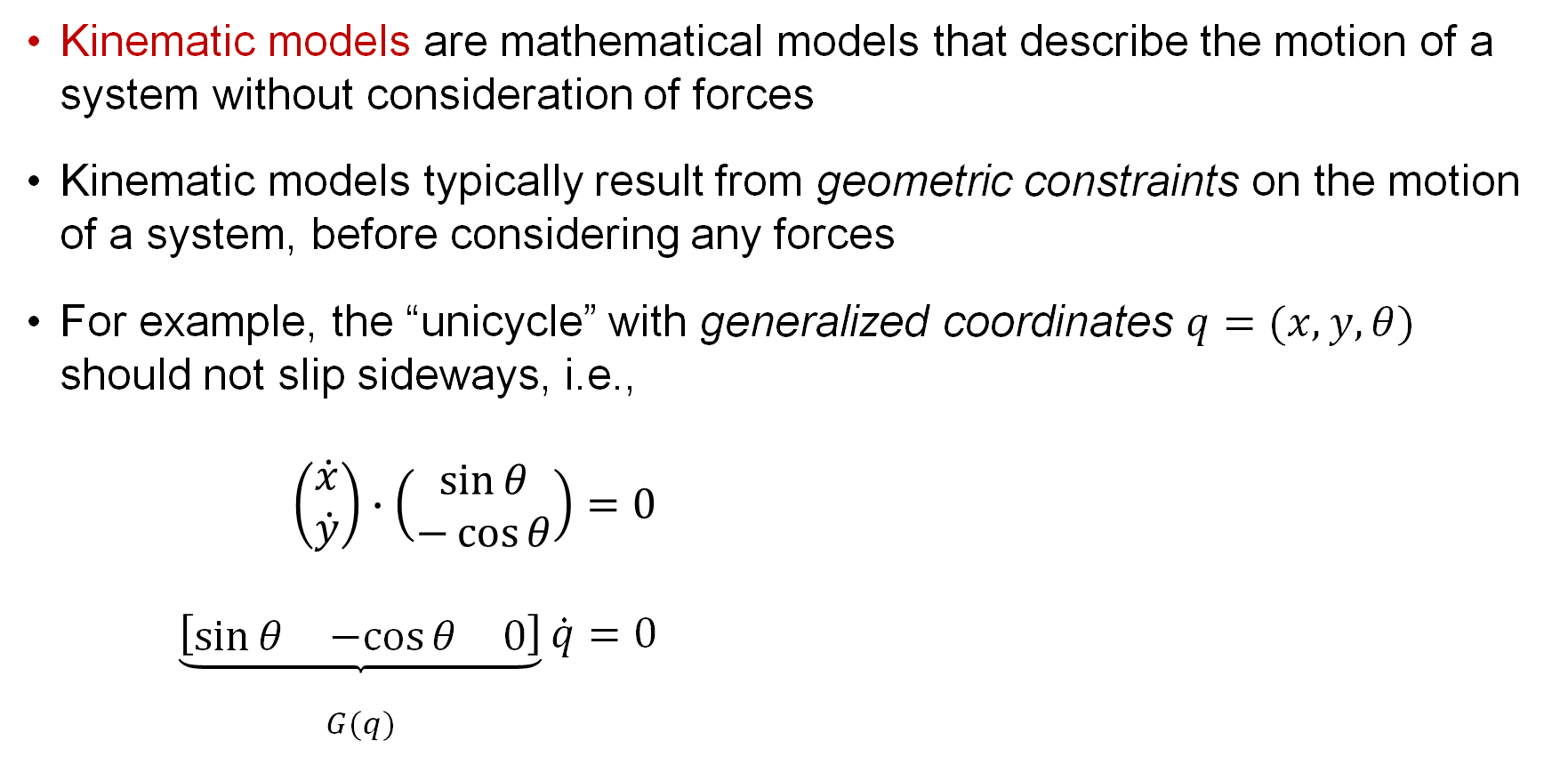
Kinematic models
Kinematic models are mathematical models that describe the motion of a system without consideration of forces
Kinematic models typically result from geometric constraints on the motion of a system, before considering any forces
For example, the “unicycle” with generalized coordinates $q=(x,y,θ)$ should not slip sideways, i.e., $\left(\begin{matrix}\dot{x} \\ \dot{y}\end{matrix}\right)∙\left(\begin{matrix}\sin{θ} \\ −\cos{θ}\end{matrix}\right)=0$ $\underset{\begin{aligned} \\ G(q)\end{aligned}}{\underbrace{\left[\begin{matrix}\sin{θ} & −cos{θ} & 0\end{matrix}\right]}}\dot{q}=0$
This relation induces a kinematic model, as we will see shortly

Slide 8
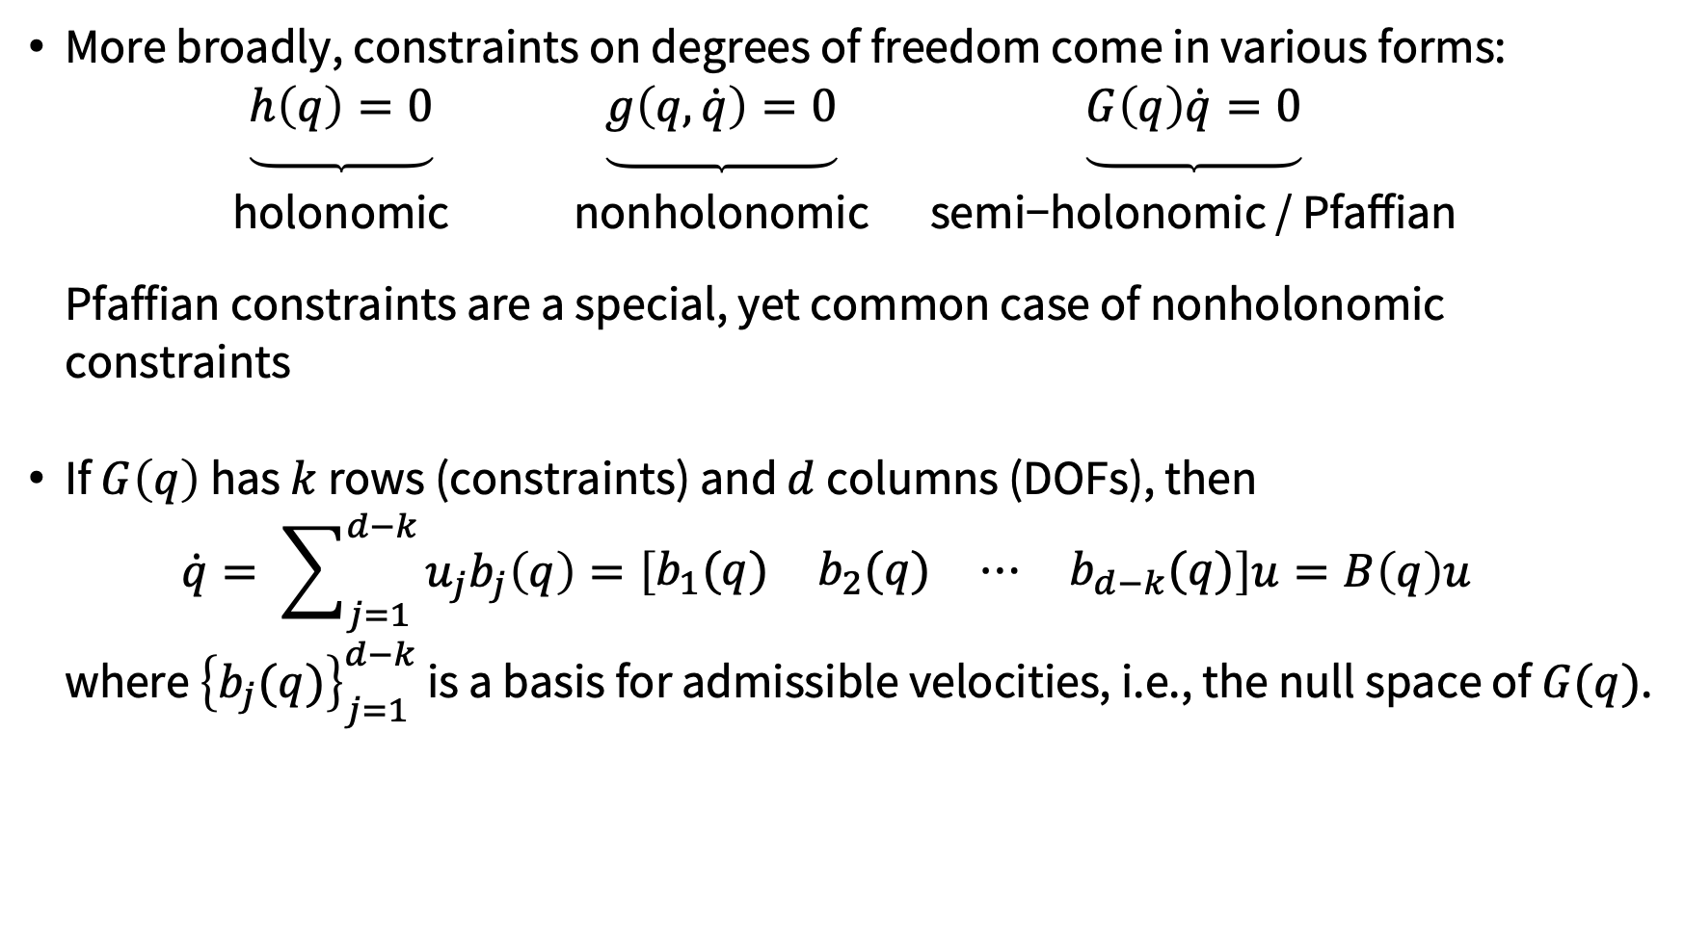
Holonomic and nonholonomic constraints
More broadly, constraints on degrees of freedom come in various forms: $\underset{\begin{aligned} \\ \text{holonomic} \\ \end{aligned}}{\underbrace{h\left(q\right)=0}} \underset{\begin{aligned} \\ \text{nonholonomic} \\ \end{aligned}}{\underbrace{g\left(q,\dot{q}\right)=0}} \underset{\begin{aligned} \\ \text{semi−holonomic / Pfaffian} \\ \end{aligned}}{\underbrace{G\left(q\right)\dot{q}=0}}$ Pfaffian constraints are a special, yet common case of nonholonomic constraints
If $G\left(q\right)$ has $k$ rows (constraints) and $d$ columns (DOFs), then $\dot{q}= \sum_{j=1}^{d−k}{u_{j}b_{j}\left(q\right)=\left[\begin{matrix}b_{1}(q) & b_{2}(q) & ⋯ & b_{d−k}(q)\end{matrix}\right]u}=B\left(q\right)u$ where ${\left\{b_{j}(q)\right\}}_{j=1}^{d−k}$ is a basis for admissible velocities, i.e., the null space of $G(q)$.
Kinematic model of the constrained system

Slide 9
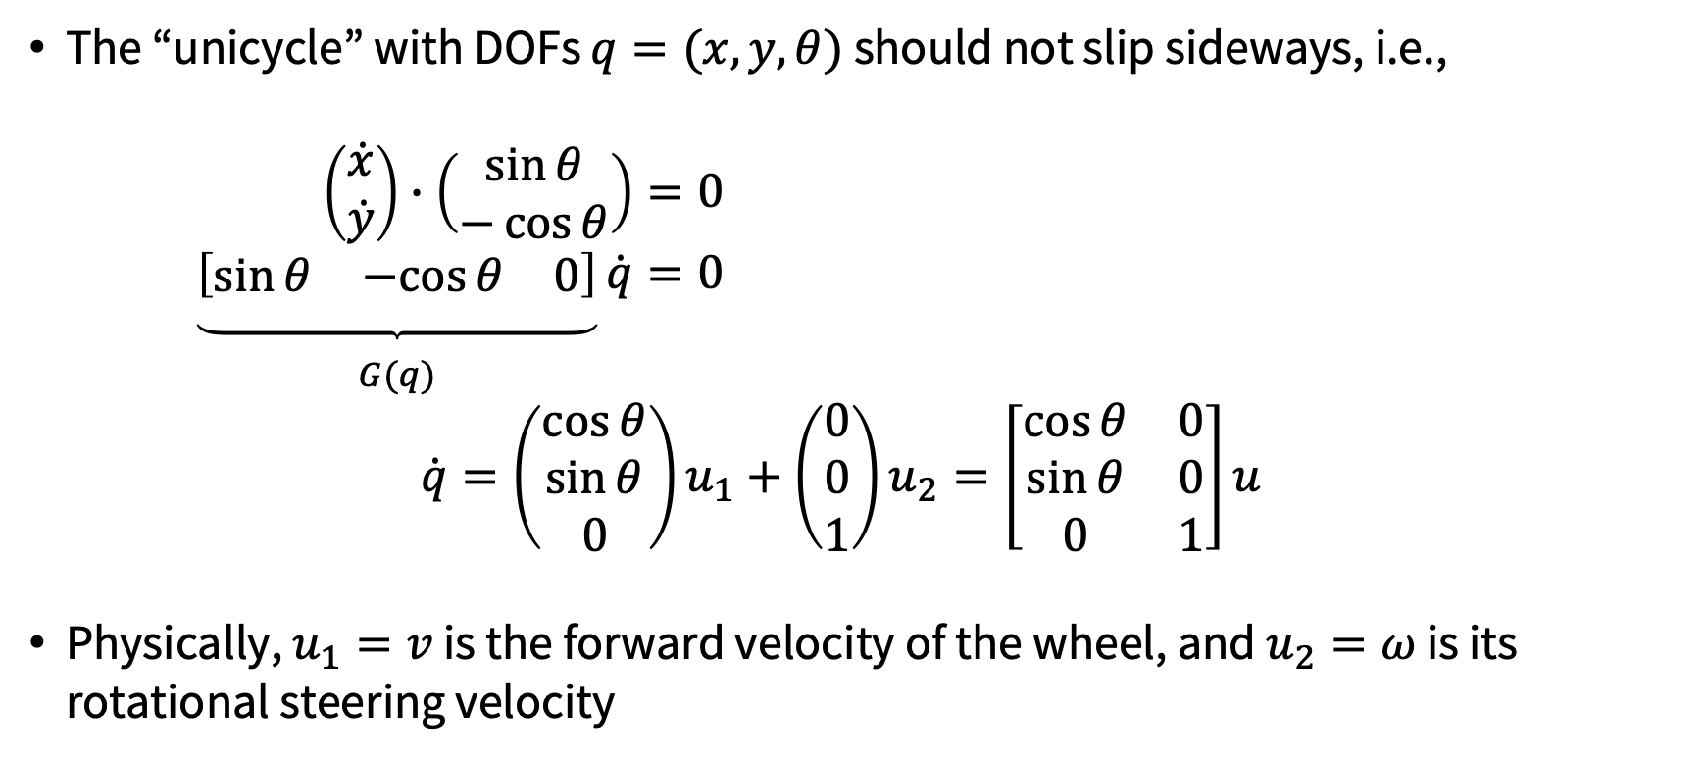
Back to unicycle example
The “unicycle” with DOFs $q=(x,y,θ)$ should not slip sideways, i.e., $\left(\begin{matrix}\dot{x} \\ \dot{y}\end{matrix}\right)∙\left(\begin{matrix}\sin{θ} \\ −\cos{θ}\end{matrix}\right)=0$ $\underset{\begin{aligned} \\ G(q)\end{aligned}}{\underbrace{\left[\begin{matrix}\sin{θ} & −cos{θ} & 0\end{matrix}\right]}}\dot{q}=0$ $\dot{q}=\left(\begin{matrix}\cos{θ} \\ \sin{θ} \\ 0\end{matrix}\right)u_{1}+\left(\begin{matrix}0 \\ 0 \\ 1\end{matrix}\right)u_{2}=\left[\begin{matrix}\cos{θ} & 0 \\ \sin{θ} & 0 \\ 0 & 1\end{matrix}\right]u$
Physically, $u_{1}=v$ is the forward velocity of the wheel, and $u_{2}=ω$ is its rotational steering velocity

Slide 10
Unicycle and differential drive models
unicycle
differential drive
We can alternate between these kinematic models via the one-to-one input mappings:

Slide 11
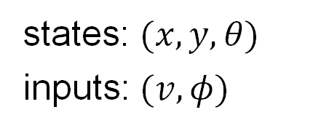
Simple car model
states: $(x,y,θ)$
inputs: $(v, φ)$
Simple car model
Reeds-Shepp car
Dubins car
References:
J.-P. Laumond. Robot motion planning and control. 1998.
S. LaValle. Planning algorithms. 2006.

Slide 12
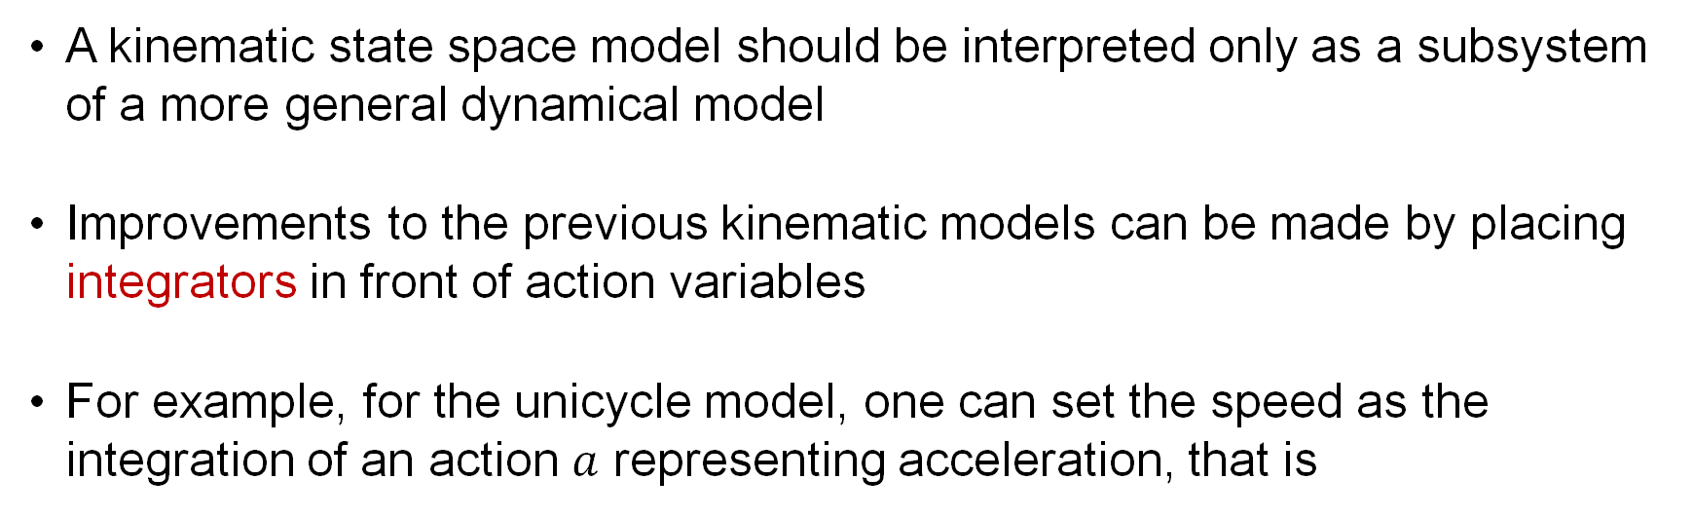
From kinematic to dynamic models
A kinematic state space model should be interpreted only as a subsystem of a more general dynamical model
Improvements to the previous kinematic models can be made by placing integrators in front of action variables
For example, for the unicycle model, one can set the speed as the integration of an action $a$ representing acceleration, that is
states: $\left(x,y,θ,v\right)$ inputs: $(ω,a)$

Slide 13
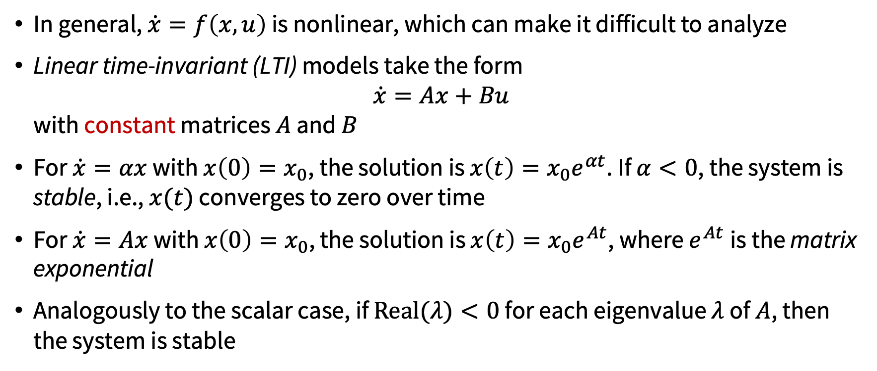
Linear time-invariant models
In general, $\dot{x}=f\left(x, u\right)$ is nonlinear, which can make it difficult to analyze
Linear time-invariant (LTI) models take the form $\dot{x}=Ax+Bu$ with constant matrices $A$ and $B$
For $\dot{x}=αx$ with $x\left(0\right)=x_{0}$, the solution is $x\left(t\right)=x_{0}e^{αt}$. If $α<0$, the system is stable, i.e., $x(t)$ converges to zero over time
For $\dot{x}=Ax$ with $x\left(0\right)=x_{0}$, the solution is $x\left(t\right)=x_{0}e^{At}$, where $e^{At}$is the matrix exponential
Analogously to the scalar case, if $\operatorname{Real}{(λ)}<0$ for each eigenvalue $λ$ of $A$, then the system is stable

Slide 14
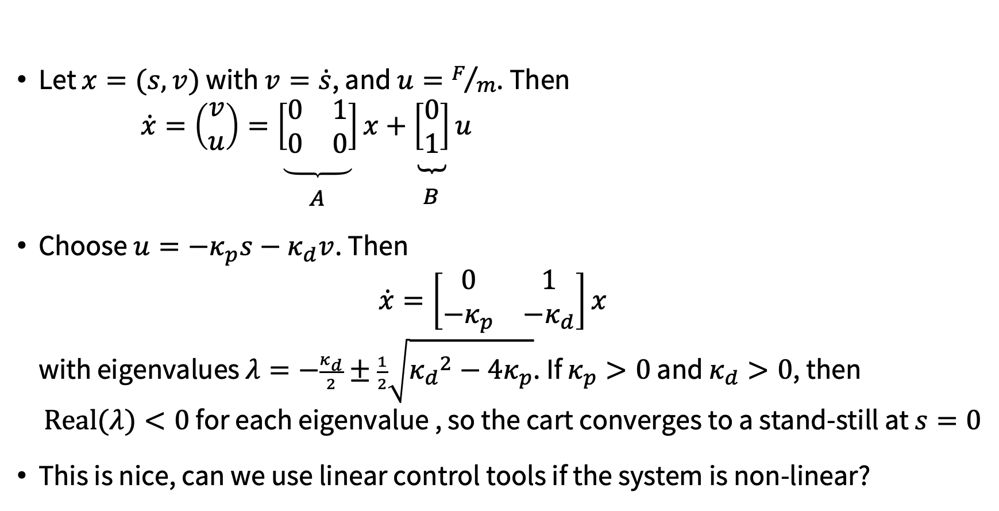



Example: PD control for a double-integrator
Let $x=(s,v)$ with $v=\dot{s}$, and $u=F/m$. Then $\dot{x}=\left(\begin{matrix}v \\ u\end{matrix}\right)=\underset{\begin{aligned} \\ A\end{aligned}}{\underbrace{\left[\begin{matrix}0 & 1 \\ 0 & 0\end{matrix}\right]}}x+\underset{\begin{aligned} \\ B\end{aligned}}{\underbrace{\left[\begin{matrix}0 \\ 1\end{matrix}\right]}}u$
Choose $u=−κ_{p}s−κ_{d}v$. Then $\dot{x}=\left[\begin{matrix}0 & 1 \\ −κ_{p} & −κ_{d}\end{matrix}\right]x$ with eigenvalues $λ=−\frac{κ_{d}}{2}±\frac{1}{2}\sqrt{{κ_{d}}^{2}−4κ_{p}}$. If $κ_{p}>0$ and $κ_{d}>0$, then $\operatorname{Real}{(λ)}<0$ for each eigenvalue , so the cart converges to a stand-still at $s=0$
This is nice, can we use linear control tools if the system is non-linear?
$$m$$
$$F$$
$$s$$

Slide 15







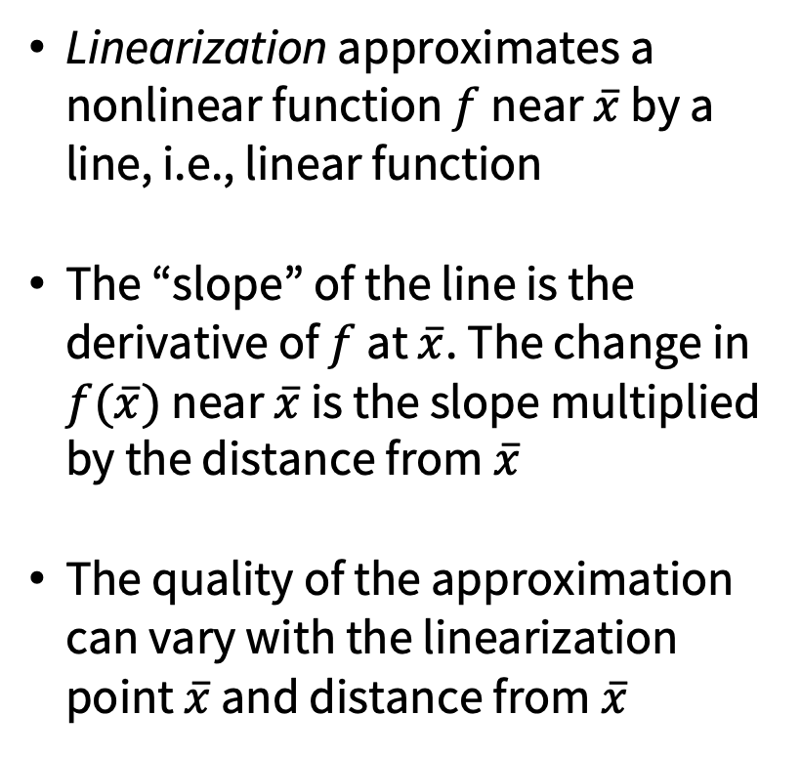
Linearization
offset
slope
delta
Linearization approximates a nonlinear function $f$ near $\overline{x}$ by a line, i.e., linear function
The “slope” of the line is the derivative of $f$ at $\overline{x}$. The change in $f(\overline{x})$ near $\overline{x}$ is the slope multiplied by the distance from $\overline{x}$
The quality of the approximation can vary with the linearization point $\overline{x}$ and distance from $\overline{x}$
$$f(x)$$
$$f(x)≈f\left({\overline{x}}^{\left(2\right)}\right)+\frac{∂f}{∂x}\left({\overline{x}}^{\left(2\right)}\right)\left(x−{\overline{x}}^{\left(2\right)}\right)$$
$$f(x)$$
$$f(x)≈f\left({\overline{x}}^{\left(1\right)}\right)+\frac{∂f}{∂x}\left({\overline{x}}^{\left(1\right)}\right)\left(x−{\overline{x}}^{\left(1\right)}\right)$$
$$x$$
$$x^{(1)}$$
$$x^{(2)}$$

Slide 16
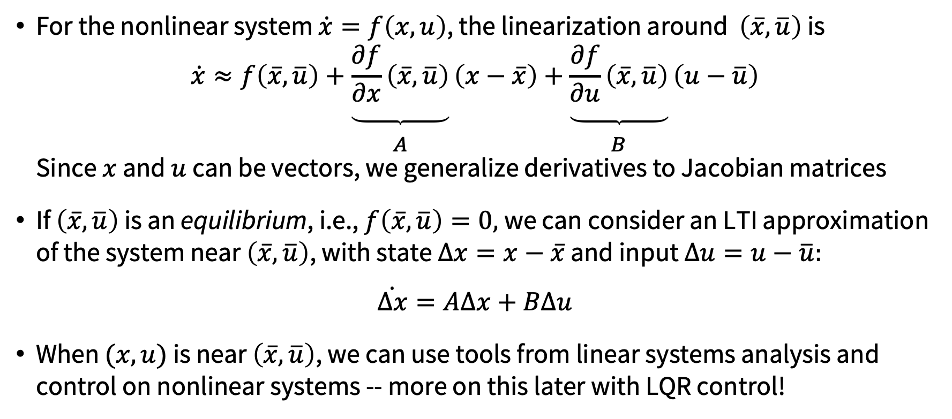
Linearization of non-linear state-space models
For the nonlinear system $\dot{x}=f\left(x, u\right)$, the linearization around $\left(\overline{x},\overline{u}\right)$ is $\dot{x}≈f\left(\overline{x},\overline{u}\right)+\underset{\begin{aligned} \\ A\end{aligned}}{\underbrace{\frac{∂f}{∂x}\left(\overline{x},\overline{u}\right)}}\left(x−\overline{x}\right)+\underset{\begin{aligned} \\ B\end{aligned}}{\underbrace{\frac{∂f}{∂u}\left(\overline{x},\overline{u}\right)}}\left(u−\overline{u}\right)$ Since $x$ and $u$ can be vectors, we generalize derivatives to Jacobian matrices
If $\left(\overline{x},\overline{u}\right)$ is an equilibrium, i.e., $f\left(\overline{x},\overline{u}\right)=0,$we can consider an LTI approximation of the system near $\left(\overline{x},\overline{u}\right)$, with state $∆x=x−\overline{x}$ and input $∆u=u−\overline{u}:$
$$\dot{Δx}=AΔx+BΔu$$
When $(x,u)$ is near $\left(\overline{x},\overline{u}\right)$, we can use tools from linear systems analysis and control on nonlinear systems -- more on this later with LQR control!

Slide 17
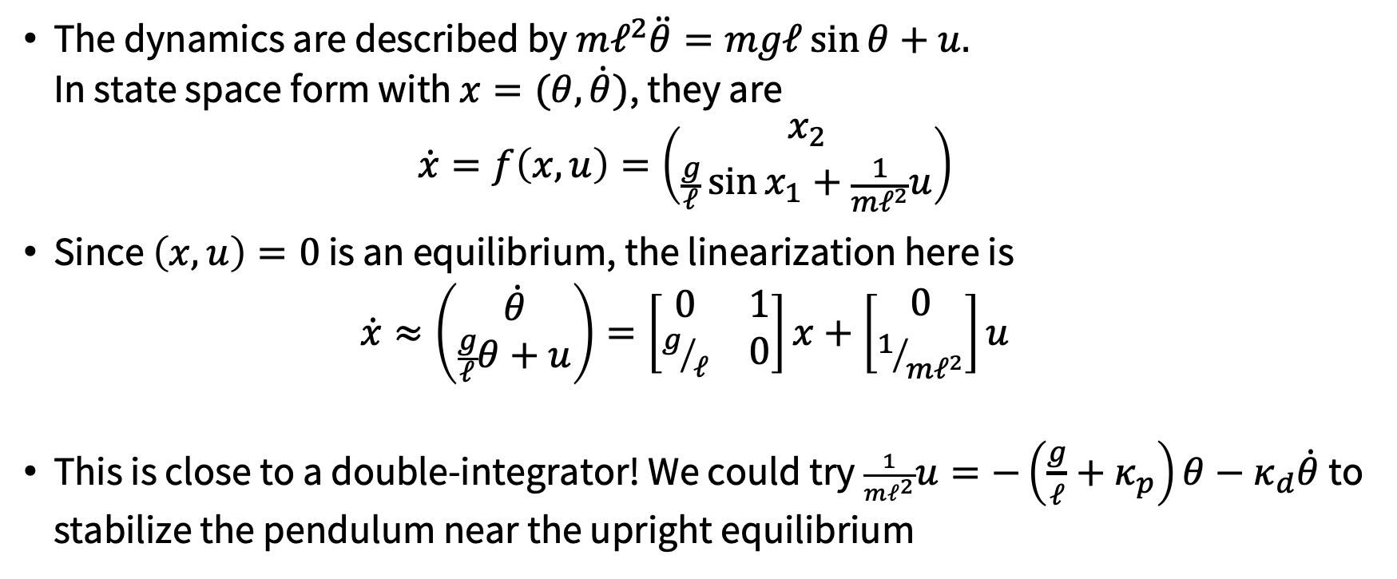




Example: Inverted pendulum
The dynamics are described by $mℓ^{2}\ddot{θ}=mgℓ\sin{θ}+u$. In state space form with $x=(θ,\dot{θ})$, they are $\dot{x}=f\left(x,u\right)=\left(\begin{matrix}x_{2} \\ \frac{g}{ℓ}\sin{x_{1}}+\frac{1}{mℓ^{2}}u\end{matrix}\right)$
Since $\left(x,u\right)=0$ is an equilibrium, the linearization here is $\dot{x}≈\left(\begin{matrix}\dot{θ} \\ \frac{g}{ℓ}θ+u\end{matrix}\right)=\left[\begin{matrix}0 & 1 \\ g/ℓ & 0\end{matrix}\right]x+\left[\begin{matrix}0 \\ 1/{mℓ^{2}}\end{matrix}\right]u$
This is close to a double-integrator! We could try $\frac{1}{mℓ^{2}}u=−\left(\frac{g}{ℓ}+κ_{p}\right)θ−κ_{d}\dot{θ}$ to stabilize the pendulum near the upright equilibrium
$$mg$$
$$θ$$
$$ℓ$$
$$u$$

Slide 18
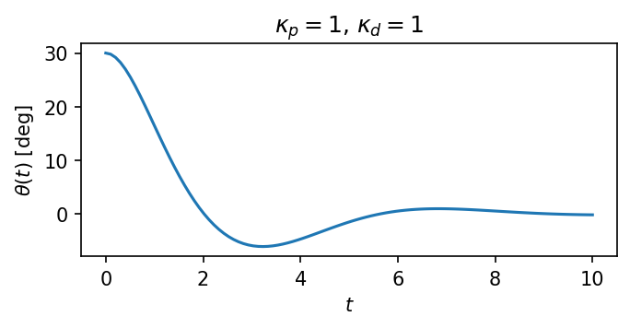





Example: Inverted pendulum
We try $\frac{1}{mℓ^{2}}u=−\left(\frac{g}{ℓ}+κ_{p}\right)θ−κ_{d}\dot{θ}$ to stabilize the pendulum near the upright equilibrium:
We will later discuss how we actually simulate this system on a computer
$$mg$$
$$θ$$
$$ℓ$$
$$u$$

Slide 19
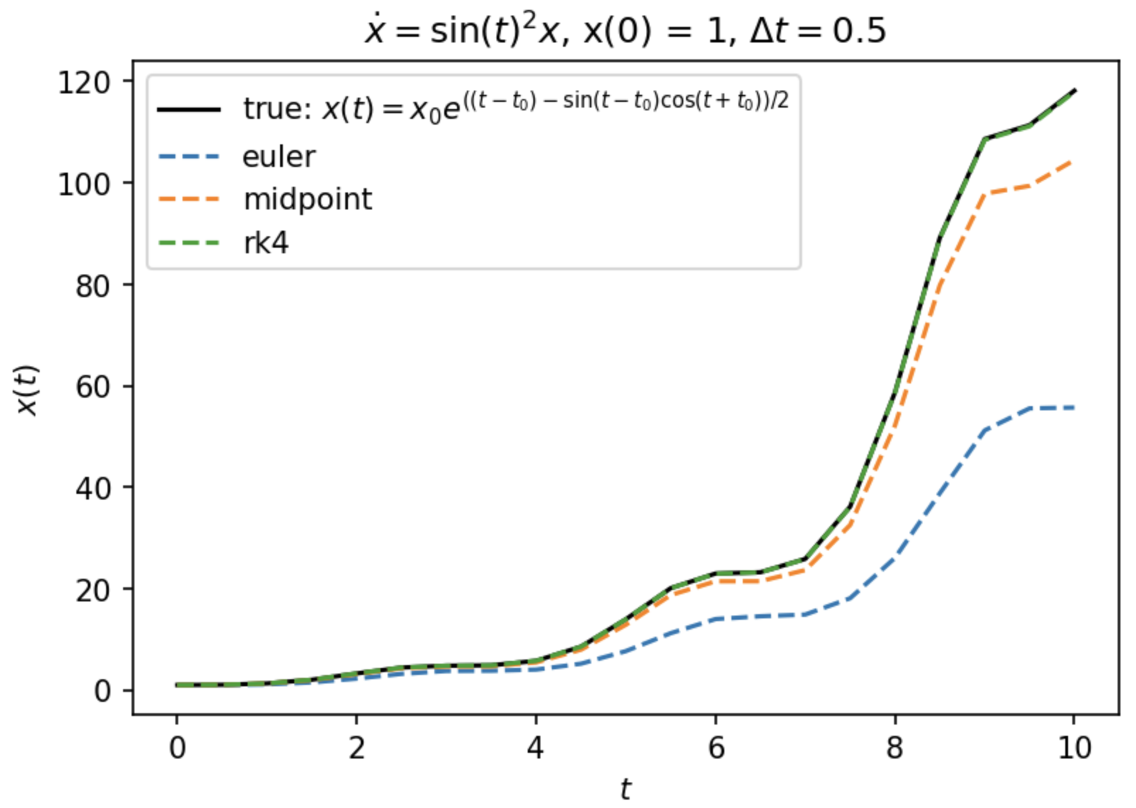
Next time

Slide 20
Attendance Form

