Slide 1
Principles of Robot Autonomy I
State space dynamics – computation and simulation

Slide 2

Attendance Form

Slide 3
Agenda
State space dynamics
Simulation / numerical integration
Efficient computation (auto-differentiation)
Readings
Chapter 1, sections 1.4 – 1.5 in D. Gammelli, J. Lorenzetti, K. Luo, G. Zardini, M. Pavone. Principles of Robot Autonomy. 2026.

Slide 4
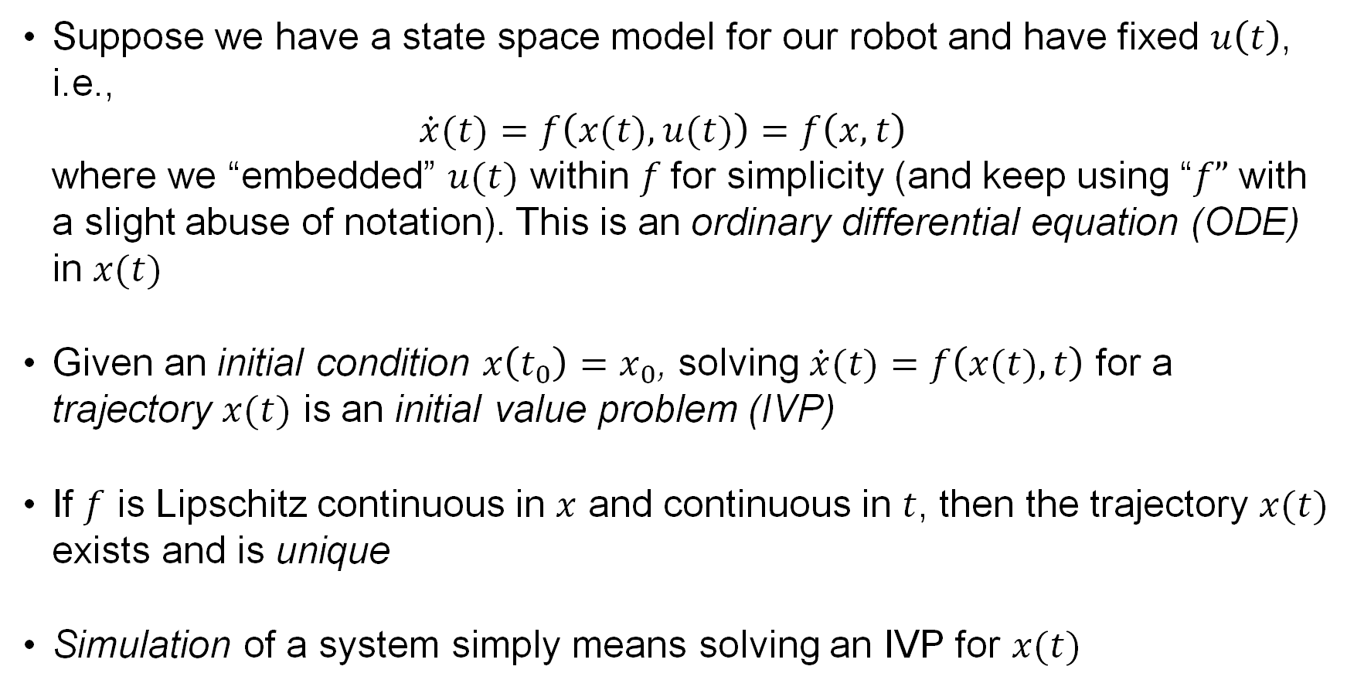
Simulation
Suppose we have a state space model for our robot and have fixed $u\left(t\right)$, i.e., $\dot{x}(t)=f\left(x(t),u(t)\right)=f\left(x,t\right)$ where we “embedded” $u(t)$ within $f$for simplicity (and keep using “$f”$ with a slight abuse of notation). This is an ordinary differential equation (ODE) in $x(t)$
Given an initial condition $x\left(t_{0}\right)=x_{0}$, solving $\dot{x}(t)=f\left(x(t),t\right)$ for a trajectory $x(t)$ is an initial value problem (IVP)
If $f$ is Lipschitz continuous in $x$ and continuous in $t$, then the trajectory $x(t)$ exists and is unique
Simulation of a system simply means solving an IVP for $x(t)$

Slide 5
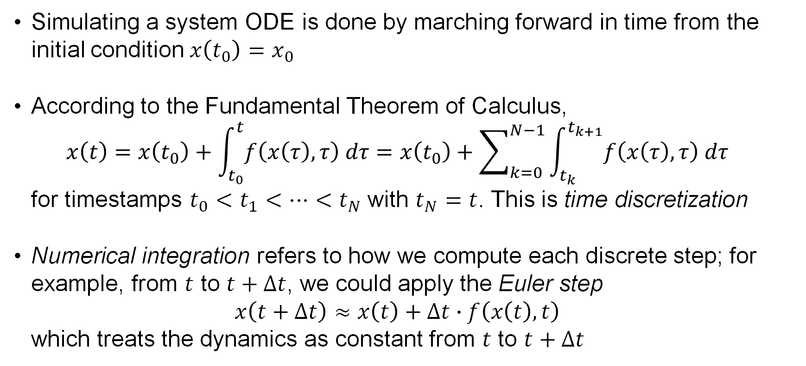
Numerical integration
Simulating a system ODE is done by marching forward in time from the initial condition $x\left(t_{0}\right)=x_{0}$
According to the Fundamental Theorem of Calculus, $x\left(t\right)=x\left(t_{0}\right)+\int_{t_{0}}^{t}{f\left(x\left(τ\right),τ\right) dτ}=x\left(t_{0}\right)+\sum_{k=0}^{N−1}{\int_{t_{k}}^{t_{k+1}}{f\left(x\left(τ\right),τ\right) dτ}}$ for timestamps $t_{0}<t_{1}<⋯<t_{N}$ with $t_{N}=t$. This is time discretization
Numerical integration refers to how we compute each discrete step; for example, from $t$ to $t+∆t$, we could apply the Euler step $x\left(t+∆t\right)≈x\left(t\right)+∆t∙f\left(x\left(t\right),t\right)$ which treats the dynamics as constant from $t$ to $t+∆t$

Slide 6
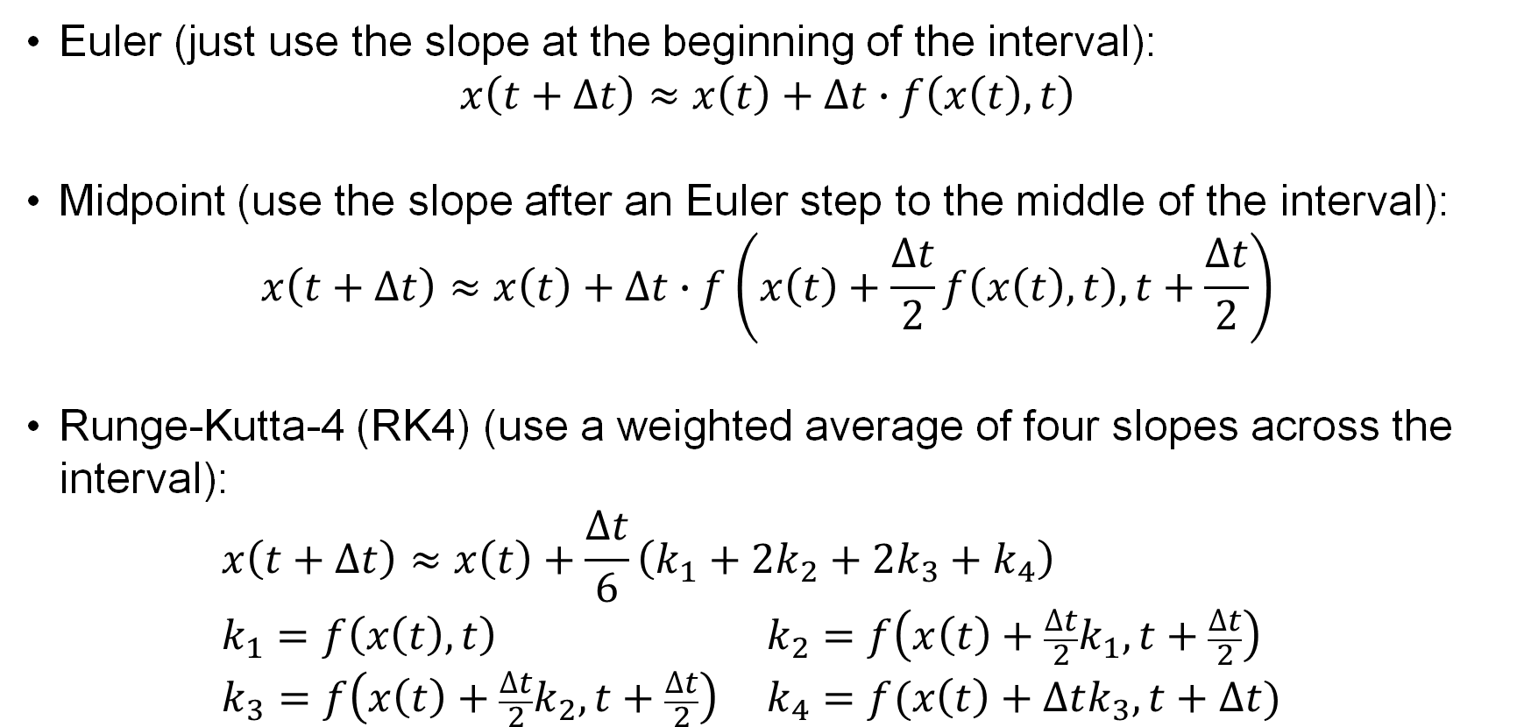
Numerical integration methods
Euler (just use the slope at the beginning of the interval): $x\left(t+∆t\right)≈x\left(t\right)+∆t∙f\left(x\left(t\right),t\right)$
Midpoint (use the slope after an Euler step to the middle of the interval): $x\left(t+∆t\right)≈x\left(t\right)+∆t∙f\left(x\left(t\right)+\frac{∆t}{2}f\left(x\left(t\right),t\right),t+\frac{∆t}{2}\right)$
Runge-Kutta-4 (RK4) (use a weighted average of four slopes across the interval): $x\left(t+∆t\right)≈x\left(t\right)+\frac{∆t}{6}\left(k_{1}+{2k}_{2}+{2k}_{3}+k_{4}\right)$ $k_{1}=f\left(x\left(t\right),t\right) k_{2}=f\left(x\left(t\right)+\frac{∆t}{2}k_{1},t+\frac{∆t}{2}\right)$ $k_{3}=f\left(x\left(t\right)+\frac{∆t}{2}k_{2},t+\frac{∆t}{2}\right) k_{4}=f(x\left(t\right)+∆tk_{3},t+∆t)$

Slide 7
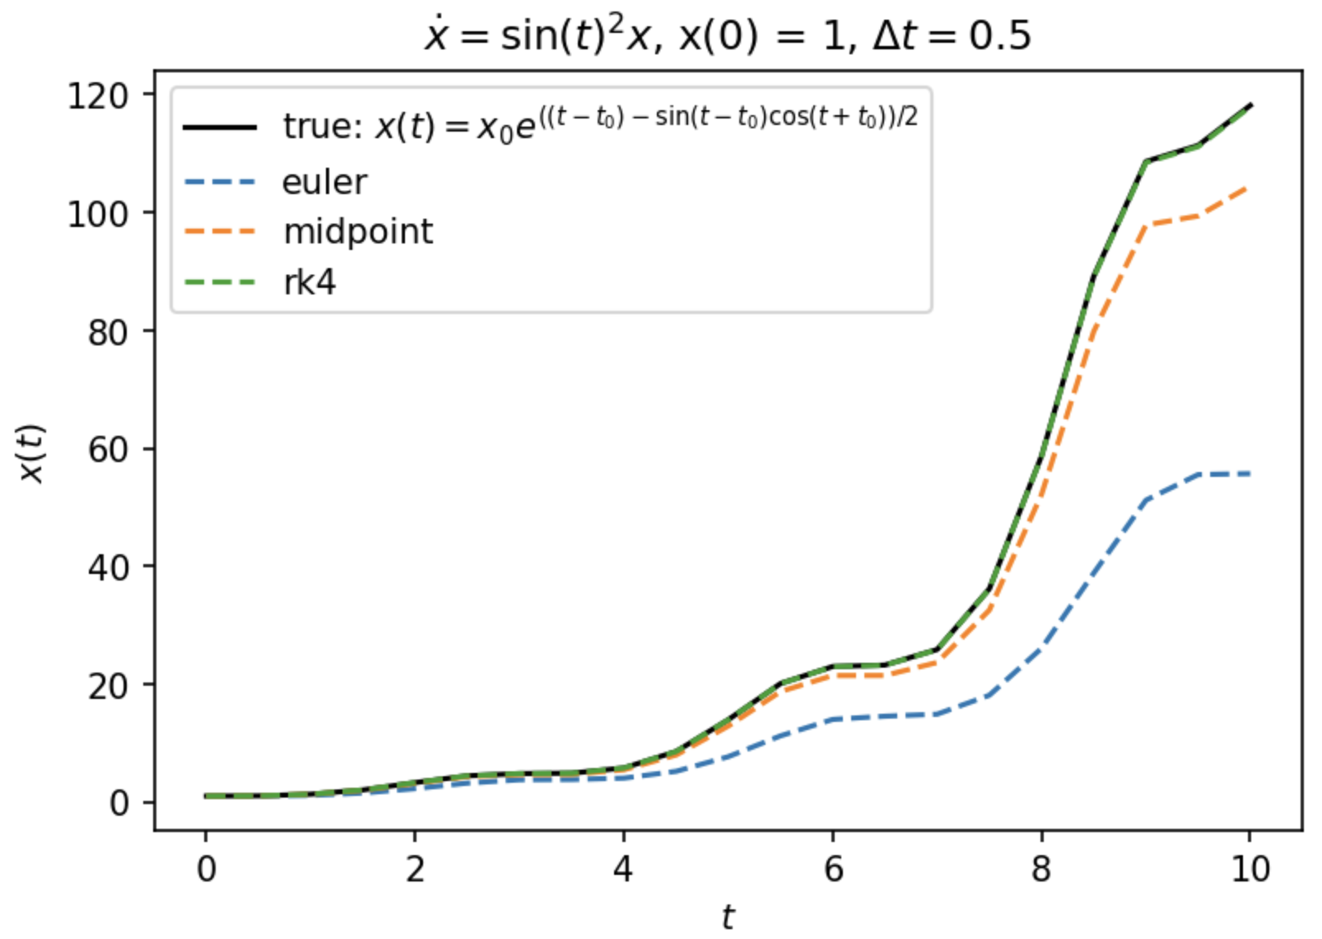

Truncation error
Higher-order integration schemes use more function evaluations to reduce “local” (i.e., one-step) and “global” (i.e., accumulated) truncation error.
Local / global truncation errors for each method:
Euler: $𝒪\left({∆t}^{2}\right)$ / $𝒪\left(∆t\right)$
midpoint: $𝒪\left({∆t}^{3}\right)$ / $𝒪\left({∆t}^{2}\right)$
Runge-Kutta (RK4): $𝒪\left({∆t}^{5}\right)$ / $𝒪\left({∆t}^{4}\right)$

Slide 8
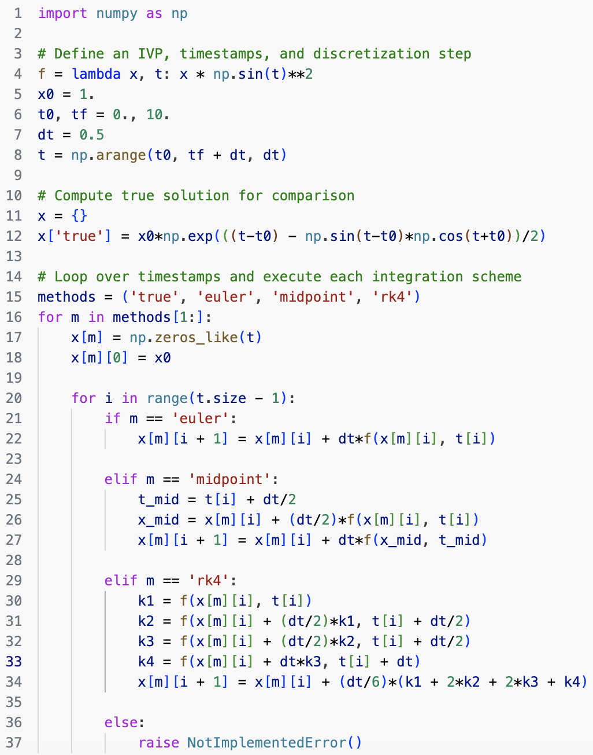
Example: ODE integration “by hand”

Slide 9
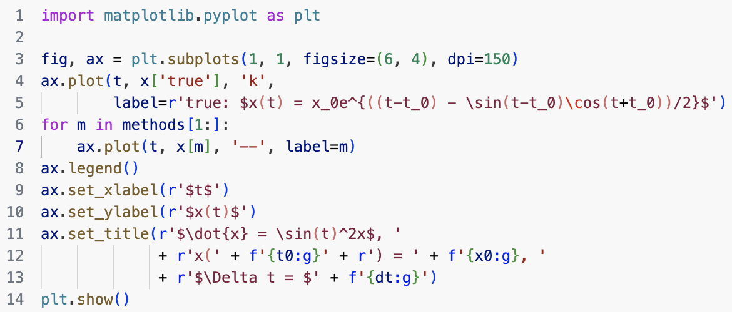
Example: ODE integration “by hand”
Free, open-source plotting functionality is provided by Matplotlib
Check out the documentation! https://matplotlib.org

Slide 10
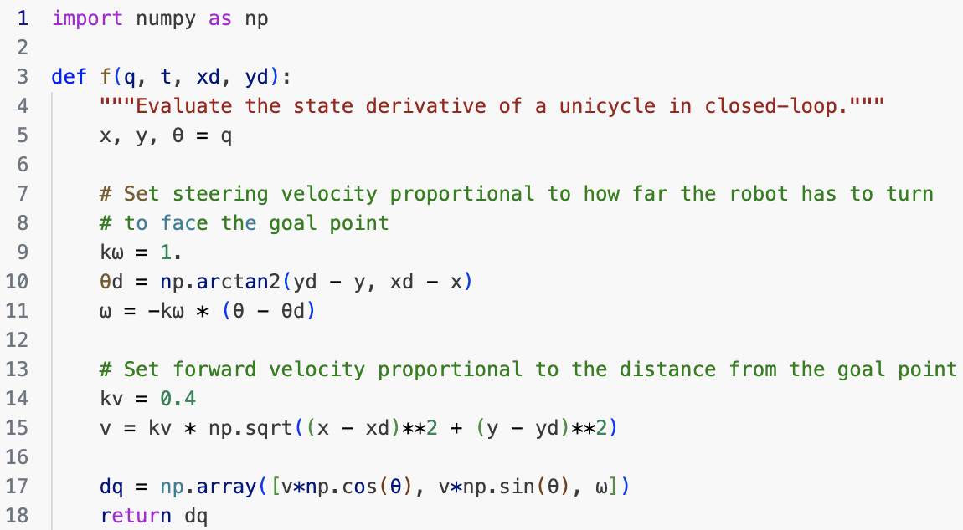
Example: Unicycle robot simulation
Set the control input to guide the robot towards a target point $\left(x_{d},y_{d}\right)$, and simulate the “closed-loop” system

Slide 11
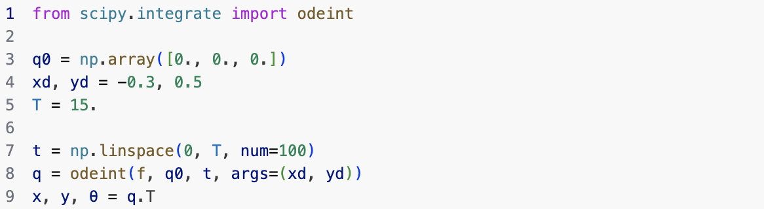
Example: Unicycle robot simulation
ODE integration is done by odeint from scipy.integrate, which uses the RK45 scheme (i.e., Runge-Kutta with an adaptive step size)

Slide 12
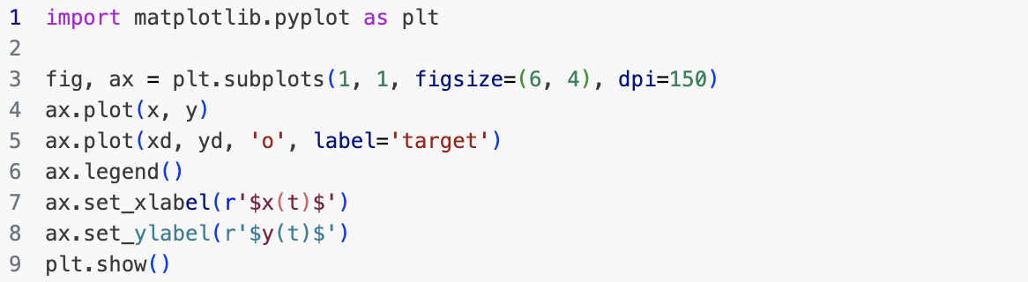
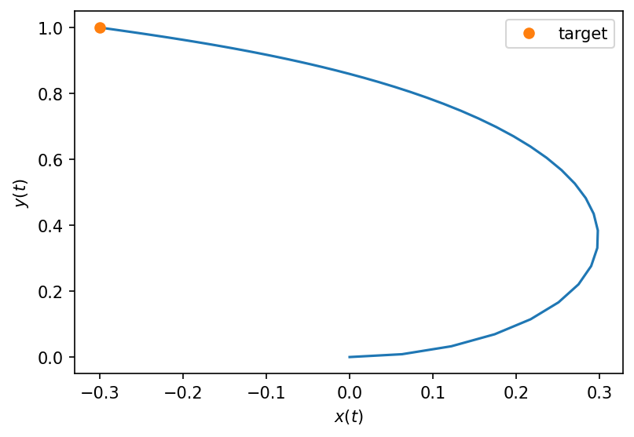
Example: Unicycle robot simulation

Slide 13
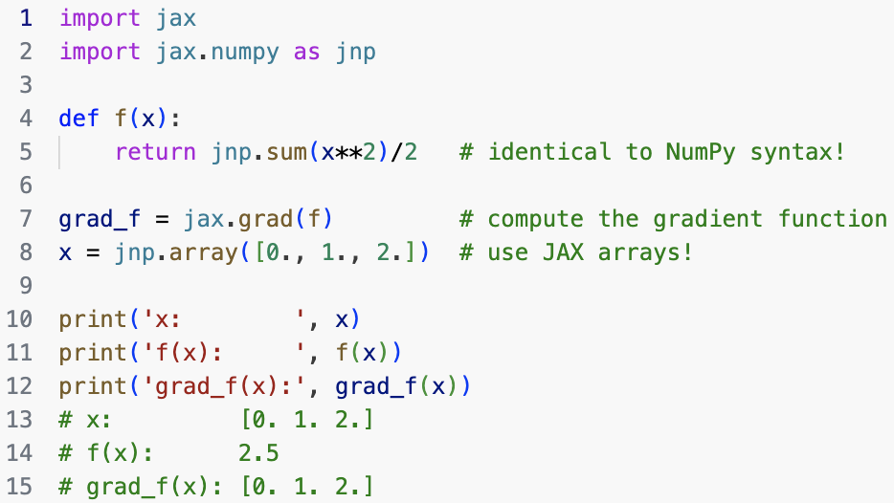
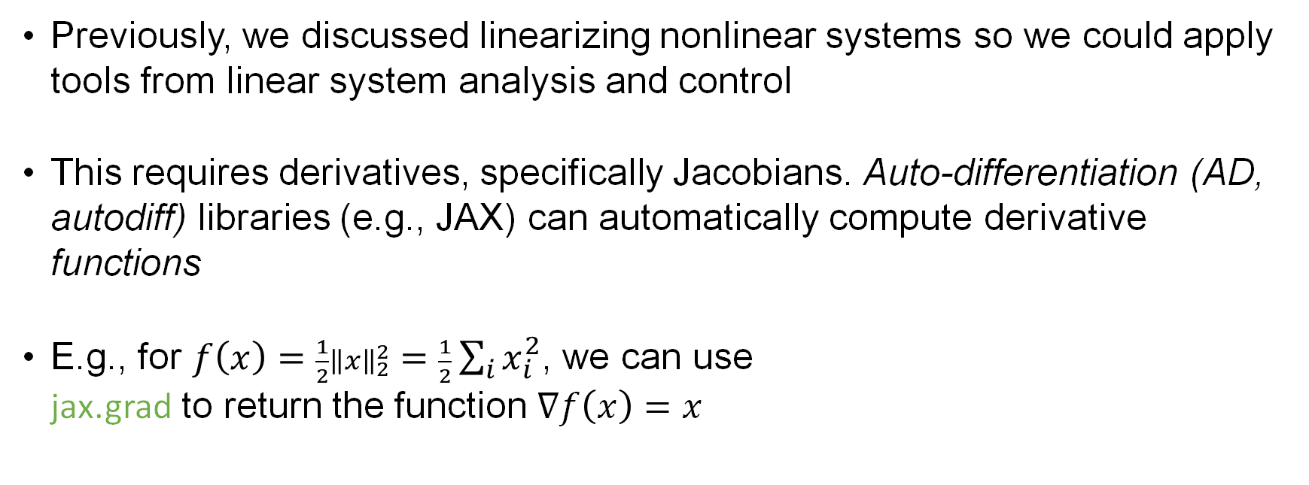
Auto-differentiation in Python via JAX
Previously, we discussed linearizing nonlinear systems so we could apply tools from linear system analysis and control
This requires derivatives, specifically Jacobians. Auto-differentiation (AD, autodiff) libraries (e.g., JAX) can automatically compute derivative functions
E.g., for $f\left(x\right)=\frac{1}{2}{\left\|x\right\|}_{2}^{2}=\frac{1}{2}\sum_{i}{x_{i}^{2}}$, we can use jax.grad to return the function $∇f\left(x\right)=x$

Slide 14
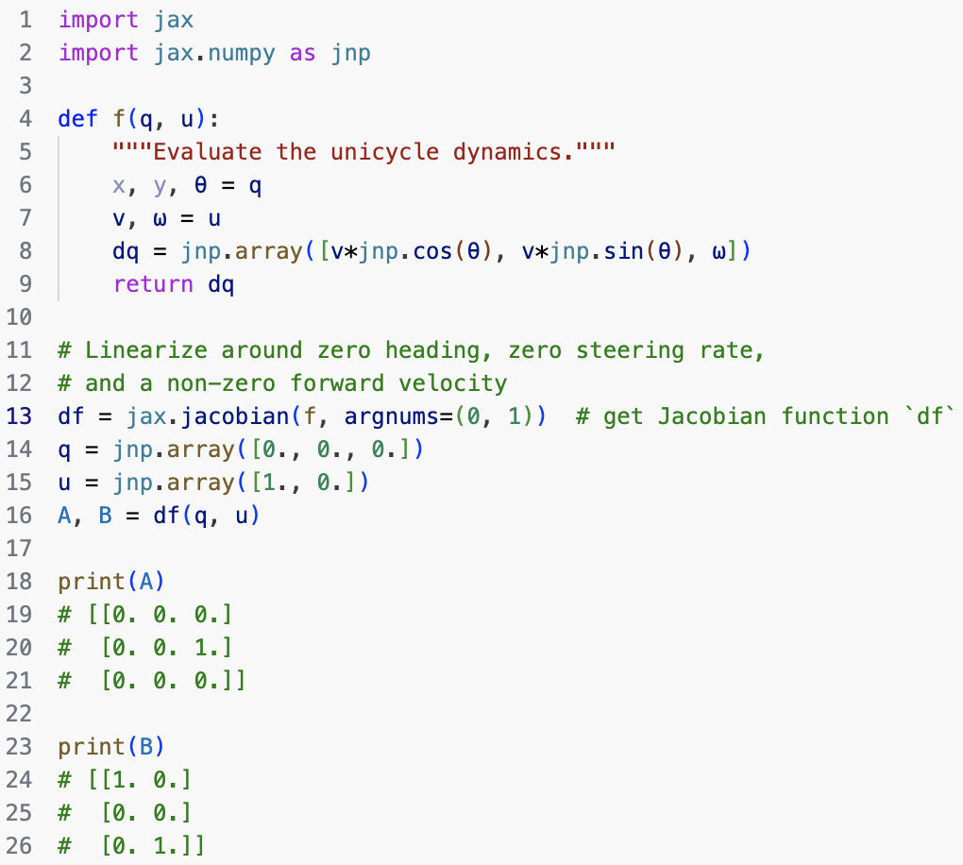

Example: Jacobians of unicycle dynamics
You can derive the Jacobians of around $\left(\overline{q},\overline{u}\right)$ to show $\frac{∂f}{∂q}=\left[\begin{matrix}0 & 0 & −\overline{v}\sin{\overline{θ}} \\ 0 & 0 & \overline{v}\cos{\overline{θ}} \\ 0 & 0 & 0\end{matrix}\right]$, $\frac{∂f}{∂u}=\left[\begin{matrix}\cos{\overline{θ}} & 0 \\ \sin{\overline{θ}} & 0 \\ 0 & 1\end{matrix}\right]$ or use JAX to compute them automatically (useful for more complicated systems later)

Slide 15
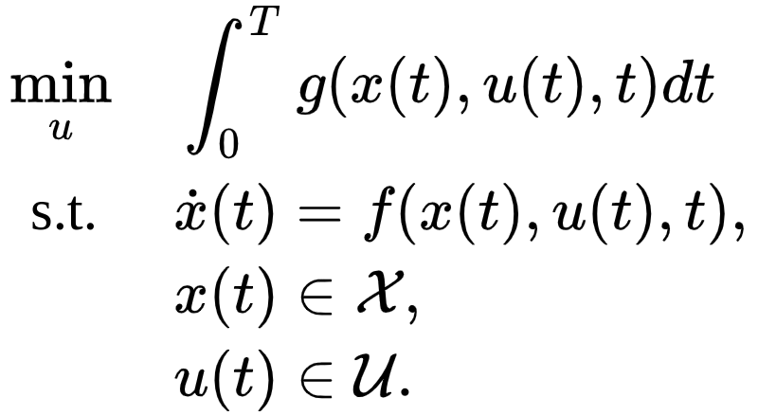
Next time

Slide 16
Attendance Form

