Slide 1
Principles of Robot Autonomy I
Trajectory Optimization

Slide 2

Attendance Form

Slide 3
Agenda
Trajectory optimization
Optimization-based methods
Differential flatness
Readings
Chapter 2, section 2.1 and sections 2.3 – 2.4 in D. Gammelli, J. Lorenzetti, K. Luo, G. Zardini, M. Pavone. Principles of Robot Autonomy. 2026.

Slide 4
The see-think-act cycle
This week’s focus

Slide 5
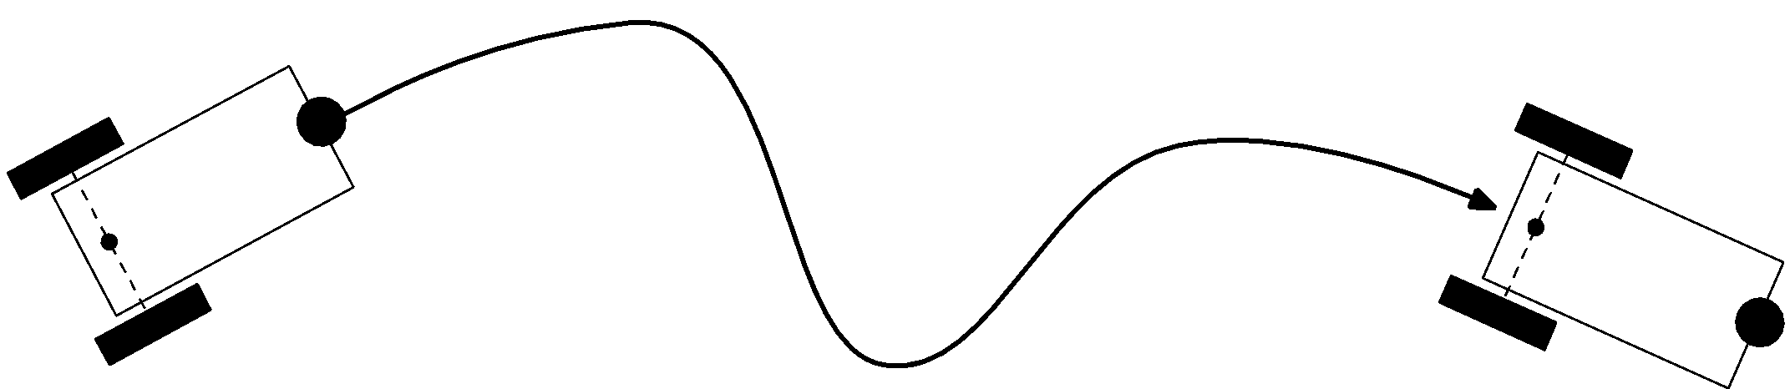
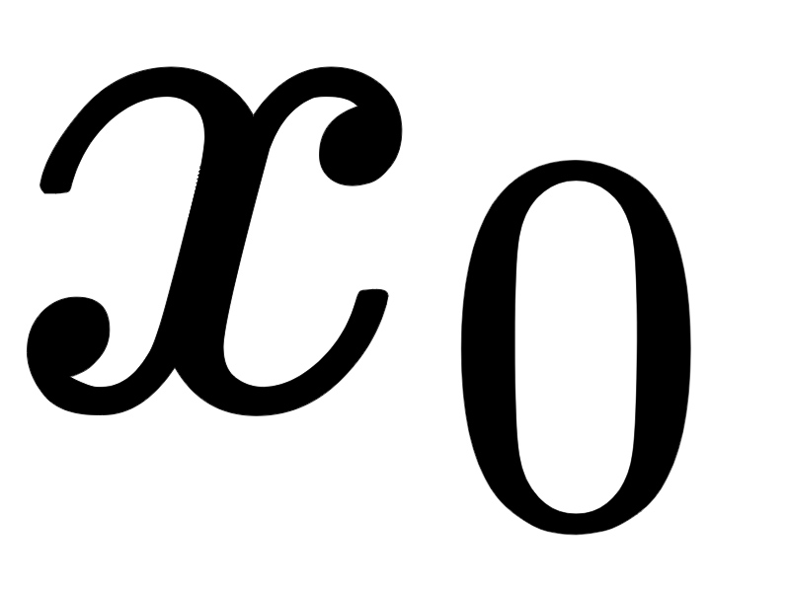
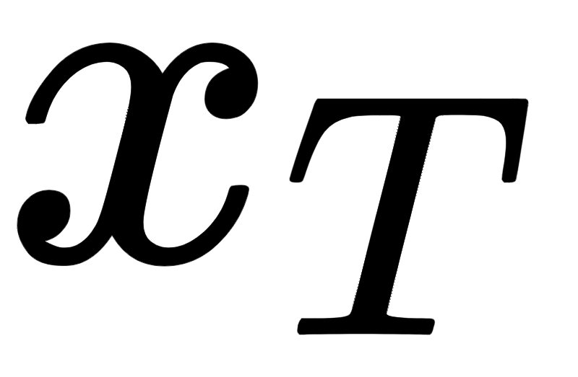

Motion generation and control
Given the state space model of a robotic system, that is
$$\dot{x}(t)=f\left(x\left(t\right),u\left(t\right),t\right)$$
how can we control its motion from an initial configuration to a desired configuration?

Slide 6
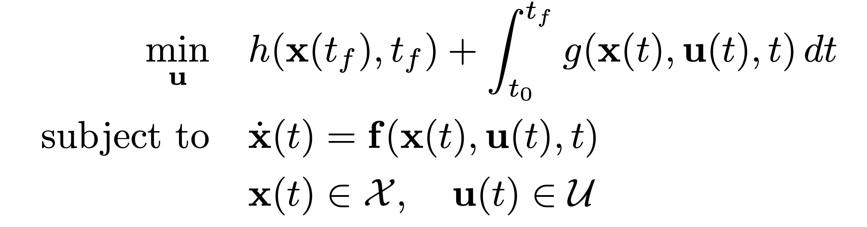
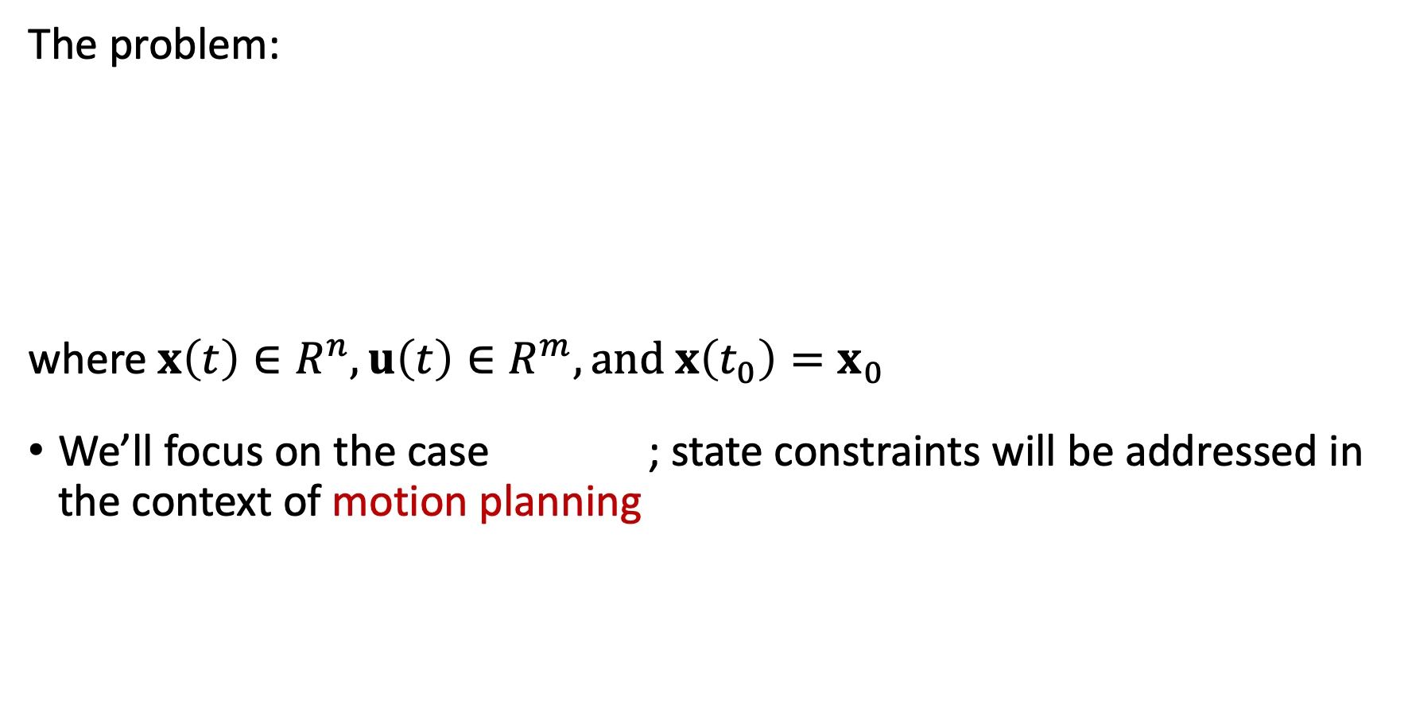
Optimal control problem
The problem:
where $x\left(t\right)∈R^{n}, u\left(t\right)∈R^{m}, and x\left(t_{0}\right)=x_{0}$
We’ll focus on the case ; state constraints will be addressed in the context of motion planning

Slide 7
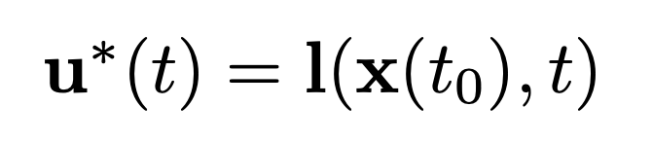
Forms of optimal control
If a functional relationship of the form
can be found, then the optimal control is said to be in closed-loop form
If the optimal control law is determined as a function of time for a specified initial state value
then the optimal control is said to be in open-loop form
A good compromise: two-step design
Reference trajectory
Reference control
(open-loop)
Trajectory-tracking law
(closed-loop)
Tracking error

Slide 8
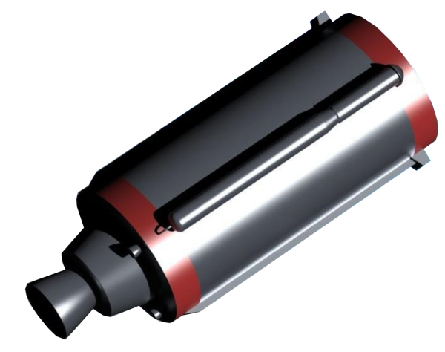
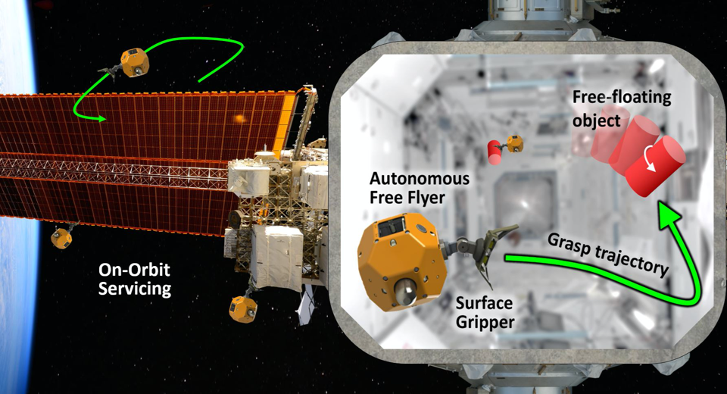
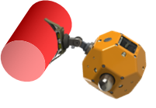

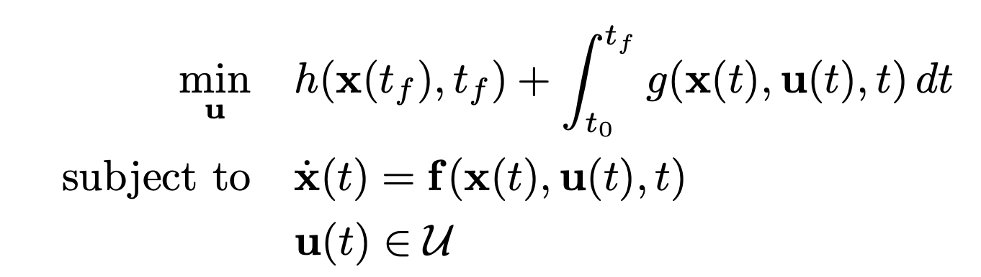
Trajectory optimization
We want to find an open-loop
control trajectory
that solves the optimal control problem (OCP)
cost (fuel consumption)
dynamics
constraints
Similar to before, but focus is on open-loop control and we also remove state constraints (more general formulations are possible though!)

Slide 9
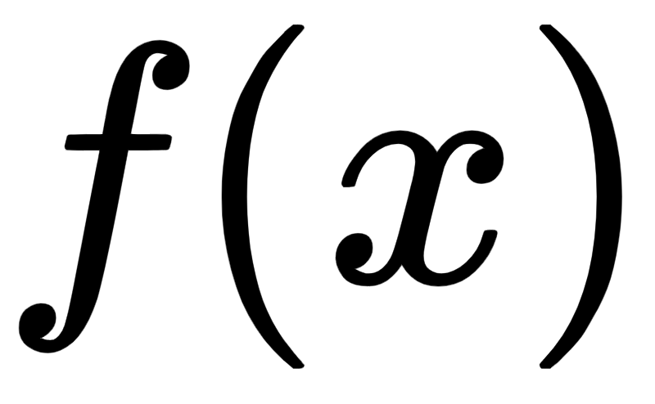
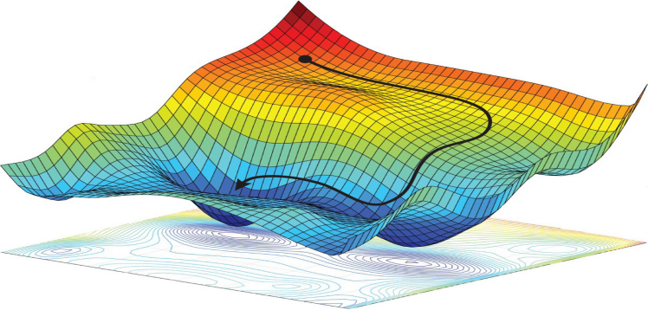

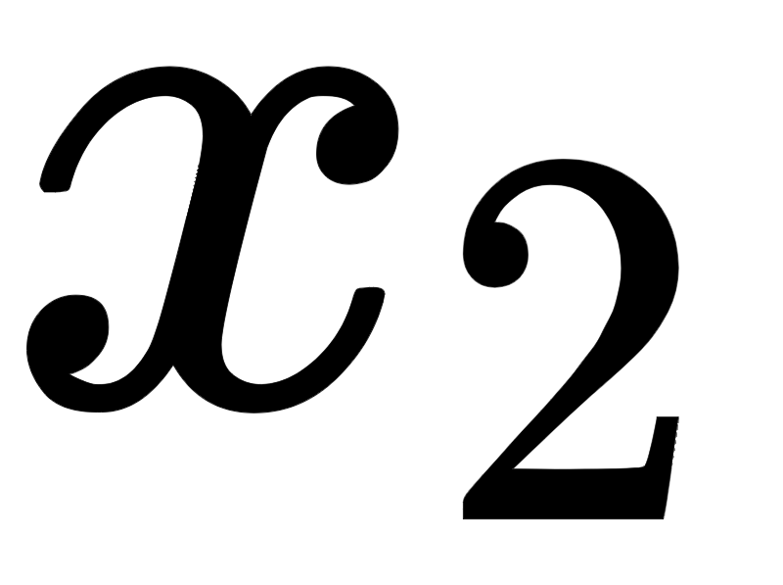

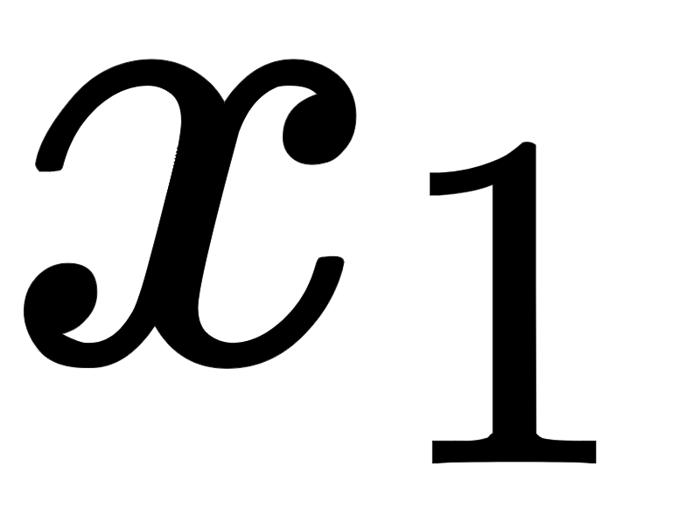
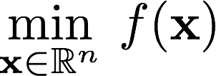
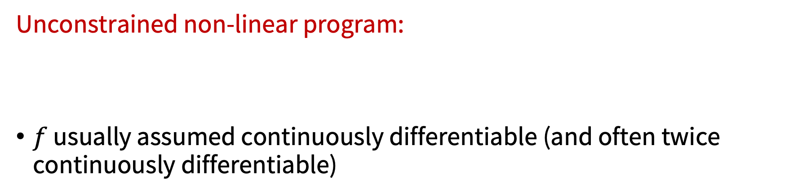
Non-linear optimization
1-D
cost (fuel consumption)
cost
2-D
Optimization variable (control input)
Unconstrained non-linear program:
$f$ usually assumed continuously differentiable (and often twice continuously differentiable)

Slide 10
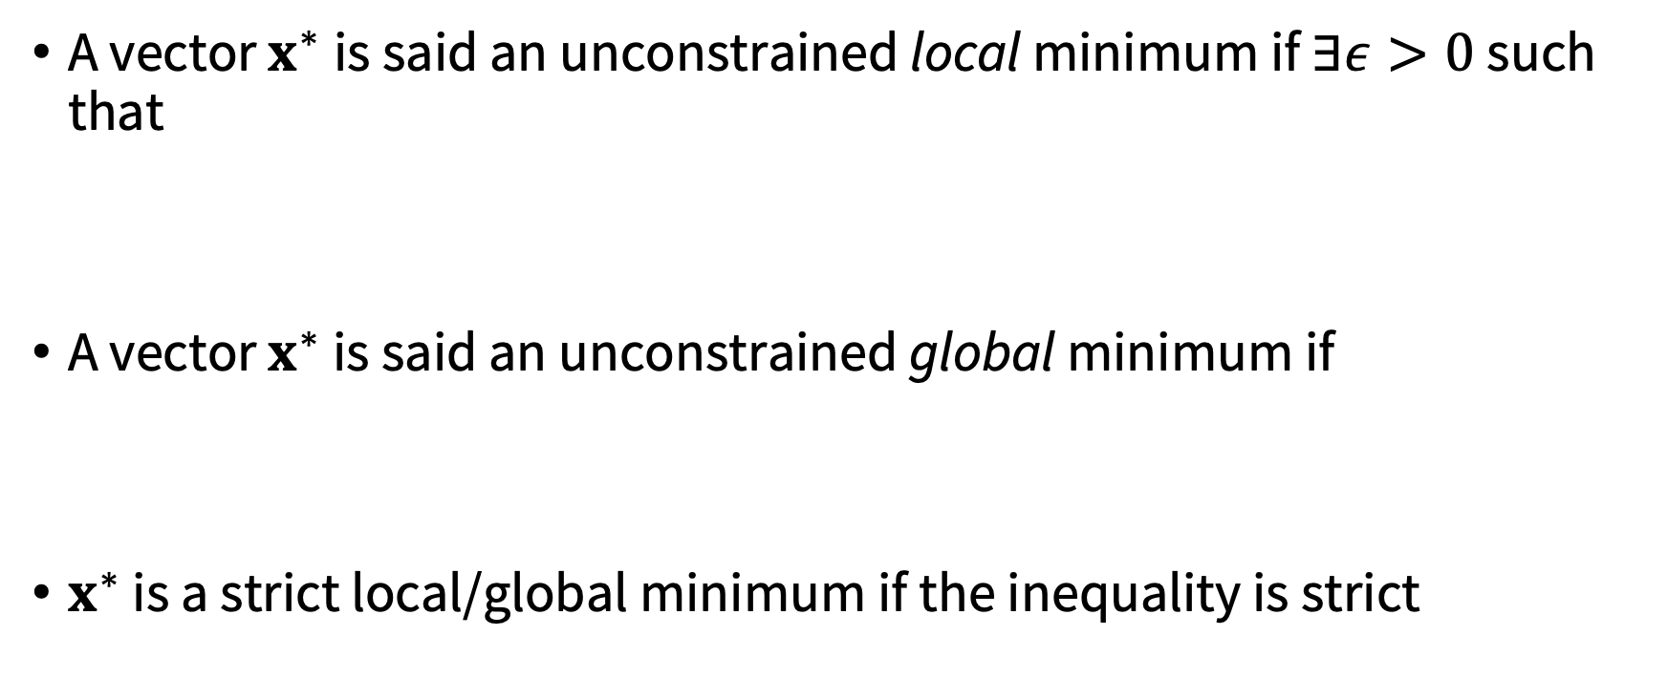
Local and global minima
A vector $x^{∗}$is said an unconstrained local minimum if $∃ε>0$ such that
A vector $x^{∗}$ is said an unconstrained global minimum if
$x^{∗}$ is a strict local/global minimum if the inequality is strict

Slide 11

Necessary conditions for optimality
Key idea: compare cost of a vector with cost of its close neighbors
Assume $f∈C^{1}$, by using Taylor series expansion
If $f∈C^{2}$

Slide 12
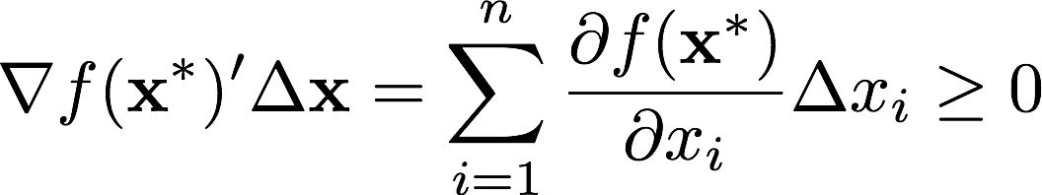
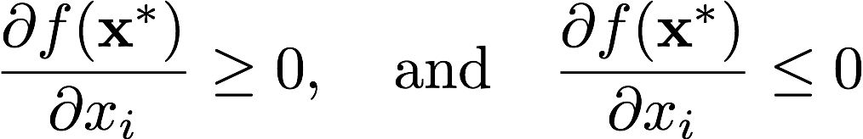
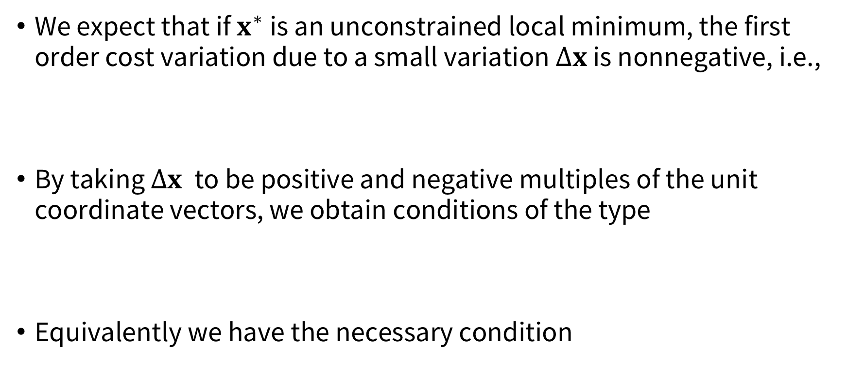
Necessary conditions for optimality
We expect that if $x^{∗}$ is an unconstrained local minimum, the first order cost variation due to a small variation $Δx$ is nonnegative, i.e.,
By taking $Δx$ to be positive and negative multiples of the unit coordinate vectors, we obtain conditions of the type
Equivalently we have the necessary condition

Slide 13
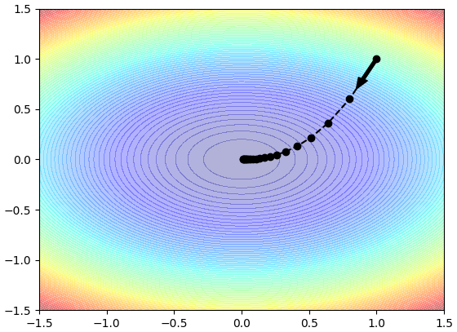
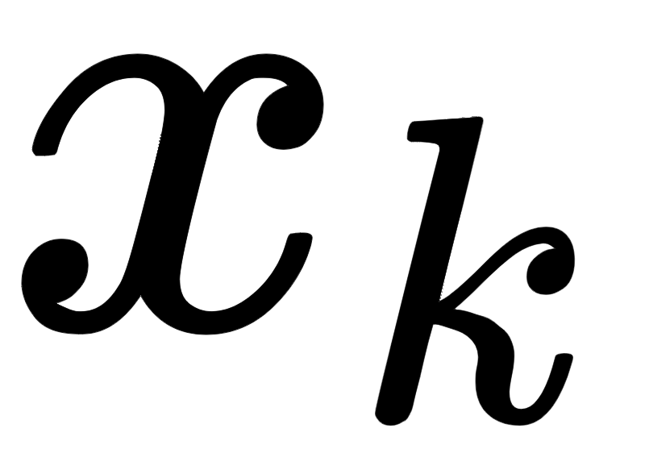
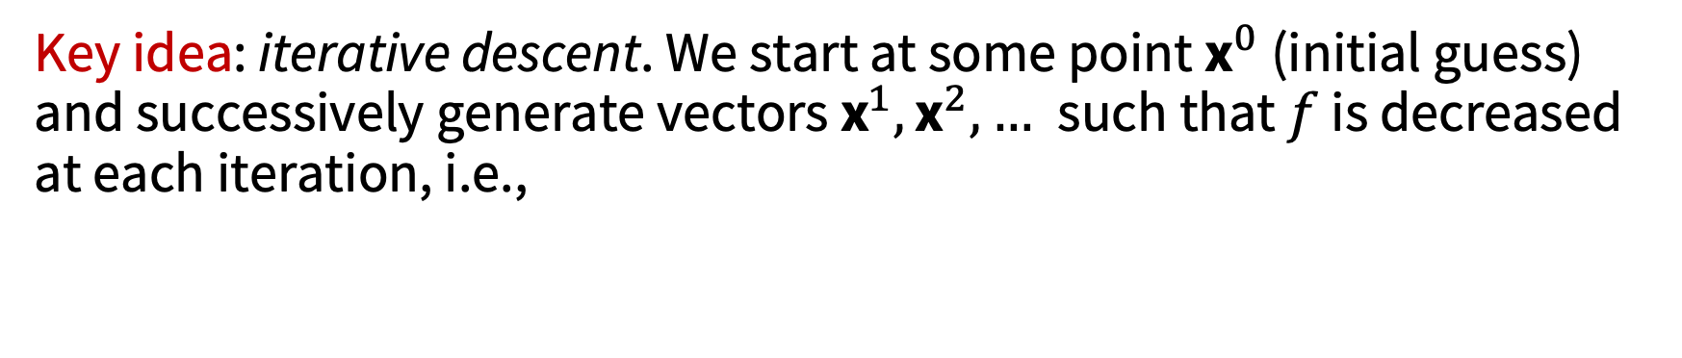

Computational methods
Key idea: iterative descent. We start at some point ${\text{x}}^{0}$ (initial guess) and successively generate vectors ${\text{x}}^{1},{\text{x}}^{2},…$such that $f$ is decreased at each iteration, i.e.,
The hope is to decrease $f$ all the way to a minimum

Slide 14
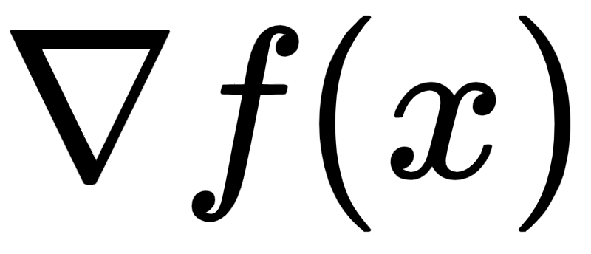

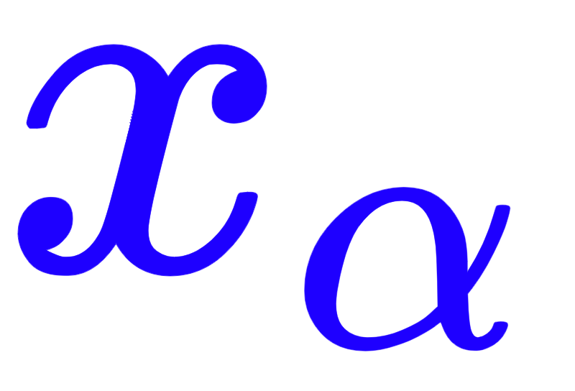


Gradient method
Given $\text{x}∈ℝ^{n}$ with $∇f\left(x\right)≠0$, consider the half line of vectors
From first order Taylor expansion ($α$ small)
So for $α$ small enough $f(x_{α})$ is smaller than $f(x)$!

Slide 15
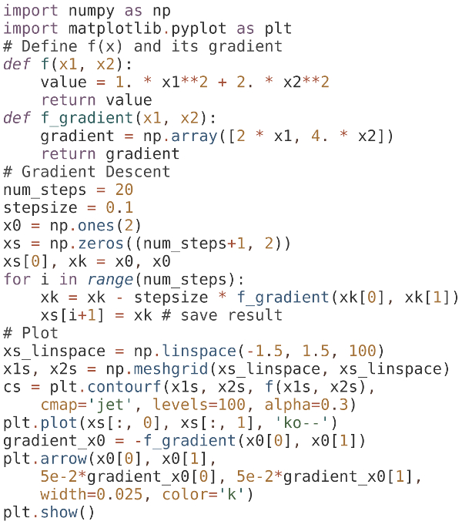
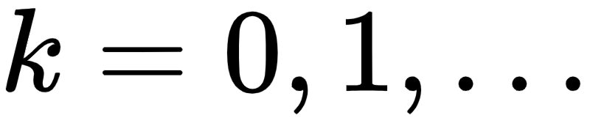

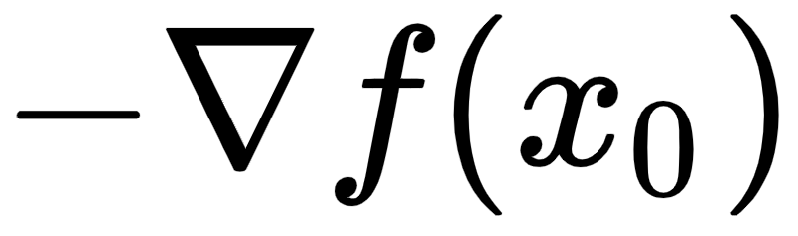
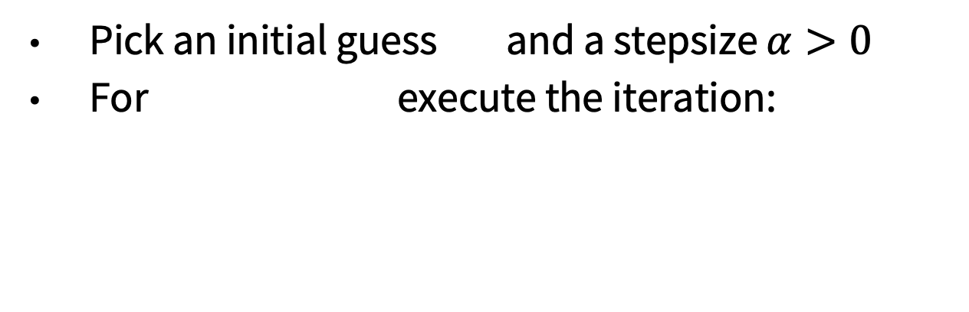
Gradient descent
Pick an initial guess and a stepsize $α>0$
For execute the iteration:
Play with lecture_5_1.ipynb

Slide 16

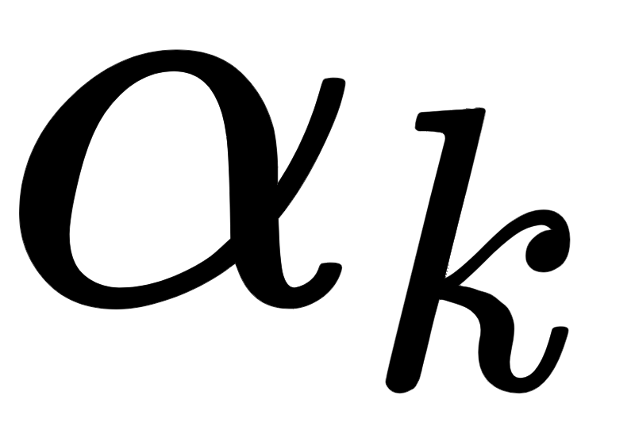
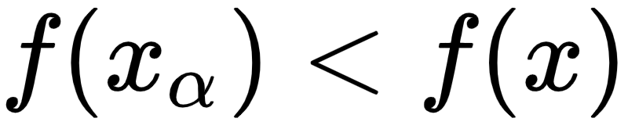
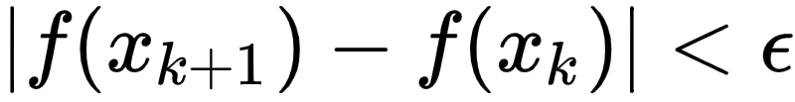
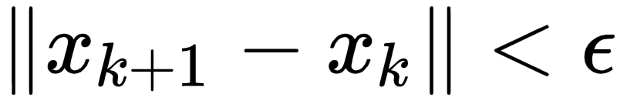
Gradient descent: additional considerations
Tuning parameter: stepsize
Use a decreasing sequence
Select it automatically at each descent step to ensure that
Termination criteria: stop after fixed number of iterations or once or

Slide 17
Back to trajectory optimization
Two broad classes of methods (for more details, see AA203):
Direct methods: transcribe infinite problem into finite dimensional, nonlinear programming (NLP) problem, and solve NLP ⇒ “First discretize, then optimize”
Indirect methods: attempt to find a minimum point “indirectly,” by solving the necessary conditions of optimality ⇒ “First optimize, then discretize”

Slide 18

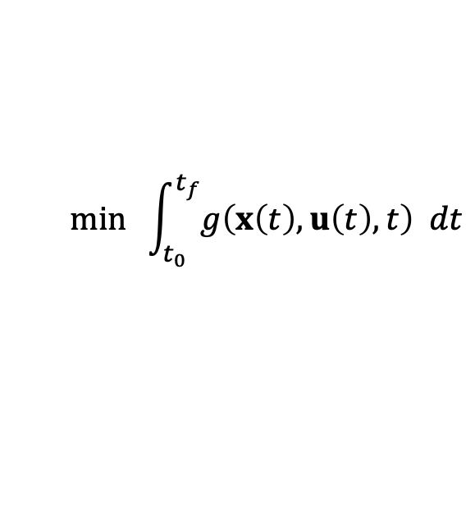
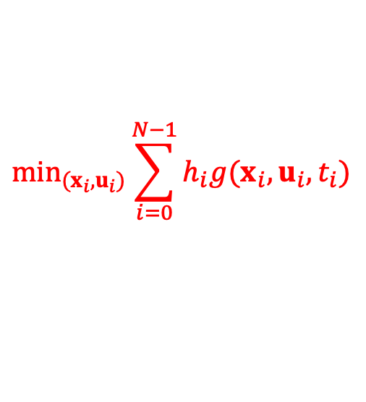
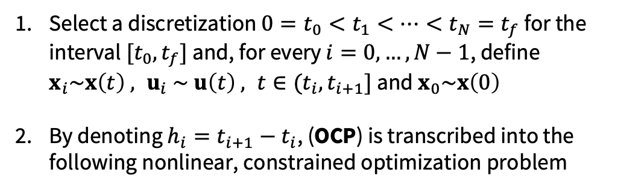


Direct methods: nonlinear programming transcription
Forward Euler time discretization
$$min \int_{t_{0}}^{t_{f}}{g\left(x\left(t\right),u\left(t\right),t\right) dt}$$
Select a discretization $0=t_{0}<t_{1}<…<t_{N}=t_{f}$ for the interval $[t_{0},t_{f}]$ and, for every $i=0,…,N−1$, define $x_{i}\sim x\left(t\right) , u_{i} \sim u\left(t\right) , t∈(t_{i},t_{i+1}]$ and $x_{0}\sim x\left(0\right)$
By denoting $h_{i}=t_{i+1}−t_{i}$, (OCP) is transcribed into the following nonlinear, constrained optimization problem
$\dot{x}(t)=f\left(x\left(t\right),u\left(t\right),t\right)$, $t∈\text{[}t_{0}, t_{f}\text{]}$
(OCP)
$u\left(t\right)∈U⊆ℝ^{m}$, $t∈\text{[}t_{0}\text{, }t_{f}\text{]}$
$$\min_{(x_{i},u_{i})}\sum_{i=0}^{N−1}{h_{i}g(x_{i},u_{i},t_{i})}$$
$x\left(0\right)= x_{0}$, $x\left(t_{f}\right)=x_{t_{f}}$
Initial and final conditions
(NLOP)
$$x_{i+1}=x_{i}+h_{i}f\left(x_{i},u_{i},t_{i}\right), i=0,…,N−1$$
$$u_{i}∈U , i=0,…,N−1 ,x_{N}=x_{t_{f}}$$

Slide 19
Direct methods: software packages
Some software packages:
DIDO: http://www.elissarglobal.com/academic/products/
PROPT: http://tomopt.com/tomlab/products/propt/
GPOPS: http://www.gpops2.com/
CasADi: https://github.com/casadi/casadi/wiki
ACADO: http://acado.github.io/
Trajax: https://github.com/google/trajax
In addition to implementing efficient trajectory optimization algorithms, many of these tools provide easier-to-use modeling languages for problem specification

Slide 20
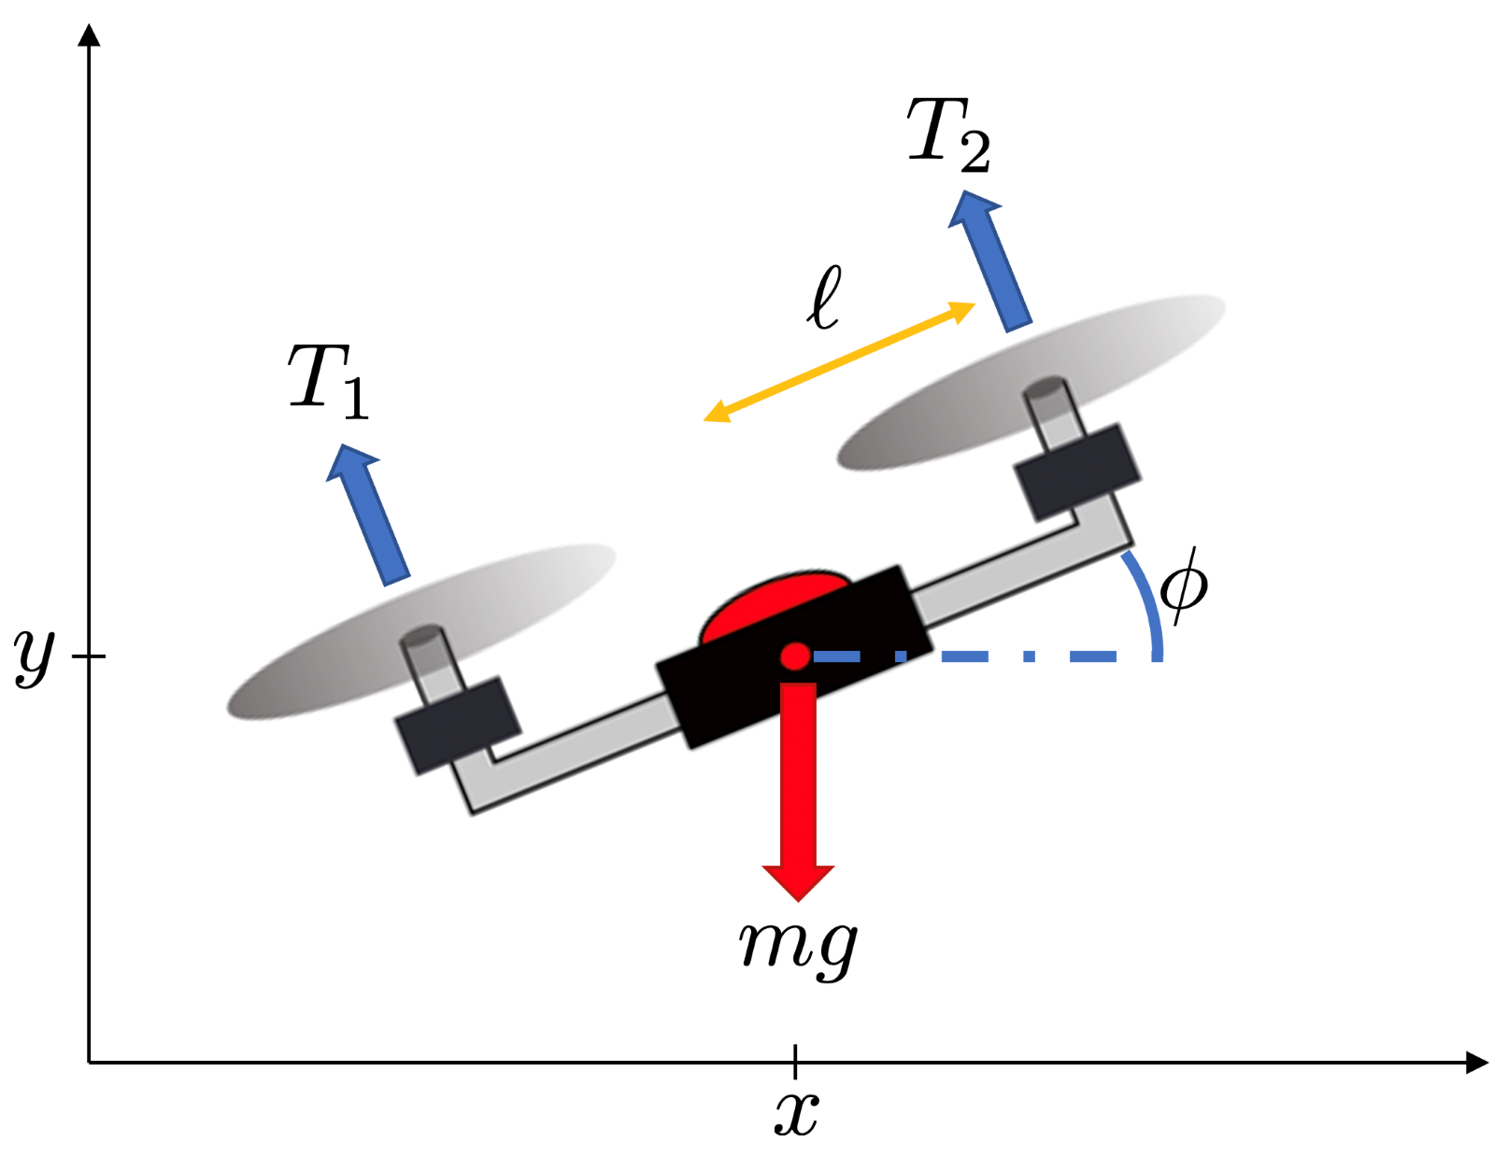
Illustrative example: planar quadrotor
(energy objective)
subject to dynamics
Play with lecture_5_2.ipynb

Slide 21
Differential flatness
Computing “good” feasible trajectories is often sufficient for trajectory generation purposes, and typically much faster than computing optimal ones
A class of systems for which trajectory generation is particularly easy are the so-called differentially flat systems
Reference: M. J. Van Nieuwstadt and R. M. Murray. Real‐time trajectory generation for differentially flat systems. 1998.

Slide 22
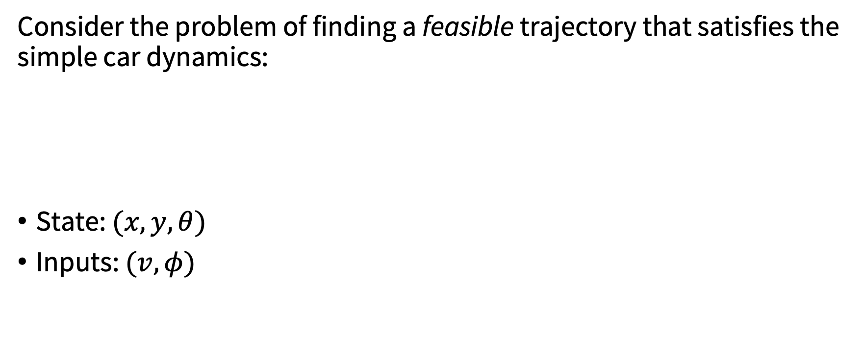
Motivating example: simple car
Consider the problem of finding a feasible trajectory that satisfies the simple car dynamics:
State: $(x,y, θ)$
Inputs: $(v,φ)$
Simple car

Slide 23
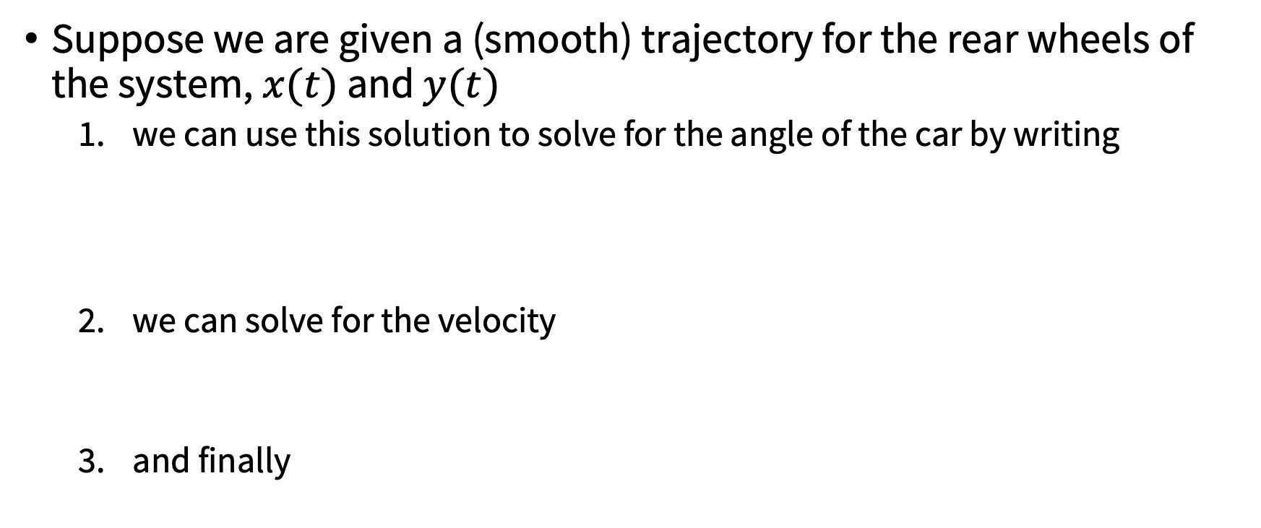
Structure of the dynamics for simple car steering
Suppose we are given a (smooth) trajectory for the rear wheels of the system, $x(t)$ and $y(t)$
we can use this solution to solve for the angle of the car by writing
we can solve for the velocity
and finally

Slide 24
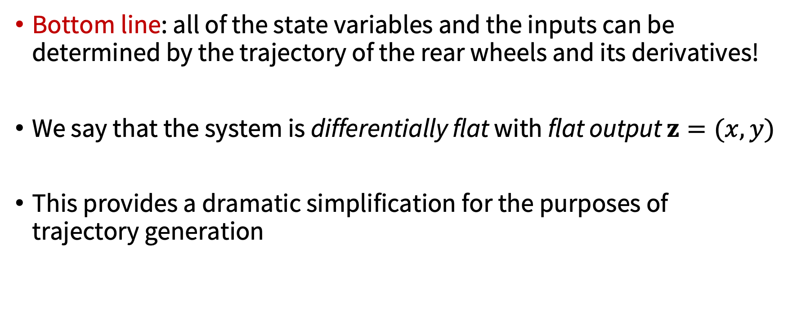
Structure of the dynamics for simple car steering
Bottom line: all of the state variables and the inputs can be determined by the trajectory of the rear wheels and its derivatives!
We say that the system is differentially flat with flat output $z=(x,y)$
This provides a dramatic simplification for the purposes of trajectory generation

Slide 25
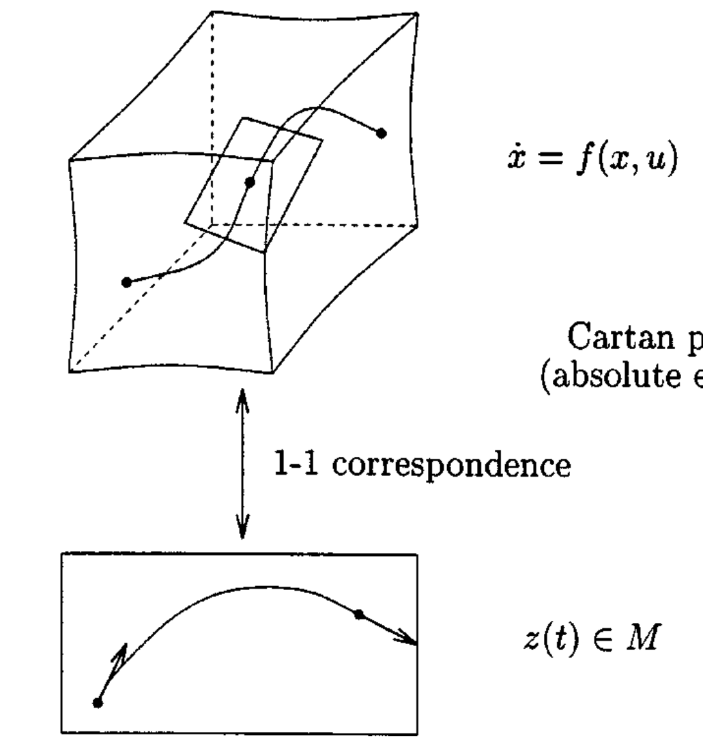
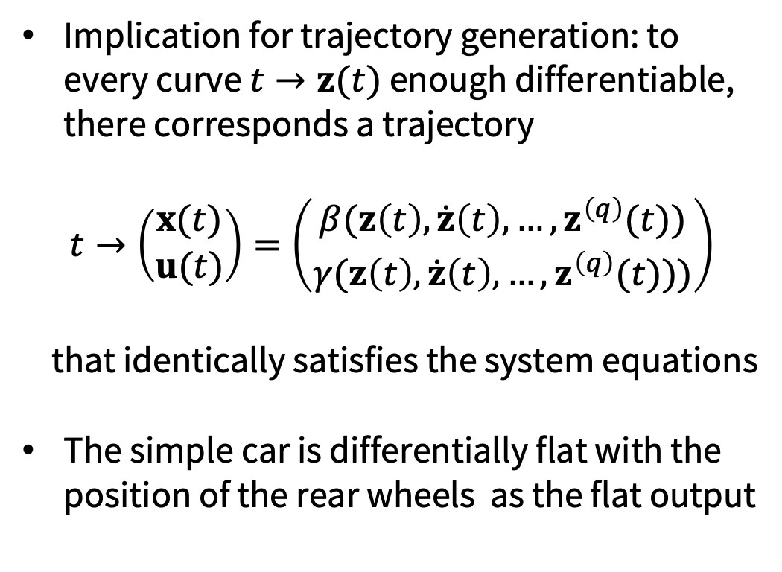


Differential flatness
Implication for trajectory generation: to every curve $t→z(t)$ enough differentiable, there corresponds a trajectory
$$t→\left(\begin{matrix}x(t) \\ u(t)\end{matrix}\right)=\left(\begin{matrix}β(z\left(t\right),\dot{z}\left(t\right),…,z^{\left(q\right)}(t)) \\ γ(z\left(t\right),\dot{z}\left(t\right),…,z^{\left(q\right)}(t)))\end{matrix}\right)$$
that identically satisfies the system equations
The simple car is differentially flat with the position of the rear wheels as the flat output
$$\dot{x}=f(x,u)$$
$$z\left(t\right)∈M$$
No dynamics!
From Nieuwstadt, Murray. 1998.

Slide 26
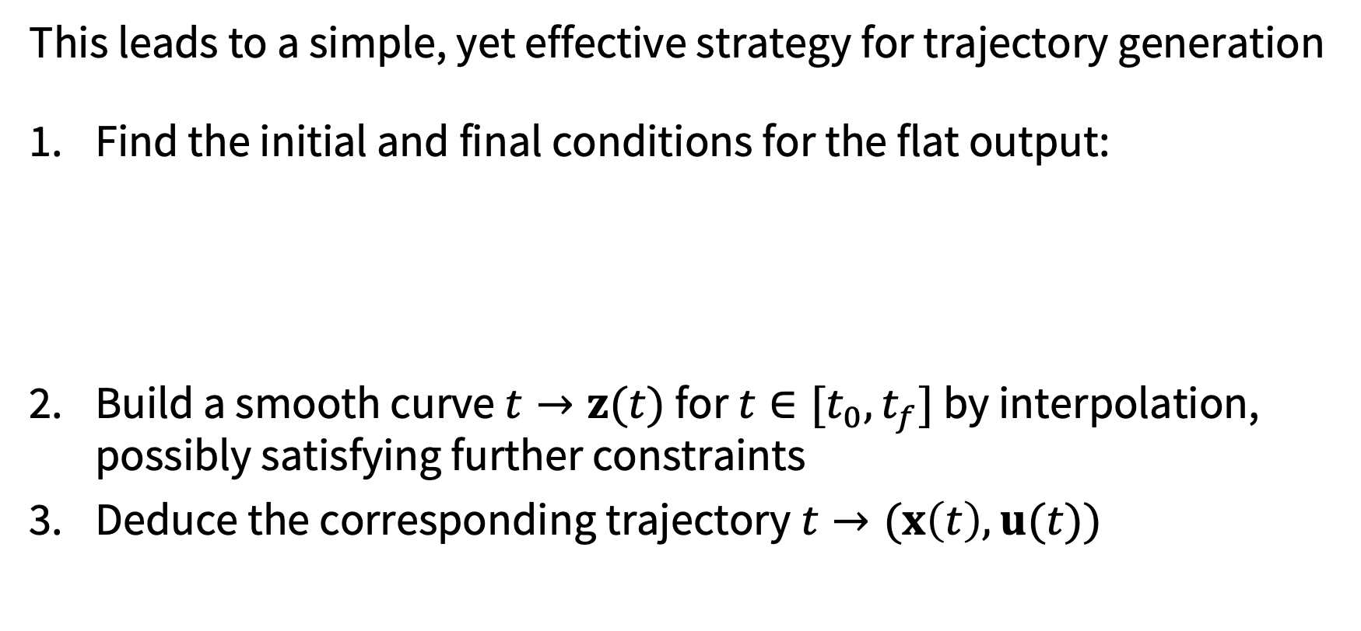
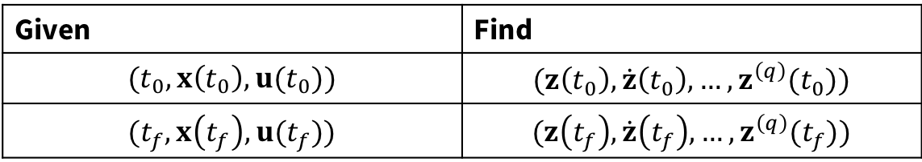
Practical implications
This leads to a simple, yet effective strategy for trajectory generation
Find the initial and final conditions for the flat output:
Build a smooth curve $t→z(t)$ for $t∈[t_{0}, t_{f}]$ by interpolation, possibly satisfying further constraints
Deduce the corresponding trajectory$t→(x\left(t\right),u(t))$
Given | Find
$$(t_{0}, x\left(t_{0}\right),u(t_{0}))$$ | $$(z\left(t_{0}\right),\dot{z}\left(t_{0}\right),…, z^{\left(q\right)}(t_{0}))$$
$$(t_{f}, x\left(t_{f}\right),u(t_{f}))$$ | $$(z\left(t_{f}\right),\dot{z}\left(t_{f}\right),…, z^{\left(q\right)}(t_{f}))$$

Slide 27

More on step 2
We can parameterize the flat output trajectory using a set of smooth basis functions $ψ_{i}(t)$
and then solve (Problem 2(i - iv) in pset 1)
For more details see: “Optimization-Based Control” by Richard Murray

Slide 28
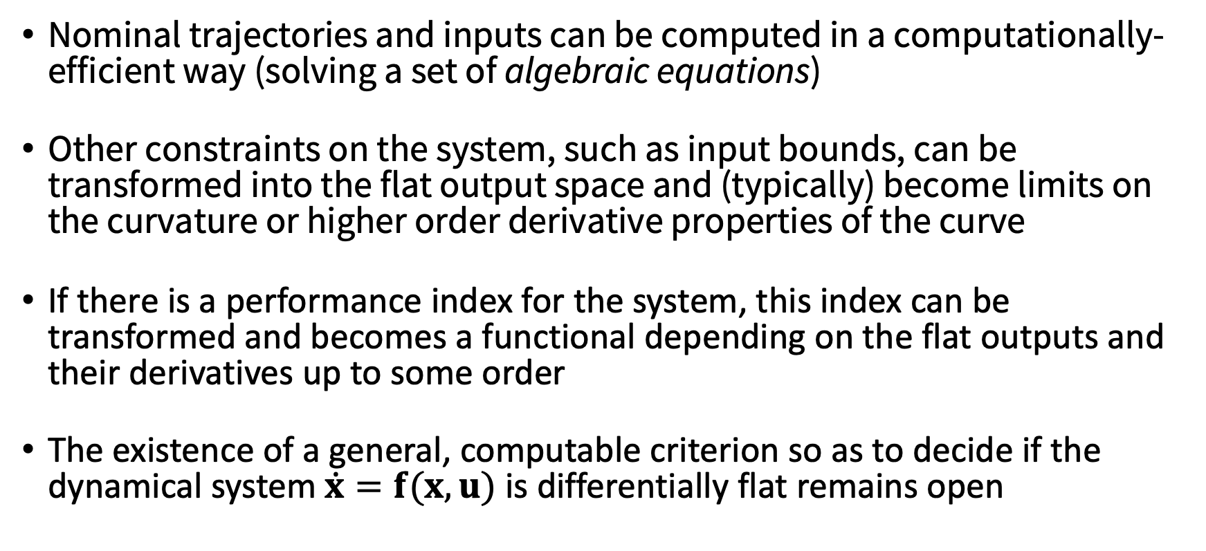
Key points
Nominal trajectories and inputs can be computed in a computationally-efficient way (solving a set of algebraic equations)
Other constraints on the system, such as input bounds, can be transformed into the flat output space and (typically) become limits on the curvature or higher order derivative properties of the curve
If there is a performance index for the system, this index can be transformed and becomes a functional depending on the flat outputs and their derivatives up to some order
The existence of a general, computable criterion so as to decide if the dynamical system $\dot{x}=f(x,u)$ is differentially flat remains open

Slide 29
The planar quadrotor is differentially flat!
Play with lecture_5_2.ipynb

Slide 30
Next time

