Slide 1
Principles of Robot Autonomy I
Trajectory tracking

Slide 2

Attendance Form

Slide 3
Agenda
Trajectory tracking
Based on differential flatness techniques
Based on LQR techniques
Readings
Chapter 3, sections 3.1 – 3.3 in D. Gammelli, J. Lorenzetti, K. Luo, G. Zardini, M. Pavone. Principles of Robot Autonomy. 2026.

Slide 4
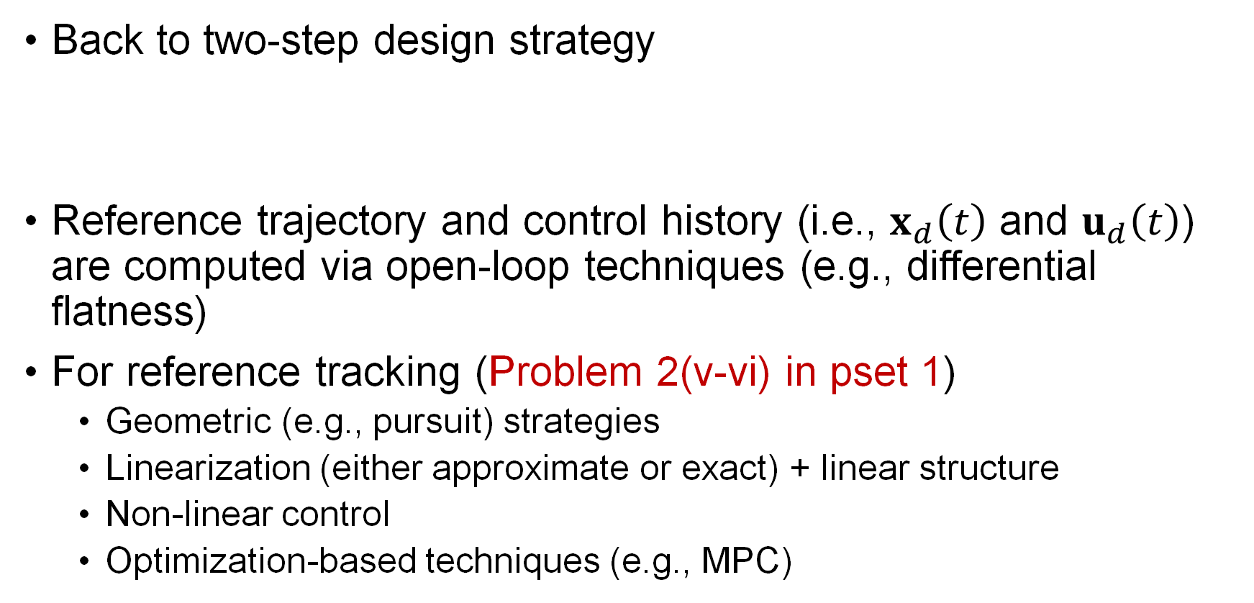
Trajectory tracking
Back to two-step design strategy
Reference trajectory and control history (i.e., $x_{d}\left(t\right)$ and $u_{d}\left(t\right)$) are computed via open-loop techniques (e.g., differential flatness)
For reference tracking (Problem 2(v-vi) in pset 1)
Geometric (e.g., pursuit) strategies
Linearization (either approximate or exact) + linear structure
Non-linear control
Optimization-based techniques (e.g., MPC)
Tracking control law

Slide 5
The see-think-act cycle
Closed-loop control/tracking

Slide 6
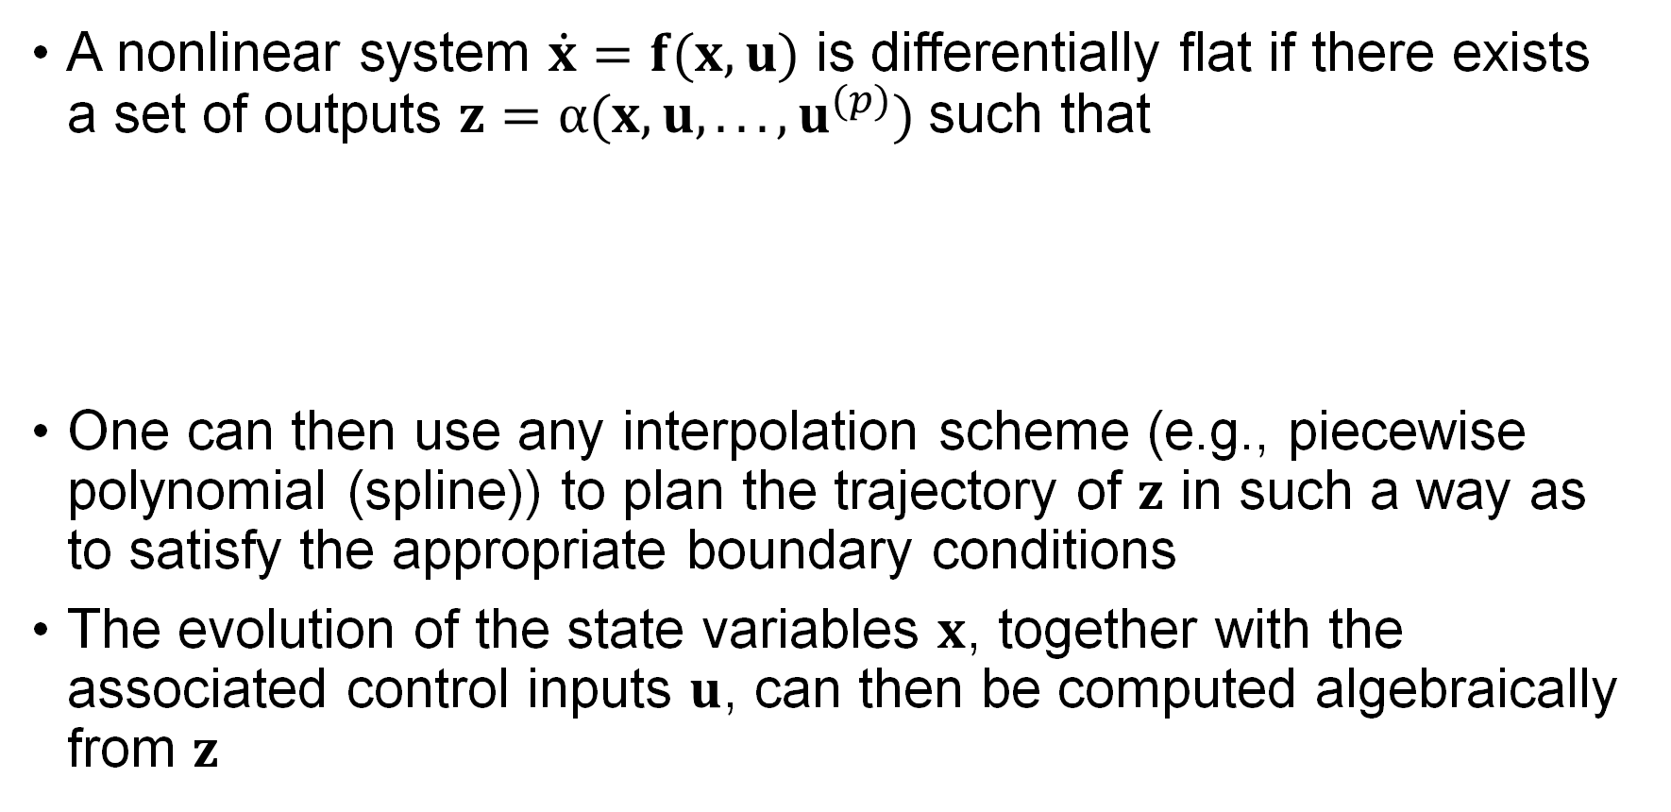
Differential flatness (recap)
A nonlinear system $\dot{x}=f(x,u)$ is differentially flat if there exists a set of outputs $z=α(x,u,. . . ,u^{(p)})$such that
One can then use any interpolation scheme (e.g., piecewise polynomial (spline)) to plan the trajectory of $z$ in such a way as to satisfy the appropriate boundary conditions
The evolution of the state variables $x$, together with the associated control inputs $u$, can then be computed algebraically from $z$

Slide 7

Trajectory tracking for differentially flat systems
Example: dynamically extended unicycle model
The system is differentially flat with flat outputs $(x,y)$, in particular

Slide 8
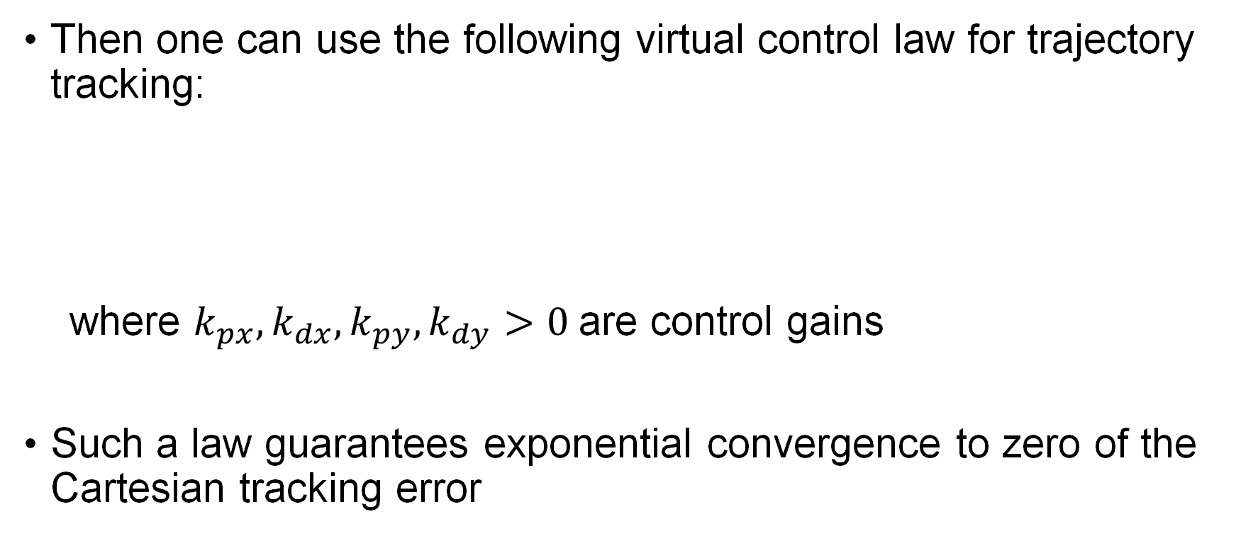
Trajectory tracking for differentially flat systems
Then one can use the following virtual control law for trajectory tracking:
where $k_{px},k_{dx}, k_{py}, k_{dy}>0$are control gains
Such a law guarantees exponential convergence to zero of the Cartesian tracking error

Slide 9
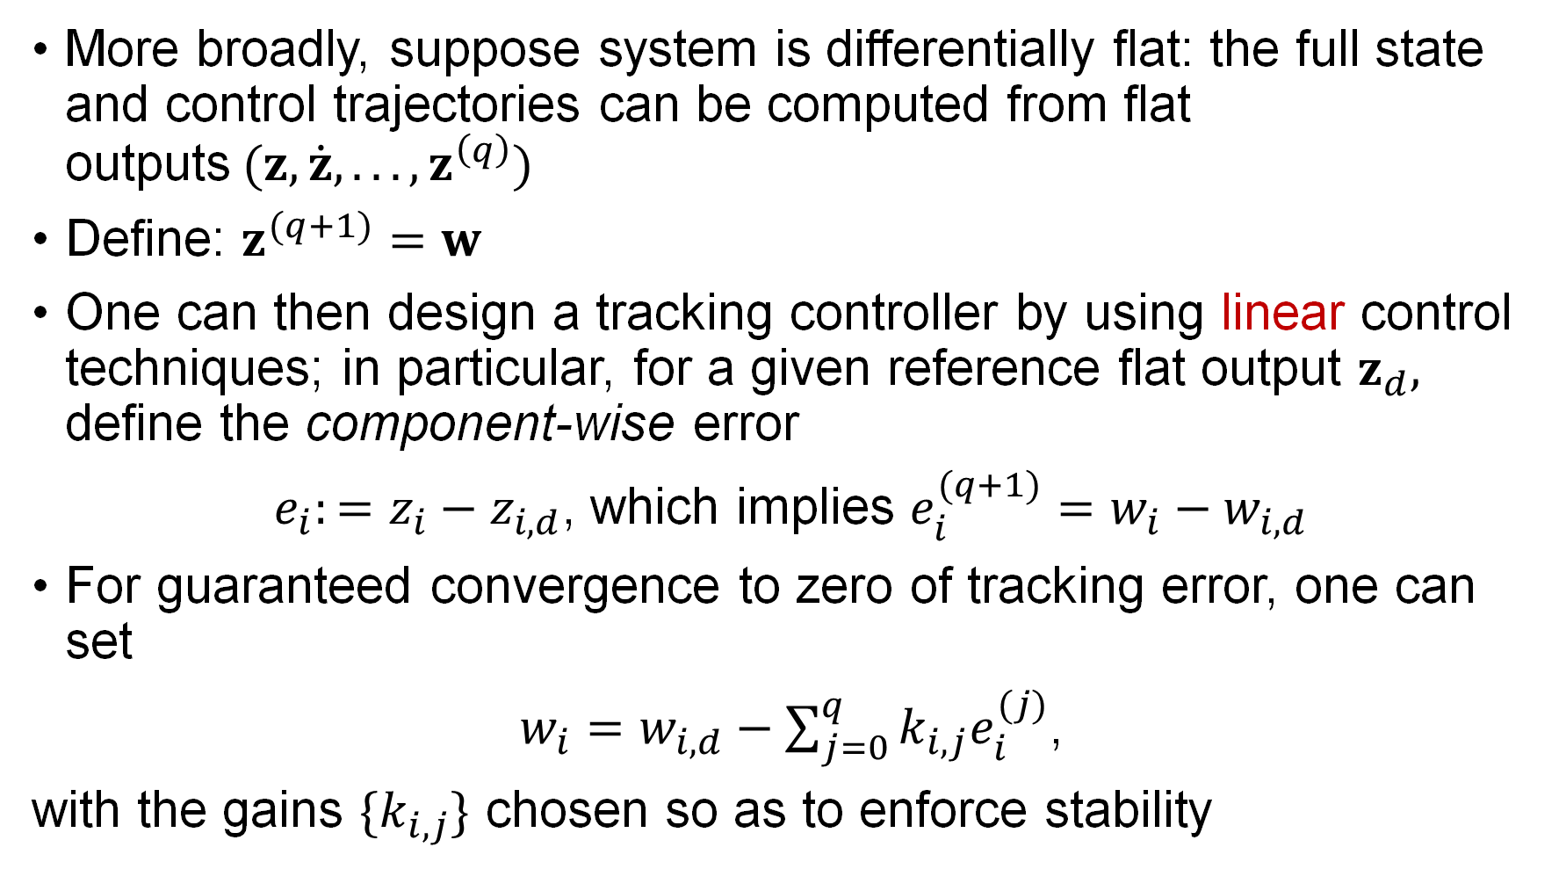
Trajectory tracking for differentially flat systems
More broadly, suppose system is differentially flat: the full state and control trajectories can be computed from flat outputs$(z,\dot{z}, .. . ,z^{\left(q\right)})$
Define: $z^{(q+1)}=w$
One can then design a tracking controller by using linear control techniques; in particular, for a given reference flat output $z_{d},$ define the component-wise error
$e_{i}:=z_{i}−z_{i,d}$, which implies $e_{i}^{(q+1)}=w_{i}−w_{i,d}$
For guaranteed convergence to zero of tracking error, one can set
$w_{i}=w_{i,d}−\sum_{j=0}^{q}{k_{i,j}e_{i}^{(j)}}$,
with the gains $\{k_{i,j}\}$ chosen so as to enforce stability

Slide 10
LQR-based methods
The previous approach only works for differentially flat systems
How can we control more general classes of systems?
Nonlinear control techniques
Linear-quadratic regulation (LQR) methods

Slide 11
LQR-based methods
The previous approach only works for differentially flat systems
How can we control more general classes of systems?
Nonlinear control techniques
Linear-quadratic regulation (LQR) methods

Slide 12
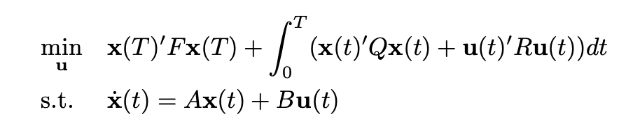
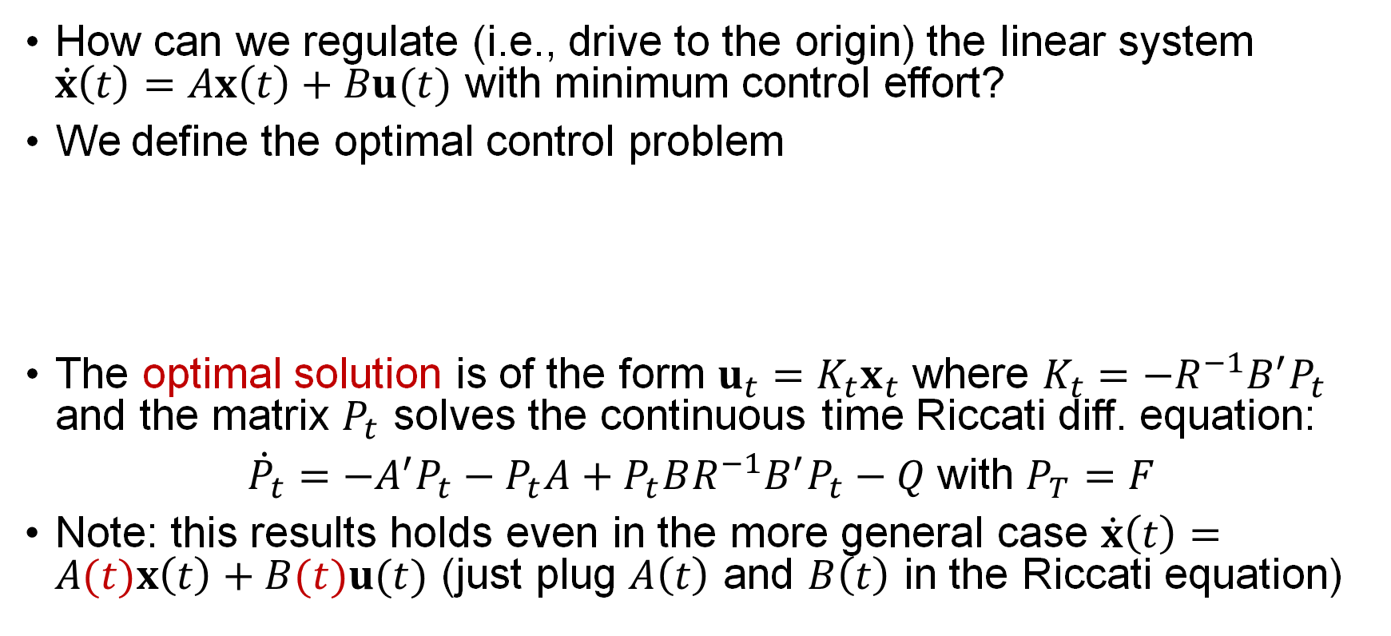
Linear-quadratic regulator (LQR)
How can we regulate (i.e., drive to the origin) the linear system $\dot{x}\left(t\right)=Ax\left(t\right)+Bu(t)$ with minimum control effort?
We define the optimal control problem
The optimal solution is of the form $u_{t}=K_{t}x_{t}$ where $K_{t}={−R}^{−1}B^{′}P_{t}$ and the matrix $P_{t}$ solves the continuous time Riccati diff. equation:
${\dot{P}}_{t}=−A^{′}P_{t}−P_{t}A+P_{t}BR^{−1}B^{′}P_{t}−Q$with $P_{T}=F$
Note: this results holds even in the more general case $\dot{x}\left(t\right)=A(t)x\left(t\right)+B(t)u(t)$ (just plug $A\left(t\right)$ and $B\left(t\right)$ in the Riccati equation)

Slide 13
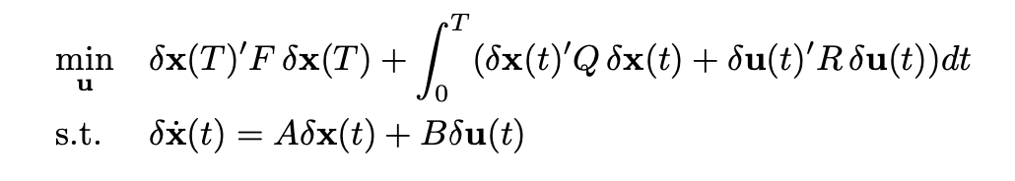
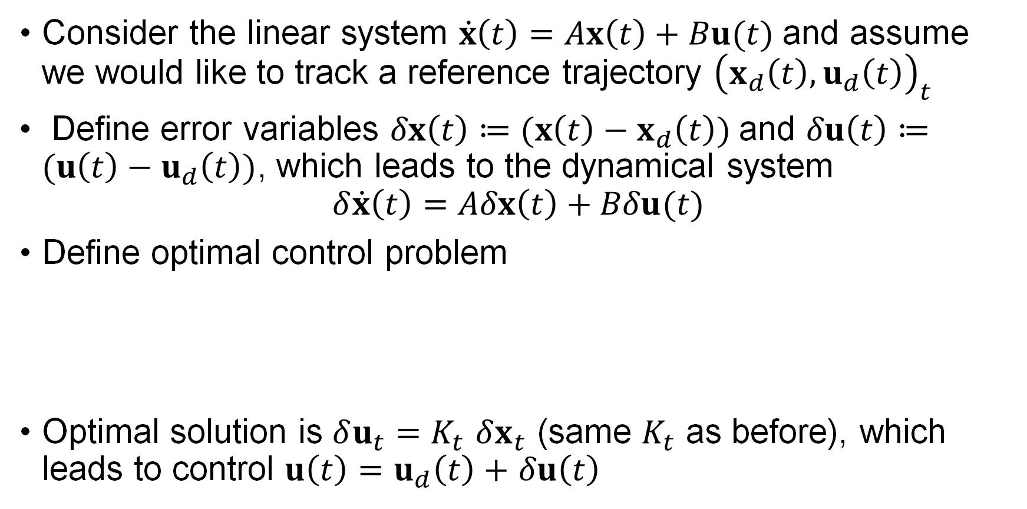
Tracking LQR – linear case
Consider the linear system $\dot{x}\left(t\right)=Ax\left(t\right)+Bu(t)$and assume we would like to track a reference trajectory ${\left(x_{d}\left(t\right),u_{d}\left(t\right)\right)}_{t}$
Define error variables $δx\left(t\right)≔(x\left(t\right)−x_{d}\left(t\right))$and $δu\left(t\right)≔(u\left(t\right)−u_{d}\left(t\right))$, which leads to the dynamical system
$$δ\dot{x}\left(t\right)=Aδx\left(t\right)+Bδu(t)$$
Define optimal control problem
Optimal solution is $δu_{t}=K_{t}$ $δx_{t}$ (same $K_{t}$ as before), which leads to control $u\left(t\right)=$ $u_{d}\left(t\right)+$ $δu\left(t\right)$

Slide 14
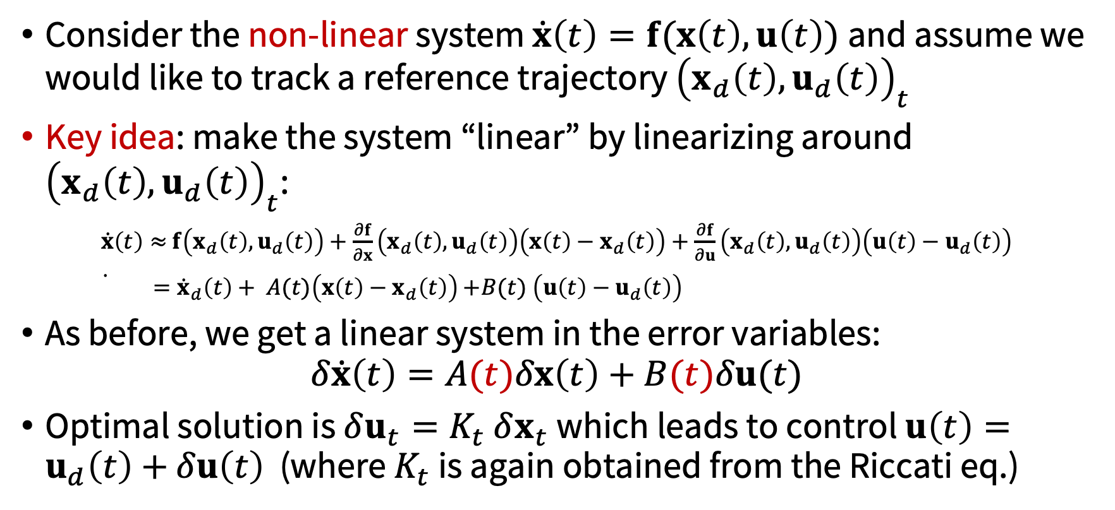
Tracking LQR – nonlinear case
Consider the non-linear system $\dot{x}\left(t\right)=f(x\left(t\right),u\left(t\right))$and assume we would like to track a reference trajectory ${\left(x_{d}\left(t\right),u_{d}\left(t\right)\right)}_{t}$
Key idea: make the system “linear” by linearizing around ${\left(x_{d}\left(t\right),u_{d}\left(t\right)\right)}_{t}$:
$\dot{x}\left(t\right)≈$ $f\left(x_{d}\left(t\right),u_{d}\left(t\right)\right)+\frac{∂f}{∂x}\left(x_{d}\left(t\right),u_{d}\left(t\right)\right)\left(x\left(t\right)−x_{d}\left(t\right)\right)+\frac{∂f}{∂u}\left(x_{d}\left(t\right),u_{d}\left(t\right)\right)\left(u\left(t\right)−u_{d}\left(t\right)\right)$
${\dot{ =\dot{x}}}_{d}\left(t\right)+ A(t)\left(x\left(t\right)−x_{d}\left(t\right)\right)$ $+B(t) \left(u\left(t\right)−u_{d}\left(t\right)\right)$
As before, we get a linear system in the error variables:
$$δ\dot{x}\left(t\right)=A(t)δx\left(t\right)+B(t)δu(t)$$
Optimal solution is $δu_{t}=K_{t}$ $δx_{t}$ which leads to control $u\left(t\right)=$ $u_{d}\left(t\right)+$ $δu\left(t\right)$ (where $K_{t}$ is again obtained from the Riccati eq.)

Slide 15
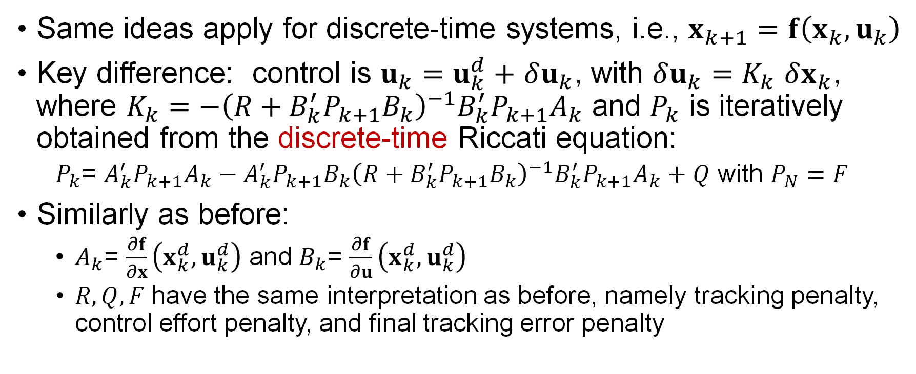
Transferring results to discrete case
Same ideas apply for discrete-time systems, i.e., $x_{k+1}=f\left(x_{k},u_{k}\right)$
Key difference: control is $u_{k}=$ $u_{k}^{d}+$ $δu_{k}$, with $δu_{k}=K_{k}$ $δx_{k}$, where $K_{k}=−{\left(R+B_{k}^{′}P_{k+1}B_{k}\right)}^{−1}B_{k}^{′}P_{k+1}A_{k}$ and $P_{k}$ is iteratively obtained from the discrete-time Riccati equation:
$P_{k}$= $A_{k}^{′}P_{k+1}A_{k}−A_{k}^{′}P_{k+1}B_{k}{\left(R+B_{k}^{′}P_{k+1}B_{k}\right)}^{−1}B_{k}^{′}P_{k+1}A_{k}+Q$ with $P_{N}=F$
Similarly as before:
$A_{k}$= $\frac{∂f}{∂x}\left(x_{k}^{d},u_{k}^{d}\right)$ and $B_{k}$= $\frac{∂f}{∂u}\left(x_{k}^{d},u_{k}^{d}\right)$
$R, Q, F$have the same interpretation as before, namely tracking penalty, control effort penalty, and final tracking error penalty

Slide 16
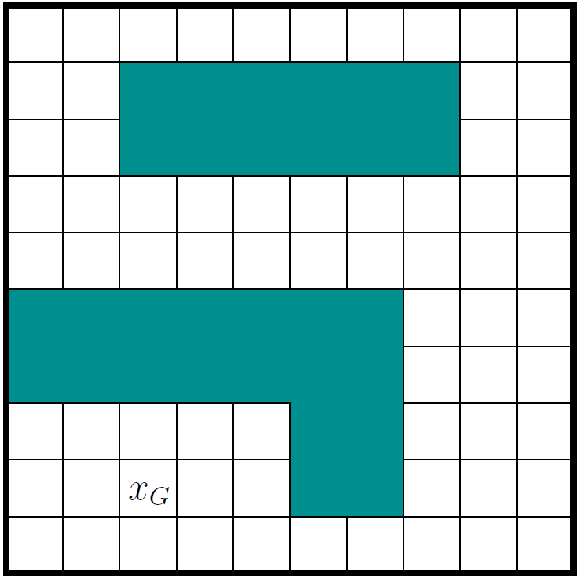
Next time

