Slide 1
Principles of Robot Autonomy I
Motion planning I: graph search algorithms

Slide 2

Attendance Form

Slide 4
Agenda
Agenda
Introduction to motion planning
Search-based algorithms for motion planning
Configuration spaces and combinatorial motion planning
Readings:
Chapter 4, sections 4.1 – 4.2 in D. Gammelli, J. Lorenzetti, K. Luo, G. Zardini, M. Pavone. Principles of Robot Autonomy. 2026.

Slide 5
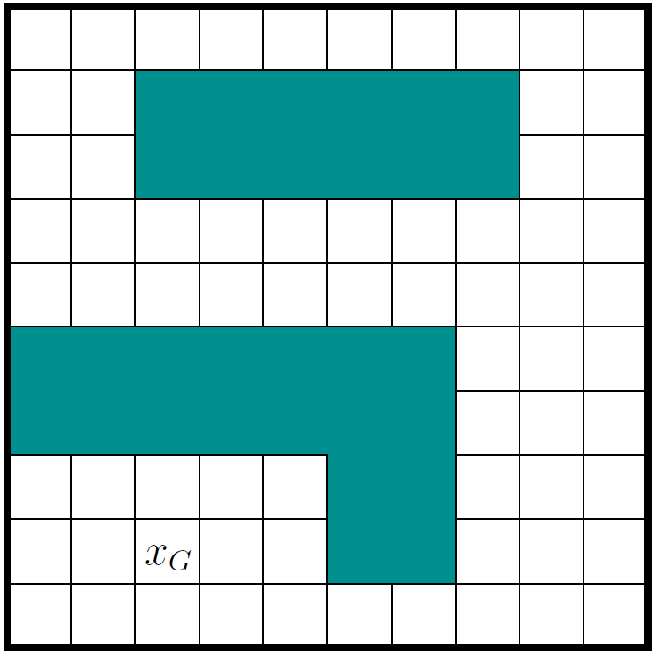
Motion planning
Problem definition: Compute sequence of actions that drives a robot from an initial condition to a terminal condition while avoiding obstacles, respecting motion constraints, and possibly optimizing a cost function

Slide 6
The see-think-act cycle

Slide 7
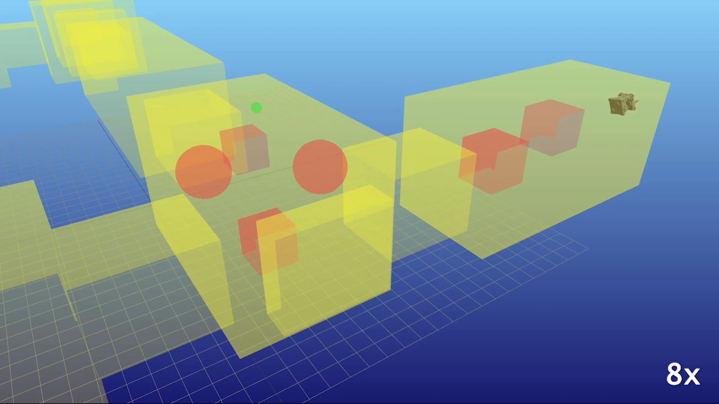

Slide 8
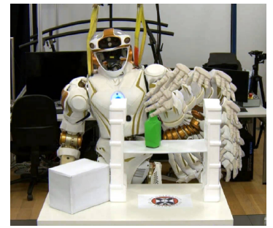
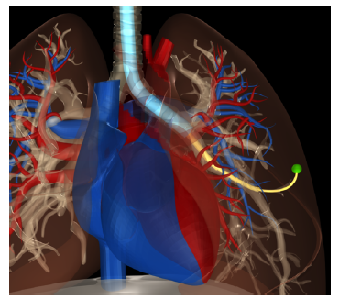
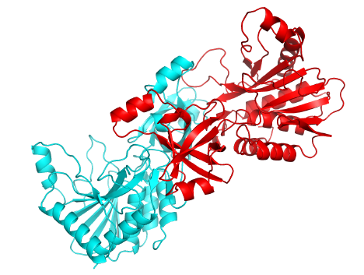
More examples of motion planning
Steering autonomous vehicles
Controlling humanoid robot
Surgery planning
Protein folding
…

Slide 9
Some history
Formally defined in the 1970s
Development of exact, combinatorial solutions in the 1980s
Development of sampling-based methods in the 1990s
Deployment on real-time systems in the 2000s
Current research: inclusion of differential and logical constraints, planning under uncertainty, parallel implementation, and more

Slide 10


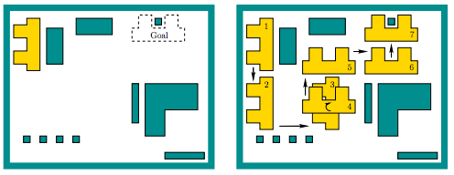
Simplest setup
Assume 2D workspace:
is the obstacle region with polygonal boundary
Robot is a rigid polygon
Problem: given initial placement of robot, compute how to gradually move it into a desired goal placement so that it never touches the obstacle region

Slide 11
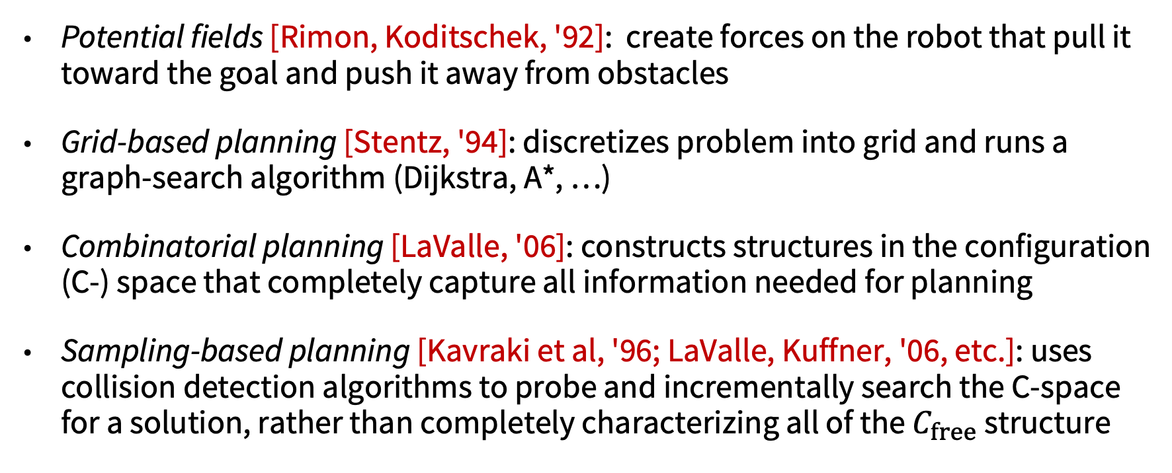
Popular approaches
Potential fields [Rimon, Koditschek, '92]: create forces on the robot that pull it toward the goal and push it away from obstacles
Grid-based planning [Stentz, '94]: discretizes problem into grid and runs a graph-search algorithm (Dijkstra, A*, …)
Combinatorial planning [LaValle, '06]: constructs structures in the configuration (C-) space that completely capture all information needed for planning
Sampling-based planning [Kavraki et al, '96; LaValle, Kuffner, '06, etc.]: uses collision detection algorithms to probe and incrementally search the C-space for a solution, rather than completely characterizing all of the $C_{free}$ structure

Slide 12
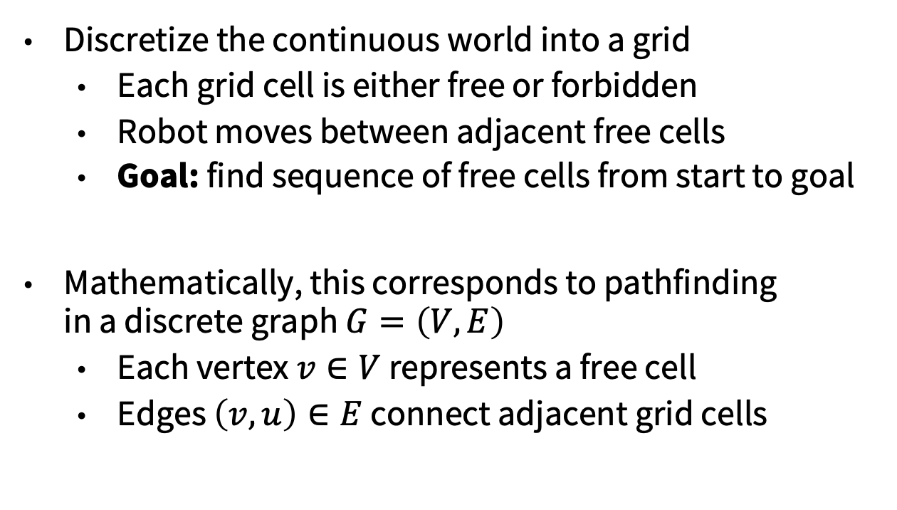
Grid-based approaches
Discretize the continuous world into a grid
Each grid cell is either free or forbidden
Robot moves between adjacent free cells
Goal: find sequence of free cells from start to goal
Mathematically, this corresponds to pathfinding in a discrete graph $G=\left(V,E\right)$
Each vertex $v∈V$ represents a free cell
Edges $\left(v,u\right)∈E$ connect adjacent grid cells

Slide 13


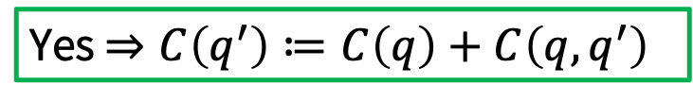
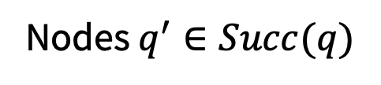

Graph search algorithms
Having determined decomposition, how to find “best” path?
Label-Correcting Algorithms: $C(q)$: cost-of-arrival from $q_{I} to q$
Yes $⇒C\left(q^{′}\right)≔C\left(q\right)+C\left(q,q^{′}\right)$
$$q^{′}≠q_{G}?$$
$$C\left(q\right)+C\left(q,q^{′}\right)≤\min\left(C\left(q^{′}\right), UPPER\right)?$$
Node $q$
Nodes $q^{′}∈Succ(q)$
FRONTIER/ALIVE/PRIORITY QUEUE

Slide 14
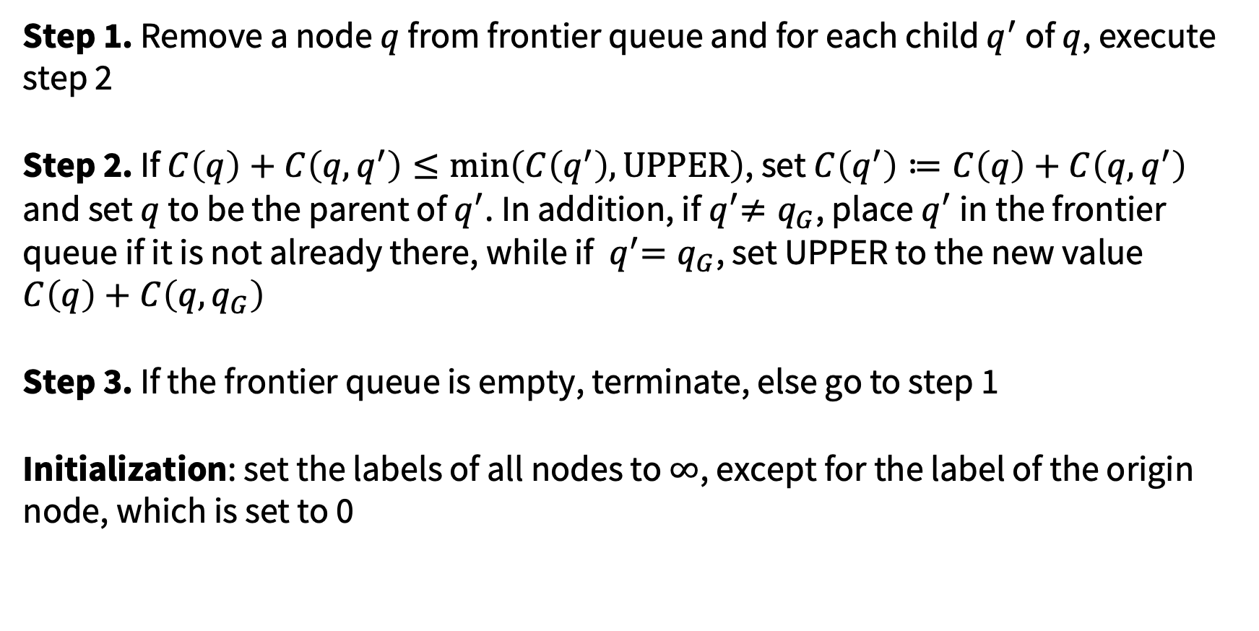
Label correcting algorithm
Step 1. Remove a node $q$ from frontier queue and for each child $q^{′}$ of $q$, execute step 2
Step 2. If $C\left(q\right)+C\left(q,q^{′}\right)≤\min\left(C\left(q^{′}\right), UPPER\right)$, set $C\left(q^{′}\right)≔C\left(q\right)+C\left(q,q^{′}\right)$ and set $q$ to be the parent of $q^{′}$. In addition, if${ q}^{′}≠q_{G}$, place $q^{′}$ in the frontier queue if it is not already there, while if ${ q}^{′}=q_{G}$, set UPPER to the new value $C\left(q\right)+C\left(q,q_{G}\right)$
Step 3. If the frontier queue is empty, terminate, else go to step 1
Initialization: set the labels of all nodes to $∞$, except for the label of the origin node, which is set to 0

Slide 15
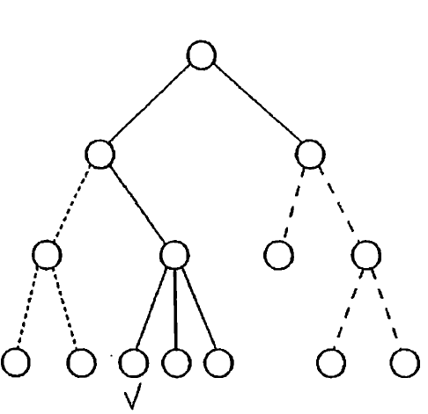
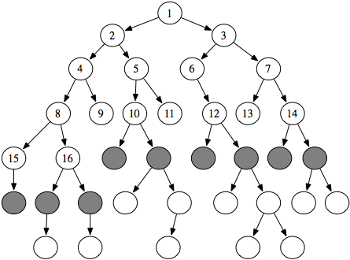
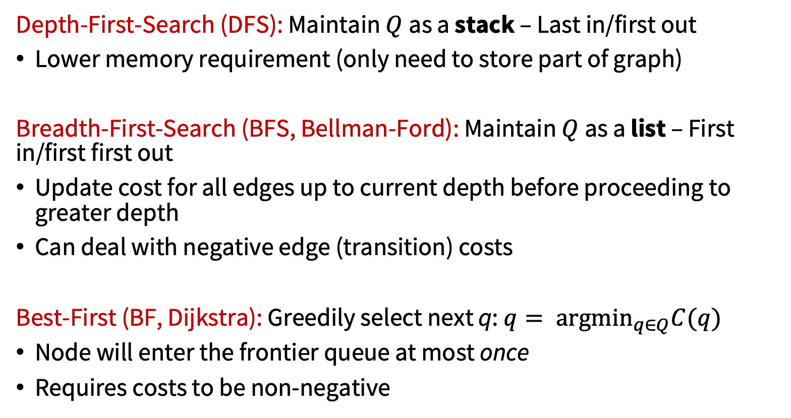
GetNext() ?
Depth-First-Search (DFS): Maintain $Q$as a stack – Last in/first out
Lower memory requirement (only need to store part of graph)
Breadth-First-Search (BFS, Bellman-Ford): Maintain $Q$as a list – First in/first first out
Update cost for all edges up to current depth before proceeding to greater depth
Can deal with negative edge (transition) costs
Best-First (BF, Dijkstra): Greedily select next q: $q= {argmin}_{q∈Q}C(q)$
Node will enter the frontier queue at most once
Requires costs to be non-negative

Slide 16
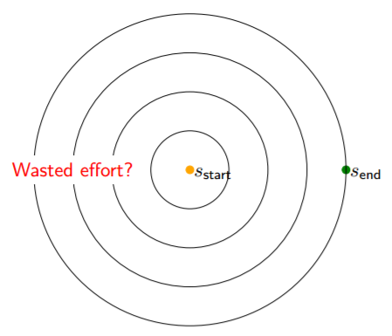
Correctness and improvements
Theorem
If a feasible path exists from $q_{I}$ to $q_{G}$, then algorithm terminates in finite time with $C\left(q_{G}\right)$ equal to the optimal cost of traversal, $C^{∗}\left(q_{G}\right)$.
* https://en.wikipedia.org/wiki/Dijkstra%27s_algorithm

Slide 17

A*: Improving Dijkstra
Dijkstra orders by optimal “cost-to-arrival”
Faster results if order by “cost-to-arrival”+ (approximate) “cost-to-go”
That is, strengthen test
$$C\left(q\right)+C\left(q,q^{′}\right)≤UPPER$$
to
$$C\left(q\right)+C\left(q,q^{′}\right)+h(q^{′})≤UPPER$$
where $h\left(q\right)$is a heuristic for optimal cost-to-go (specifically, a positive underestimate)
In this way, fewer nodes will be placed in the frontier queue
This modification still guarantees that the algorithm will terminate with a shortest path
Many variations are possible… see (Problem 2 in pset 2)

Slide 18
Grid-based approaches: summary
Pros:
Simple and easy to use
Fast (for some problems)
Cons:
Resolution dependent
Not guaranteed to find solution if grid resolution is not small enough
Limited to simple robots
Grid size is exponential in the number of DOFs

Slide 19
Back to continuous motion planning
Assume 2D workspace:
is the obstacle region with polygonal boundary
Robot is a rigid polygon
Problem: Given initial placement of robot, compute how to gradually move it into a desired goal placement so that it never touches the obstacle region

Slide 20
Back to continuous motion planning
Key point: motion planning problem described in the real-world, but it really lives in another space -- the configuration (C-) space!

Slide 21

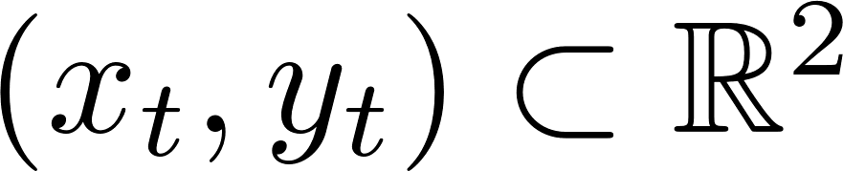


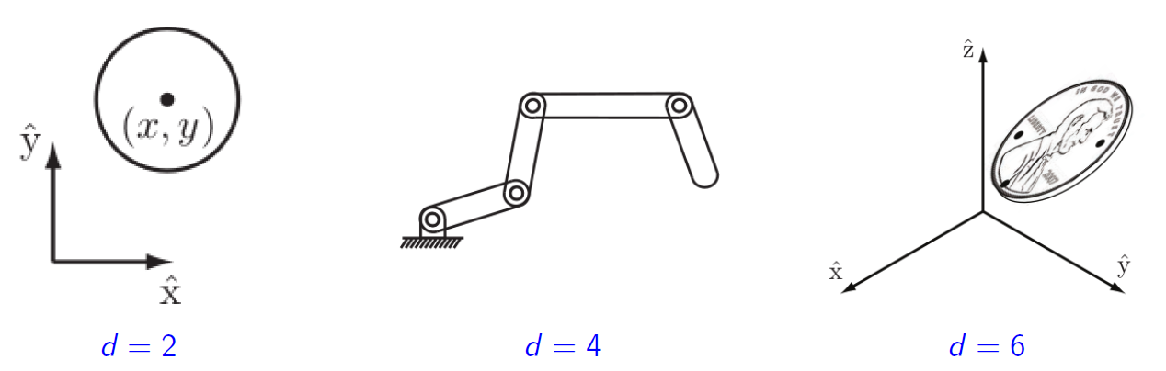
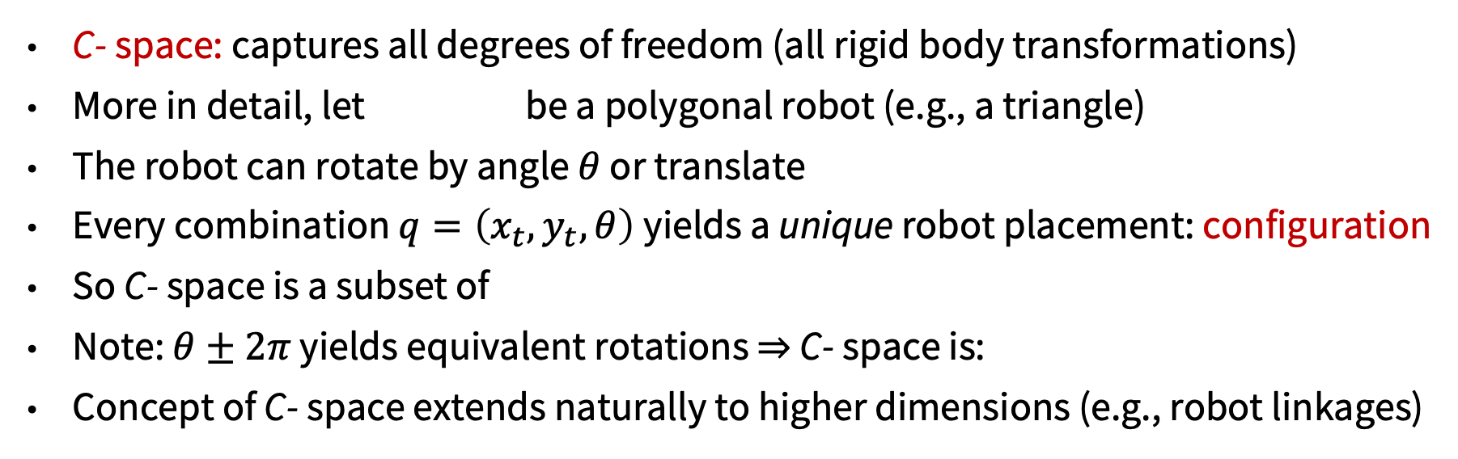
Configuration space
C- space: captures all degrees of freedom (all rigid body transformations)
More in detail, let be a polygonal robot (e.g., a triangle)
The robot can rotate by angle $θ$ or translate
Every combination $q=\left(x_{t}, y_{t}, θ\right)$yields a unique robot placement: configuration
So C- space is a subset of
Note: $θ±2π$ yields equivalent rotations $⇒$ C- space is:
Concept of C- space extends naturally to higher dimensions (e.g., robot linkages)

Slide 22
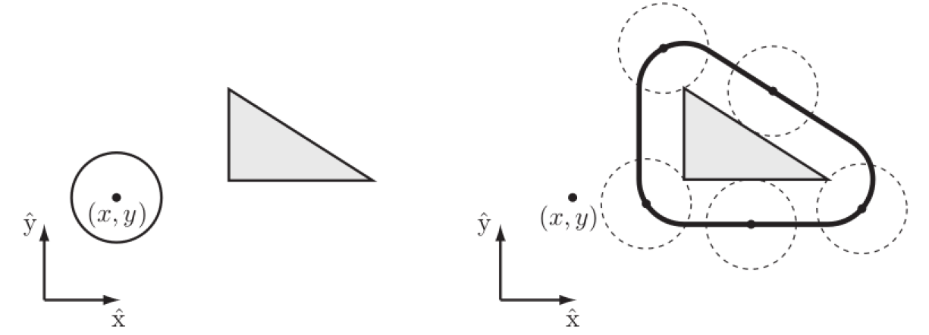

Configuration free space
The subset $ℱ⊆𝒞$ of all collision free configurations is the free space
free space
obstacle
forbidden space

Slide 23
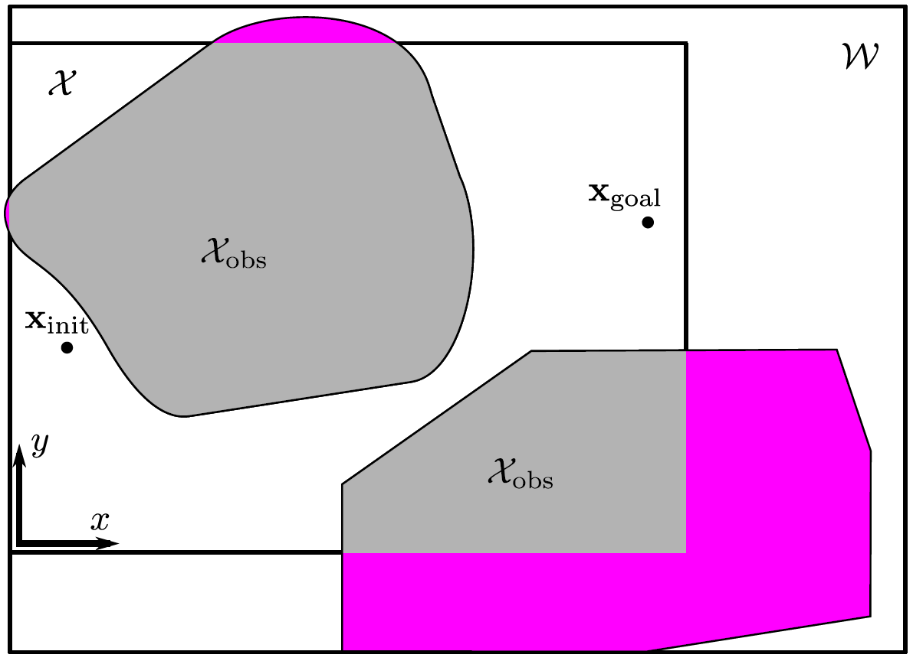
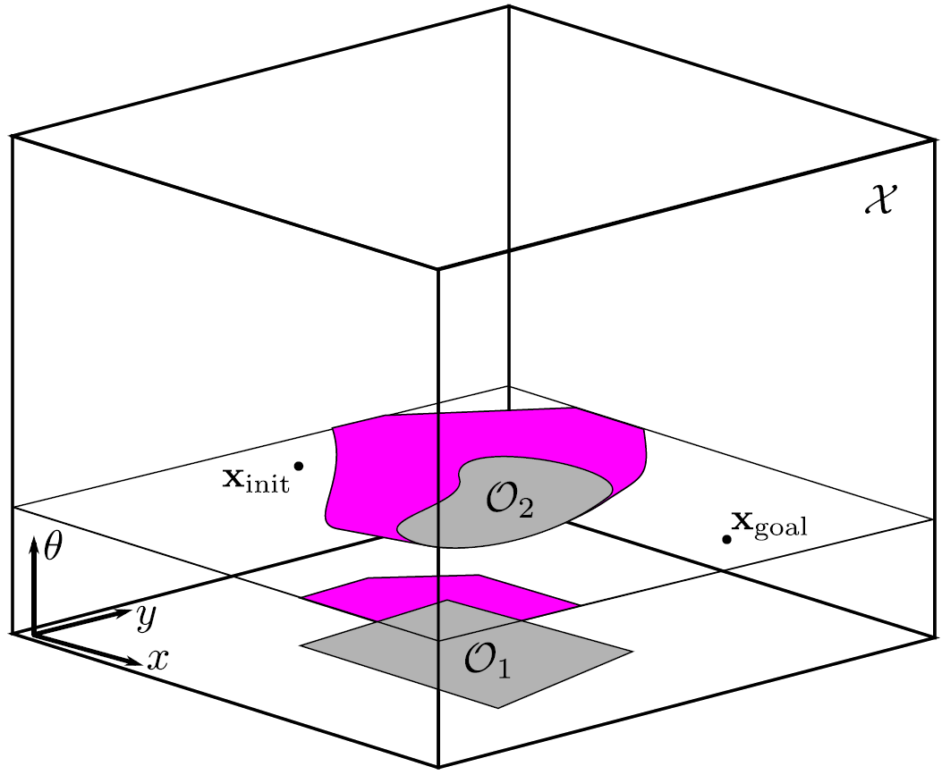
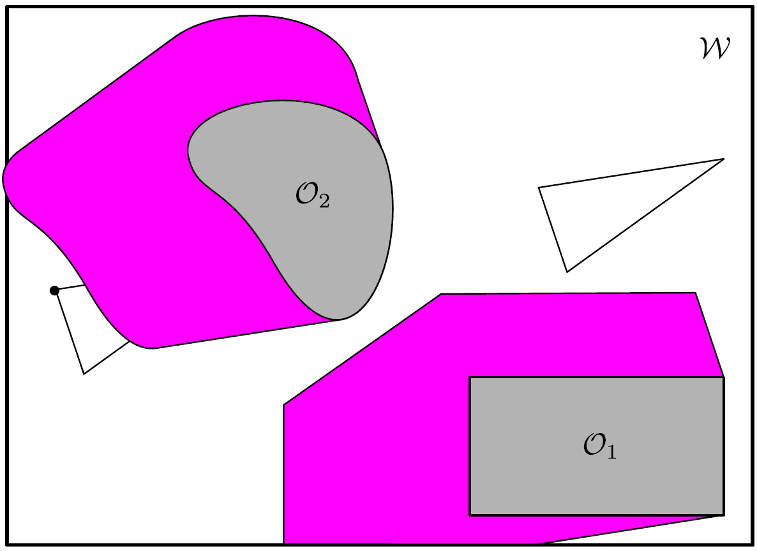
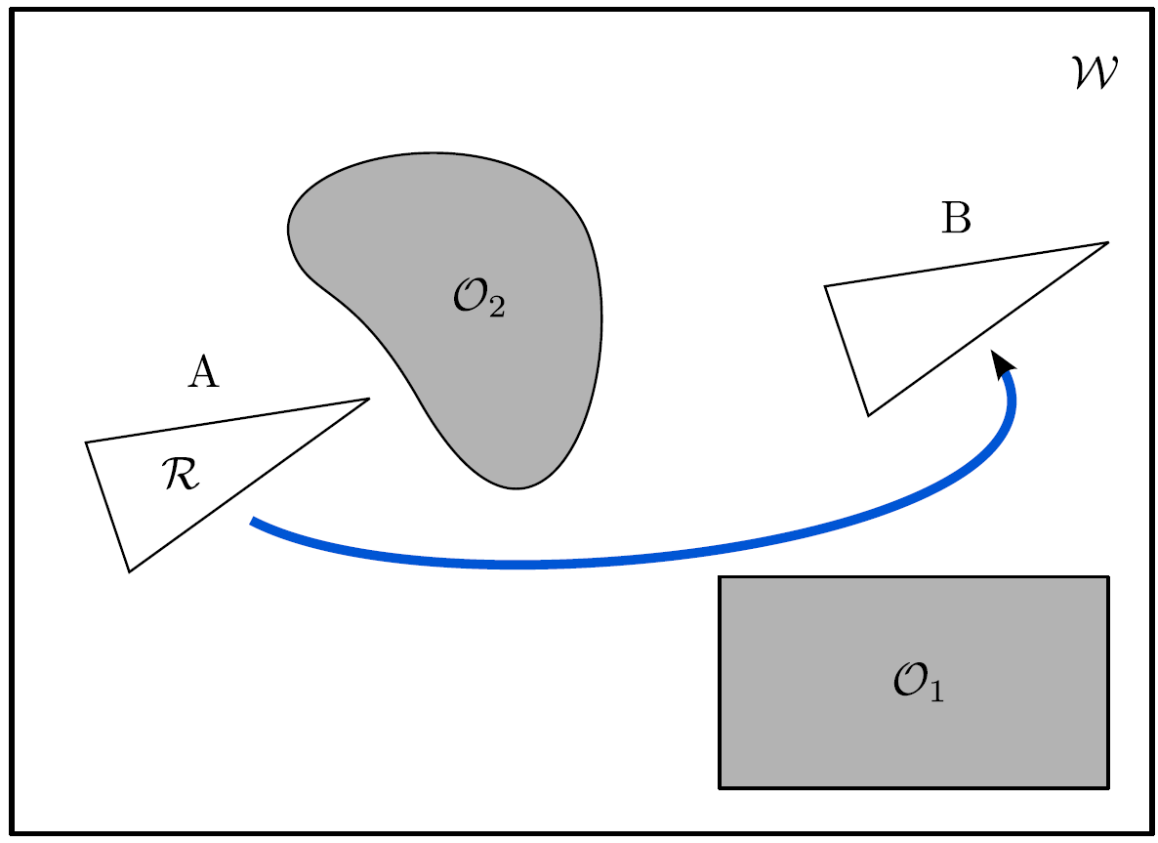
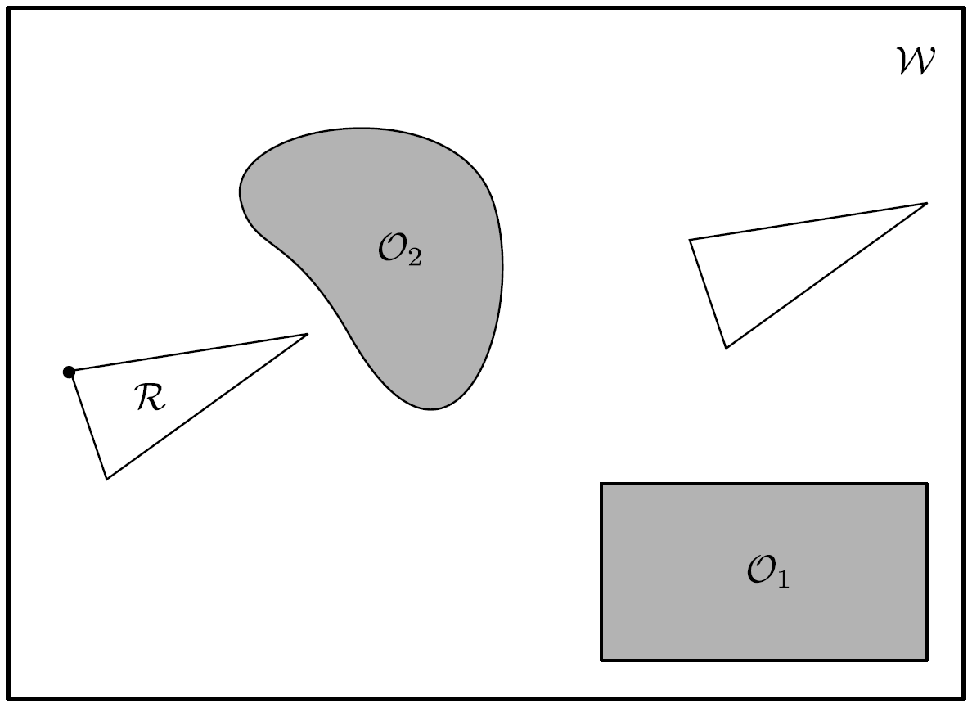
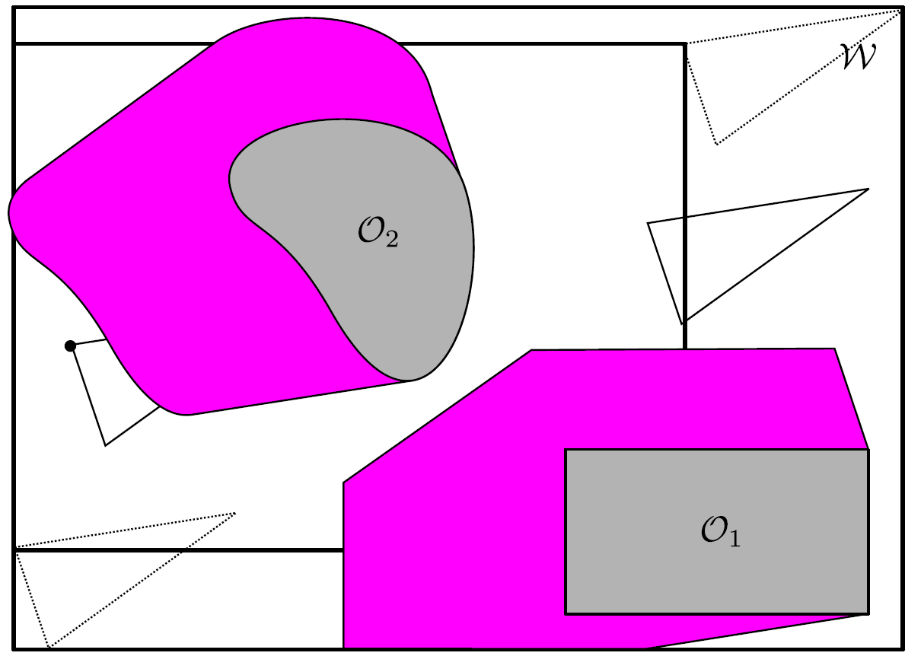
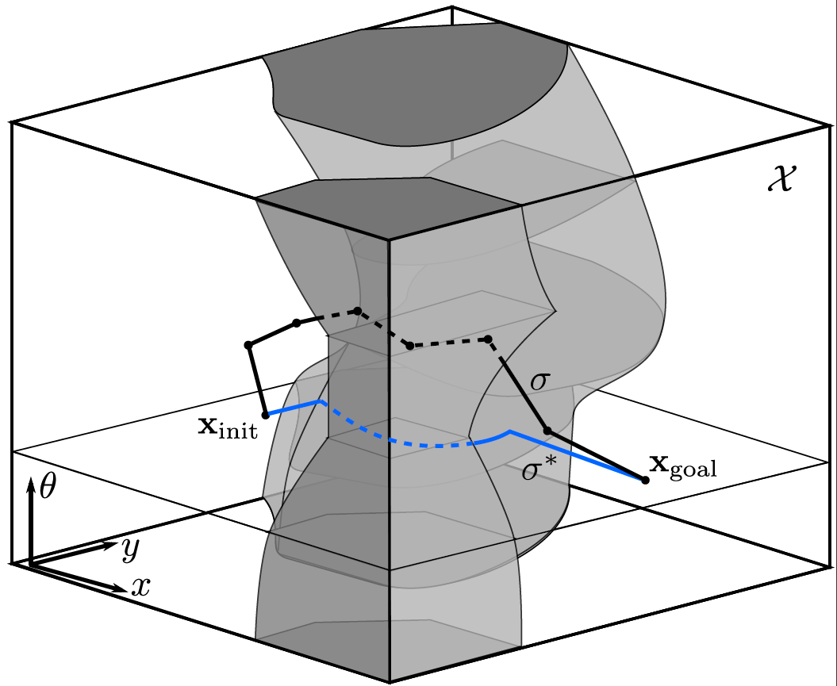
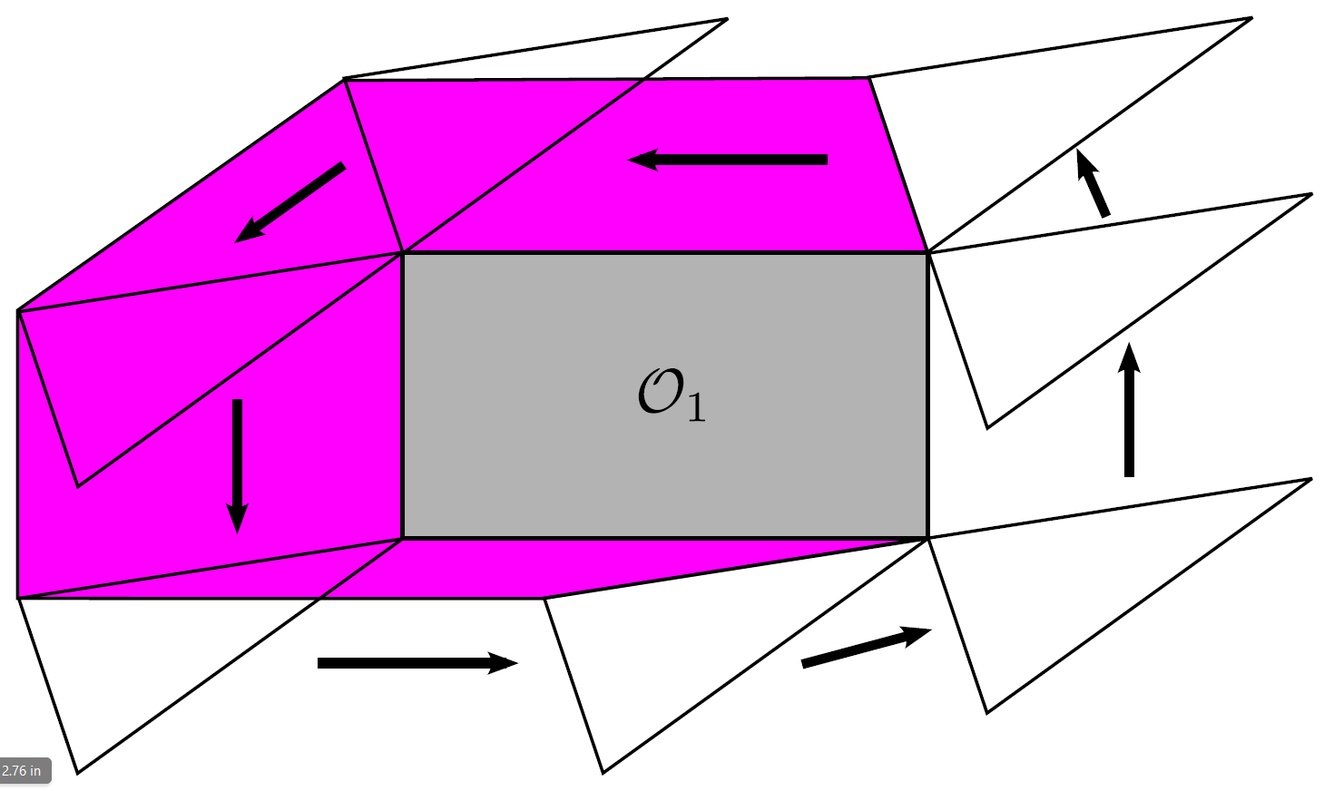
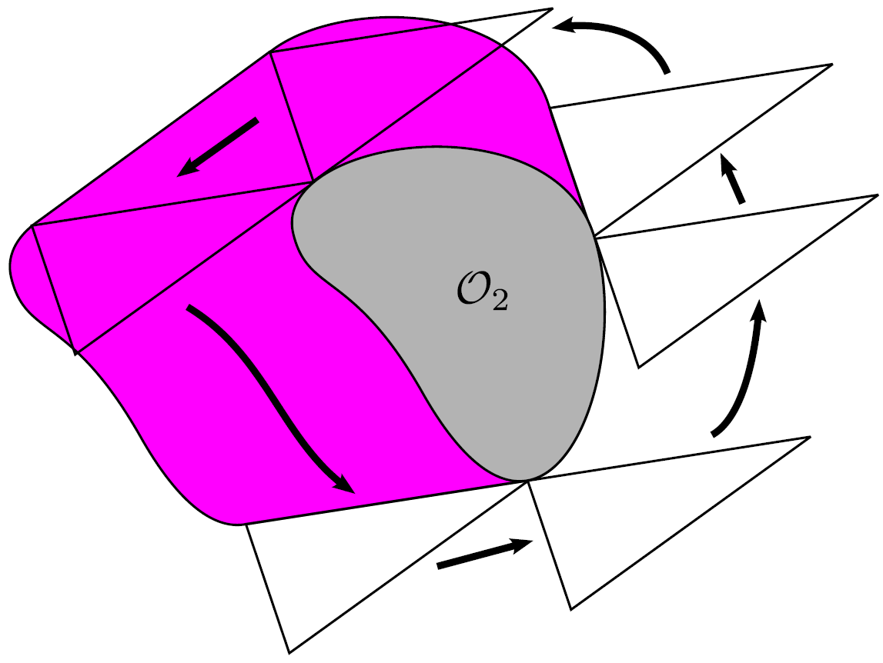

Slide 24
Bottom line: explicitly computing C free spaces in high-dimensional settings is hard!

Slide 25
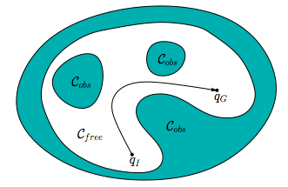
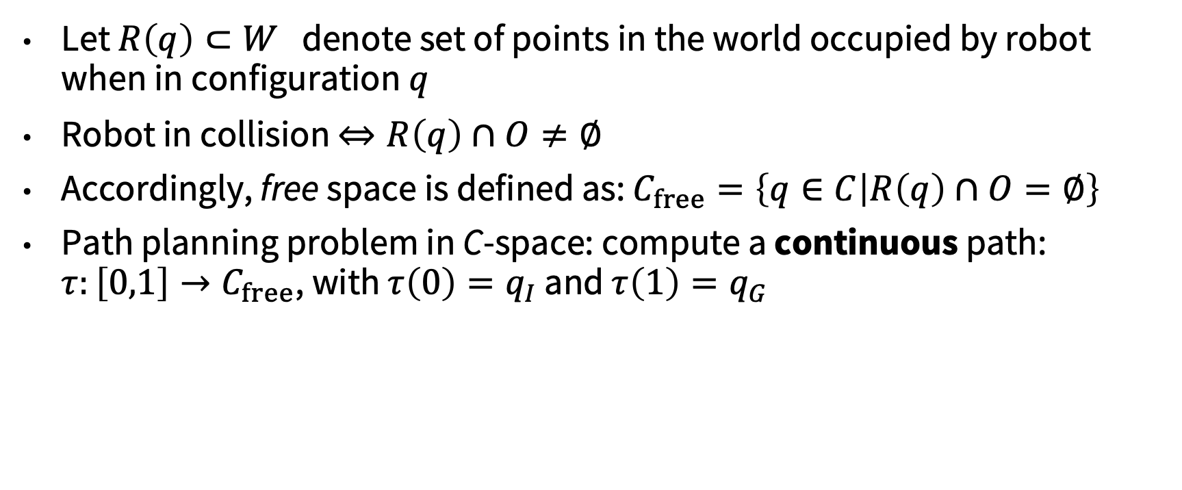
Planning in C-space
Let $R\left(q\right)⊂W$ denote set of points in the world occupied by robot when in configuration $q$
Robot in collision $⇔R\left(q\right)∩O≠∅$
Accordingly, free space is defined as: $C_{free}=\left\{q∈C | R\left(q\right)∩O=∅\right\}$
Path planning problem in C-space: compute a continuous path: $τ:\left[0,1\right]→C_{free}$, with $τ\left(0\right)=q_{I}$ and $τ\left(1\right)=q_{G}$

Slide 26
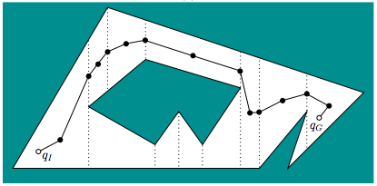
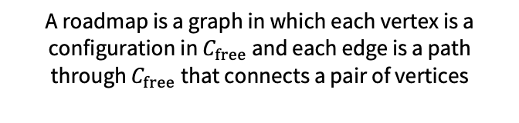
Combinatorial planning
Combinatorial approaches to motion planning find paths through continuous configuration space without resorting to approximations
Key idea: compute a roadmap, which provides a discrete representation of continuous motion planning problem without losing any of the original connectivity information needed to solve it
Such approaches are typically complete (i.e., guaranteed to find a solution), but are typically limited to small number of DOFs due to the challenge of exactly computing C free spaces
A roadmap is a graph in which each vertex is a configuration in $C_{free}$ and each edge is a path through $C_{free}$that connects a pair of vertices
Notes:
Check connectivity combinatorial

Slide 27
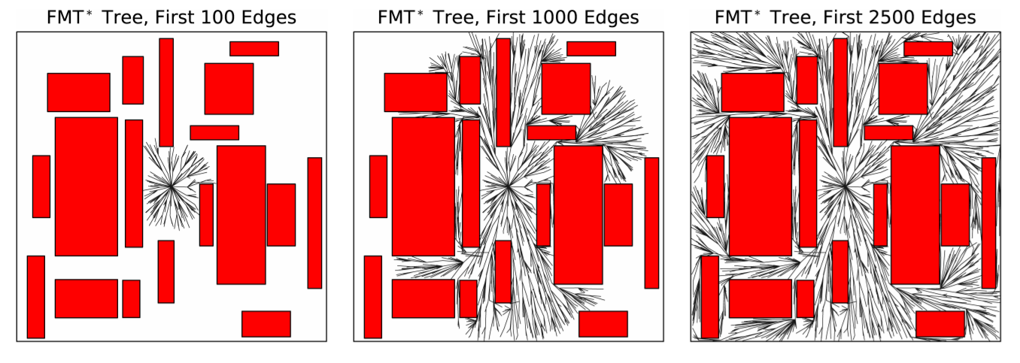
Next time: sampling-based planning

