Slide 1
Principles of Robot Autonomy I
Motion planning II: sampling-based methods

Slide 2

Attendance Form

Slide 4
Agenda
Agenda
Sampling-based algorithms for motion planning
Readings:
Chapter 5, sections 5.1 – 5.5 in D. Gammelli, J. Lorenzetti, K. Luo, G. Zardini, M. Pavone. Principles of Robot Autonomy. 2026.

Slide 5
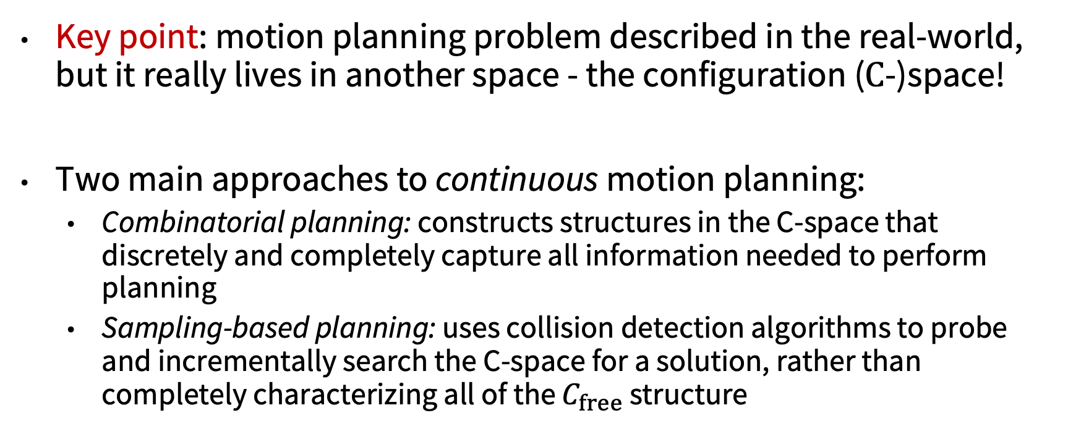
Motion planning algorithms
Key point: motion planning problem described in the real-world, but it really lives in another space - the configuration ($C$-)space!
Two main approaches to continuous motion planning:
Combinatorial planning: constructs structures in the C-space that discretely and completely capture all information needed to perform planning
Sampling-based planning: uses collision detection algorithms to probe and incrementally search the C-space for a solution, rather than completely characterizing all of the $C_{free}$ structure

Slide 6
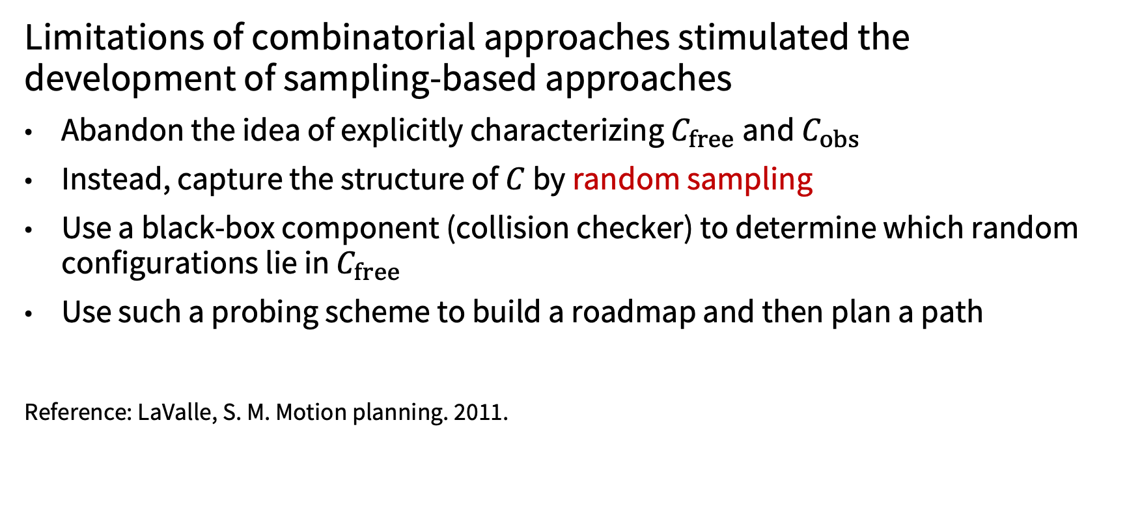
Sampling-based motion planning
Limitations of combinatorial approaches stimulated the development of sampling-based approaches
Abandon the idea of explicitly characterizing $C_{free}$and $C_{obs}$
Instead, capture the structure of $C$ by random sampling
Use a black-box component (collision checker) to determine which random configurations lie in $C_{free}$
Use such a probing scheme to build a roadmap and then plan a path
Reference: LaValle, S. M. Motion planning. 2011.

Slide 7
Sampling-based motion planning
Pros:
Conceptually simple
Relatively-easy to implement
Flexible: one algorithm applies to a variety of robots and problems
Beyond the geometric case: can cope with complex differential constraints, uncertainty, etc.
Cons:
Unclear how many samples should be generated to retrieve a solution
Can not determine whether a solution does not exist

Slide 8
Review of sampling-based methods
Traditionally, two major approaches:
Probabilistic Roadmap (PRM): graph-based
Multi-query planner, i.e., designed to solve multiple path queries on the same scenario
Original version: [Kavraki et al., ‘96]
“Lazy” version: [Bohlin & Kavraki, ‘00]
Dynamic version: [Jaillet & T. Simeon, ‘04]
Asymptotically optimal version: [Karaman & Frazzoli, '11]
Rapidly-exploring Random Trees (RRT): tree-based
Single-query planner
Original version: [LaValle & Kuner, ‘01]
RDT: [LaValle, ‘06]
SRT: [Plaku et al., ‘05]
Asymptotically optimal version [Karaman & Frazzoli, '11]

Slide 9

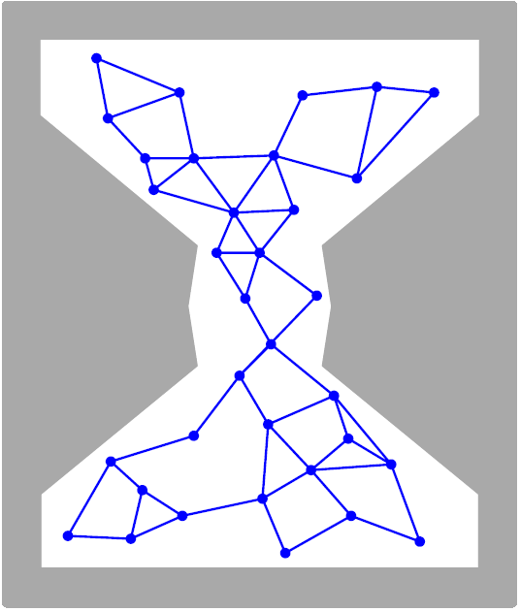
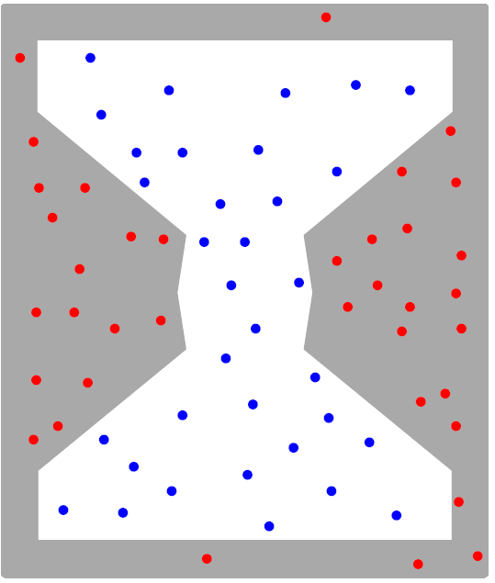
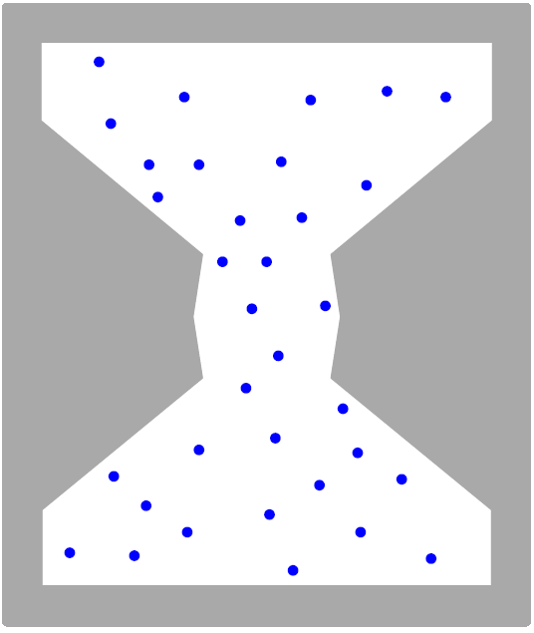
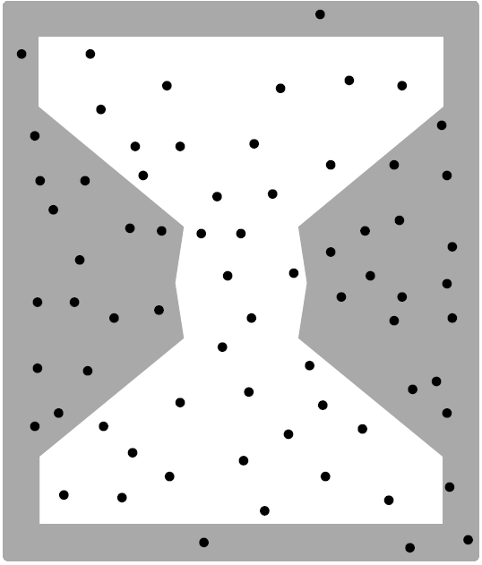
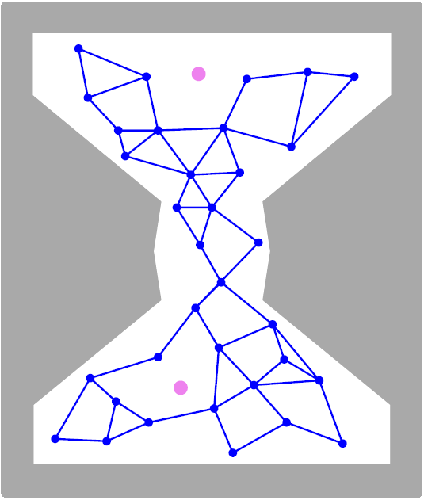
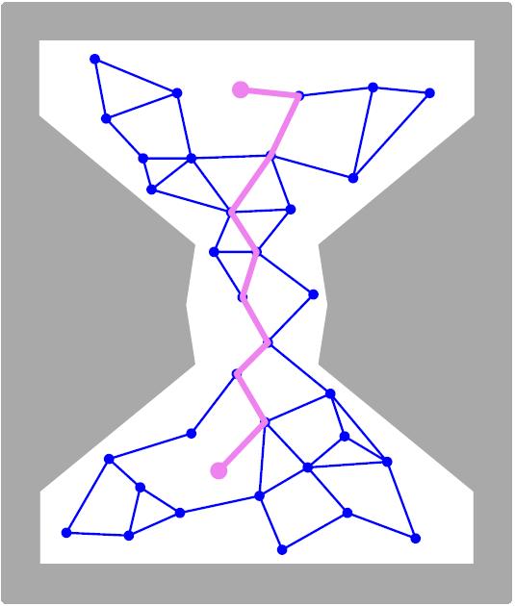
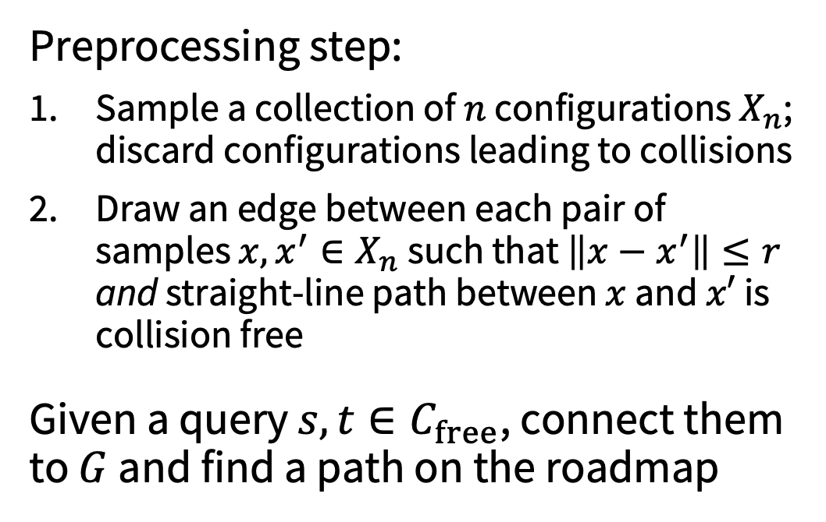

Probabilistic roadmaps (PRM)
A multi-query planner, which generates a roadmap (graph) $G$, embedded in the free space
Preprocessing step:
Sample a collection of $n$ configurations $X_{n}$; discard configurations leading to collisions
Draw an edge between each pair of samples $x,x^{′}∈X_{n}$ such that $\left\|x−x^{′}\right\|≤r$ and straight-line path between $x$ and $x′$ is collision free
Given a query $s,t∈C_{free}$, connect them to $G$ and find a path on the roadmap

Slide 10
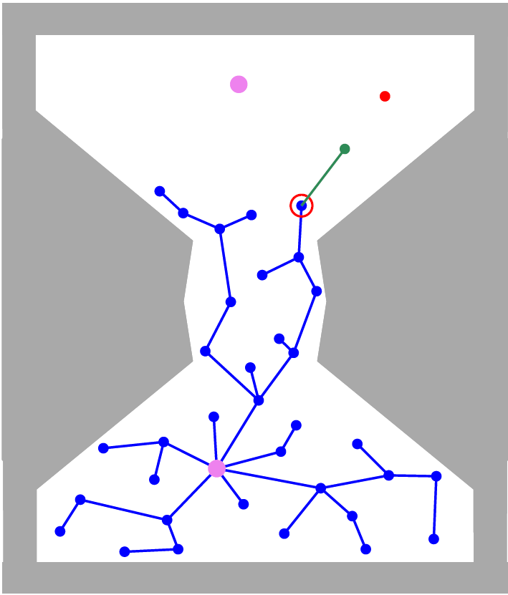
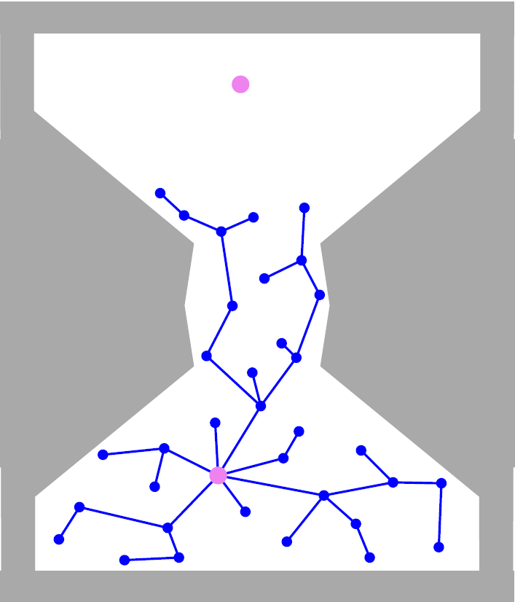
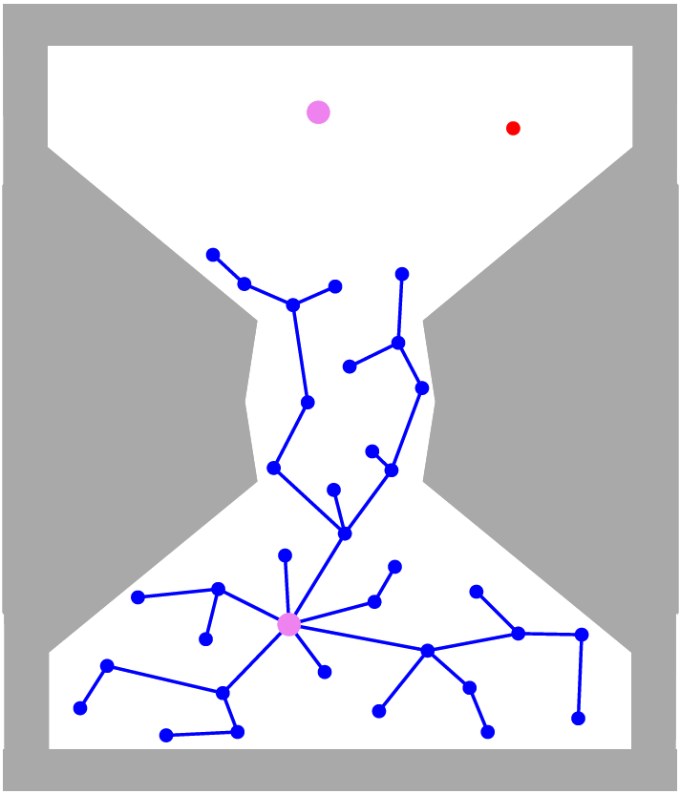
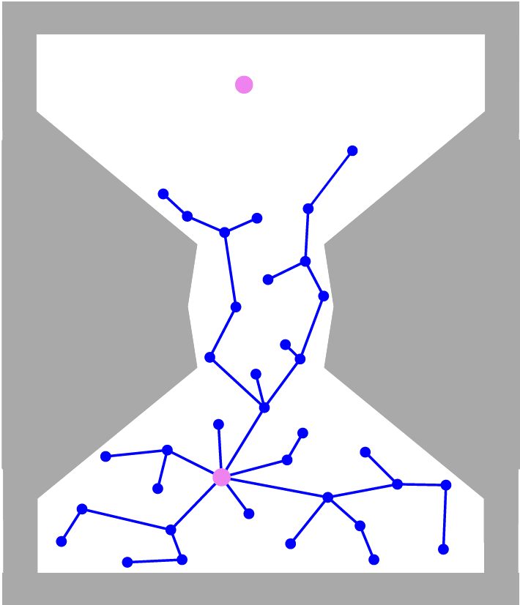
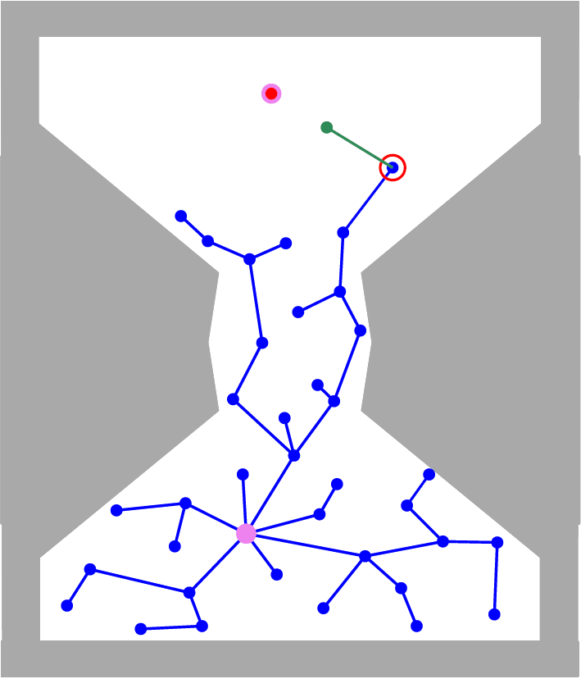
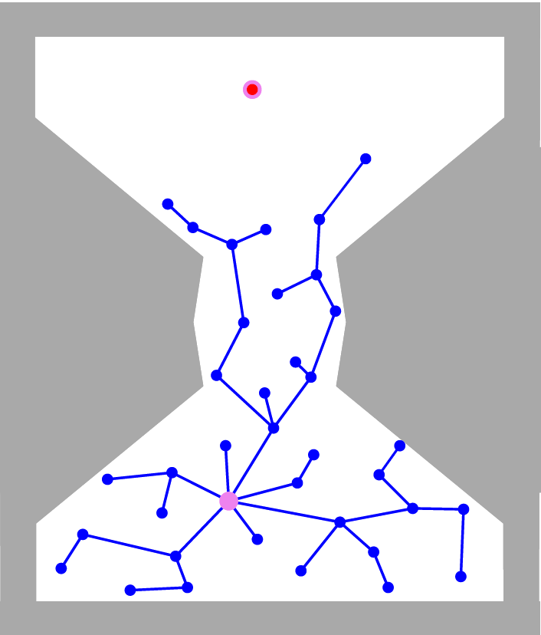
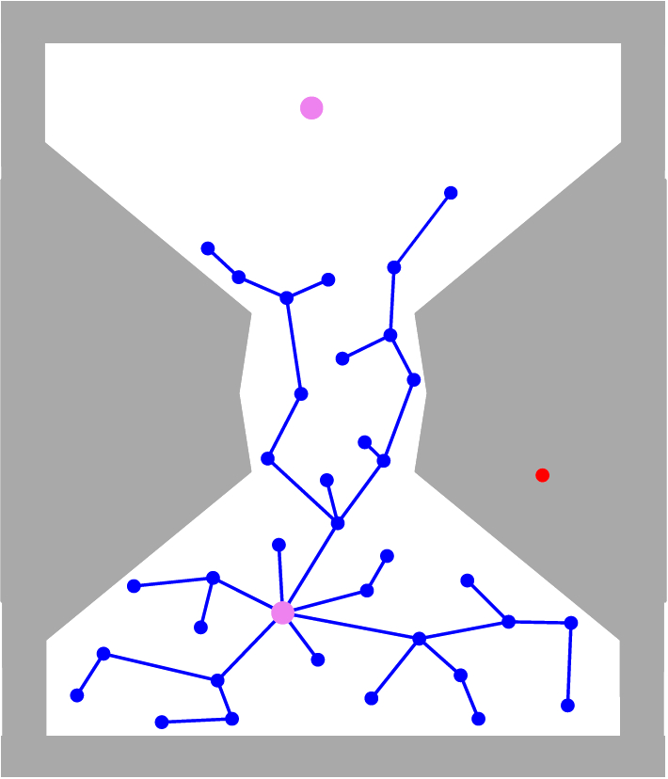
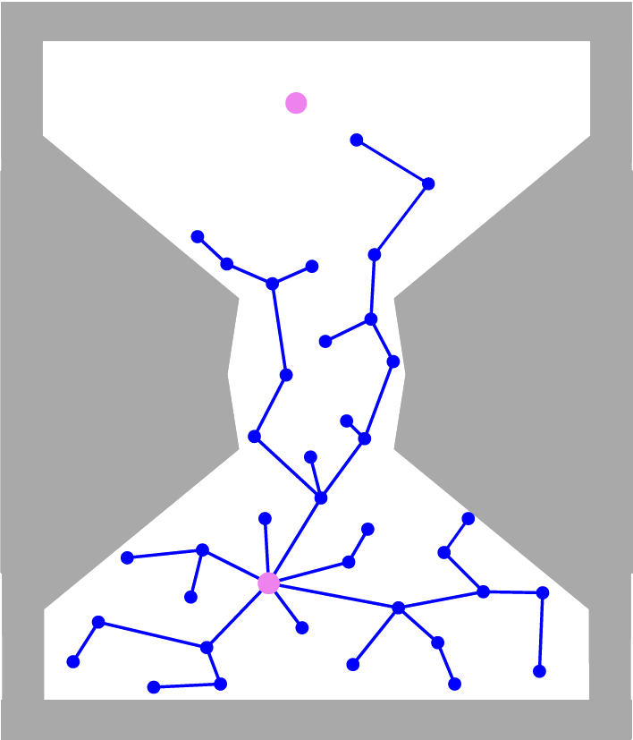
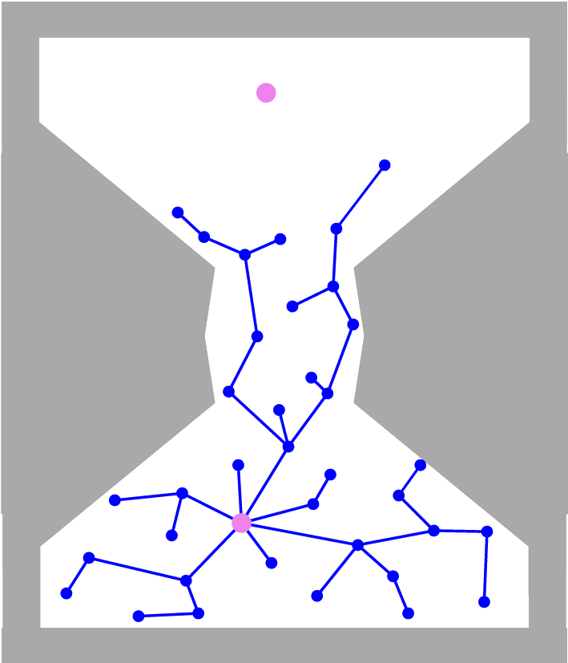
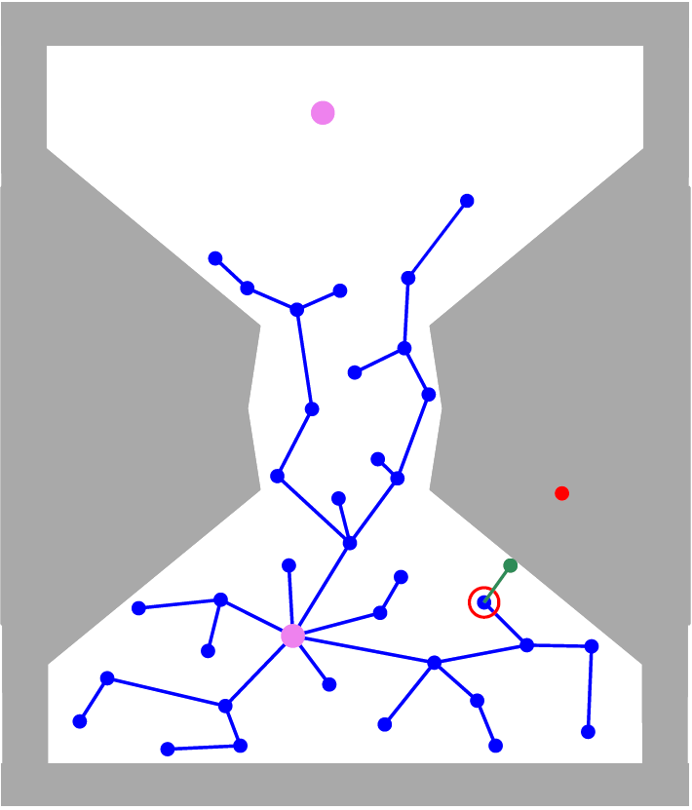
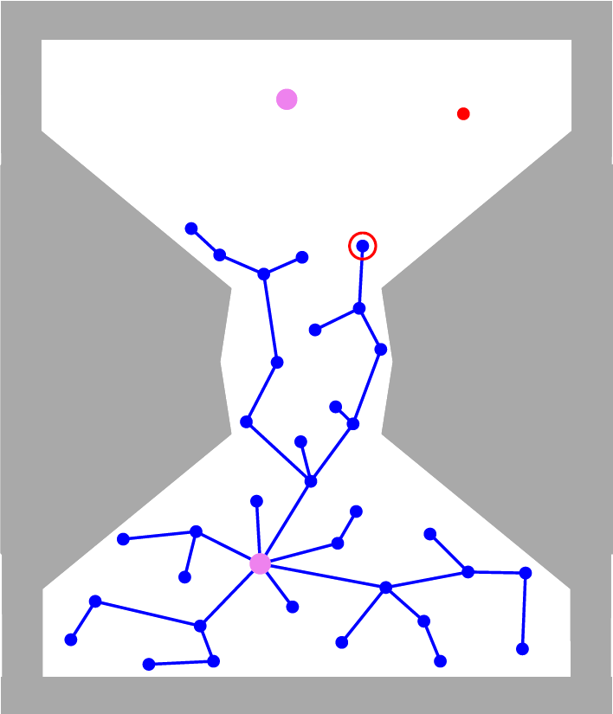
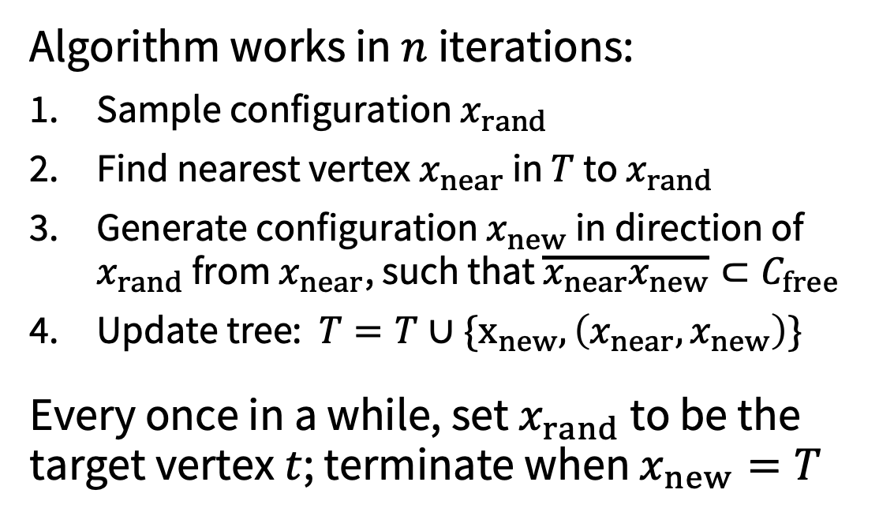

Rapidly-exploring random trees (RRT)
A single-query planner, which grows a tree $T$ , rooted at the start configuration $s$, embedded in $C_{free}$
Algorithm works in $n$ iterations:
Sample configuration $x_{rand}$
Find nearest vertex $x_{near}$ in $T$ to $x_{rand}$
Generate configuration $x_{new}$ in direction of $x_{rand}$ from $x_{near}$, such that $\overline{x_{near}x_{new}}⊂C_{free}$
Update tree: $T=T∪\{x_{new},\left(x_{near},x_{new}\right)\}$
Every once in a while, set $x_{rand}$ to be the target vertex $t$; terminate when $x_{new}=T$

Slide 11
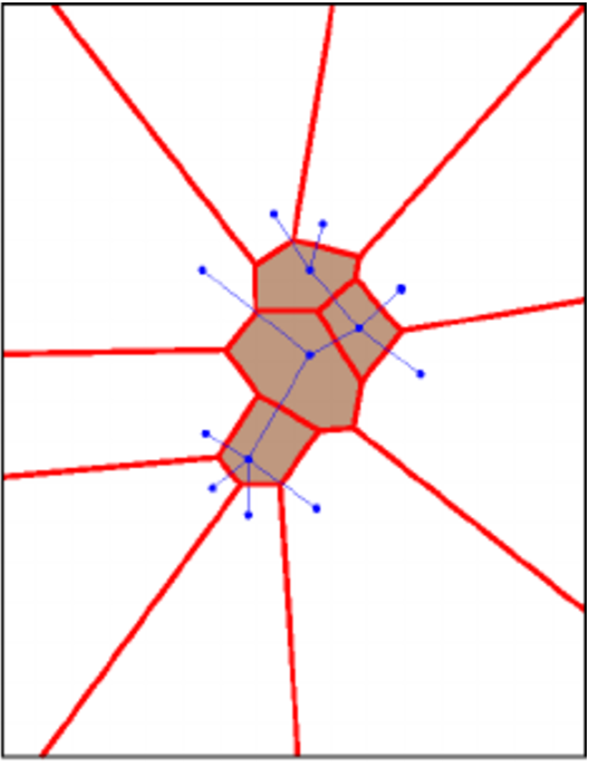
Rapidly-exploring random trees (RRT)
RRT is known to work quite well in practice
Its performance can be attributed to its Voronoi bias:
Consider a Voronoi diagram with respect to the vertices of the tree
For each vertex, its Voronoi cell consists of all points that are closer to that vertex than to any other
Vertices on the frontier of the tree have larger Voronoi cells – hence sampling in those regions is more likely

Slide 12
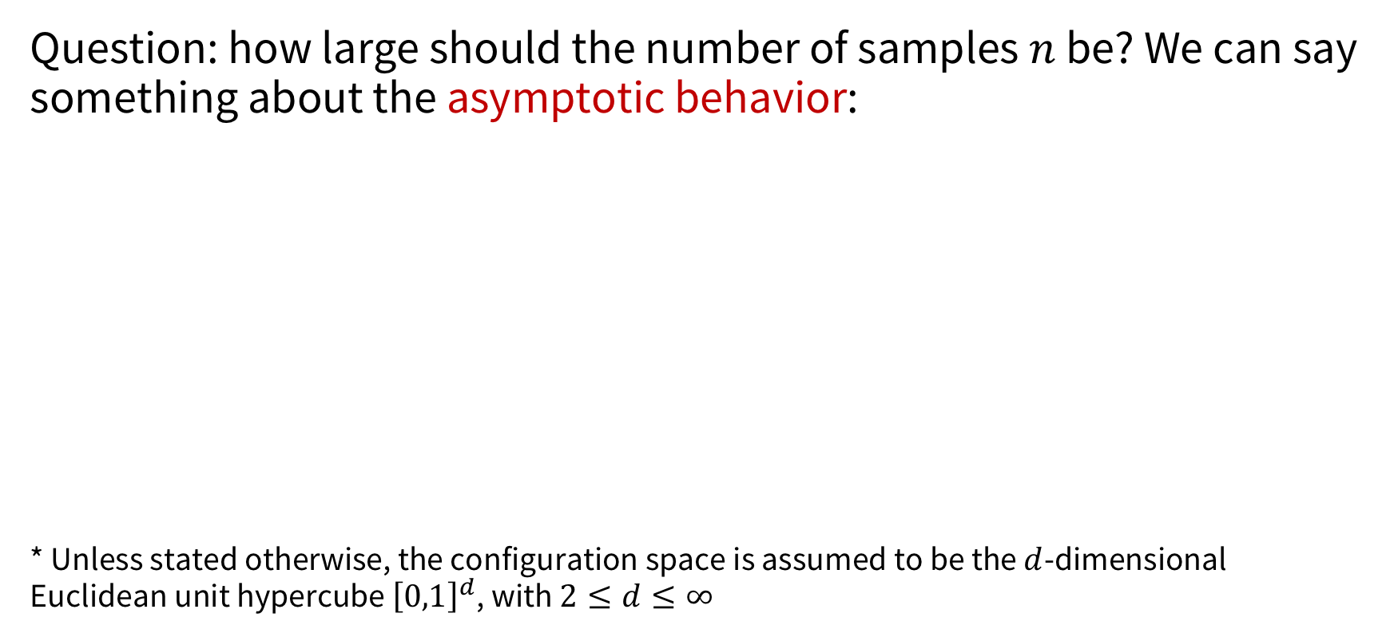
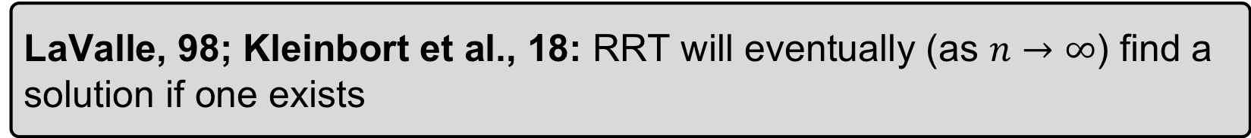
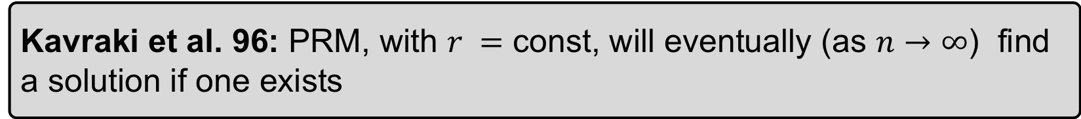
Theoretical guarantees: probabilistic completeness
Question: how large should the number of samples $n$ be? We can say something about the asymptotic behavior:
* Unless stated otherwise, the configuration space is assumed to be the $d$-dimensional Euclidean unit hypercube ${\left[0,1\right]}^{d}$, with $2≤d≤∞$
Kavraki et al. 96: PRM, with $r =$ const, will eventually (as $n→∞$) find a solution if one exists
LaValle, 98; Kleinbort et al., 18: RRT will eventually (as $n→∞$) find a solution if one exists

Slide 13
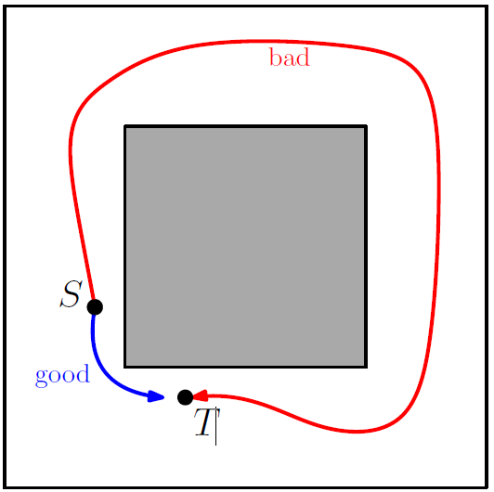
Theoretical guarantees: quality
Question: what can be said about the quality of the returned solution for PRM and RRT, in terms of length, energy, etc.?
Nechushtan et al. (2011) and Karaman and Frazzoli (2011) proved that RRT can produce arbitrarily-bad paths with non-negligible probability: for example, RRT would prefer to take the long (red) way

Slide 14
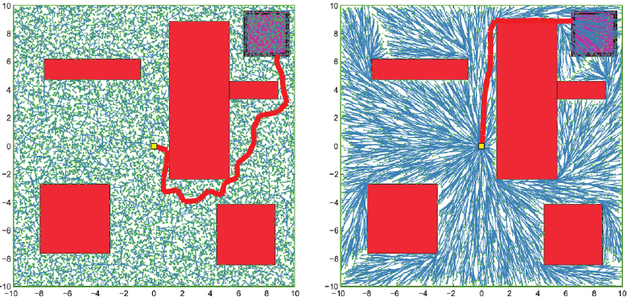
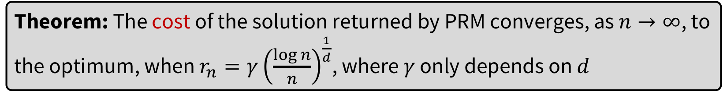
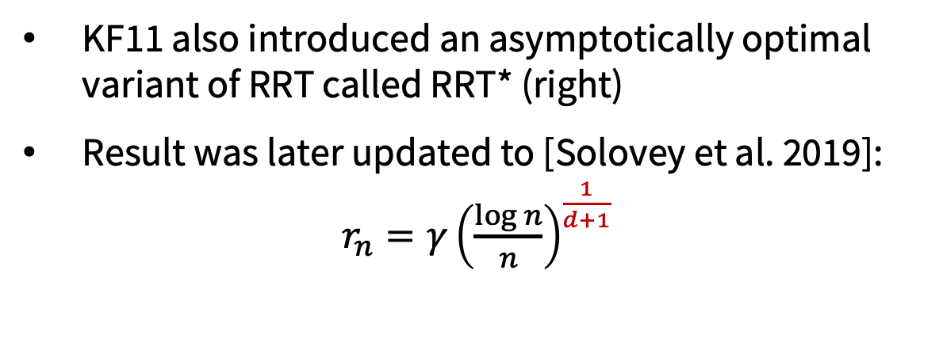
Theoretical guarantees: quality
Karaman and Frazzoli in 2011 provided the first rigorous study of optimality in sampling-based planners:
Theorem: The cost of the solution returned by PRM converges, as $n→∞$, to the optimum, when $r_{n}=γ{\left(\frac{\log{n}}{n}\right)}^{\frac{1}{d}}$, where $γ$ only depends on $d$
KF11 also introduced an asymptotically optimal variant of RRT called RRT* (right)
Result was later updated to [Solovey et al. 2019]:
$r_{n}=γ{\left(\frac{\log{n}}{n}\right)}^{\frac{1}{d+1}}$

Slide 15
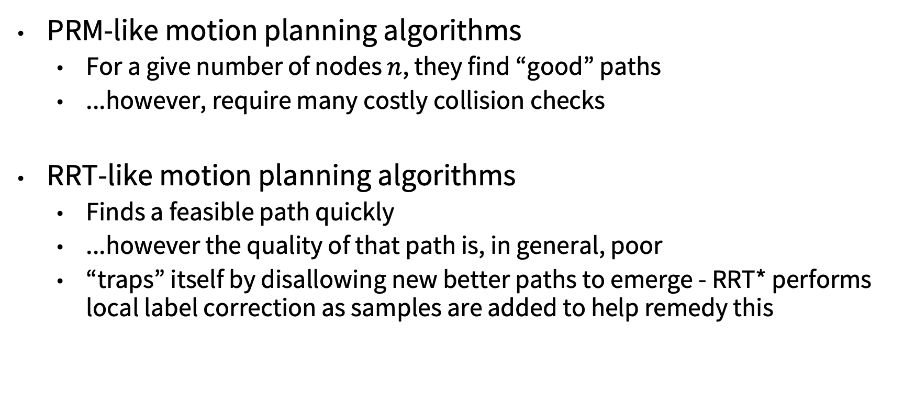
Observations
PRM-like motion planning algorithms
For a give number of nodes $n$, they find “good” paths
...however, require many costly collision checks
RRT-like motion planning algorithms
Finds a feasible path quickly
...however the quality of that path is, in general, poor
“traps” itself by disallowing new better paths to emerge - RRT* performs local label correction as samples are added to help remedy this

Slide 16
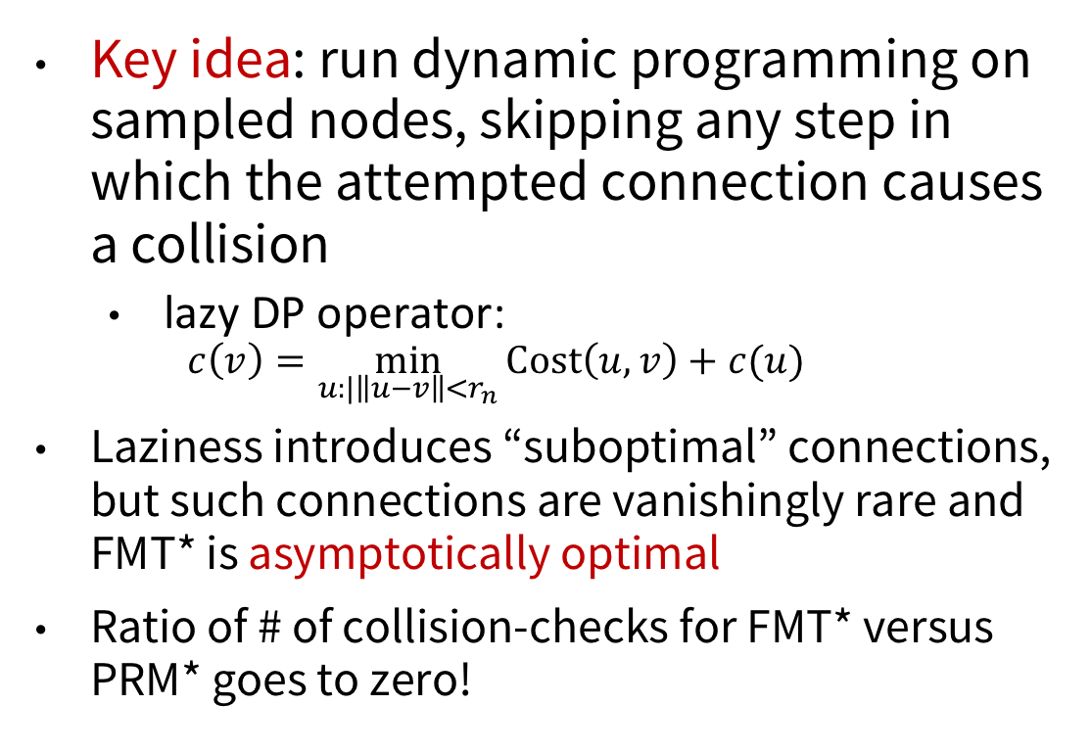
Fast Marching Tree Algorithm (FMT*)
Key idea: run dynamic programming on sampled nodes, skipping any step in which the attempted connection causes a collision
lazy DP operator:
$$c\left(v\right)=\min_{u:|\left\|u−v\right\|<r_{n}}{Cost\left(u,v\right)+c(u)}$$
Laziness introduces “suboptimal” connections, but such connections are vanishingly rare and FMT* is asymptotically optimal
Ratio of # of collision-checks for FMT* versus PRM* goes to zero!
Reference: Janson et al. Fast Marching Tree: A Fast Marching Sampling-Based Method for Optimal Motion Planning in Many Dimensions. 2015

Slide 17
Sampling-based planning: summary
Sampling-based planners transform the difficult global problem into a large set of local and easy problems
A key ingredient is collision detection, which is conceptually easy, as it can be solved in the workspace (2D or 3D)
Local planning (edge validation) is typically performed by dense sampling of path and collision detection
Another key ingredient is nearest-neighbor search: given a query point find its nearest neighbor(s) within a set of points -- also well studied theoretically and practically

Slide 18
More on sampling-based motion planning
Kinodynamic planning
Randomized versus deterministic planning sequences
Biased sampling

Slide 19
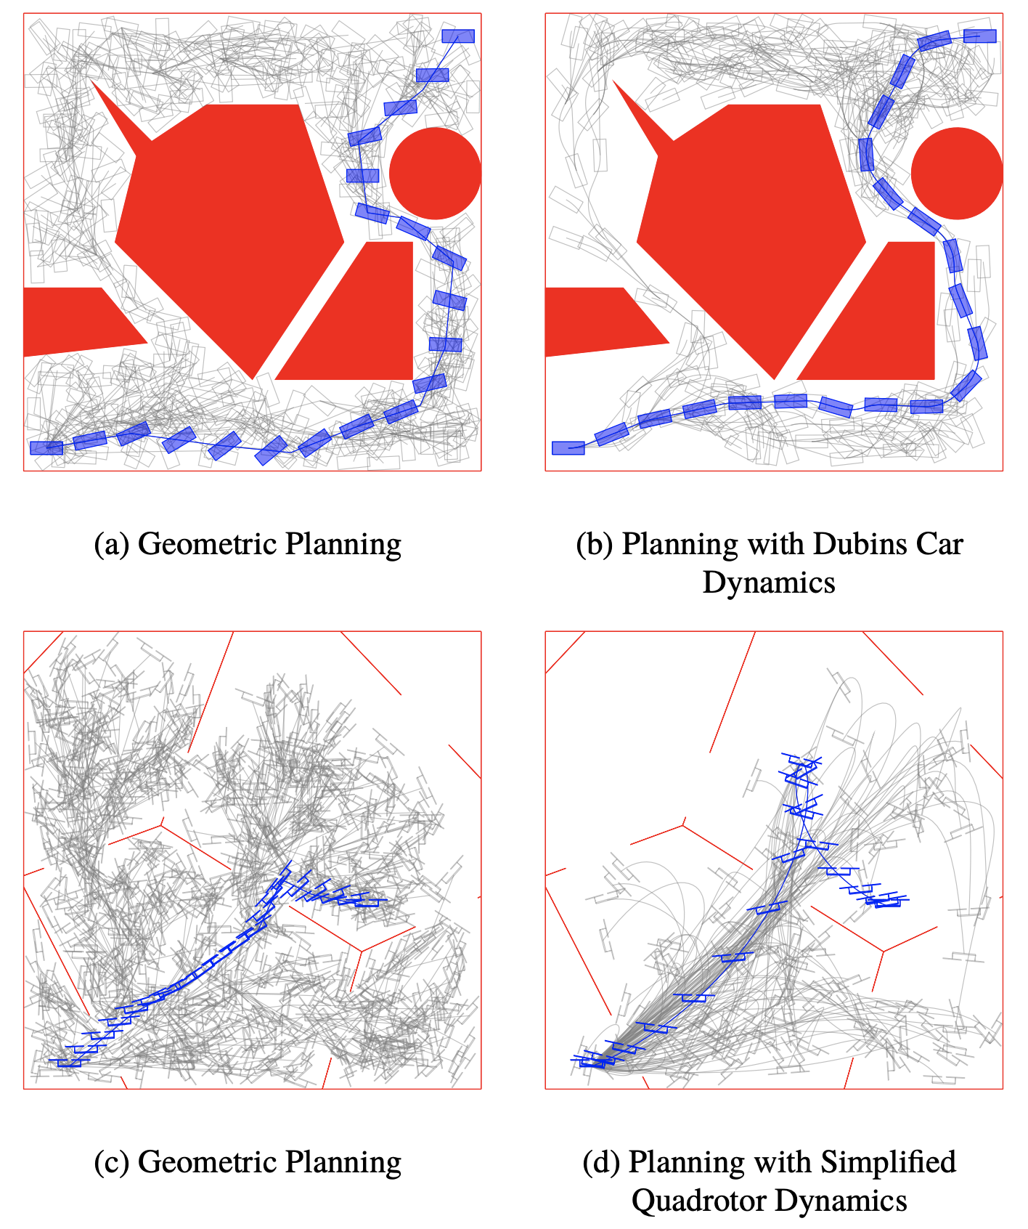
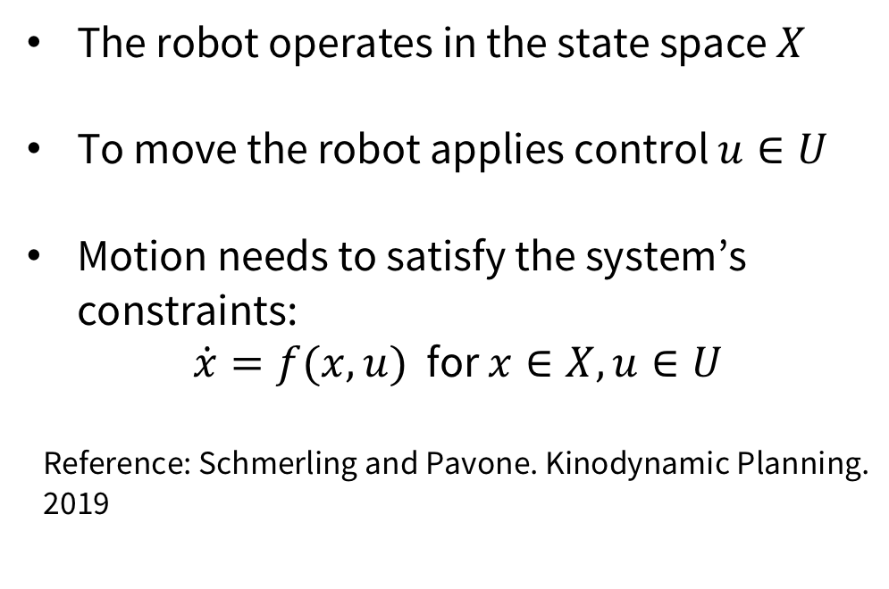
Kinodynamic planning
Kinodynamic motion planning problem: in addition to obstacle avoidance, paths are subject to differential constraints
The robot operates in the state space $X$
To move the robot applies control $u∈U$
Motion needs to satisfy the system’s constraints:
$\dot{x}=f(x,u)$ for $x∈X,u∈U$
Reference: Schmerling and Pavone. Kinodynamic Planning. 2019

Slide 20
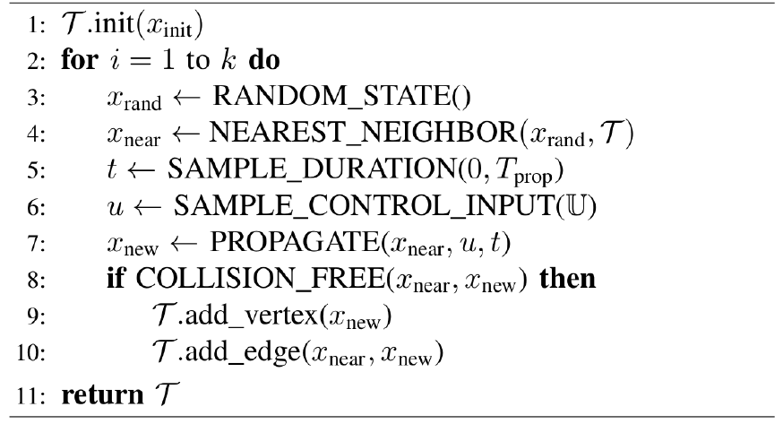

Forward-propagation-based algorithms
RRT can be extended to kinodynamic case in a relatively easy way:
Draw a random state and find its nearest neighbor $x_{near}$
Sample a random control $u∈U$ and random duration $t$
Forward propagate the control $u$ for $t$ time from $x_{near}$
Reference: Kleinbort et al. Probabilistic completeness of RRT for geometric and kinodynamic planning with forward propagation. 2018.

Slide 21
Should probabilistic planners be probabilistic?
Key question: would theoretical guarantees and practical performance still hold if these algorithms were to be derandomized, i.e., run on deterministic samples?
Important question as derandomization would:
Ease certification process
Ease use of offline computation
Potentially simplify a number of operations (e.g., NN search)
Answer: Yes! See: Janson et al. Deterministic Sampling-Based Motion Planning: Optimality, Complexity, and Performance. 2018.

Slide 22
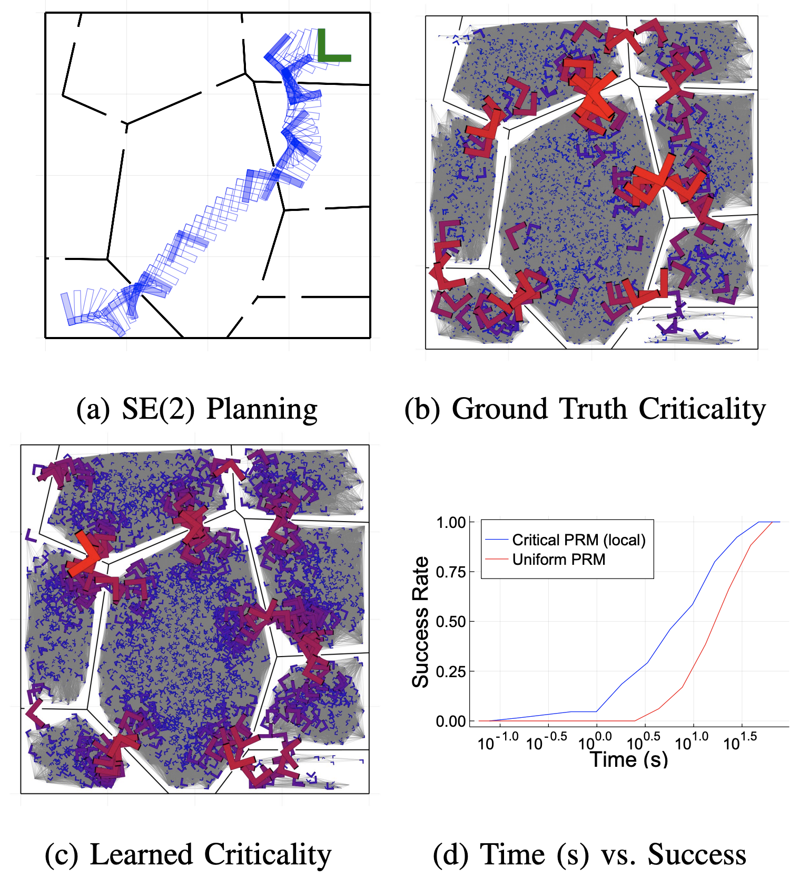
Biased sampling for SBMP
Potential issue with uniform sampling: narrow corridors in C-space require many samples to identify/traverse
Key idea: bias sampling towards suspected such challenging regions of C-space
Biased sampling distributions can be hand-constructed and/or adapt online (e.g., Hybrid Sampling PRM), or learned from prior experience solving similar planning problems
References:
Hsu et al. Hybrid PRM sampling with a cost-sensitive adaptive strategy. 2005.
Ichter et al. Learned Critical Probabilistic Roadmaps for Robotic Motion Planning. 2020.

Slide 23
Next time

