Slide 1
Principles of Robot Autonomy I
Robotic sensors and introduction to computer vision

Slide 2

Attendance Form

Slide 3
Agenda
Agenda
Overview of key performance characteristics for robotic sensors
Overview of main sensors for robot autonomy, e.g. proprioceptive / exteroceptive, passive / active
Intro to computer vision
Readings:
Chapter 6, sections 6.1 – 6.4 in D. Gammelli, J. Lorenzetti, K. Luo, G. Zardini, M. Pavone. Principles of Robot Autonomy. 2026.

Slide 4
Sensors for mobile robots

Slide 5
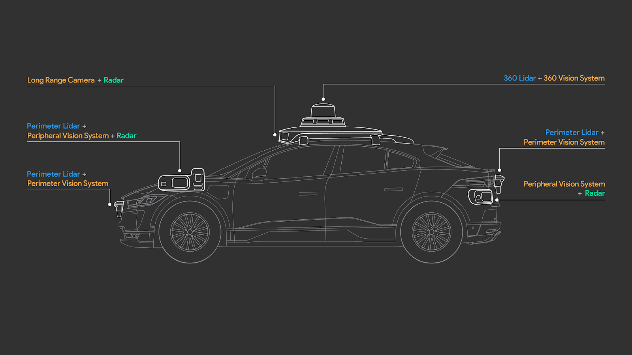
Example: self-driving cars

Slide 6
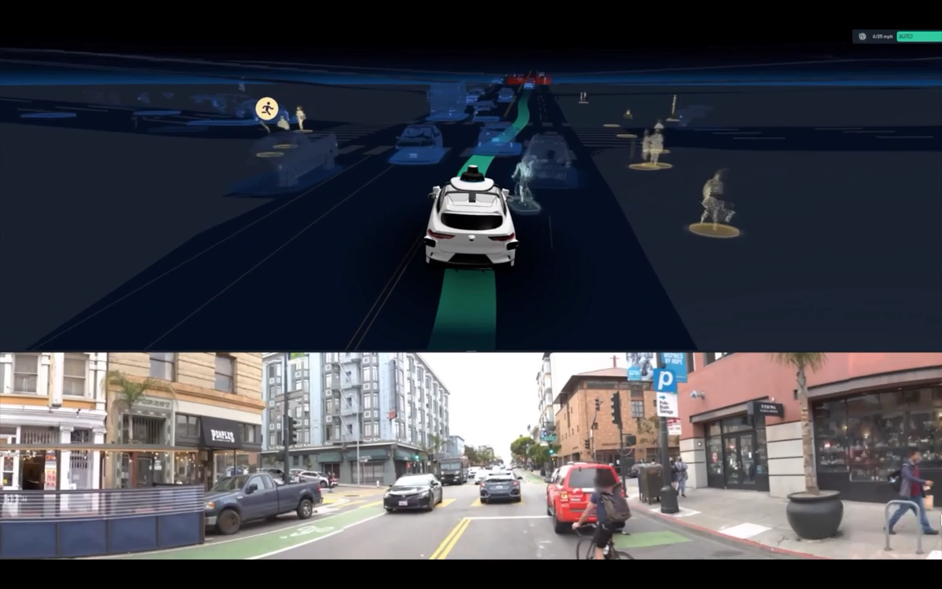

Slide 7
Classification of sensors
Proprioceptive: measure values internal to the robot
E.g.: motor speed, robot arm joint angles, and battery voltage
Exteroceptive: acquire information from the robot’s environment
E.g.: distance measurements and light intensity
Passive: measure ambient environmental energy entering the sensor
Challenge: performance heavily depends on the environment
E.g.: temperature probes and cameras
Active: emit energy into the environment and measure the reaction
Challenge: might affect the environment
E.g.: ultrasonic sensors and laser rangefinders

Slide 8
Sensor performance: design specs
Dynamic range: ratio between the maximum and minimum input values (for normal sensor operation)
Resolution: minimum difference between two values that can be detected by a sensor
Linearity: whether or not the sensor’s output response depends linearly on the input
Bandwidth or frequency: speed at which a sensor provides readings (in Hertz)

Slide 9
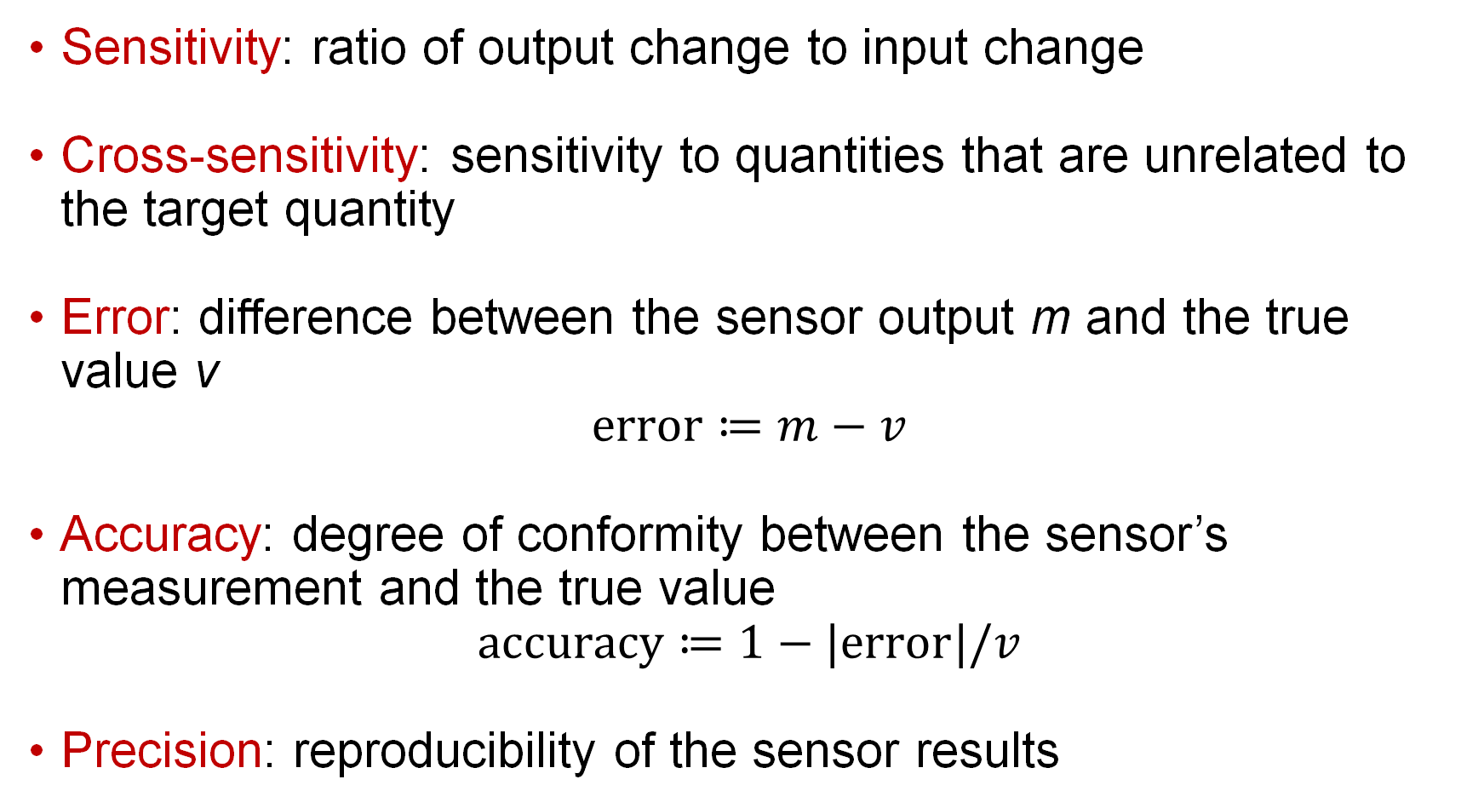
Sensor performance: in situ specs
Sensitivity: ratio of output change to input change
Cross-sensitivity: sensitivity to quantities that are unrelated to the target quantity
Error: difference between the sensor output m and the true value v
$$e\text{rror}≔m−v$$
Accuracy: degree of conformity between the sensor’s measurement and the true value
$$\text{a}\text{ccuracy}≔1−\text{|error}|/v$$
Precision: reproducibility of the sensor results

Slide 10
Sensor errors
Systematic errors: caused by factors that can in theory be modeled; they are deterministic
E.g.: calibration errors
Random errors: cannot be predicted with sophisticated models; they are stochastic
E.g.: spurious range-finding errors
Error analysis: performed via a probabilistic analysis
Common assumption: symmetric, unimodal (and often Gaussian) distributions; convenient, but often a coarse simplification
Error propagation characterized by the error propagation law

Slide 11
An ecosystem of sensors
Encoders
Heading sensors
Accelerometers and IMU
Beacons
Active ranging
Cameras

Slide 12
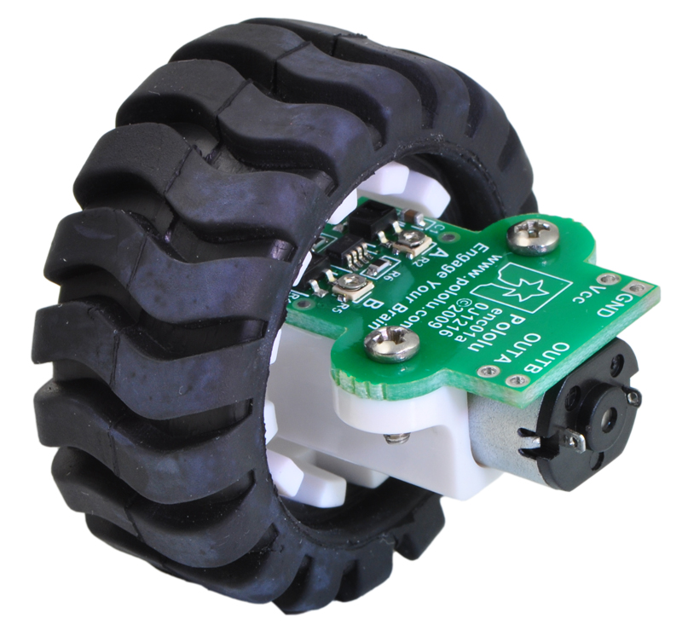
Encoders
Encoder: an electro-mechanical device that converts motion into a sequence of digital pulses, which can be converted to relative or absolute position measurements
proprioceptive sensor
can be used for robot localization
Wheel encoder
Credit: Pololu
Fundamental principle of optical encoders: use a light shining onto a photodiode through slits in a metal or glass disc
Credit: Honest Sensor

Slide 13
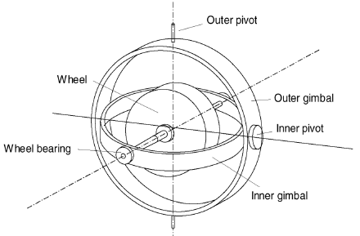
Heading sensors
Used to determine robot’s orientation, it can be:
Proprioceptive, e.g., gyroscope (heading sensor that preserves its orientation in relation to a fixed reference frame)
Exteroceptive, e.g., compass (shows direction relative to the geographic cardinal directions)
Fusing measurements with velocity information, one can obtain a position estimate (via integration) -> dead reckoning
Fundamental principle of mechanical gyroscopes: angular momentum associated with spinning wheel keeps the axis of rotation inertially stable
Credit: SNS

Slide 14
Accelerometer and IMU
Accelerometer: device that measures all external forces acting upon it
Mechanical accelerometer: essentially, a spring-mass-damper system
with m mass of proof mass, c damping coefficient, k spring constant; in steady state
Modern accelerometers use MEMS (cantilevered beam + proof mass); deflection measured via capacitive or piezoelectric effects

Slide 15
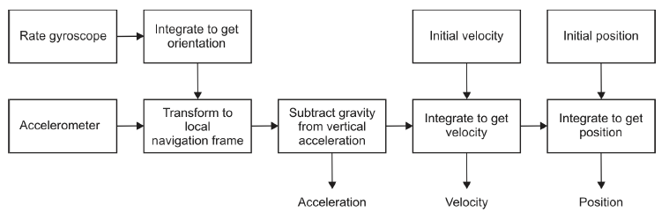
Inertial Measurement Unit (IMU)
Definition: device that uses gyroscopes and accelerometers to estimate the relative position, orientation, velocity, and acceleration of a moving vehicle with respect to an inertial frame
Drift is a fundamental problem: to cancel drift, periodic references to external measurements are required
Credit: SNS

Slide 16
Beacons
Definition: signaling devices with precisely known positions
Early examples: stars, lighthouses
Modern examples: GPS, motion capture systems

Slide 17
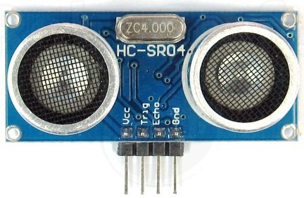
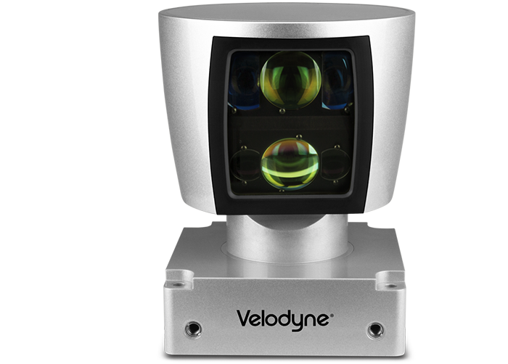
Active ranging
Provide direct measurements of distance to objects in vicinity
Key elements for both localization and environment reconstruction
Main types:
Time-of-flight active ranging sensors (e.g., ultrasonic and laser rangefinder)
Geometric active ranging sensors (optical triangulation and structured light)
Credit: https://electrosome.com/hc-sr04-ultrasonic-sensor-pic/

Slide 18
Time-of-flight active ranging
Fundamental principle: time-of-flight ranging makes use of the propagation of the speed of sound or of an electromagnetic wave
Travel distance is given by
where d is the distance traveled, c is the speed of the wave propagation, and t is the time of flight
Propagation speeds:
Sound: 0.3 m/ms
Light: 0.3 m/ns
Performance depends on several factors, e.g., uncertainties in determining the exact time of arrival and interaction with the target

Slide 19
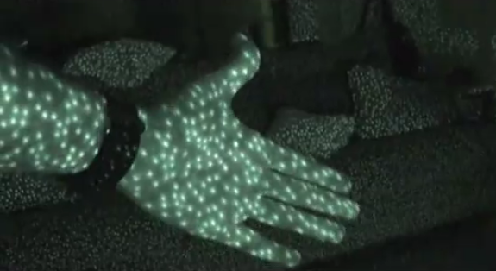
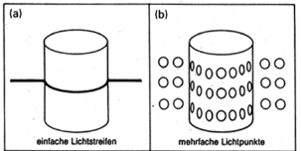
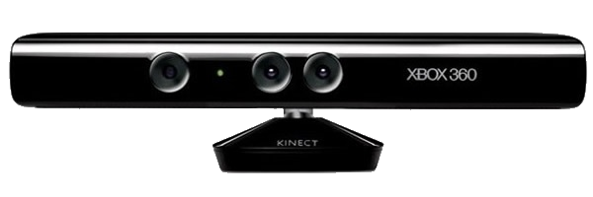
Geometric active ranging
Fundamental principle: use geometric properties in the measurements to establish distance readings
The sensor projects a known light pattern (e.g., point, line, or texture); the reflection is captured by a receiver and, together with known geometric values, range is estimated via triangulation
Examples:
Optical triangulation (1D sensor)
Structured light (2D and 3D sensor)
Credit: Matt Fisher

Slide 20
Several other sensors are available
Classical, e.g.:
Radar (possibly using Doppler effect to produce velocity data)
Tactile sensors
Emerging technologies:
Artificial skins
Neuromorphic cameras

Slide 21
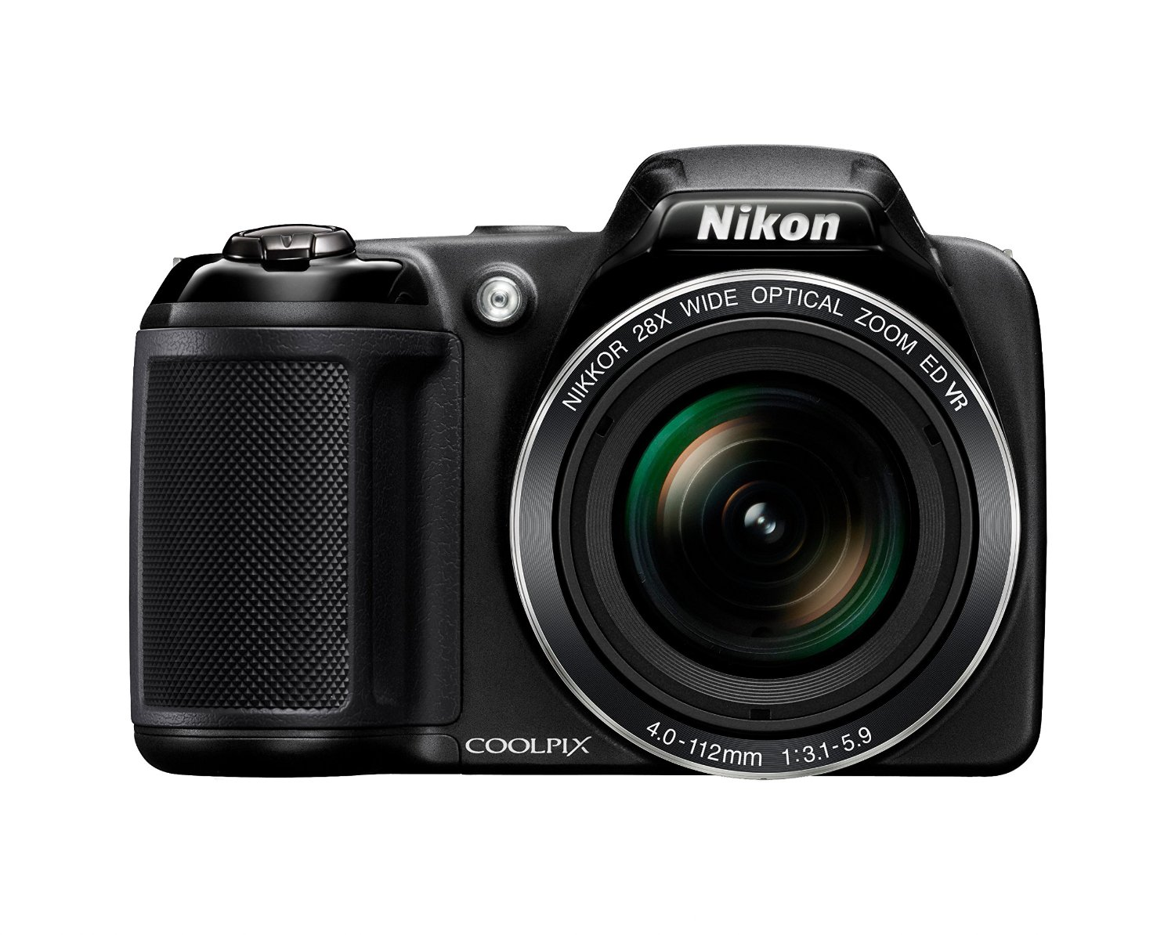
Introduction to computer vision
Aim
Learn about cameras and camera models
Learn about the outputs of perception and what they might be used for
Readings
Siegwart, Nourbakhsh, Scaramuzza. Introduction to Autonomous Mobile Robots. Section 4.2.3.
D. A. Forsyth and J. Ponce [FP]. Computer Vision: A Modern Approach (2nd Edition). Prentice Hall, 2011. Chapter 1.
R. Hartley and A. Zisserman [HZ]. Multiple View Geometry in Computer Vision. Academic Press, 2002. Chapter 6.1.

Slide 22
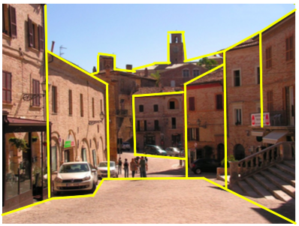
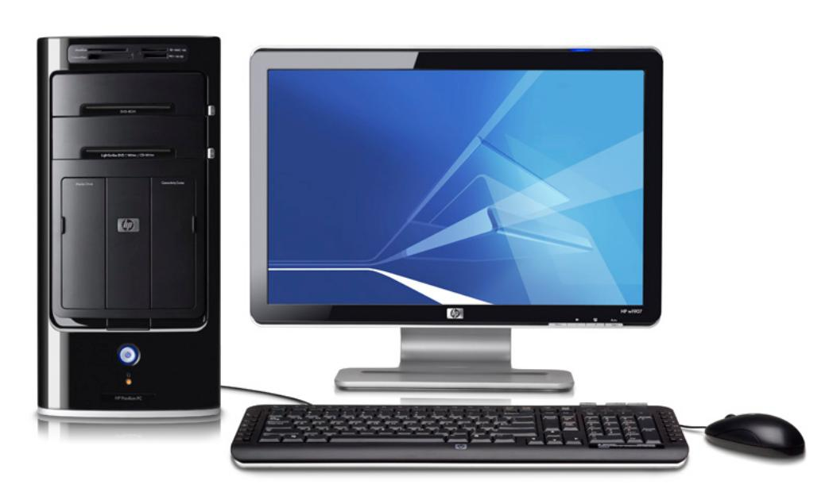
Vision
Vision: ability to interpret the surrounding environment using light in the visible spectrum reflected by objects in the environment
Human eye: provides enormous amount of information, ~millions of bits per second
Cameras (e.g., CCD, CMOS): capture light -> convert to digital image -> process to get relevant information (from geometric to semantic)
Sky
Information extraction
Interpretation
Car

Slide 23
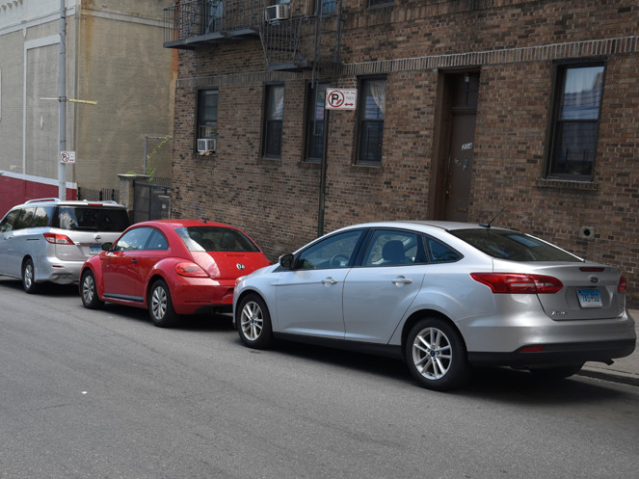

Computer Vision Pipeline
Real-world scene
Sensing device
Digital image
(array of pixel values)
Relevant information
Scene Representation
Car
Car
Car

Slide 24
Real-world scene
Digital image
(array of pixel values)
Scene Representation
Relevant information
Car
Car
Car
Information Extraction:
Features – e.g. edges, corners, texture, colors, etc.
3D structure

Slide 25
Real-world scene
Digital image
(array of pixel values)
Scene Representation
Relevant information
Car
Car
Car
Interpretation:
Object detection
Object tracking
Image registration
Image segmentation

Slide 26
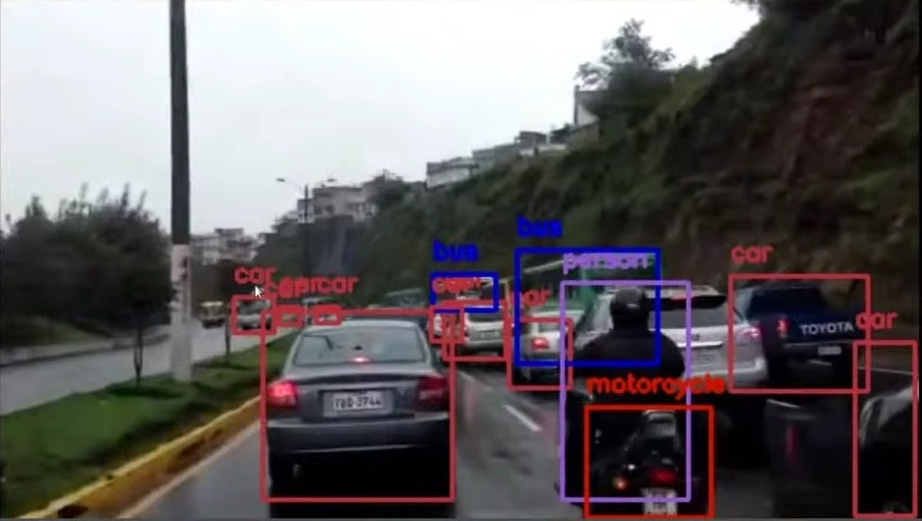
Object Detection
Goal: Detect instances of semantic objects of a certain class
E.g. pedestrian detection, face detection
Approaches:
Traditional methods, e.g.:
Scale-invariant feature transform (SIFT)
Histogram of Oriented Gradients (HOG)
Learning-based:
Using region proposals
Without region proposals: You Only Look Once (YOLO), Single Shot Detector (SSD)

Slide 27
Object Tracking
Goal: Follow and locate a specific object across a sequence of images or video frames
Applications: Autonomous driving, surveillance, augmented reality, medical imaging, sports analysis, etc.
Approaches:
Traditional methods, e.g. mean-shift tracking or Kalman filters
Learning-based methods, e.g. Siamese networks or recurrent neural networks (RNNs)

Slide 28
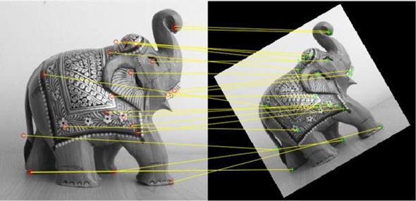
Image Registration
Goal: Transform different sets of data into one coordinate system
Examples:
Data from multiple photographs (e.g. with different viewpoints)
Data from different sensors (e.g. LIDAR and RGB camera)
Example of LIDAR-camera registration shown in Notebook 9!
Source: Mathworks

Slide 29
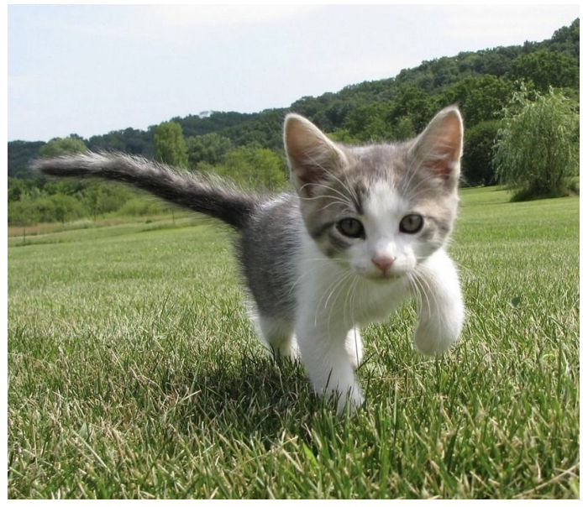
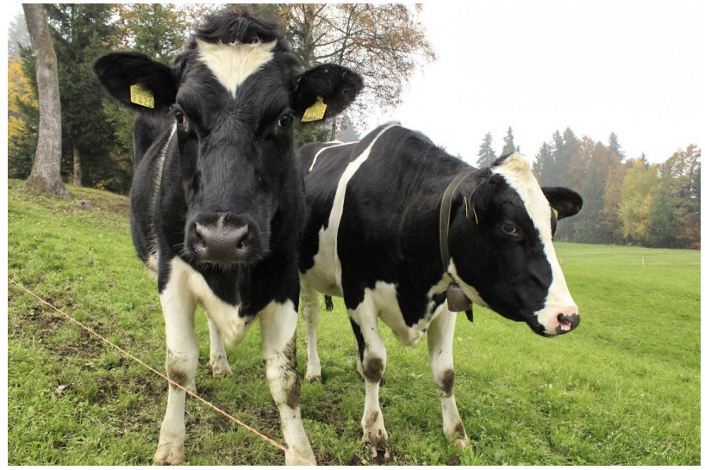
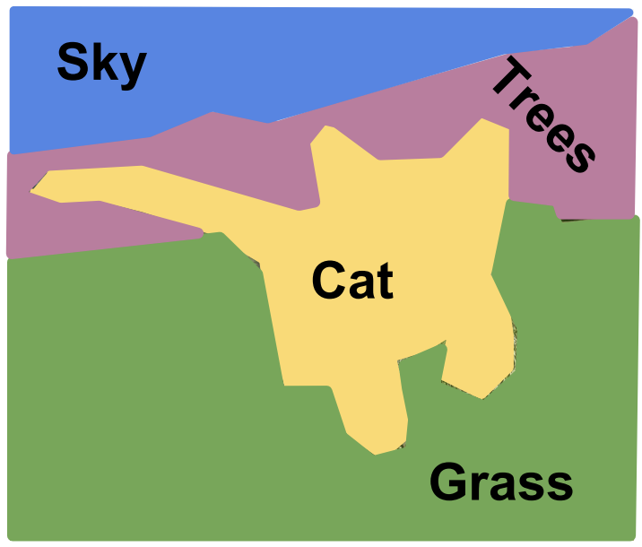
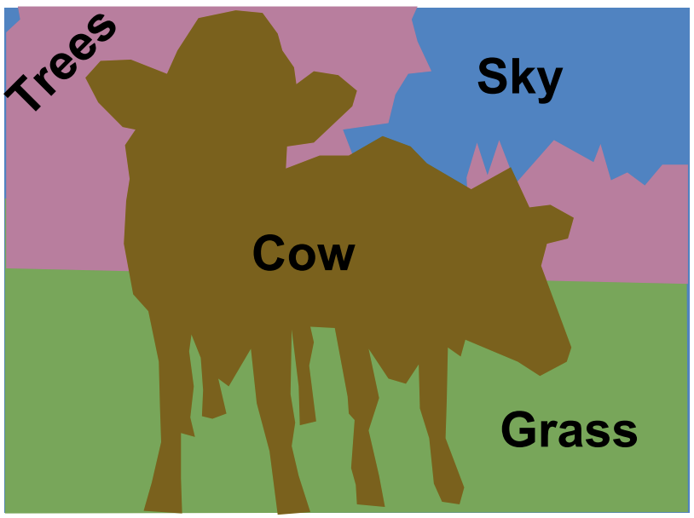

Image Segmentation
Semantic segmentation:
Label each pixel in the image with a category label
Doesn’t differentiate instances, only cares about pixels
Instance segmentation:
Label each pixel with its object instance
Identifies individual objects within each category
Source:
Stanford CS 231n lecture slides

Slide 30
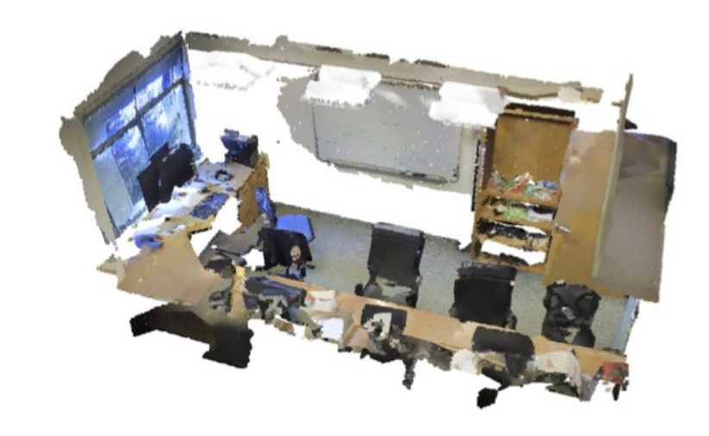
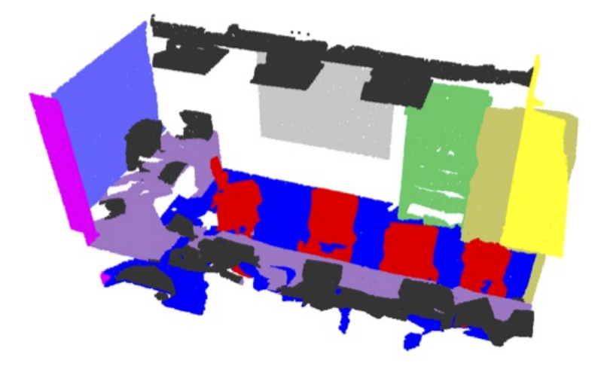
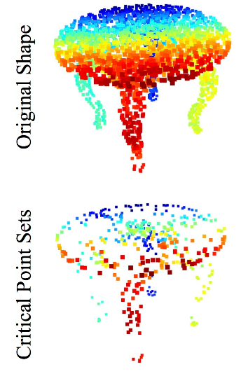
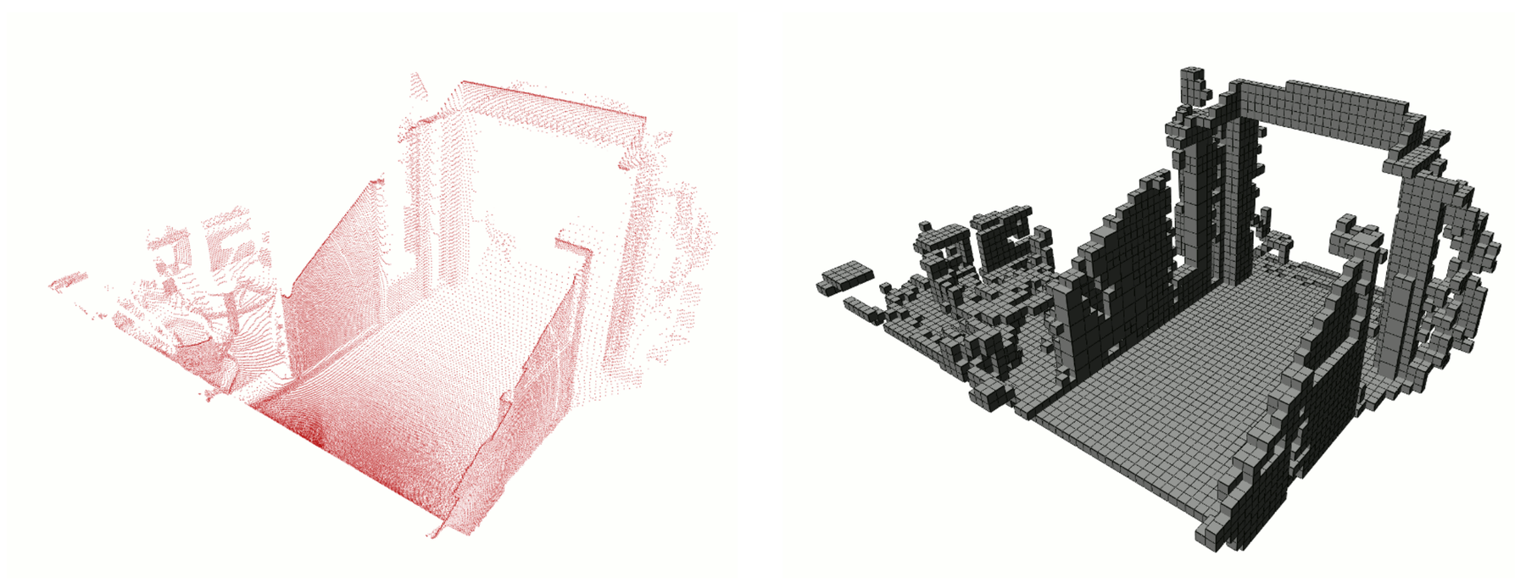
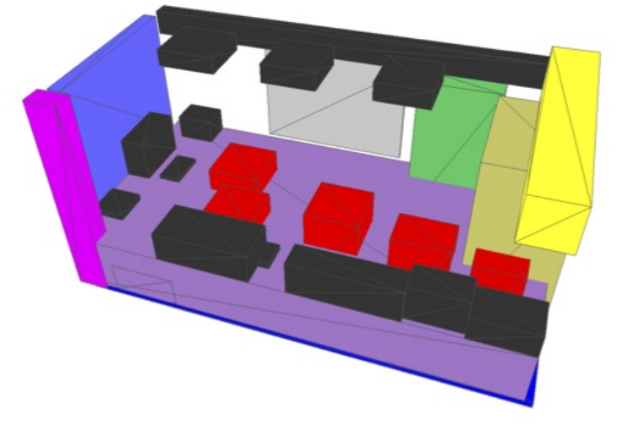
Information extraction and interpretation can also be done with LIDAR data!
Point cloud
Features
Tasks
Semantic segmentation
Critical points
Occupancy grid map
Object detection
Images from PointNet and OctoMap

Slide 31
From Scenes to Digital Images
Real-world scene
Digital image
(array of pixel values)
Sensing device
Relevant information
Scene Representation
Car
Car
Car

Slide 32
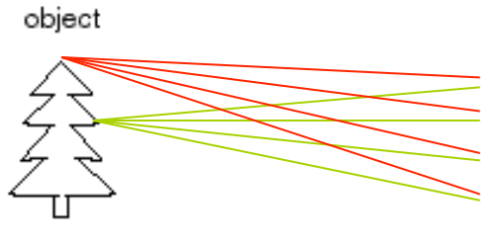
How to capture an image of the world?
Light is reflected by the object and scattered in all directions
If we simply add a photoreceptive surface, the captured image will be extremely blurred
Photoreceptive surface

Slide 33
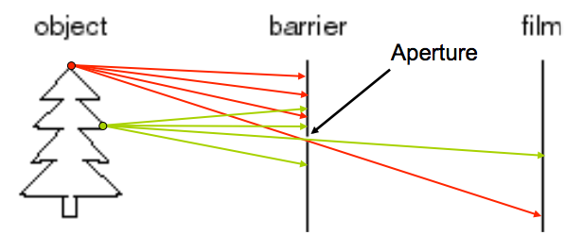
Pinhole camera
Idea: add a barrier to block off most of the rays
Pinhole camera: a camera without a lens but with a tiny aperture, a pinhole
Photoreceptive surface
Aperture

Slide 34
A long history
Very old idea (several thousands of years BC)
First clear description from Leonardo Da Vinci (1502)
Oldest known published drawing of a camera obscura by Gemma Frisius (1544)

Slide 35
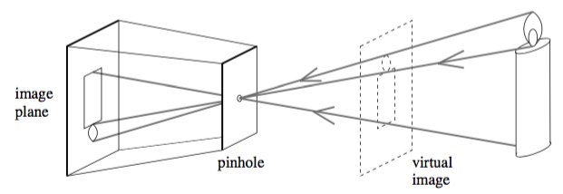
Pinhole camera
Focal length f
Perspective projection creates inverted images
Sometimes it is convenient to consider a virtual image associated with a plane lying in front of the pinhole
Virtual image not inverted but otherwise equivalent to the actual one
Pinhole of aperture
Credit: FP Chapter 1

Slide 36
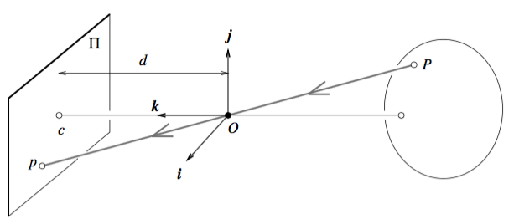

Pinhole perspective
Image plane
Since P, O, and p are collinear: $\overline{Op}=λ\overline{OP}$ for some $λ∈R$
Also, z=f, hence
Pinhole
Image center
Perspective
Optical axis
Credit: FP Chapter 1

Slide 37
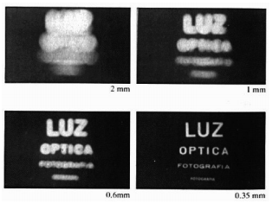
Issues with pinhole camera
Larger aperture -> greater number of light rays that pass through the aperture -> blur
Smaller aperture -> fewer number of light rays that pass through the aperture -> darkness (+ diffraction)
Solution: add a lens to replace the aperture!

Slide 38
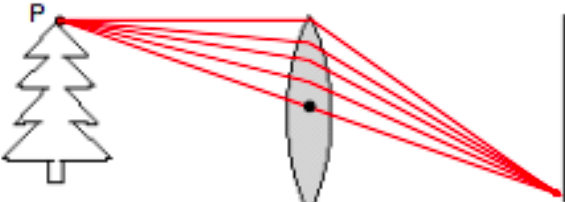
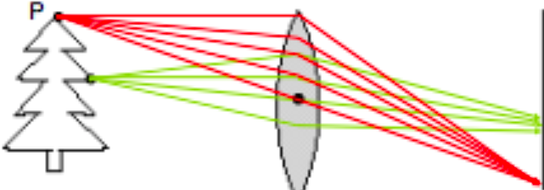
Lenses
Lens: an optical element that focuses light by means of refraction

Slide 39
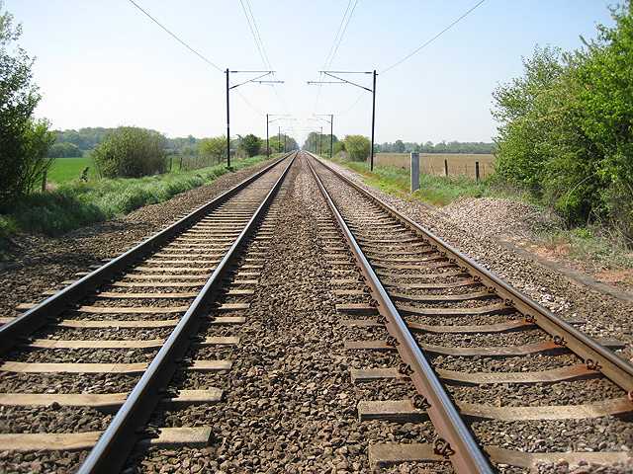
Next time: camera models & calibration

