Slide 1
AA203 Optimal and Learning-based Control
Course overview; intro to nonlinear optimization

Slide 2
Course mechanics
Teaching team:
Instructors: Marco Pavone (OH: Tue 1–2pm) and Daniele Gammelli (OH: Wed 3– 4pm)
CAs: Ellie Brosius (OH: Wed 10-11am), Hugo Buurmeijer (OH: Thu 1-2pm), and Pranit Mohnot (OH: Wed 10-11am)
Logistics:
Lecture slides, homework assignments: http://asl.stanford.edu/aa203/
Lecture recordings, announcements: https://canvas.stanford.edu/courses/222759
Discussion forum: https://edstem.org/us/courses/97334/discussion
Homework submission: https://www.gradescope.com/courses/1288305
For urgent questions: aa203-spr2526-staff@lists.stanford.edu

Slide 3
Course requirements
• Homework: there will be a total of four graded problem sets
• Mixture of theory and implementation (Python)
• Final exam: scheduled for June 8th, 3:30-6:30pm
• Grading:
• Homework: 80% (20% per HW)
• Final exam: 20%
• Ed Discussion: bonus up to 5%, 0.5% per endorsed post
Late day policy: students are given a total of 6 free late days that may be used for the homework; a maximum of 2 late days will be allowed on a given assignment

Slide 4
Course material
Course notes: an evolving set of partial course notes is available at https://github.com/StanfordASL/AA203-Notes
Recitations: Friday recitations (weeks 1-4 on Fridays, 1:30 – 2:30pm in Durand 251) led by the CAs covering relevant tools (computational and mathematical)
Textbooks that may be valuable for context or further reference are listed in the syllabus

Slide 5
Prerequisites
Familiarity with a standard undergraduate engineering mathematics curriculum (e.g., CME100-106; vector calculus, ordinary differential equations, introductory probability theory)
Strong familiarity with linear algebra (e.g., EE263 or CME200)
Nice-to-have: a course in optimization (e.g., EE364A, CME307, CS 205L, CS269O, AA222)
To get the most out of this class, at least one of:
A course in machine learning (e.g., CS229, CS230, CS231N)
or
A course in control (e.g., ENGR205, AA212)
Homework 0 (ungraded) is out now to help you gauge your preparedness

Slide 6
Caveats
Arguably, this class aims for “breadth over depth”
Past students have found self-study of the details necessary
This class is quite challenging/demanding

Slide 7
Today’s Outline
Context and course goals
Problem formulation for optimal control
Introduction to non-linear optimization

Slide 8
Today’s Outline
Context and course goals
Problem formulation for optimal control
Introduction to non-linear optimization

Slide 9
Feedback control
Tracking a reference signal
Reference
+
Controller
Control
System
Output
Σ
–
Measurement
Sensor

Slide 10
Feedback control
Tracking a reference signal
Thermostat
setting
Gas flow rate
Room temperature
+
Controller
Furnace/ home
Σ
–
Measured temperature
Thermometer

Slide 11
Feedback control
Disturbance
Reference tracking, with uncertainty
Reference
+
Controller
Control
System
Output
Σ
–
Measurement
Sensor
Sensor noise

Slide 12
Feedback control desiderata
Stability: multiple notions; loosely system output is “under control”
Tracking: the output should track the reference “as closely as possible”
Disturbance rejection: the output should be “as insensitive as possible” to disturbances/noise
Robustness: controller should still perform well up to “some degree of” model misspecification

Slide 13
What’s missing?
Performance: mathematical quantification of the above desiderata, and providing a control that best realizes the tradeoffs between them
Planning: providing an appropriate reference trajectory for the controller to track (particularly nontrivial, e.g., when controlling mobile robots)
Learning: a controller that adapts to an initially unknown, or possibly time-varying system

Slide 14
Course overview
Imitation learning
Control
Adaptive
optimal control
Model-free RL
Model-based RL
Feedback control
Adaptive control
Optimal and learning control
Open-loop
MPC
Closed-loop
Indirect methods
Direct
methods
DP
HJB / HJI

Slide 15
Course goals
To learn the theoretical and implementation aspects of main techniques in optimal and learning-based control

Slide 16
Course goals
To learn the theoretical and implementation aspects of main techniques in optimal and learning-based control
To provide a unified framework and context for understanding and relating these techniques to each other

Slide 17
Today’s Outline
Context and course goals
Problem formulation for optimal control
Introduction to non-linear optimization

Slide 18
Problem formulation
Mathematical description of the system to be controlled
Statement of the constraints
Specification of a performance criterion

Slide 19

Mathematical model
Where
are the state variables
are the control inputs

Slide 20

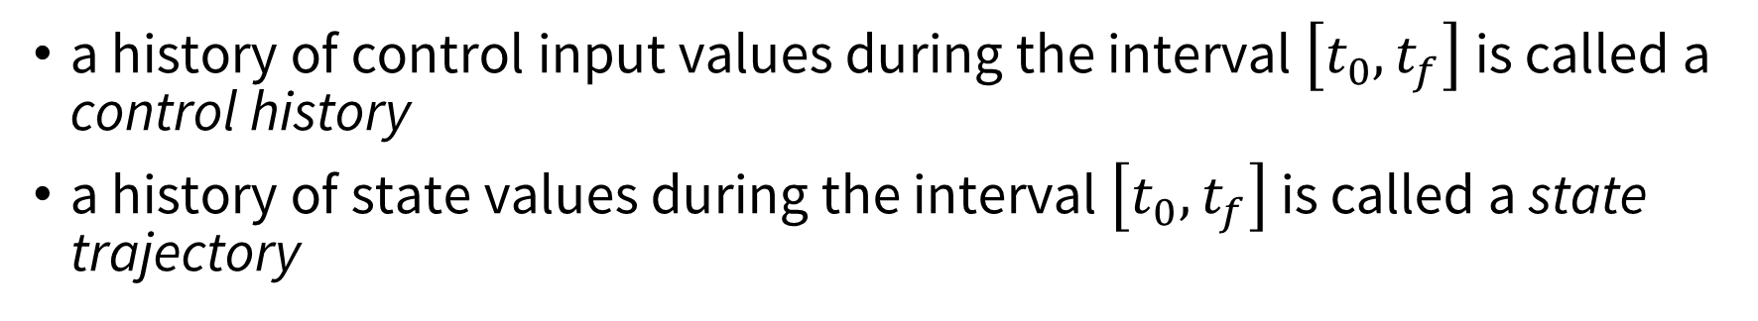
Mathematical model
In compact form
a history of control input values during the interval $\left[t_{0}, t_{f}\right]$ is called a control history
a history of state values during the interval $\left[t_{0}, t_{f}\right]$ is called a state trajectory

Slide 21
Illustrative example: double integrator
Double integrator: point mass under controlled acceleration

Slide 22
Illustrative example: double integrator
Double integrator: point mass under controlled acceleration

Slide 23
Illustrative example: double integrator
Double integrator: point mass under controlled acceleration

Slide 24
Illustrative example: double integrator
Double integrator: point mass under controlled acceleration
LTI system

Slide 25


Constraints
initial and final conditions (boundary conditions)
constraints on state trajectories
control authority
and many more...

Slide 26
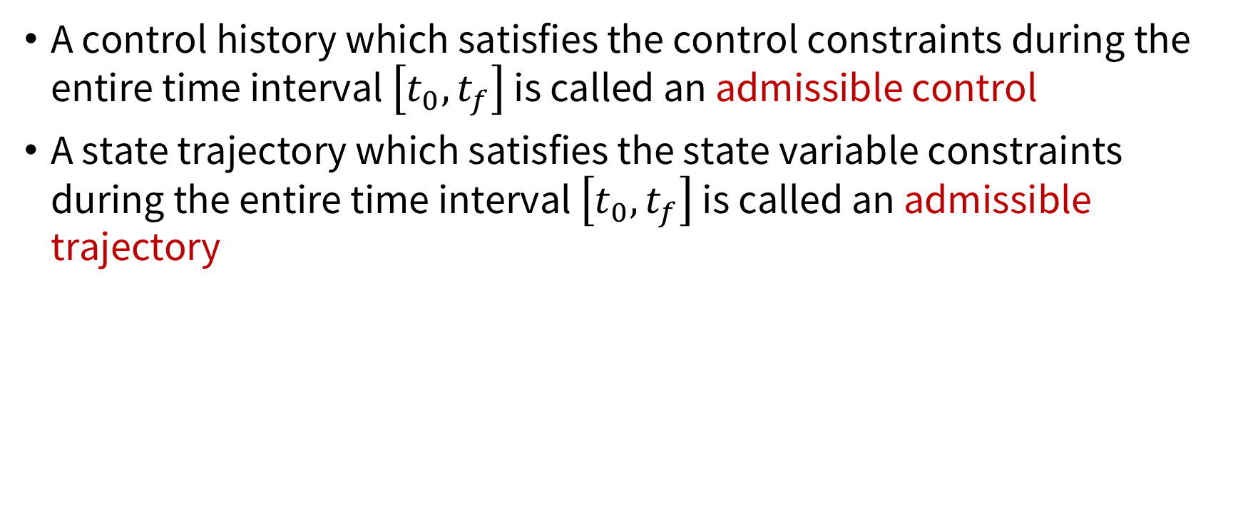
Constraints
A control history which satisfies the control constraints during the entire time interval $\left[t_{0}, t_{f}\right]$ is called an admissible control
A state trajectory which satisfies the state variable constraints during the entire time interval $\left[t_{0}, t_{f}\right]$ is called an admissible trajectory

Slide 27
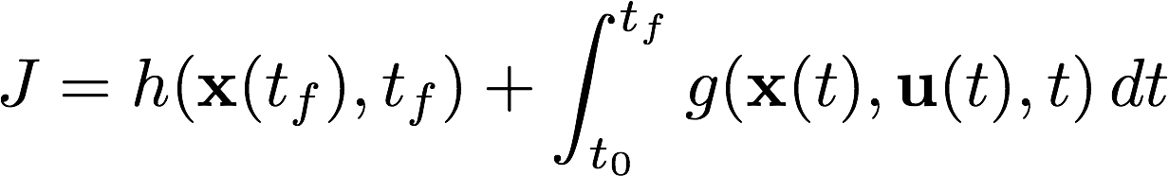
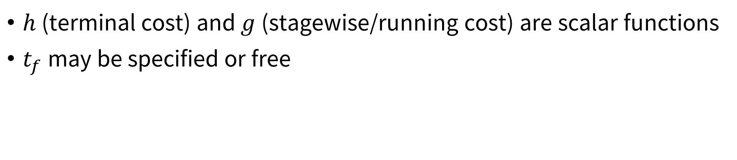
Performance measure
$h$ (terminal cost) and $g$ (stagewise/running cost) are scalar functions
$t_{f}$ may be specified or free

Slide 28
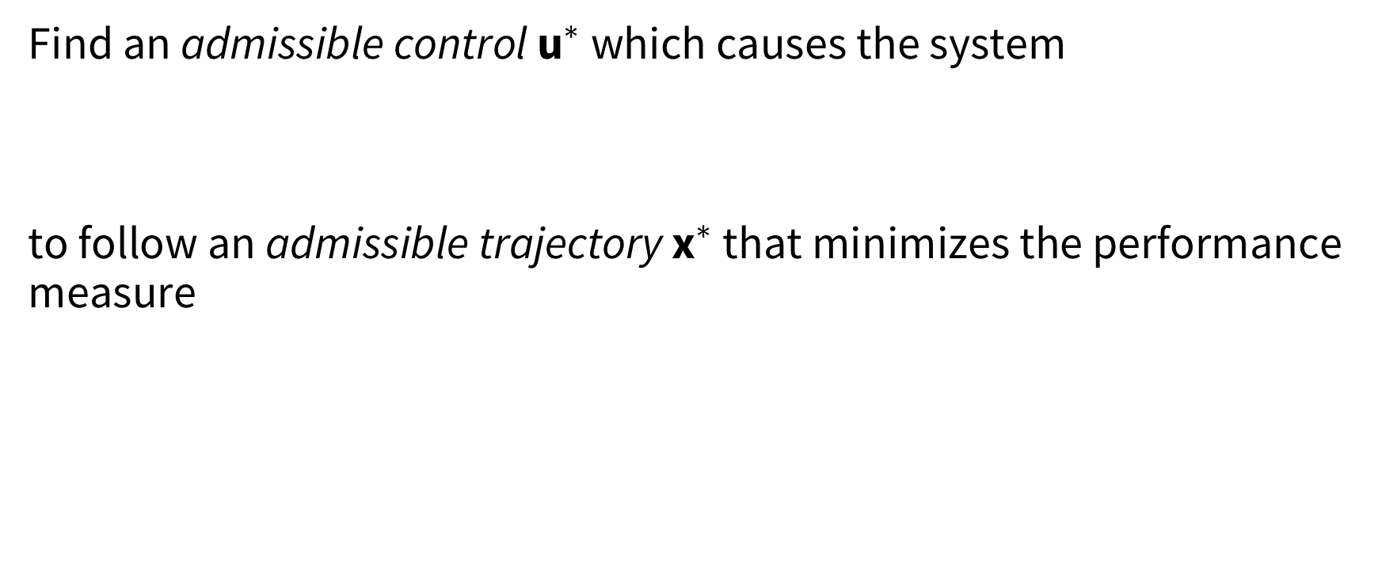
Optimal control problem
Find an admissible control ${\text{u}}^{∗}$ which causes the system
to follow an admissible trajectory ${\text{x}}^{∗}$ that minimizes the performance measure
Very general problem formulation!

Slide 29
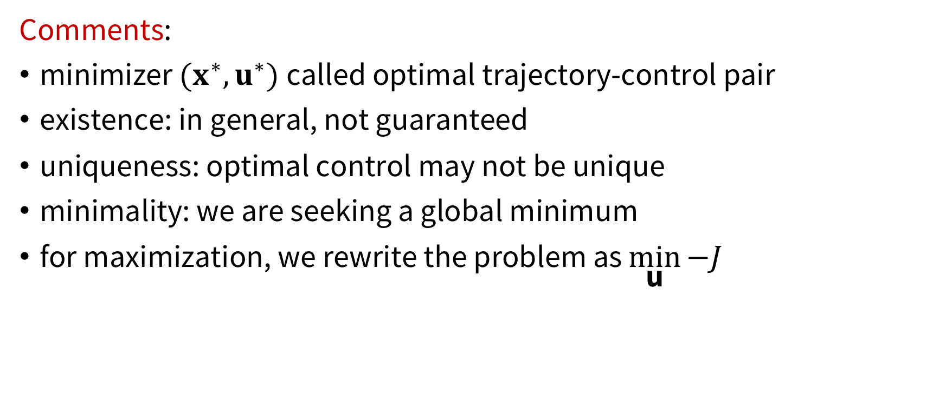
Optimal control problem
Comments:
minimizer $(x^{∗},u^{∗})$called optimal trajectory-control pair
existence: in general, not guaranteed
uniqueness: optimal control may not be unique
minimality: we are seeking a global minimum
for maximization, we rewrite the problem as $\min_{\text{u}}{−J}$

Slide 30
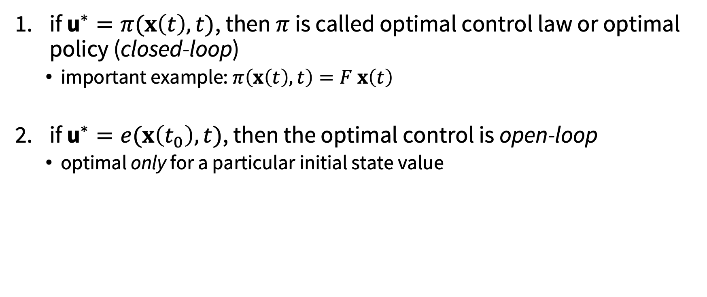
Forms of optimal control
if ${\text{u}}^{∗}=π(x\left(t\right),t)$, then $π$ is called optimal control law or optimal policy (closed-loop)
important example: $π\left(x\left(t\right),t\right)=F x\left(t\right)$
if ${\text{u}}^{∗}=e(x\left(t_{0}\right),t)$, then the optimal control is open-loop
optimal only for a particular initial state value

Slide 31
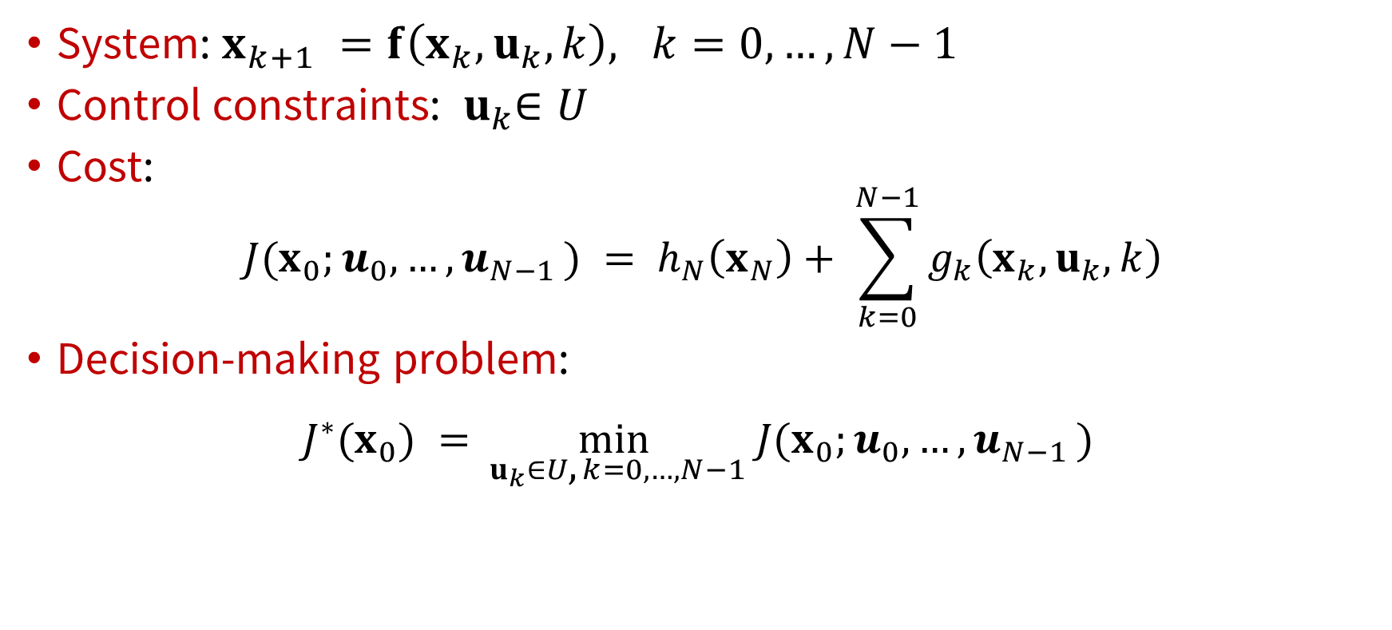
Discrete-time formulation
System: $x_{k+1} =f\left(x_{k}, u_{k},k\right), k=0, …, N−1$
Control constraints: ${ u}_{k}∈U$
Cost:
$$J{(x}_{0};u_{0},…, u_{N−1 }) = h_{N}\left(x_{N}\right)+ \sum_{k=0}^{N−1}{g_{k}\left(x_{k}, u_{k},k\right)}$$
Decision-making problem:
$$J^{∗}{(x}_{0}) =\min_{{ u}_{k}∈U\text{, }k=0,…,N−1} J{(x}_{0};u_{0},…, u_{N−1 })$$

Slide 32
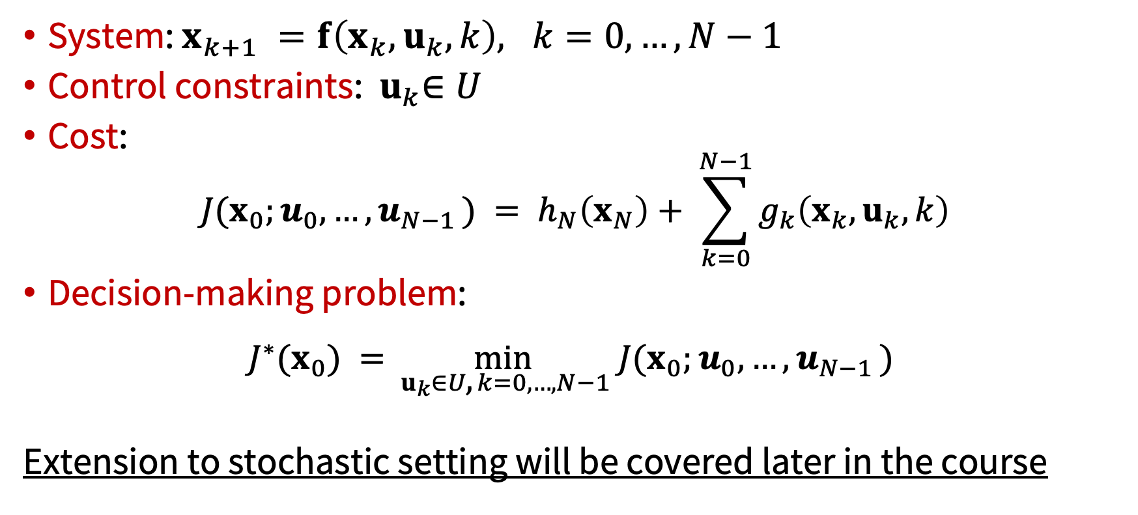
Discrete-time formulation
System: $x_{k+1} =f\left(x_{k}, u_{k},k\right), k=0, …, N−1$
Control constraints: ${ u}_{k}∈U$
Cost:
$$J{(x}_{0};u_{0},…, u_{N−1 }) = h_{N}\left(x_{N}\right)+ \sum_{k=0}^{N−1}{g_{k}\left(x_{k}, u_{k},k\right)}$$
Decision-making problem:
$$J^{∗}{(x}_{0}) =\min_{{ u}_{k}∈U\text{, }k=0,…,N−1} J{(x}_{0};u_{0},…, u_{N−1 })$$
Extension to stochastic setting will be covered later in the course

Slide 33
Today’s Outline
Context and course goals
Problem formulation for optimal control
Introduction to non-linear optimization

Slide 34
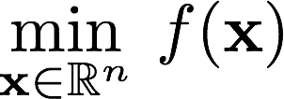
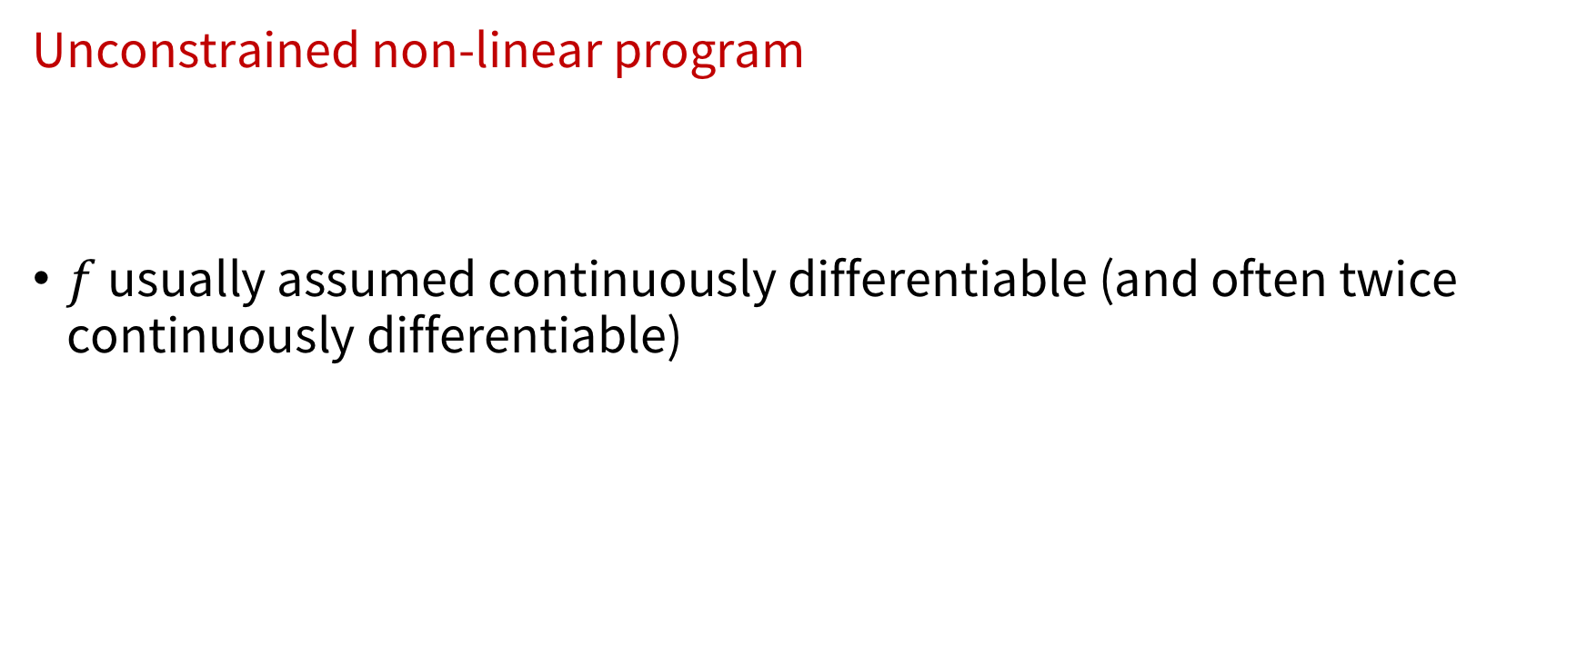
Non-linear optimization
Unconstrained non-linear program
$f$ usually assumed continuously differentiable (and often twice continuously differentiable)

Slide 35
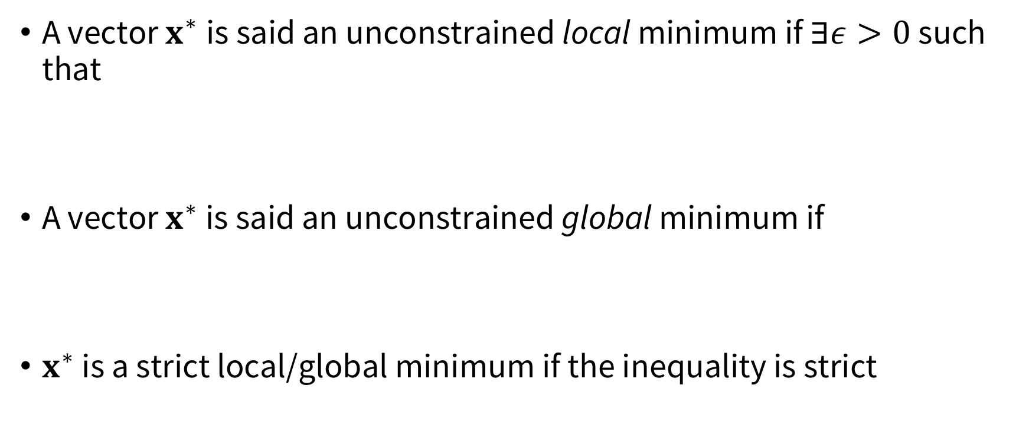
Local and global minima
A vector $x^{∗}$is said an unconstrained local minimum if $∃ε>0$ such that
A vector $x^{∗}$ is said an unconstrained global minimum if
$x^{∗}$ is a strict local/global minimum if the inequality is strict

Slide 36

Necessary conditions for optimality
Key idea: compare cost of a vector with cost of its close neighbors
Assume $f∈C^{1}$, by using Taylor series expansion
If $f∈C^{2}$

Slide 37
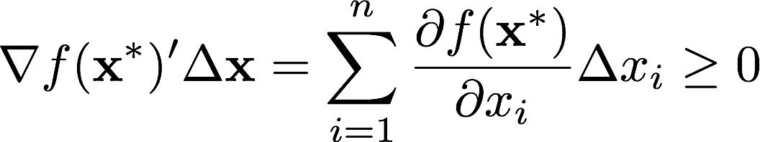
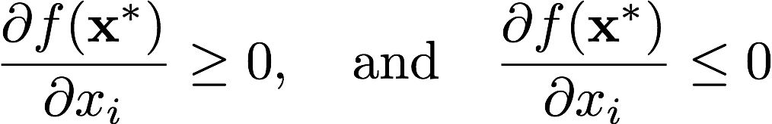
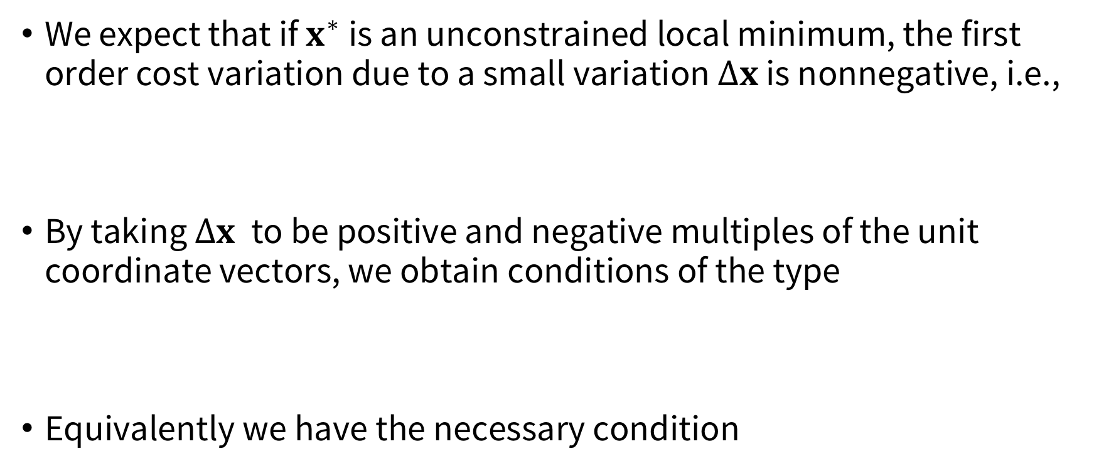
Necessary conditions for optimality
We expect that if $x^{∗}$ is an unconstrained local minimum, the first order cost variation due to a small variation $Δx$ is nonnegative, i.e.,
By taking $Δx$ to be positive and negative multiples of the unit coordinate vectors, we obtain conditions of the type
Equivalently we have the necessary condition

Slide 38
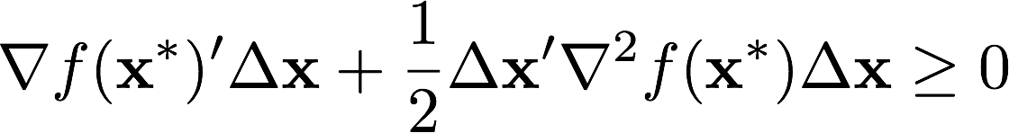
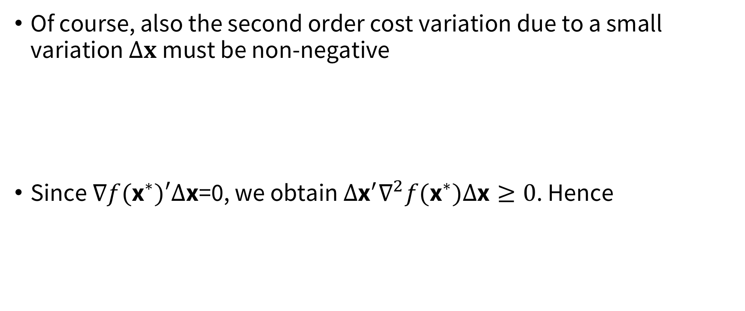
Necessary conditions for optimality
Of course, also the second order cost variation due to a small variation $Δx$must be non-negative
Since $∇f({\text{x}}^{∗})′∆\text{x}\text{=0}\text{, }$we obtain $∆{\text{x}}^{′}∇^{2}f({\text{x}}^{∗})∆\text{x}≥0$. Hence

Slide 39

NOC – formal
Theorem: NOC
Let $x^{∗}$be an unconstrained local minimum of $f:ℝ^{n}↦$ $ℝ$ and assume that $f$ is $C^{1}$ in an open set $S$ containing $x^{∗}$. Then
If in addition $f∈C^{2}$ within $S$,
(first order NOC)
positive semidefinite
(second order NOC)

Slide 40
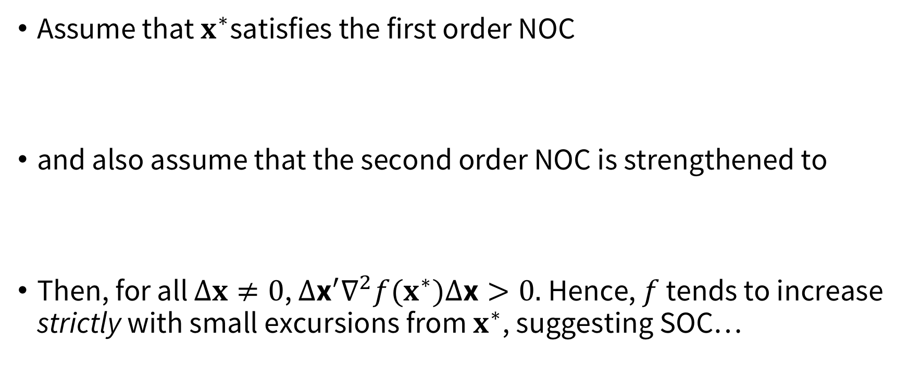
SOC
Assume that $x^{∗}$satisfies the first order NOC
and also assume that the second order NOC is strengthened to
Then, for all $Δx≠0$, $∆{\text{x}}^{′}∇^{2}f(x^{∗})∆\text{x}>0.$Hence, $f$ tends to increase strictly with small excursions from $x^{∗}$, suggesting SOC…
positive definite

Slide 41

SOC
Theorem: SOC
L$et f:ℝ^{n}↦$ $ℝ$ b$e C^{2}$ in an open set $S$. Suppose that a vector $x^{∗}∈S$satisfies the conditions
Then $x^{∗}$ is a strict unconstrained local minimum of $f$
and
positive definite

Slide 42
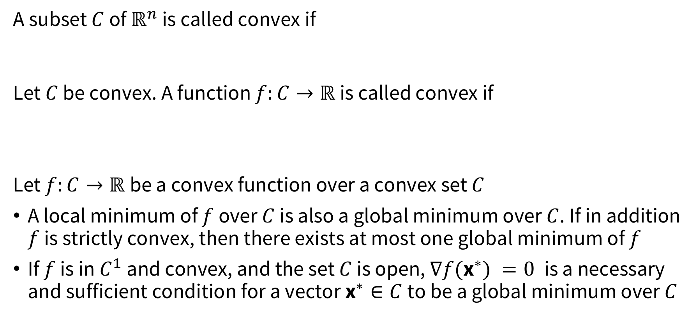
Special case: convex optimization
A subset $C$ of $ℝ^{n}$ is called convex if
Let $C$ be convex. A function $f:C→ℝ$is called convex if
Let $f:C→ℝ$be a convex function over a convex set $C$
A local minimum of $f$ over $C$ is also a global minimum over $C$. If in addition $f$ is strictly convex, then there exists at most one global minimum of $f$
If $f$ is in $C^{1}$ and convex, and the set $C$ is open, $∇f({\text{x}}^{∗}) =0$is a necessary and sufficient condition for a vector ${\text{x}}^{∗}∈C$to be a global minimum over $C$

Slide 43
Discussion
Optimality conditions are important to filter candidates for global minima
They often provide the basis for the design and analysis of optimization algorithms
They can be used for sensitivity analysis

Slide 44
Next lecture
Computational methods for non-linear optimization;
constrained optimization

