Slide 1
AA203 Optimal and Learning-based Control
HJB, HJI, and reachability analysis

Slide 2
Roadmap
Model-free RL
Control
Adaptive
optimal control
Model-based RL
Feedback control
Adaptive control
Optimal and learning control
Open-loop
MPC
Closed-loop
Indirect methods
Direct
methods
DP
HJB / HJI
LQR
iLQR
DDP
LQR
Reachability analysis
2

Slide 3
Dynamic Programming
Previous lectures: focus on discrete-time setting
This lecture: focus on continuous-time setting
dynamic programming approach leads to HJB / HJI equation: non-linear partial differential equation
HJB application: solution to continuous LQR problem
HJI application: reachability analysis
Readings: lecture notes and references therein, in particular:
Bansal S., Chen M., Herbert S., Tomlin C. J., “Hamilton-Jacobi reachability: A brief overview and recent advances,” 2017.
Chen M., Tomlin C. J., “Hamilton–Jacobi reachability: Some recent theoretical advances and applications in unmanned airspace management,” 2018.

Slide 4

Continuous-time model
Last time:
Model: $x_{k+1} =f\left(x_{k}, u_{k}, k\right),$
Cost: $J{(x}_{0}) = h_{N}\left(x_{N}\right)+ \sum_{k=0}^{N−1}{g\left(x_{k},u_{k},k\right)}$
This time:
Model: $\dot{x}\left(t\right)=f\left(x\left(t\right),u\left(t\right), t\right),$
Cost: $J\left(x\left(t_{0}\right)\right)=h\left(x\left(t_{f}\right), t_{f}\right)+ \int_{t_{0}}^{t_{f}}{g\left(x\left(τ\right),u\left(τ\right), τ\right) dτ}$
where $t_{0}$ and $t_{f}$ are fixed

Slide 5
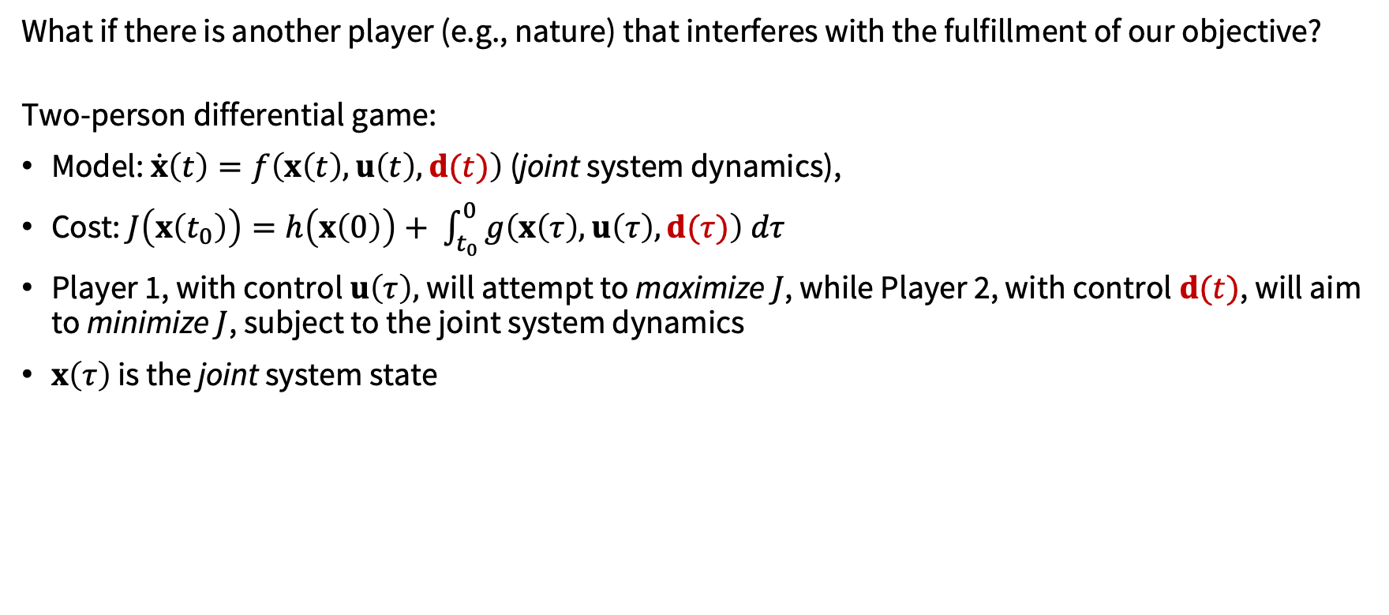
Two-person, zero-sum differential games
What if there is another player (e.g., nature) that interferes with the fulfillment of our objective?
Two-person differential game:
Model: $\dot{x}\left(t\right)=f\left(x\left(t\right),u\left(t\right), d(t)\right)$ (joint system dynamics),
Cost: $J\left(x\left(t_{0}\right)\right)=h\left(x\left(0\right)\right)+ \int_{t_{0}}^{0}{g\left(x\left(τ\right),u\left(τ\right), d(τ)\right) dτ}$
Player 1, with control $u\left(τ\right),$will attempt to maximize $J$, while Player 2, with control $d(t)$, will aim to minimize $J$, subject to the joint system dynamics
$x\left(τ\right)$ is the joint system state

Slide 6
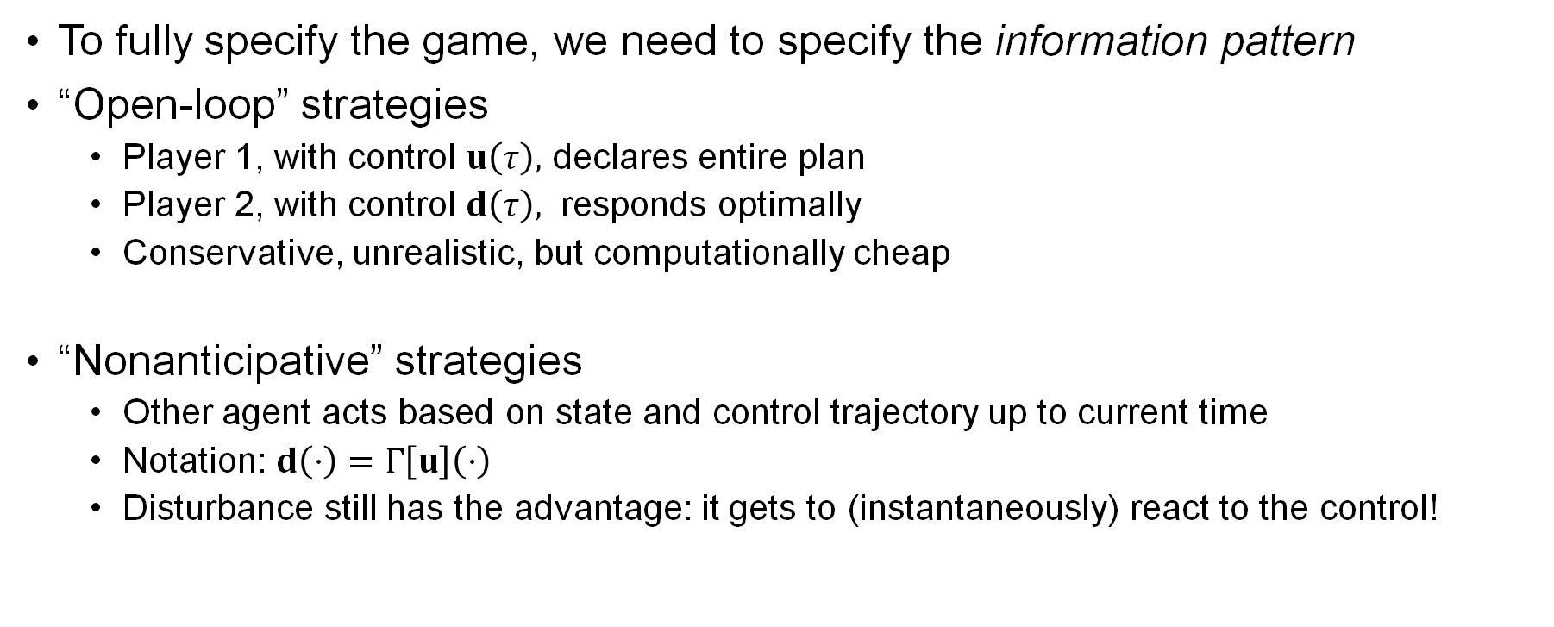
Information pattern
To fully specify the game, we need to specify the information pattern
“Open-loop” strategies
Player 1, with control $u\left(τ\right),$ declares entire plan
Player 2, with control $d\left(τ\right),$ responds optimally
Conservative, unrealistic, but computationally cheap
“Nonanticipative” strategies
Other agent acts based on state and control trajectory up to current time
Notation: $d\left(⋅\right)=Γ\left[u\right]\left(⋅\right)$
Disturbance still has the advantage: it gets to (instantaneously) react to the control!

Slide 7
Hamilton-Jacobi-Isaacs (HJI) equation
Key idea: apply principle of optimality
The “truncated” problem is
$$J\left(x\left(t\right),t\right)=\min_{Γ\left[u\right]\left(⋅\right)}\max_{u\left(⋅\right)}\left[\int_{t}^{0}{g\left(x\left(τ\right),u\left(τ\right),d\left(τ\right)\right)dτ}+h\left(x\left(0\right)\right)\right]$$
Worst-case disturbance – aims to thwart the controller

Slide 8
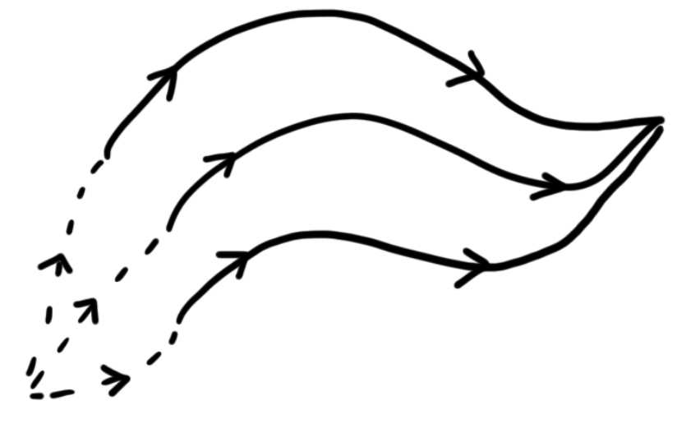












HJI equation
$$J_{b_{1}d}^{∗}$$
$$d$$
$$b_{1}$$
$$b_{2}$$
$$J_{b_{2}d}^{∗}$$
$${\tilde{J}}_{ab_{1}}$$
$${\tilde{J}}_{ab_{2}}$$
$$J_{b_{3}d}^{∗}$$
Dynamic programming principle:
Approximate integral and Taylor expand $J\left(x\left(t+Δt\right),t+Δt\right)$
Derive Hamilton-Jacobi-Isaacs partial differential equation (HJI PDE)
$$b_{3}$$
$$a$$
$${\tilde{J}}_{ab_{3}}$$
$$J\left(x\left(t\right),t\right)=\min_{Γ\left[u\right]\left(⋅\right)}\max_{u\left(⋅\right)}\left[\int_{t}^{t+Δt}{g\left(x(τ),u\left(τ\right),d\left(τ\right)\right)dτ}+J\left(x\left(t+Δt\right),t+Δt\right)\right]$$

Slide 9

HJI equation
Approximations for small $Δt$:
$$J\left(x\left(t\right),t\right)=\min_{Γ\left[u\right]\left(⋅\right)}\max_{u\left(⋅\right)}\left[\int_{t}^{t+Δt}{g\left(x\left(τ\right),u\left(τ\right),d\left(τ\right)\right)dτ}+J\left(x\left(t+Δt\right),t+Δt\right)\right]$$

Slide 10

HJI equation
Approximations for small $Δt$:
$$J\left(x\left(t\right),t\right)=\min_{Γ\left[u\right]\left(⋅\right)}\max_{u\left(⋅\right)}\left[\int_{t}^{t+Δt}{g\left(x\left(τ\right),u\left(τ\right),d\left(τ\right)\right)dτ}+J\left(x\left(t+Δt\right),t+Δt\right)\right]$$
$$g\left(x\left(t\right),u\left(t\right),d\left(t\right)\right)Δt$$

Slide 11

HJI equation
Approximations for small $Δt$:
$$x\left(t\right)+Δtf\left(x,u,d\right)$$
$$J\left(x\left(t\right),t\right)=\min_{Γ\left[u\right]\left(⋅\right)}\max_{u\left(⋅\right)}\left[\int_{t}^{t+Δt}{g\left(x\left(τ\right),u\left(τ\right),d\left(τ\right)\right)dτ}+J\left(x\left(t+Δt\right),t+Δt\right)\right]$$
$$g\left(x\left(t\right),u\left(t\right),d\left(t\right)\right)Δt$$

Slide 12
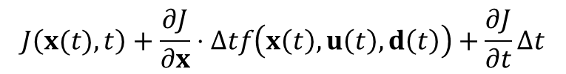
HJI equation
Approximations for small $Δt$:
$$x\left(t\right)+Δtf\left(x,u,d\right)$$
$$J\left(x\left(t\right),t\right)=\min_{Γ\left[u\right]\left(⋅\right)}\max_{u\left(⋅\right)}\left[\int_{t}^{t+Δt}{g\left(x\left(τ\right),u\left(τ\right),d\left(τ\right)\right)dτ}+J\left(x\left(t+Δt\right),t+Δt\right)\right]$$
$$J\left(x(t),t\right)+\frac{∂J}{∂x}⋅Δtf\left(x\left(t\right),u\left(t\right),d\left(t\right)\right)+\frac{∂J}{∂t}Δt$$
$$g\left(x\left(t\right),u\left(t\right),d\left(t\right)\right)Δt$$

Slide 13

HJI equation
Approximations for small $Δt$:
Omit $t$ dependence…
$J\left(x,t\right)$ does not depend on $u$ or $d$
$$x\left(t\right)+Δtf\left(x,u,d\right)$$
$$J\left(x\left(t\right),t\right)=\min_{Γ\left[u\right]\left(⋅\right)}\max_{u\left(⋅\right)}\left[\int_{t}^{t+Δt}{g\left(x\left(τ\right),u\left(τ\right),d\left(τ\right)\right)dτ}+J\left(x\left(t+Δt\right),t+Δt\right)\right]$$
$$J\left(x(t),t\right)+\frac{∂J}{∂x}⋅Δtf\left(x\left(t\right),u\left(t\right),d\left(t\right)\right)+\frac{∂J}{∂t}Δt$$
$$g\left(x\left(t\right),u\left(t\right),d\left(t\right)\right)Δt$$
$$J\left(x,t\right)=\max_{u}\min_{d}\left[g\left(x,u,d\right)Δt +J\left(x,t\right)+\frac{∂J}{∂x}⋅Δtf\left(x,u,d\right)+\frac{∂J}{∂t}Δt \right]$$
Assume (instantaneously) constant $u$ and $d$ → optimization over vectors, not functions!
Order of max and min reverse (proof given in references)
$$J\left(x,t\right)=J\left(x,t\right)+\max_{u}\min_{d}\left[g\left(x,u,d\right)Δt +\frac{∂J}{∂x}⋅Δtf\left(x,u,d\right)+\frac{∂J}{∂t}Δt \right]$$

Slide 14
HJI equation
Approximations for small $Δt$:
Omit $t$ dependence…
$J\left(x,t\right)$ does not depend on $u$ or $d$
$$x\left(t\right)+Δtf\left(x,u,d\right)$$
$$J\left(x\left(t\right),t\right)=\min_{Γ\left[u\right]\left(⋅\right)}\max_{u\left(⋅\right)}\left[\int_{t}^{t+Δt}{g\left(x\left(τ\right),u\left(τ\right),d\left(τ\right)\right)dτ}+J\left(x\left(t+Δt\right),t+Δt\right)\right]$$
$$J\left(x(t),t\right)+\frac{∂J}{∂x}⋅Δtf\left(x\left(t\right),u\left(t\right),d\left(t\right)\right)+\frac{∂J}{∂t}Δt$$
$$g\left(x\left(t\right),u\left(t\right),d\left(t\right)\right)Δt$$
$$J\left(x,t\right)=\max_{u}\min_{d}\left[g\left(x,u,d\right)Δt +J\left(x,t\right)+\frac{∂J}{∂x}⋅Δtf\left(x,u,d\right)+\frac{∂J}{∂t}Δt \right]$$
Assume (instantaneously) constant $u$ and $d$ → optimization over vectors, not functions!
Order of max and min reverse (proof given in references)
$$J\left(x,t\right)=J\left(x,t\right)+\max_{u}\min_{d}\left[g\left(x,u,d\right)Δt +\frac{∂J}{∂x}⋅Δtf\left(x,u,d\right)+\frac{∂J}{∂t}Δt \right]$$

Slide 15
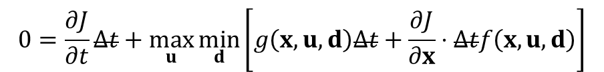
HJI equation
Approximations for small $Δt$:
Omit $t$ dependence…
$J\left(x,t\right)$ does not depend on $u$ or $d$
$$x\left(t\right)+Δtf\left(x,u,d\right)$$
$$J\left(x\left(t\right),t\right)=\min_{Γ\left[u\right]\left(⋅\right)}\max_{u\left(⋅\right)}\left[\int_{t}^{t+Δt}{g\left(x\left(τ\right),u\left(τ\right),d\left(τ\right)\right)dτ}+J\left(x\left(t+Δt\right),t+Δt\right)\right]$$
$$J\left(x(t),t\right)+\frac{∂J}{∂x}⋅Δtf\left(x\left(t\right),u\left(t\right),d\left(t\right)\right)+\frac{∂J}{∂t}Δt$$
$$g\left(x\left(t\right),u\left(t\right),d\left(t\right)\right)Δt$$
$$J\left(x,t\right)=\max_{u}\min_{d}\left[g\left(x,u,d\right)Δt +J\left(x,t\right)+\frac{∂J}{∂x}⋅Δtf\left(x,u,d\right)+\frac{∂J}{∂t}Δt \right]$$
Assume (instantaneously) constant $u$ and $d$ → optimization over vectors, not functions!
Order of max and min reverse (proof given in references)
$$0=\frac{∂J}{∂t}Δt+\max_{u}\min_{d}\left[g\left(x,u,d\right)Δt+\frac{∂J}{∂x}⋅Δtf\left(x,u,d\right)\right]$$

Slide 16
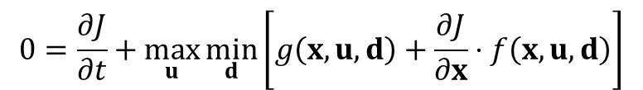
HJI equation
Approximations for small $Δt$:
Omit $t$ dependence…
$J\left(x,t\right)$ does not depend on $u$ or $d$
$$x\left(t\right)+Δtf\left(x,u,d\right)$$
$$J\left(x\left(t\right),t\right)=\min_{Γ\left[u\right]\left(⋅\right)}\max_{u\left(⋅\right)}\left[\int_{t}^{t+Δt}{g\left(x\left(τ\right),u\left(τ\right),d\left(τ\right)\right)dτ}+J\left(x\left(t+Δt\right),t+Δt\right)\right]$$
$$J\left(x(t),t\right)+\frac{∂J}{∂x}⋅Δtf\left(x\left(t\right),u\left(t\right),d\left(t\right)\right)+\frac{∂J}{∂t}Δt$$
$$g\left(x\left(t\right),u\left(t\right),d\left(t\right)\right)Δt$$
$$J\left(x,t\right)=\max_{u}\min_{d}\left[g\left(x,u,d\right)Δt +J\left(x,t\right)+\frac{∂J}{∂x}⋅Δtf\left(x,u,d\right)+\frac{∂J}{∂t}Δt \right]$$
Assume (instantaneously) constant $u$ and $d$ → optimization over vectors, not functions!
Order of max and min reverse (proof given in references)
$$0=\frac{∂J}{∂t}+\max_{u}\min_{d}\left[g\left(x,u,d\right)+\frac{∂J}{∂x}⋅f\left(x,u,d\right)\right]$$

Slide 17
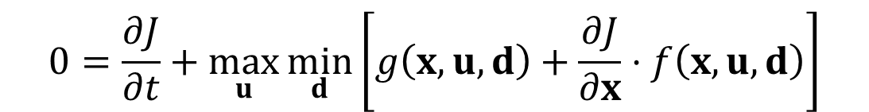
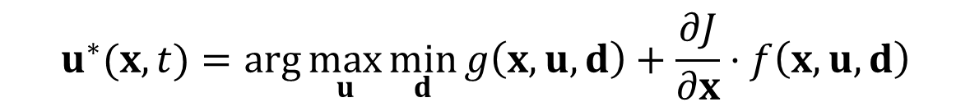

HJI equation
The end result is the Hamilton-Jacobi-Isaacs (HJI) equation
with boundary condition
Given the cost-to-go function, the optimal control for Player 1 is
$$0=\frac{∂J}{∂t}+\max_{u}\min_{d}\left[g\left(x,u,d\right)+\frac{∂J}{∂x}⋅f\left(x,u,d\right)\right]$$
The “Hamiltonian”
$$J(x,0)=h(x)$$
$$u^{∗}(x,t)=\arg{\max_{u}{\min_{d}{g\left(x,u,d\right)+\frac{∂J}{∂x}⋅f\left(x,u,d\right)}}}$$

Slide 18
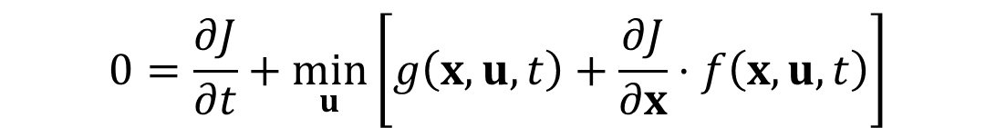
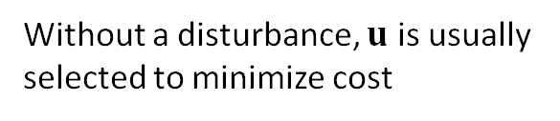


HJB equation
In case there is no disturbance, end result is the Hamilton-Jacobi-Bellman (HJB) equation
with boundary condition
Given the cost-to-go function, the optimal control is
Without a disturbance, $u$ is usually selected to minimize cost
$$0=\frac{∂J}{∂t}+\min_{u}\left[g\left(x,u,t\right)+\frac{∂J}{∂x}⋅f\left(x,u,t\right)\right]$$
$$J(x,0)=h(x)$$
$$u^{∗}(x,t)=\arg{\min_{u}{g\left(x,u,t\right)+\frac{∂J}{∂x}⋅f\left(x,u,t\right)}}$$

Slide 19
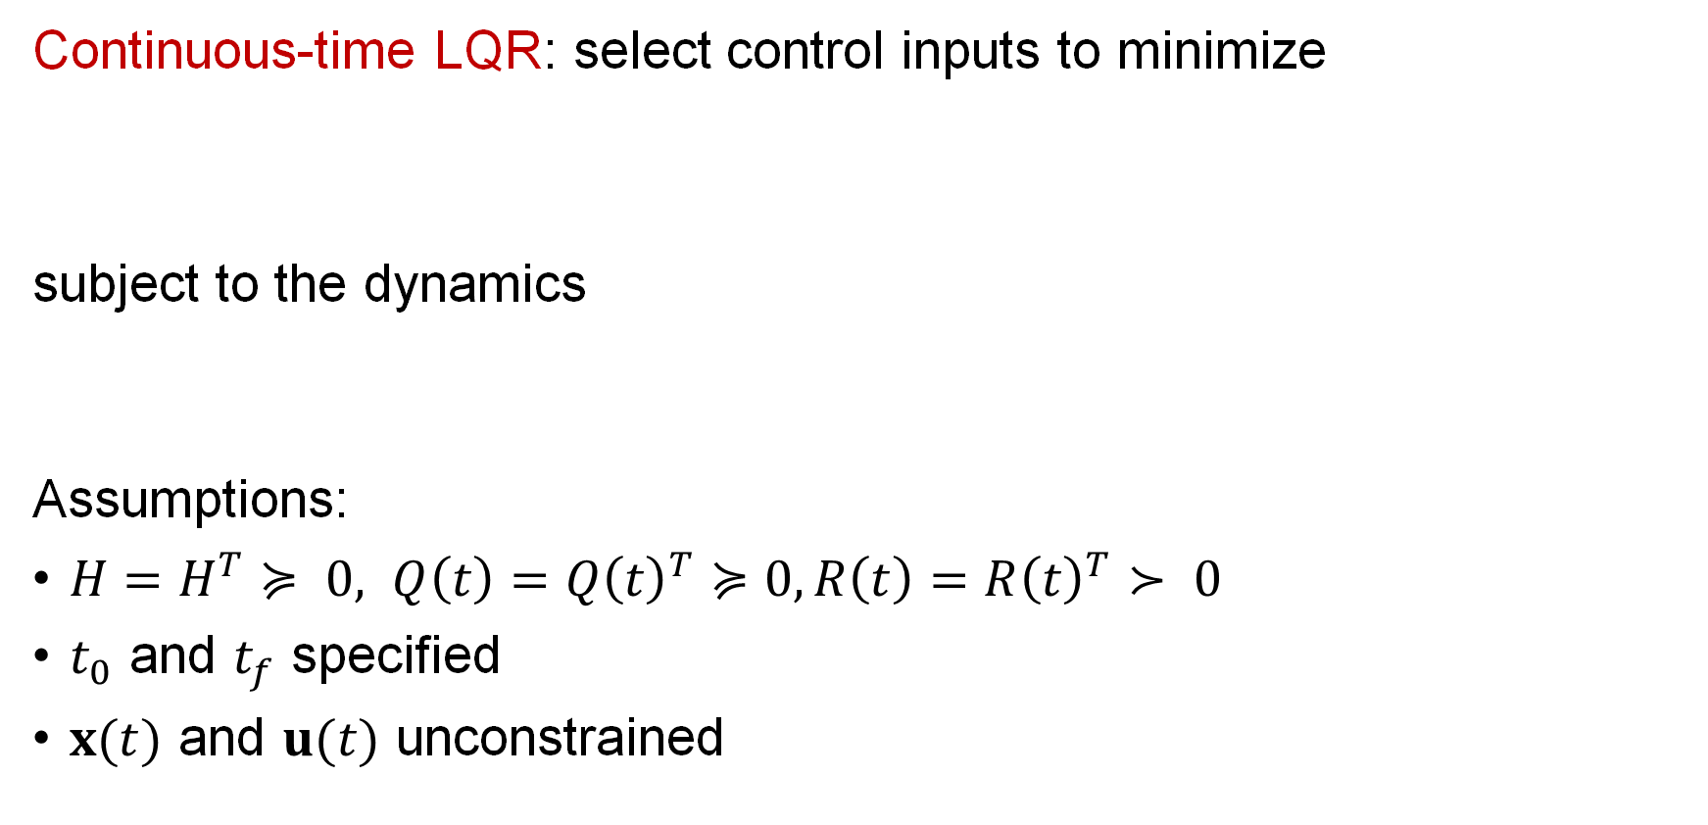
Continuous-time LQR
Continuous-time LQR: select control inputs to minimize
subject to the dynamics
Assumptions:
$H=H^{T}≽ 0, Q\left(t\right)=Q{\left(t\right)}^{T}≽0, R\left(t\right)=R{\left(t\right)}^{T}≻ 0$
$t_{0}$ and $t_{f}$ specified
$x(t)$ and $u(t)$ unconstrained

Slide 20
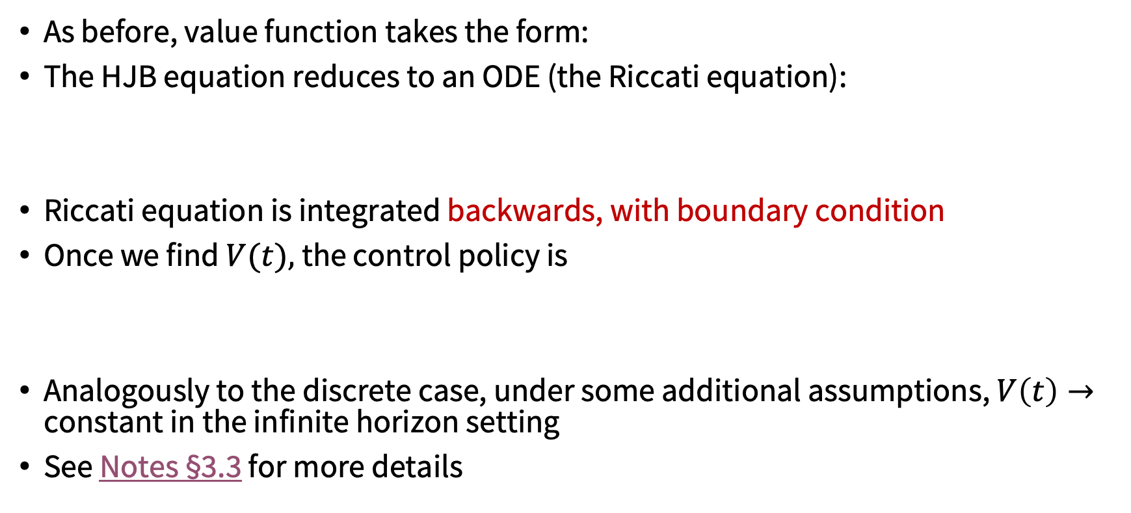
Continuous-time LQR
As before, value function takes the form:
The HJB equation reduces to an ODE (the Riccati equation):
Riccati equation is integrated backwards, with boundary condition
Once we find $V(t),$the control policy is
Analogously to the discrete case, under some additional assumptions, $V\left(t\right)→$ constant in the infinite horizon setting
See Notes §3.3 for more details

Slide 21
Applications of differential games
Pursuit-evasion games
homicidal chauffeur problem
Reachability analysis
And many more (e.g., in economics)

Slide 22
Applications of differential games
Pursuit-evasion games
homicidal chauffeur problem
Reachability analysis
And many more (e.g., in economics)

Slide 23
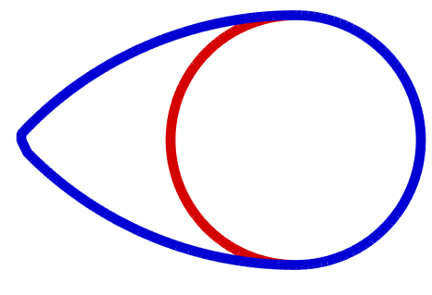
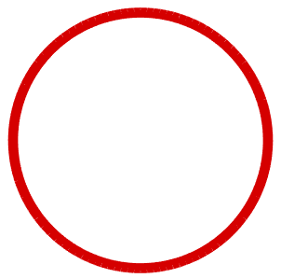
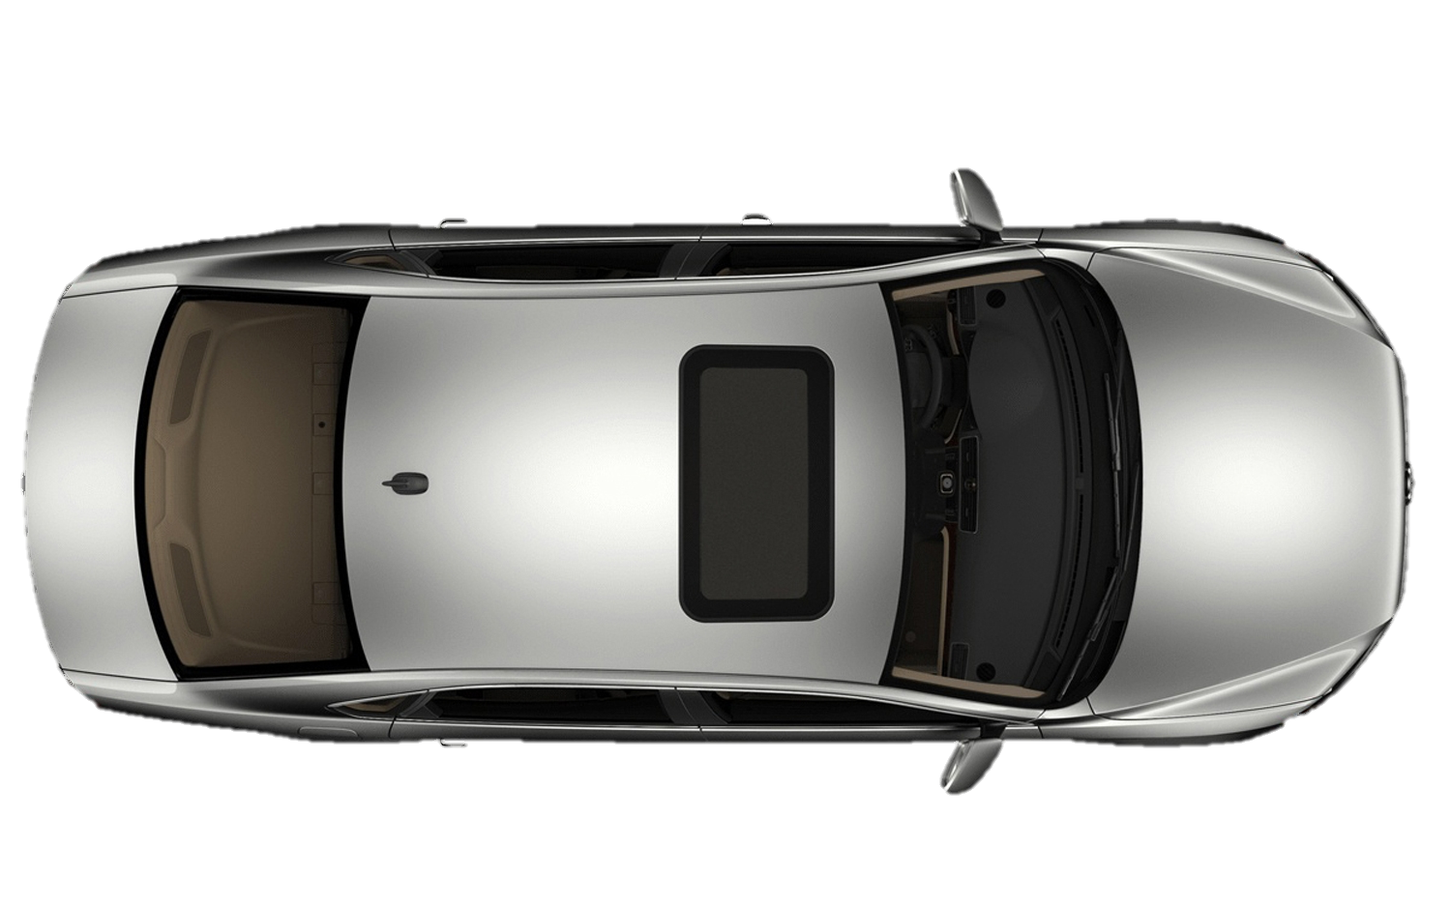

Reachability analysis: avoidance
Reachable set
Unsafe region
Inputs:
System model
Unsafe region: e.g., obstacle
Control policy
Backward reachable set
(States leading to danger)

Slide 24
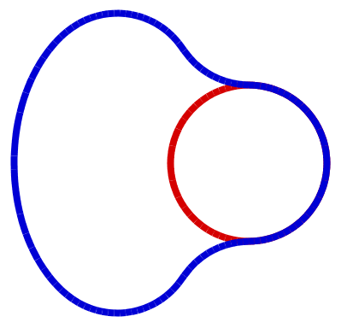
Reachability analysis: goal reaching
Backward reachable set
Target set
Control policy
Inputs:
System model
Goal region
Backward reachable set
(States leading to goal)

Slide 25
Reachability analysis
$𝒜\left(t\right)=\left\{\overline{x}:∃Γ\left[u\right]\left(⋅\right), ∀u\left(⋅\right), \dot{x}=f\left(x,u,d\right),x\left(t\right)=\overline{x},x\left(0\right)∈𝒯\right\}$
Model of robot
Unsafe region
Backward reachable set (states leading to danger)
Control policy
Model of robot
Goal region
Control policy
Backward reachable set (states leading to goal)
$ℛ\left(t\right)=\left\{\overline{x}:∀Γ\left[u\right]\left(⋅\right), ∃u\left(⋅\right), \dot{x}=f\left(x,u,d\right),x\left(t\right)=\overline{x},x\left(0\right)∈𝒯\right\}$

Slide 26
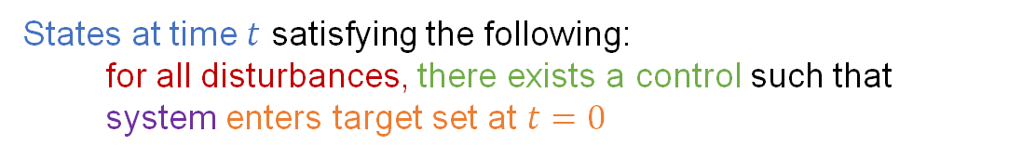
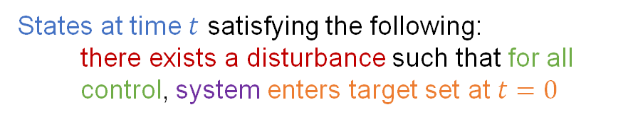
Reachability analysis
States at time $t$ satisfying the following:
there exists a disturbance such that for all control, system enters target set at $t=0$
$𝒜\left(t\right)=\left\{\overline{x}:∃Γ\left[u\right]\left(⋅\right), ∀u\left(⋅\right), \dot{x}=f\left(x,u,d\right),x\left(t\right)=\overline{x},x\left(0\right)∈𝒯\right\}$
Model of robot
Unsafe region
Backward reachable set (states leading to danger)
Control policy
Model of robot
Goal region
Control policy
Backward reachable set (states leading to goal)
$ℛ\left(t\right)=\left\{\overline{x}:∀Γ\left[u\right]\left(⋅\right), ∃u\left(⋅\right), \dot{x}=f\left(x,u,d\right),x\left(t\right)=\overline{x},x\left(0\right)∈𝒯\right\}$
States at time $t$ satisfying the following:
for all disturbances, there exists a control such that system enters target set at $t=0$
26

Slide 27
From HJI to reachability analysis
Computation of the BRS entails solving a differential game where the outcome is Boolean (the system either reaches the target set or not)
One can “encode” this Boolean outcome in the HJI PDE by (1) removing the running cost and (2) picking the final cost to denote set membership
Value function at each state is the worst case terminal value you can reach

Slide 28
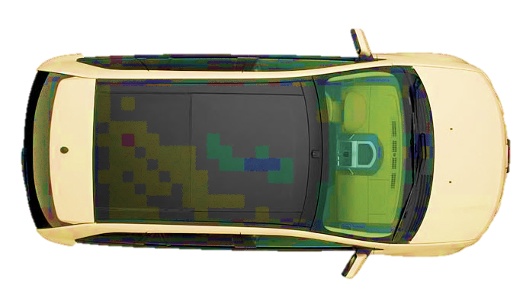
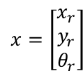
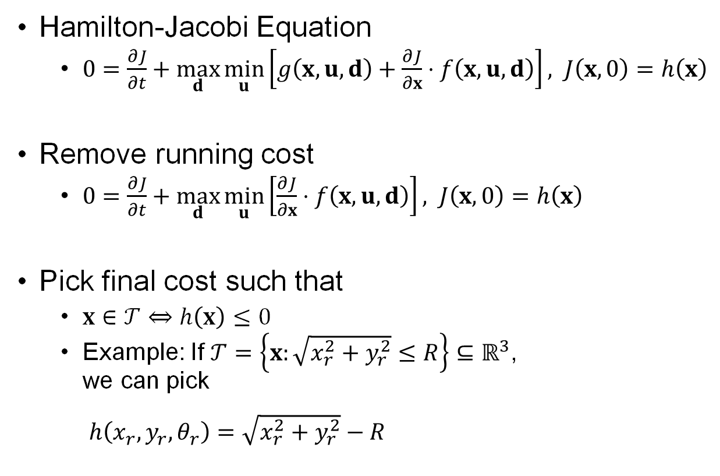


From HJI to reachability analysis
Hamilton-Jacobi Equation
$0=\frac{∂J}{∂t}+\max_{d}\min_{u}\left[g\left(x,u,d\right)+\frac{∂J}{∂x}⋅f\left(x,u,d\right)\right], J\left(x,0\right)=h\left(x\right)$
Remove running cost
$0=\frac{∂J}{∂t}+\max_{d}\min_{u}\left[\frac{∂J}{∂x}⋅f\left(x,u,d\right)\right], J\left(x,0\right)=h\left(x\right)$
Pick final cost such that
$x∈𝒯⇔h\left(x\right)≤0$
Example: If $𝒯=\left\{x:\sqrt{x_{r}^{2}+y_{r}^{2}}≤R\right\}⊆ℝ^{3}$, we can pick $h\left(x_{r}, y_{r},θ_{r}\right)=\sqrt{x_{r}^{2}+y_{r}^{2}}−R$
$$\left(x_{r},y_{r}\right)$$
$$x=\left[\begin{aligned}x_{r} \\ y_{r} \\ θ_{r}\end{aligned}\right]$$
$$θ_{r}$$
R

Slide 29



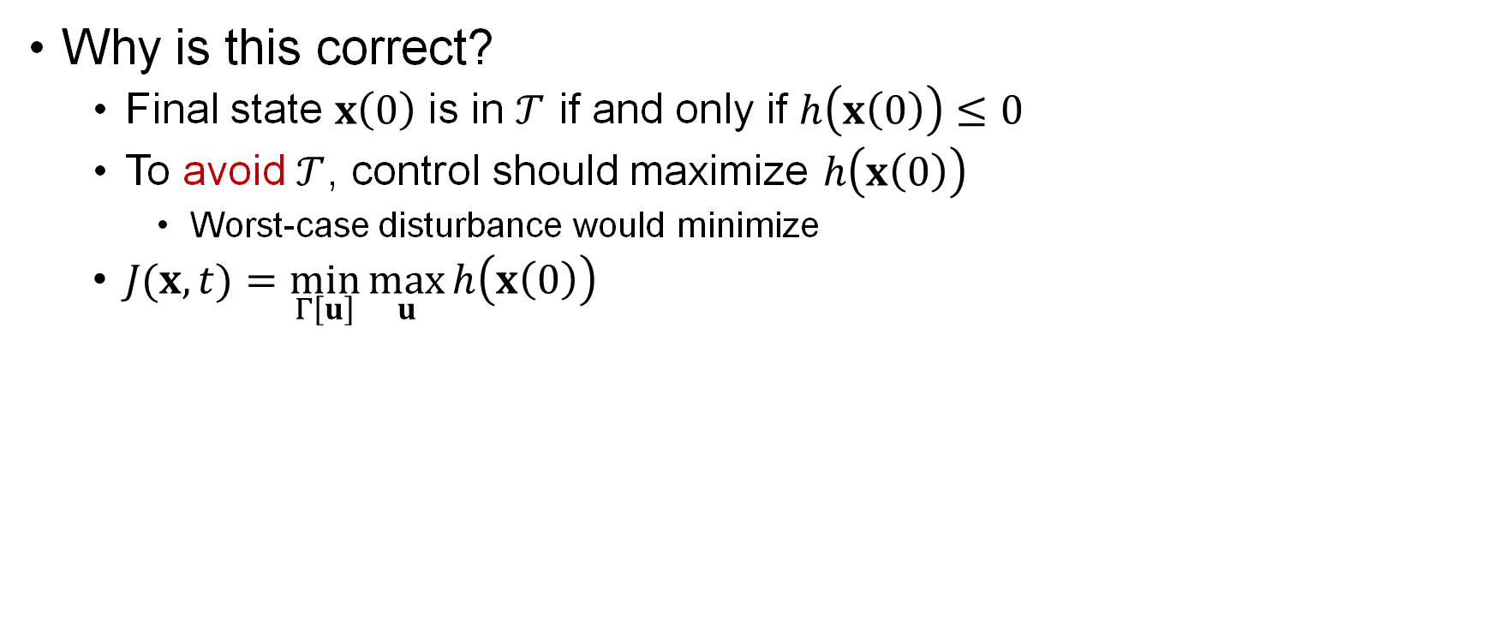
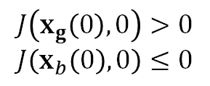
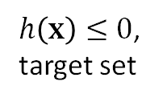

Pick Final Cost
Why is this correct?
Final state $x\left(0\right)$ is in $𝒯$ if and only if $h\left(x\left(0\right)\right)≤0$
To avoid $𝒯$, control should maximize $h\left(x\left(0\right)\right)$
Worst-case disturbance would minimize
$J(x,t)=\min_{Γ\left[u\right]}{\max_{u}{h\left(x\left(0\right)\right)}}$
$$x_{g}\left(0\right)$$
$$x_{b}\left(0\right)$$
$$x_{g}\left(t\right)$$
$h\left(x\right)≤0$,
target set
$$x_{b}\left(t\right)$$
$$J\left(x_{g}\left(0\right),0\right)>0$$
$$J\left(x_{b}\left(0\right),0\right)≤0$$

Slide 30
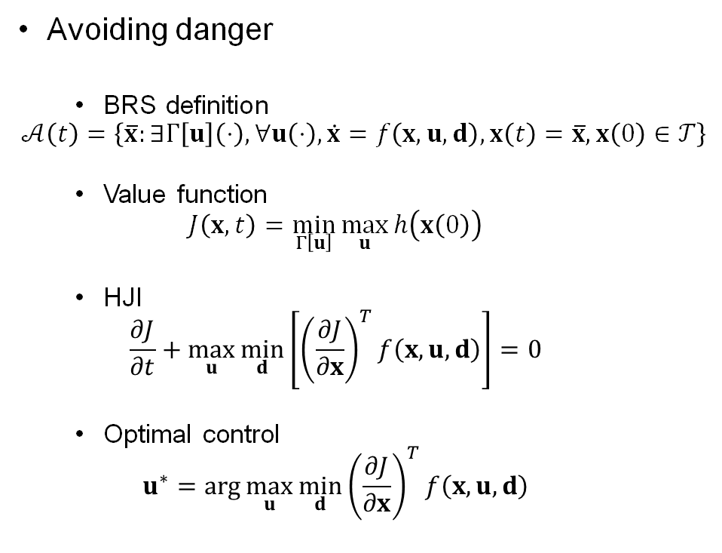
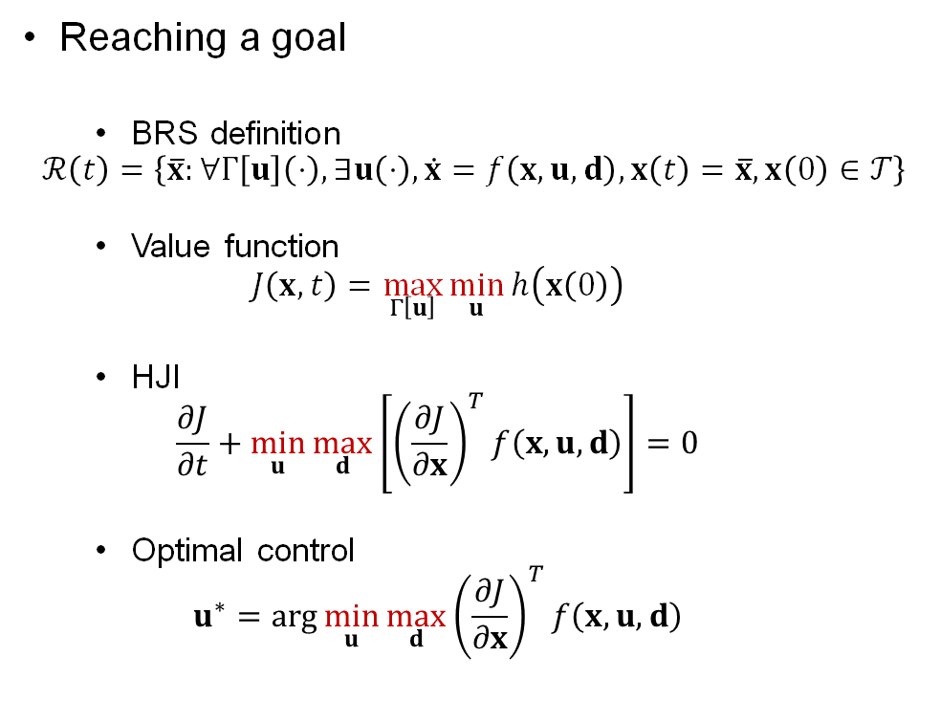
Reaching vs. Avoiding
Avoiding danger
BRS definition
$$𝒜\left(t\right)=\left\{\overline{x}:∃Γ\left[u\right]\left(⋅\right), ∀u\left(⋅\right), \dot{x}=f\left(x,u,d\right),x\left(t\right)=\overline{x},x\left(0\right)∈𝒯\right\}$$
Value function
$$J\left(x,t\right)=\min_{Γ\left[u\right]}{\max_{u}{h\left(x\left(0\right)\right)}}$$
HJI
$$\frac{∂J}{∂t}+\max_{u}\min_{d}\left[{\left(\frac{∂J}{∂x}\right)}^{T}f\left(x,u,d\right)\right]=0$$
Optimal control
$$u^{∗}=\arg{\max_{u}{\min_{d}{{\left(\frac{∂J}{∂x}\right)}^{T}f\left(x,u,d\right)}}}$$
Reaching a goal
BRS definition
$$ℛ\left(t\right)=\left\{\overline{x}:∀Γ\left[u\right]\left(⋅\right), ∃u\left(⋅\right), \dot{x}=f\left(x,u,d\right),x\left(t\right)=\overline{x},x\left(0\right)∈𝒯\right\}$$
Value function
$$J\left(x,t\right)=\max_{Γ\left[u\right]}{\min_{u}{h\left(x\left(0\right)\right)}}$$
HJI
$$\frac{∂J}{∂t}+\min_{u}\max_{d}\left[{\left(\frac{∂J}{∂x}\right)}^{T}f\left(x,u,d\right)\right]=0$$
Optimal control
$$u^{∗}=\arg{\min_{u}{\max_{d}{{\left(\frac{∂J}{∂x}\right)}^{T}f\left(x,u,d\right)}}}$$

Slide 31





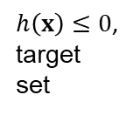



“Sets” vs. “Tubes”
Backward reachable set (BRS)
Only final time matters
Initial states that pass through target are not necessarily in BRS
Not ideal for safety
Backward reachable tube (BRT)
Keep track of entire time duration
Initial states that pass through target are in BRT
Used to make safety guarantees
$$x_{g}\left(0\right)$$
$$x_{b}\left(0\right)$$
$$x_{B}\left(0\right)$$
$$J\left(x_{g}\left(0\right),0\right)>0$$
$$J\left(x_{b}\left(0\right),0\right)≤0$$
$$J\left(x_{B}\left(0\right),0\right)>0$$
$$x_{g}\left(t\right)$$
$$J\left(x_{g}\left(0\right),0\right)>0$$
$$J\left(x_{b}\left(0\right),0\right)≤0$$
$$J\left(x_{B}\left(0\right),0\right)≤0$$
$h\left(x\right)≤0$,
target set
$$x_{B}\left(t\right)$$
$$x_{b}\left(t\right)$$

Slide 32

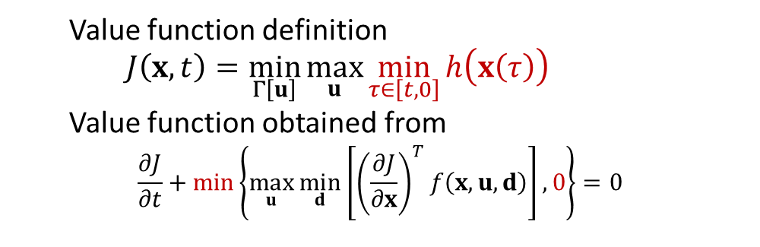


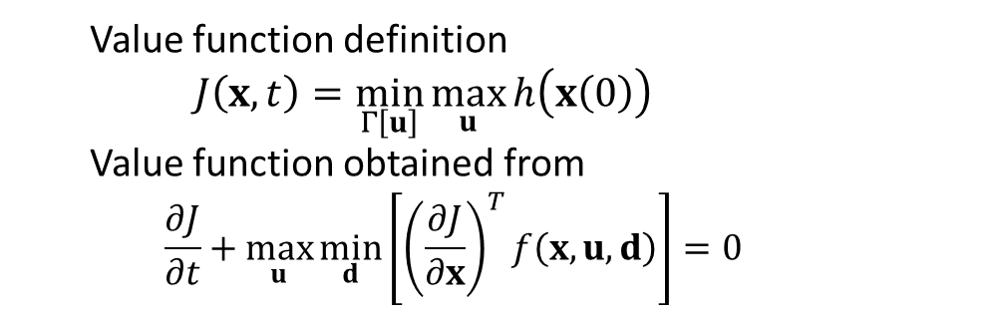


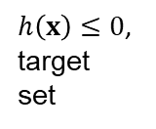



“Sets” vs. “Tubes”
Backward reachable set (BRS)
Backward reachable tube (BRT)
$$x_{g}\left(0\right)$$
$$x_{b}\left(0\right)$$
$$x_{B}\left(0\right)$$
$$J\left(x_{g}\left(0\right),0\right)>0$$
$$J\left(x_{b}\left(0\right),0\right)≤0$$
$$J\left(x_{B}\left(0\right),0\right)>0$$
$$x_{g}\left(t\right)$$
$$J\left(x_{g}\left(0\right),0\right)>0$$
$$J\left(x_{b}\left(0\right),0\right)≤0$$
$$J\left(x_{B}\left(0\right),0\right)≤0$$
$h\left(x\right)≤0$,
target set
$$x_{B}\left(t\right)$$
$$x_{b}\left(t\right)$$
Value function definition
$$J\left(x,t\right)=\min_{Γ\left[u\right]}{\max_{u}{h\left(x\left(0\right)\right)}}$$
Value function obtained from
$$\frac{∂J}{∂t}+\max_{u}\min_{d}\left[{\left(\frac{∂J}{∂x}\right)}^{T}f\left(x,u,d\right)\right]=0$$
Value function definition
$$J\left(x,t\right)=\min_{Γ\left[u\right]}{\max_{u}{\min_{τ∈\left[t,0\right]}{h\left(x\left(τ\right)\right)}}}$$
Value function obtained from
$$\frac{∂J}{∂t}+\underset{}{min\left\{\max_{u}\min_{d}\left[{\left(\frac{∂J}{∂x}\right)}^{T}f\left(x,u,d\right)\right], 0\right\}}=0$$

Slide 33
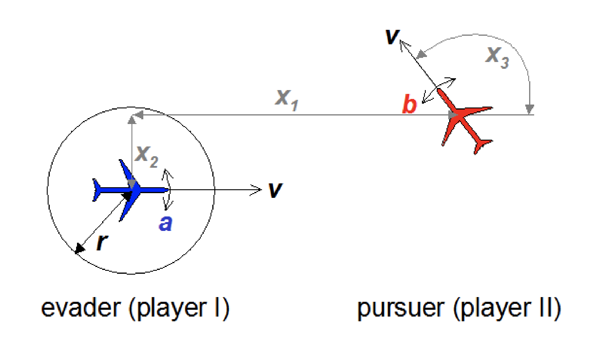
Example: pursuit/evasion with two identical vehicles
With evader (a), pursuer (b) dynamics we consider the relative system in (a)’s frame
Courtesy of Ian Mitchell, “ToolboxLS”,
Section 2.6.1

Slide 34
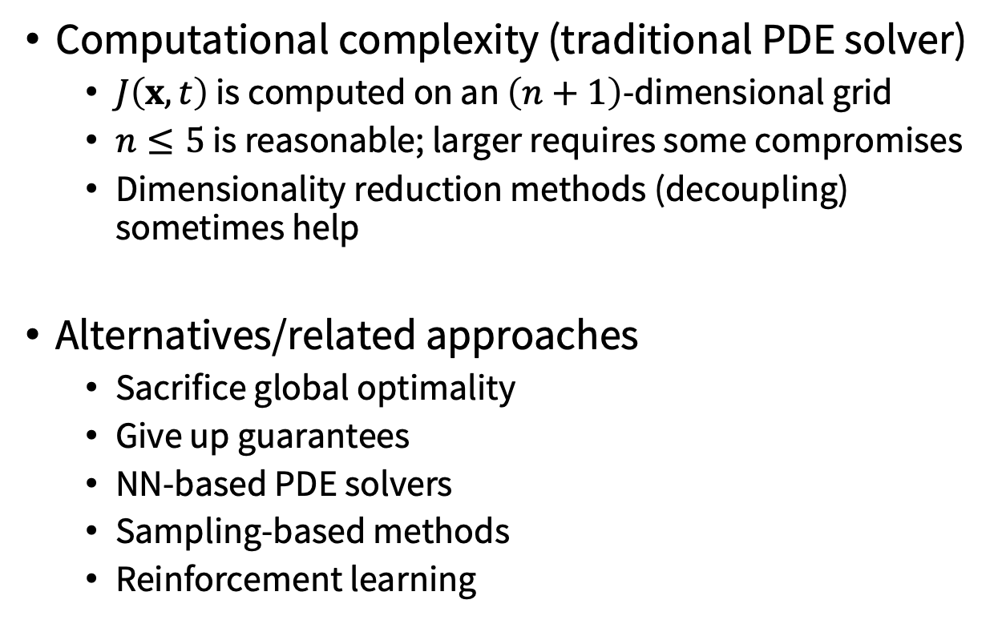
Computational aspects
Computational complexity (traditional PDE solver)
$J\left(x,t\right)$ is computed on an $\left(n+1\right)$-dimensional grid
$n≤5$ is reasonable; larger requires some compromises
Dimensionality reduction methods (decoupling) sometimes help
Alternatives/related approaches
Sacrifice global optimality
Give up guarantees
NN-based PDE solvers
Sampling-based methods
Reinforcement learning

Slide 35
Next time
Model Predictive Control

