Slide 1
AA203 Optimal and Learning-based Control
Persistent feasibility of MPC (cont’d), stability of MPC, and explicit MPC

Slide 2
Roadmap
Model-free RL
Control
Adaptive
optimal control
Model-based RL
Feedback control
Adaptive control
Optimal and learning control
Open-loop
MPC
Closed-loop
Indirect methods
Direct
methods
DP
HJB / HJI
LQR
iLQR
DDP
LQR
Reachability analysis
2

Slide 3
Model predictive control
Persistent feasibility of MPC (cont'd)
Stability of MPC
Explicit MPC
Reading:
F. Borrelli, A. Bemporad, M. Morari. Predictive Control for Linear and Hybrid Systems, 2017.
J. B. Rawlings, D. Q. Mayne, M. M. Diehl. Model Predictive Control: Theory, Computation, and Design, 2017.

Slide 4

Persistent feasibility theorem
Feasibility theorem: if set $X_{f}$ is a control invariant set for system:
$x\left(t+1\right)=Ax\left(t\right)+Bu\left(t\right),$ $x\left(t\right)∈X, u\left(t\right)∈U, t≥0$
then the MPC law is persistently feasible

Slide 5
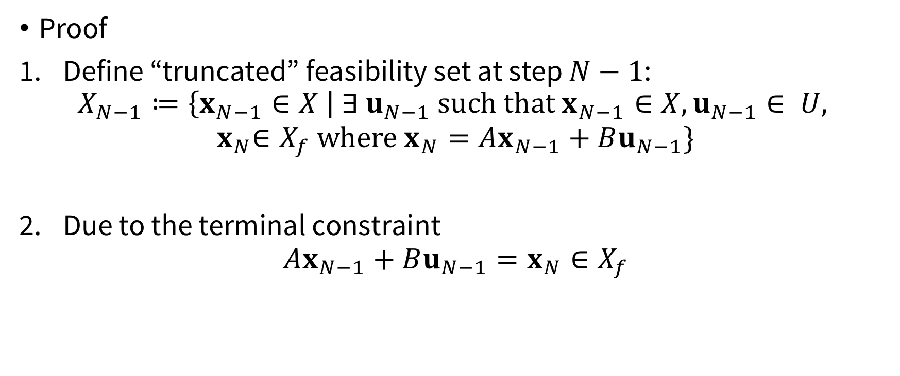
Persistent feasibility theorem
Proof
Define “truncated” feasibility set at step $N−1$:
$$X_{N−1}≔\left\{x_{N−1}∈X \right| ∃ u_{N−1} such that x_{N−1}∈X, u_{N−1}∈ U,$$
$${ x}_{N}∈X_{f} where x_{N}=Ax_{N−1}+Bu_{N−1}\}$$
Due to the terminal constraint
$$Ax_{N−1}+Bu_{N−1}=x_{N}∈X_{f}$$

Slide 6
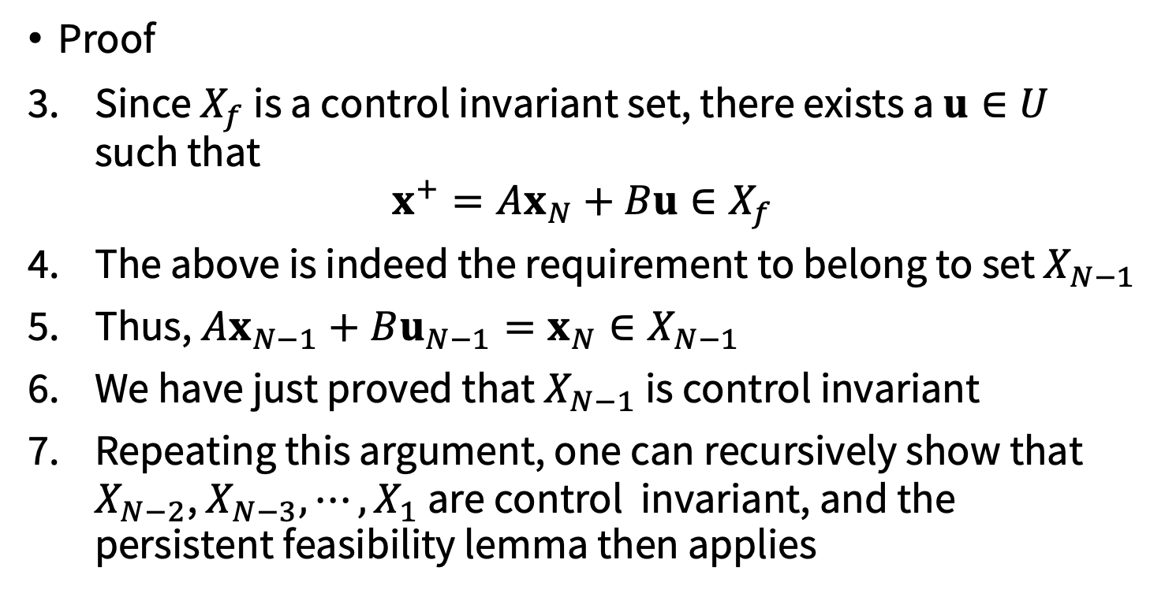
Persistent feasibility theorem
Proof
Since $X_{f}$ is a control invariant set, there exists a $u∈U$ such that
$$x^{+}=Ax_{N}+Bu∈X_{f}$$
The above is indeed the requirement to belong to set $X_{N−1}$
Thus, $Ax_{N−1}+Bu_{N−1}=x_{N}∈X_{N−1}$
We have just proved that $X_{N−1}$ is control invariant
Repeating this argument, one can recursively show that $X_{N−2}$, $X_{N−3},⋯{,X}_{1}$ are control invariant, and the persistent feasibility lemma then applies

Slide 7
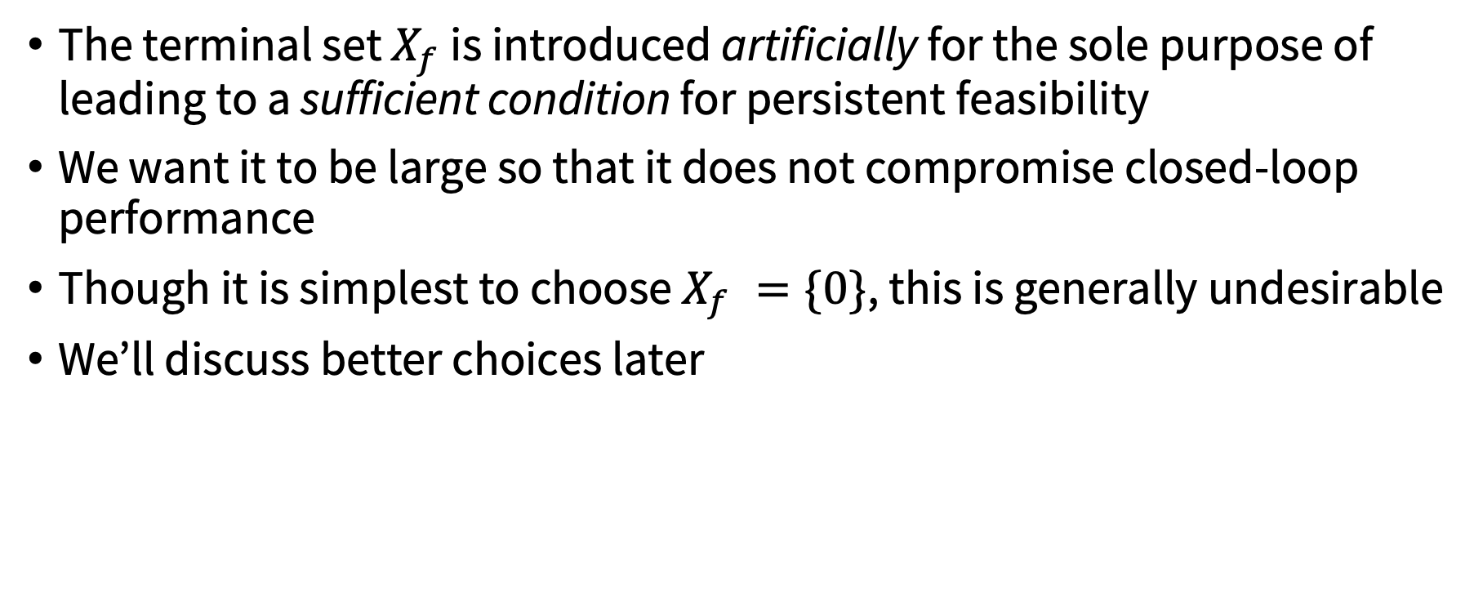
Practical aspects of persistent feasibility
The terminal set $X_{f}$ is introduced artificially for the sole purpose of leading to a sufficient condition for persistent feasibility
We want it to be large so that it does not compromise closed-loop performance
Though it is simplest to choose $X_{f} =\{0\}$, this is generally undesirable
We’ll discuss better choices later

Slide 8
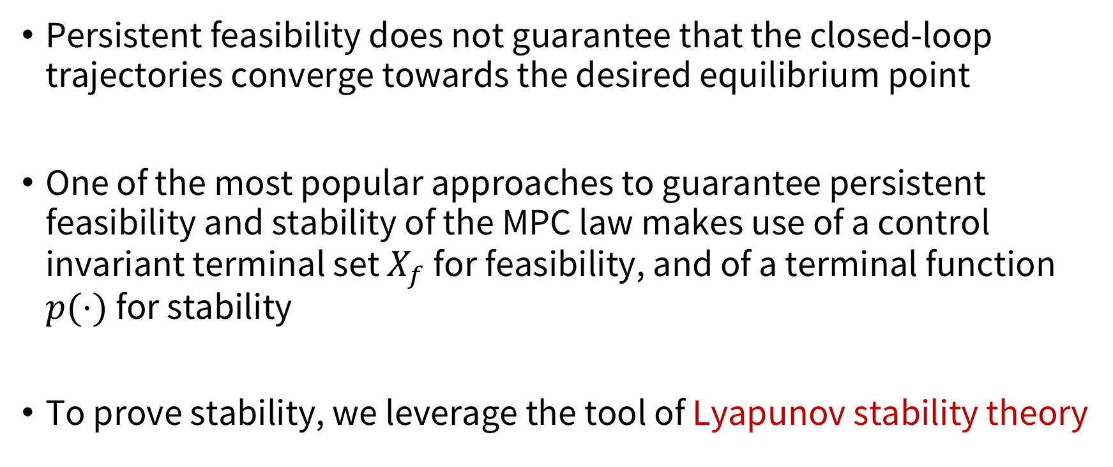
Stability of MPC
Persistent feasibility does not guarantee that the closed-loop trajectories converge towards the desired equilibrium point
One of the most popular approaches to guarantee persistent feasibility and stability of the MPC law makes use of a control invariant terminal set $X_{f}$ for feasibility, and of a terminal function $p(⋅)$ for stability
To prove stability, we leverage the tool of Lyapunov stability theory

Slide 9
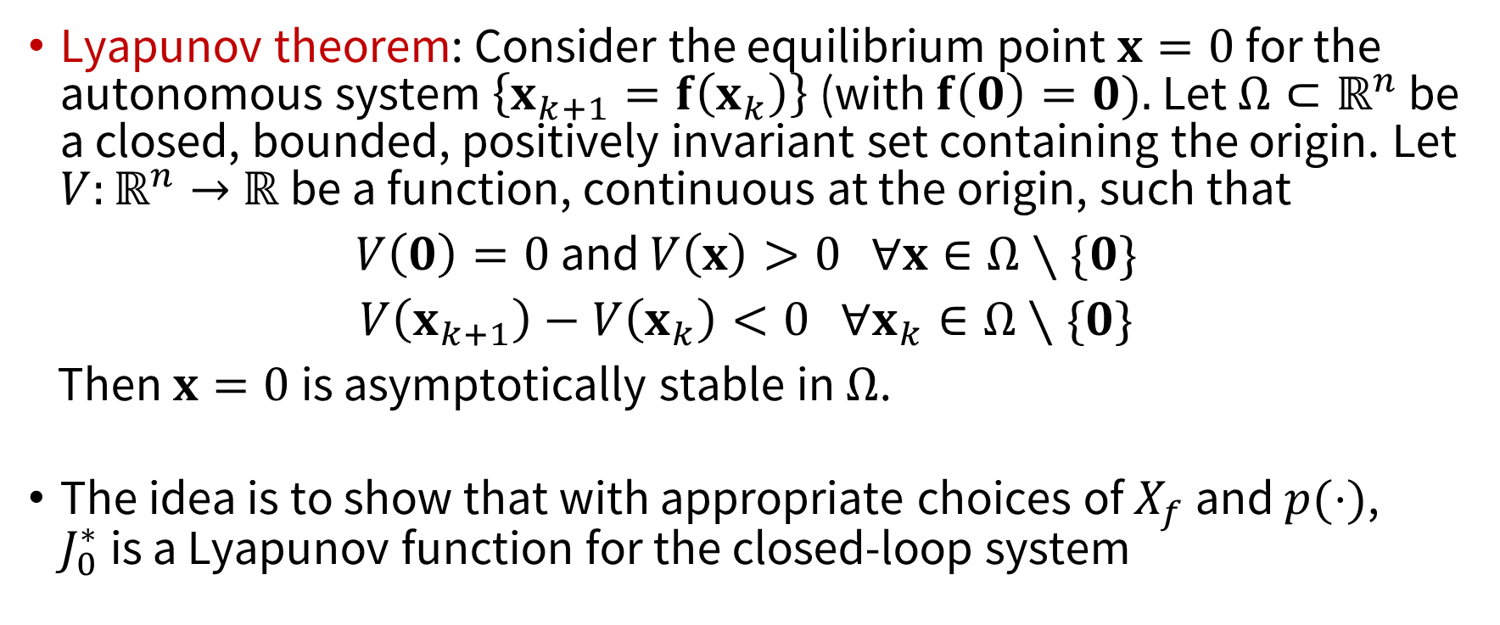
Lyapunov stability theory
Lyapunov theorem: Consider the equilibrium point $x=0$ for the autonomous system $\left\{x_{k+1}=f\left(x_{k}\right)\right\}$ (with $f\left(0\right)=0).$ Let $Ω⊂ℝ^{n}$ be a closed, bounded, positively invariant set containing the origin. Let $V:ℝ^{n}→$ $ℝ$be a function, continuous at the origin, such that
$V\left(0\right)=0$ and $V\left(x\right)>0$ $∀x∈Ω∖\{0\}$
$V\left(x_{k+1}\right)−V\left(x_{k}\right)<0$ $∀x_{k}∈Ω∖\{0\}$
Then $x=0$ is asymptotically stable in $Ω$.
The idea is to show that with appropriate choices of $X_{f}$ and $p(⋅)$, $J_{0}^{∗}$ is a Lyapunov function for the closed-loop system

Slide 10
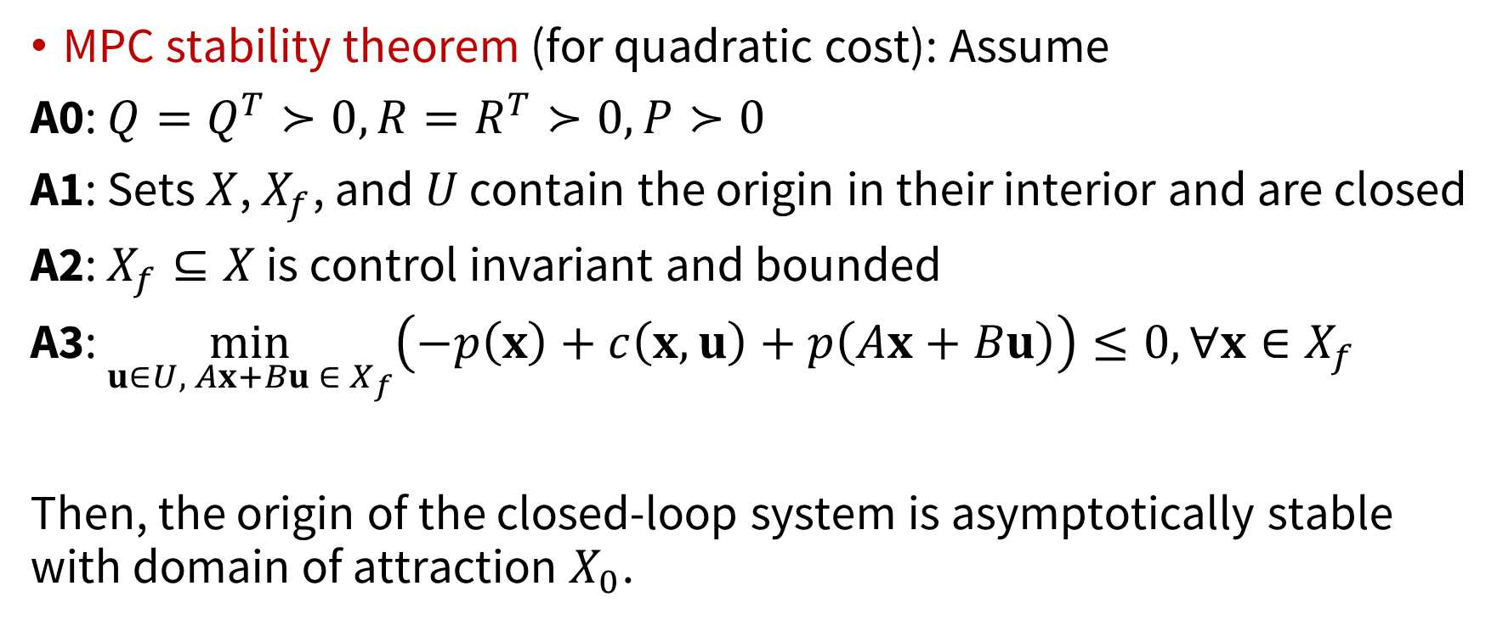
MPC stability theorem
MPC stability theorem (for quadratic cost): Assume
A0: $Q=Q^{T}≻0,R=R^{T}≻0, P≻0$
A1: Sets $X$, $X_{f}$, and $U$ contain the origin in their interior and are closed
A2: $X_{f}⊆X$ is control invariant and bounded
A3: $\min_{u∈U, Ax+Bu ∈{ X}_{f}}\left(−p\left(x\right)+c\left(x,u\right)+p\left(Ax+Bu\right)\right)≤0, ∀x∈X_{f}$
Then, the origin of the closed-loop system is asymptotically stable with domain of attraction $X_{0}$.

Slide 11
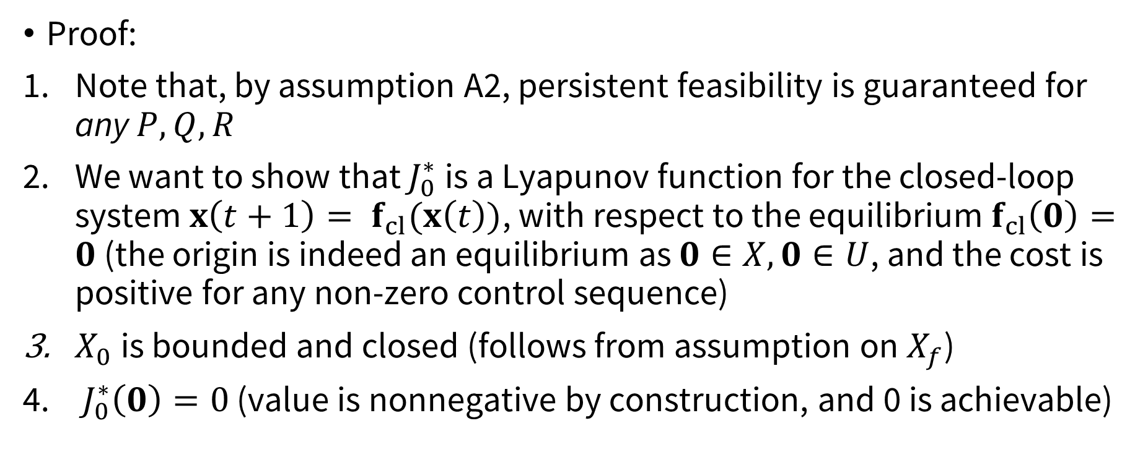
MPC stability theorem
Proof:
Note that, by assumption A2, persistent feasibility is guaranteed for any $P,Q,R$
We want to show that $J_{0}^{∗}$ is a Lyapunov function for the closed-loop system $x\left(t+1\right)= f_{cl}(x\left(t\right))$, with respect to the equilibrium $f_{cl}\left(0\right)=0$ (the origin is indeed an equilibrium as $0∈X, 0∈U$, and the cost is positive for any non-zero control sequence)
$X_{0}$ is bounded and closed (follows from assumption on $X_{f}$)
$J_{0}^{∗}\left(0\right)=0$ (value is nonnegative by construction, and 0 is achievable)

Slide 12
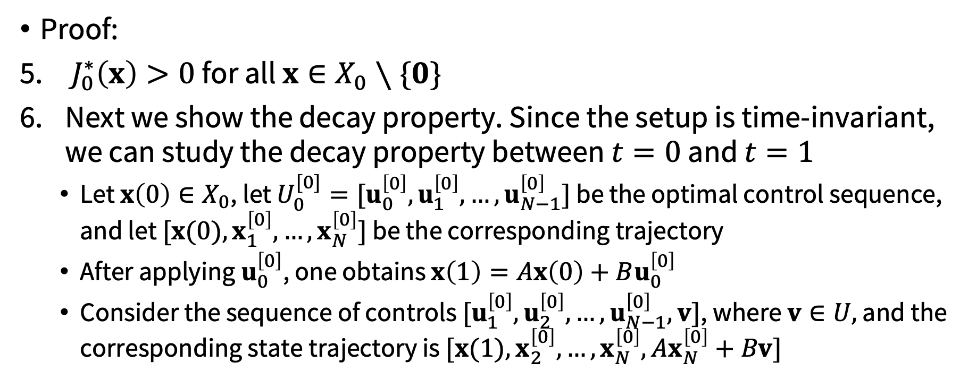
MPC stability theorem
Proof:
$J_{0}^{∗}\left(x\right)>0$ for all $x∈X_{0}∖\{0\}$
Next we show the decay property. Since the setup is time-invariant, we can study the decay property between $t=0$ and $t=1$
Let $x\left(0\right)∈X_{0}$, let $U_{0}^{[0]}=[u_{0}^{\left[0\right]},u_{1}^{\left[0\right]},…,u_{N−1}^{\left[0\right]}]$ be the optimal control sequence, and let $[x(0),x_{1}^{\left[0\right]},…,x_{N}^{\left[0\right]}]$ be the corresponding trajectory
After applying $u_{0}^{\left[0\right]}$, one obtains $x\left(1\right)=Ax\left(0\right)+Bu_{0}^{\left[0\right]}$
Consider the sequence of controls $[u_{1}^{\left[0\right]},u_{2}^{\left[0\right]},…,u_{N−1}^{\left[0\right]},v]$, where $v∈U,$ and the corresponding state trajectory is $[x(1),x_{2}^{\left[0\right]},…,x_{N}^{\left[0\right]},Ax_{N}^{\left[0\right]}+Bv]$

Slide 13
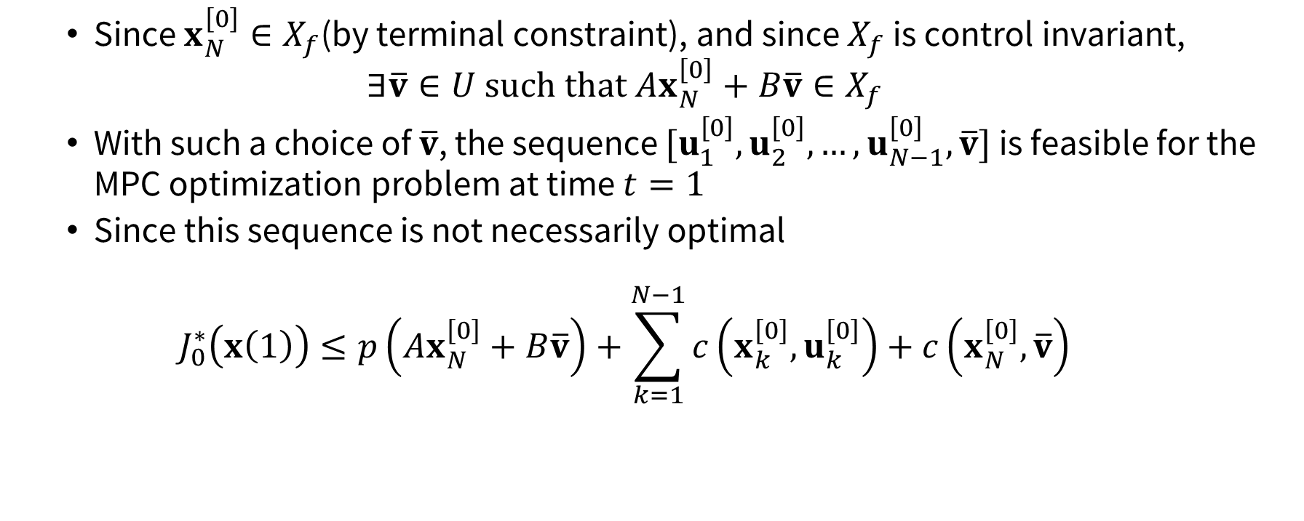
MPC stability theorem
Since $x_{N}^{\left[0\right]}∈X_{f}$(by terminal constraint), and since $X_{f}$ is control invariant,
$$∃\overline{v}∈U such that Ax_{N}^{\left[0\right]}+B\overline{v}∈X_{f}$$
With such a choice of $\overline{v}$, the sequence $[u_{1}^{\left[0\right]},u_{2}^{\left[0\right]},…,u_{N−1}^{\left[0\right]},\overline{v}]$ is feasible for the MPC optimization problem at time $t=1$
Since this sequence is not necessarily optimal
$$J_{0}^{∗}\left(x\left(1\right)\right)≤p\left(Ax_{N}^{\left[0\right]}+B\overline{v}\right)+\sum_{k=1}^{N−1}{c\left(x_{k}^{\left[0\right]},u_{k}^{\left[0\right]}\right)}+c\left(x_{N}^{\left[0\right]},\overline{v}\right)$$

Slide 14
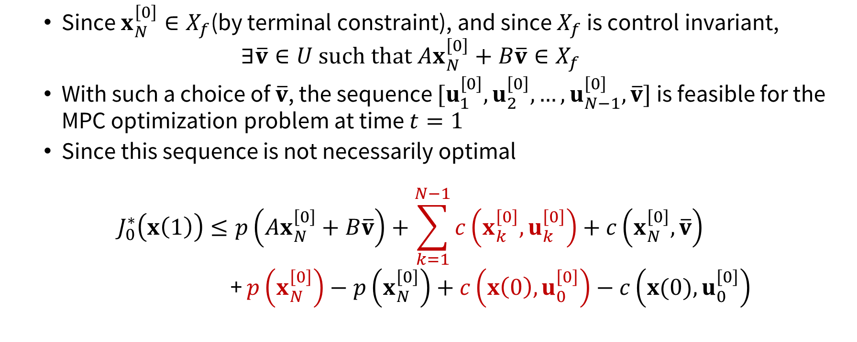
MPC stability theorem
Since $x_{N}^{\left[0\right]}∈X_{f}$(by terminal constraint), and since $X_{f}$ is control invariant,
$$∃\overline{v}∈U such that Ax_{N}^{\left[0\right]}+B\overline{v}∈X_{f}$$
With such a choice of $\overline{v}$, the sequence $[u_{1}^{\left[0\right]},u_{2}^{\left[0\right]},…,u_{N−1}^{\left[0\right]},\overline{v}]$ is feasible for the MPC optimization problem at time $t=1$
Since this sequence is not necessarily optimal
$$J_{0}^{∗}\left(x\left(1\right)\right)≤p\left(Ax_{N}^{\left[0\right]}+B\overline{v}\right)+\sum_{k=1}^{N−1}{c\left(x_{k}^{\left[0\right]},u_{k}^{\left[0\right]}\right)}+c\left(x_{N}^{\left[0\right]},\overline{v}\right)$$
+ $p\left(x_{N}^{\left[0\right]}\right)−p\left(x_{N}^{\left[0\right]}\right)+c\left(x\left(0\right),u_{0}^{\left[0\right]}\right)−c\left(x(0),u_{0}^{\left[0\right]}\right)$

Slide 15
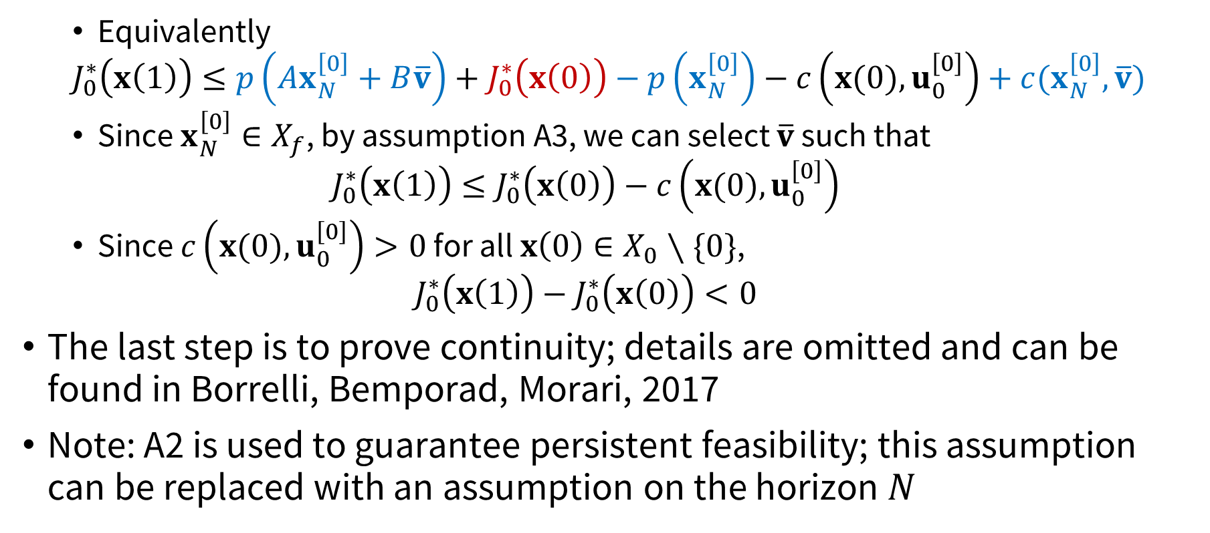
MPC stability theorem
Equivalently
$$J_{0}^{∗}\left(x\left(1\right)\right)≤p\left(Ax_{N}^{\left[0\right]}+B\overline{v}\right)+J_{0}^{∗}\left(x\left(0\right)\right)−p\left(x_{N}^{\left[0\right]}\right)−c\left(x(0),u_{0}^{\left[0\right]}\right)+c(x_{N}^{\left[0\right]},\overline{v})$$
Since $x_{N}^{\left[0\right]}∈X_{f}$, by assumption A3, we can select $\overline{v}$ such that
$$J_{0}^{∗}\left(x\left(1\right)\right)≤J_{0}^{∗}\left(x\left(0\right)\right)−c\left(x(0),u_{0}^{\left[0\right]}\right)$$
Since $c\left(x(0),u_{0}^{\left[0\right]}\right)>0$ for all $x\left(0\right)∈X_{0}∖\{0\}$,
$$J_{0}^{∗}\left(x\left(1\right)\right)−J_{0}^{∗}\left(x\left(0\right)\right)<0$$
The last step is to prove continuity; details are omitted and can be found in Borrelli, Bemporad, Morari, 2017
Note: A2 is used to guarantee persistent feasibility; this assumption can be replaced with an assumption on the horizon $N$

Slide 16

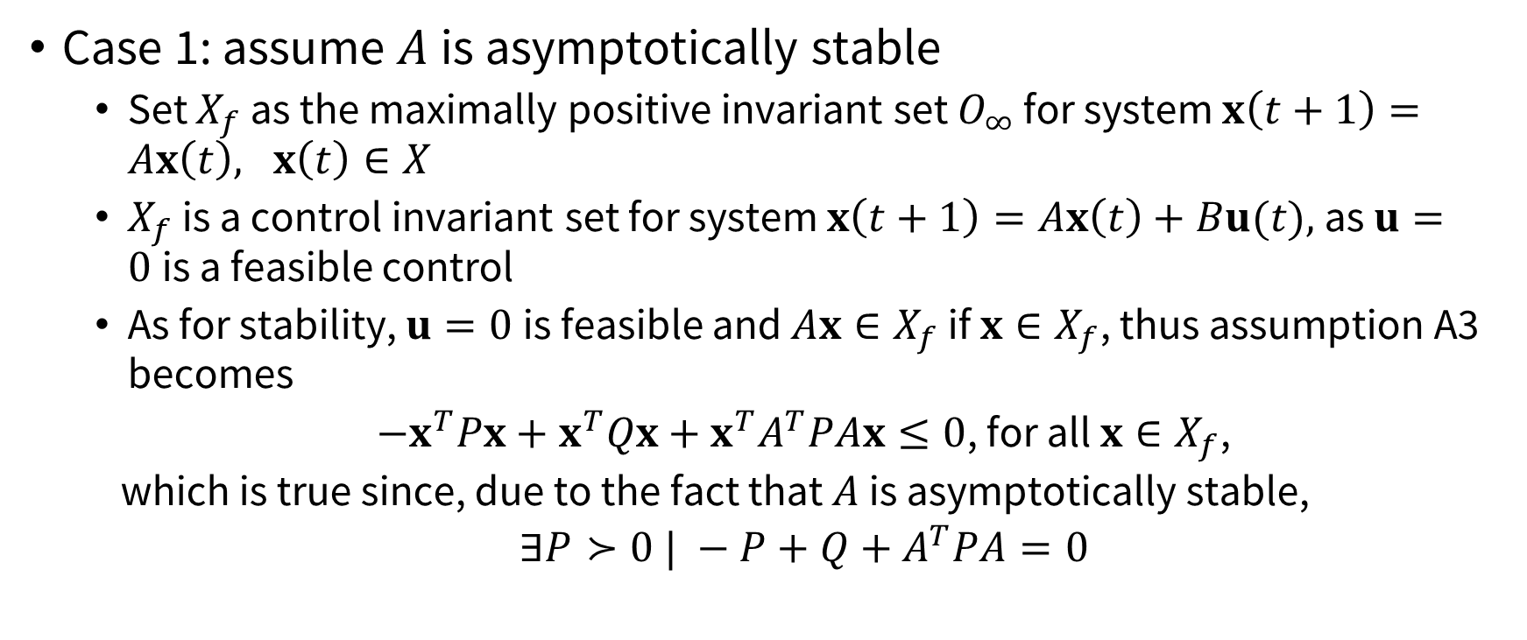
How to choose $X_{f}$ and $P?$
Case 1: assume $A$ is asymptotically stable
Set $X_{f}$ as the maximally positive invariant set $O_{∞}$ for system $x\left(t+1\right)=Ax\left(t\right), x\left(t\right)∈X$
$X_{f}$ is a control invariant set for system $x\left(t+1\right)=Ax\left(t\right)+Bu(t),$as $u=0$is a feasible control
As for stability, $u=0$is feasible and $Ax∈X_{f}$ if $x∈X_{f}$, thus assumption A3 becomes
$−x^{T}Px+x^{T}Qx+x^{T}A^{T}PAx≤0$, for all $x∈X_{f}$,
which is true since, due to the fact that $A$ is asymptotically stable,
$∃P≻0 | −P+Q+A^{T}PA=0$
(Lyapunov Equation)
Cost-to-go/value function

Slide 17
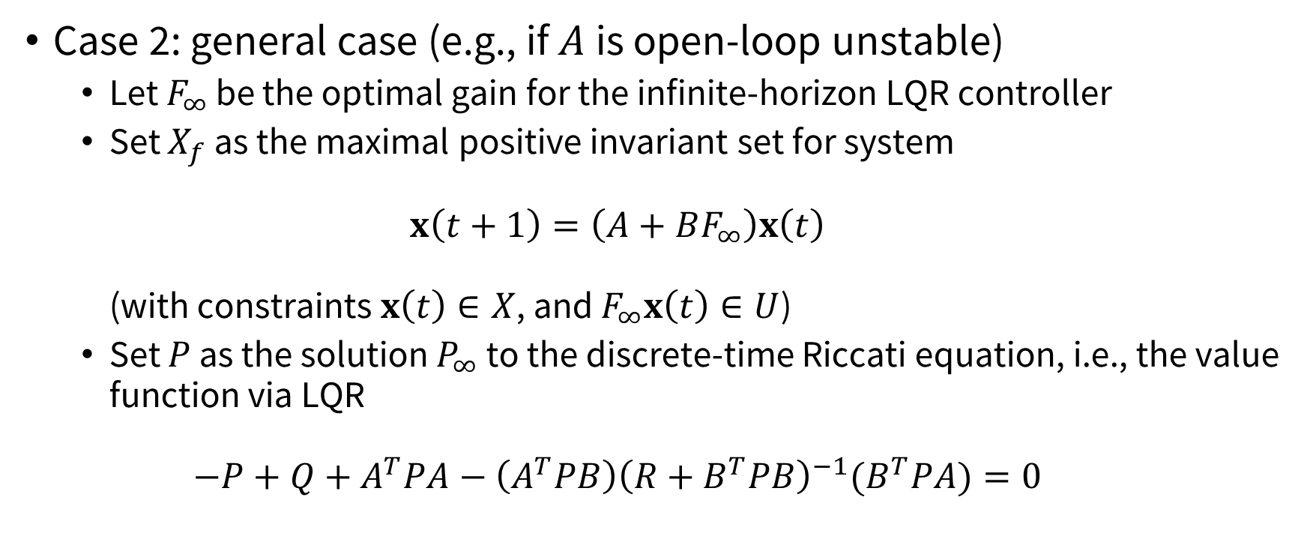
How to choose $X_{f}$ and $P?$
Case 2: general case (e.g., if $A$ is open-loop unstable)
Let $F_{∞}$ be the optimal gain for the infinite-horizon LQR controller
Set $X_{f}$ as the maximal positive invariant set for system $x\left(t+1\right)=\left(A+BF_{∞}\right)x\left(t\right)$ (with constraints $x\left(t\right)∈X$, and $F_{∞}x\left(t\right)∈U$)
Set $P$ as the solution $P_{∞}$ to the discrete-time Riccati equation, i.e., the value function via LQR $−P+Q+A^{T}PA−\left(A^{T}PB\right){\left(R+B^{T}PB\right)}^{−1}(B^{T}PA)=0$

Slide 18
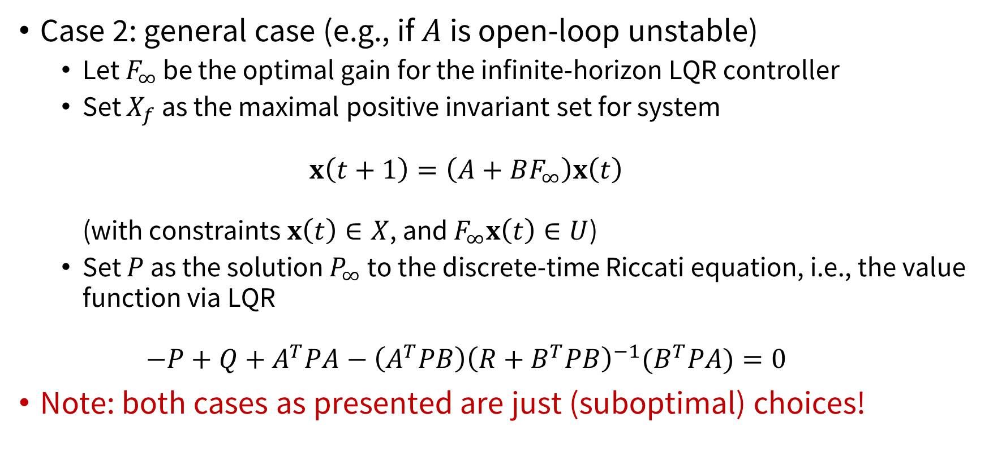
How to choose $X_{f}$ and $P?$
Case 2: general case (e.g., if $A$ is open-loop unstable)
Let $F_{∞}$ be the optimal gain for the infinite-horizon LQR controller
Set $X_{f}$ as the maximal positive invariant set for system $x\left(t+1\right)=\left(A+BF_{∞}\right)x\left(t\right)$ (with constraints $x\left(t\right)∈X$, and $F_{∞}x\left(t\right)∈U$)
Set $P$ as the solution $P_{∞}$ to the discrete-time Riccati equation, i.e., the value function via LQR $−P+Q+A^{T}PA−\left(A^{T}PB\right){\left(R+B^{T}PB\right)}^{−1}(B^{T}PA)=0$
Note: both cases as presented are just (suboptimal) choices!

Slide 19
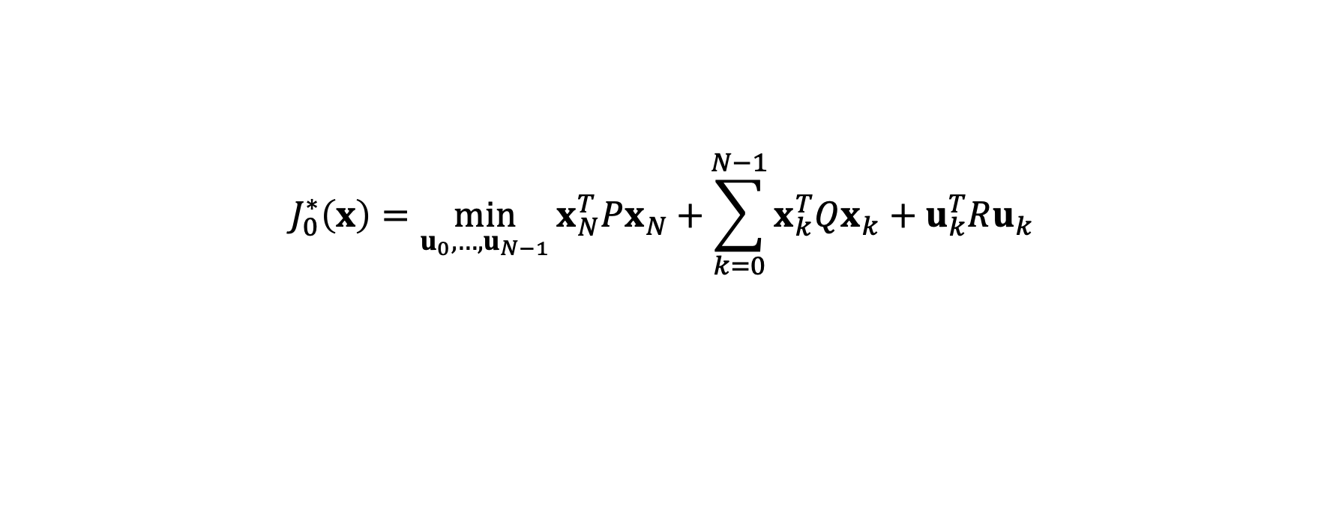

Explicit MPC
In some cases, the MPC law can be pre-computed $→$ no need for online optimization
Important case: constrained LQR
$$J_{0}^{∗}\left(x\right)=\min_{u_{0}, …,u_{N−1}}{x_{N}^{T}Px_{N}+}\sum_{k=0}^{N−1}{x_{k}^{T}Qx_{k}+u_{k}^{T}Ru_{k}}$$
subject to${ x}_{k+1}=Ax_{k}+Bu_{k}, k=0,…,N−1$
${ x}_{k}∈X, { u}_{k}∈U, k=0,…,N−1$
${ x}_{N}∈X_{f}$
${ x}_{0}=x$

Slide 20
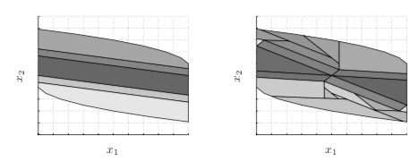
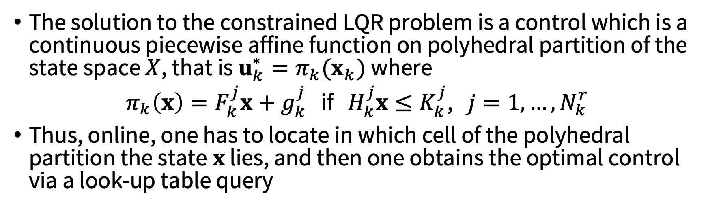
Explicit MPC
The solution to the constrained LQR problem is a control which is a continuous piecewise affine function on polyhedral partition of the state space $X$, that is $u_{k}^{∗}=π_{k}(x_{k})$ where
$π_{k}\left(x\right)=F_{k}^{j}x+g_{k}^{j}$ if $H_{k}^{j}x≤K_{k}^{j}$, $j=1, …, N_{k}^{r}$
Thus, online, one has to locate in which cell of the polyhedral partition the state$x$ lies, and then one obtains the optimal control via a look-up table query

Slide 21
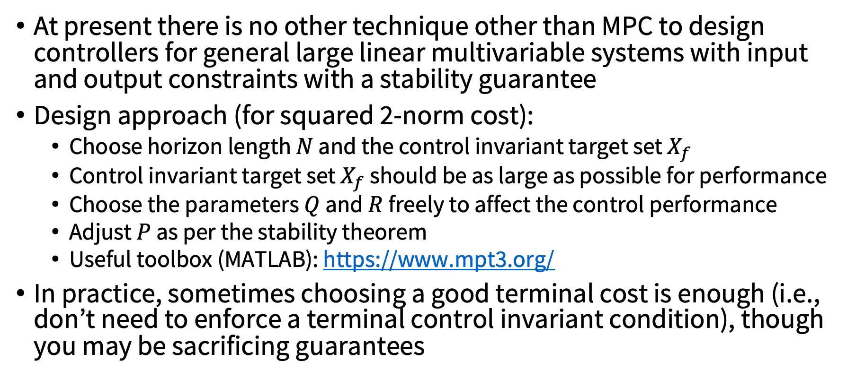
Tuning and practical use
At present there is no other technique other than MPC to design controllers for general large linear multivariable systems with input and output constraints with a stability guarantee
Design approach (for squared 2-norm cost):
Choose horizon length $N$ and the control invariant target set $X_{f}$
Control invariant target set $X_{f}$ should be as large as possible for performance
Choose the parameters $Q$ and $R$ freely to affect the control performance
Adjust $P$ as per the stability theorem
Useful toolbox (MATLAB): https://www.mpt3.org/
In practice, sometimes choosing a good terminal cost is enough (i.e., don’t need to enforce a terminal control invariant condition), though you may be sacrificing guarantees

Slide 22
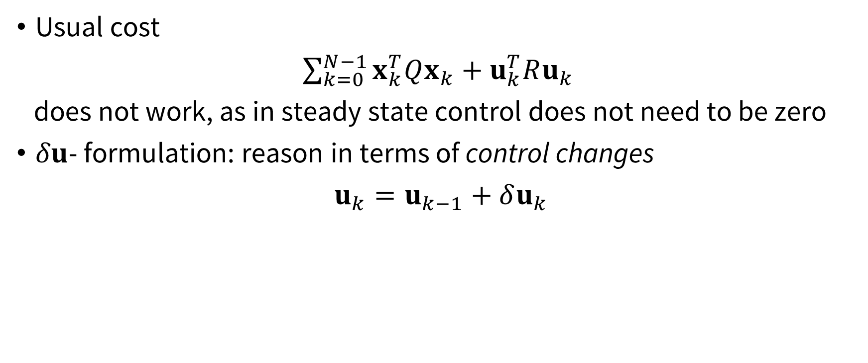
MPC for reference tracking
Usual cost
$\sum_{k=0}^{N−1}{x_{k}^{T}Qx_{k}+u_{k}^{T}Ru_{k}}$
does not work, as in steady state control does not need to be zero
$δu$- formulation: reason in terms of control changes
$u_{k}=u_{k−1}+δu_{k}$

Slide 23
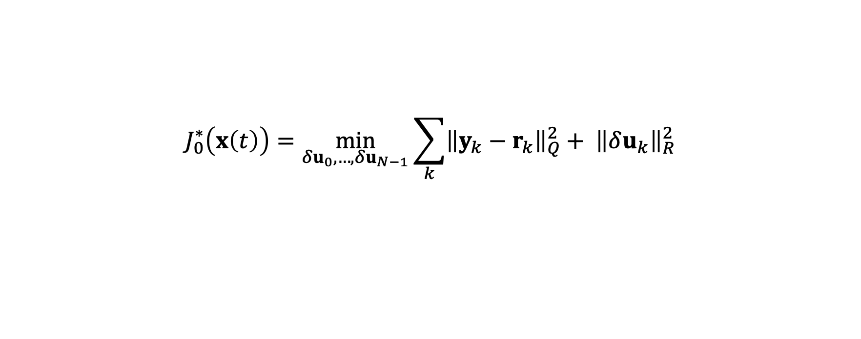
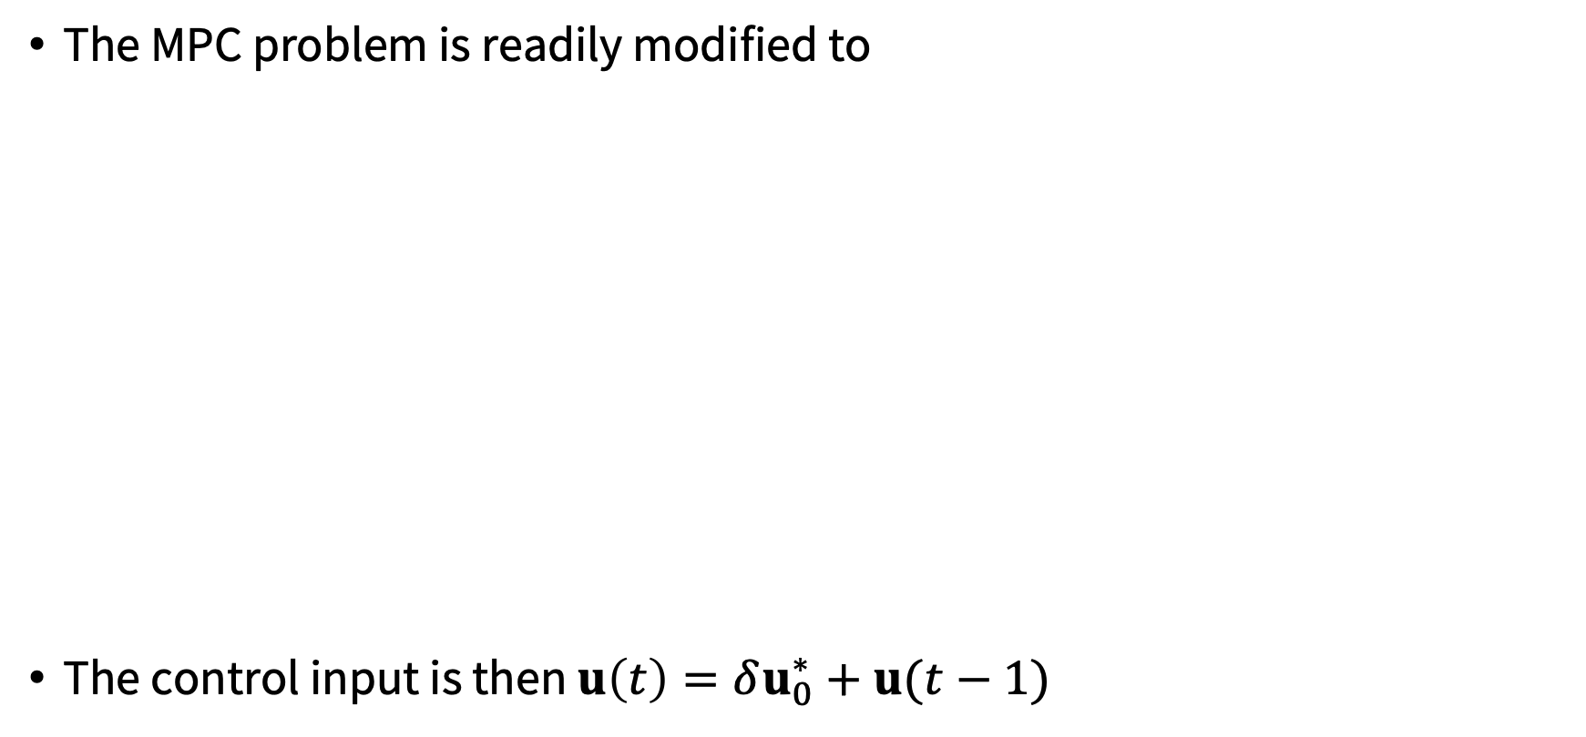
MPC for reference tracking
The MPC problem is readily modified to
The control input is then $u\left(t\right)=δu_{0}^{∗}+u(t−1)$
$$J_{0}^{∗}\left(x\left(t\right)\right)=\min_{δu_{0},…, δu_{N−1}}{\sum_{k}{{\left\|y_{k}−r_{k}\right\|}_{Q}^{2}+ {\left\|δu_{k}\right\|}_{R}^{2}}}$$
subject to${ x}_{k+1}=Ax_{k}+Bu_{k}, k=0,…,N−1$
${ y}_{k}=Cx_{k}, k=0,…,N−1$
${ x}_{k}∈X, { u}_{k}∈U, k=0,…,N−1$
${ x}_{N}∈X_{f}$
$u_{k}=u_{k−1}+δu_{k}, k=0,…,N−1$
${ x}_{0}=x\left(t\right), { u}_{−1}=u(t−1)$

Slide 24
Next time
Intro to learning
Sys ID
Adaptive control

