Slide 1
AA203 Optimal and Learning-based Control
Intro to learning; System identification and adaptive control

Slide 2
Course overview
Model-free RL
Control
Adaptive
optimal control
Model-based RL
Feedback control
Adaptive control
Optimal and learning control
Open-loop
MPC
Closed-loop
Indirect methods
Direct
methods
DP
HJB / HJI

Slide 3
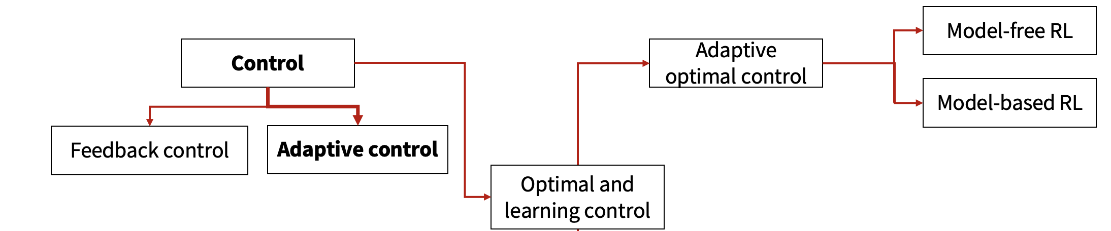
Outline
Intro to learning settings

Slide 4
Outline
Intro to learning settings
System ID
Adaptive control
MRAC: Model Reference Adaptive Control
MIAC: Model Identification Adaptive Control

Slide 5
Feedback control
Reference tracking, with uncertainty
Reference
+
Controller
Control
System
Output
Σ
–
Measurement
Sensor

Slide 6
Feedback control
Reference tracking, with uncertainty
Reference
+
Controller
Control
?
Output
Σ
–
Measurement
Sensor

Slide 7
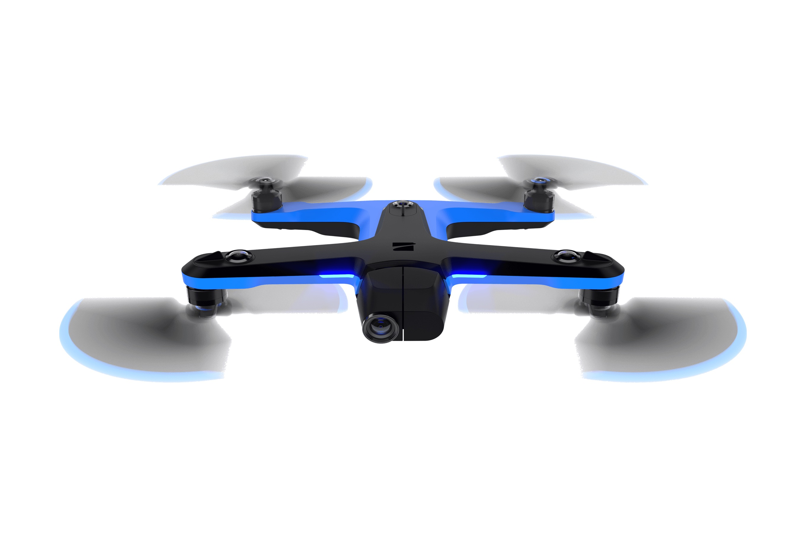

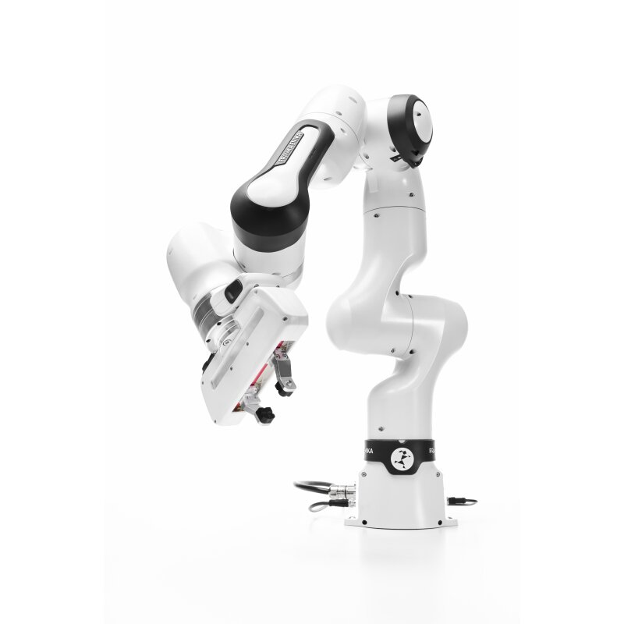
Approaches
How do we handle uncertainty?
In many cases, when uncertainties have only a small effect, a feedback controller will adequately compensate for model error
Example: A quadrotor compensating for mild wind gusts using PID control
We can use robust control approaches (e.g., minimax control strategies)
Example: A Harrier VTOL aircraft near hover must remain stable despite large, unpredictable air turbulence — robust control ensures safe performance even under worst-case wind conditions
We can use observed state transitions to attempt to identify patterns and improve our control strategy
Example: A robotic arm learning to adjust its grip based on object slip detected during previous grasp attempts

Slide 8
What can we learn?
If we want to use measurements to improve control performance, we can either:
Use measurements to directly improve controller
Direct adaptive control
Imitation learning
Model-free reinforcement learning
Use measurements to learn model, use model to improve controller
System identification
Indirect adaptive control
Model-based reinforcement learning

Slide 9
What can we learn?
If we want to use measurements to improve control performance, we can either:
Use measurements to directly improve controller
Direct adaptive control
Imitation learning
Model-free reinforcement learning
Use measurements to learn model, use model to improve controller
System identification
Indirect adaptive control
Model-based reinforcement learning
Today
Upcoming weeks
Upcoming weeks
Today
Today
Upcoming weeks

Slide 10
How does learning happen?
Three possible learning settings:
“Zero” episodes: the system identification approach, in which learning is done based on data gathered before operation
One episode: want to learn and re-optimize our controller online → this is the standard setting for adaptive control
Multiple episodes: interact with the environment in episodes, in which the system is reset at the start of each episode; learning and policy optimization can happen between episodes → this is the standard setting for reinforcement learning

Slide 11
Outline
Intro to learning settings
System ID
Adaptive control
MRAC: Model Reference Adaptive Control
MIAC: Model Identification Adaptive Control

Slide 12
System identification for learning-based control
For many problems, we don’t need to learn online
A standard control engineering pipeline is to do experiments in advance to build a data-driven model of the dynamics
Then, we can use this model for planning and control without further learning online
Relies on having an engineer in the loop for learning, designing experiments, resetting the system, etc.
Linear regression is one of the main system id tools

Slide 13
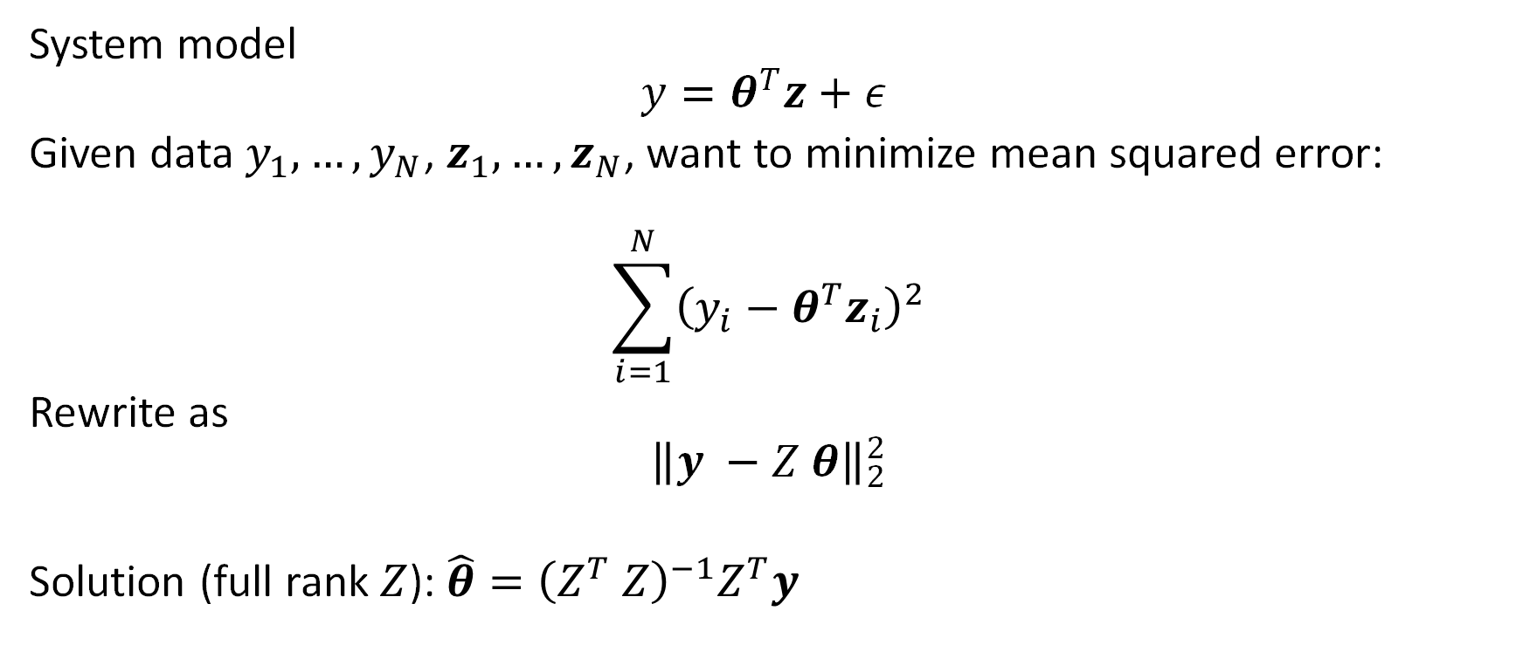
Least squares
System model
$$y=θ^{T}z+ε$$
Given data $y_{1}, …, y_{N}$, $z_{1}, …, z_{N}$, want to minimize mean squared error:
$$\sum_{i=1}^{N}{{\left(y_{i}−θ^{T}z_{i}\right)}^{2}}$$
Rewrite as
$${\left\|y −Z θ\right\|}_{2}^{2}$$
Solution (full rank $Z$): $\hat{θ}={\left(Z^{T} Z\right)}^{−1}Z^{T}y$

Slide 14
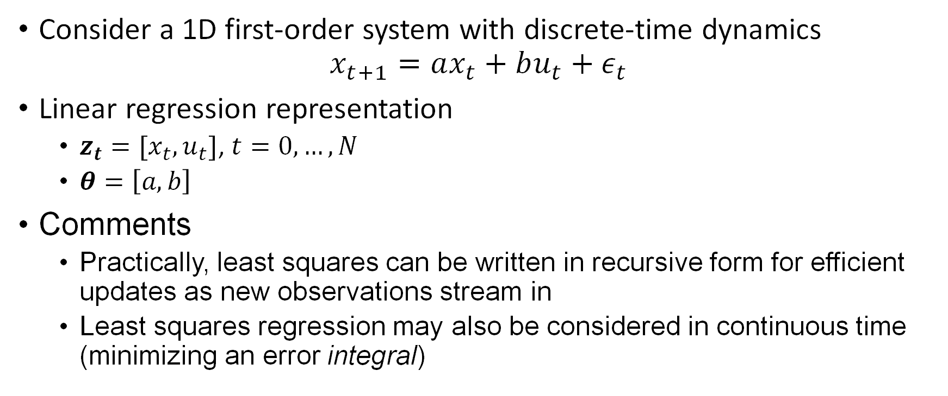
Example: first order model
Consider a 1D first-order system with discrete-time dynamics
$$x_{t+1}=ax_{t}+bu_{t}+ε_{t}$$
Linear regression representation
$z_{t}=[x_{t},u_{t}]$, $t=0,…, N$
$θ=\left[a, b\right]$
Comments
Practically, least squares can be written in recursive form for efficient updates as new observations stream in
Least squares regression may also be considered in continuous time (minimizing an error integral)

Slide 15
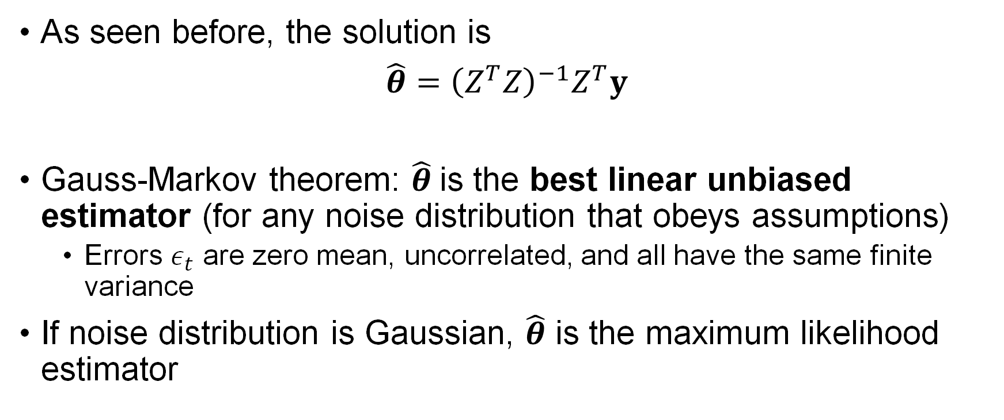
Linear regression for system id
As seen before, the solution is
$\hat{θ}=$ ${{\left(Z^{T}Z\right)}^{−1}Z}^{T}y$
Gauss-Markov theorem: $\hat{θ}$is the best linear unbiased estimator (for any noise distribution that obeys assumptions)
Errors $ε_{t}$ are zero mean, uncorrelated, and all have the same finite variance
If noise distribution is Gaussian, $\hat{θ}$ is the maximum likelihood estimator

Slide 16

Persistent excitation
Classical question: what are sufficient conditions for our estimator $\hat{θ}$ to converge?

Slide 17
Persistent excitation
Classical question: what are sufficient conditions for our estimator $\hat{θ}$ to converge?

Slide 18

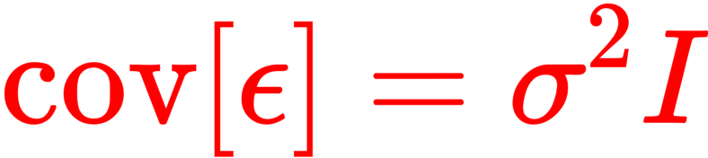
Persistent excitation
Classical question: what are sufficient conditions for our estimator $\hat{θ}$ to converge?

Slide 19
Persistent excitation
Classical question: what are sufficient conditions for our estimator $\hat{θ}$ to converge?
→ criterion such that if our sys id/adaptive control system operates forever, then we’ll have identified the system perfectly

Slide 20
Performance questions
Practically, the system identification approach leads to several questions:
What if we have a data budget?
How much data is required to learn the model?
How can we quantify a “good” estimate?
We care about controller performance, not model accuracy, so do we require an accurate model?
How should we design the inputs used for data collection?
What if we’re learning while doing?
What if an engineer can’t intervene to prevent system failure during data collection?
What if our system does not fall in the class of systems we are considering?

Slide 21
Outline
Intro to learning settings
System ID
Adaptive control
MRAC: Model Reference Adaptive Control
MIAC: Model Identification Adaptive Control

Slide 22
Adaptive control
Broadly, adaptive control aims to perform online adaptation of the policy to improve performance
This can be done via directly updating the policy or updating the model and re-optimizing or re-computing the controller
Most classical adaptive control work does not consider the optimal adaptive control problem; they focus on proving stability of the coupled controller + adaptive component + system dynamics

Slide 23
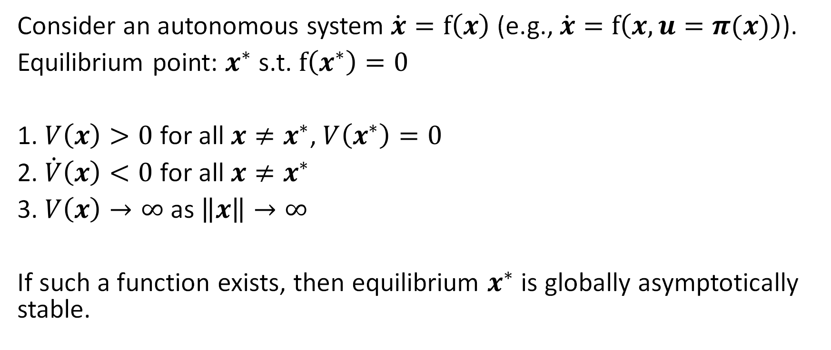
Detour: Lyapunov theorem for global stability
Consider an autonomous system $\dot{x}=f\left(x\right)$ (e.g., $\dot{x}=f\left(x,u=π(x)\right)$).
Equilibrium point: $x^{∗}$ s.t. $f\left(x^{∗}\right)=0$
1. $V\left(x\right)>0$ for all $x≠x^{∗}$, $V\left(x^{∗}\right)=0$
2. $\dot{V}\left(x\right)<0$ for all $x≠x^{∗}$
3. $V\left(x\right)→∞$ as $\left\|x\right\|→∞$
If such a function exists, then equilibrium $x^{∗}$ is globally asymptotically stable.

Slide 24
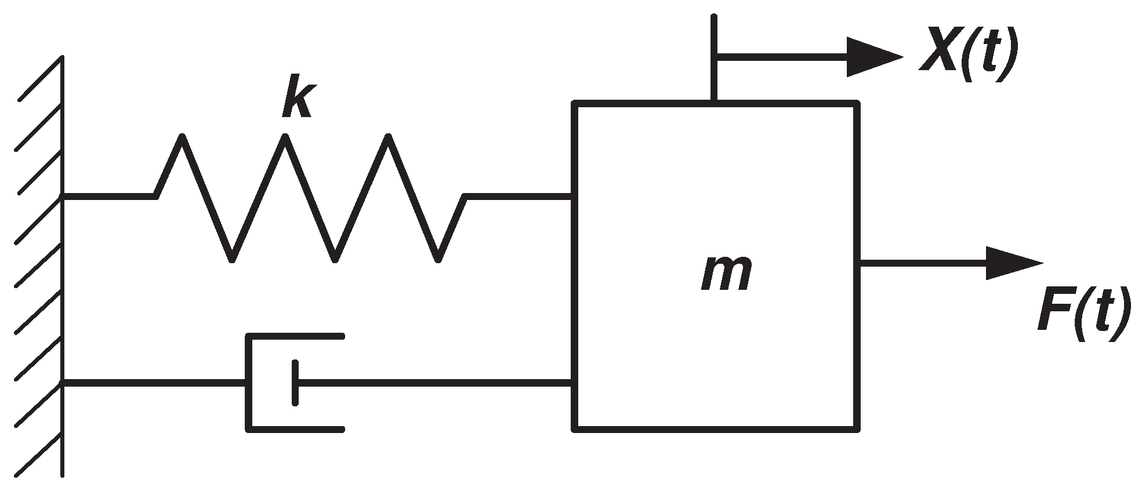
Detour: stability analysis via Lyapunov
Mass/Spring/Damper
Consider the total energy of the system:

Slide 25
Adaptive control approaches
Encompasses a large variety of techniques, including :
Model reference adaptive control (MRAC)
Model identification adaptive control (MIAC)

Slide 26
Model reference adaptive control (MRAC)
A model reference adaptive controller is composed of four parts:
A plant containing unknown parameters
A reference model for compactly specifying the desired output
A feedback control law containing adjustable parameters
An adaptation mechanism for updating the adjustable parameters
Compared to reward functions, a reference model is an alternative way to specify how a system should behave
The reference model provides the ideal plant response which the adaptation mechanism should seek in adjusting the parameters

Slide 27
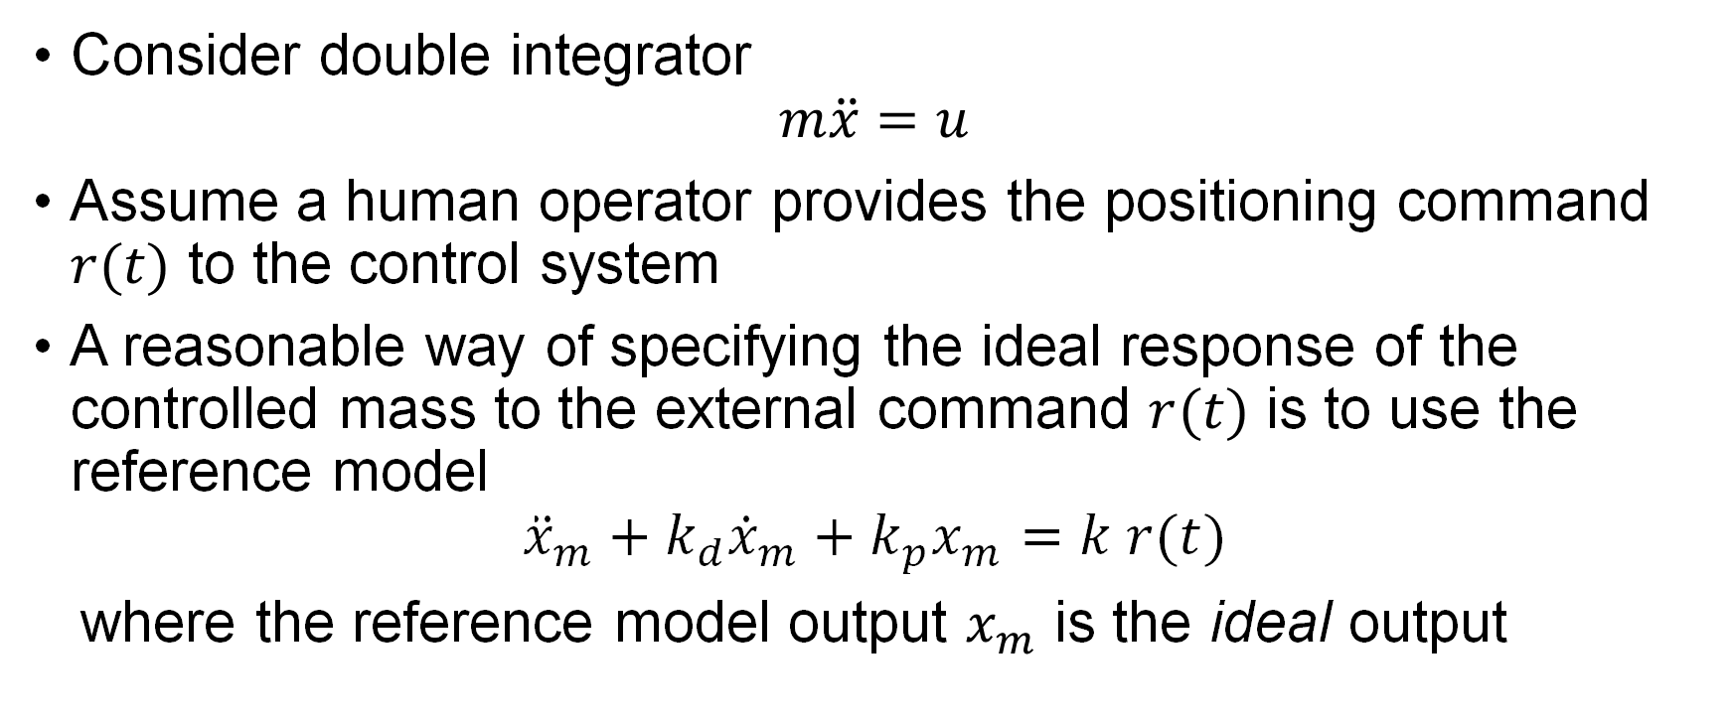
Example of MRAC control
Consider double integrator
$$m\ddot{x}=u$$
Assume a human operator provides the positioning command $r(t)$ to the control system
A reasonable way of specifying the ideal response of the controlled mass to the external command $r(t)$ is to use the reference model
$${\ddot{x}}_{m}+k_{d}{\dot{x}}_{m}+k_{p}x_{m}=k r(t)$$
where the reference model output $x_{m}$ is the ideal output

Slide 28
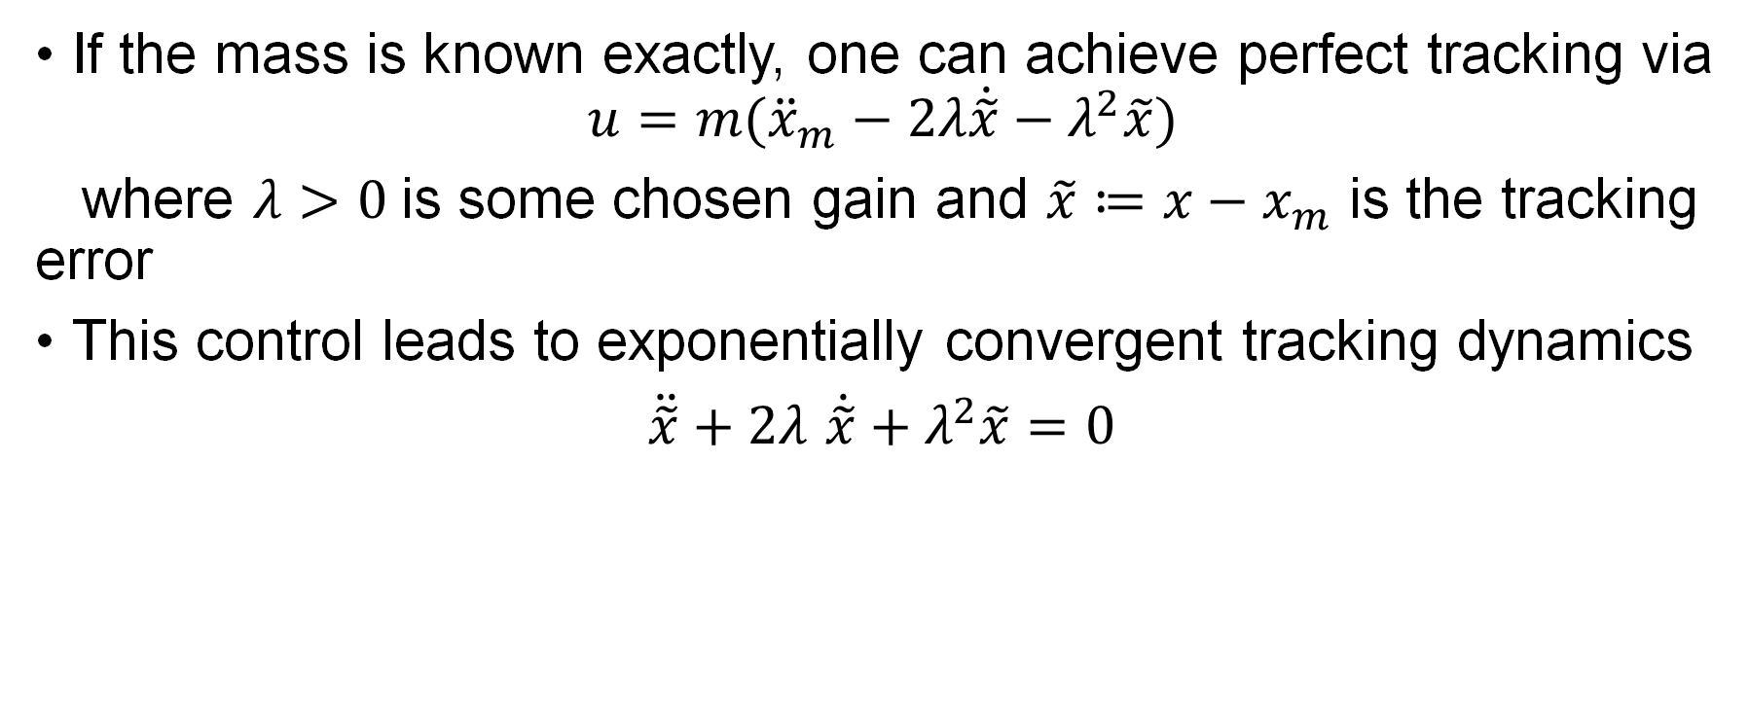
Example of MRAC control
If the mass is known exactly, one can achieve perfect tracking via
$$u=m({\ddot{x}}_{m}−2λ\dot{\tilde{x}}−λ^{2}\tilde{x})$$
where $λ>0$is some chosen gain and $\tilde{x}≔x−x_{m}$ is the tracking error
This control leads to exponentially convergent tracking dynamics
$\ddot{\tilde{x}}+2λ$ $\dot{\tilde{x}}+λ^{2}\tilde{x}=0$

Slide 29
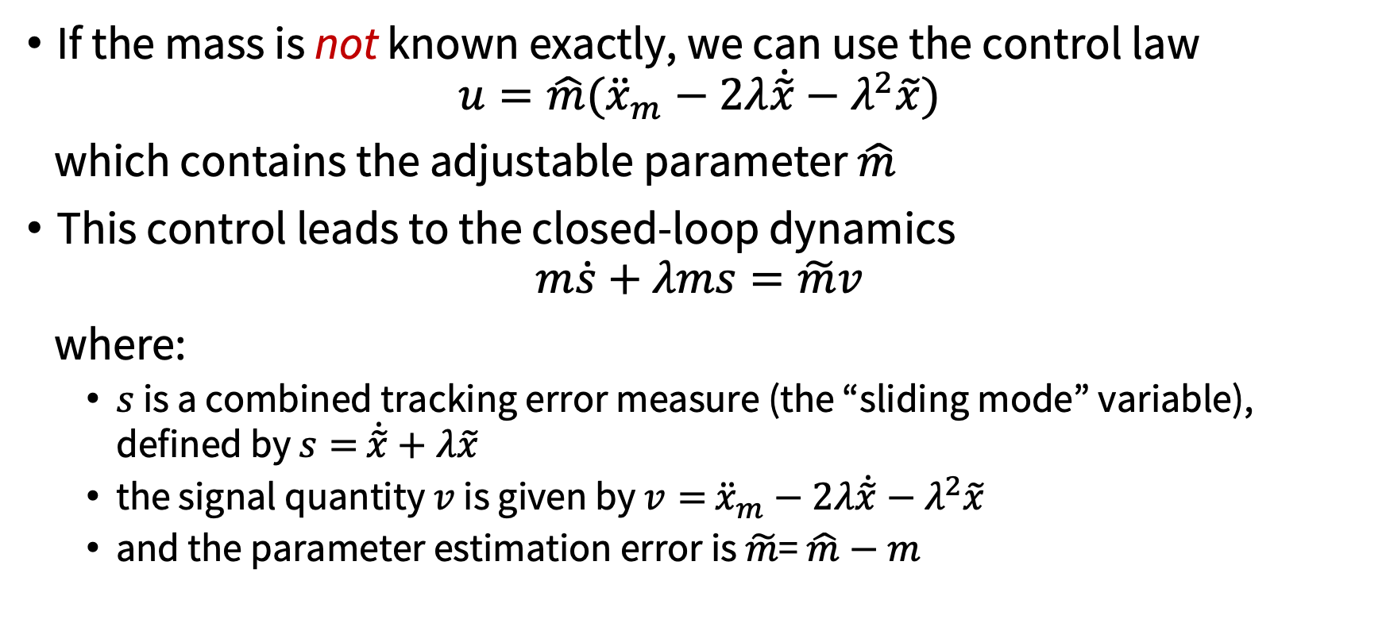
Example of MRAC control
If the mass is not known exactly, we can use the control law
$$u=\hat{m}({\ddot{x}}_{m}−2λ\dot{\tilde{x}}−λ^{2}\tilde{x})$$
which contains the adjustable parameter $\hat{m}$
This control leads to the closed-loop dynamics
$$m\dot{s}+λms=\tilde{m}v$$
where:
$s$ is a combined tracking error measure (the “sliding mode” variable), defined by $s=$ $\dot{\tilde{x}}+λ\tilde{x}$
the signal quantity $v$ is given by $v=$ ${\ddot{x}}_{m}−2λ\dot{\tilde{x}}−λ^{2}\tilde{x}$
and the parameter estimation error is $\tilde{m}$= $\hat{m}−m$

Slide 30
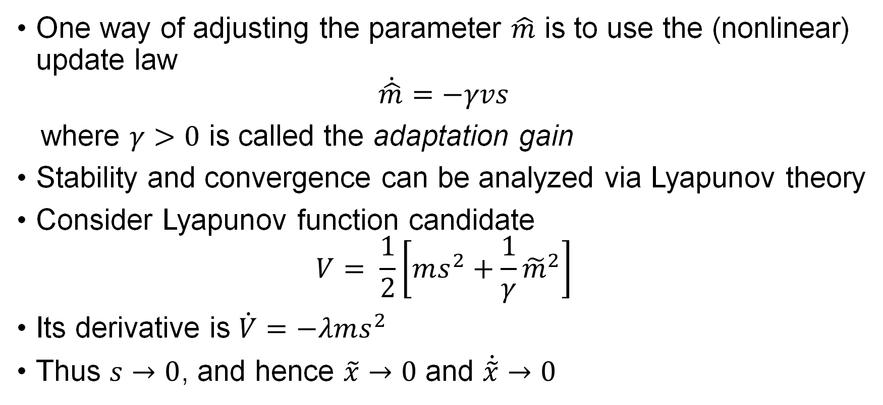
Example of MRAC control
One way of adjusting the parameter $\hat{m}$ is to use the (nonlinear) update law
$$\dot{\hat{m}}=−γvs$$
where $γ>0$ is called the adaptation gain
Stability and convergence can be analyzed via Lyapunov theory
Consider Lyapunov function candidate
$$V= \frac{1}{2}\left[ms^{2}+\frac{1}{γ}{\tilde{m}}^{2}\right]$$
Its derivative is $\dot{V}=−λms^{2}$
Thus $s→0$, and hence $\tilde{x}→0$ and $\dot{\tilde{x}}→0$

Slide 31
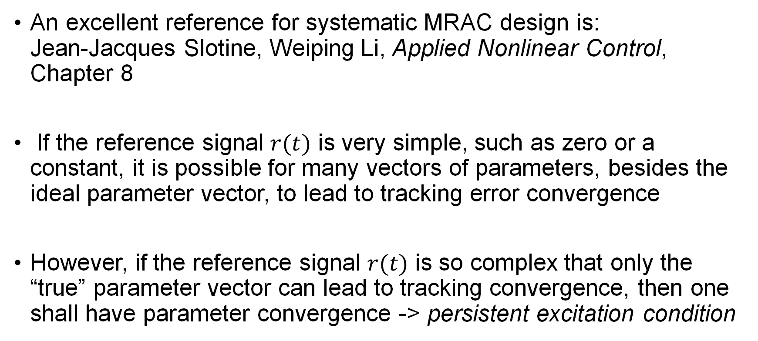
MRAC
An excellent reference for systematic MRAC design is: Jean-Jacques Slotine, Weiping Li, Applied Nonlinear Control, Chapter 8
If the reference signal $r(t)$ is very simple, such as zero or a constant, it is possible for many vectors of parameters, besides the ideal parameter vector, to lead to tracking error convergence
However, if the reference signal $r(t)$ is so complex that only the “true” parameter vector can lead to tracking convergence, then one shall have parameter convergence -> persistent excitation condition

Slide 32
Model identification adaptive control
MIAC (also referred to as self-tuning) simply combines model estimation with a controller that uses the estimated model
Important distinction between certainty-equivalent and cautious approaches
Certainty-equivalent: maintains point estimate of model and uses that model for policy selection/optimization. Can be suboptimal, risky.
Cautious: Maintains measure of estimator uncertainty, incorporates the uncertainty into the controller. This is often overly robust because it does not account for future info gain!

Slide 33
MRAC vs. MIAC
MRAC and MIAC arise from two different perspectives:
parameters in MRAC are updated so as to minimize tracking error between the plant output and the reference model output
parameters in MIAC are updated so as to minimize the data-fitting error
MIAC controllers are in general more flexible, as one can couple various controllers with various estimators
However, correctness of MIAC controllers is more difficult to guarantee, as if the signals are not rich, the estimated parameters may not be close to the “true” values, and stability and convergence may not be ensured
In contrast, for MRAC, stability and convergence are usually guaranteed regardless of the richness of the signals

Slide 34
Next class
Intro to Imitation Learning (IL) and Reinforcement Learning (RL)

