Slide 1
AA203 Optimal and Learning-based Control
Fundamentals of Reinforcement Learning

Slide 2
Course overview
Imitation Learning
Model-free RL
Control
Adaptive
optimal control
Model-based RL
Feedback control
Adaptive control
Optimal and learning control
Open-loop
MPC
Closed-loop
Indirect methods
Direct
methods
DP
HJB / HJI

Slide 3
Outline
Recap: The RL problem and exact methods (based on dynamic programming)
From exact methods to model-free control
Monte Carlo Learning
Temporal-Difference (TD) Learning
The skeleton of an RL algorithm

Slide 4
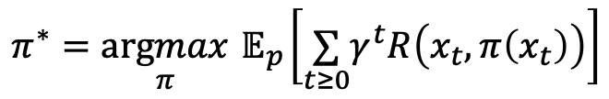





Recap: Markov Decision Process
State:
$$x∈𝒳$$
Action:
$$u∈𝒰$$
Typically represented as a tuple
Transition function / Dynamics: $T\left(x_{t}∣x_{t−1},u_{t−1}\right)=p\left(x_{t}∣x_{t−1},u_{t−1}\right)$
$$ℳ=(𝒳,𝒰,T,R,γ)$$
Reward function:
$$r_{t}=R(x_{t},u_{t}):𝒳×𝒰→ℝ$$
Discount factor:
$$γ∈(0,1)$$
Goal: choose a policy that maximizes cumulative (discounted) reward
$$π^{∗}=\underset{π}{argmax}{ 𝔼}_{p}\left[\underset{t≥0}{∑}γ^{t}R\left(x_{t},π\left(x_{t}\right)\right)\right]$$

Slide 5
Recap: Value Functions and Bellman Equations
The optimal value function satisfies Bellman’s equation:
Bellman Optimality Equation
For any stationary policy 𝜋, the values are the unique solution to the equation
Bellman Expectation Equation

Slide 6
Recap: Value Functions and Bellman Equations
The optimal state-action value function (Q function) $Q^{∗}(x,u)$ satisfies Bellman’s equation:
$$Q^{∗}(x_{t},u_{t})=R(x_{t},u_{t})+γ\underset{x_{t+1}∈X}{∑}T\left(x_{t+1}∣x_{t},u_{t}\right)\max_{u_{t+1}}Q^{∗}\left(x_{t+1},u_{t+1}\right)$$
Bellman Optimality Equation
For any stationary policy 𝜋, the corresponding Q function satisfies
$$Q_{π}(x_{t},u_{t})=R(x_{t},u_{t})+γ\underset{x_{t+1}∈X}{∑}T\left(x_{t+1}∣x_{t},u_{t}\right)Q_{π}\left(x_{t+1},π\left(x_{t+1}\right)\right)$$
Bellman Expectation Equation

Slide 7
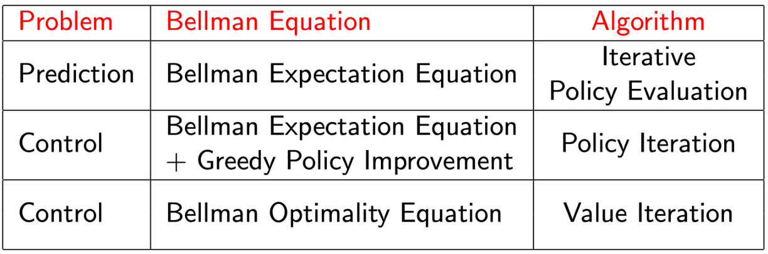
Solving MDPs
In previous lectures, we resorted to exact methods

Slide 8
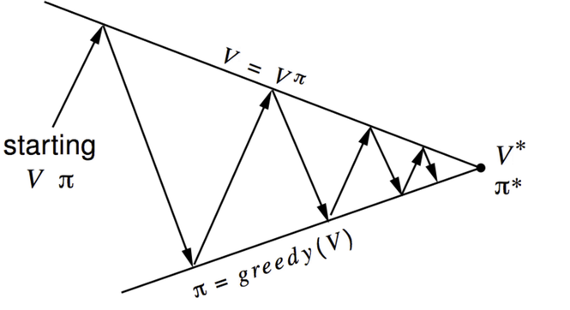
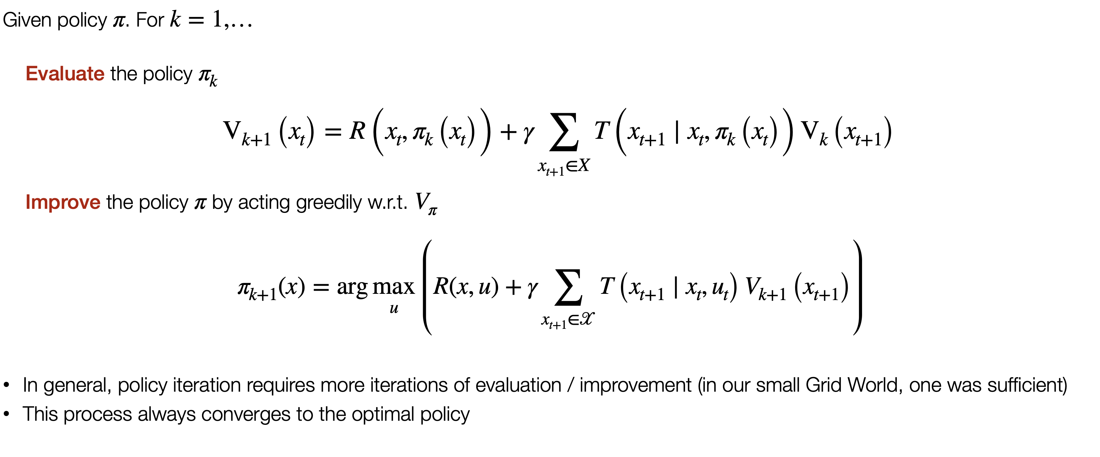
(Another look at) Policy Iteration

Slide 9
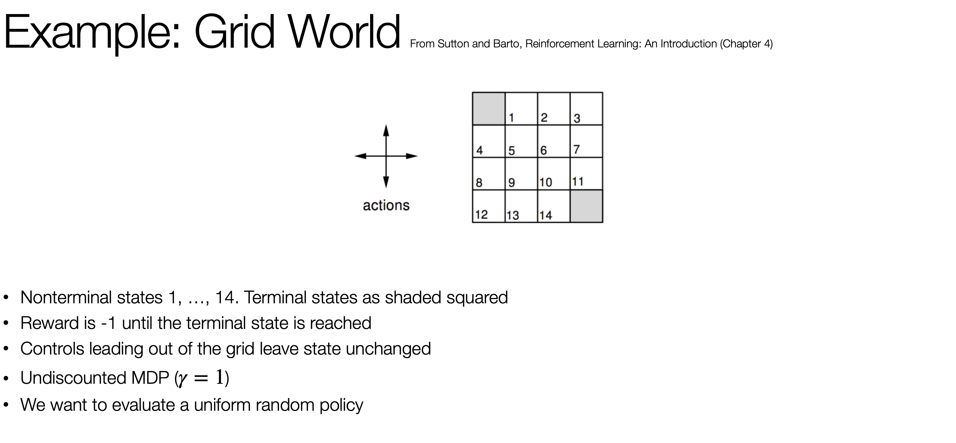

Slide 10
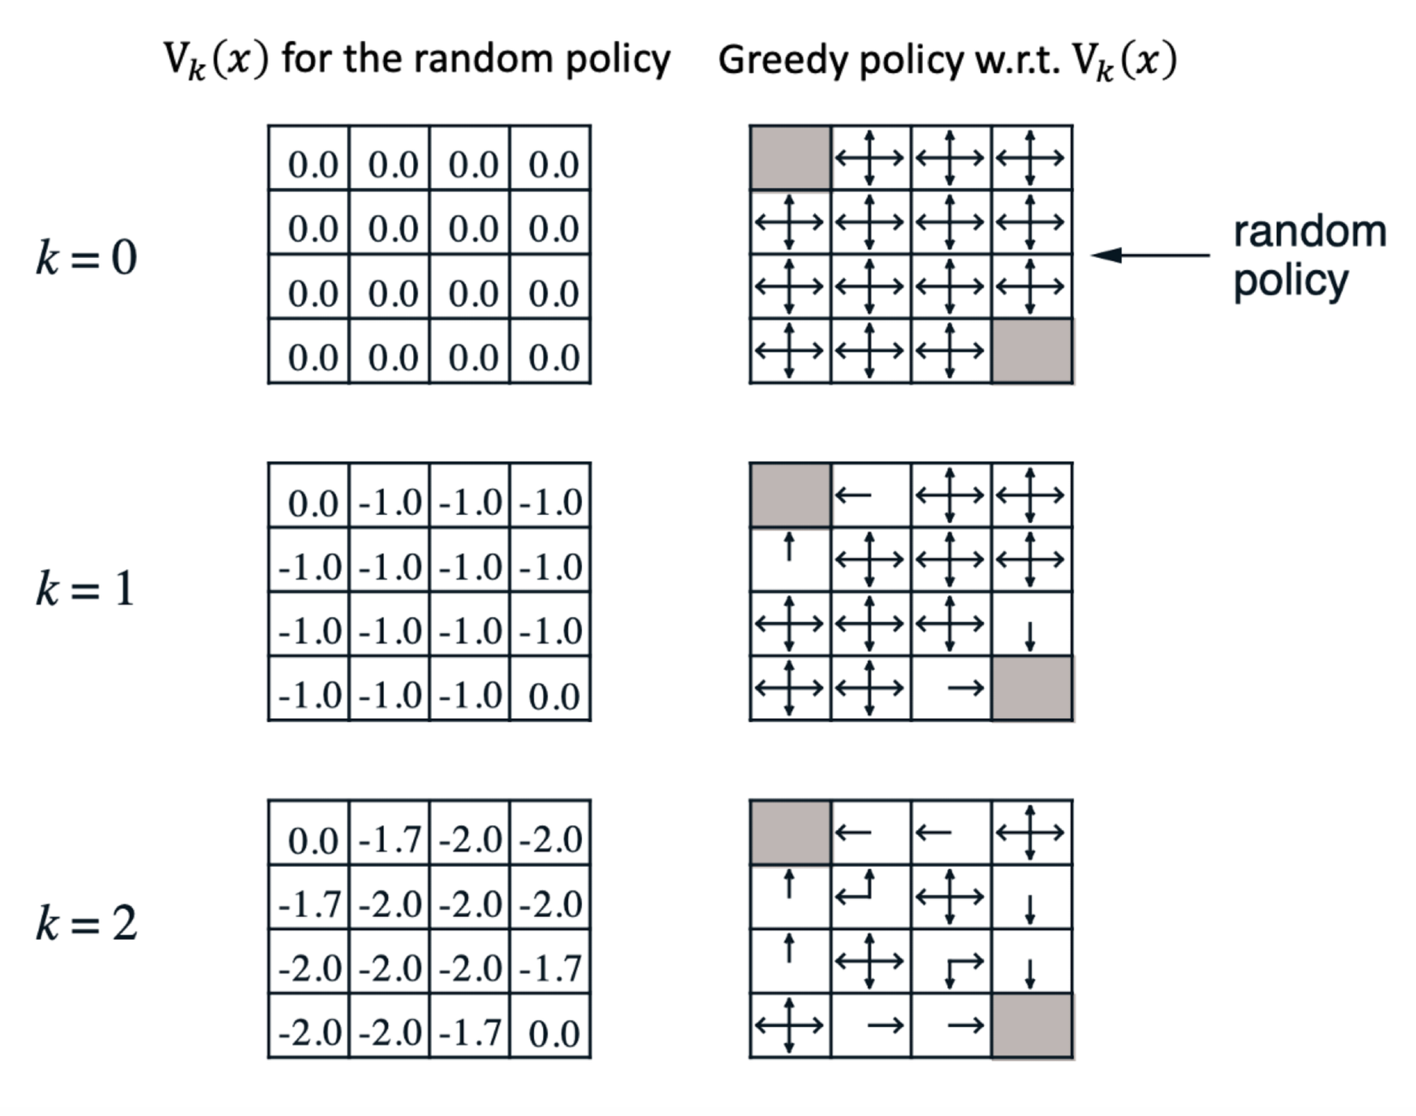

Slide 11
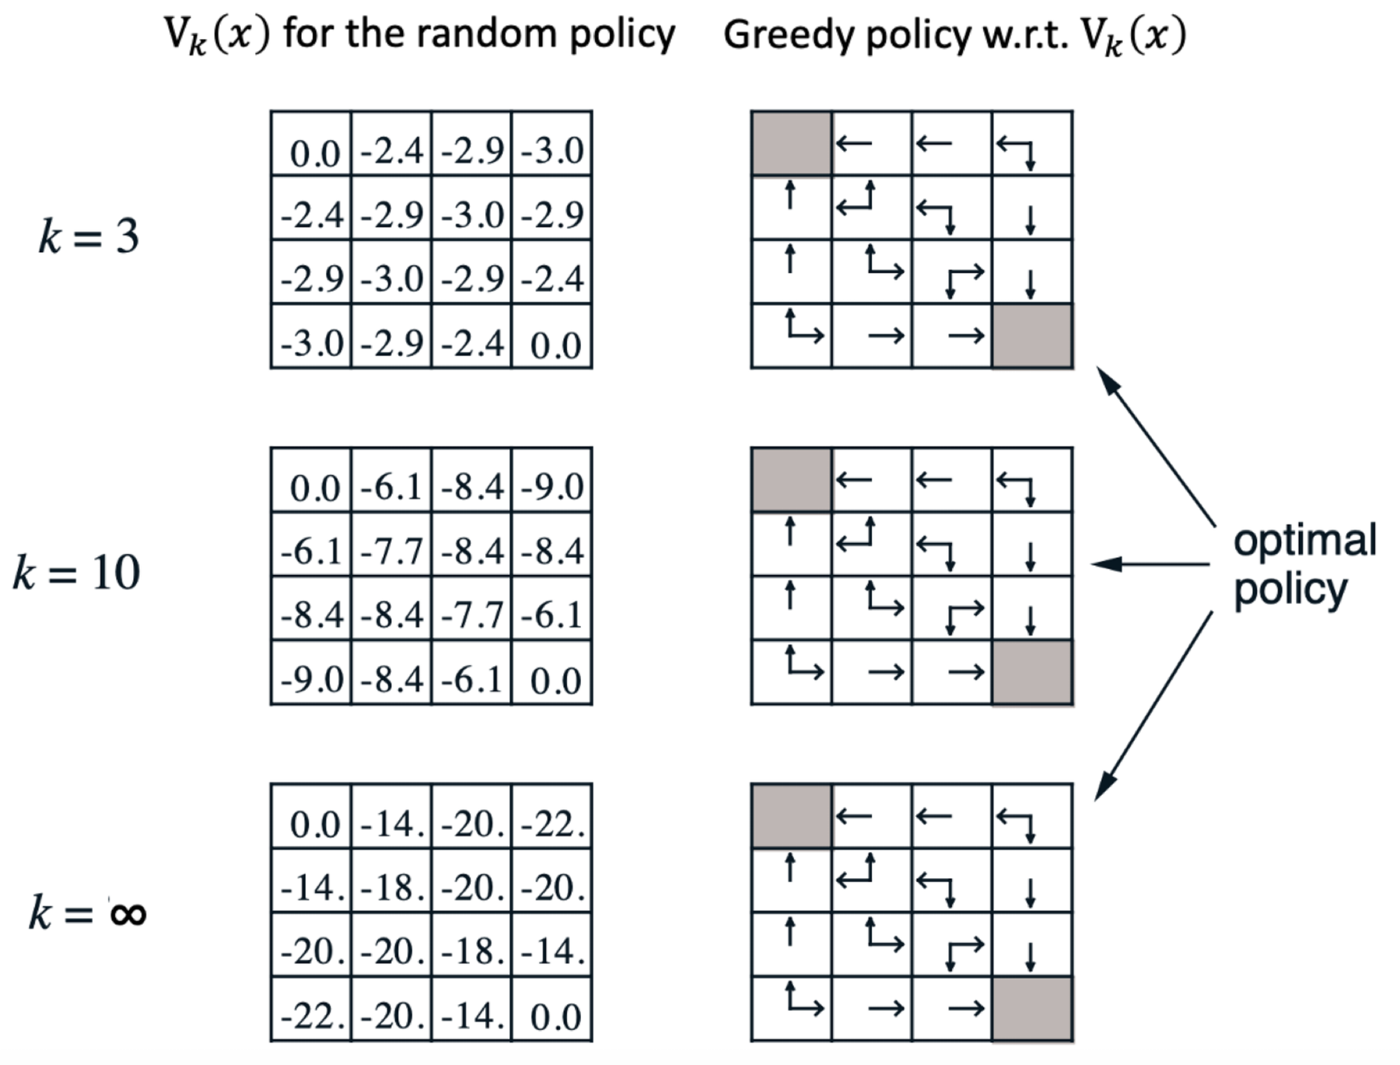

Slide 14
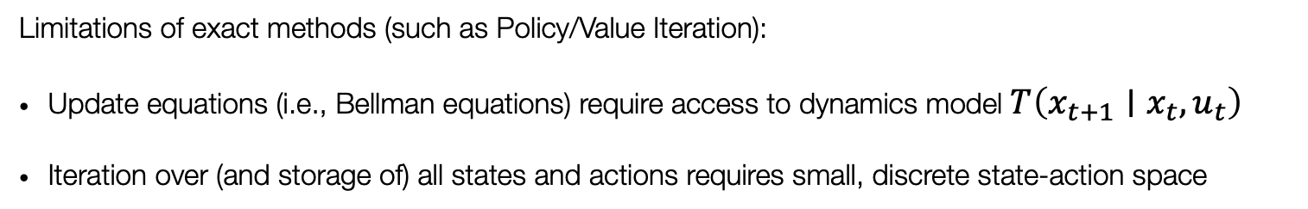
Solving MDPs
In previous lectures, we resorted to exact methods
All of these formulations require a model of the MDP!
To solve unknown MDPs, we’ll use interactions with the environment
Limitations of exact methods (such as Policy/Value Iteration):
Update equations (i.e., Bellman equations) require access to dynamics model $T\left(x_{t+1}∣x_{t},u_{t}\right)$
Iteration over (and storage of) all states and actions requires small, discrete state-action space
Sampling-based approximations
Function approximation

Slide 15
Outline
Recap: The RL problem and exact methods (based on dynamic programming)
From exact methods to model-free control
Monte Carlo Learning
Temporal-Difference (TD) Learning
The skeleton of an RL algorithm

Slide 16
Monte Carlo Reinforcement Learning
MC methods learn directly from episodes of experience
MC is model-free: no knowledge of MDP transitions / rewards
MC uses the simplest possible idea: value = mean return
Recall that the return is the total discounted reward:
Caveat: can only apply MC to episodic MDPs
All episodes must terminate
$$G_{t}=R_{t+1}+γR_{t+2}+…+γ^{T−1}R_{T}$$

Slide 17


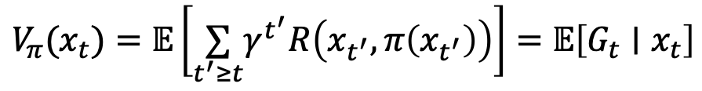
Monte Carlo Policy Evaluation
Let’s consider Monte Carlo methods for learning the state-value function $V_{π}(x)$ from episodes of experience under policy $π$
Recall that the value function is the expected return
Monte-Carlo policy evaluation uses empirical mean return instead of expected return
$$G_{t}=R_{t+1}+γR_{t+2}+…+γ^{T−1}R_{T}$$
$$V_{π}(x_{t})=𝔼\left[\underset{t^{′}≥t}{∑}γ^{t^{′}}R\left(x_{t^{′}},π\left(x_{t^{′}}\right)\right)\right]=𝔼\left[G_{t}∣x_{t}\right]$$

Slide 18
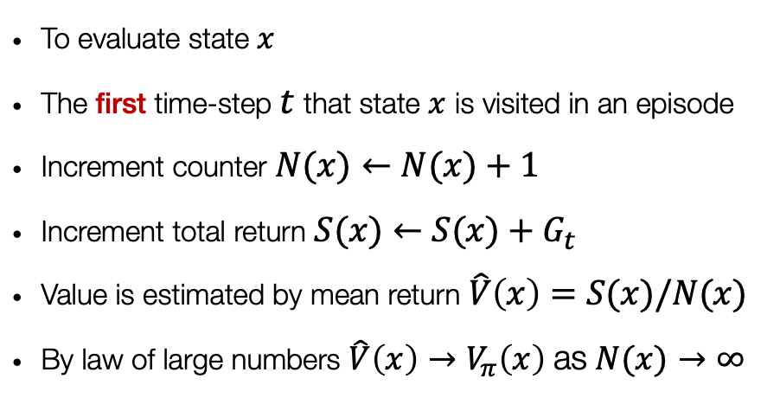
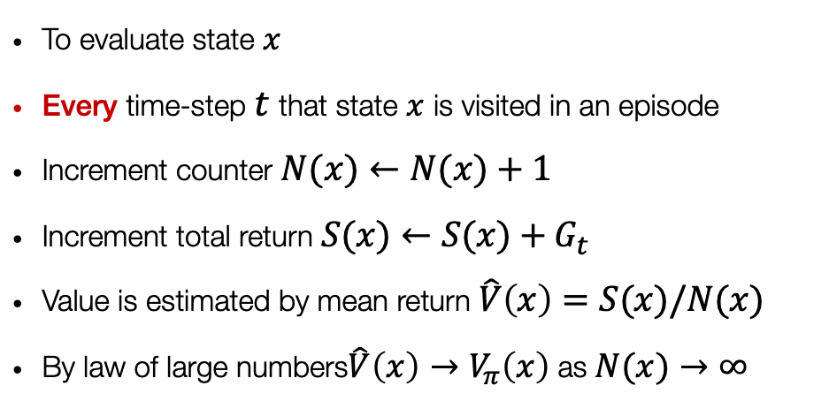
Monte Carlo Policy Evaluation
First-visit
Every-visit
To evaluate state $x$
The first time-step $t$ that state $x$ is visited in an episode
Increment counter $N(x)←N(x)+1$
Increment total return $S(x)←S(x)+G_{t}$
Value is estimated by mean return $\hat{V}\left(x\right)=S(x)/N(x)$
By law of large numbers $\hat{V}\left(x\right)→V_{π}\left(x\right)$ as $N(x)→∞$
To evaluate state $x$
Every time-step $t$ that state $x$ is visited in an episode
Increment counter $N(x)←N(x)+1$
Increment total return $S(x)←S(x)+G_{t}$
Value is estimated by mean return$\hat{V}\left(x\right)=S(x)/N(x)$
By law of large numbers$\hat{V}\left(x\right)→V_{π}\left(x\right)$ as $N(x)→∞$

Slide 19
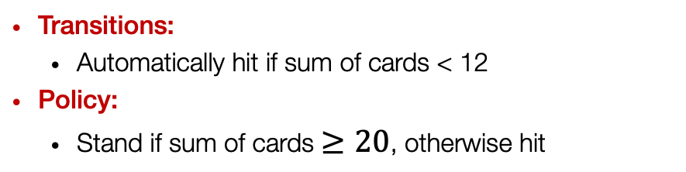
Example: Blackjack
States (200 possible states):
Current sum (12-21)
Dealer’s showing card (ace-10)
Do I have a ‘usable’ ace (yes-no)
Actions:
Stand: stop receiving cards (and terminate)
Hit: take another card (no replacement)
Reward:
For stand:
+1 if sum of cards > sum of dealer cards
0 if sum of cards = sum of dealer cards
-1 if sum of cards < sum of dealer cards
For hit:
-1 if sum of cards > 21 (and terminate)
0 otherwise
Transitions:
Automatically hit if sum of cards < 12
Policy:
Stand if sum of cards $≥20$, otherwise hit

Slide 20
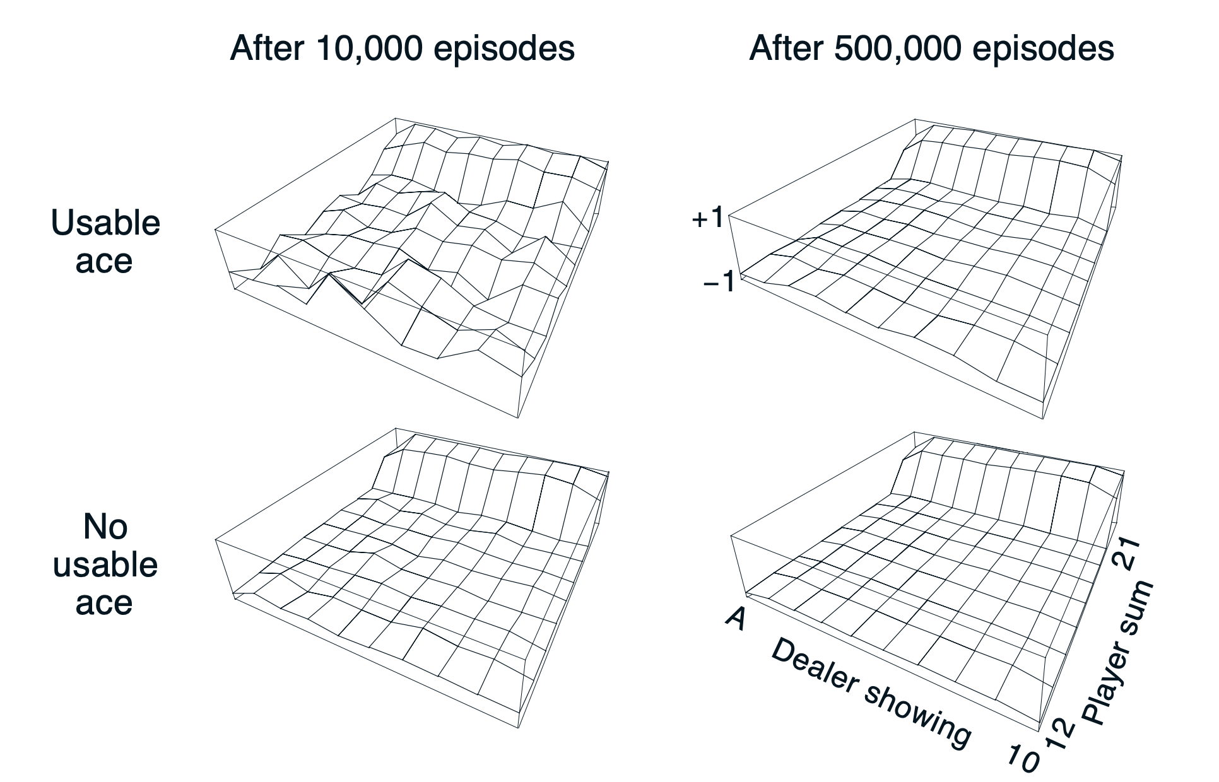
Example: Blackjack
Questions:
Consider the diagrams on the right
Why does the estimated value function jump up for the last two rows in the rear?
Why does it drop off for the whole last row on the left?

Slide 21
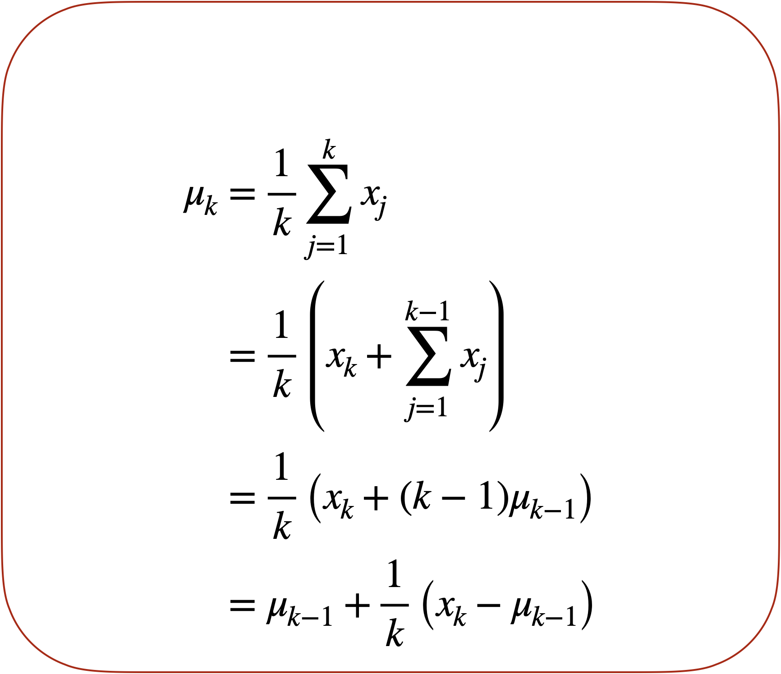
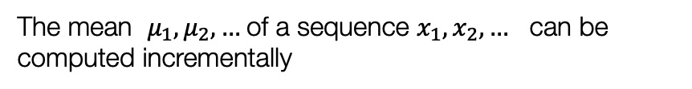
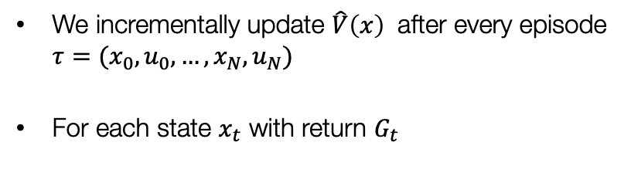
Incremental updates
We incrementally update $\hat{V}\left(x\right)$ after every episode $τ=(x_{0},u_{0},…,x_{N},u_{N})$
For each state $x_{t}$ with return $G_{t}$
The mean $μ_{1},μ_{2}, …$of a sequence $x_{1},x_{2}, …$ can be computed incrementally
In non-stationary problems, it is often useful to track a running mean to forget old (and ultimately less relevant) episodes

Slide 22
Outline
Recap: The RL problem and exact methods (based on dynamic programming)
From exact methods to model-free control
Monte Carlo Learning
Temporal-Difference (TD) Learning
The skeleton of an RL algorithm

Slide 23
Temporal-Difference Learning
TD is a combination of Monte Carlo and Dynamic Programming ideas
Like MC, TD is model-free: no knowledge of MDP transitions / rewards. TD can learn from experience
Like DP, TD methods update estimates based in part on other learned estimates, without waiting for a final outcome (they bootstrap)
TD updates a guess towards a guess

Slide 24

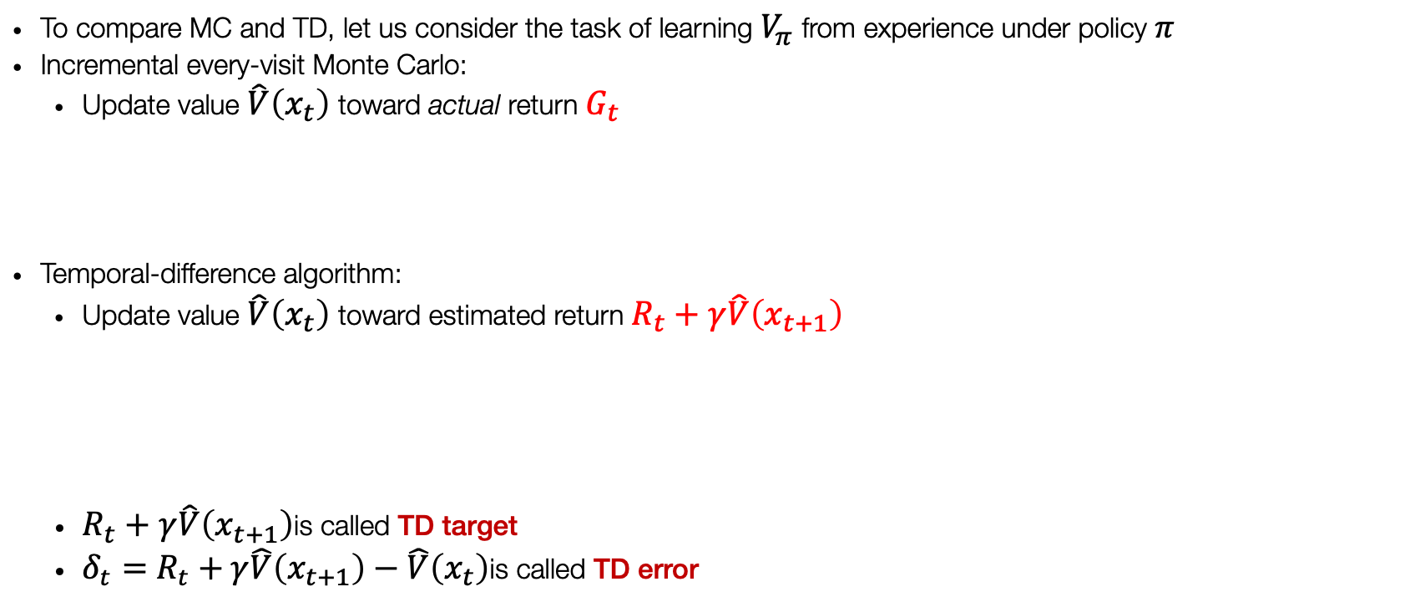
Temporal-Difference Learning
To compare MC and TD, let us consider the task of learning $V_{π}$ from experience under policy $π$
Incremental every-visit Monte Carlo:
Update value $\hat{V}\left(x_{t}\right)$toward actual return $G_{t}$
Temporal-difference algorithm:
Update value $\hat{V}\left(x_{t}\right)$toward estimated return $R_{t}+γ\hat{V}\left(x_{t+1}\right)$
$R_{t}+γ\hat{V}\left(x_{t+1}\right)$is called TD target
$δ_{t}=R_{t}+γ\hat{V}\left(x_{t+1}\right)−\hat{V}\left(x_{t}\right)$is called TD error
$$\hat{V}\left(x_{t}\right)←\hat{V}\left(x_{t}\right)+α\left(G_{t}−\hat{V}\left(x_{t}\right)\right)$$
$$\hat{V}\left(x_{t}\right)←\hat{V}\left(x_{t}\right)+α\left(R_{t}+γ\hat{V}\left(x_{t+1}\right)−\hat{V}\left(x_{t}\right)\right)$$
TD methods combine:
the sampling of Monte Carlo
with the bootstrapping of DP

Slide 25
Advantages and disadvantages of MC vs TD
TD can learn before knowing the final outcome
TD can learn online after every step
MC must wait until the end of the episode
TD can learn without the final outcome
TD can learn from incomplete sequences
MC can only learn from complete sequences
TD works in continuing (non-terminating) environments
MC only works in episodic (terminating) environments

Slide 26
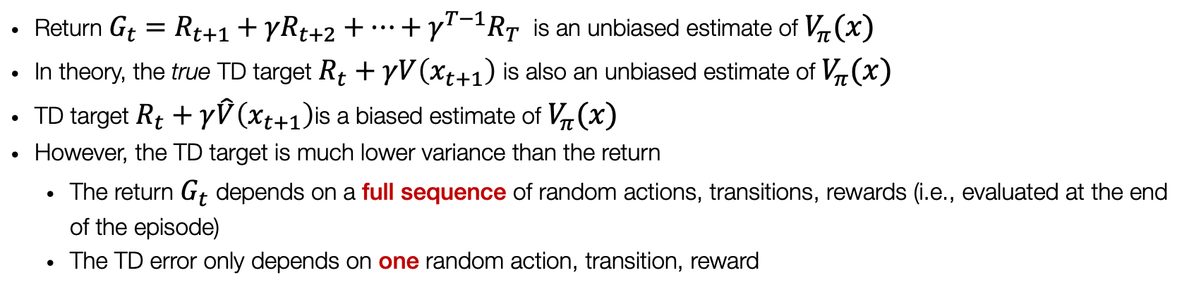
Bias-Variance Trade-off
Return $G_{t}=R_{t+1}+γR_{t+2}+…+γ^{T−1}R_{T}$ is an unbiased estimate of $V_{π}(x)$
In theory, the true TD target $R_{t}+γV\left(x_{t+1}\right)$ is also an unbiased estimate of $V_{π}(x)$
TD target $R_{t}+γ\hat{V}\left(x_{t+1}\right)$is a biased estimate of $V_{π}(x)$
However, the TD target is much lower variance than the return
The return $G_{t}$ depends on a full sequence of random actions, transitions, rewards (i.e., evaluated at the end of the episode)
The TD error only depends on one random action, transition, reward

Slide 27

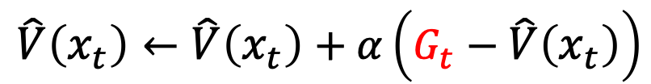



Monte-Carlo Backup
$$\hat{V}\left(x_{t}\right)←\hat{V}\left(x_{t}\right)+α\left(G_{t}−\hat{V}\left(x_{t}\right)\right)$$
$$x_{t}$$
$$u_{t}$$
$$x_{t+1}$$
$$r_{t}$$
Terminal state

Slide 28





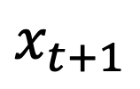
Temporal-Difference Backup
$$\hat{V}\left(x_{t}\right)←\hat{V}\left(x_{t}\right)+α\left(R_{t}+γ\hat{V}\left(x_{t+1}\right)−\hat{V}\left(x_{t}\right)\right)$$
$$x_{t}$$
$$u_{t}$$
$$u_{t}$$
$$x_{t+1}$$
$$x_{t+1}$$
$$r_{t}$$
$$r_{t}$$

Slide 29

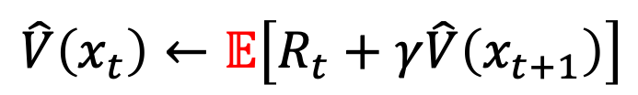
Dynamic Programming Backup
$$\hat{V}\left(x_{t}\right)←𝔼\left[R_{t}+γ\hat{V}\left(x_{t+1}\right)\right]$$
$$x_{t}$$

Slide 30
Bootstrapping and sampling
Sampling: define the update through samples to approximate expectations
MC samples
TD samples
DP does not sample
Bootstrapping: define the update through an estimate
MC does not bootstrap
TD bootstraps
DP bootstraps

Slide 31
A unifying view of RL

Slide 32
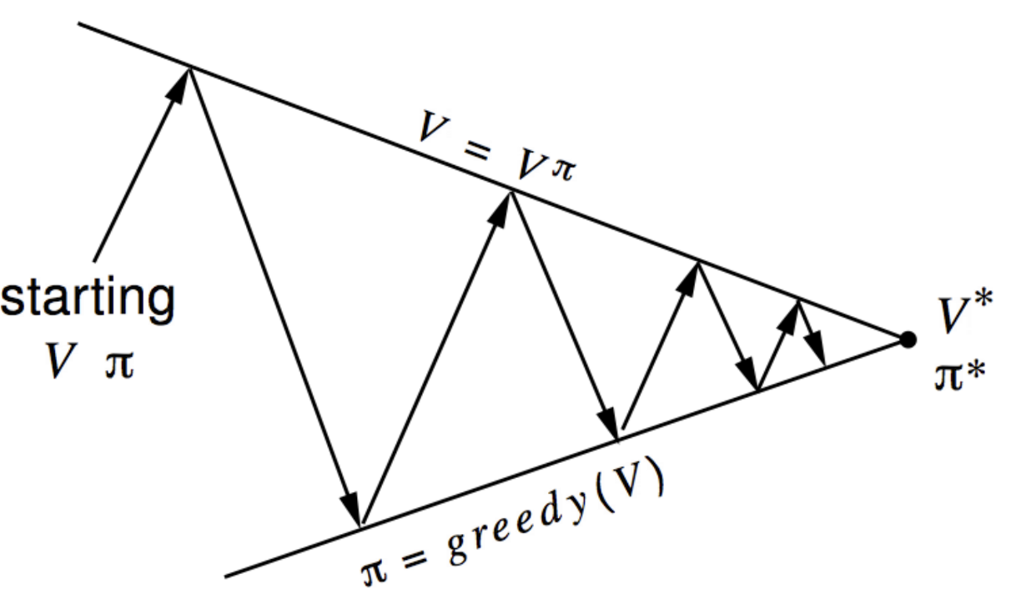
Generalized Policy Iteration
In previous lectures, we discussed Policy Iteration as consisting of two simultaneous, interactive processes: Policy Evaluation and Policy Improvement
We use the term generalized policy iteration (GPI) to refer to the general idea of letting policy-evaluation and policy improvement processes interact, independent of the granularity and other details of the two processes.
Policy Evaluation: Iterative policy evaluation
Policy Improvement: Greedy policy improvement

Slide 33
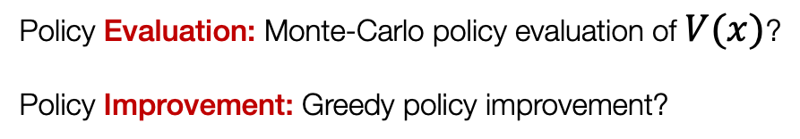

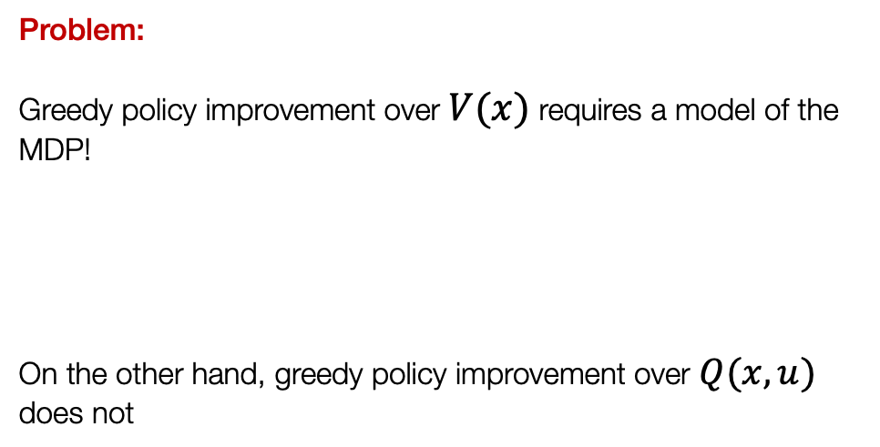
GPI with Monte-Carlo Evaluation
Problem:
Greedy policy improvement over $V(x)$ requires a model of the MDP! On the other hand, greedy policy improvement over $Q(x,u)$ does not
$$π_{k+1}(x)=arg\max_{u}\left(R(x,u)+γ\underset{x_{t+1}∈𝒳}{∑}T\left(x_{t+1}∣x_{t},u_{t}\right)V_{k+1}\left(x_{t+1}\right)\right)$$
Policy Evaluation: Monte-Carlo policy evaluation of $V(x)$?
Policy Improvement: Greedy policy improvement?
$$π_{k+1}(x)=arg\max_{u}Q(x,u)$$

Slide 34
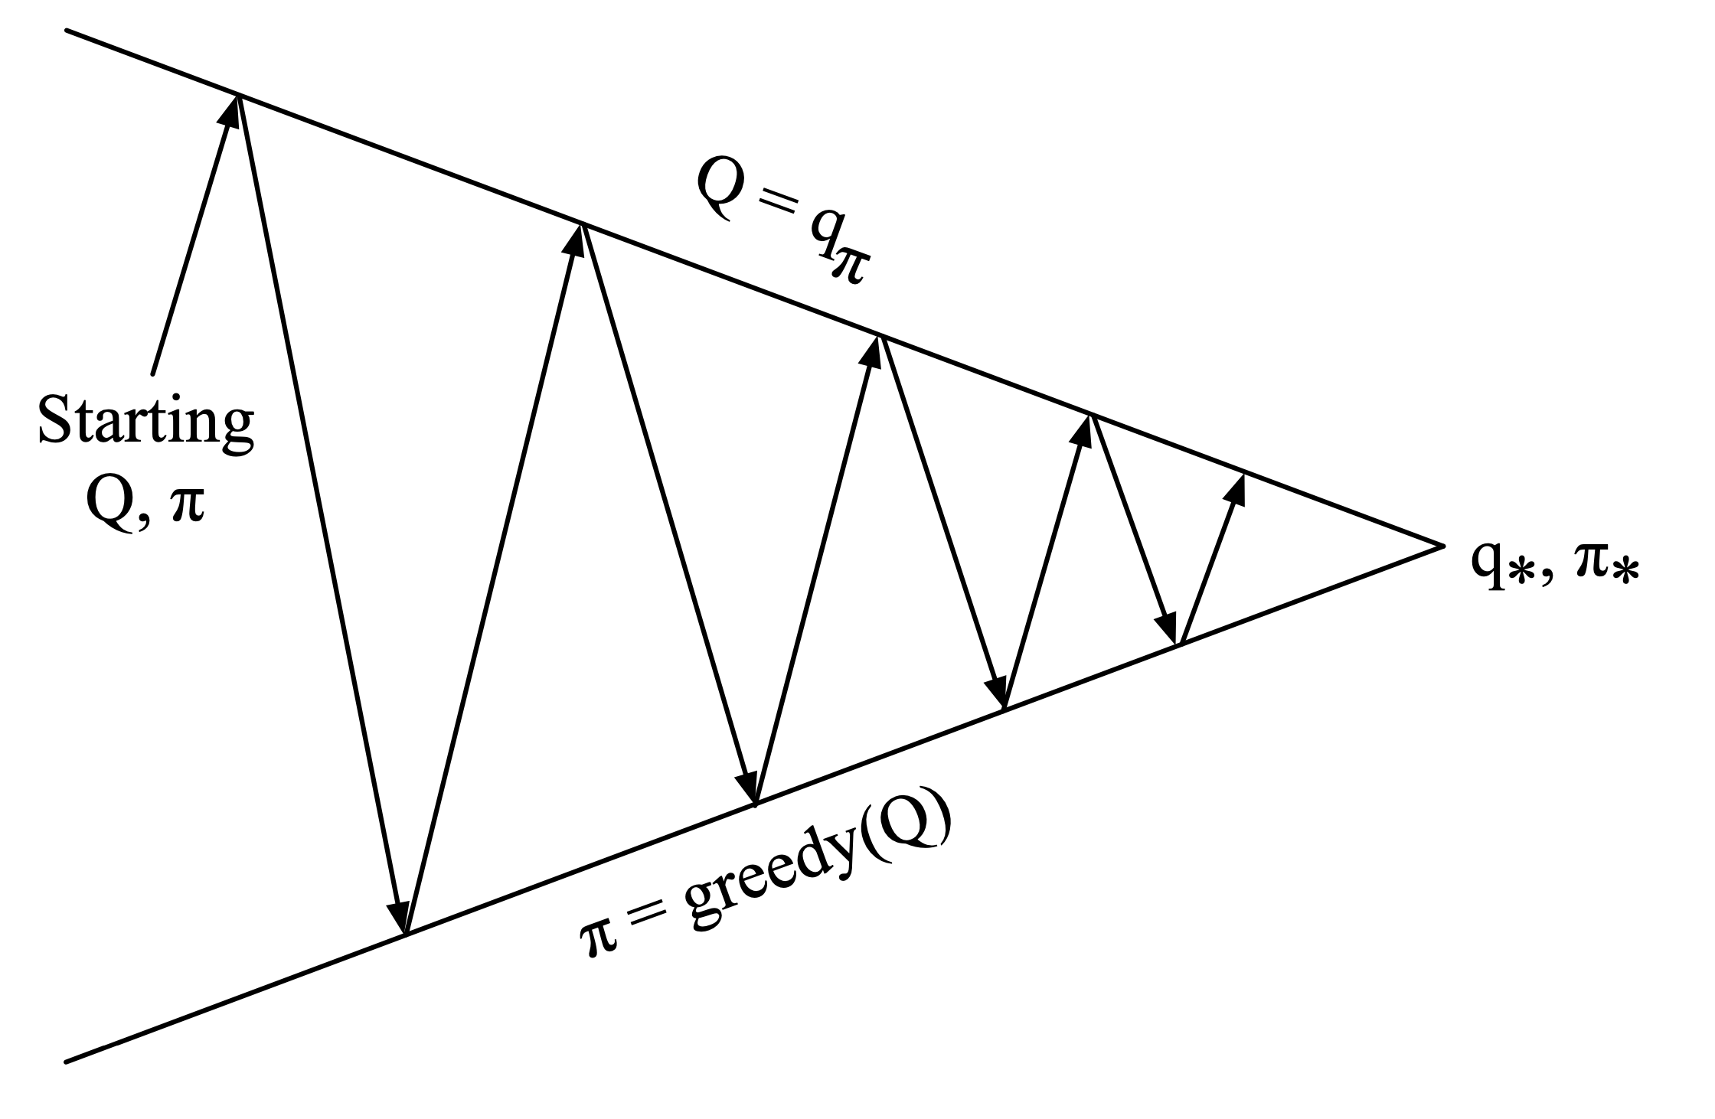
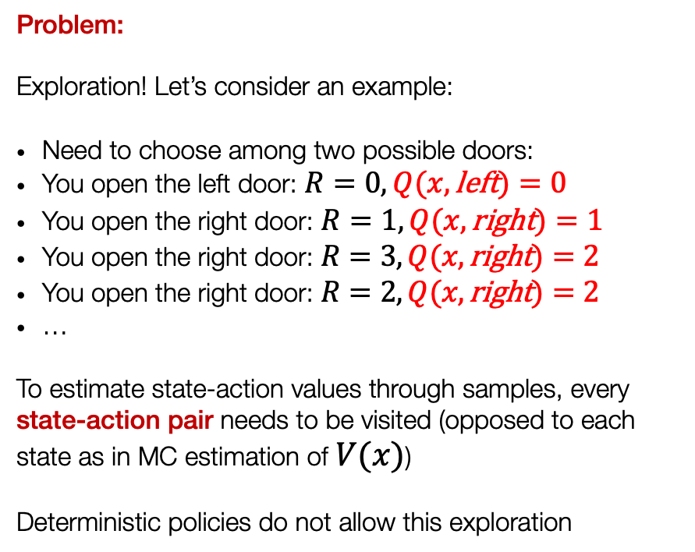

GPI with state-action value function
Problem:
Exploration! Let’s consider an example:
Need to choose among two possible doors:
You open the left door: $R=0,Q(x, \text{left})=0$
You open the right door: $R=1,Q(x, \text{right})=1$
You open the right door: $R=3,Q(x, \text{right})=2$
You open the right door: $R=2,Q(x, \text{right})=2$
…
To estimate state-action values through samples, every state-action pair needs to be visited (opposed to each state as in MC estimation of $V(x)$)
Deterministic policies do not allow this exploration
Policy Evaluation: Monte-Carlo policy evaluation of $Q(x,u)$
Policy Improvement: Greedy policy improvement?

Slide 35
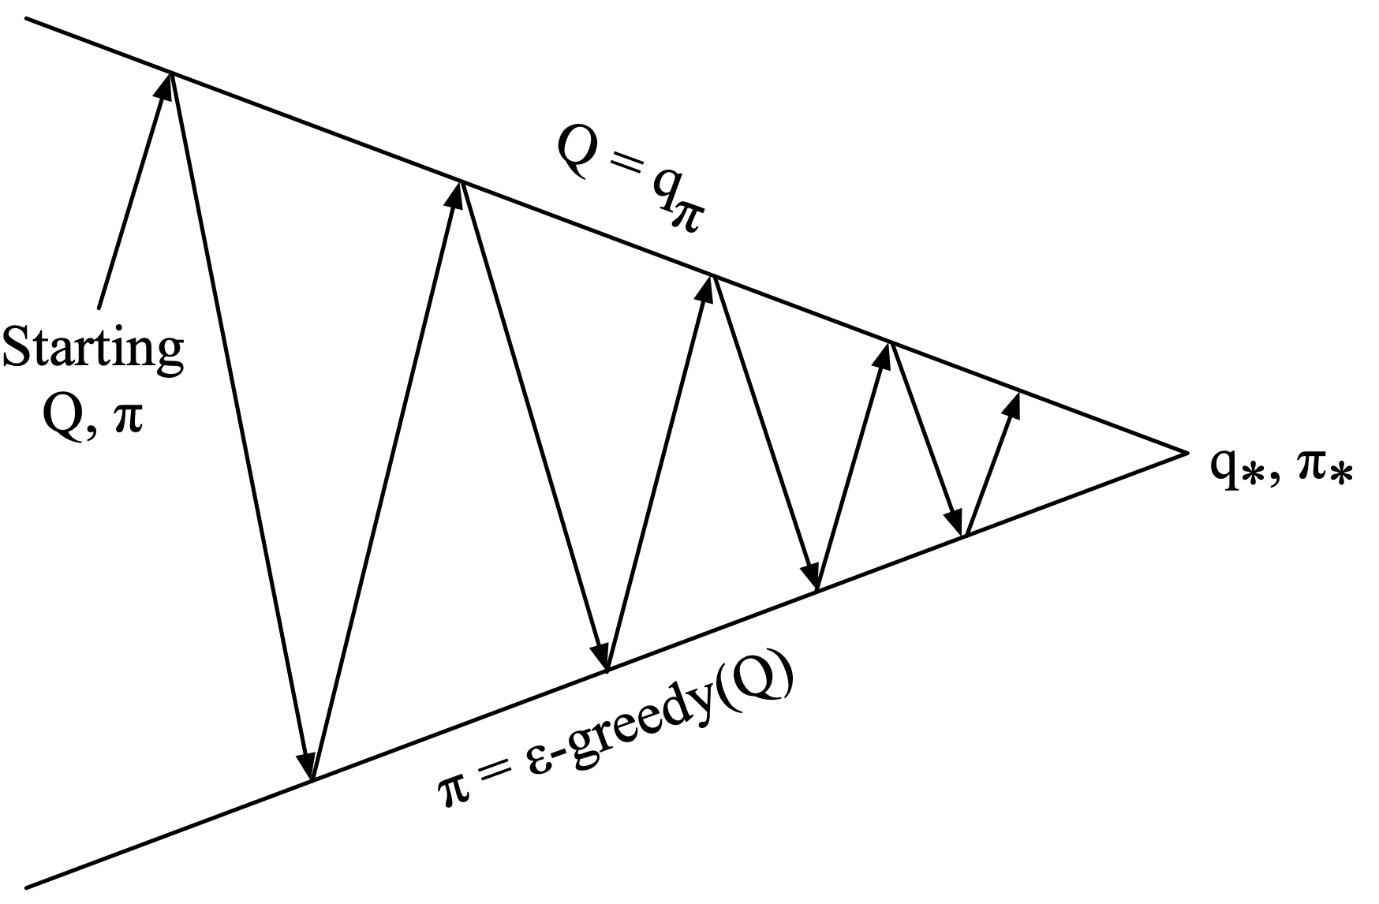
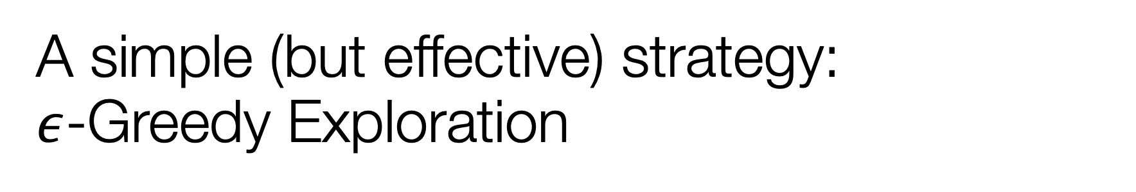
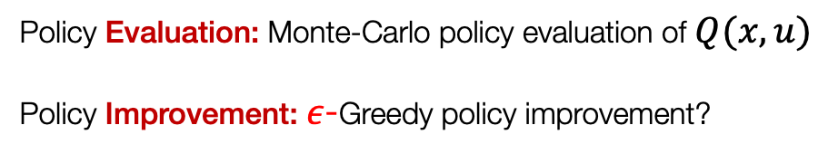
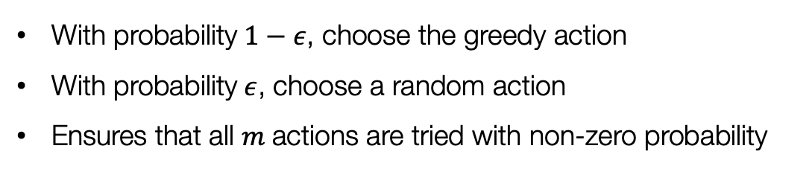
A simple (but effective) strategy: $ε$-Greedy Exploration
With probability $1−ε$, choose the greedy action
With probability $ε$, choose a random action
Ensures that all $m$actions are tried with non-zero probability
Policy Evaluation: Monte-Carlo policy evaluation of $Q(x,u)$
Policy Improvement: $ε$-Greedy policy improvement?

Slide 36
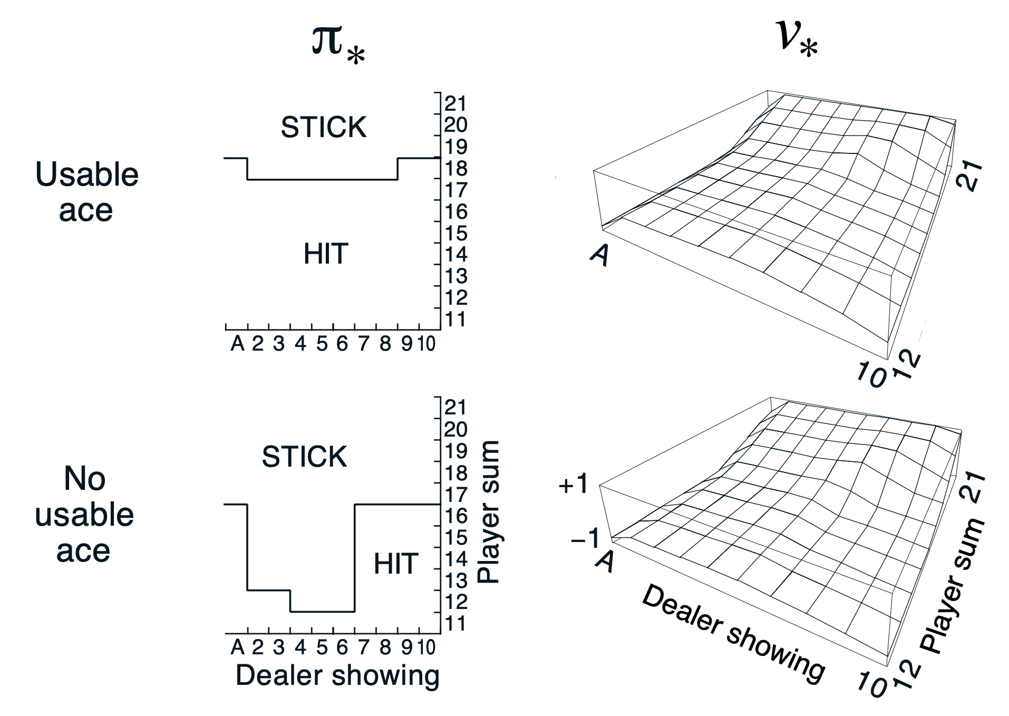
Example: Blackjack

Slide 37
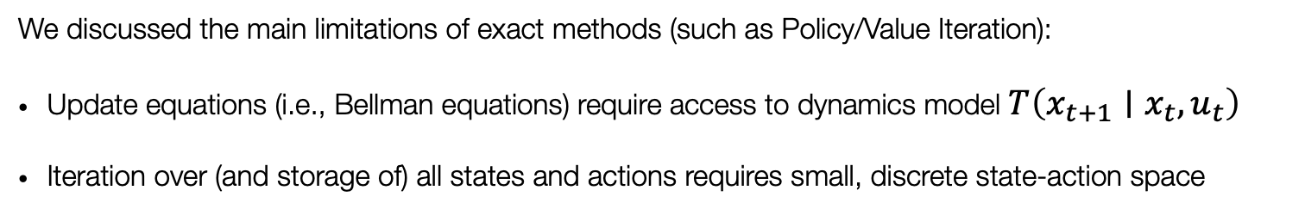
To recap…
We discussed the main limitations of exact methods (such as Policy/Value Iteration):
Update equations (i.e., Bellman equations) require access to dynamics model $T\left(x_{t+1}∣x_{t},u_{t}\right)$
Iteration over (and storage of) all states and actions requires small, discrete state-action space
Sampling-based approximations
Function approximation
We introduced core ideas such as Monte-Carlo and Temporal-Difference Learning and derived ways to solve unknown MDPs
However, we did not discuss methods to deal with high-dimensional state/action spaces… more on this later!

Slide 38
Outline
Recap: The RL problem
From exact methods to model-free control
Monte Carlo Learning
Temporal-Difference (TD) Learning
The skeleton of an RL algorithm

Slide 39


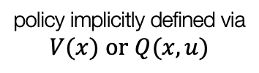

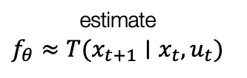
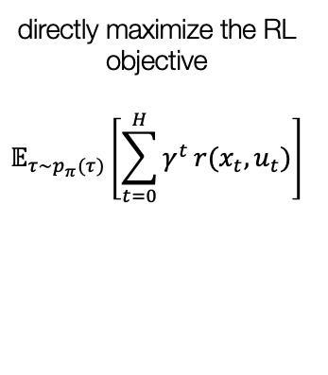

A taxonomy of RL
RL Algorithms
do not use dynamics $T(x_{t+1}|x_{t},u_{t})$
Model-free
Model-based
use dynamics $T(x_{t+1}|x_{t},u_{t})$
Policy optimization
Value-based
Learn the model
Given the model
directly maximize the RL objective
$$𝔼_{τ∼p_{π}(τ)}​\left[\sum_{t=0}^{H}{γ^{t}}r(x_{t},u_{t})\right]$$
policy implicitly defined via
$$V(x) \text{or} Q(x,u)$$
estimate
$$f_{θ}≈T(x_{t+1}∣x_{t},u_{t})$$
$T(x_{t+1}|x_{t},u_{t})$ is known
$$\text{set} π(x_{t})={\text{argmax}}_{u}Q(x_{t},u_{t})$$

Slide 40
The skeleton of an RL algorithm
Adapted from CS 185/285

Slide 41


The skeleton of an RL algorithm
Adapted from CS 185/285
$$π(u_{t}|x_{t})$$
Generate samples
$$τ=(x_{0},u_{0},…,x_{N},u_{N})$$

Slide 42
The skeleton of an RL algorithm
Adapted from CS 185/285
Fit a model / estimate return
$$π(u_{t}|x_{t})$$
Generate samples
$$τ=(x_{0},u_{0},…,x_{N},u_{N})$$

Slide 43
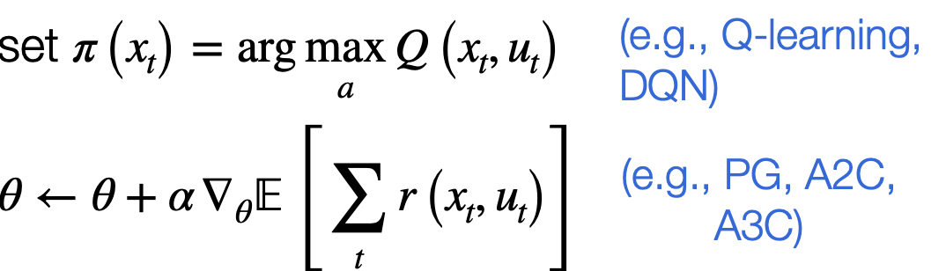
The skeleton of an RL algorithm
Adapted from CS 185/285
Fit a model / estimate return
$$π(u_{t}|x_{t})$$
Generate samples
$$τ=(x_{0},u_{0},…,x_{N},u_{N})$$
Improve the policy

Slide 44
Next time
Value-based RL

