Slide 1
AA203 Optimal and Learning-based Control
Model-free Reinforcement Learning: Value-based Methods

Slide 2
Course overview
Imitation Learning
Model-free RL
Control
Adaptive
optimal control
Model-based RL
Feedback control
Adaptive control
Optimal and learning control
Open-loop
MPC
Closed-loop
Indirect methods
Direct
methods
DP
HJB / HJI

Slide 3
References
R. Sutton, and A. Barto, Reinforcement Learning: An Introduction, 2018
RL Course by David Silver, Advanced Topics (COMPM050/COMPGI13)

Slide 4
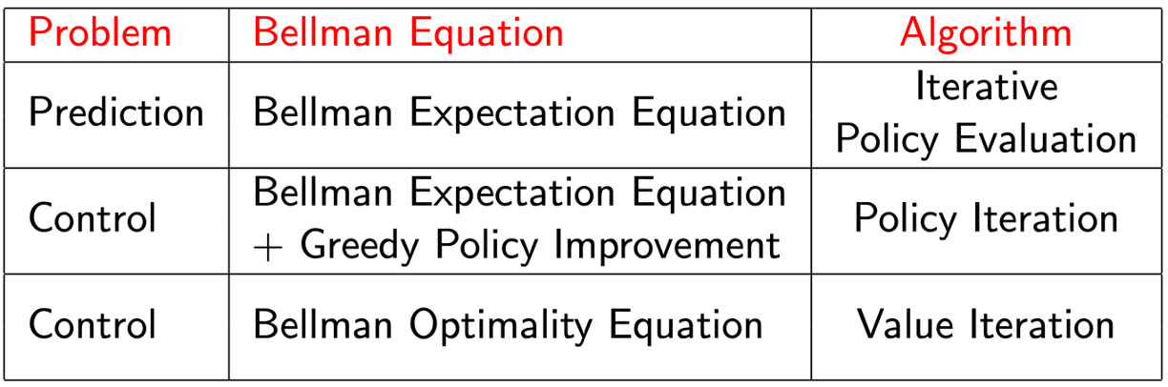




Review
In previous lectures, we made the distinction between prediction (given a policy $π$, estimate $V_{π},Q_{π}$) and control (learn the optimal policy $π^{∗}$)
Motivated by Dynamic Programming, we discussed exact methods for solving MDPs:
Policy Iteration
Value Iteration
Limitation: Update equations (i.e., Bellman equations) require access to dynamics model $T\left(x_{t+1}∣x_{t},u_{t}\right)$
We saw how to use sampling and bootstrapping to approximate the expectations in the update equations:
Monte Carlo (MC) Learning
Temporal-Difference (TD) Learning
take action
$$u_{t}$$
$$x_{t}$$
$$x_{t+1}$$
observe state
$$r_{t+1}$$

Slide 5















For prediction:
Dynamic Programming backup
Monte Carlo backup
$$\hat{V}(x_{t})←𝔼​\left[R_{t}+γ\hat{V}(x_{t+1})\right]$$
$$\hat{V}(x_{t})←\hat{V}(x_{t})+α\left(G_{t}−\hat{V}(x_{t})\right)$$
$$x_{t}$$
$$x_{t}$$
$$u_{t}$$
$$x_{t+1}$$
$$r_{t}$$
Terminal state
Sampling: define the update through samples to approximate expectations
MC samples
TD samples
DP does not sample
Bootstrapping: define the update through an estimate
MC does not bootstrap
TD bootstraps
DP bootstraps
Temporal-Difference backup
$$\hat{V}(x_{t})←\hat{V}(x_{t})+α\left(R_{t}+γ\hat{V}(x_{t+1})−\hat{V}(x_{t})\right)$$
$$x_{t}$$
$$u_{t}$$
$$u_{t}$$
$$r_{t}$$
$$x_{t+1}$$
$$x_{t+1}$$
$$r_{t}$$

Slide 6
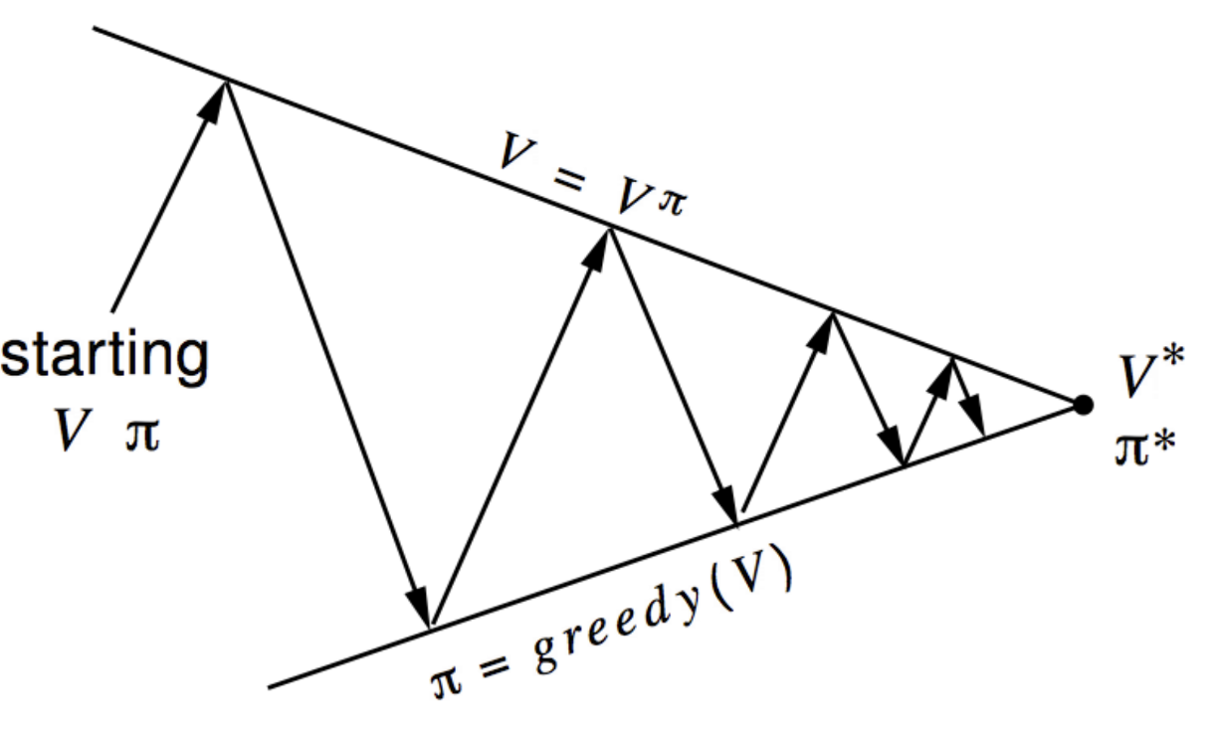
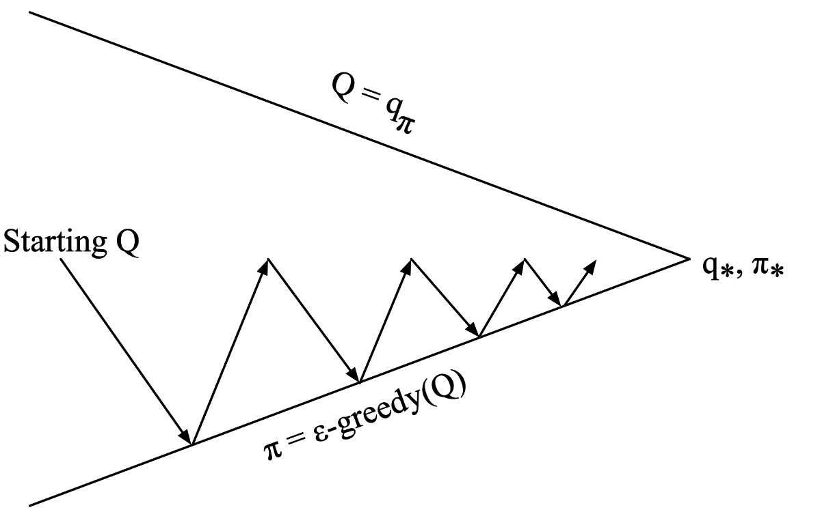
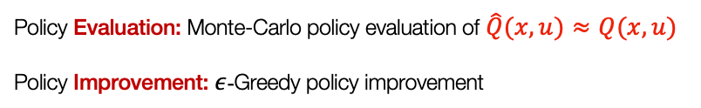
For control:
Generalized Policy Iteration
“Monte-Carlo Control”
Policy Evaluation: Monte-Carlo policy evaluation of $\hat{Q}(x,u)≈Q(x,u)$
Policy Improvement: $ε$-Greedy policy improvement

Slide 7
Outline
Value-based Methods
Tabular methods
On-policy & Off-policy
SARSA
Q-learning
Value function approximation
Deep (Value-based) RL Methods & Applications

Slide 8
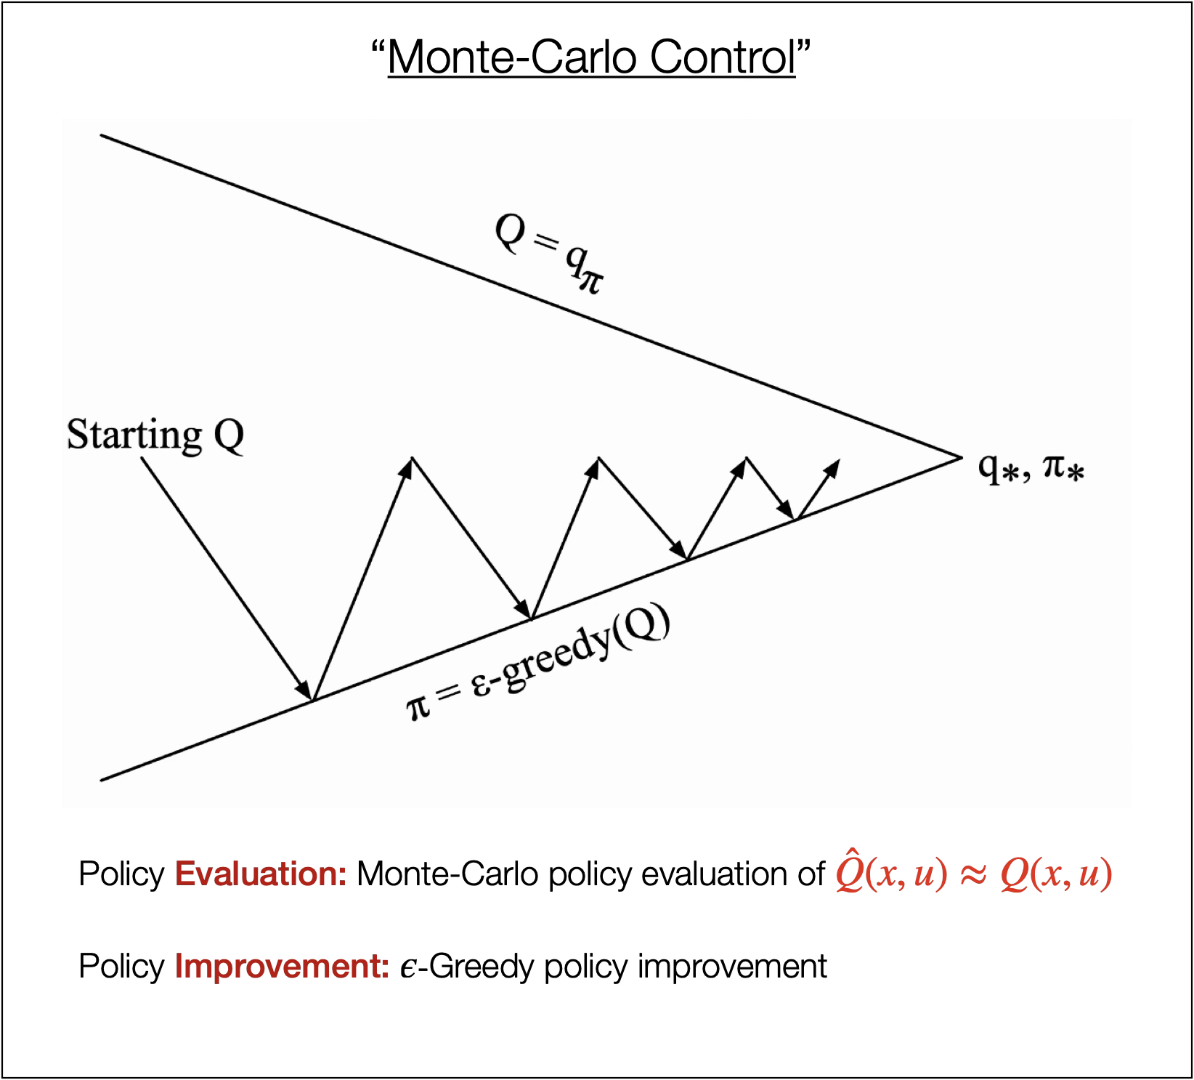
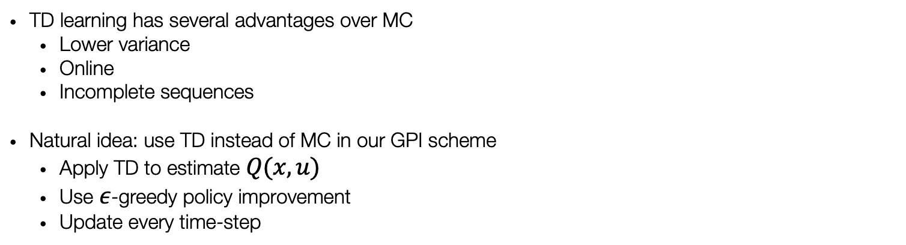
Temporal-Difference Control
TD learning has several advantages over MC
Lower variance
Online
Incomplete sequences
Natural idea: use TD instead of MC in our GPI scheme
Apply TD to estimate $Q(x,u)$
Use $ε$-greedy policy improvement
Update every time-step

Slide 9
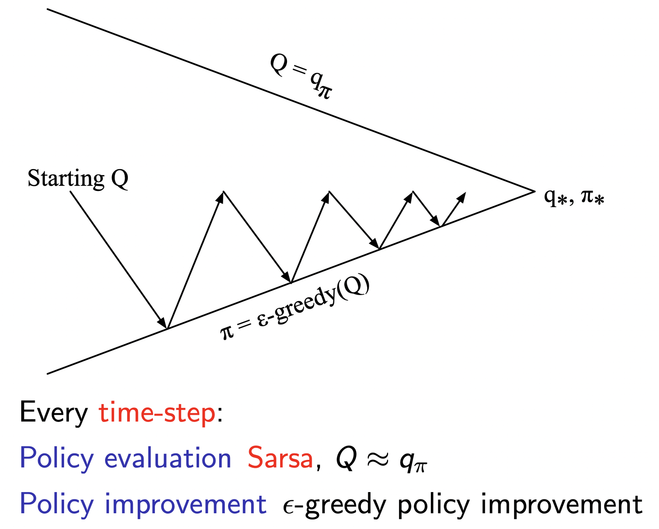
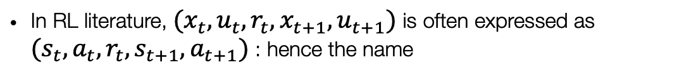

Updating action-value functions with Sarsa
Uses every element of the quintuple of events, $(x_{t},u_{t},r_{t},x_{t+1},u_{t+1})$, that make up a transition from one state–action pair to the next through the following update rule
Temporal-Difference backup
$$Q(x_{t},u_{t})←Q(x_{t},u_{t})+α\left(r_{t}+γQ(x_{t+1},u_{t+1})−Q(x_{t},u_{t})\right)$$
$$\hat{V}(x_{t})←\hat{V}(x_{t})+α\left(R_{t}+γ\hat{V}(x_{t+1})−\hat{V}(x_{t})\right)$$
In RL literature, $(x_{t},u_{t},r_{t},x_{t+1},u_{t+1})$ is often expressed as $(s_{t},a_{t},r_{t},s_{t+1},a_{t+1})$ : hence the name

Slide 10
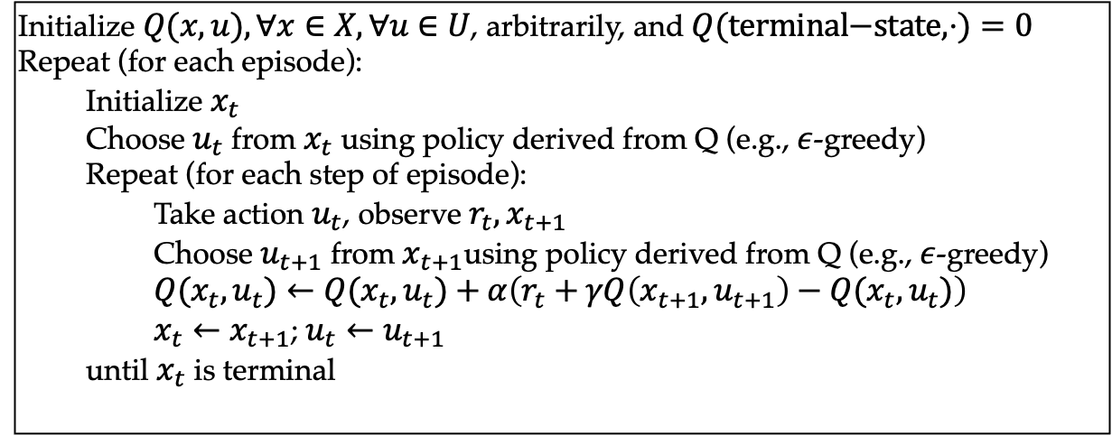
Sarsa algorithm
Initialize $Q(x,u),∀x∈X,∀u∈U$, arbitrarily, and $Q(\text{terminal−state},⋅)=0$
Repeat (for each episode):
Initialize $x_{t}$
Choose $u_{t}$ from $x_{t}$ using policy derived from Q (e.g., $ε$-greedy)
Repeat (for each step of episode):
Take action $u_{t}$, observe $r_{t},x_{t+1}$
Choose $u_{t+1}$ from $x_{t+1}$using policy derived from Q (e.g., $ε$-greedy)
$Q(x_{t},u_{t})←Q(x_{t},u_{t})+α\left(r_{t}+γQ\left(x_{t+1},u_{t+1}\right)−Q(x_{t},u_{t})\right)$
$x_{t}←x_{t+1}$; $u_{t}←u_{t+1}$
until $x_{t}$ is terminal

Slide 11
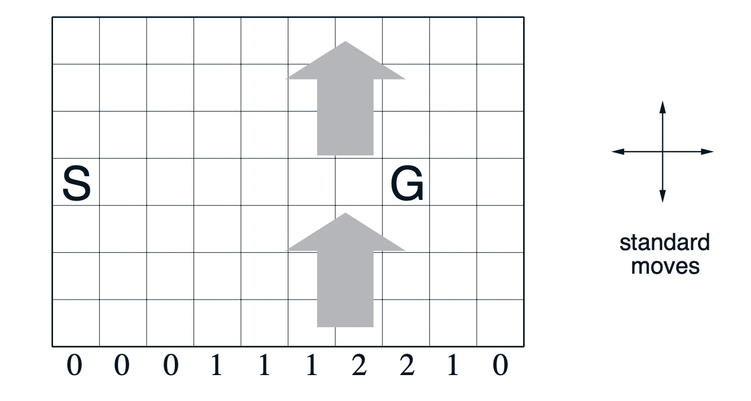
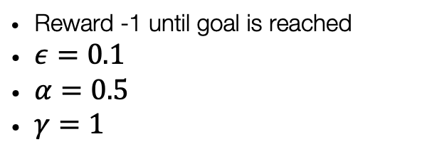
Windy Gridworld example
Reward -1 until goal is reached
$ε=0.1$
$α=0.5$
$γ=1$

Slide 12
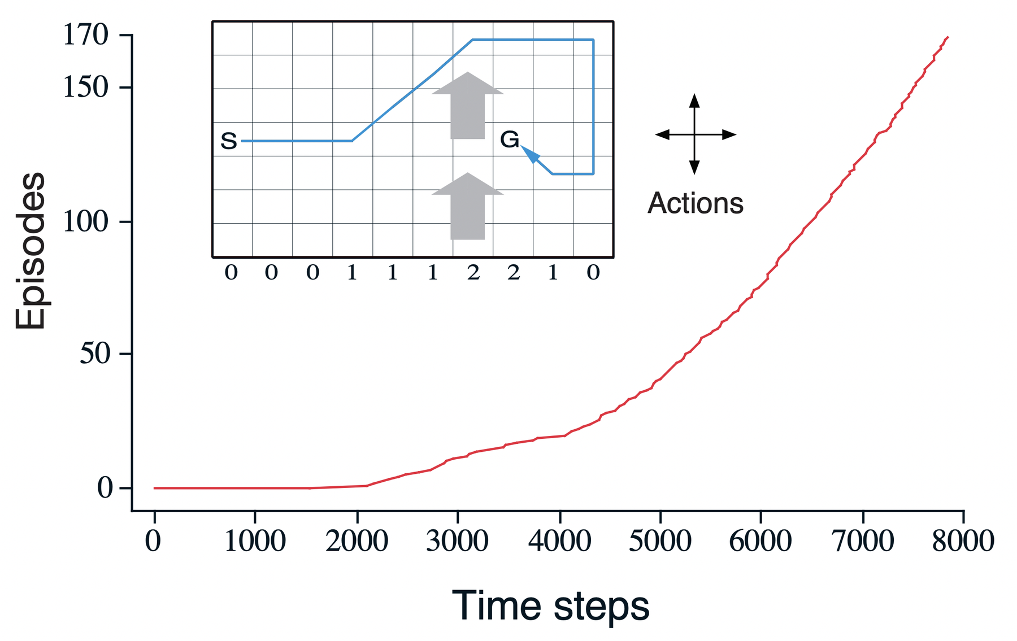
Windy Gridworld example
Question:
Would MC methods easily apply to this problem? And why?
Tip: consider termination criteria

Slide 13
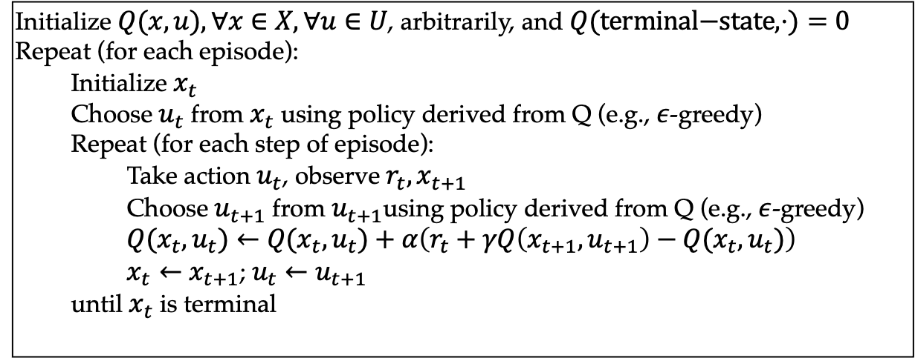
Sarsa algorithm for ?-policy control
On-policy: evaluate or improve the policy that is used to make decisions
Off-policy: evaluate or improve a policy different from that used to generate the data
Initialize $Q(x,u),∀x∈X,∀u∈U$, arbitrarily, and $Q(\text{terminal−state},⋅)=0$
Repeat (for each episode):
Initialize $x_{t}$
Choose $u_{t}$ from $x_{t}$ using policy derived from Q (e.g., $ε$-greedy)
Repeat (for each step of episode):
Take action $u_{t}$, observe $r_{t},x_{t+1}$
Choose $u_{t+1}$ from $u_{t+1}$using policy derived from Q (e.g., $ε$-greedy)
$Q(x_{t},u_{t})←Q(x_{t},u_{t})+α\left(r_{t}+γQ\left(x_{t+1},u_{t+1}\right)−Q(x_{t},u_{t})\right)$
$x_{t}←x_{t+1}$; $u_{t}←u_{t+1}$
until $x_{t}$ is terminal

Slide 14
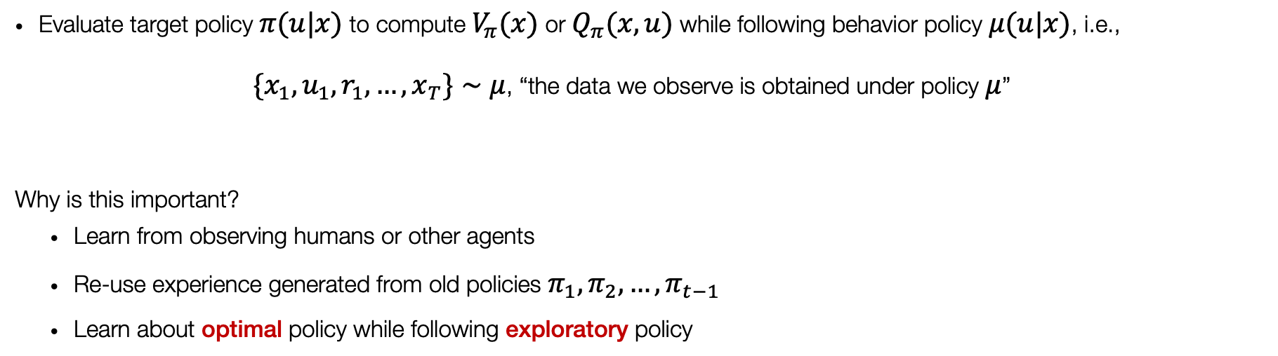
Off-policy learning
Evaluate target policy $π(u|x)$ to compute $V_{π}(x)$ or $Q_{π}(x,u)$ while following behavior policy $μ(u|x)$, i.e.,
$\{x_{1},u_{1},r_{1},…,x_{T}\}∼μ$, “the data we observe is obtained under policy $μ$”
Why is this important?
Learn from observing humans or other agents
Re-use experience generated from old policies $π_{1},π_{2},…,π_{t−1}$
Learn about optimal policy while following exploratory policy

Slide 15
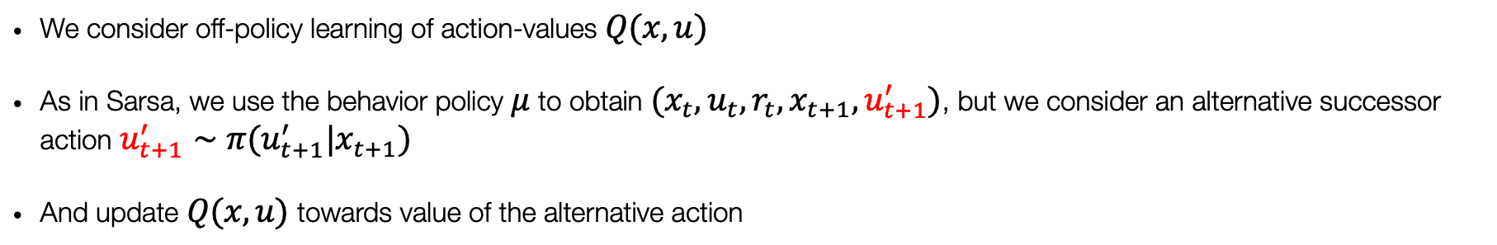
Off-policy learning of action-values
We consider off-policy learning of action-values $Q(x,u)$
As in Sarsa, we use the behavior policy $μ$ to obtain $(x_{t},u_{t},r_{t},x_{t+1},u_{t+1}^{′})$, but we consider an alternative successor action $u_{t+1}^{′}∼π(u_{t+1}^{′}|x_{t+1})$
And update $Q(x,u)$ towards value of the alternative action
$$Q(x_{t},u_{t})←Q(x_{t},u_{t})+α\left(r_{t}+γQ\left(x_{t+1},u_{t+1}^{′}\right)−Q{(x}_{t},u_{t})\right)$$

Slide 16
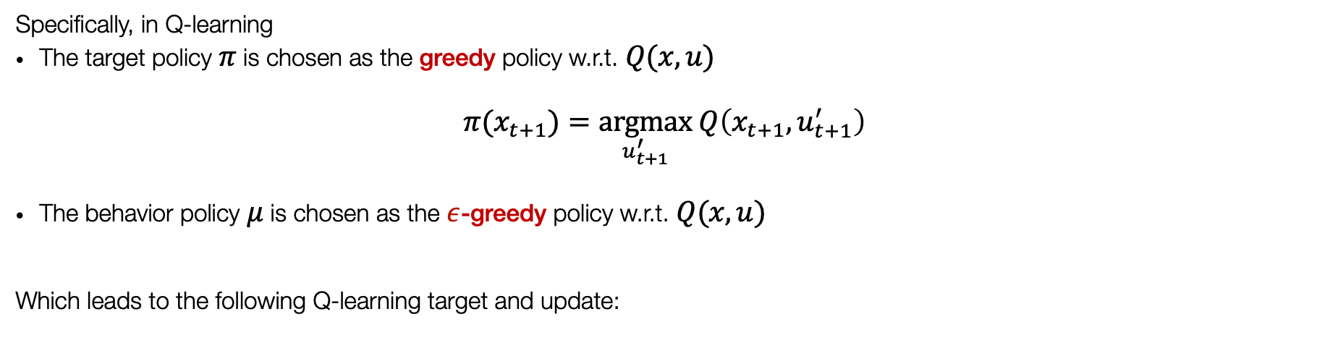
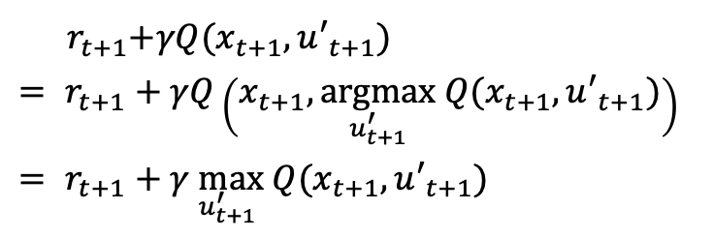
Q-learning
Specifically, in Q-learning
The target policy $π$ is chosen as the greedy policy w.r.t. $Q(x,u)$
$$π(x_{t+1})=\underset{u_{t+1}^{′}}{argmax} Q\left(x_{t+1},u_{t+1}^{′}\right)$$
The behavior policy $μ$ is chosen as the $ε$-greedy policy w.r.t. $Q(x,u)$
Which leads to the following Q-learning target and update:
$${ r}_{t+1}+γQ(x_{t+1},u′_{t+1})$$
$$= r_{t+1}+γQ\left(x_{t+1},\underset{u_{t+1}^{′}}{argmax} Q(x_{t+1},u′_{t+1})\right)$$
$$= r_{t+1}+γ\max_{u_{t+1}^{′}} Q(x_{t+1},u′_{t+1})$$
$$Q(x_{t},u_{t})←Q(x_{t},u_{t})+α\left(r_{t}+γ \max_{u_{t+1}^{′}}Q(x_{t+1},u′_{t+1})−Q(x_{t},u_{t})\right)$$

Slide 17
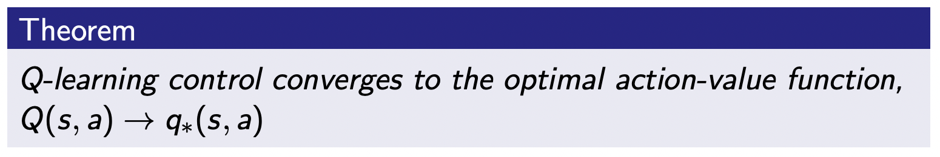
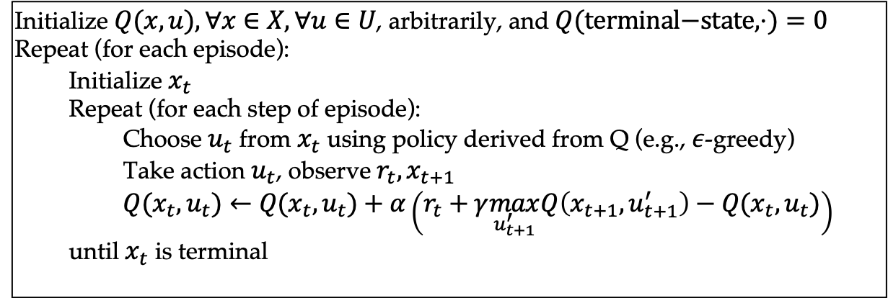
Q-learning algorithm for off-policy control
Initialize $Q(x,u),∀x∈X,∀u∈U$, arbitrarily, and $Q(\text{terminal−state},⋅)=0$
Repeat (for each episode):
Initialize $x_{t}$
Repeat (for each step of episode):
Choose $u_{t}$ from $x_{t}$ using policy derived from Q (e.g., $ε$-greedy)
Take action $u_{t}$, observe $r_{t},x_{t+1}$
$Q(x_{t},u_{t})←Q(x_{t},u_{t})+α\left(r_{t}+γ\max_{u_{t+1}^{′}}Q\left(x_{t+1},u_{t+1}^{′}\right)−Q(x_{t},u_{t})\right)$
until $x_{t}$ is terminal

Slide 18
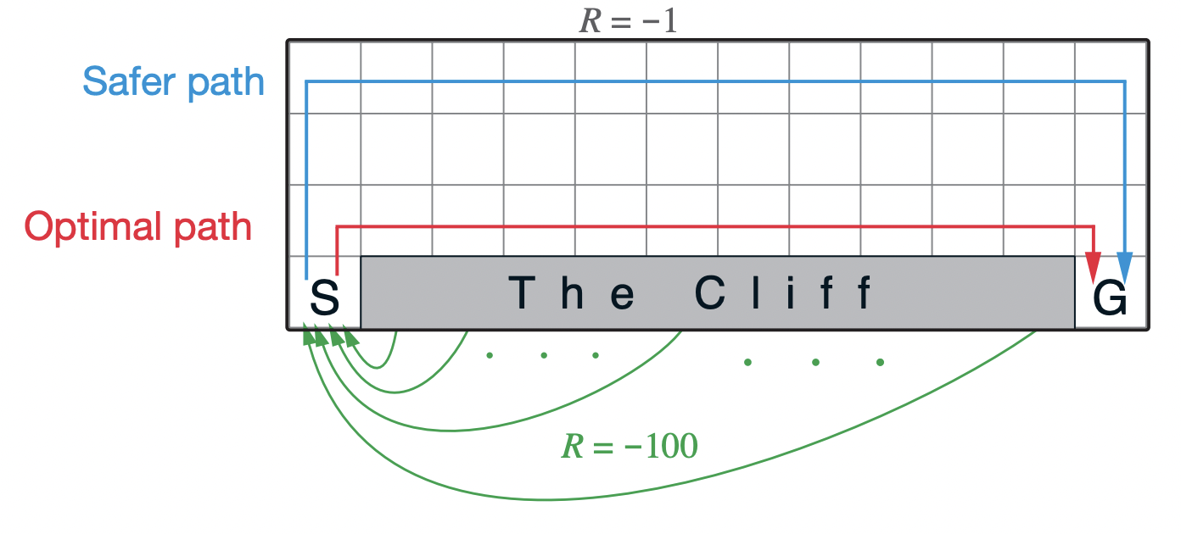
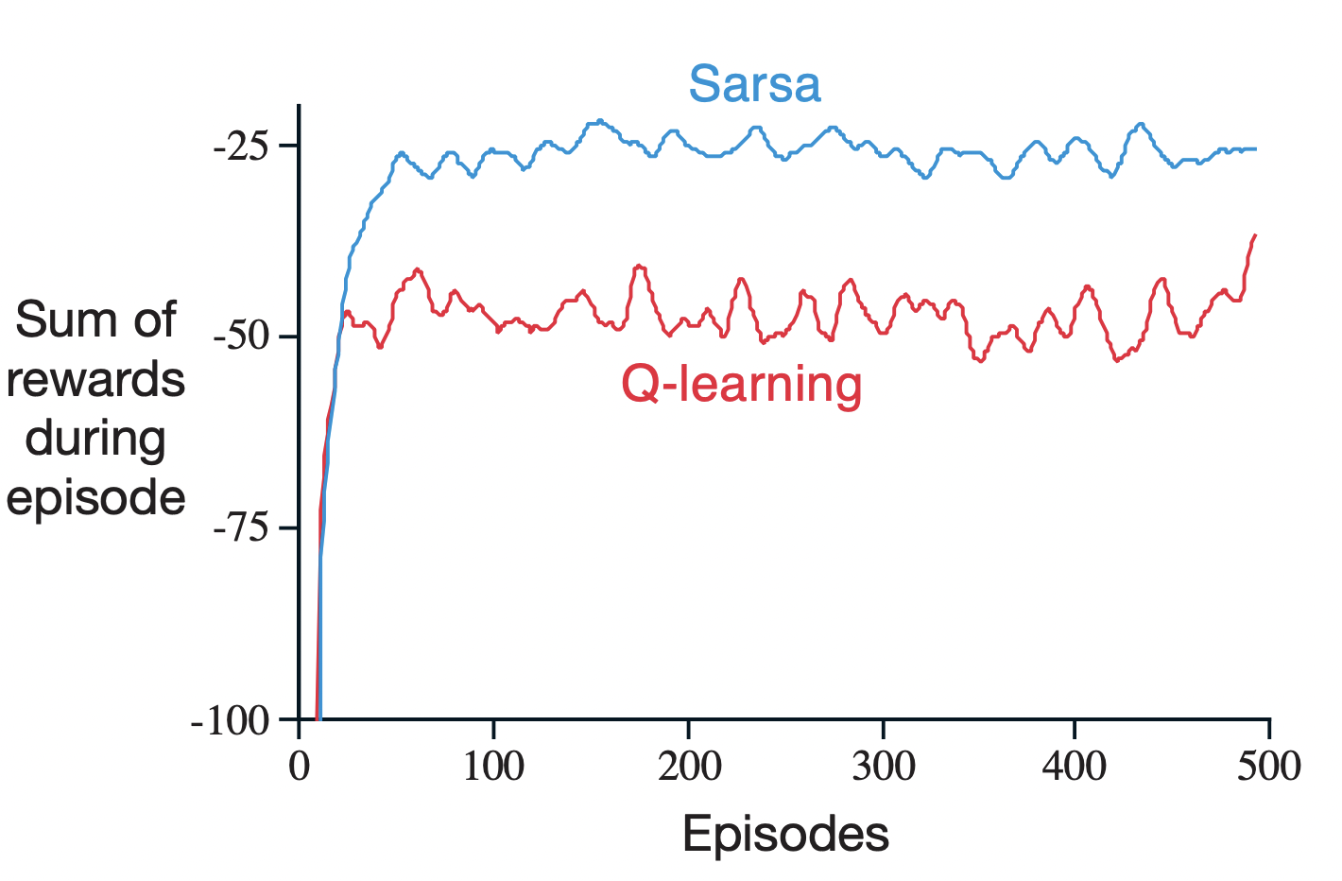
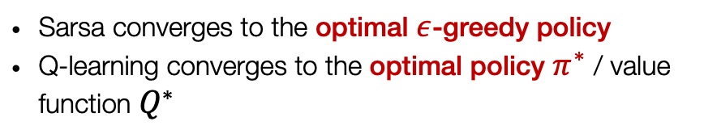
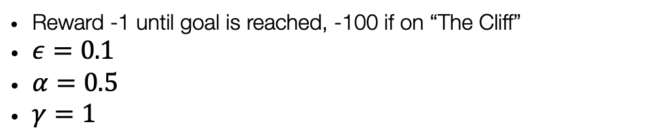
Differences between Sarsa and Q-learning
(Policy achieved by Sarsa)
Reward -1 until goal is reached, -100 if on “The Cliff”
$ε=0.1$
$α=0.5$
$γ=1$
(Policy achieved by Q-learning)
Sarsa converges to the optimal $ε$-greedy policy
Q-learning converges to the optimal policy $π^{∗}$ / value function $Q^{∗}$

Slide 19
Outline
Value-based Methods
Tabular methods
On-policy & Off-policy
SARSA
Q-learning
Value function approximation
Deep (Value-based) RL Methods & Applications

Slide 20

Solving large-scale problems with RL
Reinforcement learning can be used to solve large problems, e.g.,
Backgammon: ${10}^{20}$ states
All those problems where we have a continuous state space
Go: ${10}^{170}$ states
How can we scale the methods we developed over the last lectures?

Slide 21
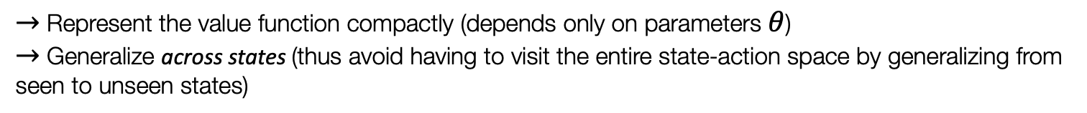
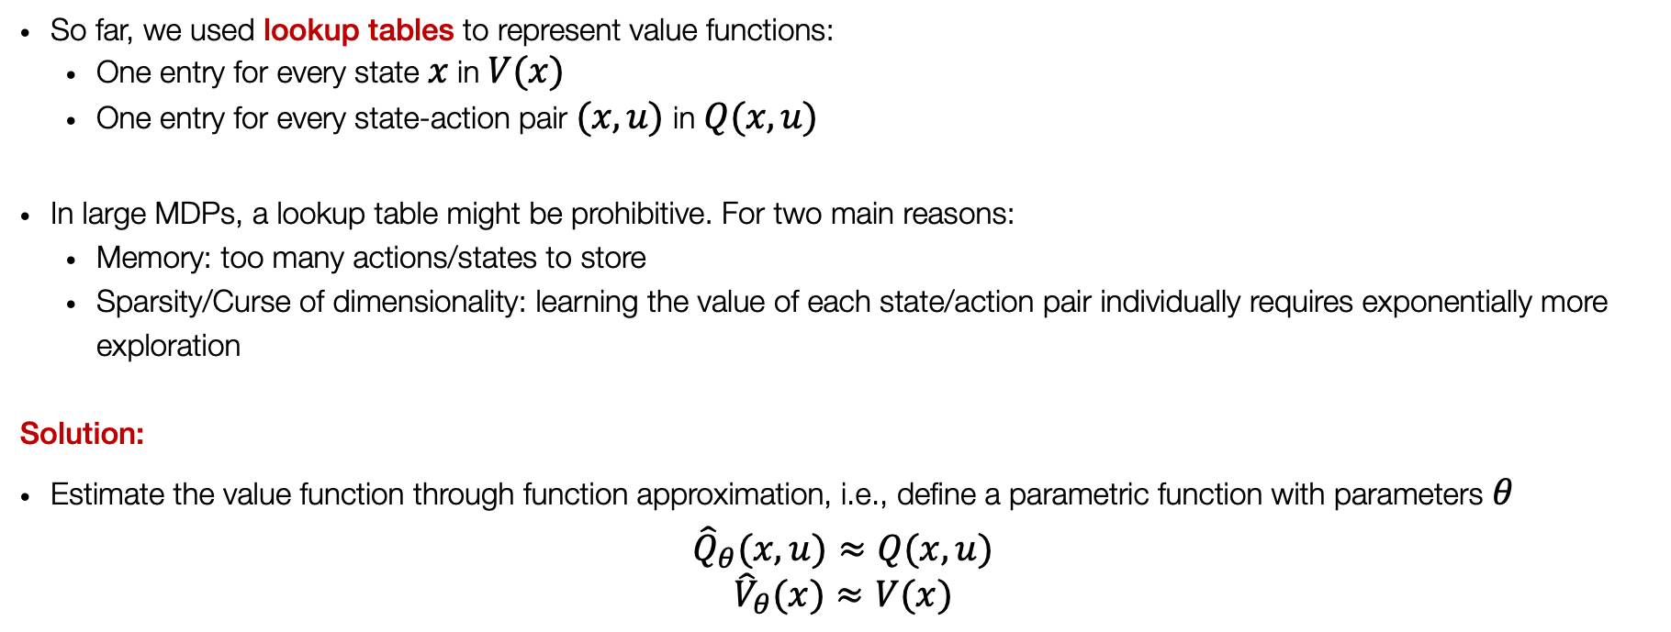
Value function approximation
So far, we used lookup tables to represent value functions:
One entry for every state $x$ in $V(x)$
One entry for every state-action pair $(x,u)$ in $Q(x,u)$
In large MDPs, a lookup table might be prohibitive. For two main reasons:
Memory: too many actions/states to store
Sparsity/Curse of dimensionality: learning the value of each state/action pair individually requires exponentially more exploration
Solution:
Estimate the value function through function approximation, i.e., define a parametric function with parameters $θ$
$${\hat{Q}}_{θ}(x,u)≈Q(x,u)$$
$${\hat{V}}_{θ}(x)≈V(x)$$
$→$ Represent the value function compactly (depends only on parameters $θ$)
$→$ Generalize across states (thus avoid having to visit the entire state-action space by generalizing from seen to unseen states)

Slide 22
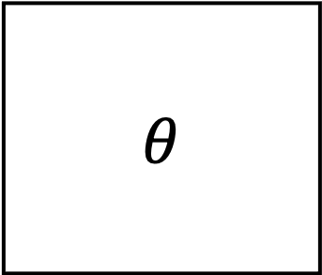

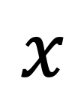
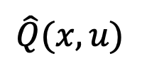
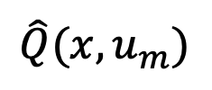
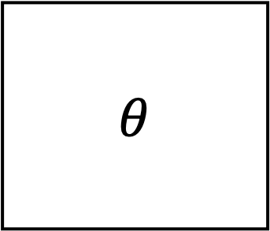
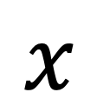
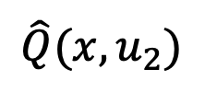
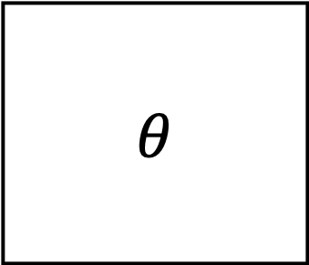
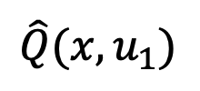
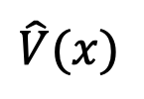
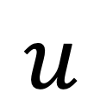
Different types of value function approximations
$$\hat{V}(x)$$
$$\hat{Q}(x,u)$$
$$\hat{Q}(x,u_{1})$$
$$\hat{Q}(x,u_{2})$$
$$\hat{Q}(x,u_{m})$$
$$…$$
$$θ$$
$$θ$$
$$θ$$
$$x$$
$$x$$
$$u$$
$$x$$
There are many possible function approximators
Linear regression, Neural network, Random forest, Nearest neighbor, etc.

Slide 23
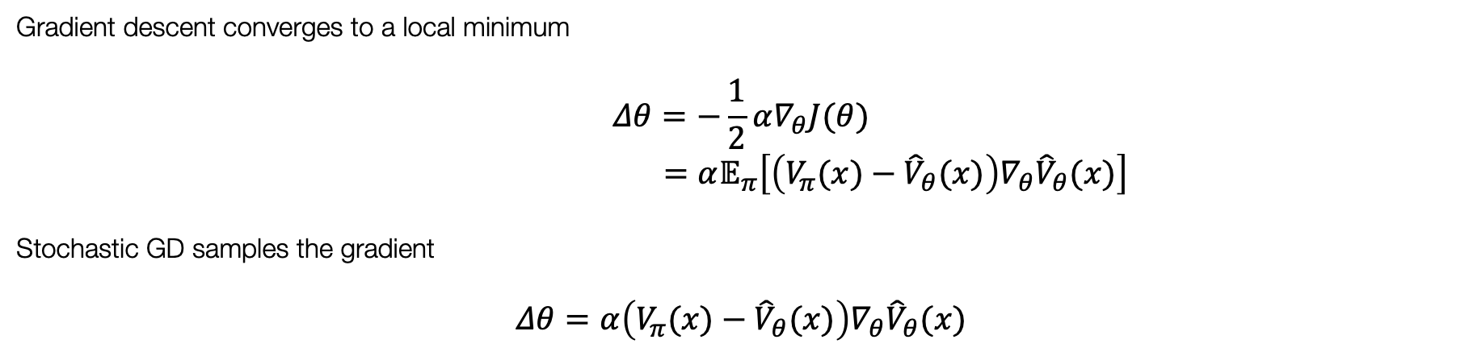
Approximating value fn. by (stochastic) gradient descent
Goal: find the parameter vector $θ$ that minimizes the “error” between the estimated value${ \hat{V}}_{θ}\left(x\right)$ and the true value $V_{π}(x)$, e.g., MSE
$$J(θ)=𝔼_{π}​\left[{\left(V_{π}(x)−{\hat{V}}_{θ}(x)\right)}^{2}\right]$$
Gradient descent converges to a local minimum
$$Δθ=−\frac{1}{2}α∇_{θ}J(θ)$$
$$=α𝔼_{π}​\left[\left(V_{π}(x)−{\hat{V}}_{θ}(x)\right)∇_{θ}{\hat{V}}_{θ}(x)\right]$$
Stochastic GD samples the gradient
$$Δθ=α\left(V_{π}(x)−{\hat{V}}_{θ}(x)\right)∇_{θ}{\hat{V}}_{θ}(x)$$

Slide 24
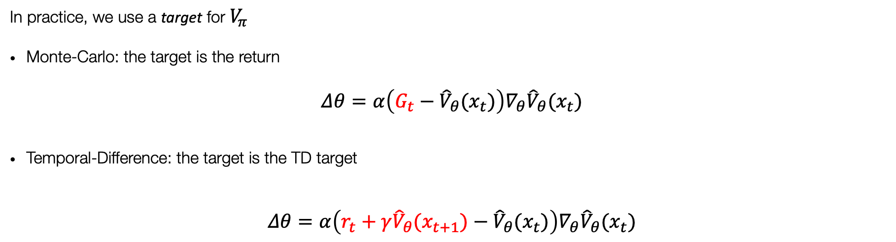
Approximating value fn. by (stochastic) gradient descent
In the previous slide, we assumed to know the true value function $V_{π}$ $→$ in RL there is no supervisor, only reward fn.
In practice, we use a target for $V_{π}$
Monte-Carlo: the target is the return
$$Δθ=α\left(G_{t}−{\hat{V}}_{θ}(x_{t})\right)∇_{θ}{\hat{V}}_{θ}(x_{t})$$
Temporal-Difference: the target is the TD target
$$Δθ=α\left(r_{t}+γ{\hat{V}}_{θ}(x_{t+1})−{\hat{V}}_{θ}(x_{t})\right)∇_{θ}{\hat{V}}_{θ}(x_{t})$$

Slide 25
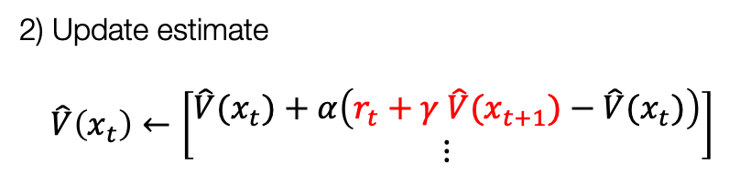




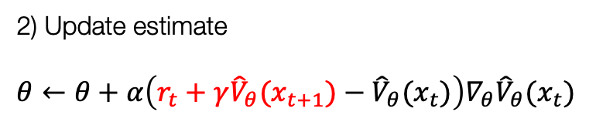


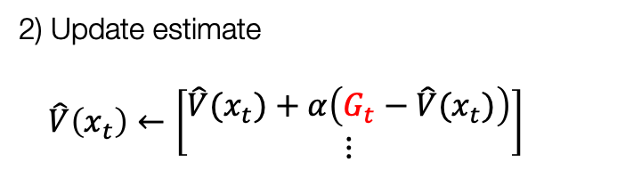


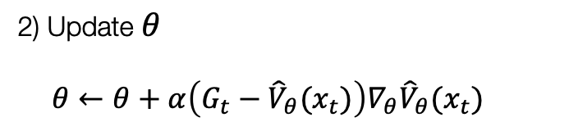



Intuition
$$x_{1}$$
…
$$x_{T}$$
$$u_{1},r_{1}$$
$$u_{T−1},r_{T−1}$$
$$x_{0}$$
$$u_{0},r_{0}$$
$$x_{2}$$
Tabular $\hat{V}\left(x_{t}\right)$
Fn. Approx.${ \hat{V}}_{θ}(x_{t})$
1) Compute return $G_{t}=r_{t}+γr_{t+1}+…,∀t$
1) Collect dataset $𝒟=\{(x_{t},G_{t})\}$
MC
2) Update estimate
$$\hat{V}\left(x_{t}\right)←\left[\begin{matrix}\hat{V}(x_{t})+α\left(G_{t}−\hat{V}(x_{t})\right) \\ ⋮\end{matrix}\right]$$
2) Update $θ$
$$θ←θ+α\left(G_{t}−{\hat{V}}_{θ}(x_{t})\right)∇_{θ}{\hat{V}}_{θ}(x_{t})$$
1) Compute target $r_{t}+γ \hat{V}(x_{t+1}),∀t$
1) Collect dataset $𝒟=\{(x_{t},r_{t}+γ{\hat{V}}_{θ}(x_{t+1}))\}$
TD
2) Update estimate
$\hat{V}\left(x_{t}\right)←\left[\begin{matrix}\hat{V}(x_{t})+α\left(r_{t}+γ \hat{V}(x_{t+1})−\hat{V}(x_{t})\right) \\ ⋮\end{matrix}\right]$
2) Update estimate
$$θ←θ+α\left(r_{t}+γ{\hat{V}}_{θ}(x_{t+1})−{\hat{V}}_{θ}(x_{t})\right)∇_{θ}{\hat{V}}_{θ}(x_{t})$$

Slide 26
Action-value function approximation
Exactly the same intuitions apply when we try to approximate the action value function:
Ideally, we’d minimize the mean-squared error between the estimated value ${\hat{Q}}_{θ}(x,u)$ and the true value $Q_{π}(x,u)$
$$J(θ)=𝔼_{π}​\left[Q_{π}(x,u)−{\hat{Q}}_{θ}(x,u)\right]$$
via stochastic gradient descent to find a local minimum
$$Δθ=α\left(Q_{π}(x,u)−{\hat{Q}}_{θ}(x,u)\right)∇_{θ}{\hat{Q}}_{θ}(x,u)$$
Fitted Q-Iteration: in practice, update $θ$ via stochastic gradient descent on TD target
$$Δθ=α\left(r_{t}+γ\max_{u_{t+1}^{′}}Q_{θ}(x_{t+1},u′_{t+1})−{\hat{Q}}_{θ}(x_{t},u_{t})\right)∇_{θ}{\hat{Q}}_{θ}(x_{t},u_{t})$$

Slide 27
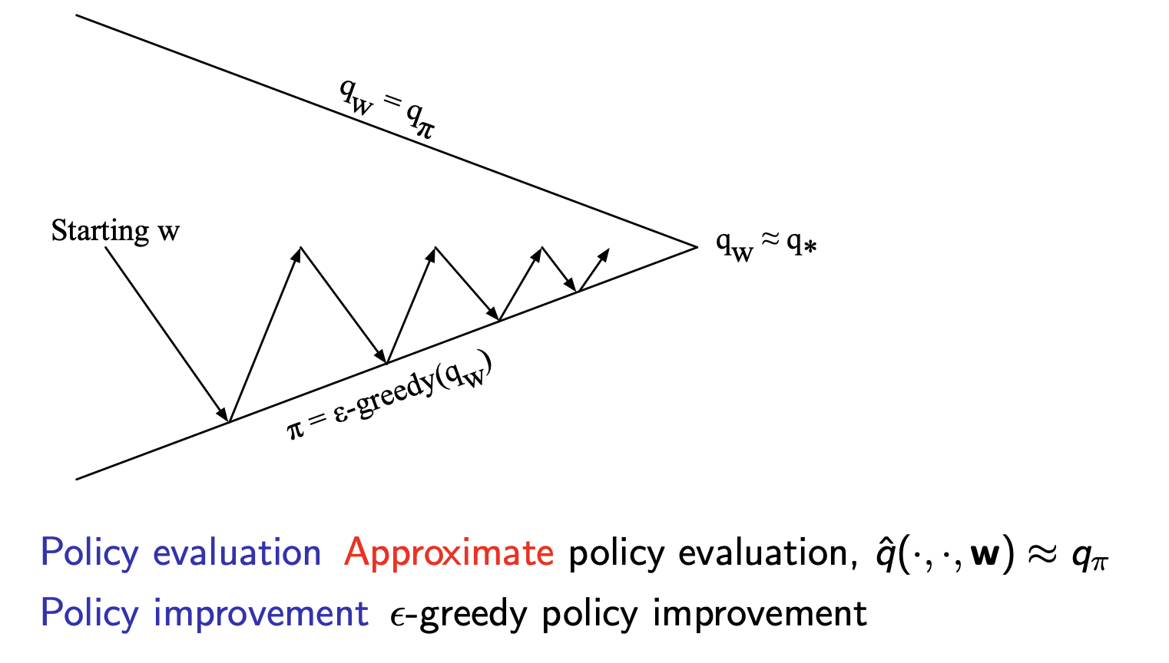
Control with function approximation

Slide 28
Review: The skeleton of an RL algorithm
Fit a model / estimate return
Generate samples
Improve the policy

Slide 29
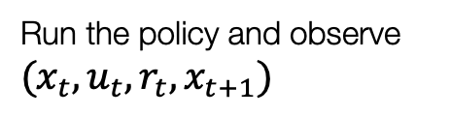

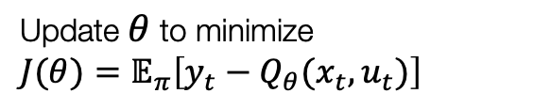
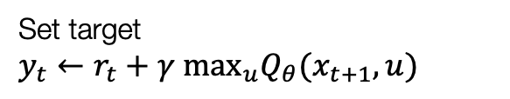
The skeleton of fitted Q-learning
Set target
$$y_{t}←r_{t}+γ {\text{max}}_{u}Q_{θ}(x_{t+1},u)$$
Fit a model / estimate return
Update $θ$ to minimize
$$J(θ)=𝔼_{π}​\left[y_{t}−Q_{θ}(x_{t},u_{t})\right]$$
Run the policy and observe $(x_{t},u_{t},r_{t},x_{t+1})$
Generate samples
Improve the policy
$$\text{set} π(x_{t})={\text{argmax}}_{u}Q_{θ}(x_{t},u_{t})$$

Slide 30
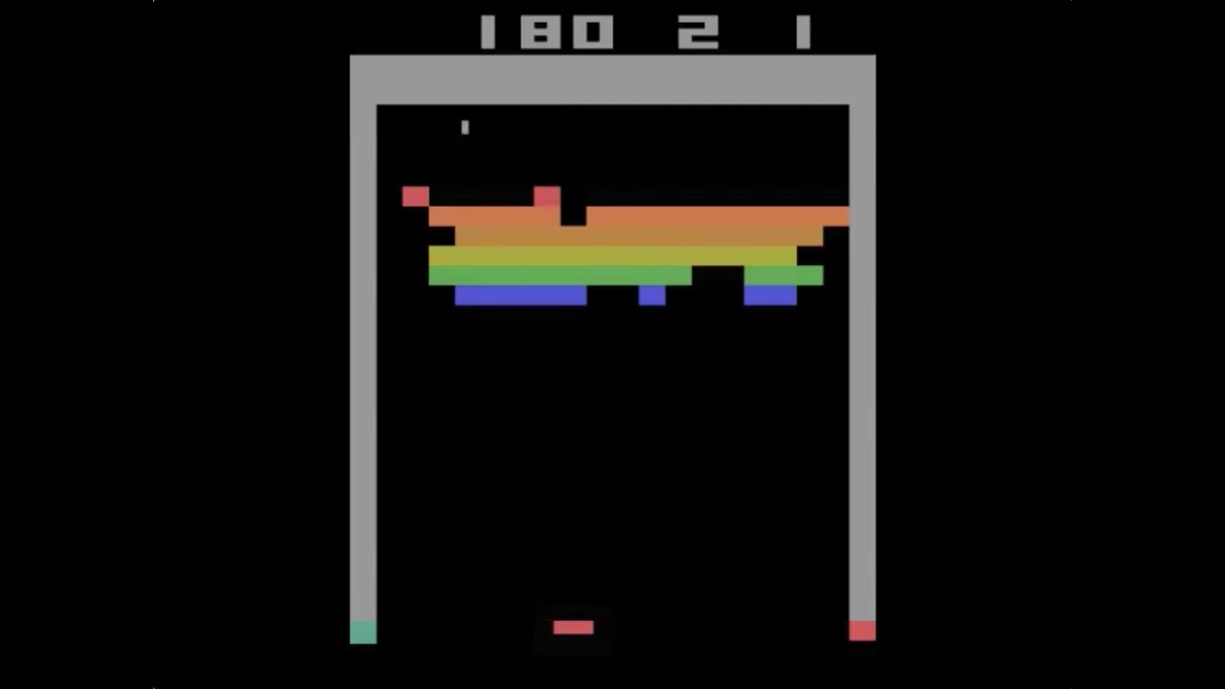
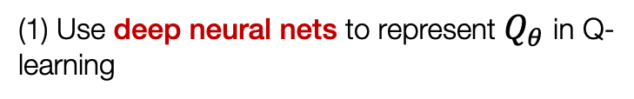
Deep Q-Networks (DQN)
One of the most popular Deep RL algorithms and arguably one of the first successes of RL with neural networks
(1) Use deep neural nets to represent $Q_{θ}$ in Q-learning
(2) Uses experience replay and fixed Q-targets

Slide 31
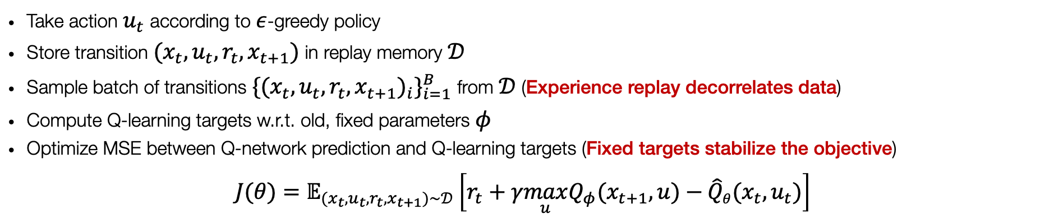
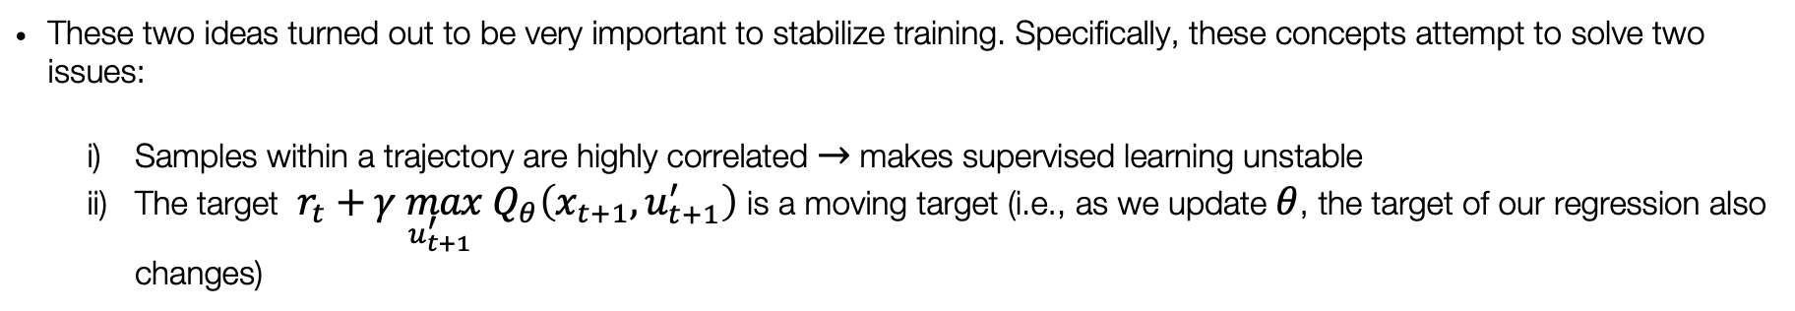
Deep Q-Networks (DQN)
(2) Uses experience replay and fixed Q-targets
These two ideas turned out to be very important to stabilize training. Specifically, these concepts attempt to solve two issues:
Samples within a trajectory are highly correlated $→$ makes supervised learning unstable
The target $r_{t}+γ\max_{u_{t+1}^{′}}{ Q}_{θ}\left(x_{t+1},u_{t+1}^{′}\right)$ is a moving target (i.e., as we update $θ$, the target of our regression also changes)
Intuitively:
Take action $u_{t}$ according to $ε$-greedy policy
Store transition $(x_{t},u_{t},r_{t},x_{t+1})$ in replay memory $𝒟$
Sample batch of transitions $\{(x_{t},u_{t},r_{t},x_{t+1})_{i}\}_{i=1}^{B}$ from $𝒟$ (Experience replay decorrelates data)
Compute Q-learning targets w.r.t. old, fixed parameters $φ$
Optimize MSE between Q-network prediction and Q-learning targets (Fixed targets stabilize the objective)
$$J(θ)=𝔼_{(x_{t},u_{t},r_{t},x_{t+1})∼𝒟}\left[r_{t}+γ\max_{u}Q_{φ}(x_{t+1},u)−{\hat{Q}}_{θ}(x_{t},u_{t})\right]$$

Slide 32
Next time
Model-free RL: policy optimization methods

