Slide 1
AA203 Optimal and Learning-based Control
Model-free Reinforcement Learning: Policy Optimization

Slide 2
Course overview
Imitation Learning
Model-free RL
Control
Adaptive
optimal control
Model-based RL
Feedback control
Adaptive control
Optimal and learning control
Open-loop
MPC
Closed-loop
Indirect methods
Direct
methods
DP
HJB / HJI

Slide 3


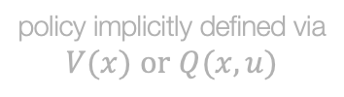

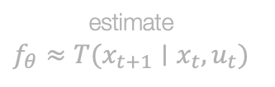
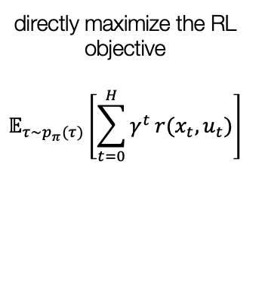

A taxonomy of RL
RL Algorithms
do not use dynamics $T(x_{t+1}|x_{t},u_{t})$
Model-free
Model-based
use dynamics $T(x_{t+1}|x_{t},u_{t})$
Policy optimization
Value-based
Learn the model
Given the model
directly maximize the RL objective
$$𝔼_{τ∼p_{π}(τ)}​\left[\sum_{t=0}^{H}{γ^{t}}r(x_{t},u_{t})\right]$$
policy implicitly defined via
$$V(x) \text{or} Q(x,u)$$
estimate
$$f_{θ}≈T(x_{t+1}∣x_{t},u_{t})$$
$T(x_{t+1}|x_{t},u_{t})$ is known
$$\text{set} π(x_{t})={\text{argmax}}_{u}Q(x_{t},u_{t})$$

Slide 4
Outline
Intro to policy gradients
REINFORCE algorithm
Reducing variance of policy gradient
Actor-Critic methods
Advantage
Architecture design
Deep RL Algorithms & Applications
References:
Berkeley: CS 185/285 & Deep RL Bootcamp

Slide 5
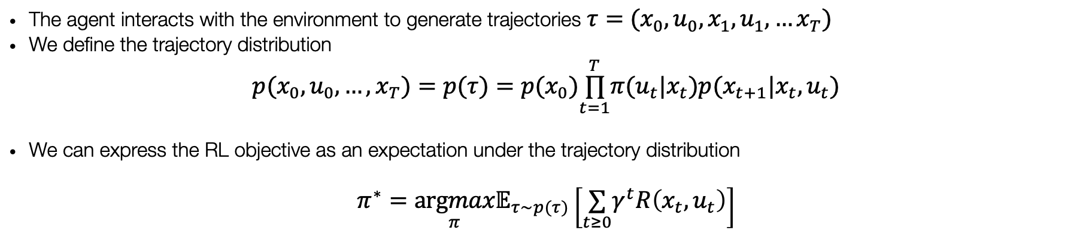





The goal of reinforcement learning
take action
$$u_{t}$$
$$x_{t}$$
observe state
$$x_{t+1}$$
$$r_{t}$$
observe reward
$$r_{t+1}$$
The agent interacts with the environment to generate trajectories $τ=(x_{0},u_{0},x_{1},u_{1},…x_{T})$
We define the trajectory distribution
$$p(x_{0},u_{0},…,x_{T})=p(τ)=p(x_{0})\overset{T}{\underset{t=1}{∏}}π(u_{t}|x_{t})p(x_{t+1}|x_{t},u_{t})$$
We can express the RL objective as an expectation under the trajectory distribution
$$π^{∗}=\underset{π}{argmax}𝔼_{τ∼p(τ)}\left[\underset{t≥0}{∑}γ^{t}R\left(x_{t},u_{t}\right)\right]$$

Slide 6

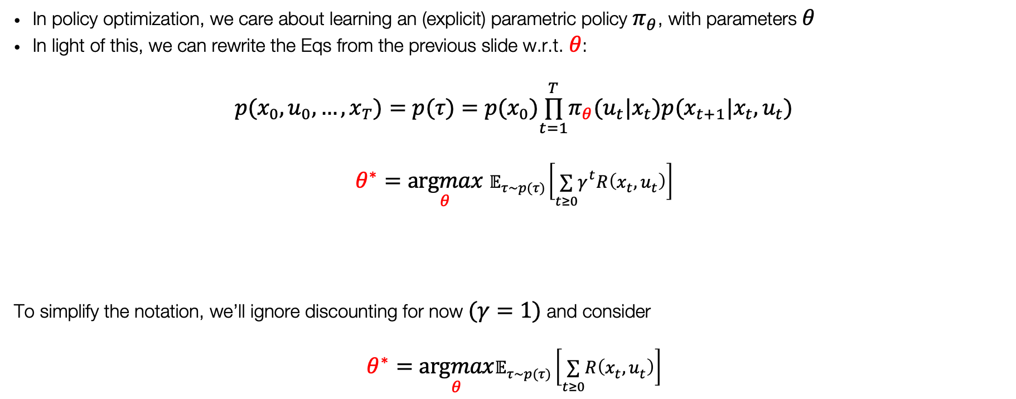
Policy Optimization
In policy optimization, we care about learning an (explicit) parametric policy $π_{θ}$, with parameters $θ$
In light of this, we can rewrite the Eqs from the previous slide w.r.t. $θ$:
$$p(x_{0},u_{0},…,x_{T})=p(τ)=p(x_{0})\overset{T}{\underset{t=1}{∏}}π_{θ}(u_{t}|x_{t})p(x_{t+1}|x_{t},u_{t})$$
$$θ^{∗}=\underset{θ}{argmax}{ 𝔼}_{τ∼p(τ)}\left[\underset{t≥0}{∑}γ^{t}R\left(x_{t},u_{t}\right)\right]$$
To simplify the notation, we’ll ignore discounting for now $(γ=1)$ and consider
$$θ^{∗}=\underset{θ}{argmax}𝔼_{τ∼p(τ)}\left[\underset{t≥0}{∑}R\left(x_{t},u_{t}\right)\right]$$
$$J(θ)$$
$$J(θ)$$

Slide 7

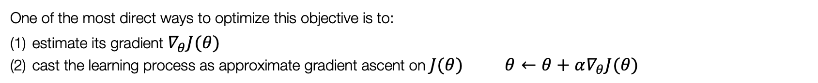
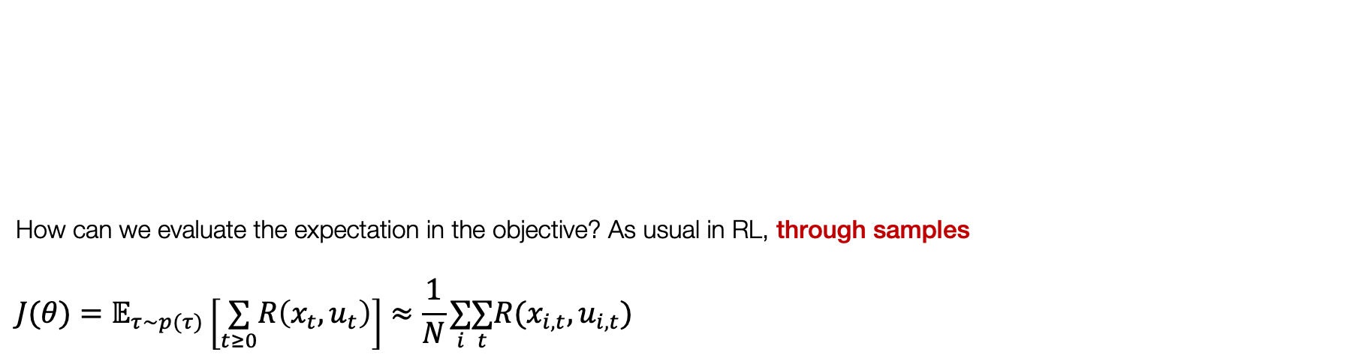

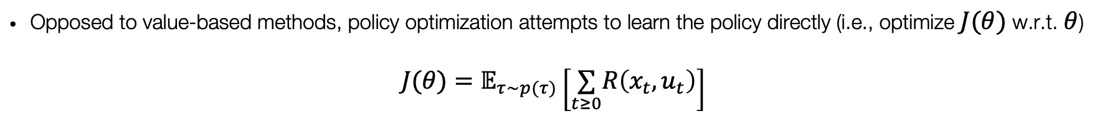
Evaluating the objective
Opposed to value-based methods, policy optimization attempts to learn the policy directly (i.e., optimize $J(θ)$ w.r.t. $θ$)
$$J(θ)=𝔼_{τ∼p(τ)}\left[\underset{t≥0}{∑}R\left(x_{t},u_{t}\right)\right]$$
How can we evaluate the expectation in the objective? As usual in RL, through samples
$$J(θ)=𝔼_{τ∼p(τ)}\left[\underset{t≥0}{∑}R\left(x_{t},u_{t}\right)\right]≈\frac{1}{N}\underset{i}{∑}\underset{t}{∑}R(x_{i,t},u_{i,t})$$
One of the most direct ways to optimize this objective is to:
estimate its gradient $∇_{θ}J(θ)$
cast the learning process as approximate gradient ascent on $J(θ)$ $θ←θ+α∇_{θ}J(θ)$
…
$$τ=(x_{0},u_{0},x_{1},u_{1},…x_{T})$$

Slide 8
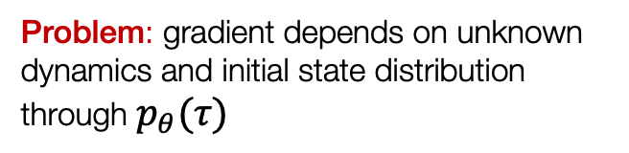
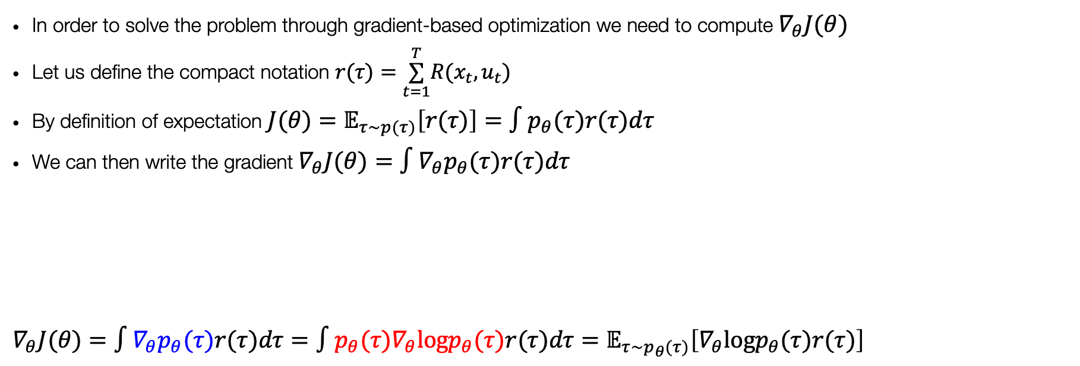
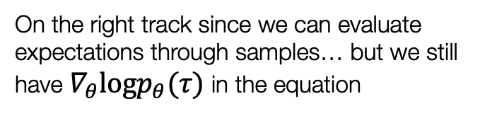
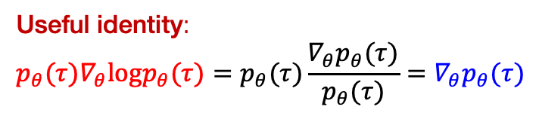
Direct policy gradient
In order to solve the problem through gradient-based optimization we need to compute $∇_{θ}J(θ)$
Let us define the compact notation $r(τ)=\overset{T}{\underset{t=1}{∑}}R(x_{t},u_{t})$
By definition of expectation $J(θ)=𝔼_{τ∼p(τ)}\left[r(τ)\right]=∫p_{θ}(τ)r(τ)dτ$
We can then write the gradient $∇_{θ}J(θ)=∫∇_{θ}p_{θ}(τ)r(τ)dτ$
$$∇_{θ}J(θ)=∫∇_{θ}p_{θ}(τ)r(τ)dτ=∫p_{θ}(τ)∇_{θ}logp_{θ}(τ)r(τ)dτ=𝔼_{τ∼p_{θ}(τ)}\left[∇_{θ}logp_{θ}(τ)r(τ)\right]$$
Problem: gradient depends on unknown dynamics and initial state distribution through $p_{θ}(τ)$
Useful identity:
$$p_{θ}(τ)∇_{θ}logp_{θ}(τ)=p_{θ}(τ)\frac{∇_{θ}p_{θ}(τ)}{p_{θ}(τ)}=∇_{θ}p_{θ}(τ)$$
On the right track since we can evaluate expectations through samples… but we still have $∇_{θ}logp_{θ}(τ)$ in the equation

Slide 9
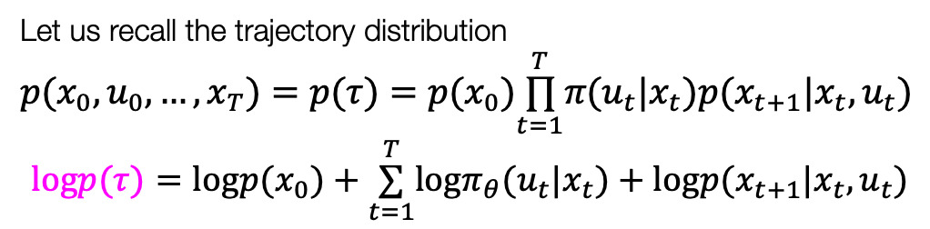
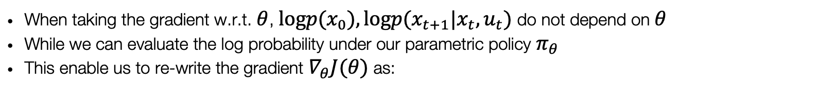
Direct policy gradient
Let us recall the trajectory distribution
$$p(x_{0},u_{0},…,x_{T})=p(τ)=p(x_{0})\overset{T}{\underset{t=1}{∏}}π(u_{t}|x_{t})p(x_{t+1}|x_{t},u_{t})$$
$$logp(τ)=logp(x_{0})+\overset{T}{\underset{t=1}{∑}}logπ_{θ}(u_{t}|x_{t})+logp(x_{t+1}|x_{t},u_{t})$$
$$∇_{θ}J(θ)=𝔼_{τ∼p_{θ}(τ)}\left[∇_{θ}logp_{θ}(τ)r(τ)\right]=𝔼_{τ∼p_{θ}(τ)}\left[∇_{θ}\left[logp(x_{0})+\overset{T}{\underset{t=1}{∑}}logπ_{θ}(u_{t}|x_{t})+logp(x_{t+1}|x_{t},u_{t})\right]r(τ)\right]$$
When taking the gradient w.r.t. $θ$, $logp(x_{0}),logp(x_{t+1}|x_{t},u_{t})$ do not depend on $θ$
While we can evaluate the log probability under our parametric policy $π_{θ}$
This enable us to re-write the gradient $∇_{θ}J(θ)$ as:
$$∇_{θ}J(θ)=𝔼_{τ∼p_{θ}(τ)}\left[\left(\overset{T}{\underset{t=1}{∑}}∇_{θ}logπ_{θ}\left(u_{t}∣x_{t}\right)\right)\left(\overset{T}{\underset{t=1}{∑}}R\left(x_{t},u_{t}\right)\right)\right]$$
Everything inside this expectation is known

Slide 10
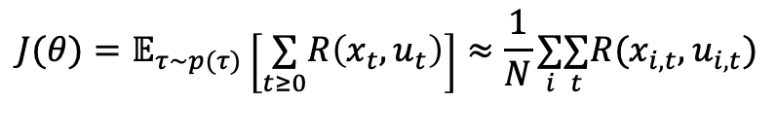
Direct policy gradient
$$∇_{θ}J(θ)=𝔼_{τ∼p_{θ}(τ)}\left[\left(\overset{T}{\underset{t=1}{∑}}∇_{θ}logπ_{θ}\left(u_{t}∣x_{t}\right)\right)\left(\overset{T}{\underset{t=1}{∑}}R\left(x_{t},u_{t}\right)\right)\right]$$
Everything inside this expectation is known
$$J(θ)=𝔼_{τ∼p(τ)}\left[\underset{t≥0}{∑}R\left(x_{t},u_{t}\right)\right]≈\frac{1}{N}\underset{i}{∑}\underset{t}{∑}R(x_{i,t},u_{i,t})$$
Recall how we use samples to evaluate the objective:
We can use the same idea to evaluate the gradient:
$$∇_{θ}J(θ)=𝔼_{τ∼p_{θ}(τ)}\left[\left(\overset{T}{\underset{t=1}{∑}}∇_{θ}logπ_{θ}\left(u_{t}∣x_{t}\right)\right)\left(\overset{T}{\underset{t=1}{∑}}R\left(x_{t},u_{t}\right)\right)\right]≈\frac{1}{N}\overset{N}{\underset{i=1}{∑}}\left[\left(\overset{T}{\underset{t=1}{∑}}∇_{θ}logπ_{θ}\left(u_{i,t}∣x_{i,t}\right)\right)\left(\overset{T}{\underset{t=1}{∑}}R\left(x_{i,t},u_{i,t}\right)\right)\right]$$

Slide 11

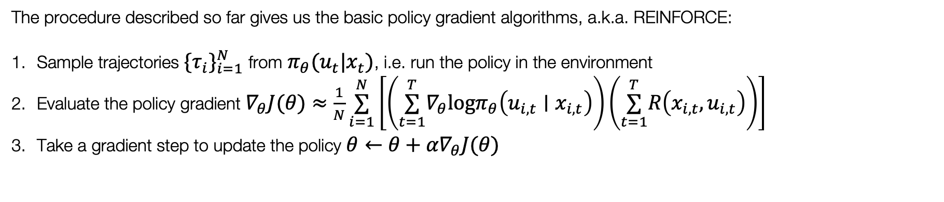


REINFORCE algorithm
The procedure described so far gives us the basic policy gradient algorithms, a.k.a. REINFORCE:
Sample trajectories $\{τ_{i}\}_{i=1}^{N}$ from $π_{θ}(u_{t}|x_{t})$, i.e. run the policy in the environment
Evaluate the policy gradient $∇_{θ}J(θ)≈\frac{1}{N}\overset{N}{\underset{i=1}{∑}}\left[\left(\overset{T}{\underset{t=1}{∑}}∇_{θ}logπ_{θ}\left(u_{i,t}∣x_{i,t}\right)\right)\left(\overset{T}{\underset{t=1}{∑}}R\left(x_{i,t},u_{i,t}\right)\right)\right]$
Take a gradient step to update the policy $θ←θ+α∇_{θ}J(θ)$
Fit a model / estimate return
Estimate the return (via MC)
$$\overset{T}{\underset{t=1}{∑}}R\left(x_{i,t},u_{i,t}\right)$$
Run the policy and observe
Generate samples
$$\{τ_{i}\}_{i=1}^{N}$$
Improve the policy
$$θ←θ+α∇_{θ}J(θ)$$

Slide 12
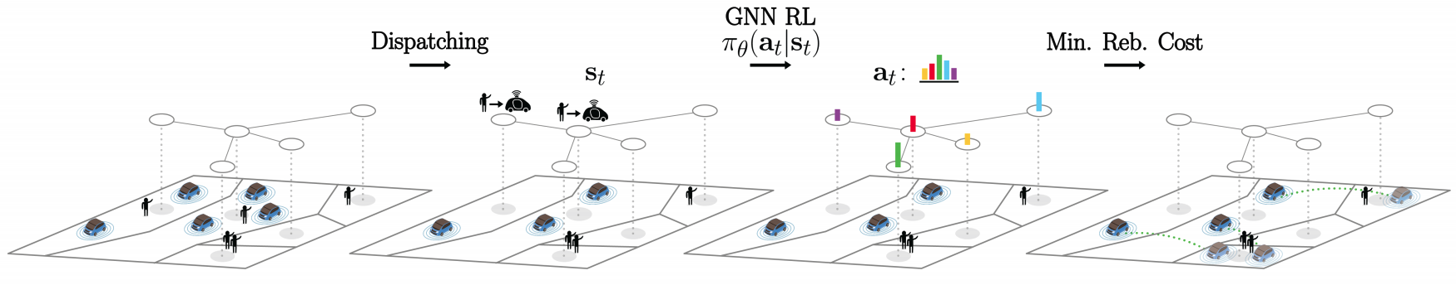
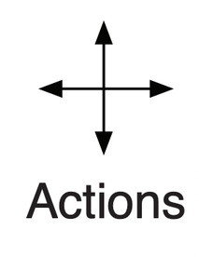
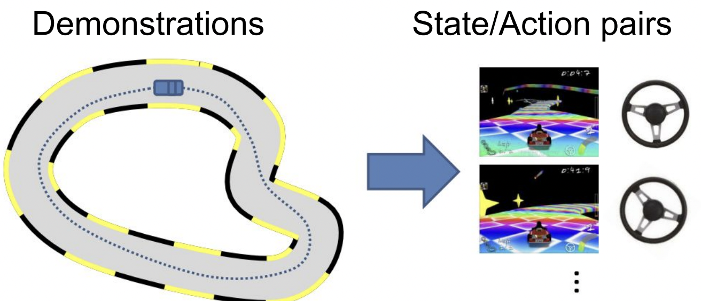

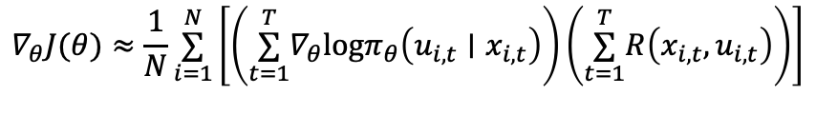
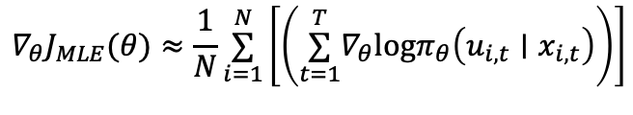

Intuition: “what is PG doing?”
$$∇_{θ}J(θ)≈\frac{1}{N}\overset{N}{\underset{i=1}{∑}}\left[\left(\overset{T}{\underset{t=1}{∑}}∇_{θ}logπ_{θ}\left(u_{i,t}∣x_{i,t}\right)\right)\left(\overset{T}{\underset{t=1}{∑}}R\left(x_{i,t},u_{i,t}\right)\right)\right]$$
Consider the expression we derived for the policy gradient
Discrete action space
Continuous action space
Acceleration
Let’s compare it with the expression of the gradient when performing maximum likelihood (e.g., supervised learning):
$$x_{t}$$
$$u_{t}$$
$$∇_{θ}J_{MLE}(θ)≈\frac{1}{N}\overset{N}{\underset{i=1}{∑}}\left[\left(\overset{T}{\underset{t=1}{∑}}∇_{θ}logπ_{θ}\left(u_{i,t}∣x_{i,t}\right)\right)\right]$$
The policy gradient is a weighted version of the MLE gradient

Slide 13
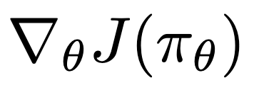
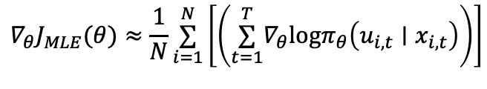
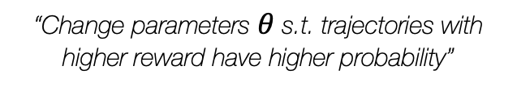
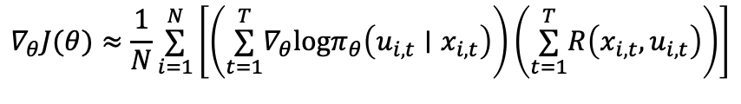
Intuition: “what is PG doing?”
$$∇_{θ}J(θ)≈\frac{1}{N}\overset{N}{\underset{i=1}{∑}}\left[\left(\overset{T}{\underset{t=1}{∑}}∇_{θ}logπ_{θ}\left(u_{i,t}∣x_{i,t}\right)\right)\left(\overset{T}{\underset{t=1}{∑}}R\left(x_{i,t},u_{i,t}\right)\right)\right]$$
Policy gradient:
$$∇_{θ}J_{MLE}(θ)≈\frac{1}{N}\overset{N}{\underset{i=1}{∑}}\left[\left(\overset{T}{\underset{t=1}{∑}}∇_{θ}logπ_{θ}\left(u_{i,t}∣x_{i,t}\right)\right)\right]$$
Maximum Likelihood:
…
Taking a step in the direction the policy gradient essentially means:
“Change parameters $θ$ s.t. trajectories with higher reward have higher probability”
PG formalizes the idea of learning by “trial and error”

Slide 14
Outline
Intro to policy gradients
REINFORCE algorithm
Reducing variance of policy gradient
Actor-Critic methods
Advantage
Architecture design
Deep RL Algorithms & Applications
References:
Berkeley: CS 185/285 & Deep RL Bootcamp

Slide 15
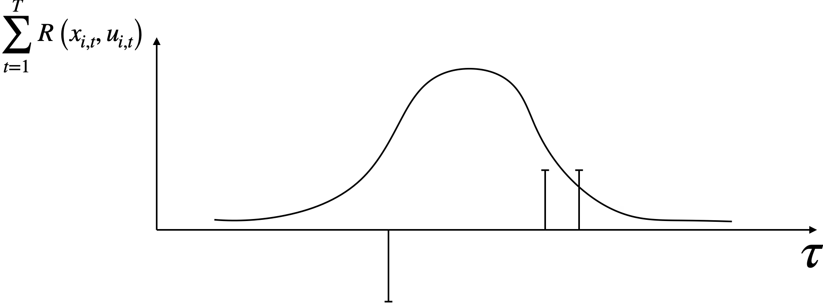
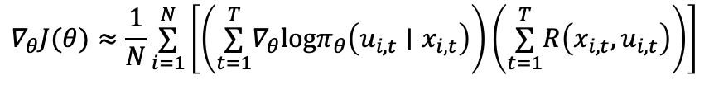
Problem: high variance of the PG
$$∇_{θ}J(θ)≈\frac{1}{N}\overset{N}{\underset{i=1}{∑}}\left[\left(\overset{T}{\underset{t=1}{∑}}∇_{θ}logπ_{θ}\left(u_{i,t}∣x_{i,t}\right)\right)\left(\overset{T}{\underset{t=1}{∑}}R\left(x_{i,t},u_{i,t}\right)\right)\right]$$
Policy gradient:
Let’s consider the following example:

Slide 16
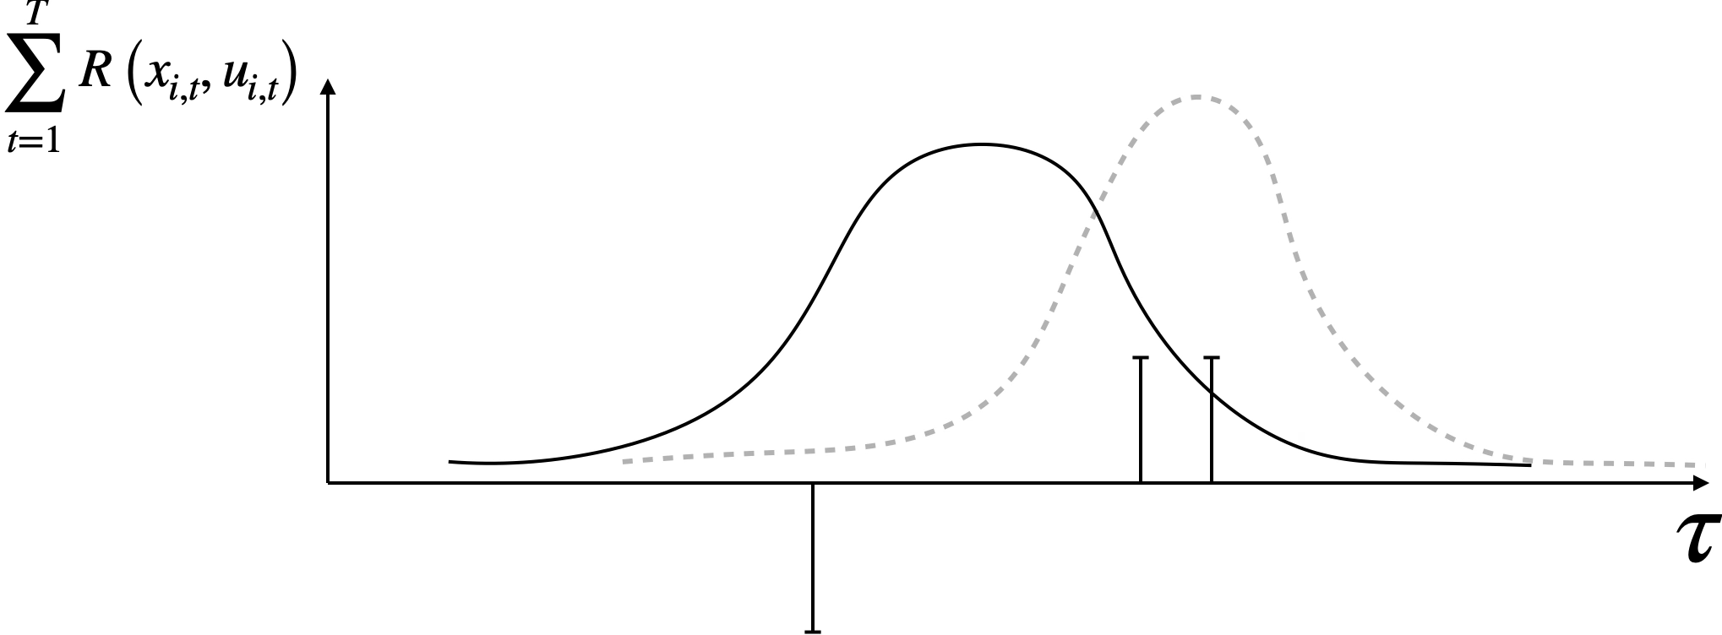
Problem: high variance of the PG
$$∇_{θ}J(θ)≈\frac{1}{N}\overset{N}{\underset{i=1}{∑}}\left[\left(\overset{T}{\underset{t=1}{∑}}∇_{θ}logπ_{θ}\left(u_{i,t}∣x_{i,t}\right)\right)\left(\overset{T}{\underset{t=1}{∑}}R\left(x_{i,t},u_{i,t}\right)\right)\right]$$
Policy gradient:
Let’s consider the following example:

Slide 17
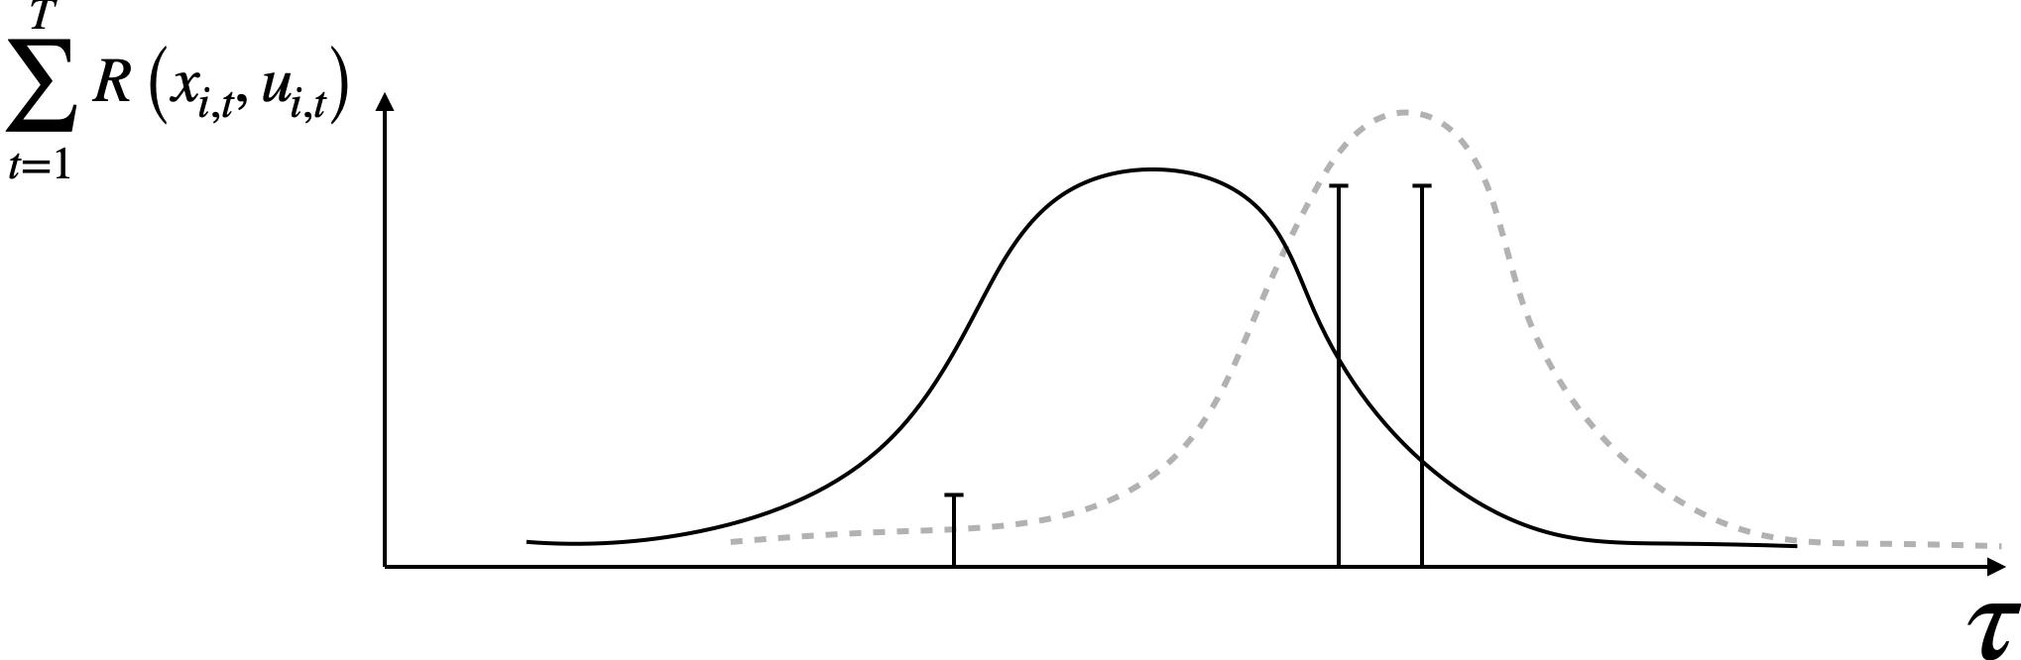
Problem: high variance of the PG
$$∇_{θ}J(θ)≈\frac{1}{N}\overset{N}{\underset{i=1}{∑}}\left[\left(\overset{T}{\underset{t=1}{∑}}∇_{θ}logπ_{θ}\left(u_{i,t}∣x_{i,t}\right)\right)\left(\overset{T}{\underset{t=1}{∑}}R\left(x_{i,t},u_{i,t}\right)\right)\right]$$
Policy gradient:
Let’s consider the following example:

Slide 18
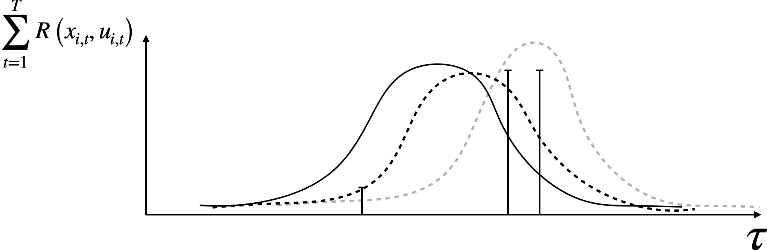
Problem: high variance of the PG
$$∇_{θ}J(θ)≈\frac{1}{N}\overset{N}{\underset{i=1}{∑}}\left[\left(\overset{T}{\underset{t=1}{∑}}∇_{θ}logπ_{θ}\left(u_{i,t}∣x_{i,t}\right)\right)\left(\overset{T}{\underset{t=1}{∑}}R\left(x_{i,t},u_{i,t}\right)\right)\right]$$
Policy gradient:
Let’s consider the following example:
Depending on the sample, the policy gradient can vary wildly: PG estimator has high variance
This negatively affects learning: worse performance, slower convergence
A lot of research in the domain of Policy Optimization revolves around finding ways to lower the variance of the policy gradient

Slide 19
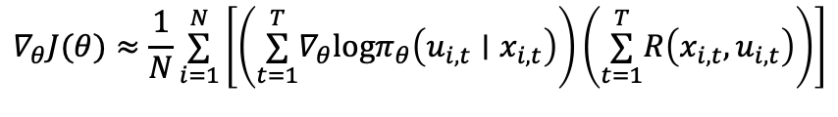
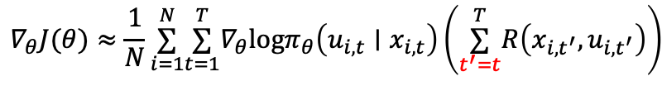
Reducing the variance
$$∇_{θ}J(θ)≈\frac{1}{N}\overset{N}{\underset{i=1}{∑}}\left[\left(\overset{T}{\underset{t=1}{∑}}∇_{θ}logπ_{θ}\left(u_{i,t}∣x_{i,t}\right)\right)\left(\overset{T}{\underset{t=1}{∑}}R\left(x_{i,t},u_{i,t}\right)\right)\right]$$
A first simple approach to reduce the variance entails using causality: “policy at time $t^{′}$ cannot affect reward at time $t<t^{′}$”
Consider this equivalent expression:
$$∇_{θ}J(θ)≈\frac{1}{N}\overset{N}{\underset{i=1}{∑}}\overset{T}{\underset{t=1}{∑}}∇_{θ}logπ_{θ}\left(u_{i,t}∣x_{i,t}\right)\left(\overset{T}{\underset{t^{′}=t}{∑}}R\left(x_{i,t^{′}},u_{i,t^{′}}\right)\right)$$

Slide 20





Baseline
A second (and extremely important) approach to reduce variance of PG estimators relates with the concept of baseline
Let’s reconsider our intuition on PG, i.e., “making good behavior more likely”
$$\overset{T}{\underset{t=1}{∑}}R\left(x_{i,t},u_{i,t}\right)$$
$$\overset{T}{\underset{t=1}{∑}}R\left(x_{i,t},u_{i,t}\right)$$
$$τ$$
$$τ$$
However, PG will only do this if the returns are centered (e.g., consider the counter-example on the right)
Intuitively, we want to “center” our returns, such that:
The probability of behavior that is better than average gets increased
The probability of behavior that is worse than average gets decreased
We are going to subtract a baseline $b$ from the expression of the PG
$$∇_{θ}J(θ)≈\frac{1}{N}\overset{N}{\underset{i=1}{∑}}∇_{θ}logπ_{θ}\left(τ\right)\left[r\left(τ\right)−b\right]$$

Slide 21
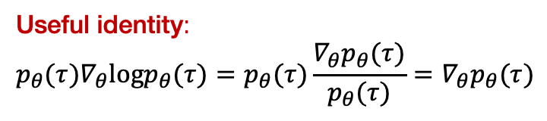
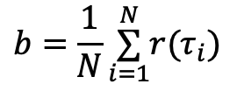
A closer look at the baseline
$$∇_{θ}J(θ)=𝔼_{τ∼p_{θ}(τ)}\left[∇_{θ}logp_{θ}(τ)r(τ)\right]→∇_{θ}J(θ)=𝔼_{τ∼p_{θ}(τ)}\left[∇_{θ}logp_{θ}(τ)(r(τ)−b)\right]$$
Claim: adding the baseline does not change the value of the expected gradient
Useful identity:
$$p_{θ}(τ)∇_{θ}logp_{θ}(τ)=p_{θ}(τ)\frac{∇_{θ}p_{θ}(τ)}{p_{θ}(τ)}=∇_{θ}p_{θ}(τ)$$
To prove that, let’s consider the following expectation:
$$𝔼\left[∇_{θ}logp_{θ}\left(τ\right)b\right]=∫p_{θ}(τ)∇_{θ}logp_{θ}(τ)bdτ=∫∇_{θ}p_{θ}(τ)bdτ=b∇_{θ}∫p_{θ}(τ)dτ=b∇_{θ}1=0$$
which makes our estimate of the gradient (with baseline) unbiased in expectation
$$b=\frac{1}{N}\overset{N}{\underset{i=1}{∑}}r(τ_{i})$$
An extremely effective choice of the baseline is the average return,
(We’ll see how this motivates many popular RL algorithms…)

Slide 22
Example

Slide 23

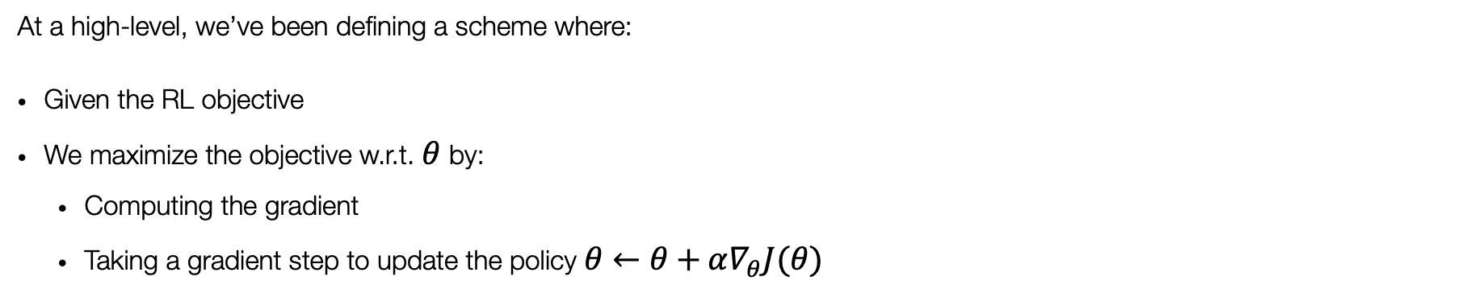
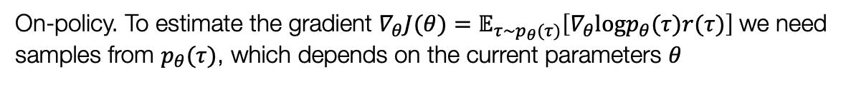

Properties of policy gradient
At a high-level, we’ve been defining a scheme where:
Given the RL objective
We maximize the objective w.r.t. $θ$ by:
Computing the gradient
Taking a gradient step to update the policy $θ←θ+α∇_{θ}J(θ)$
$$J(θ)=𝔼_{τ∼p(τ)}\left[r(τ)\right]=∫p_{θ}(τ)r(τ)dτ$$
Pros:
Naturally handles continuous/discrete action spaces
Directly optimizes the RL objective — can be more stable than Q-learning, i.e., fixed-point iteration
$$∇_{θ}J(θ)=𝔼_{τ∼p_{θ}(τ)}\left[∇_{θ}logp_{θ}(τ)r(τ)\right]$$
Cons:
On-policy. This can be extremely sample inefficient!
Question:
Is this on- or off-policy? And why?
On-policy. To estimate the gradient $∇_{θ}J(θ)=𝔼_{τ∼p_{θ}(τ)}\left[∇_{θ}logp_{θ}(τ)r(τ)\right]$we need samples from $p_{θ}(τ)$, which depends on the current parameters 𝜃
23

Slide 24
Outline
Intro to policy gradients
REINFORCE algorithm
Reducing variance of policy gradient
Actor-Critic methods
Advantage
Architecture design
Deep RL Algorithms & Applications
References:
Berkeley: CS 185/285 & Deep RL Bootcamp

Slide 25

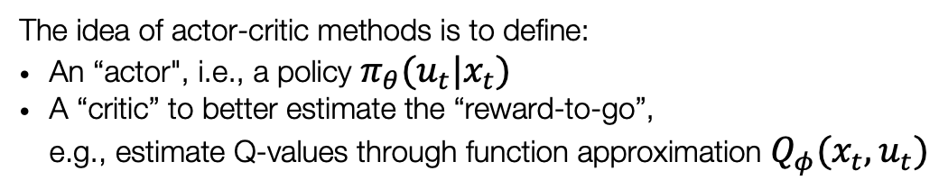


From PG to Actor-Critic methods
Once again, let’s consider the policy gradient $∇_{θ}J(θ)≈\frac{1}{N}\overset{N}{\underset{i=1}{∑}}\overset{T}{\underset{t=1}{∑}}∇_{θ}logπ_{θ}\left(u_{i,t}∣x_{i,t}\right)\left(\overset{T}{\underset{t^{′}=t}{∑}}R\left(x_{i,t^{′}},u_{i,t^{′}}\right)\right)$
“reward-to-go”
This one-sample estimate of the reward-to-go contributes to the high variance of the PG
$$𝔼_{τ∼p(τ)}\left[\overset{T}{\underset{t^{′}=t}{∑}}R\left(x_{i,t^{′}},u_{i,t^{′}}\right)\right]$$
The idea of actor-critic methods is to define:
An “actor", i.e., a policy $π_{θ}(u_{t}|x_{t})$
A “critic” to better estimate the “reward-to-go”, e.g., estimate Q-values through function approximation $Q_{φ}(x_{t},u_{t})$
=
$$Q_{π}(x_{t},u_{t})$$
$$p(x_{t+1}|x_{t},u_{t})$$
By using this better estimate of the reward-to-go we can get a lower variance policy gradient:
$$∇_{θ}J(θ)≈\frac{1}{N}\overset{N}{\underset{i=1}{∑}}\overset{T}{\underset{t=1}{∑}}∇_{θ}log{ π}_{θ}\left(u_{i,t}∣x_{i,t}\right)Q_{φ}(x_{t},u_{t})$$
25

Slide 26
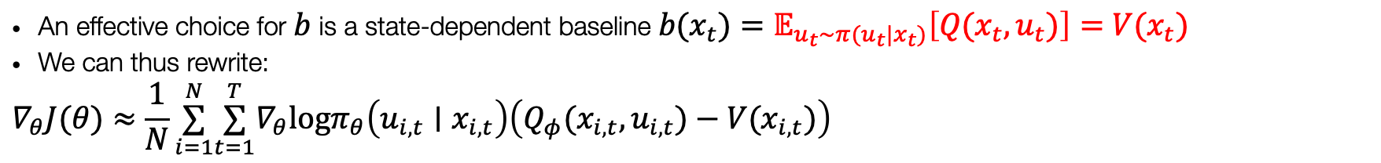
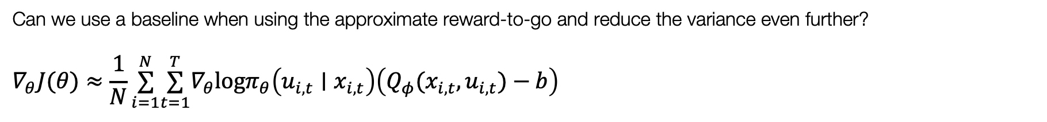
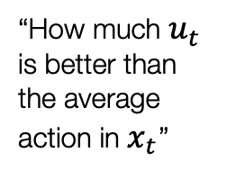
What about the baseline?
Can we use a baseline when using the approximate reward-to-go and reduce the variance even further?
$$∇_{θ}J(θ)≈\frac{1}{N}\overset{N}{\underset{i=1}{∑}}\overset{T}{\underset{t=1}{∑}}∇_{θ}logπ_{θ}\left(u_{i,t}∣x_{i,t}\right)\left(Q_{φ}(x_{i,t},u_{i,t})−b\right)$$
An effective choice for $b$ is a state-dependent baseline $b(x_{t})=𝔼_{u_{t}∼π(u_{t}|x_{t})}\left[Q(x_{t},u_{t})\right]=V(x_{t})$
We can thus rewrite:
$$∇_{θ}J(θ)≈\frac{1}{N}\overset{N}{\underset{i=1}{∑}}\overset{T}{\underset{t=1}{∑}}∇_{θ}logπ_{θ}\left(u_{i,t}∣x_{i,t}\right)\left(Q_{φ}(x_{i,t},u_{i,t})−V(x_{i,t})\right)$$
“How much $u_{t}$ is better than the average action in $x_{t}$”
Following this gradient:
increases the probability of actions that have returns better than average
decreases the probability of actions that have returns worse than average
The function $A(x_{t},u_{t})=Q_{φ}(x_{t},u_{t})−V(x_{t})$ is usually referred to as advantage function

Slide 27

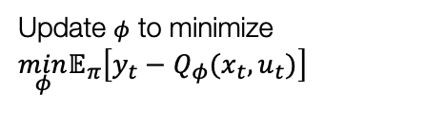






Fitted Q-learning:
Set target
$$y_{t}←r_{t}+γ\max_{u}Q_{φ}(x_{t+1},u)$$
REINFORCE:
Estimate the return (via MC)
Fit a model / estimate return
Fit a model / estimate return
$$\overset{T}{\underset{t=1}{∑}}R\left(x_{i,t},u_{i,t}\right)$$
Update $φ$ to minimize
$$\min_{φ}𝔼_{π}\left[y_{t}−Q_{φ}(x_{t},u_{t})\right]$$
Run policy and observe trajectories
Generate samples
Generate samples
Run policy and observe trajectories
Improve the policy
$$S\text{et} π\left(x_{t}\right)=arg\max_{u}Q_{θ}\left(x_{t},u_{t}\right)$$
Improve the policy
$$∇_{θ}J(θ)≈\frac{1}{N}\overset{N}{\underset{i=1}{∑}}\left[\left(\overset{T}{\underset{t=1}{∑}}∇_{θ}logπ_{θ}\left(u_{i,t}∣x_{i,t}\right)\right)\left(\overset{T}{\underset{t=1}{∑}}R\left(x_{i,t},u_{i,t}\right)\right)\right]$$
$$θ←θ+α∇_{θ}J(θ)$$
Actor-Critic:
Fit a model / estimate return
Fit $V_{π},Q_{π}$ or $A_{π}$
Run policy and observe trajectories
Generate samples
Improve the policy
$$θ←θ+α∇_{θ}J(θ)$$

Slide 28


Actor-Critic:
Fit a model / estimate return
Fit $V_{π},Q_{π}$ or $A_{π}$
Run policy and observe trajectories
Generate samples
Improve the policy
$$θ←θ+α∇_{θ}J(θ)$$
What quantity should we estimate? What are the trade-offs between estimating $V_{π}(x_{t}),Q_{π}(x_{t},u_{t})$ or $A_{π}$? No wrong/right, answer, it depends. For now, let’s consider the complexity of the estimation problem (i.e., fitting $V_{π}$ is easier: only $x_{t}$ as input)
$$Q_{π}(x_{t},u_{t})=𝔼_{τ∼p(τ)}\left[\overset{T}{\underset{t^{′}=t}{∑}}R\left(x_{i,t^{′}},u_{i,t^{′}}\right)\right]=r\left(x_{t},u_{t}\right)+𝔼_{x_{t+1}∼p\left(x_{t+1}∣x_{t},u_{t}\right)}\left[V_{π}\left(x_{t+1}\right)\right]≈r\left(x_{t},u_{t}\right)+V_{π}\left(x_{t+1}\right)$$
$$A_{π}(x_{t},u_{t})=Q_{π}(x_{t},u_{t})−V_{π}(x_{t})≈r\left(x_{t},u_{t}\right)+V_{π}\left(x_{t+1}\right)−V_{π}\left(x_{t}\right)$$
This enables us to “only” fit $V_{π}$
28

Slide 29
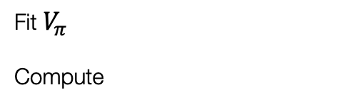

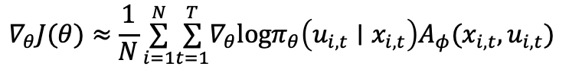
Advantage Actor-Critic (A2C):
Fit $V_{π}$
Compute
Fit a model / estimate return
$$A_{π}(x_{t},u_{t})=r\left(x_{t},u_{t}\right)+V_{π}\left(x_{t+1}\right)−V_{π}\left(x_{t}\right)$$
Run policy and observe trajectories
Generate samples
$$∇_{θ}J(θ)≈\frac{1}{N}\overset{N}{\underset{i=1}{∑}}\overset{T}{\underset{t=1}{∑}}∇_{θ}logπ_{θ}\left(u_{i,t}∣x_{i,t}\right)A_{φ}(x_{i,t},u_{i,t})$$
Improve the policy
$$θ←θ+α∇_{θ}J(θ)$$
What quantity should we estimate? What are the trade-offs between estimating $V_{π}(x_{t}),Q_{π}(x_{t},u_{t})$ or $A_{π}$? No wrong/right, answer, it depends. For now, let’s consider the complexity of the estimation problem (i.e., fitting $V_{π}$ is easier: only $x_{t}$ as input)
$$Q_{π}(x_{t},u_{t})=𝔼_{τ∼p(τ)}\left[\overset{T}{\underset{t^{′}=t}{∑}}R\left(x_{i,t^{′}},u_{i,t^{′}}\right)\right]=r\left(x_{t},u_{t}\right)+𝔼_{x_{t+1}∼p\left(x_{t+1}∣x_{t},u_{t}\right)}\left[V_{π}\left(x_{t+1}\right)\right]≈r\left(x_{t},u_{t}\right)+V_{π}\left(x_{t+1}\right)$$
$$A_{π}(x_{t},u_{t})=Q_{π}(x_{t},u_{t})−V_{π}(x_{t})≈r\left(x_{t},u_{t}\right)+V_{π}\left(x_{t+1}\right)−V_{π}\left(x_{t}\right)$$
This enables us to “only” fit $V_{π}$
29

Slide 30
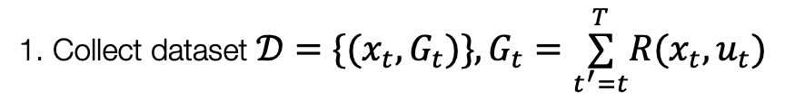
Advantage Actor-Critic (A2C):
Fit $V_{π}$
Compute
Fit a model / estimate return
$$A_{π}(x_{t},u_{t})=r\left(x_{t},u_{t}\right)+V_{π}\left(x_{t+1}\right)−V_{π}\left(x_{t}\right)$$
Run policy and observe trajectories
Generate samples
$$∇_{θ}J(θ)≈\frac{1}{N}\overset{N}{\underset{i=1}{∑}}\overset{T}{\underset{t=1}{∑}}∇_{θ}logπ_{θ}\left(u_{i,t}∣x_{i,t}\right)A_{φ}(x_{i,t},u_{i,t})$$
Improve the policy
$$θ←θ+α∇_{θ}J(θ)$$
When fitting $V_{π}$, we can use different targets to define the supervised learning labels
Question:
How to fit with MC target?
1. Collect dataset $𝒟=\{(x_{t},G_{t})\},G_{t}=\overset{T}{\underset{t^{′}=t}{∑}}R(x_{t},u_{t})$
2. Supervised regression on $𝒟$
How to fit with TD target?
1. Collect dataset $𝒟=\{(x_{t},r_{t}+γ{\hat{V}}_{θ}(x_{t}))\}$
2. Supervised regression on $𝒟$
30

Slide 31
Example: AlphaGo paper
Paper
31

Slide 32
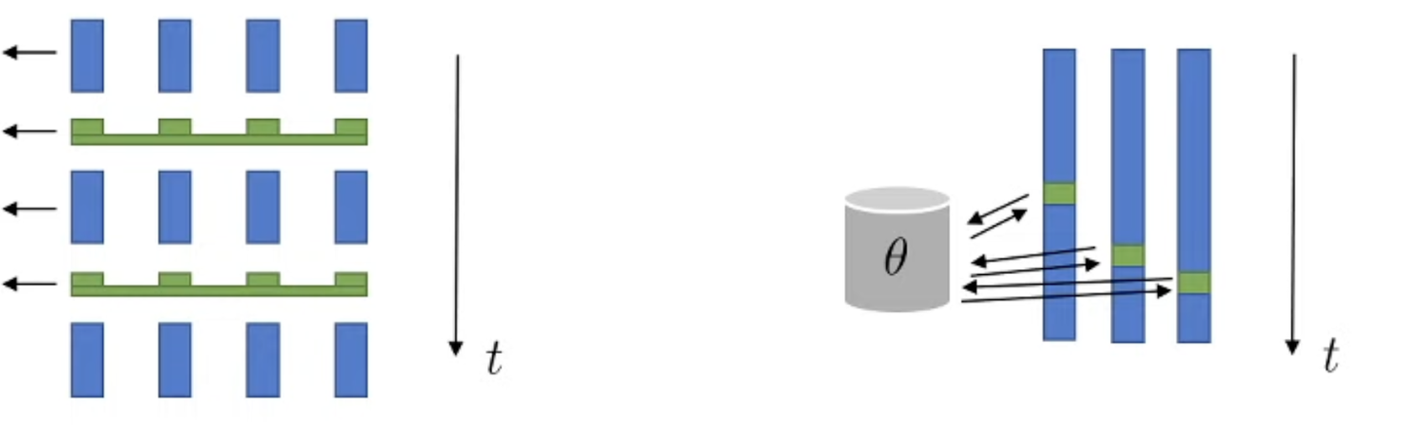







Architecture design
Fit $V_{π}$
Compute
Fit a model / estimate return
$$A_{π}(x_{t},u_{t})=r\left(x_{t},u_{t}\right)+V_{π}\left(x_{t+1}\right)−V_{π}\left(x_{t}\right)$$
Run policy and observe trajectories
Generate samples
$$∇_{θ}J(θ)≈\frac{1}{N}\overset{N}{\underset{i=1}{∑}}\overset{T}{\underset{t=1}{∑}}∇_{θ}logπ_{θ}\left(u_{i,t}∣x_{i,t}\right)A_{φ}(x_{i,t},u_{i,t})$$
Improve the policy
$$θ←θ+α∇_{θ}J(θ)$$
In practice, one could opt for different designs of this same algorithms, e.g.,:
Two network vs shared network
Parallel processing: synchronized vs asynchronous
Simple, typically more stable
Does not share features
$$x$$
$$V_{π}(x)$$
Get$(x_{t},u_{t},x_{t+1},r_{t})$
Update $θ$
Get $(x_{t},u_{t},x_{t+1},r_{t})$
$$π(u|x)$$
Update $θ$
$$x$$
32

Slide 33
Outline
Intro to policy gradients
REINFORCE algorithm
Reducing variance of policy gradient
Actor-Critic methods
Advantage
Architecture design
Deep RL Algorithms & Applications
References:
Berkeley: CS 185/285 & Deep RL Bootcamp

Slide 34
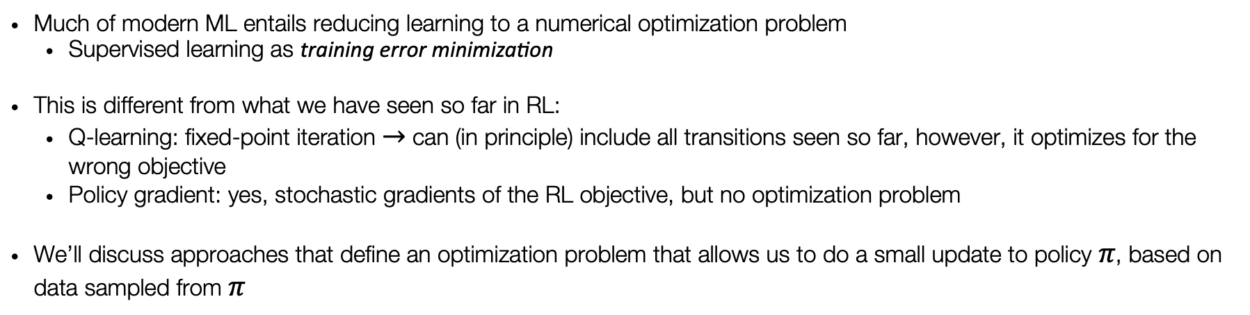
Reducing RL to optimization
Much of modern ML entails reducing learning to a numerical optimization problem
Supervised learning as training error minimization
This is different from what we have seen so far in RL:
Q-learning: fixed-point iteration $→$ can (in principle) include all transitions seen so far, however, it optimizes for the wrong objective
Policy gradient: yes, stochastic gradients of the RL objective, but no optimization problem
We’ll discuss approaches that define an optimization problem that allows us to do a small update to policy $π$, based on data sampled from $π$

Slide 35
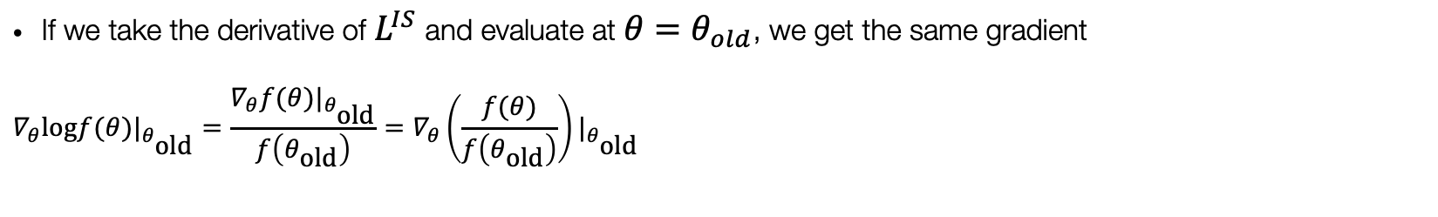
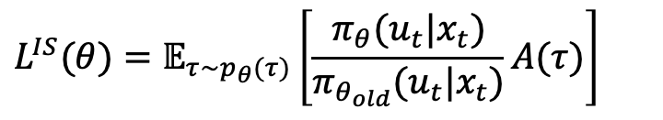


Defining the objective
$$∇_{θ}J(θ)=𝔼\left[∇_{θ}logπ_{θ}(u_{t}∣x_{t})A(x_{t},u_{t})\right]$$
We discussed how, in PO, we want to compute the following gradient
To implement this using modern auto-diff tools (e.g., Torch, Jax, Tensorflow), this means writing the following loss function:
$$L^{PG}(θ)=𝔼\left[logπ_{θ}(u_{t}∣x_{t})A(x_{t},u_{t})\right]$$
But we don’t want to optimize it too far, since we are not working with the true advantage, rather with a noisy estimate
Equivalently differentiate
$$L^{IS}(θ)=𝔼_{τ∼p_{θ}(τ)}\left[\frac{π_{θ}(u_{t}|x_{t})}{π_{θ_{old}}(u_{t}|x_{t})}A(τ)\right]$$
If we take the derivative of $L^{IS}$ and evaluate at $θ=θ_{old}$, we get the same gradient
$${∇_{θ}logf(θ)|}_{θ_{\text{old}}}=\frac{{∇_{θ}f(θ)|}_{θ_{\text{old}}}}{f\left(θ_{\text{old}}\right)}={∇_{θ}\left(\frac{f(θ)}{f\left(θ_{\text{old}}\right)}\right)|}_{θ_{\text{old}}}$$

Slide 36
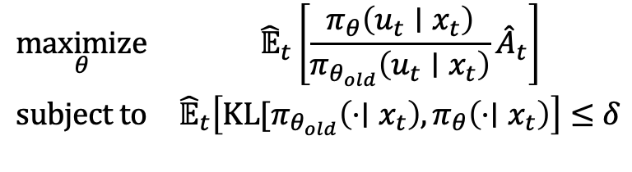
Trust Region Policy Optimization (TRPO)
$$\begin{matrix}\underset{θ}{maximize} & {\hat{𝔼}}_{t}\left[\frac{π_{θ}\left(u_{t}∣x_{t}\right)}{π_{θ_{old}}\left(u_{t}∣x_{t}\right)}{\hat{A}}_{t}\right] \\ \text{subject to} & {\hat{𝔼}}_{t}\left[KL[π_{θ_{old}}\left(⋅∣x_{t}\right),π_{θ}\left(⋅∣x_{t}\right)\right]≤δ\end{matrix}$$
Main idea: use trust region to constrain change in distribution space (opposed to e.g., parameter space)
Hard to use with architectures with multiple outputs, e.g., policy and value function
Empirically performs poorly on tasks requiring deep nets, e.g., deep CNNs, RNNs
Conjugate gradient makes implementation more complicated

Slide 37
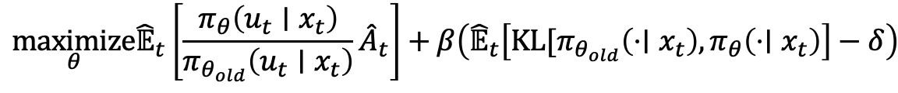

Proximal Policy Optimization (PPO)
Can we solve the problem defined in TRPO without second-order optimization?
PPO v1 - Surrogate loss with Lagrange multipliers
$$\underset{θ}{maximize}{\hat{𝔼}}_{t}\left[\frac{π_{θ}\left(u_{t}∣x_{t}\right)}{π_{θ_{old}}\left(u_{t}∣x_{t}\right)}{\hat{A}}_{t}\right]+β\left({\hat{𝔼}}_{t}\left[KL[π_{θ_{old}}\left(⋅∣x_{t}\right),π_{θ}\left(⋅∣x_{t}\right)\right]−δ\right)$$
Run SGD on the above objective
Do dual descent update for $β$
$$r(θ)=\frac{π_{θ}\left(u_{t}∣x_{t}\right)}{π_{θ_{old}}\left(u_{t}∣x_{t}\right)},r(θ_{old})=1$$
PPO v2 - Clipped surrogate loss
$$\underset{θ}{maximize}{\hat{𝔼}}_{t}\left[min(r(θ)A(τ),\text{clip}(r(θ),1−ε,1+ε)A(τ)\right]$$
Heuristically replicates constraint in the objective
One of the (if not the) most popular PO algorithm

Slide 38

Examples: Maze Navigation
Mnih et al. 2016 “Asynchronous Methods for Deep Reinforcement Learning"
Advantage Actor-Critic
Asynchronous parallel workers
Policy and Value networks: CNNs & RNNs

Slide 39


Examples: LLM Alignment

Slide 40

Examples: Maze Navigation
PPO
Trained entirely in Sim

Slide 41
Next time
Model-based RL

