Slide 1
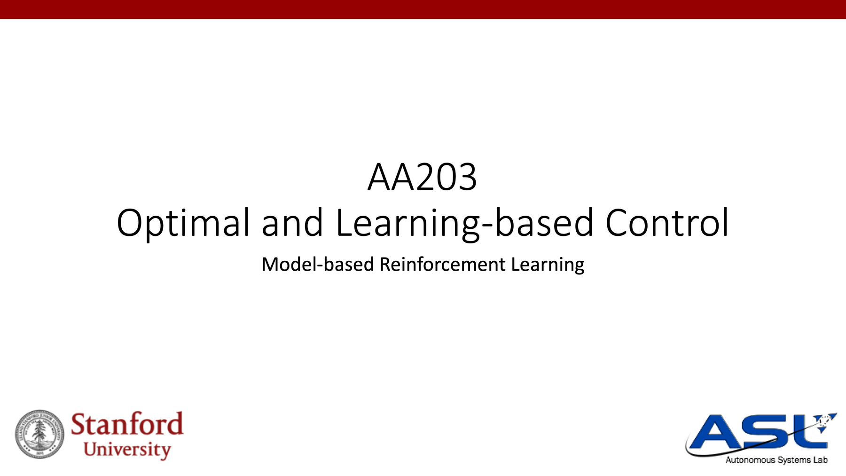

AA203 Optimal and Learning-based Control
Lecture 17
Model-based RL
Autonomous Systems Laboratory
Daniele Gammelli

Slide 2
Course overview
Imitation Learning
Model-free RL
Control
Adaptive
optimal control
Model-based RL
Feedback control
Adaptive control
Optimal and learning control
Open-loop
MPC
Closed-loop
Indirect methods
Direct
methods
DP
HJB / HJI

Slide 3


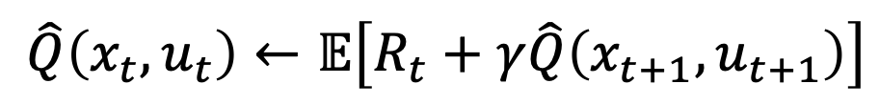







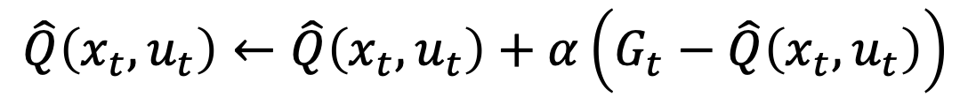



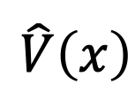

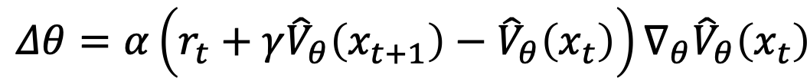
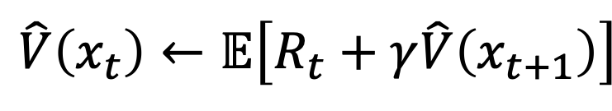



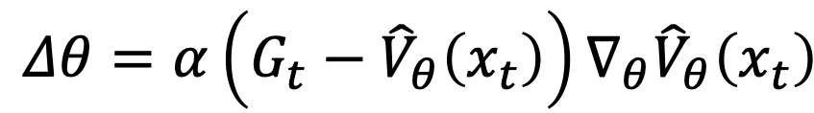
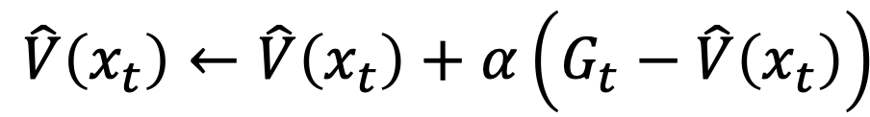




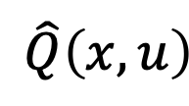



Summary: Model-free RL
We discussed different ways to estimate value functions
Unbiased
Low variance; can learn online
High variance; must reach terminal state
Biased
Dynamic Programming
Exact
Monte Carlo
Temporal-Difference
Requires knowledge of MDP
$$\hat{V}\left(x_{t}\right)←𝔼\left[R_{t}+γ\hat{V}\left(x_{t+1}\right)\right]$$
$$\hat{V}\left(x_{t}\right)←\hat{V}\left(x_{t}\right)+α\left(G_{t}−\hat{V}\left(x_{t}\right)\right)$$
$$\hat{V}\left(x_{t}\right)←\hat{V}\left(x_{t}\right)+α\left(R_{t}+γ\hat{V}\left(x_{t+1}\right)−\hat{V}\left(x_{t}\right)\right)$$
$$x_{t}$$
$$x_{t}$$
$$x_{t}$$
$$u_{t}$$
$$u_{t}$$
$$u_{t}$$
$$x_{t+1}$$
$$r_{t}$$
$$r_{t}$$
$$x_{t+1}$$
$$x_{t+1}$$
$$r_{t}$$
Terminal state
$$\hat{Q}\left(x_{t},u_{t}\right)←𝔼\left[R_{t}+γ\hat{Q}\left(x_{t+1},u_{t+1}\right)\right]$$
$$\hat{Q}\left(x_{t},u_{t}\right)←\hat{Q}\left(x_{t},u_{t}\right)+α\left(G_{t}−\hat{Q}\left(x_{t},u_{t}\right)\right)$$
$$\hat{Q}\left(x_{t},u_{t}\right)←\hat{Q}\left(x_{t},u_{t}\right)+α\left(R_{t}+γ\hat{Q}\left(x_{t+1},u_{t+1}\right)−\hat{Q}\left(x_{t},u_{t}\right)\right)$$
And how to scale these ideas through function approximation
Tabular representation:
Function approximation:
$$\hat{V}\left(x\right)$$
$$\hat{Q}\left(x,u\right)$$
$$\hat{Q}\left(x,u_{1}\right)$$
$$\hat{Q}\left(x,u_{2}\right)$$
$$\hat{Q}\left(x,u_{m}\right)$$
MC update
$$\hat{V}\left(x\right)=\left[\begin{matrix}\hat{V}\left(x_{1}\right) \\ \hat{V}\left(x_{2}\right) \\ ⋮ \\ \hat{V}\left(x_{n}\right)\end{matrix}\right]$$
$$\hat{Q}\left(x,u\right)=\left[\begin{matrix}\hat{Q}\left(x_{1},u_{1}\right)\hat{Q}\left(x_{1},u_{2}\right)…\hat{Q}\left(x_{1},u_{m}\right) \\ \hat{Q}\left(x_{2},u_{1}\right)\hat{Q}\left(x_{2},u_{2}\right)…\hat{Q}\left(x_{2},u_{m}\right) \\ ⋮ \\ \hat{Q}\left(x_{n},u_{1}\right)\hat{Q}\left(x_{n},u_{2}\right)…\hat{Q}\left(x_{n},u_{m}\right)\end{matrix}\right]$$
$$θ$$
$$…$$
$$Δθ=α\left(G_{t}−{\hat{V}}_{θ}\left(x_{t}\right)\right)∇_{θ}{\hat{V}}_{θ}\left(x_{t}\right)$$
$$θ$$
$$θ$$
TD update
$$Δθ=α\left(r_{t}+γ{\hat{V}}_{θ}\left(x_{t+1}\right)−{\hat{V}}_{θ}\left(x_{t}\right)\right)∇_{θ}{\hat{V}}_{θ}\left(x_{t}\right)$$
$$x$$
$$x$$
$$u$$
$$x$$

Slide 4
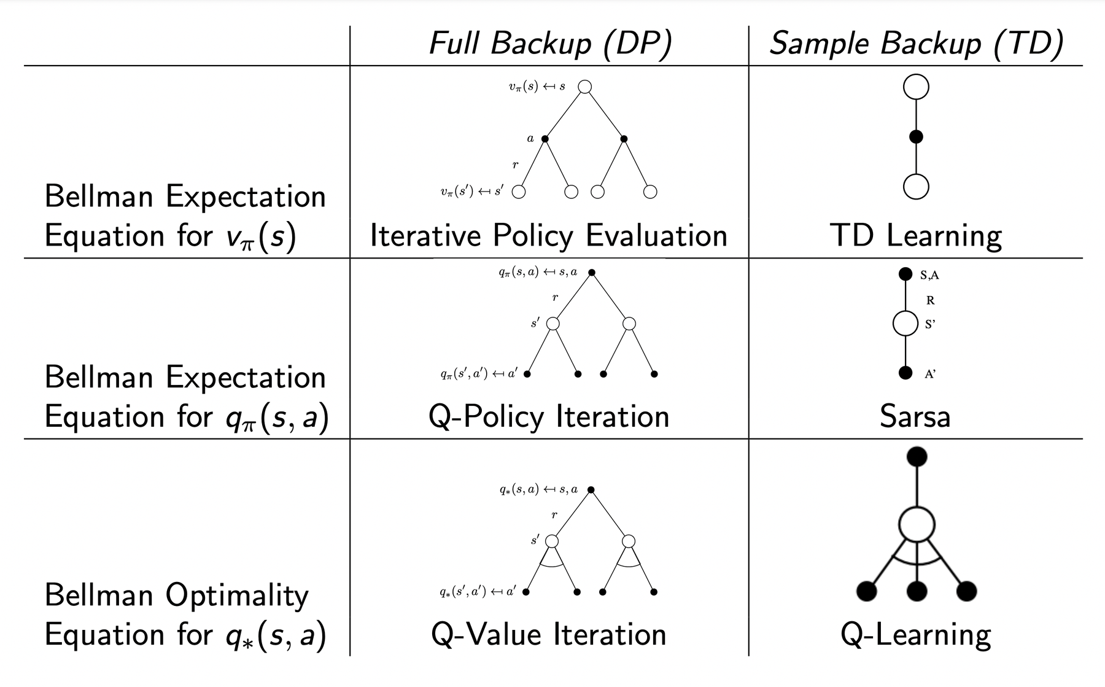
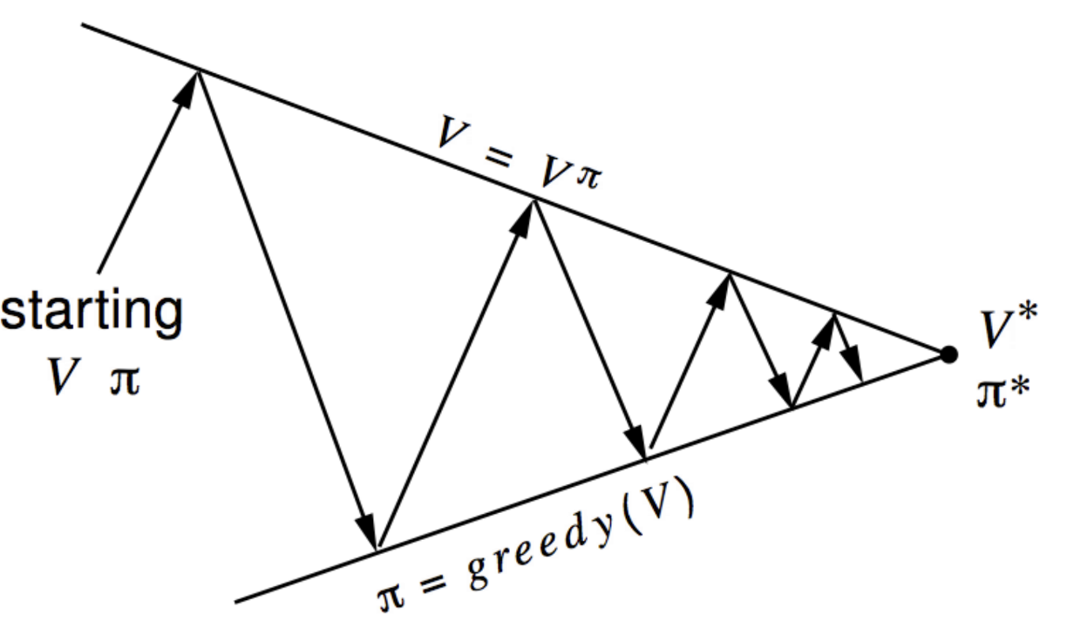
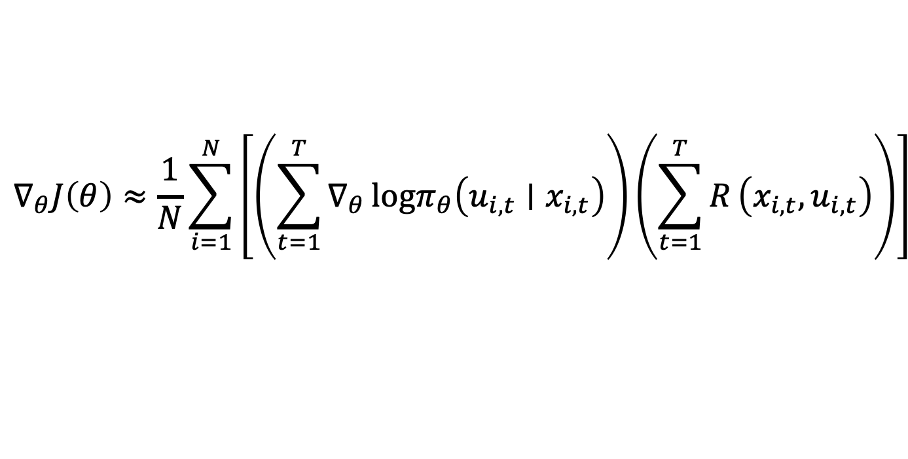
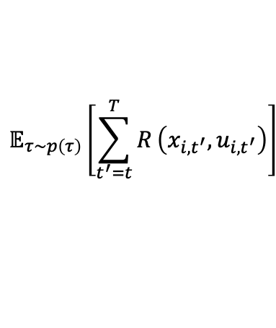

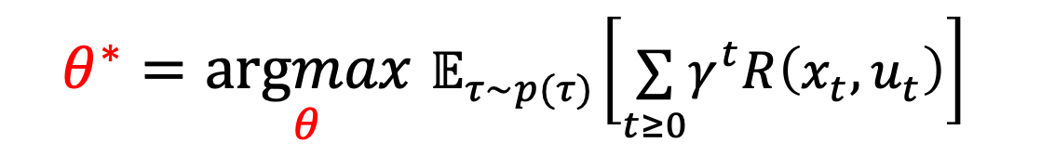
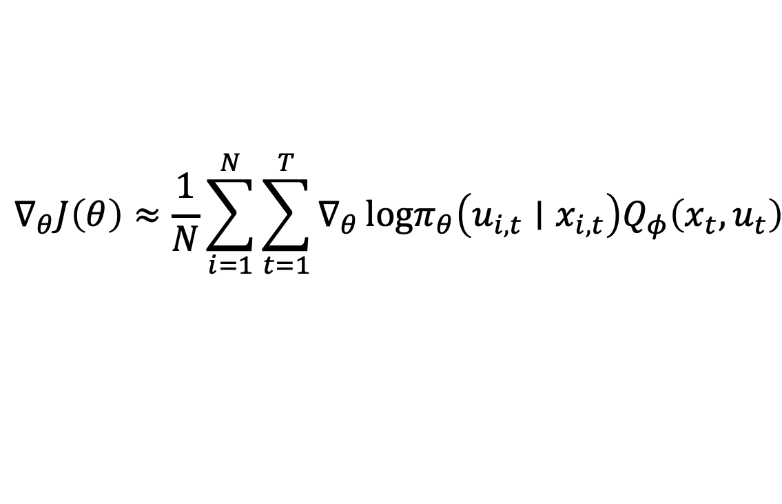
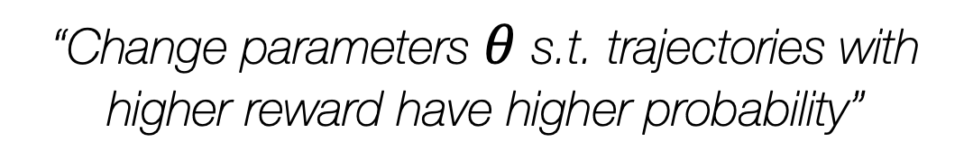
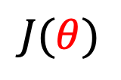
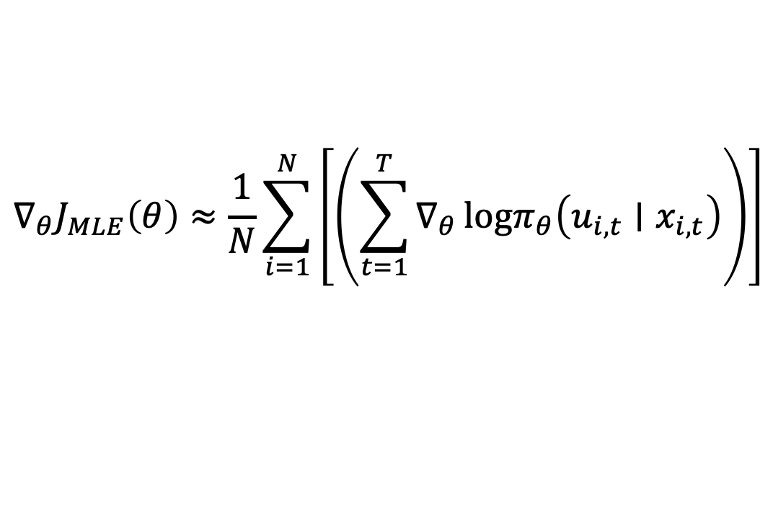

Summary: Model-free RL
Value-based methods
Generalized Policy Iteration
Sarsa & Q-learning
SARSA: on-policy
$$Q\left(x_{t},u_{t}\right)←Q\left(x_{t},u_{t}\right)+α\left(r_{t}+γQ\left(x_{t+1},u_{t+1}\right)−Q\left(x_{t},u_{t}\right)\right)$$
Q-learning: off-policy
$$Q\left(x_{t},u_{t}\right)←Q\left(x_{t},u_{t}\right)+α\left(r_{t}+γ\min_{u_{t+1}^{′}}{Q\left(x_{t+1},u_{t+1}^{′}\right)−Q\left(x_{t},u_{t}\right)}\right)$$
On-policy: evaluate or improve the policy that is used to make decisions
Off-policy: evaluate or improve a policy different from that used to generate the data
Deep RL:
(1) Use deep neural nets to represent $Q_{θ}$
(2) Uses experience replay and fixed Q-targets
In policy optimization, we care about learning an (explicit) parametric policy $π_{θ}$, with parameters $θ$ to directly maximize:
$$θ^{∗}=\underset{θ}{argmax}{ 𝔼}_{τ∼p(τ)}\left[\underset{t≥0}{∑}γ^{t}R\left(x_{t},u_{t}\right)\right]$$
$$𝔼_{τ∼p\left(τ\right)}\left[\sum_{t^{′}=t}^{T}{R}\left(x_{i,t^{′}},u_{i,t^{′}}\right)\right]$$
estimate its gradient $∇_{θ}J\left(θ\right)$
do approximate gradient ascent on $J\left(θ\right)$: $θ←θ+α∇_{θ}J\left(θ\right)$
=
$$J(θ)$$
$$Q_{π}\left(x_{t},u_{t}\right)$$
$$∇_{θ}J\left(θ\right)≈\frac{1}{N}\sum_{i=1}^{N}{\left[\left(\sum_{t=1}^{T}{∇_{θ}}logπ_{θ}\left(u_{i,t}∣x_{i,t}\right)\right)\left(\sum_{t=1}^{T}{R}\left(x_{i,t},u_{i,t}\right)\right)\right]}$$
Problem: high variance of PG
Policy gradient:
$$p\left(x_{t+1}|x_{t},u_{t}\right)$$
Solution: baselines, “critics”
Maximum Likelihood:
$$∇_{θ}J_{MLE}\left(θ\right)≈\frac{1}{N}\sum_{i=1}^{N}{\left[\left(\sum_{t=1}^{T}{∇_{θ}}logπ_{θ}\left(u_{i,t}∣x_{i,t}\right)\right)\right]}$$
“Change parameters $θ$ s.t. trajectories with higher reward have higher probability”
$$∇_{θ}J\left(θ\right)≈\frac{1}{N}\sum_{i=1}^{N}{\sum_{t=1}^{T}{∇_{θ}}}logπ_{θ}\left(u_{i,t}∣x_{i,t}\right)Q_{φ}\left(x_{t},u_{t}\right)$$
Policy Optimization

Slide 5
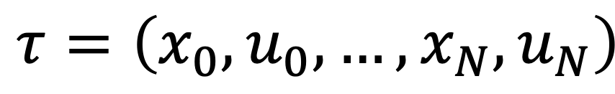
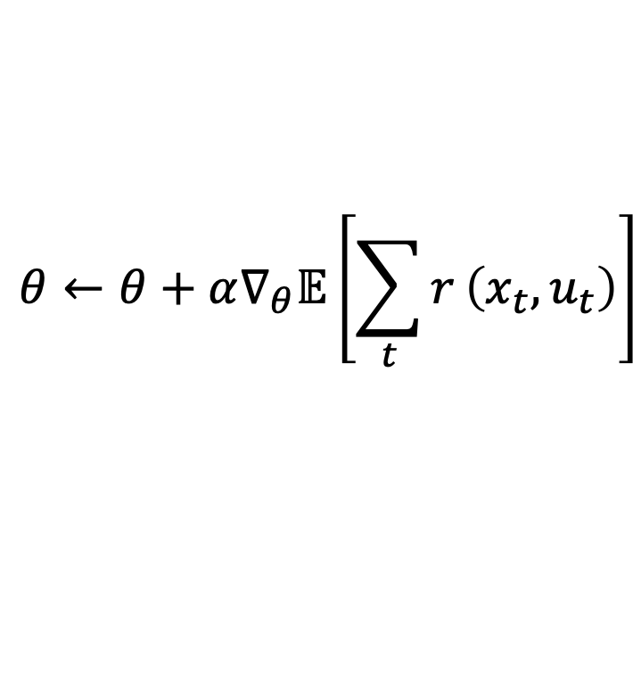
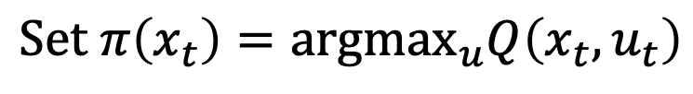
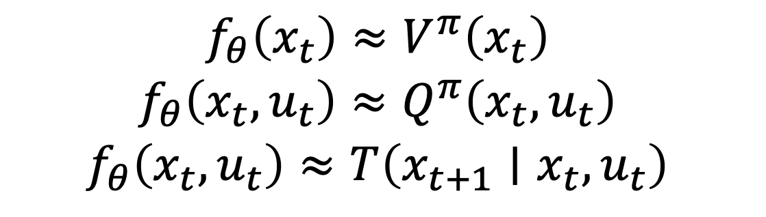
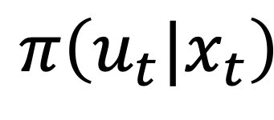
A bird’s eye view on the RL algorithms covered so far
Fit a model / estimate return
$$\begin{matrix} & f_{θ}\left(x_{t}\right)≈V^{π}\left(x_{t}\right) \\ & f_{θ}\left(x_{t},u_{t}\right)≈Q^{π}\left(x_{t},u_{t}\right) \\ & f_{θ}\left(x_{t},u_{t}\right)≈T\left(x_{t+1}∣x_{t},u_{t}\right)\end{matrix}$$
$$π\left(u_{t}|x_{t}\right)$$
Generate samples
$$τ=\left(x_{0},u_{0},…,x_{N},u_{N}\right)$$
Improve the policy
$$S\text{et} π\left(x_{t}\right)=arg\max_{u}Q\left(x_{t},u_{t}\right)$$
(e.g., Q-learning, DQN)
$$θ←θ+α∇_{θ}𝔼\left[\sum_{t}^{​}{r}\left(x_{t},u_{t}\right)\right]$$
(e.g., PG, A2C, A3C)

Slide 6
Revisiting the discussion on trade-offs
Different tradeoffs:
Sample efficiency
Stability & easy of use
Different assumptions:
Stochastic or deterministic
Continuous or discrete
Episodic or infinite horizon
Different things are easy or hard in different settings:
Easier to represent the policy?
Easier to represent the model?

Slide 7
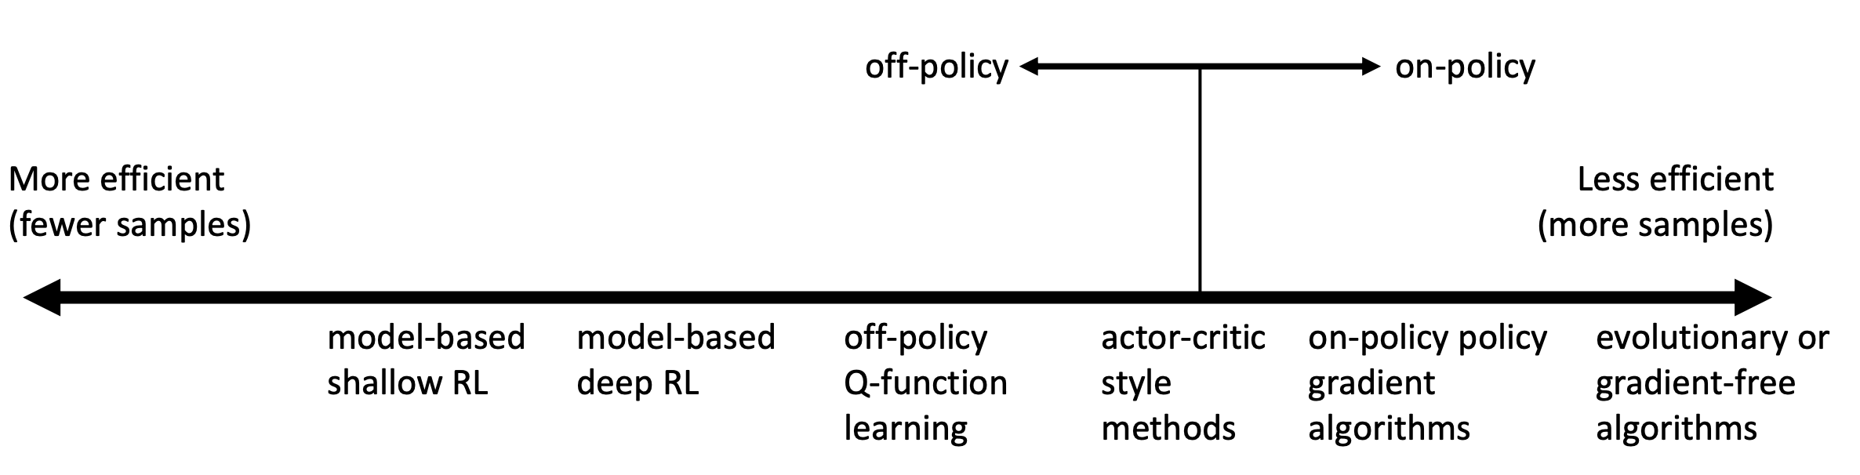
Comparison: sample efficiency
Sample efficiency = how many samples do we need to get a good policy?
Crucial question: is the algorithm on- or off-policy?
Off policy: able to improve the policy without generating new samples from the current policy
On policy: each time the policy is changed, even a little bit, we need to generate new samples
Why even bother using less efficient algorithms? Wall-clock time is not the same as efficiency!

Slide 8
Outline
Basics of model-based RL
A basic recipe (and its limitations)
Learning with high-capacity models: distributional shift
Uncertainty quantification in model-based RL
Gaussian Processes
Bootstrap Ensembles
Examples & Applications (e.g., PETS)

Slide 9
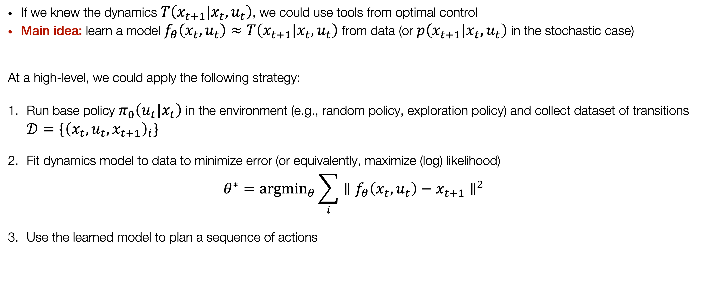
General recipe
If we knew the dynamics $T\left(x_{t+1}|x_{t},u_{t}\right)$, we could use tools from optimal control
Main idea: learn a model $f_{θ}\left(x_{t},u_{t}\right)≈T\left(x_{t+1}|x_{t},u_{t}\right)$ from data (or $p\left(x_{t+1}|x_{t},u_{t}\right)$ in the stochastic case)
At a high-level, we could apply the following strategy:
Run base policy $π_{0}\left(u_{t}|x_{t}\right)$ in the environment (e.g., random policy, exploration policy) and collect dataset of transitions $𝒟=\{{\left(x_{t},u_{t},x_{t+1}\right)}_{i}\}$
Fit dynamics model to data to minimize error (or equivalently, maximize (log) likelihood)
$$θ^{∗}=arg\min_{θ}\sum_{i}^{​}{{∥f_{θ}\left(x_{t},u_{t}\right)−x_{t+1}∥}^{2}}$$
Use the learned model to plan a sequence of actions

Slide 10
Will this work?
YES
In cases with e.g., linear-time invariant dynamics, this tends to work pretty well
Particularly effective if we can hand-engineer a dynamics representation using our knowledge of physics, and fit just a few parameters
If the dataset is generated with sufficient excitation, it gives global knowledge (i.e., some care should be taken to design a good base policy)
This is essentially how system identification works
NO
If we’re dealing with non-linear dynamics (and high-capacity models! e.g., neural networks) extrapolation is difficult and can be misleading

Slide 11

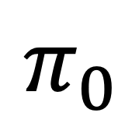

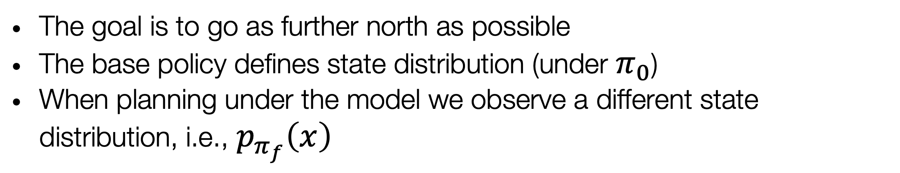
Motivating example
The goal is to go as further north as possible
The base policy defines state distribution (under $π_{0}$)
When planning under the model we observe a different state distribution, i.e., $p_{π_{f}}\left(x\right)$
$$p_{π_{f}}\left(x\right)$$
$$π_{0}$$
$$p_{π_{0}}\left(x\right)$$
The more (i) the dynamics are complex, (ii) we use high-capacity models, the easier it is incur in distribution mismatch

Slide 12
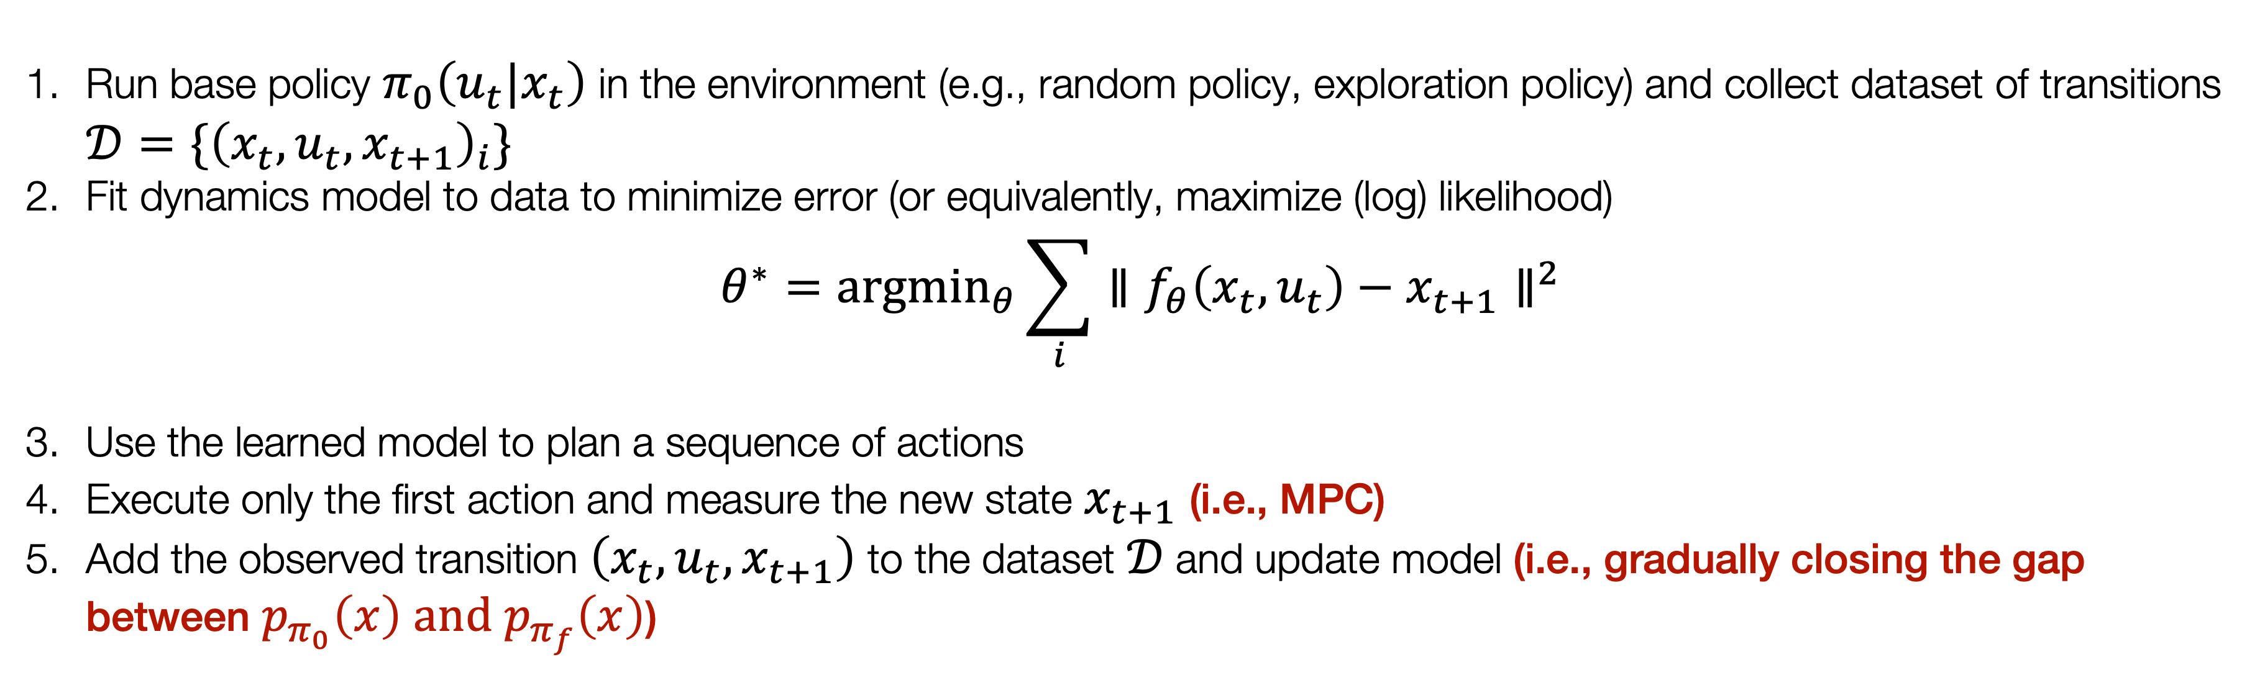
A simple improvement
We can leverage ideas from adaptive and receding-horizon control:
Run base policy $π_{0}\left(u_{t}|x_{t}\right)$ in the environment (e.g., random policy, exploration policy) and collect dataset of transitions $𝒟=\{{\left(x_{t},u_{t},x_{t+1}\right)}_{i}\}$
Fit dynamics model to data to minimize error (or equivalently, maximize (log) likelihood)
$$θ^{∗}=arg\min_{θ}\sum_{i}^{​}{{∥f_{θ}\left(x_{t},u_{t}\right)−x_{t+1}∥}^{2}}$$
Use the learned model to plan a sequence of actions
Execute only the first action and measure the new state $x_{t+1}$ (i.e., MPC)
Add the observed transition $\left(x_{t},u_{t},x_{t+1}\right)$ to the dataset $𝒟$ and update model (i.e., gradually closing the gap between $p_{π_{0}}\left(x\right) \text{and}{ p}_{π_{f}}\left(x\right)$)

Slide 13
Outline
Basics of model-based RL
A basic recipe (and its limitations)
Learning with high-capacity models: distributional shift
Uncertainty quantification in model-based RL
Gaussian Processes
Bootstrap Ensembles
Examples & Applications (e.g., PETS)

Slide 14
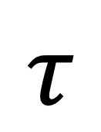
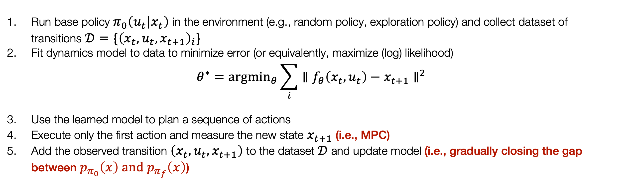
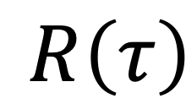
The main challenge in MBRL
Ideally, we’d want our model to:
Have high-capacity to represent complex dynamics in the high-data regime
Not overfit to observed data in the low-data regime
For example, consider the case where we fit our model to observed data and use it to plan, according to the previous scheme
Run base policy $π_{0}\left(u_{t}|x_{t}\right)$ in the environment (e.g., random policy, exploration policy) and collect dataset of transitions $𝒟=\{{\left(x_{t},u_{t},x_{t+1}\right)}_{i}\}$
Fit dynamics model to data to minimize error (or equivalently, maximize (log) likelihood)
$$θ^{∗}=arg\min_{θ}\sum_{i}^{​}{{∥f_{θ}\left(x_{t},u_{t}\right)−x_{t+1}∥}^{2}}$$
Use the learned model to plan a sequence of actions
Execute only the first action and measure the new state $x_{t+1}$ (i.e., MPC)
Add the observed transition $\left(x_{t},u_{t},x_{t+1}\right)$ to the dataset $𝒟$ and update model (i.e., gradually closing the gap between $p_{π_{0}}\left(x\right) \text{and} p_{π_{f}}\left(x\right)$)
$$R\left(τ\right)$$
$$τ$$
Problem: we’ll likely erroneously exploit our model where it is less knowledgeable
(Possible) Solution: consider how “certain” we our about the prediction

Slide 15
The role of uncertainty estimation
Specifically, by uncertainty on our predictions, we mean an expression of a distribution over possible outcomes
This allows us to reason in terms of expectations under our model
Expected reward under high-variance prediction is low

Slide 16
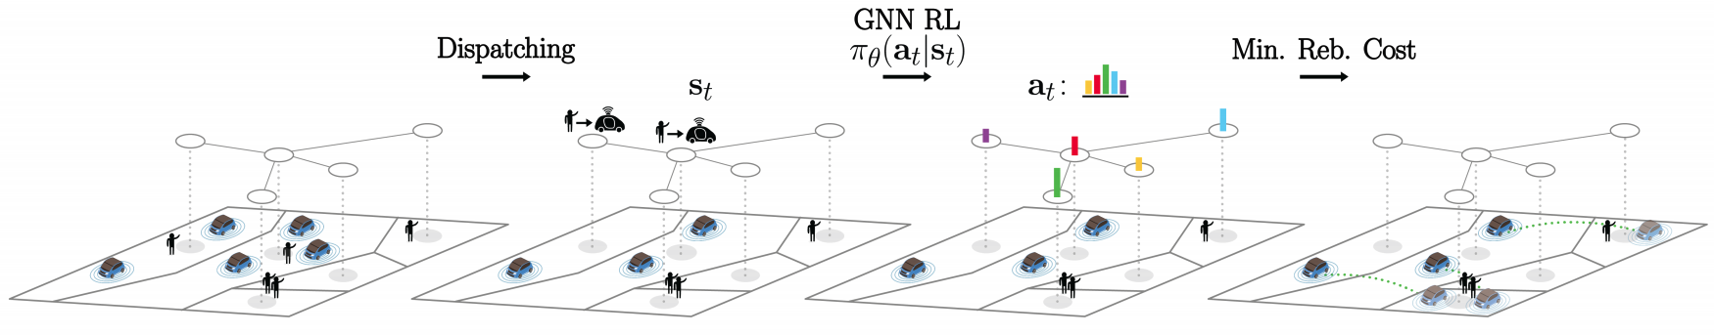
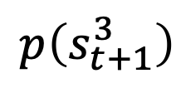
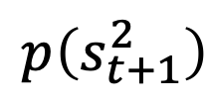

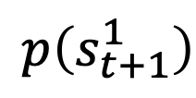
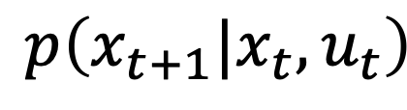


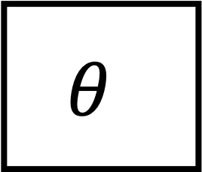
How can we model uncertainty?
Idea 1: use output entropy
Suppose we estimated a model, why not use its entropy?
$$p\left(x_{t+1}|x_{t},u_{t}\right)$$
Discrete state-space
Continuous state-space
$$θ$$
$$p\left(s_{t+1}^{1}\right)$$
$$p\left(s_{t+1}^{2}\right)$$
$$p\left(s_{t+1}^{3}\right)$$
$$s_{t+1}$$
$$x$$
$$u$$
Doing so will not take epistemic uncertainty into account
Aleatoric uncertainty:
“The process is intrinsically noisy”
Epistemic uncertainty:
“Uncertainty about the model”

Slide 17

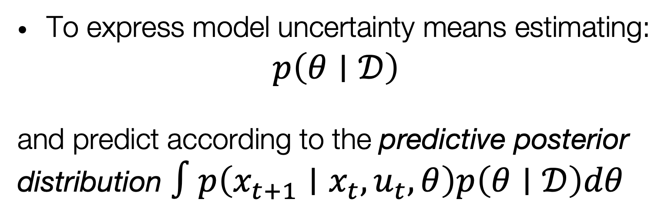
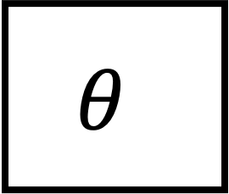
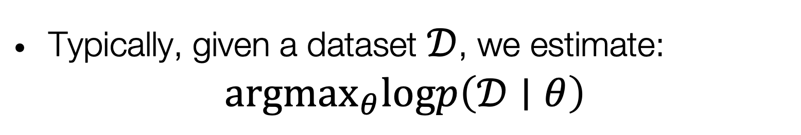

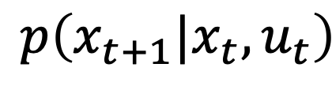
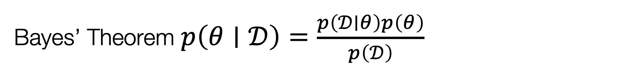
How can we model uncertainty?
Prior: $p\left(θ\right)$, Likelihood: $p\left(𝒟∣θ\right)$, Posterior $p\left(θ∣𝒟\right)$
Idea 2: estimate model uncertainty
Bayes’ Theorem $p\left(θ∣𝒟\right)=\frac{p\left(𝒟∣θ\right)p\left(θ\right)}{p\left(𝒟\right)}$
$$p\left(x_{t+1}|x_{t},u_{t}\right)$$
$$θ$$
$$x$$
$$u$$
Typically, given a dataset $𝒟$, we estimate:
$$arg\max_{θ}logp\left(𝒟∣θ\right)$$
To express model uncertainty means estimating:
$$p\left(θ∣𝒟\right)$$
and predict according to the predictive posterior distribution $∫p\left(x_{t+1}∣x_{t},u_{t},θ\right)p\left(θ∣𝒟\right)dθ$

Slide 18
(1) Gaussian Processes
Represent “distribution over functions”
Bayesian inference
Samples from prior distribution
Samples from posterior distribution
Strengths
Data efficient
Exact posterior
Weaknesses
High computational complexity
Cannot learn expressive features

Slide 19
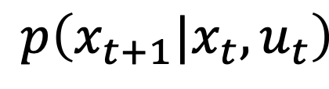













(2) Bootstrap ensembles
High level idea: “train multiple models and see if they agree”
Different models will likely agree in regions where we have data and disagree where we do not
$$p\left(x_{t+1}|x_{t},u_{t}\right)$$
$$p\left(x_{t+1}|x_{t},u_{t}\right)$$
$$p\left(x_{t+1}|x_{t},u_{t}\right)$$
$$p\left(x_{t+1}|x_{t},u_{t}\right)$$
$$p\left(θ∣𝒟\right)$$
$$θ$$
$$θ$$
$$θ$$
$$θ$$
$$x$$
$$u$$
$$x$$
$$u$$
$$x$$
$$u$$
$$x$$
$$u$$
Formally, we approximate the posterior with a mixture of Dirac distributions:
$$θ$$
$$\begin{matrix} & p\left(θ∣𝒟\right)≈\frac{1}{N}\sum_{i}^{​}{δ}\left(θ_{i}\right) \\ & ∫p\left(x_{t+1}∣x_{t},u_{t},θ\right)p\left(θ∣𝒟\right)dθ≈\frac{1}{N}\sum_{i}^{​}{p}\left(x_{t+1}∣x_{t},u_{t},θ_{i}\right)\end{matrix}$$
Usually, no need for resampling or independent datasets: SGD and random initialization make the models sufficiently independent

Slide 20

Planning with uncertainty
How can we use this additional knowledge in planning?
Given a candidate action sequence $u_{1},…,u_{T}$:
Sample $θ_{i}∼p\left(θ|𝒟\right)$ (in the case of ensembles, this is equivalent to choosing one among the models)
Propagate forward the learned dynamics according to $x_{t+1}∼p_{θ_{i}}\left(x_{t+1}|x_{t},u_{t}\right)$, for all $t$
Compute (predicted) rewards $\sum_{t}^{​}{r}\left(x_{t},u_{t}\right)$
Repeat steps 1-3 and compute the average reward: $J\left(u_{1},…,u_{T}\right)=\frac{1}{N}\sum_{i=1}^{N}{\sum_{t=1}^{H}{r}}\left(x_{t,i},u_{t}\right), \text{where}x_{t+1,i}∼p_{θ_{i}}\left(x_{t+1,i}|x_{t,i},u_{t}\right)$
Caveat: this is only a choice, one could think of other ways to approximate the posterior predictive distribution.
The general idea is that, when planning, we want to evaluate the expected reward under our model

Slide 21

Case study: PETS
Probabilistic Ensembles with Trajectory Sampling
Key idea:
Model: Use ensemble of NNs to approximate posterior over model
Propagation: sample different models and use them to generate predictions of different “futures”
Planning: apply MPC (compute action sequence via sampling, i.e., cross-entropy method (CEM) )

Slide 22



Case study: PETS

Slide 23
Concluding thoughts
Imitation Learning
Model-free RL
Control
Adaptive
optimal control
Model-based RL
Feedback control
Adaptive control
Optimal and learning control
Open-loop
MPC
Closed-loop
Indirect methods
Direct
methods
DP
HJB / HJI

Slide 24







“Model of the world”
Closed-loop / High-level decision making
Open-loop
(e.g., via HJ reachability)
MPC (e.g., tracking)
Actuators
(e.g., PID controller)

