Slide 1
AA203 Optimal and Learning-based Control
Optimization theory

Slide 2
Outline
Computational methods for unconstrained optimization
Optimization with equality constraints
Optimization with inequality constraints

Slide 3
Outline
Computational methods for unconstrained optimization
Optimization with equality constraints
Optimization with inequality constraints

Slide 4
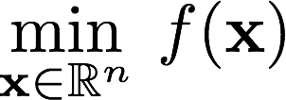
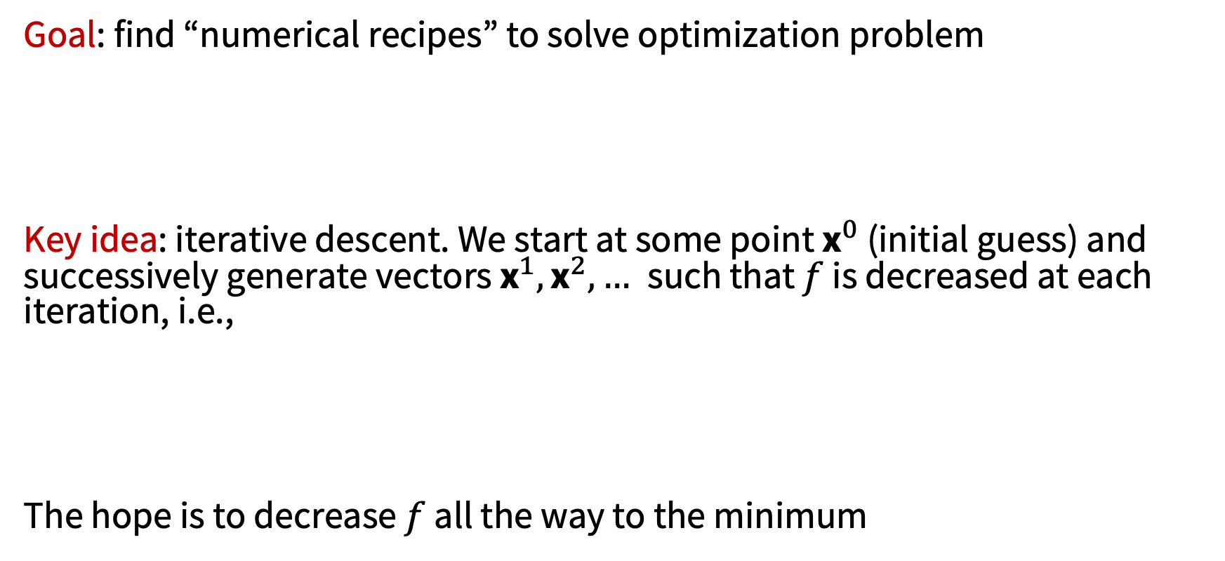
Computational methods (unconstrained case)
Goal: find “numerical recipes” to solve optimization problem
Key idea: iterative descent. We start at some point ${\text{x}}^{0}$ (initial guess) and successively generate vectors ${\text{x}}^{1},{\text{x}}^{2},…$such that $f$ is decreased at each iteration, i.e.,
The hope is to decrease $f$ all the way to the minimum

Slide 5
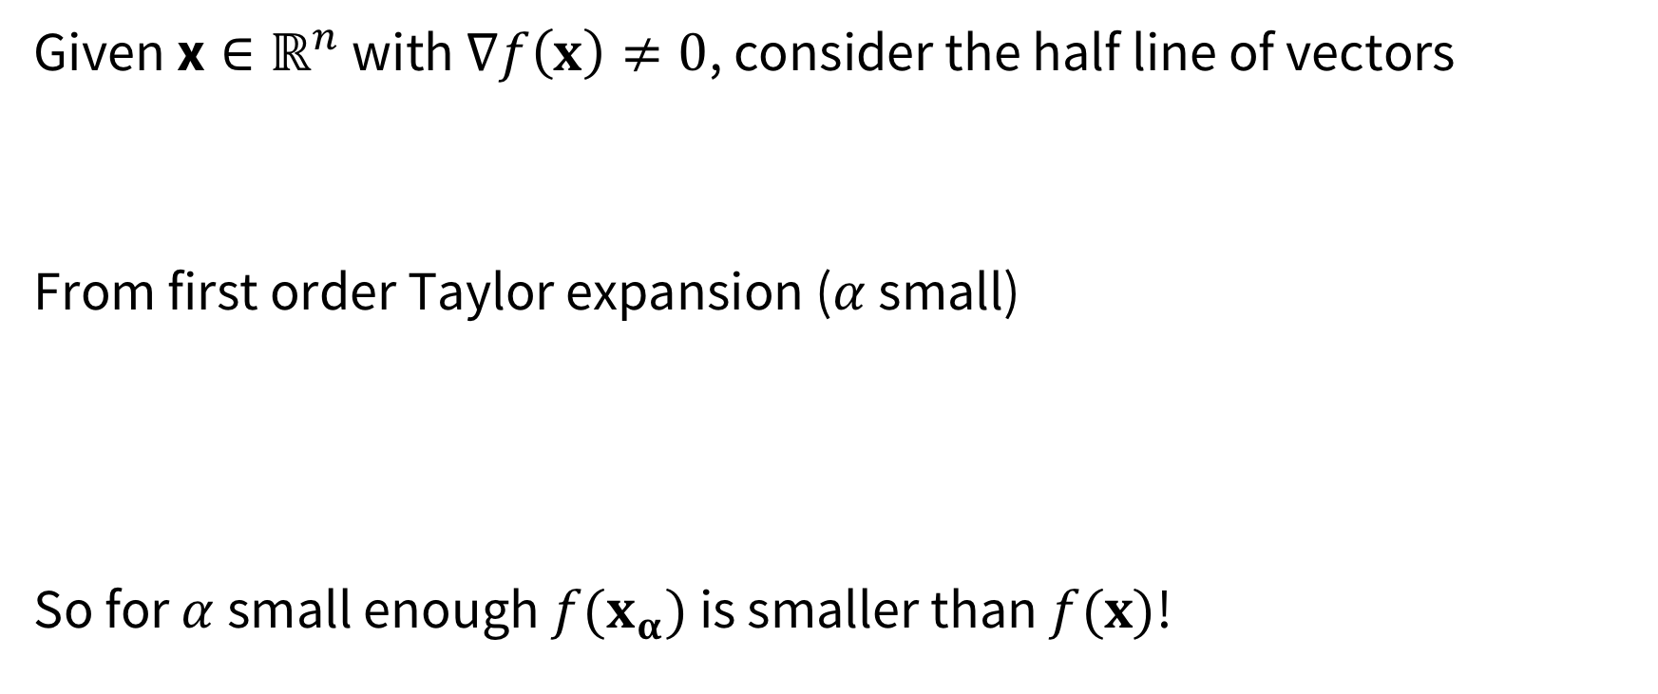
Gradient methods
Given $\text{x}∈ℝ^{n}$ with $∇f\left(x\right)≠0$, consider the half line of vectors
From first order Taylor expansion ($α$ small)
So for $α$ small enough $f(x_{α})$ is smaller than $f(x)$!

Slide 6
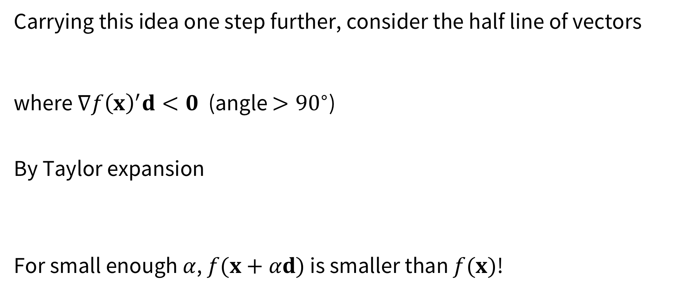
Gradient methods
Carrying this idea one step further, consider the half line of vectors
where $∇f{\left(x\right)}^{′}d<0$ (angle ${>90}^{∘}$)
By Taylor expansion
For small enough $α$, $f(x+αd)$ is smaller than $f(x)$!

Slide 7

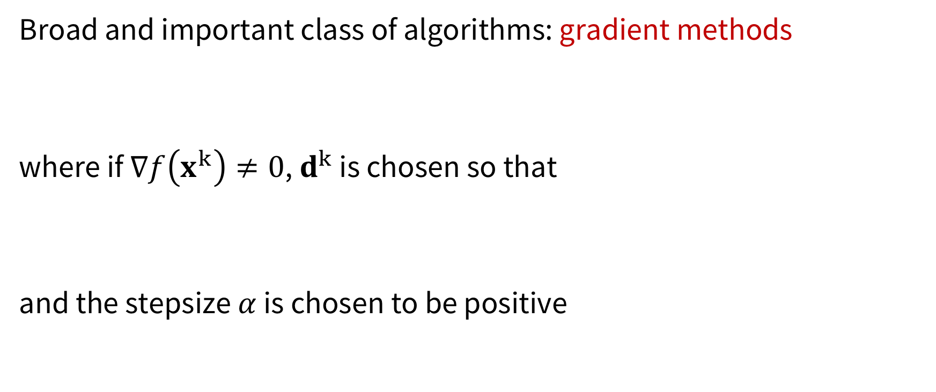
Gradient methods
Broad and important class of algorithms: gradient methods
where if $∇f\left(x^{k}\right)≠0$, $d^{k}$ is chosen so that
and the stepsize $α$ is chosen to be positive

Slide 8
Gradient descent
Most often the stepsize is chosen so that
and the method is called gradient descent. “Tuning” parameters:
selecting the descent direction
selecting the stepsize

Slide 9

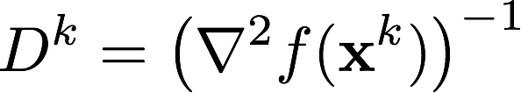


Selecting the descent direction
General class
(Obviously, $∇f{\left(x^{k}\right)}^{′}d^{k}<0$)
Popular choices:
Steepest descent:
Newton's method: provided

Slide 10
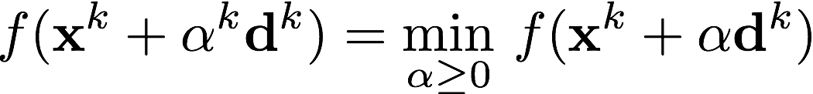
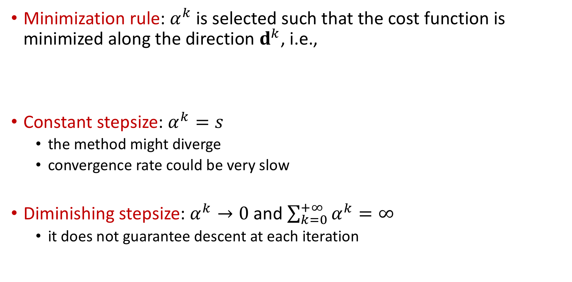
Selecting the stepsize
Minimization rule: $α^{k}$is selected such that the cost function is minimized along the direction $d^{k}$, i.e.,
Constant stepsize: $α^{k}=s$
the method might diverge
convergence rate could be very slow
Diminishing stepsize: $α^{k}→0$ and $\sum_{k=0}^{+∞}{α^{k}}=∞$
it does not guarantee descent at each iteration

Slide 11
Undiscussed in this class
Mathematical analysis:
convergence (to stationary points)
termination criteria
convergence rate
Derivative-free methods, e.g.,
coordinate descent
Nelder-Mead

Slide 12
Next: constrained optimization
constraint set usually specified in terms of equality and inequality constraints
sophisticated collection of optimality conditions, involving some auxiliary variables, called Lagrange multipliers
Viewpoints:
penalty viewpoint: we disregard the constraints and we add to the cost a high penalty for violating them
feasibility direction viewpoint: it relies on the fact that at a local minimum there can be no cost improvement when traveling a small distance along a direction that leads to feasible points

Slide 13
Outline
Computational methods for unconstrained optimization
Optimization with equality constraints
Optimization with inequality constraints

Slide 14
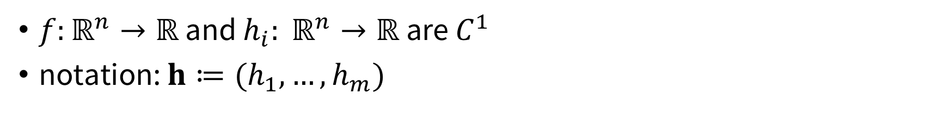
Optimization with equality constraints
$f:ℝ^{n}→ℝ$ and $h_{i}: ℝ^{n}→ℝ$ are $C^{1}$
notation: $h≔(h_{1}, …, h_{m})$

Slide 15
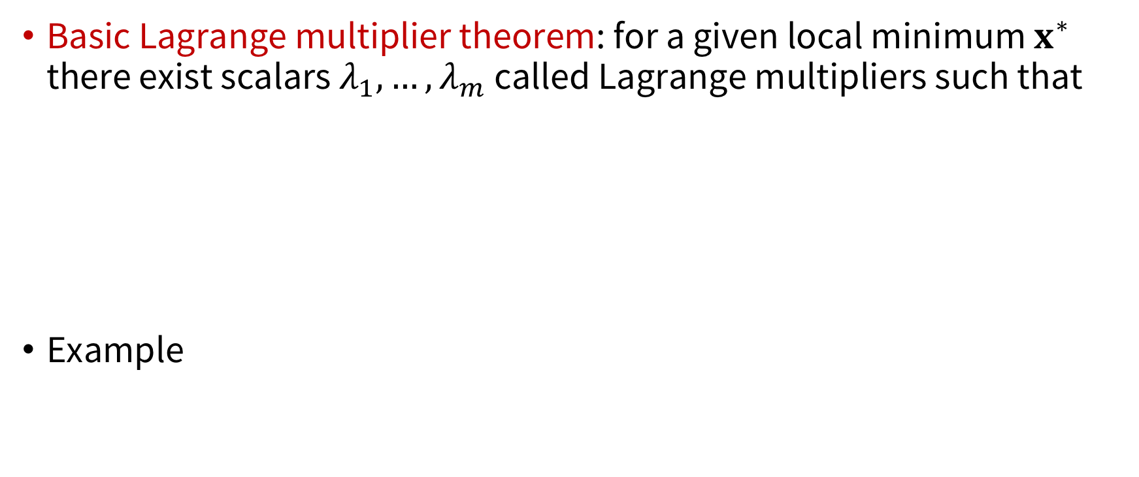
Lagrange multipliers
Basic Lagrange multiplier theorem: for a given local minimum $x^{∗}$ there exist scalars $λ_{1},…, λ_{m}$ called Lagrange multipliers such that
Example

Slide 16
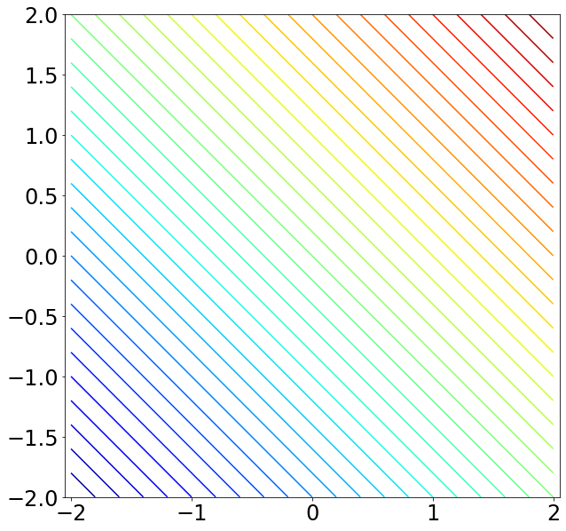
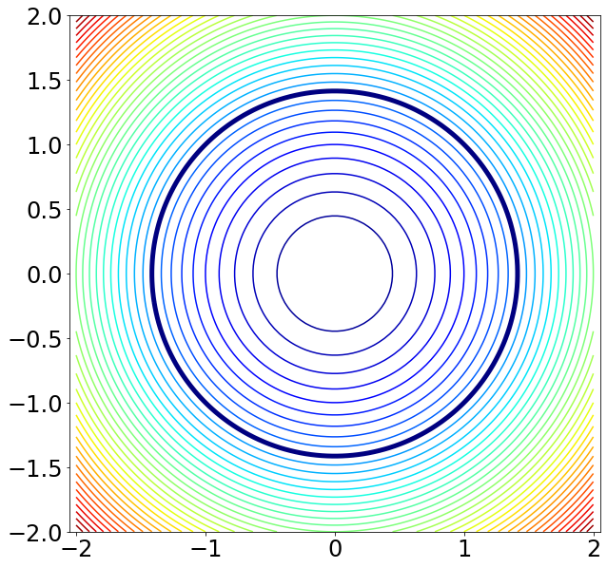
Lagrange multipliers

Slide 17
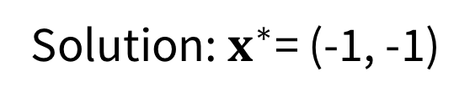
Lagrange multipliers
Basic Lagrange multiplier theorem: for a given local minimum $x^{∗}$ there exist scalars $λ_{1},…, λ_{m}$ called Lagrange multipliers such that
Example
Solution: $x^{∗}$= (-1, -1)

Slide 18
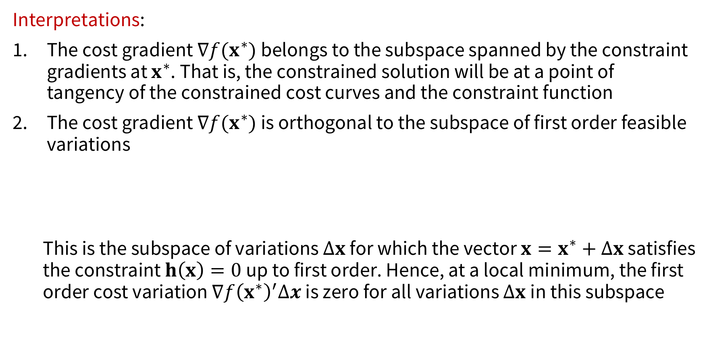
Lagrange multipliers
Interpretations:
The cost gradient $∇f(x^{∗})$ belongs to the subspace spanned by the constraint gradients at $x^{∗}$. That is, the constrained solution will be at a point of tangency of the constrained cost curves and the constraint function
The cost gradient $∇f(x^{∗})$ is orthogonal to the subspace of first order feasible variations
This is the subspace of variations $Δx$ for which the vector $x=x^{∗}+Δx$ satisfies the constraint $h\left(x\right)=0$ up to first order. Hence, at a local minimum, the first order cost variation $∇f{\left(x^{∗}\right)}^{′}Δx$ is zero for all variations $Δx$in this subspace

Slide 19

NOC
Theorem: NOC
Let $x^{∗}$be a local minimum of $f$ subject to $h\left(x\right)=0$ and assume that the constraint gradients $∇h_{1}(x^{∗}),…,∇h_{m}(x^{∗})$ are linearly independent. Then there exists a unique vector $(λ_{1},…, λ_{m}$), called a Lagrange multiplier vector, such that
(2nd order NOC and SOC are provided in AA203-Notes)

Slide 20
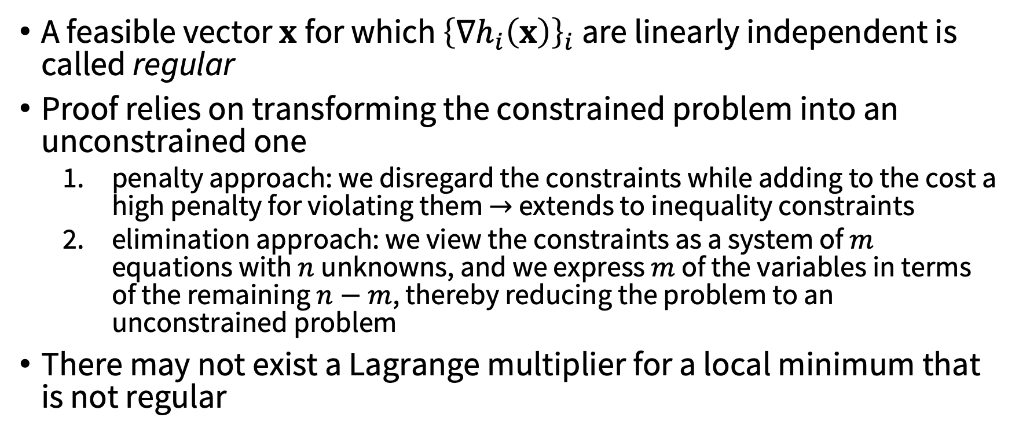
Discussion
A feasible vector $x$for which ${\left\{∇h_{i}\left(x\right)\right\}}_{i}$ are linearly independent is called regular
Proof relies on transforming the constrained problem into an unconstrained one
penalty approach: we disregard the constraints while adding to the cost a high penalty for violating them $→$ extends to inequality constraints
elimination approach: we view the constraints as a system of $m$ equations with $n$unknowns, and we express $m$ of the variables in terms of the remaining $n−m$, thereby reducing the problem to an unconstrained problem
There may not exist a Lagrange multiplier for a local minimum that is not regular

Slide 21
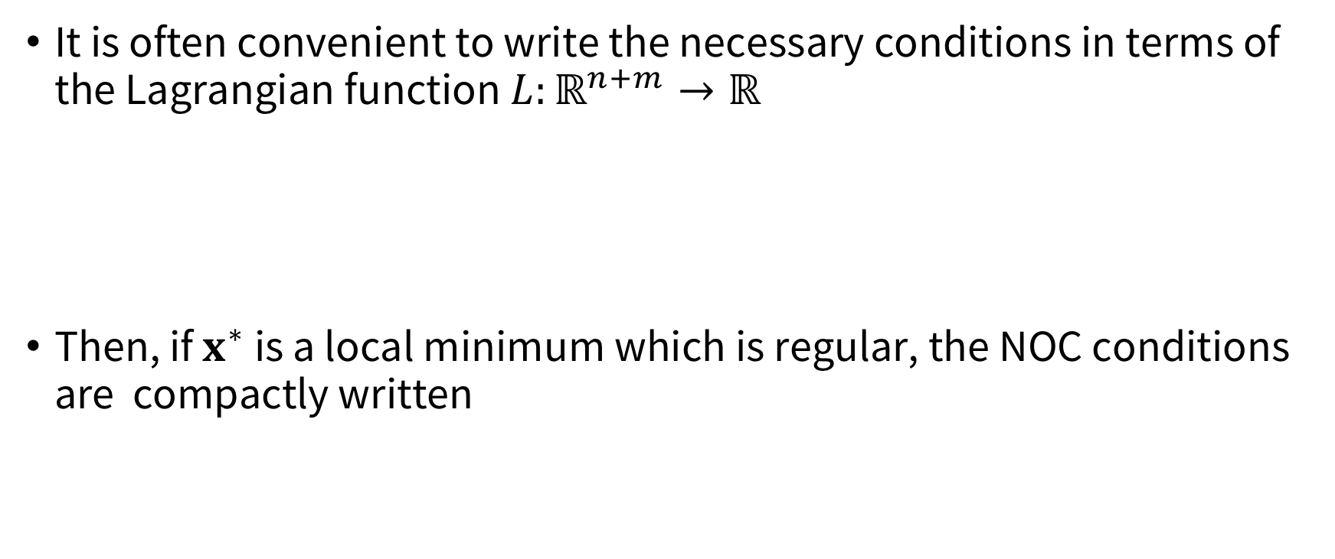

The Lagrangian function
It is often convenient to write the necessary conditions in terms of the Lagrangian function $L:ℝ^{n+m}→ℝ$
Then, if $x^{∗}$ is a local minimum which is regular, the NOC conditions are compactly written
System of $n+m$ equations with $n+m$ unknowns

Slide 22
Outline
Computational methods for unconstrained optimization
Optimization with equality constraints
Optimization with inequality constraints

Slide 23

Optimization with inequality constraints
$f$, $h_{i}$, $g_{j}$ are $C^{1}$
In compact form (ICP problem)

Slide 24
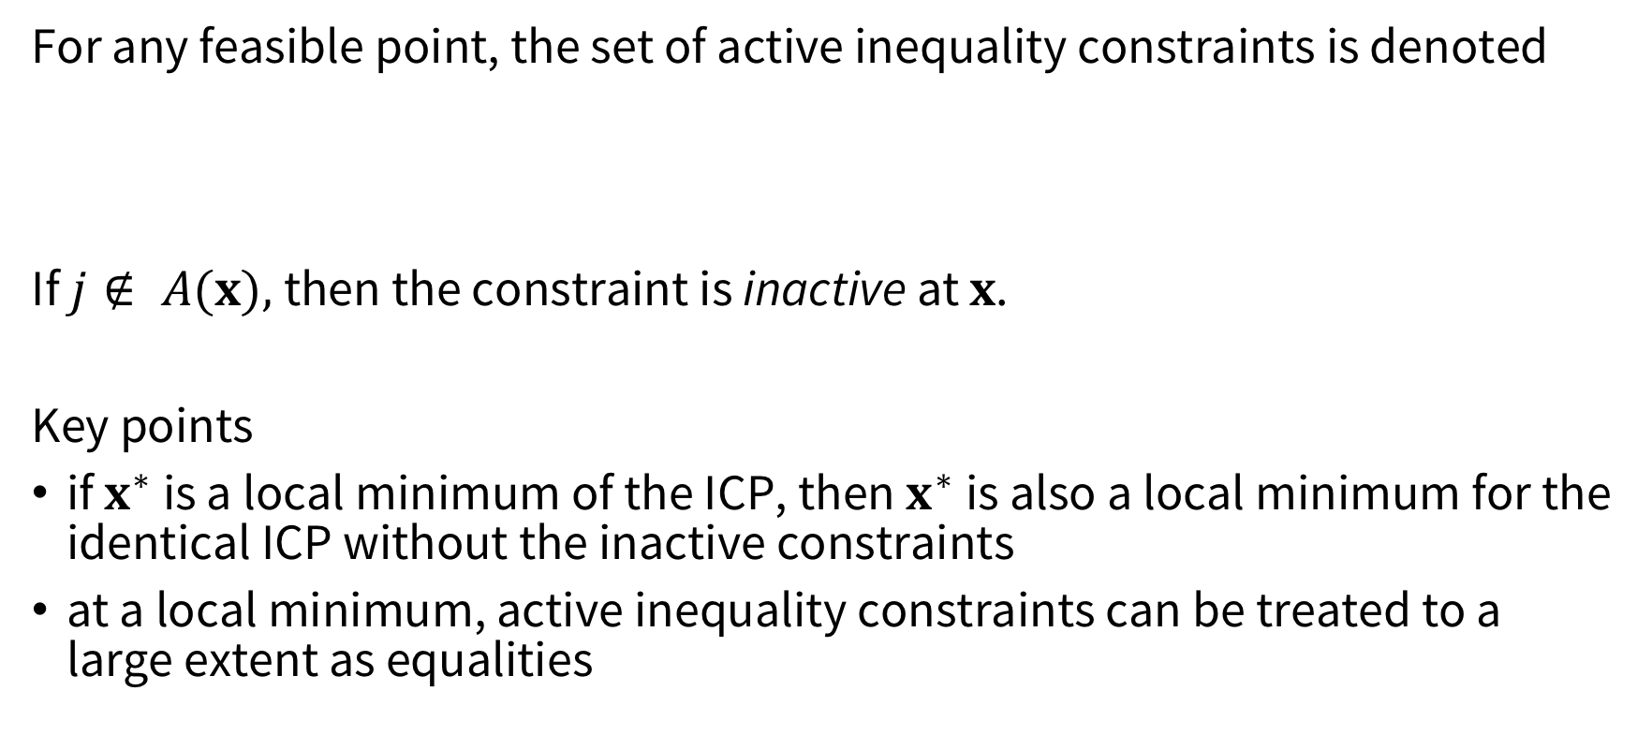
Active constraints
For any feasible point, the set of active inequality constraints is denoted
If $j∉ A(x),$then the constraint is inactive at $x$.
Key points
if $x^{∗}$ is a local minimum of the ICP, then $x^{∗}$is also a local minimum for the identical ICP without the inactive constraints
at a local minimum, active inequality constraints can be treated to a large extent as equalities

Slide 25

Active constraints
Hence, if $x^{∗}$is a local minimum of ICP, then $x^{∗}$ is also a local minimum for the equality constrained problem

Slide 26

Active constraints
Thus if $x^{∗}$is regular, there exist Lagrange multipliers $(λ_{1},…, λ_{m}$) and $μ_{j}^{∗}, j∈A(x^{∗})$, such that
or equivalently

Slide 27

Karush-Kuhn-Tucker NOC
Define the Lagrangian function
Theorem: KKT NOC
Let $x^{∗}$ be a local minimum for ICP where $f$, $h_{i}$, $g_{j}$ are $C^{1}$ and assume $x^{∗}$ is regular (equality + active inequality constraints gradients are linearly independent). Then, there exist unique Lagrange multiplier vectors $(λ_{1}^{∗}, …, λ_{m}^{∗})$, $\left(μ_{1}^{∗}, …, μ_{r}^{∗}\right)$such that

Slide 28
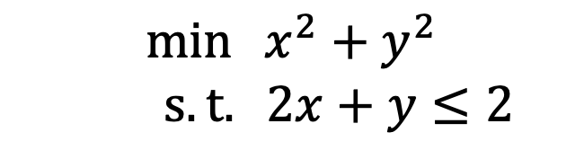

Example
$$\min{{ x}^{2} + y^{2}}$$
$s.t. 2x+y≤2$
Solution: $(0,0)$

Slide 29
Next time
Calculus of variations
(infinite-dimensional optimization!)

