Slide 1
AA203 Optimal and Learning-based Control
Calculus of variations

Slide 2
Roadmap
Model-free RL
Control
Adaptive
optimal control
Model-based RL
Feedback control
Adaptive control
Optimal and learning control
Open-loop
MPC
Closed-loop
Indirect methods
Direct
methods
DP
HJB / HJI
LQR
iLQR
DDP
LQR
Reachability analysis
2

Slide 3
Indirect methods
Goal: determine necessary conditions for optimality for a general class of optimal control problems
“Optimize then discretize”
Sometimes provides more direct (e.g., analytical) path to a solution
Reading:
D. E. Kirk. Optimal control theory: an introduction, 2004.

Slide 4

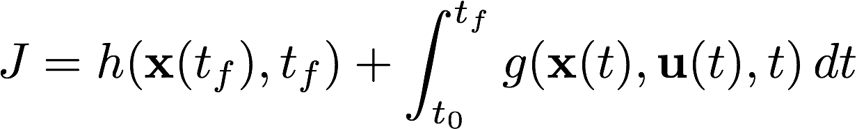
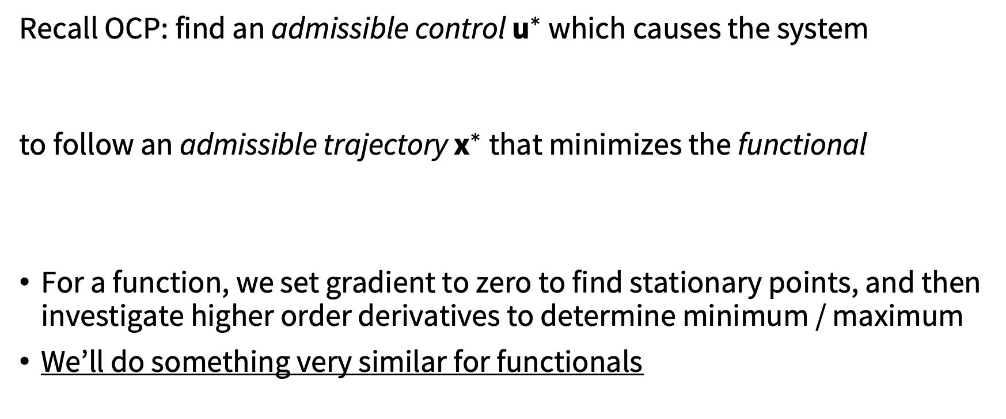
Key idea
Recall OCP: find an admissible control ${\text{u}}^{∗}$ which causes the system
to follow an admissible trajectory ${\text{x}}^{∗}$ that minimizes the functional
For a function, we set gradient to zero to find stationary points, and then investigate higher order derivatives to determine minimum / maximum
We’ll do something very similar for functionals

Slide 5
Calculus of variations (CoV)
Calculus of variations: generalization of calculus that allows one to find maxima and minima of functionals (i.e., a “function of function”), by using variations
Agenda:
Introduce new concepts for functionals by appealing to some familiar results from the theory of functions
Apply such concepts to derive the fundamental theorem of CoV
Apply the CoV to optimal control

Slide 6
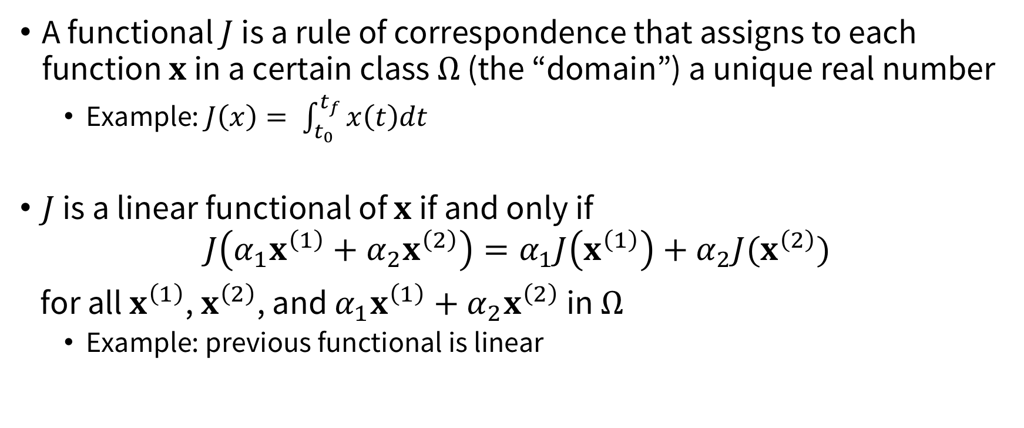
Preliminaries
A functional $J$ is a rule of correspondence that assigns to each function $x$ in a certain class $Ω$ (the “domain”) a unique real number
Example: $J\left(x\right)= \int_{t_{0}}^{t_{f}}{x\left(t\right)dt}$
$J$ is a linear functional of $x$ if and only if
$$J\left(α_{1}x^{\left(1\right)}+α_{2}x^{\left(2\right)}\right)=α_{1}J\left(x^{\left(1\right)}\right)+α_{2}J(x^{\left(2\right)})$$
for all $x^{\left(1\right)}$, $x^{\left(2\right)}$, and $α_{1}x^{\left(1\right)}+{α_{2}x}^{\left(2\right)}$ in $Ω$
Example: previous functional is linear

Slide 7
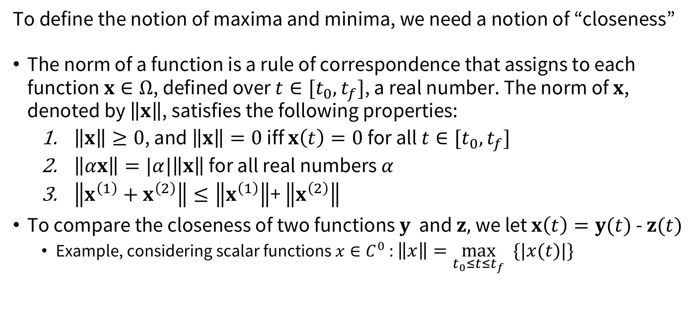
Preliminaries
To define the notion of maxima and minima, we need a notion of “closeness”
The norm of a function is a rule of correspondence that assigns to each function $x∈Ω$, defined over $t∈[t_{0},t_{f}]$, a real number. The norm of $x$, denoted by $\left\|x\right\|$, satisfies the following properties:
$\left\|x\right\|≥0$, and $\left\|x\right\|=0$ iff $x\left(t\right)=0$ for all $t∈[t_{0},t_{f}]$
$\left\|αx\right\|=|α|\left\|x\right\|$ for all real numbers $α$
$\left\|x^{\left(1\right)}+x^{\left(2\right)}\right\|≤\left\|x^{\left(1\right)}\right\|$+ $\left\|x^{\left(2\right)}\right\|$
To compare the closeness of two functions $y$ and $z,$we let $x\left(t\right)=y(t)$ - $z(t)$
Example, considering scalar functions $x∈C^{0}$: $\left\|x\right\|=\max_{t_{0}≤t≤t_{f}} \{|x(t)|\}$

Slide 8
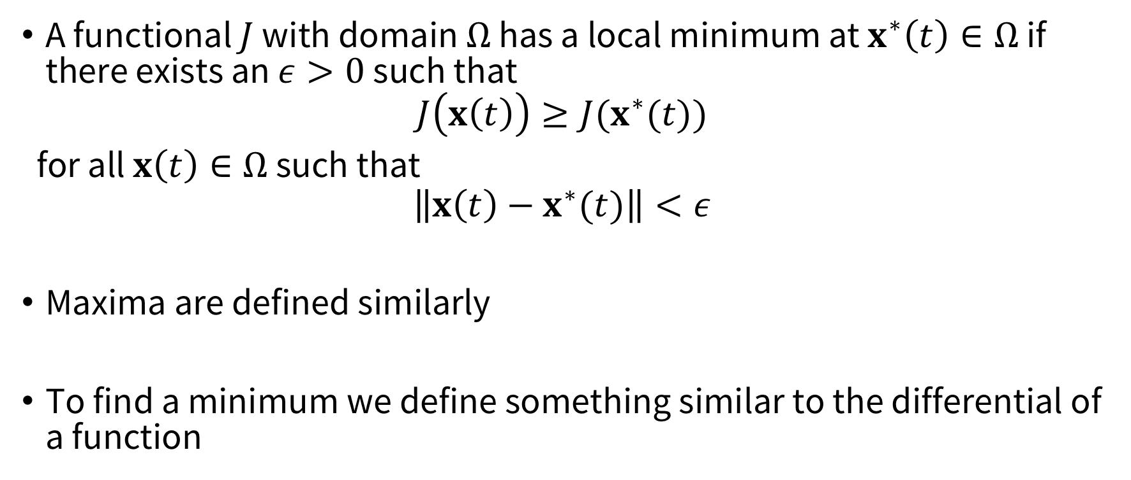
Extrema for functionals
A functional $J$ with domain $Ω$ has a local minimum at $x^{∗}\left(t\right)∈Ω$ if there exists an $ε>0$ such that
$$J\left(x\left(t\right)\right)≥J(x^{∗}(t))$$
for all $x\left(t\right)∈Ω$ such that
$$\left\|x\left(t\right)−x^{∗}(t)\right\|<ε$$
Maxima are defined similarly
To find a minimum we define something similar to the differential of a function

Slide 9

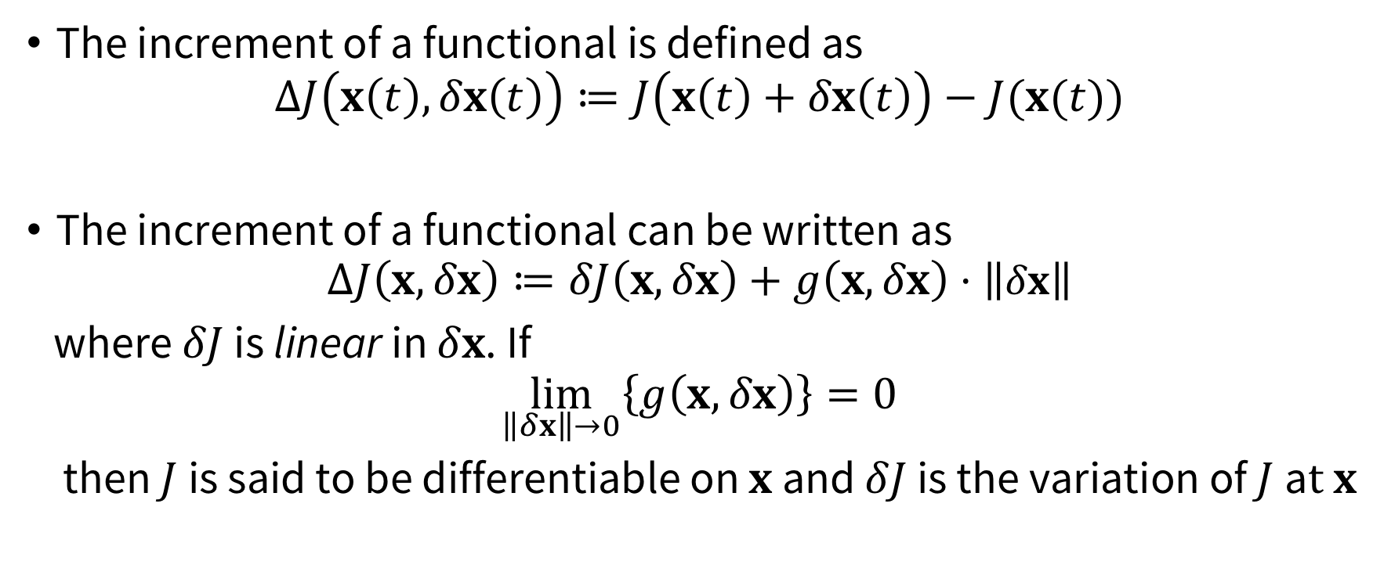
Increments and variations
The increment of a functional is defined as
$$ΔJ\left(x\left(t\right), δx\left(t\right)\right)≔J\left(x\left(t\right)+δx\left(t\right)\right)−J(x(t))$$
The increment of a functional can be written as
$$ΔJ\left(x, δx\right)≔δJ\left(x, δx\right)+g\left(x, δx\right)⋅\left\|δx\right\|$$
where $δJ$ is linear in $δx$. If
$$\lim_{\left\|δx\right\|→0}\left\{g\left(x, δx\right)\right\}=0$$
then $J$ is said to be differentiable on $x$ and $δJ$ is the variation of $J$a$t x$
Variation of $x$

Slide 10
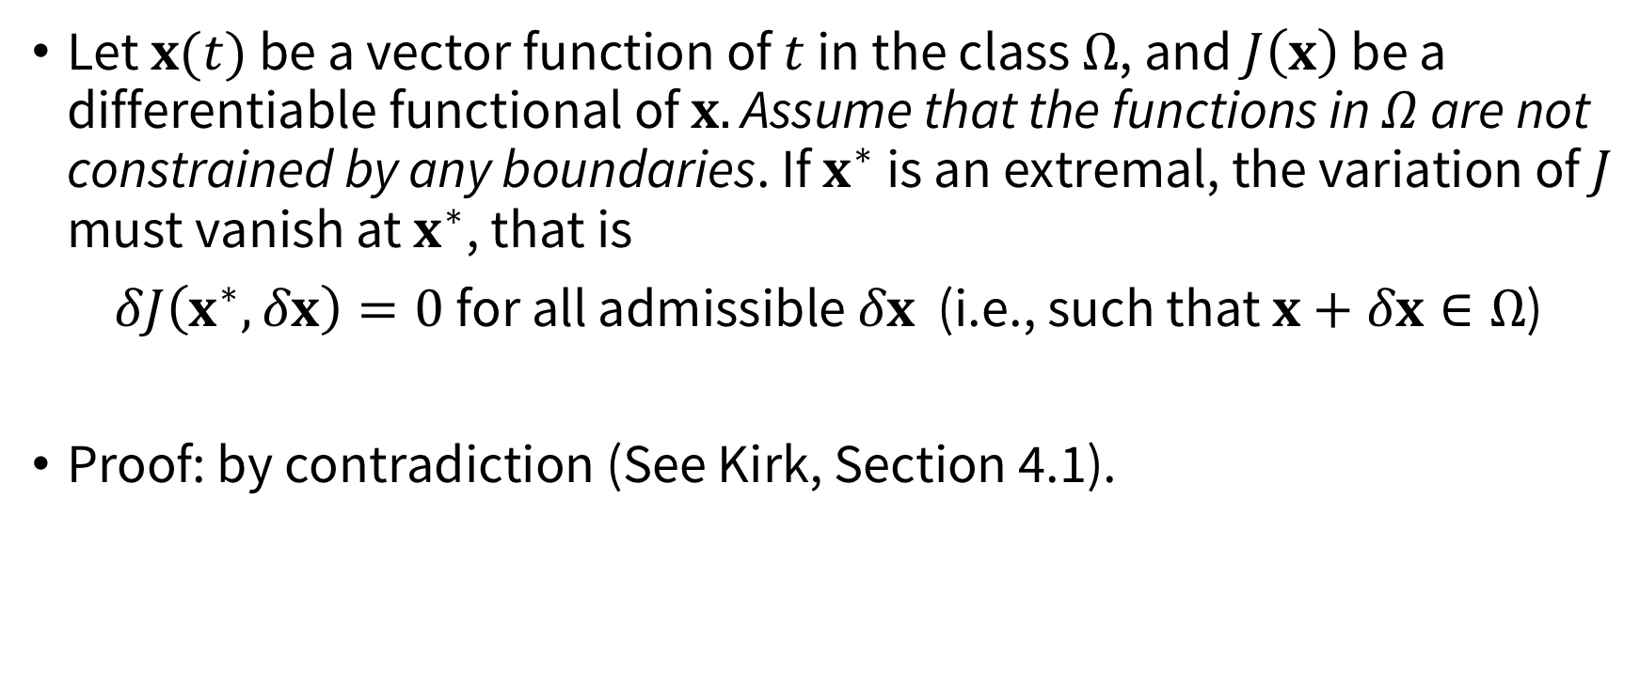
The fundamental theorem of CoV
Let $x(t)$ be a vector function of $t$ in the class $Ω$, and $J\left(x\right)$ be a differentiable functional of $x.$ Assume that the functions in $Ω$ are not constrained by any boundaries. If $x^{∗}$ is an extremal, the variation of $J$ must vanish at $x^{∗}$, that is
$δJ\left(x^{∗},δx\right)=0$ for all admissible $δx$ (i.e., such that $x+δx∈Ω$)
Proof: by contradiction (See Kirk, Section 4.1).

Slide 11
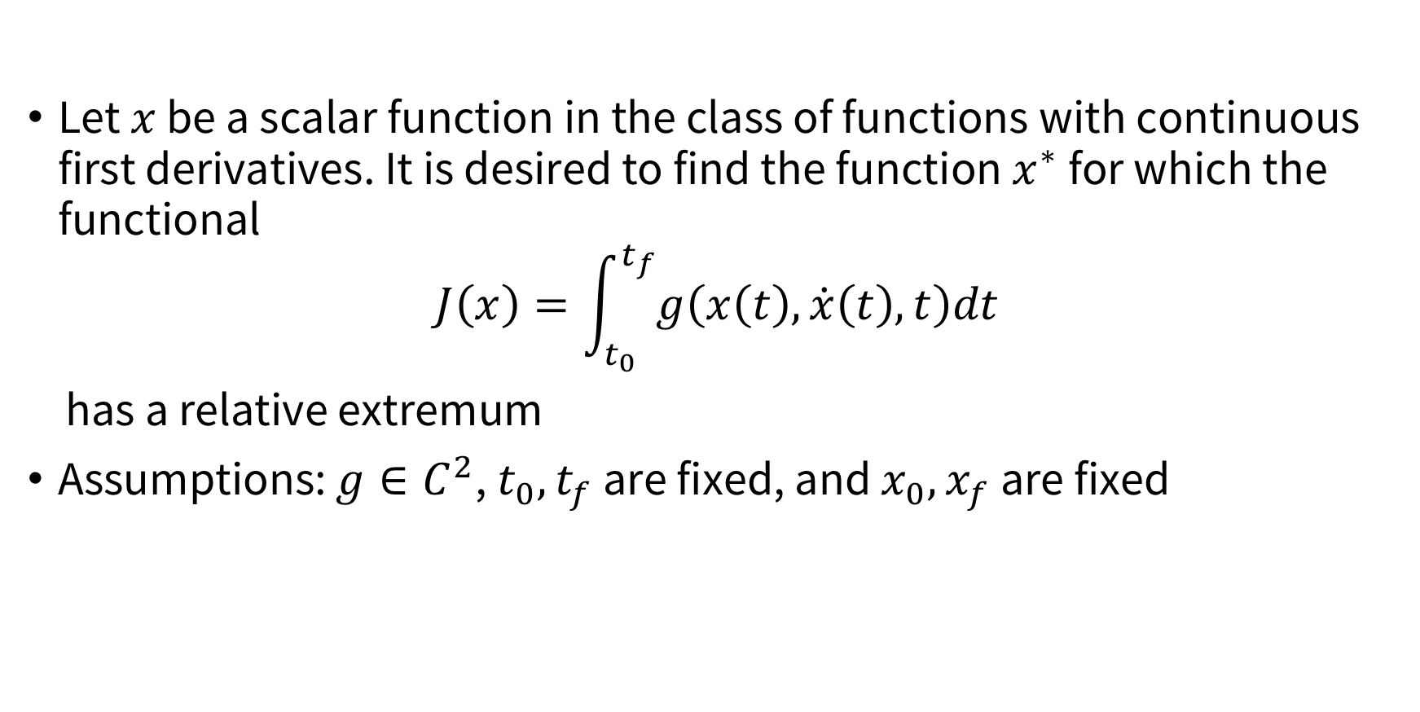
Applying CoV
Let $x$ be a scalar function in the class of functions with continuous first derivatives. It is desired to find the function $x^{∗}$ for which the functional
$$J\left(x\right)=\int_{t_{0}}^{t_{f}}{g\left(x\left(t\right), \dot{x}\left(t\right), t\right)dt}$$
has a relative extremum
Assumptions: $g∈C^{2}$, $t_{0},t_{f}$ are fixed, and $x_{0},x_{f}$ are fixed

Slide 12
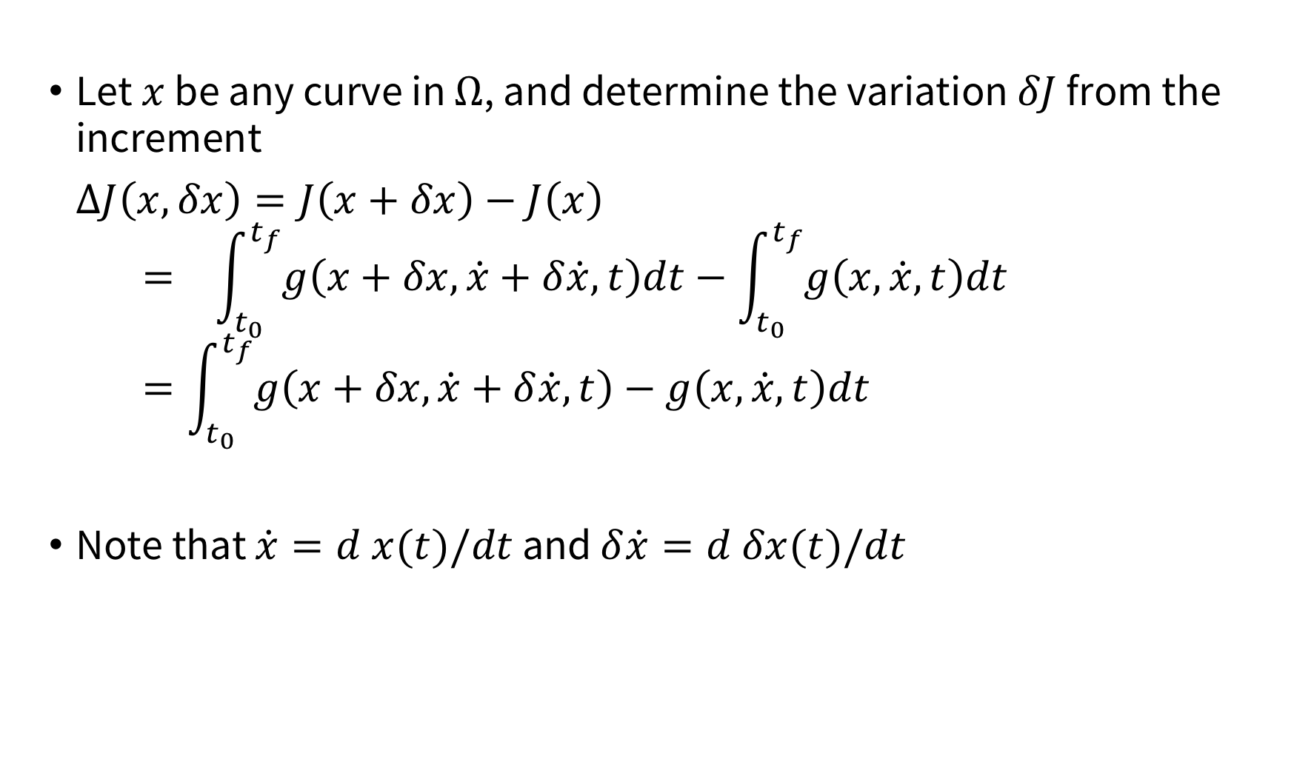
Applying CoV
Let $x$ be any curve in $Ω$, and determine the variation $δJ$ from the increment
$ΔJ\left(x,δx\right)=J\left(x+δx\right)−J\left(x\right)$
$$= \int_{t_{0}}^{t_{f}}{g\left(x+δx, \dot{x}+δ\dot{x}, t\right)dt}−\int_{t_{0}}^{t_{f}}{g\left(x, \dot{x}, t\right)dt}$$
$$=\int_{t_{0}}^{t_{f}}{g\left(x+δx, \dot{x}+δ\dot{x}, t\right)−g\left(x, \dot{x}, t\right)dt}$$
Note that $\dot{x}=d x(t)/dt$ and $δ\dot{x}=d δx(t)/dt$

Slide 13

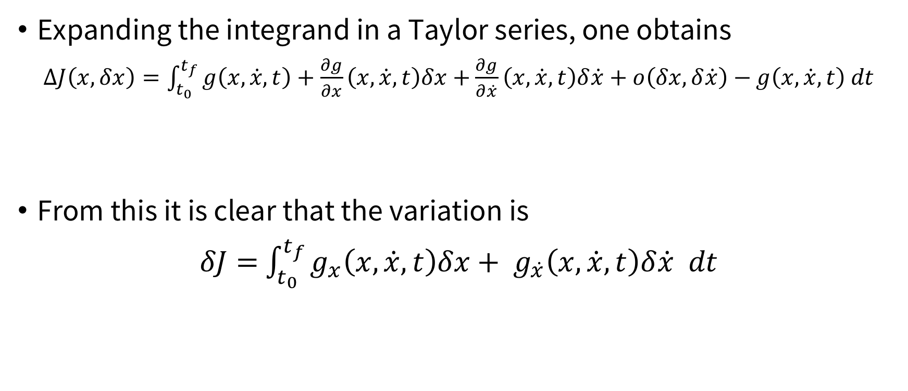

Applying CoV
Expanding the integrand in a Taylor series, one obtains
$ΔJ\left(x,δx\right)=\int_{t_{0}}^{t_{f}}{g\left(x,\dot{x},t\right)+\frac{∂g}{∂x}}\left(x,\dot{x},t\right)δx+$ $\frac{∂g}{∂\dot{x}}$ $\left(x,\dot{x},t\right)δ\dot{x}+o\left(δx,δ\dot{x}\right)−$ $g\left(x,\dot{x},t\right) dt$
From this it is clear that the variation is
$δJ=$ $\int_{t_{0}}^{t_{f}}{g_{x}\left(x,\dot{x},t\right)δx+ g_{\dot{x}}\left(x,\dot{x},t\right)δ\dot{x} dt}$
$$g_{x}$$
$$g_{\dot{x}}$$

Slide 14

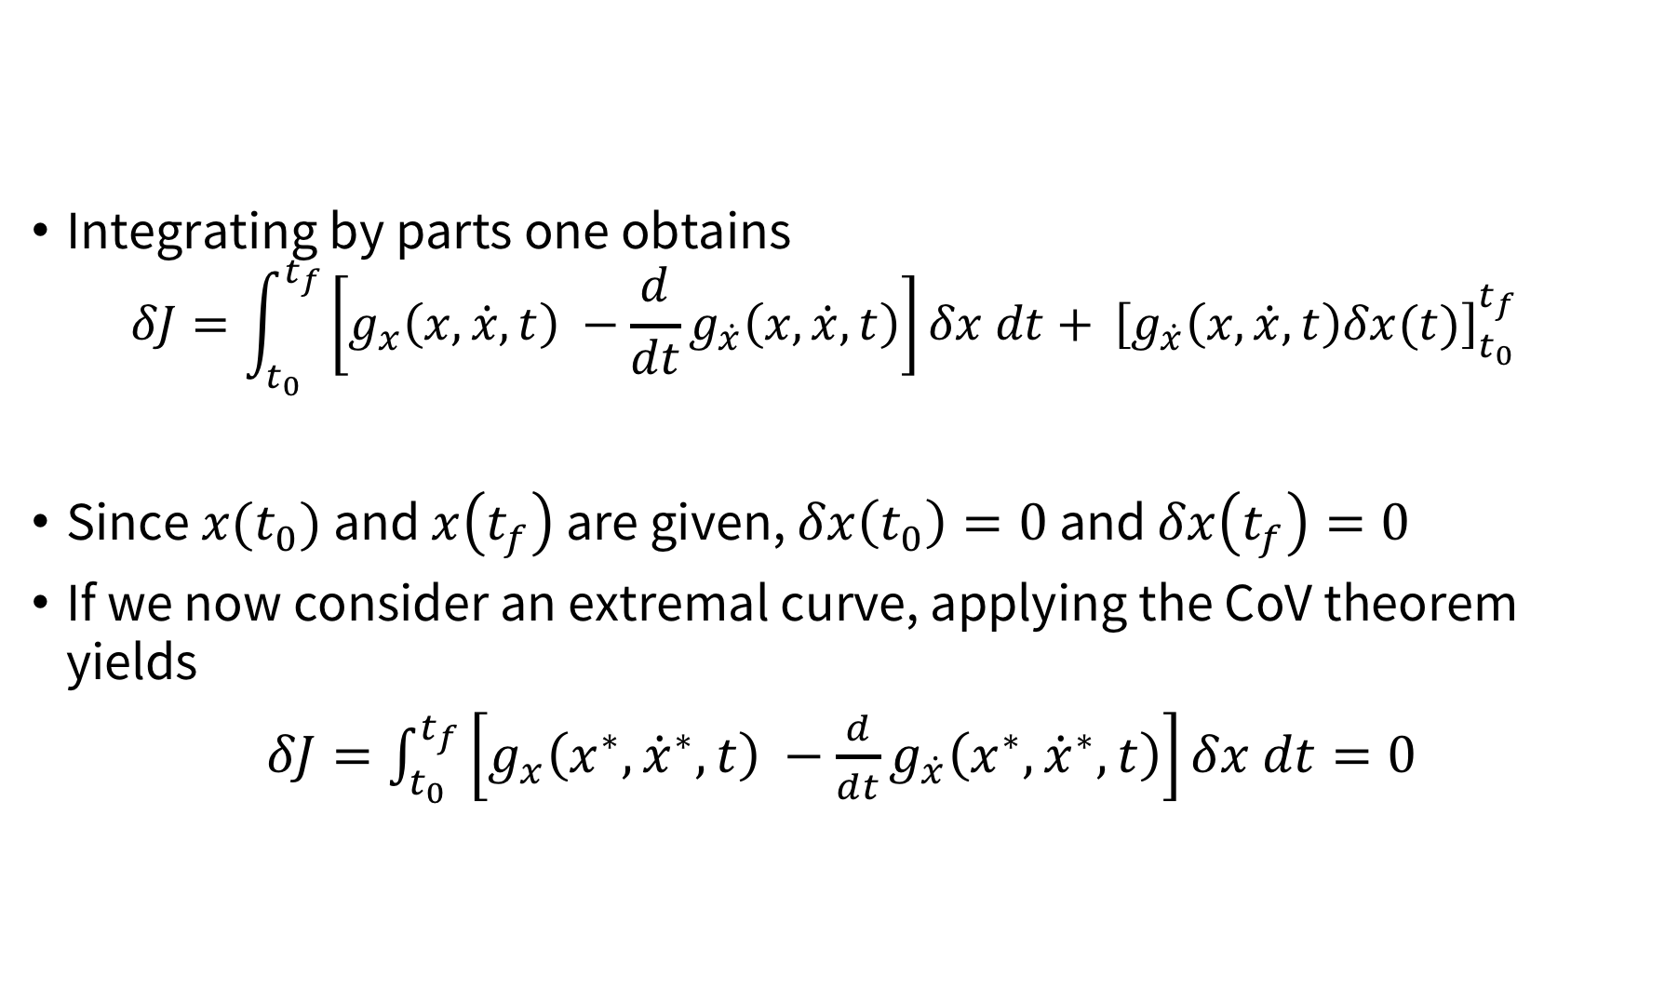
Applying CoV
Integrating by parts one obtains $δJ=\int_{t_{0}}^{t_{f}}{\left[g_{x}\left(x,\dot{x},t\right) −\frac{d}{dt}g_{\dot{x}}\left(x,\dot{x},t\right)\right]δx dt+} {\left[g_{\dot{x}}\left(x,\dot{x},t\right)δx(t)\right]}_{t_{0}}^{t_{f}}$
Since $x(t_{0})$ and $x\left(t_{f}\right)$ are given, $δx\left(t_{0}\right)=0$ and $δx\left(t_{f}\right)=0$
If we now consider an extremal curve, applying the CoV theorem yields
$δJ=\int_{t_{0}}^{t_{f}}{\left[g_{x}\left(x^{∗},{\dot{x}}^{∗},t\right) −\frac{d}{dt}g_{\dot{x}}\left(x^{∗},{\dot{x}}^{∗},t\right)\right]δx dt=0}$
For all $δx!$

Slide 15
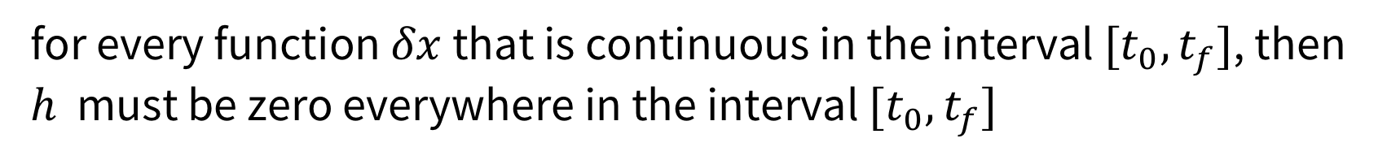
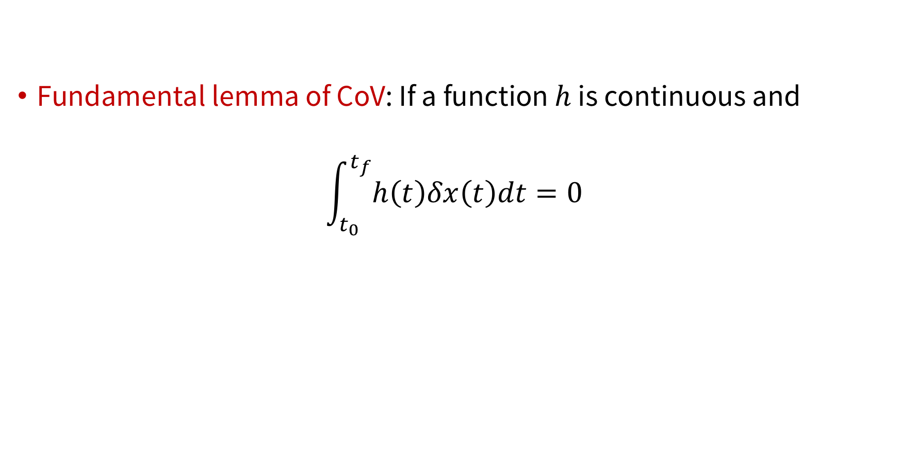
Applying CoV
Fundamental lemma of CoV: If a function $h$ is continuous and
$$\int_{t_{0}}^{t_{f}}{h\left(t\right)δx\left(t\right)dt=0}$$
for every function $δx$ that is continuous in the interval $[t_{0},t_{f}]$, then $h$ must be zero everywhere in the interval $[t_{0},t_{f}]$

Slide 16
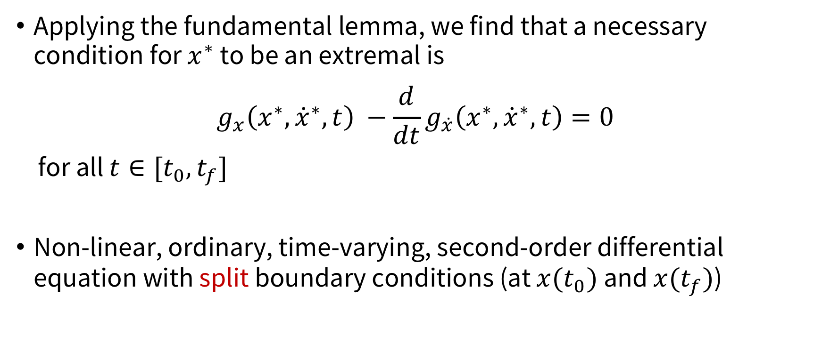
Applying CoV
Applying the fundamental lemma, we find that a necessary condition for $x^{∗}$ to be an extremal is
$$g_{x}\left(x^{∗},{\dot{x}}^{∗},t\right) −\frac{d}{dt}g_{\dot{x}}\left(x^{∗},{\dot{x}}^{∗},t\right)=0$$
for all $t∈[t_{0},t_{f}]$
Non-linear, ordinary, time-varying, second-order differential equation with split boundary conditions (at $x(t_{0})$ and $x(t_{f})$)
Euler equation

Slide 17
Example
Find shortest path between two given points
Solution: straight line!

Slide 18
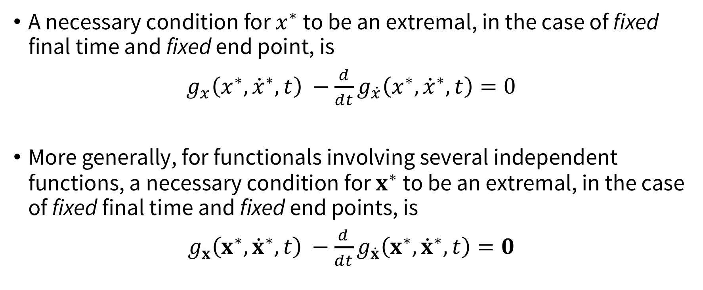
Summary
A necessary condition for $x^{∗}$ to be an extremal, in the case of fixed final time and fixed end point, is
$g_{x}\left(x^{∗},{\dot{x}}^{∗},t\right) −\frac{d}{dt}g_{\dot{x}}\left(x^{∗},{\dot{x}}^{∗},t\right)=0$
More generally, for functionals involving several independent functions, a necessary condition for $x^{∗}$ to be an extremal, in the case of fixed final time and fixed end points, is
$g_{x}\left(x^{∗},{\dot{x}}^{∗},t\right) −\frac{d}{dt}g_{\dot{x}}\left(x^{∗},{\dot{x}}^{∗},t\right)=0$

Slide 19
Next class
More general boundary conditions
Constrained extrema
Application to optimal control

