Slide 1
AA203 Optimal and Learning-based Control
CoV extensions, NOC for optimal control

Slide 2
Roadmap
Model-free RL
Control
Adaptive
optimal control
Model-based RL
Feedback control
Adaptive control
Optimal and learning control
Unconstrained
Constrained
Open-loop
MPC
Closed-loop
Indirect methods
Direct
methods
DP
HJB / HJI
LQR
iLQR
DDP
LQR
Reachability analysis
2

Slide 3
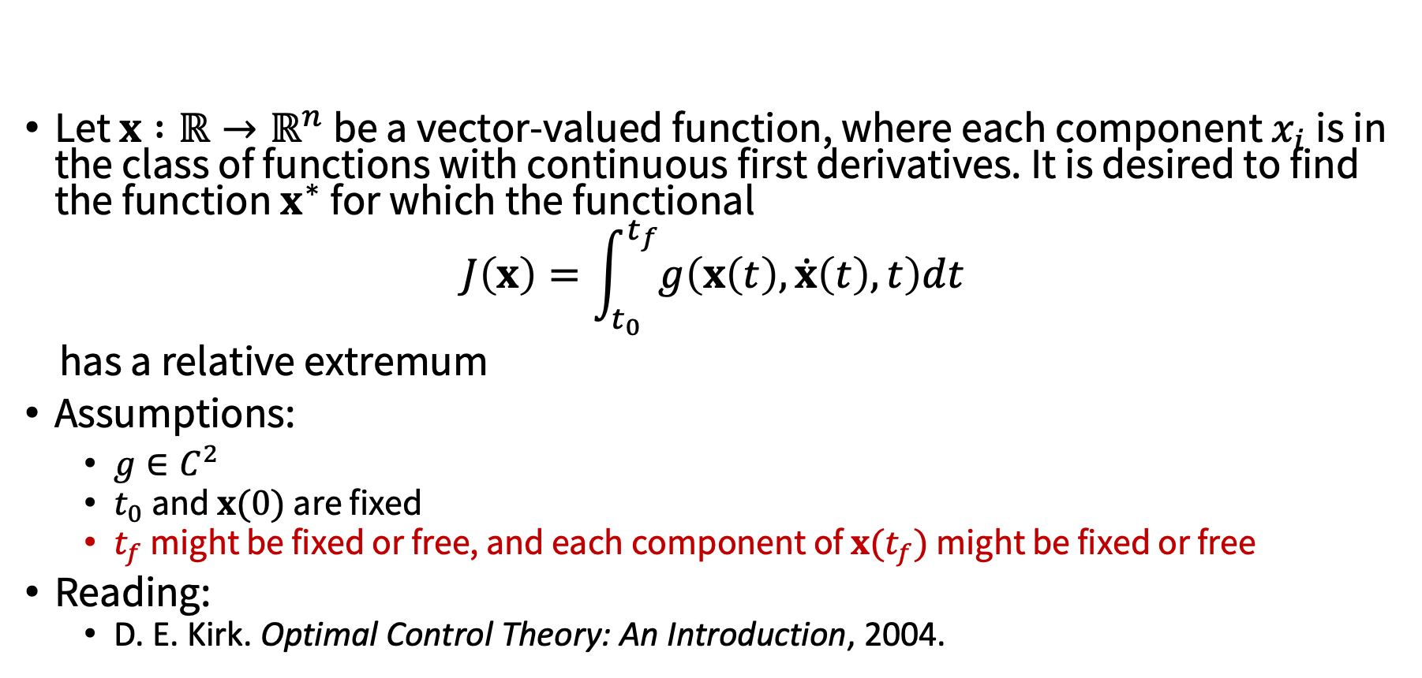
CoV extension I: generalized boundary conditions
Let $x :ℝ→ℝ^{n}$ be a vector-valued function, where each component $x_{i}$ is in the class of functions with continuous first derivatives. It is desired to find the function $x^{∗}$ for which the functional
$$J\left(x\right)=\int_{t_{0}}^{t_{f}}{g\left(x\left(t\right), \dot{x}\left(t\right), t\right)dt}$$
has a relative extremum
Assumptions:
$g∈C^{2}$
$t_{0}$and $x(0)$ are fixed
$t_{f}$ might be fixed or free, and each component of $x(t_{f})$ might be fixed or free
Reading:
D. E. Kirk. Optimal Control Theory: An Introduction, 2004.

Slide 4

CoV extension I: generalized boundary conditions
Regardless of the boundary conditions, the Euler equations
$g_{x}\left(x^{∗}(t),{\dot{x}}^{∗}(t),t\right) −\frac{d}{dt}g_{\dot{x}}\left(x^{∗}(t),{\dot{x}}^{∗}(t),t\right)=0$
must be satisfied
The required boundary conditions are found from the equation
$g_{\dot{x}}{\left(x^{∗}\left(t_{f}\right), {\dot{x}}^{∗}\left(t_{f}\right),t_{f}\right)}^{T}δx_{f}+ \left[g\left(x^{∗}(t_{f}),{\dot{x}}^{∗}(t_{f}),t_{f}\right)− g_{\dot{x}}{\left(x^{∗}\left(t_{f}\right), {\dot{x}}^{∗}\left(t_{f}\right),t_{f}\right)}^{T}{\dot{x}}^{∗}(t_{f})\right]$ $δt_{f}=0$
by making the “appropriate” substitutions for $δx_{f}$ and $δt_{f}$

Slide 5
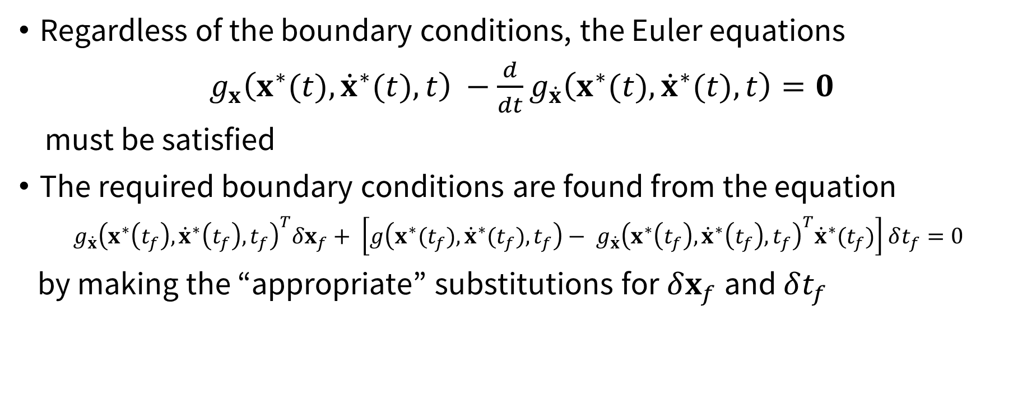
CoV extension I: generalized boundary conditions
Regardless of the boundary conditions, the Euler equations
$g_{x}\left(x^{∗}(t),{\dot{x}}^{∗}(t),t\right) −\frac{d}{dt}g_{\dot{x}}\left(x^{∗}(t),{\dot{x}}^{∗}(t),t\right)=0$
must be satisfied
The required boundary conditions are found from the equation
$g_{\dot{x}}{\left(x^{∗}\left(t_{f}\right), {\dot{x}}^{∗}\left(t_{f}\right),t_{f}\right)}^{T}δx_{f}+ \left[g\left(x^{∗}(t_{f}),{\dot{x}}^{∗}(t_{f}),t_{f}\right)− g_{\dot{x}}{\left(x^{∗}\left(t_{f}\right), {\dot{x}}^{∗}\left(t_{f}\right),t_{f}\right)}^{T}{\dot{x}}^{∗}(t_{f})\right]$ $δt_{f}=0$
by making the “appropriate” substitutions for $δx_{f}$ and $δt_{f}$

Slide 6
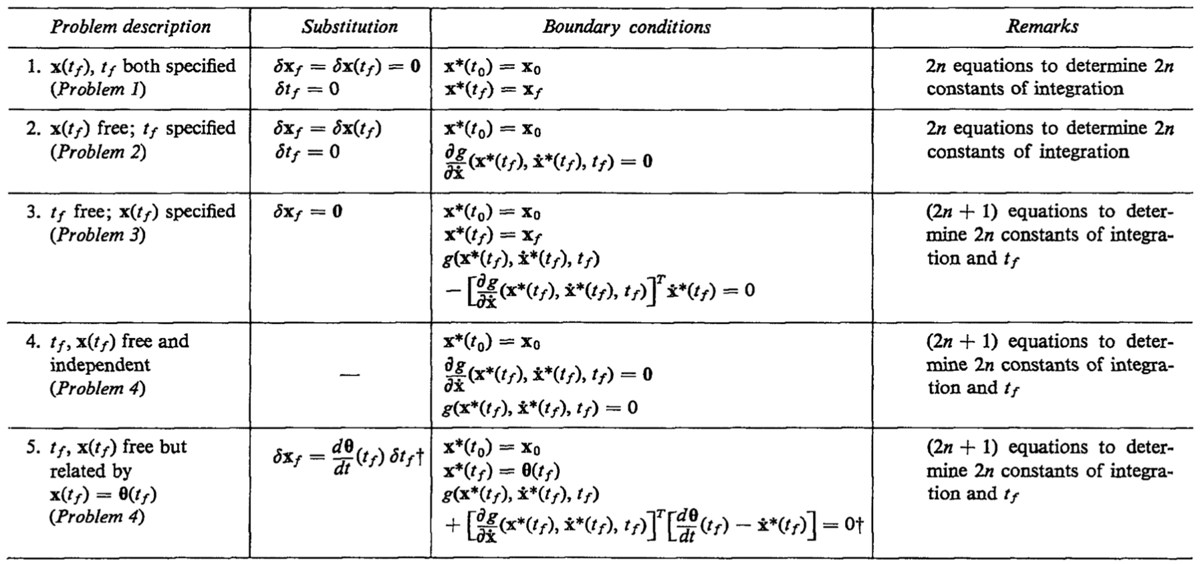
CoV extension I: generalized boundary conditions
From Kirk, Section 4.3

Slide 7

Example
Determine the smooth curve of smallest length connecting the point $x\left(0\right)=1$ to the line $t=5$
Solution: $x\left(t\right)=1$

Slide 8
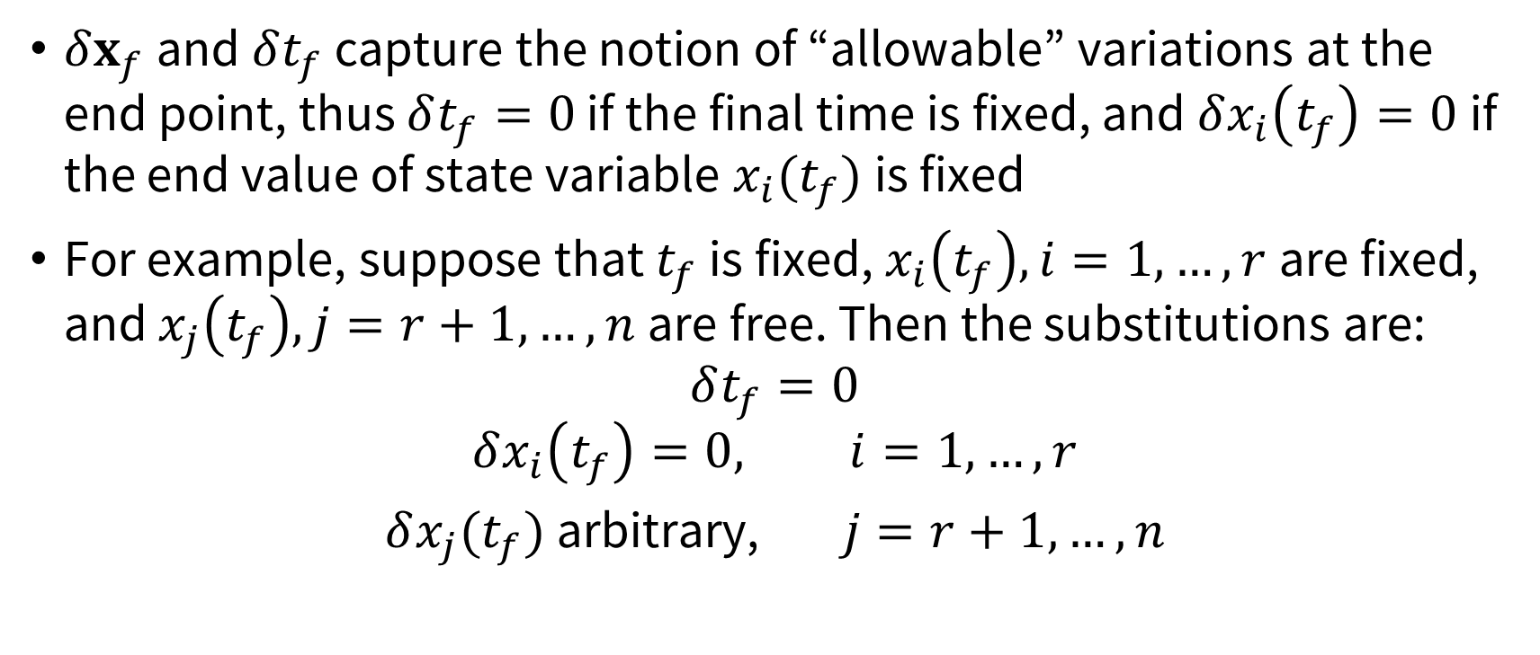
CoV extension I: generalized boundary conditions
$δx_{f}$ and $δt_{f}$ capture the notion of “allowable” variations at the end point, thus $δt_{f}=0$ if the final time is fixed, and $δx_{i}\left(t_{f}\right)=0$ if the end value of state variable $x_{i}(t_{f})$ is fixed
For example, suppose that $t_{f}$ is fixed, $x_{i}\left(t_{f}\right), i=1, …,r$are fixed, and $x_{j}\left(t_{f}\right), j=r+1, …,n$are free. Then the substitutions are:
$$δt_{f}=0$$
$$δx_{i}\left(t_{f}\right)=0, i=1, …,r$$
$δx_{j}(t_{f})$ arbitrary, $j=r+1, …,n$

Slide 9
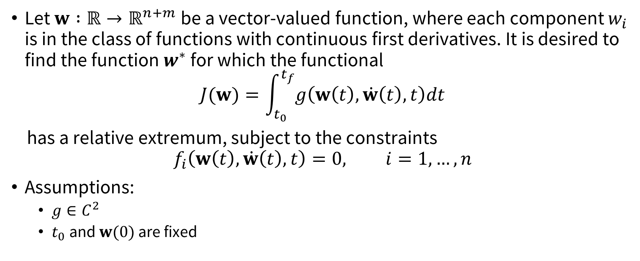
CoV extension II: constrained extrema
Let $w :ℝ→ℝ^{n+m}$ be a vector-valued function, where each component $w_{i}$ is in the class of functions with continuous first derivatives. It is desired to find the function $w^{∗}$ for which the functional
$$J(w)=\int_{t_{0}}^{t_{f}}{g\left(w\left(t\right), \dot{w}\left(t\right), t\right)dt}$$
has a relative extremum, subject to the constraints
$$f_{i}\left(w\left(t\right), \dot{w}\left(t\right), t\right)=0, i=1,…,n$$
Assumptions:
$g∈C^{2}$
$t_{0}$and $w(0)$ are fixed

Slide 10
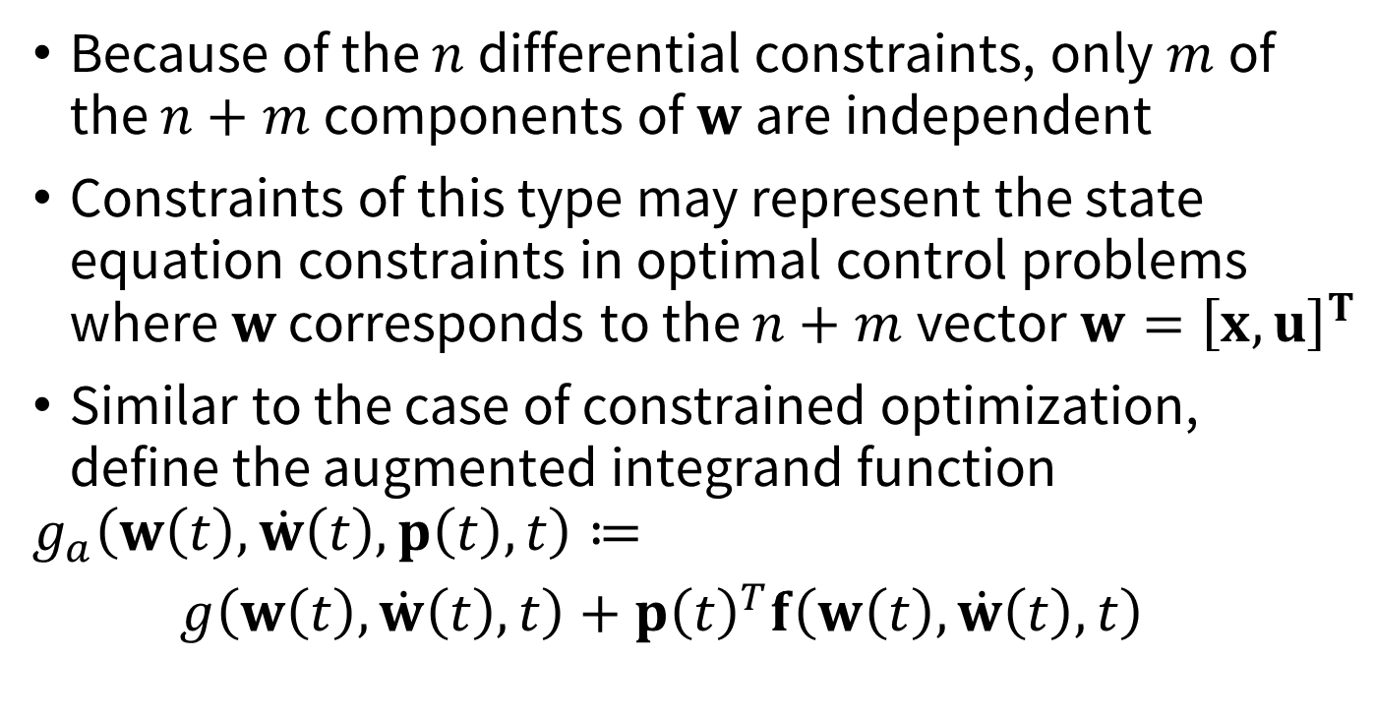
CoV extension II: constrained extrema
Because of the $n$differential constraints, only $m$of the $n+m$ components of $w$are independent
Constraints of this type may represent the state equation constraints in optimal control problems where $w$ corresponds to the $n+m$vector $w={\left[x, u\right]}^{T}$
Similar to the case of constrained optimization, define the augmented integrand function
$$g_{a}\left(w\left(t\right), \dot{w}\left(t\right), p\left(t\right), t\right)≔$$ $g\left(w\left(t\right), \dot{w}\left(t\right), t\right)+p{\left(t\right)}^{T}f\left(w\left(t\right), \dot{w}\left(t\right), t\right)$
Lagrange multipliers (now functions of time!), the “costate”

Slide 11
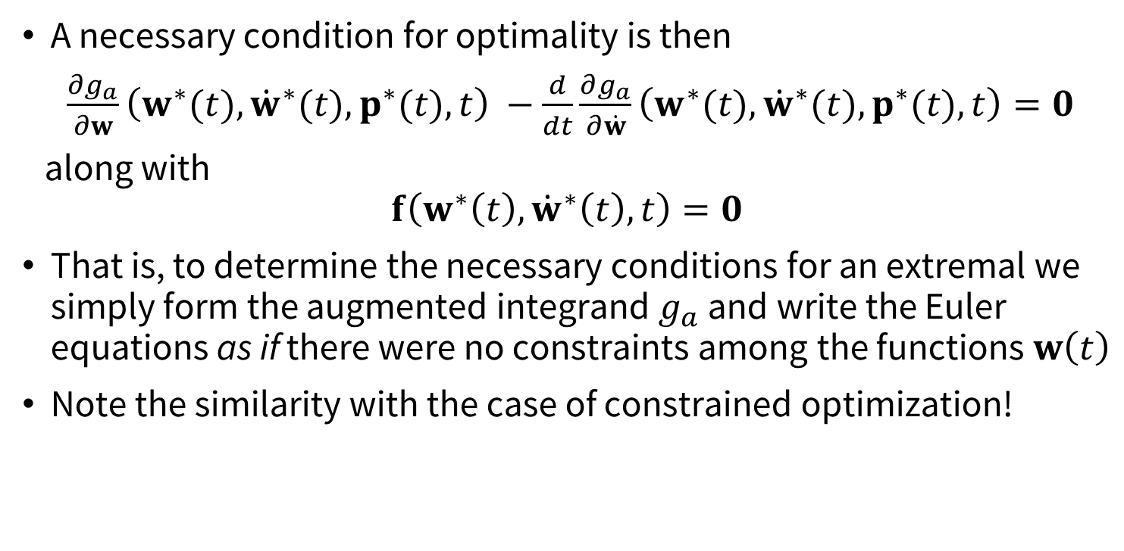
CoV extension II: constrained extrema
A necessary condition for optimality is then
$\frac{∂g_{a}}{∂w}\left(w^{∗}(t),{\dot{w}}^{∗}(t),p^{∗}(t), t\right) −\frac{d}{dt}\frac{∂g_{a}}{∂\dot{w}}\left(w^{∗}(t),{\dot{w}}^{∗}(t),p^{∗}(t), t\right)=0$
along with
$$f\left(w^{∗}\left(t\right), {\dot{w}}^{∗}\left(t\right), t\right)=0$$
That is, to determine the necessary conditions for an extremal we simply form the augmented integrand $g_{a}$ and write the Euler equations as if there were no constraints among the functions $w\left(t\right)$
Note the similarity with the case of constrained optimization!

Slide 12
The variational approach to optimal control
Roadmap:
We will first derive necessary conditions for optimal control assuming that the admissible controls are not bounded
Next, we will heuristically introduce Pontryagin’s Minimum Principle as a generalization of the fundamental theorem of CoV
Finally, we will consider special cases of problems with bounded controls and state variables

Slide 13
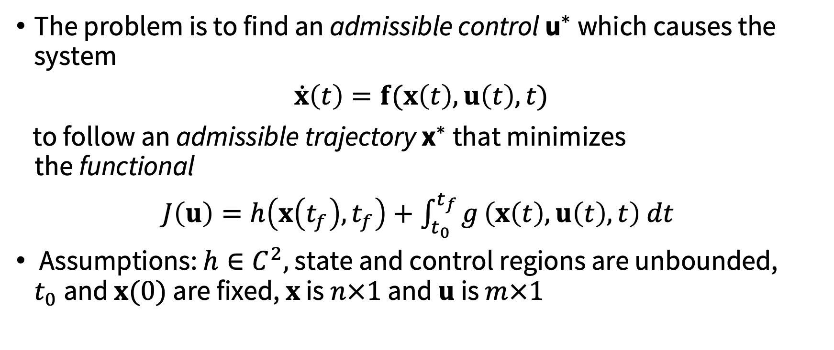
Necessary conditions for optimal control (with unbounded controls)
The problem is to find an admissible control ${\text{u}}^{∗}$ which causes the system
$\dot{x}\left(t\right)=f(x\left(t\right),u\left(t\right), t)$
to follow an admissible trajectory ${\text{x}}^{∗}$ that minimizes the functional
$J\left(u\right)=h\left(x\left(t_{f}\right),t_{f}\right)+\int_{t_{0}}^{t_{f}}{g}\left(x\left(t\right),u\left(t\right), t\right) dt$
Assumptions: $h∈C^{2},$ state and control regions are unbounded, $t_{0}$and $x(0)$ are fixed, $x$ is $n×1$ and $u$ is $m×1$

Slide 14
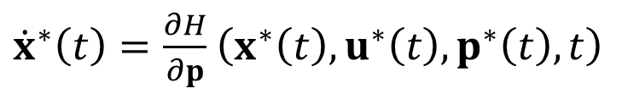
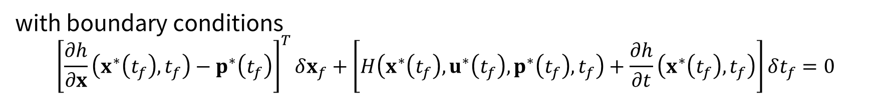
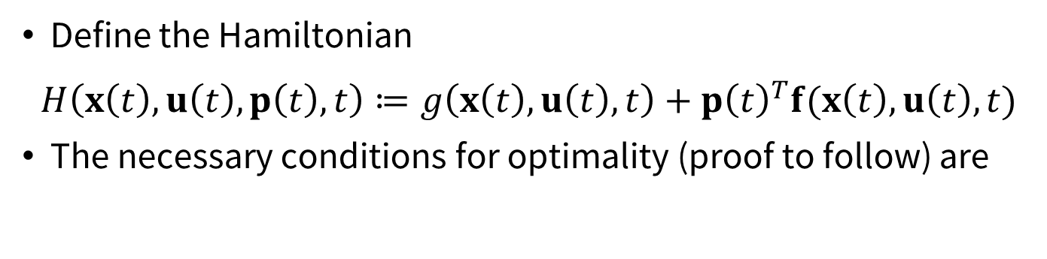

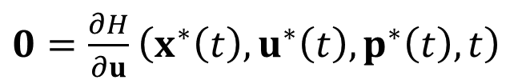
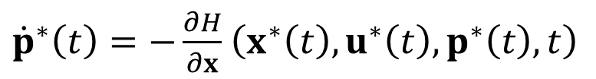
Necessary conditions for optimal control (with unbounded controls)
Define the Hamiltonian
$$H\left(x\left(t\right), u\left(t\right), p\left(t\right), t\right)≔g\left(x\left(t\right), u\left(t\right), t\right)+p{\left(t\right)}^{T}f(x\left(t\right),u\left(t\right), t)$$
The necessary conditions for optimality (proof to follow) are
${\dot{x}}^{∗}\left(t\right)=\frac{∂H}{∂p}$ $\left(x^{∗}\left(t\right), u^{∗}\left(t\right), p^{∗}\left(t\right), t\right)$
${\dot{p}}^{∗}\left(t\right)=−\frac{∂H}{∂x}$ $\left(x^{∗}\left(t\right), u^{∗}\left(t\right), p^{∗}\left(t\right), t\right)$
for all $t∈[t_{0}, t_{f}]$
$0=\frac{∂H}{∂u}$ $\left(x^{∗}\left(t\right), u^{∗}\left(t\right), p^{∗}\left(t\right), t\right)$
with boundary conditions
$${\left[\frac{∂h}{∂x}\left(x^{∗}\left(t_{f}\right),t_{f}\right)−p^{∗}\left(t_{f}\right)\right]}^{T}δx_{f}+\left[H\left(x^{∗}\left(t_{f}\right), u^{∗}\left(t_{f}\right), p^{∗}\left(t_{f}\right), t_{f}\right)+\frac{∂h}{∂t}\left(x^{∗}\left(t_{f}\right),t_{f}\right)\right]δt_{f}=0$$

Slide 15
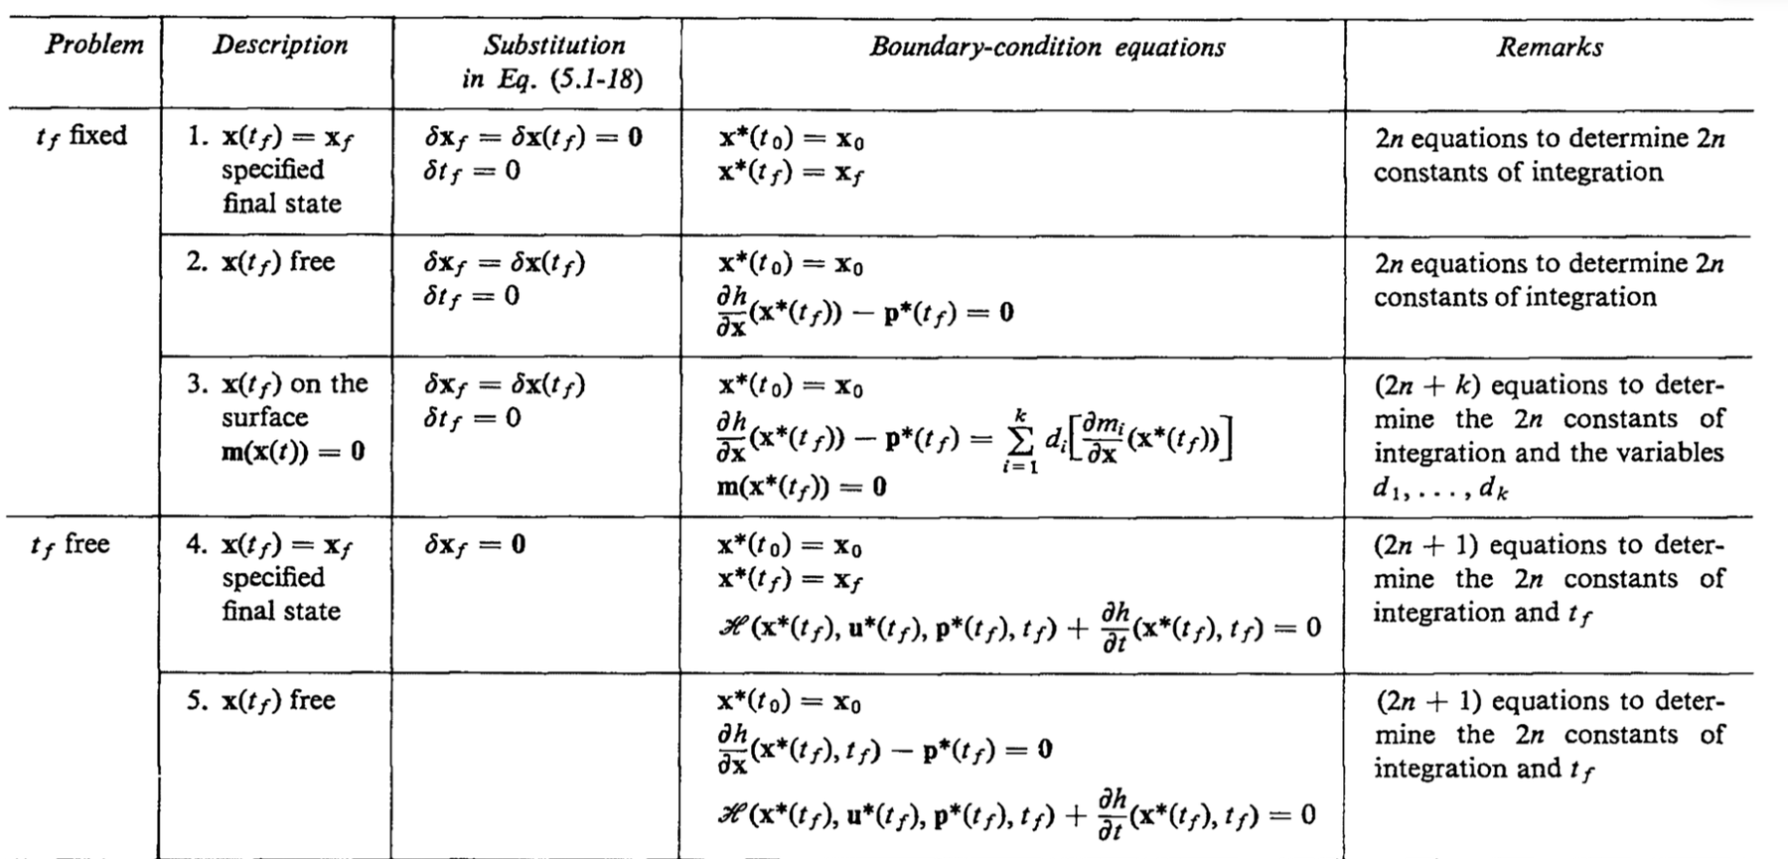
Necessary conditions for optimal control (with unbounded controls)
From Kirk, Section 5.1

Slide 16
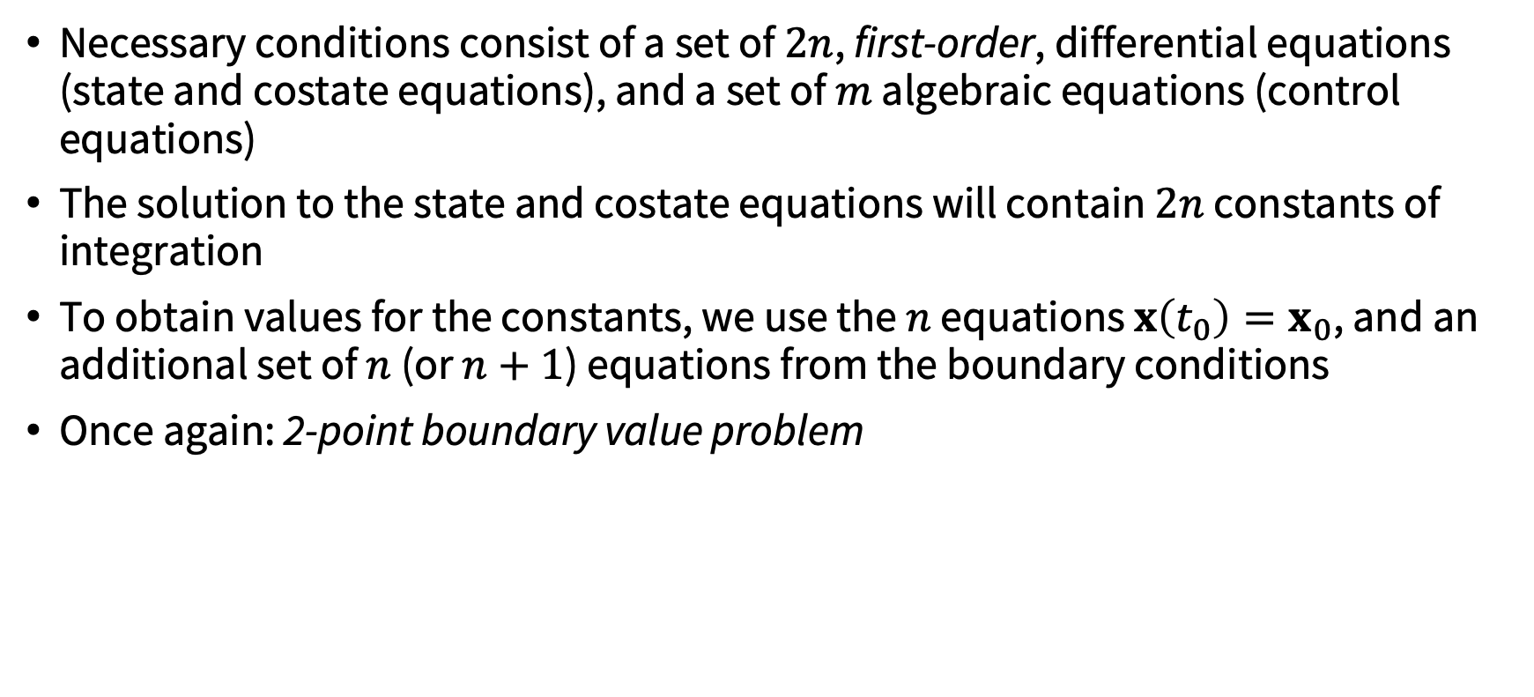
Necessary conditions for optimal control (with unbounded controls)
Necessary conditions consist of a set of $2n$, first-order, differential equations (state and costate equations), and a set of $m$ algebraic equations (control equations)
The solution to the state and costate equations will contain $2n$ constants of integration
To obtain values for the constants, we use the $n$ equations $x\left(t_{0}\right)=x_{0}$, and an additional set of $n$ (or $n+1$) equations from the boundary conditions
Once again: 2-point boundary value problem

Slide 17
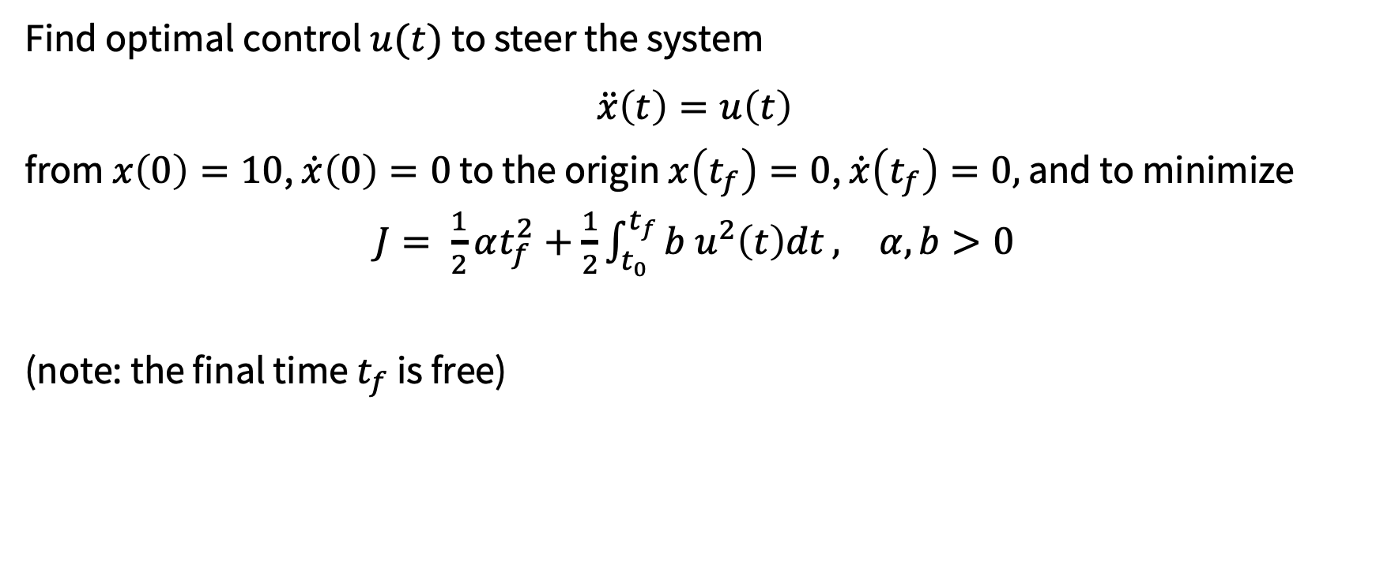
Example
Find optimal control $u(t)$ to steer the system
$$\ddot{x}\left(t\right)=u\left(t\right)$$
from $x\left(0\right)=10$, $\dot{x}\left(0\right)=0$ to the origin $x\left(t_{f}\right)=0$, $\dot{x}\left(t_{f}\right)=0,$ and to minimize
$J= \frac{1}{2}αt_{f}^{2}+\frac{1}{2}\int_{t_{0}}^{t_{f}}{b u^{2}\left(t\right)dt},$ $α, b>0$
(note: the final time $t_{f}$ is free)

Slide 18
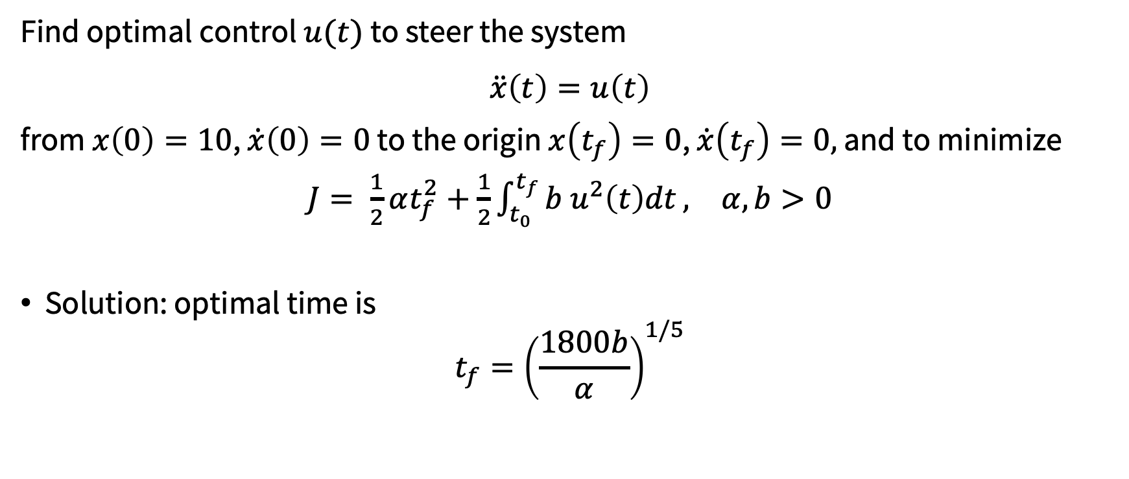
Example
Find optimal control $u(t)$ to steer the system
$$\ddot{x}\left(t\right)=u\left(t\right)$$
from $x\left(0\right)=10$, $\dot{x}\left(0\right)=0$ to the origin $x\left(t_{f}\right)=0$, $\dot{x}\left(t_{f}\right)=0,$ and to minimize
$J= \frac{1}{2}αt_{f}^{2}+\frac{1}{2}\int_{t_{0}}^{t_{f}}{b u^{2}\left(t\right)dt},$ $α, b>0$
Solution: optimal time is
$$t_{f}={\left(\frac{1800b}{α}\right)}^{1/5}$$

Slide 19
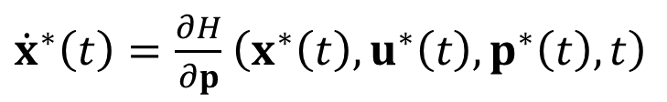
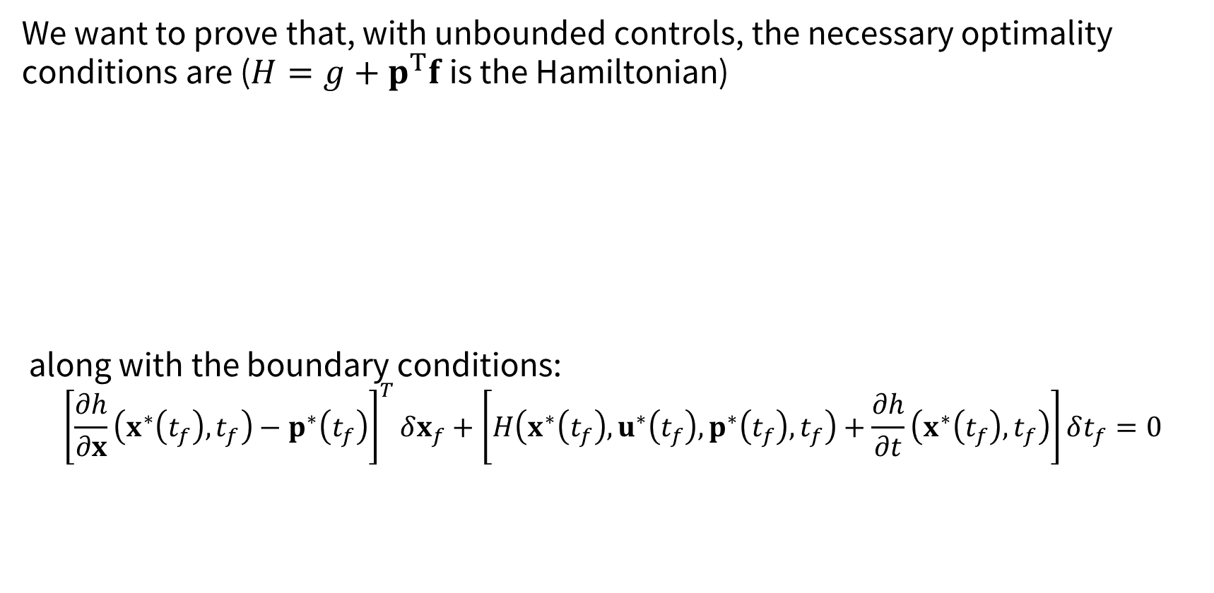

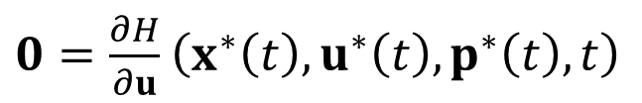
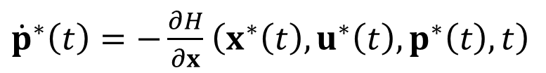
Necessary conditions for optimal control (with unbounded controls)
We want to prove that, with unbounded controls, the necessary optimality conditions are ($H=g+p^{T}f$ is the Hamiltonian)
along with the boundary conditions:
$${\left[\frac{∂h}{∂x}\left(x^{∗}\left(t_{f}\right),t_{f}\right)−p^{∗}\left(t_{f}\right)\right]}^{T}δx_{f}+\left[H\left(x^{∗}\left(t_{f}\right), u^{∗}\left(t_{f}\right), p^{∗}\left(t_{f}\right), t_{f}\right)+\frac{∂h}{∂t}\left(x^{∗}\left(t_{f}\right),t_{f}\right)\right]δt_{f}=0$$
${\dot{x}}^{∗}\left(t\right)=\frac{∂H}{∂p}$ $\left(x^{∗}\left(t\right), u^{∗}\left(t\right), p^{∗}\left(t\right), t\right)$
${\dot{p}}^{∗}\left(t\right)=−\frac{∂H}{∂x}$ $\left(x^{∗}\left(t\right), u^{∗}\left(t\right), p^{∗}\left(t\right), t\right)$
for all $t∈[t_{0}, t_{f}]$
$0=\frac{∂H}{∂u}$ $\left(x^{∗}\left(t\right), u^{∗}\left(t\right), p^{∗}\left(t\right), t\right)$

Slide 20
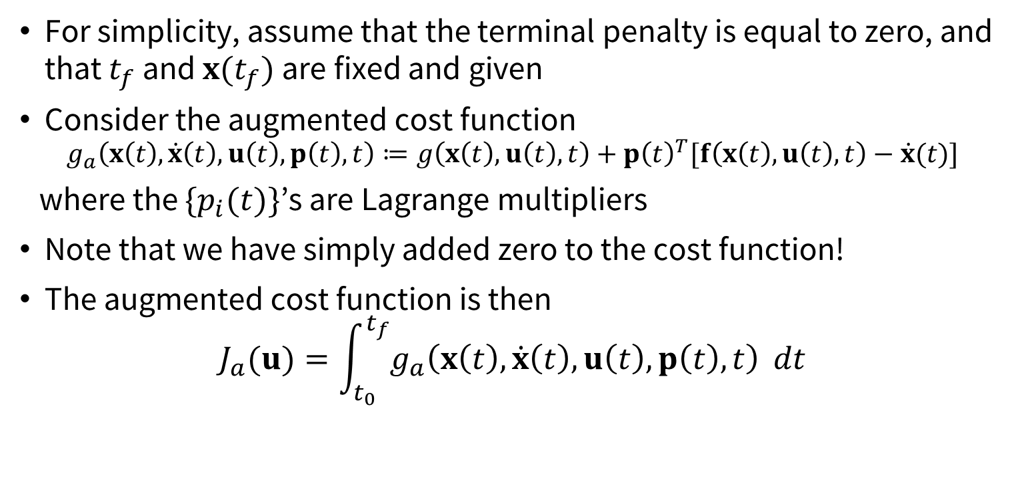
Proof sketch of NOC
For simplicity, assume that the terminal penalty is equal to zero, and that $t_{f}$ and $x(t_{f})$ are fixed and given
Consider the augmented cost function $g_{a}\left(x\left(t\right), \dot{x}\left(t\right), u\left(t\right), p\left(t\right), t\right)≔g\left(x\left(t\right), u\left(t\right), t\right)+p{\left(t\right)}^{T}[f\left(x\left(t\right), u\left(t\right), t\right)−\dot{x}(t)]$
where the ${\{p}_{i}(t)\}$’s are Lagrange multipliers
Note that we have simply added zero to the cost function!
The augmented cost function is then
$$J_{a}(u)=\int_{t_{0}}^{t_{f}}{g_{a}\left(x\left(t\right), \dot{x}\left(t\right), u\left(t\right), p\left(t\right), t\right)} dt$$

Slide 21

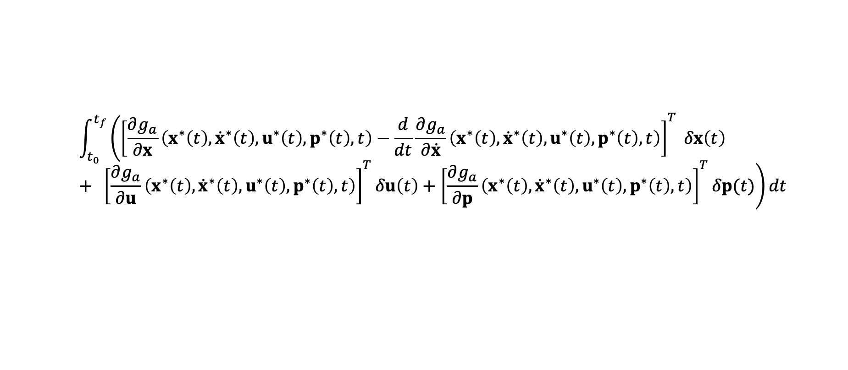
Proof sketch of NOC
$$\text{On} \text{an} \text{extremal}\text{, }\text{by} \text{applying} \text{the} \text{fundamental} \text{theorem} \text{of} \text{the} \text{CoV}$$
By the CoV theorem
$$\int_{t_{0}}^{t_{f}}{\left({\left[\frac{∂g_{a}}{∂x}\left(x^{∗}\left(t\right), {\dot{x}}^{∗}\left(t\right), u^{∗}\left(t\right), p^{∗}\left(t\right), t\right)−\frac{d}{dt}\frac{∂g_{a}}{∂\dot{x}}\left(x^{∗}\left(t\right), {\dot{x}}^{∗}\left(t\right), u^{∗}\left(t\right), p^{∗}\left(t\right), t\right)\right]}^{T} δx\left(t\right)+ {\left[\frac{∂g_{a}}{∂u}\left(x^{∗}\left(t\right), {\dot{x}}^{∗}\left(t\right), u^{∗}\left(t\right), p^{∗}\left(t\right), t\right)\right]}^{T}δu\left(t\right)+{\left[\frac{∂g_{a}}{∂p}\left(x^{∗}\left(t\right), {\dot{x}}^{∗}\left(t\right), u^{∗}\left(t\right), p^{∗}\left(t\right), t\right)\right]}^{T}δp(t)\right)dt}$$
$$0=δJ_{a}\left(u\right)=$$

Slide 22
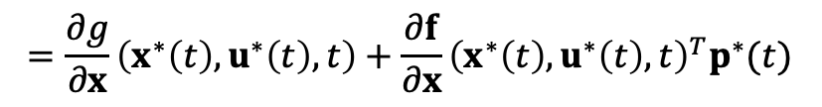
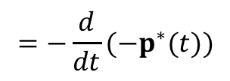

Proof sketch of NOC
$$\text{On} \text{an} \text{extremal}\text{, }\text{by} \text{applying} \text{the} \text{fundamental} \text{theorem} \text{of} \text{the} \text{CoV}$$
By the CoV theorem
$$=\frac{∂g}{∂x}\left(x^{∗}\left(t\right), u^{∗}\left(t\right), t\right)+\frac{∂f}{∂x}{\left(x^{∗}\left(t\right), u^{∗}\left(t\right), t\right)}^{T}p^{∗}(t)$$
$$=−\frac{d}{dt}(−p^{∗}(t))$$
$$\int_{t_{0}}^{t_{f}}{\left({\left[\frac{∂g_{a}}{∂x}\left(x^{∗}\left(t\right), {\dot{x}}^{∗}\left(t\right), u^{∗}\left(t\right), p^{∗}\left(t\right), t\right)−\frac{d}{dt}\frac{∂g_{a}}{∂\dot{x}}\left(x^{∗}\left(t\right), {\dot{x}}^{∗}\left(t\right), u^{∗}\left(t\right), p^{∗}\left(t\right), t\right)\right]}^{T} δx\left(t\right)+ {\left[\frac{∂g_{a}}{∂u}\left(x^{∗}\left(t\right), {\dot{x}}^{∗}\left(t\right), u^{∗}\left(t\right), p^{∗}\left(t\right), t\right)\right]}^{T}δu\left(t\right)+{\left[\frac{∂g_{a}}{∂p}\left(x^{∗}\left(t\right), {\dot{x}}^{∗}\left(t\right), u^{∗}\left(t\right), p^{∗}\left(t\right), t\right)\right]}^{T}δp(t)\right)dt}$$
$$0=δJ_{a}\left(u\right)=$$
$$=f\left(x^{∗}\left(t\right), u^{∗}\left(t\right), t\right)−{\dot{x}}^{∗}\left(t\right)$$

Slide 23
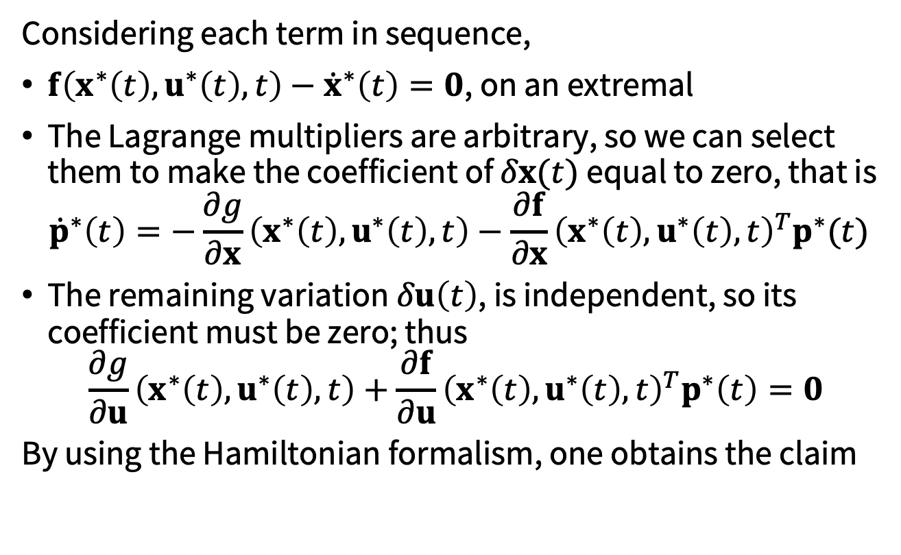
Proof sketch of NOC
Considering each term in sequence,
$f\left(x^{∗}\left(t\right), u^{∗}\left(t\right), t\right)−{\dot{x}}^{∗}\left(t\right)=0$, on an extremal
The Lagrange multipliers are arbitrary, so we can select them to make the coefficient of $δx(t)$ equal to zero, that is
$${\dot{p}}^{∗}\left(t\right)=−\frac{∂g}{∂x}\left(x^{∗}\left(t\right), u^{∗}\left(t\right), t\right)−\frac{∂f}{∂x}{\left(x^{∗}\left(t\right), u^{∗}\left(t\right), t\right)}^{T}p^{∗}(t)$$
The remaining variation $δu\left(t\right)$, is independent, so its coefficient must be zero; thus
$$\frac{∂g}{∂u}\left(x^{∗}\left(t\right), u^{∗}\left(t\right), t\right)+\frac{∂f}{∂u}{\left(x^{∗}\left(t\right), u^{∗}\left(t\right), t\right)}^{T}p^{∗}\left(t\right)=0$$
By using the Hamiltonian formalism, one obtains the claim

Slide 24
Next time
Pontryagin’s Minimum Principle
Special cases
Computational methods

