Slide 1
AA203 Optimal and Learning-based Control
Pontryagin’s Minimum Principle (PMP); computational methods

Slide 2
Roadmap
Model-free RL
Control
Adaptive
optimal control
Model-based RL
Feedback control
Adaptive control
Optimal and learning control
Unconstrained
Constrained
Open-loop
MPC
Closed-loop
Indirect methods
Direct
methods
DP
HJB / HJI
LQR
iLQR
DDP
LQR
Reachability analysis
2

Slide 3
Outline
Necessary conditions for optimal control with bounded controls:
Pontryagin’s Minimum Principle (PMP)
Examples: Applications of PMP (and insights we can derive from the analysis)
Computational methods

Slide 4
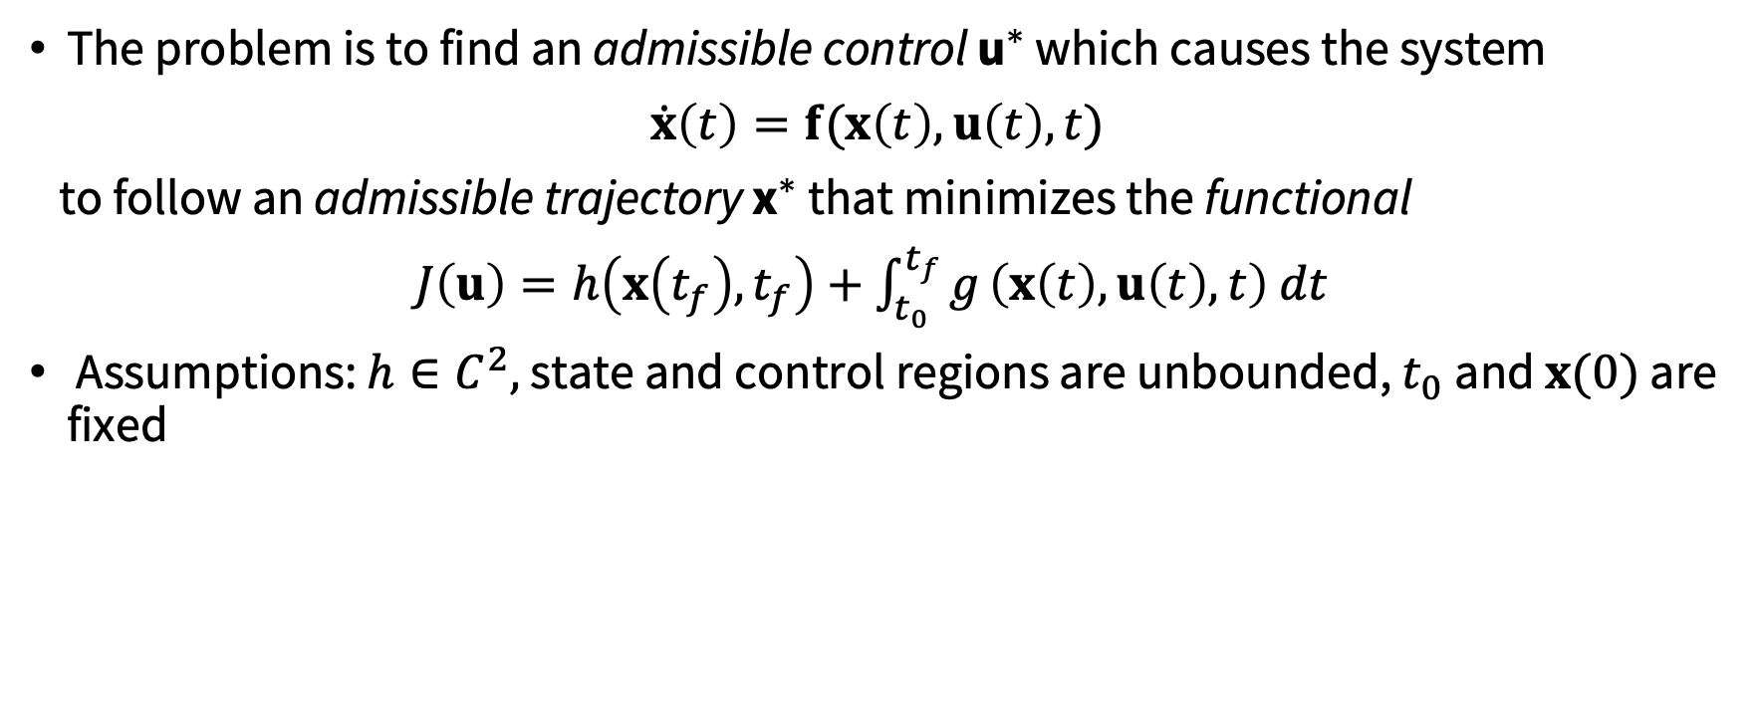
Necessary conditions for optimal control (with unbounded controls)
The problem is to find an admissible control ${\text{u}}^{∗}$ which causes the system
$\dot{x}\left(t\right)=f(x\left(t\right),u\left(t\right), t)$
to follow an admissible trajectory ${\text{x}}^{∗}$ that minimizes the functional
$J\left(u\right)=h\left(x\left(t_{f}\right),t_{f}\right)+\int_{t_{0}}^{t_{f}}{g}\left(x\left(t\right),u\left(t\right), t\right) dt$
Assumptions: $h∈C^{2},$ state and control regions are unbounded, $t_{0}$and $x(0)$ are fixed

Slide 5
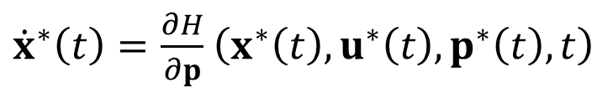
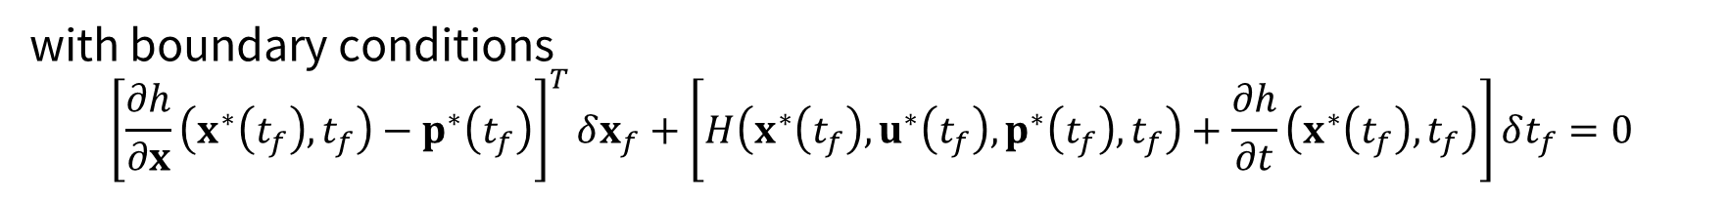
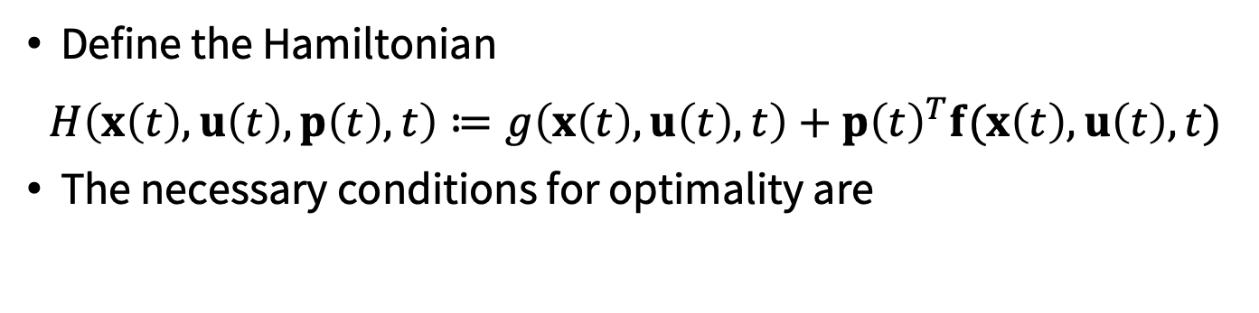

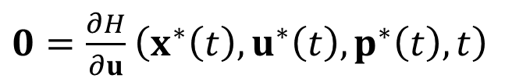
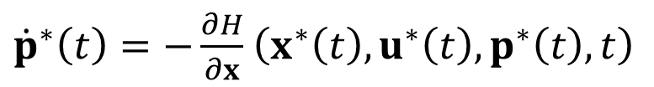
Necessary conditions for optimal control (with unbounded controls)
Define the Hamiltonian
$$H\left(x\left(t\right), u\left(t\right), p\left(t\right), t\right)≔g\left(x\left(t\right), u\left(t\right), t\right)+p{\left(t\right)}^{T}f(x\left(t\right),u\left(t\right), t)$$
The necessary conditions for optimality are
${\dot{x}}^{∗}\left(t\right)=\frac{∂H}{∂p}$ $\left(x^{∗}\left(t\right), u^{∗}\left(t\right), p^{∗}\left(t\right), t\right)$
${\dot{p}}^{∗}\left(t\right)=−\frac{∂H}{∂x}$ $\left(x^{∗}\left(t\right), u^{∗}\left(t\right), p^{∗}\left(t\right), t\right)$
for all $t∈[t_{0}, t_{f}]$
$0=\frac{∂H}{∂u}$ $\left(x^{∗}\left(t\right), u^{∗}\left(t\right), p^{∗}\left(t\right), t\right)$
with boundary conditions
$${\left[\frac{∂h}{∂x}\left(x^{∗}\left(t_{f}\right),t_{f}\right)−p^{∗}\left(t_{f}\right)\right]}^{T}δx_{f}+\left[H\left(x^{∗}\left(t_{f}\right), u^{∗}\left(t_{f}\right), p^{∗}\left(t_{f}\right), t_{f}\right)+\frac{∂h}{∂t}\left(x^{∗}\left(t_{f}\right),t_{f}\right)\right]δt_{f}=0$$

Slide 6
Necessary conditions for optimal control (with bounded controls)
So far, we have assumed that the admissible controls and states are not constrained by any boundaries
However, in realistic systems, such constraints do commonly occur
control constraints often occur due to actuation limits
state constraints often occur due to safety considerations
We will now consider the case with control constraints, which will lead to the statement of the Pontryagin’s minimum principle

Slide 7
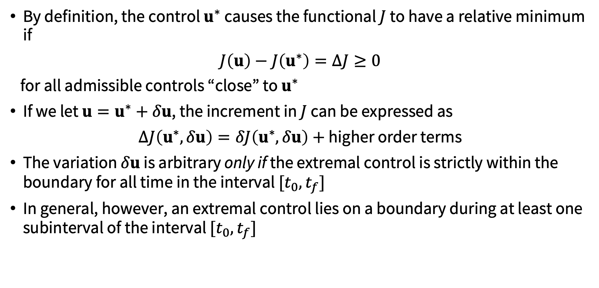
Why do control constraints complicate the analysis?
By definition, the control $u^{∗}$ causes the functional $J$ to have a relative minimum if
$J\left(u\right)−J\left(u^{∗}\right)=ΔJ≥0$
for all admissible controls “close” to $u^{∗}$
If we let $u=u^{∗}+δu$, the increment in $J$ can be expressed as
$ΔJ\left(u^{∗}, δu\right)=δJ\left(u^{∗},δu\right)+$ higher order terms
The variation $δu$ is arbitrary only if the extremal control is strictly within the boundary for all time in the interval $[t_{0},t_{f}]$
In general, however, an extremal control lies on a boundary during at least one subinterval of the interval $[t_{0},t_{f}]$

Slide 8

Why do control constraints complicate the analysis?
As a consequence, admissible control variations $δu$exist whose negatives ($−δu$) are not admissible
This implies that a necessary condition for $u^{∗}$to minimize $J$ is
$$δJ\left(u^{∗},δu\right)≥0$$
for all admissible variations with $\left\|δu\right\|$ small enough

Slide 9

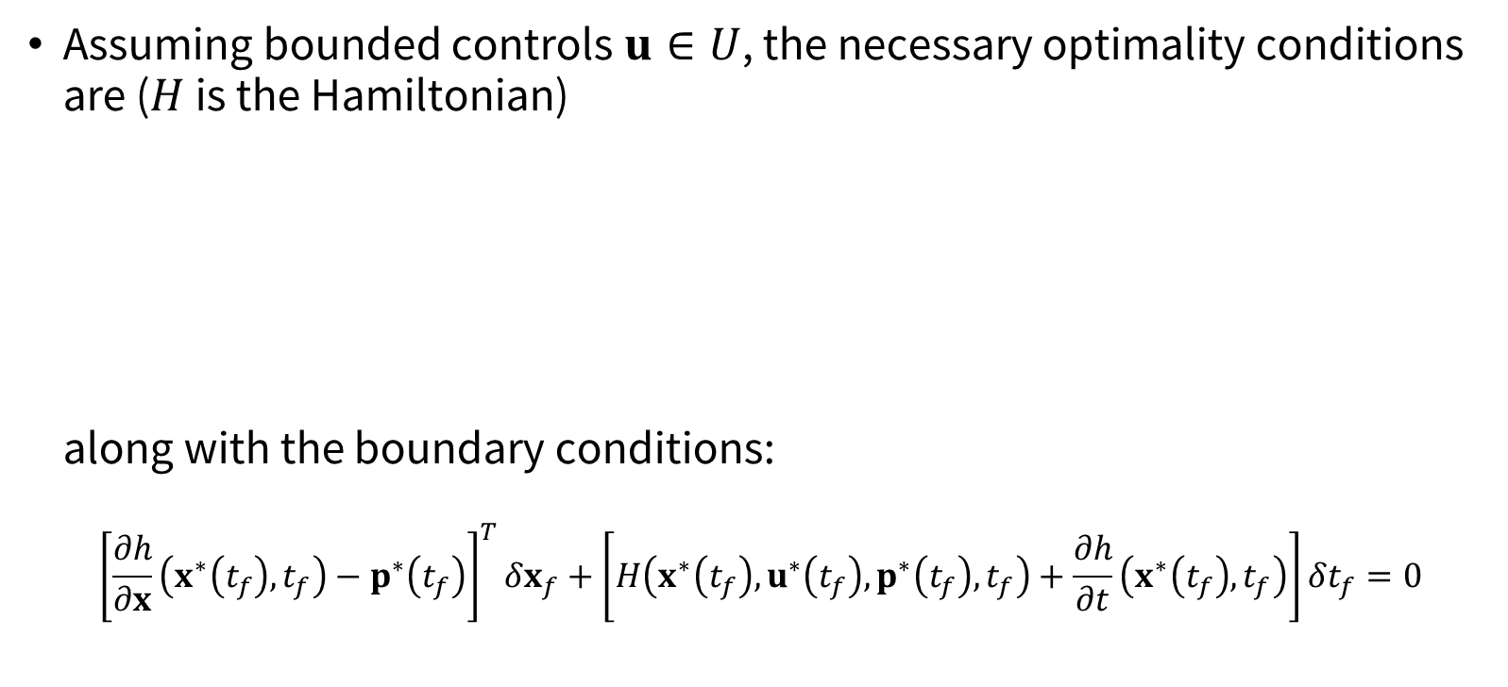
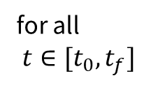
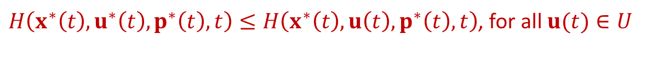

Pontryagin’s minimum principle
Assuming bounded controls $u∈U$, the necessary optimality conditions are ($H$ is the Hamiltonian)
along with the boundary conditions:
$${\left[\frac{∂h}{∂x}\left(x^{∗}\left(t_{f}\right),t_{f}\right)−p^{∗}\left(t_{f}\right)\right]}^{T}δx_{f}+\left[H\left(x^{∗}\left(t_{f}\right), u^{∗}\left(t_{f}\right), p^{∗}\left(t_{f}\right), t_{f}\right)+\frac{∂h}{∂t}\left(x^{∗}\left(t_{f}\right),t_{f}\right)\right]δt_{f}=0$$
${\dot{x}}^{∗}\left(t\right)=\frac{∂H}{∂p}$ $\left(x^{∗}\left(t\right), u^{∗}\left(t\right), p^{∗}\left(t\right), t\right)$
${\dot{p}}^{∗}\left(t\right)=−\frac{∂H}{∂x}$ $\left(x^{∗}\left(t\right), u^{∗}\left(t\right), p^{∗}\left(t\right), t\right)$
for all
$t∈[t_{0}, t_{f}]$
$H\left(x^{∗}\left(t\right), u^{∗}\left(t\right), p^{∗}\left(t\right), t\right)≤H\left(x^{∗}\left(t\right), u\left(t\right), p^{∗}\left(t\right), t\right)$, for all $u(t)∈U$

Slide 10
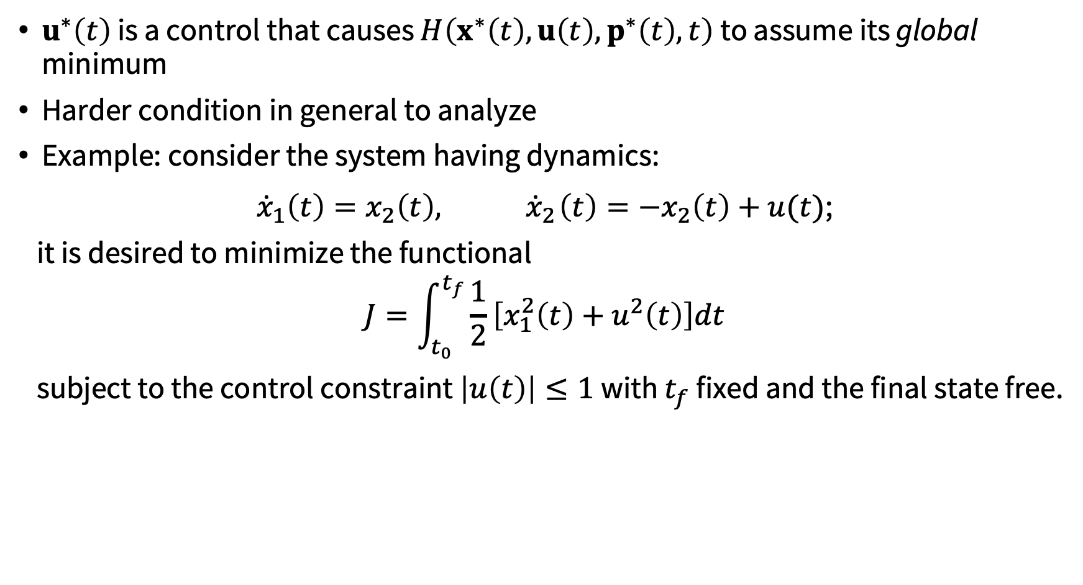
Pontryagin’s minimum principle
$u^{∗}\left(t\right)$ is a control that causes $H\left(x^{∗}\left(t\right), u\left(t\right), p^{∗}\left(t\right), t\right)$ to assume its global minimum
Harder condition in general to analyze
Example: consider the system having dynamics:
${\dot{x}}_{1}\left(t\right)=x_{2}\left(t\right),{ \dot{x}}_{2}\left(t\right)=−x_{2}\left(t\right)+u(t)$;
it is desired to minimize the functional
$$J=\int_{t_{0}}^{t_{f}}{\frac{1}{2}\left[x_{1}^{2}\left(t\right)+u^{2}\left(t\right)\right]dt}$$
subject to the control constraint $\left|u\left(t\right)\right|≤1$with $t_{f}$ fixed and the final state free.

Slide 11
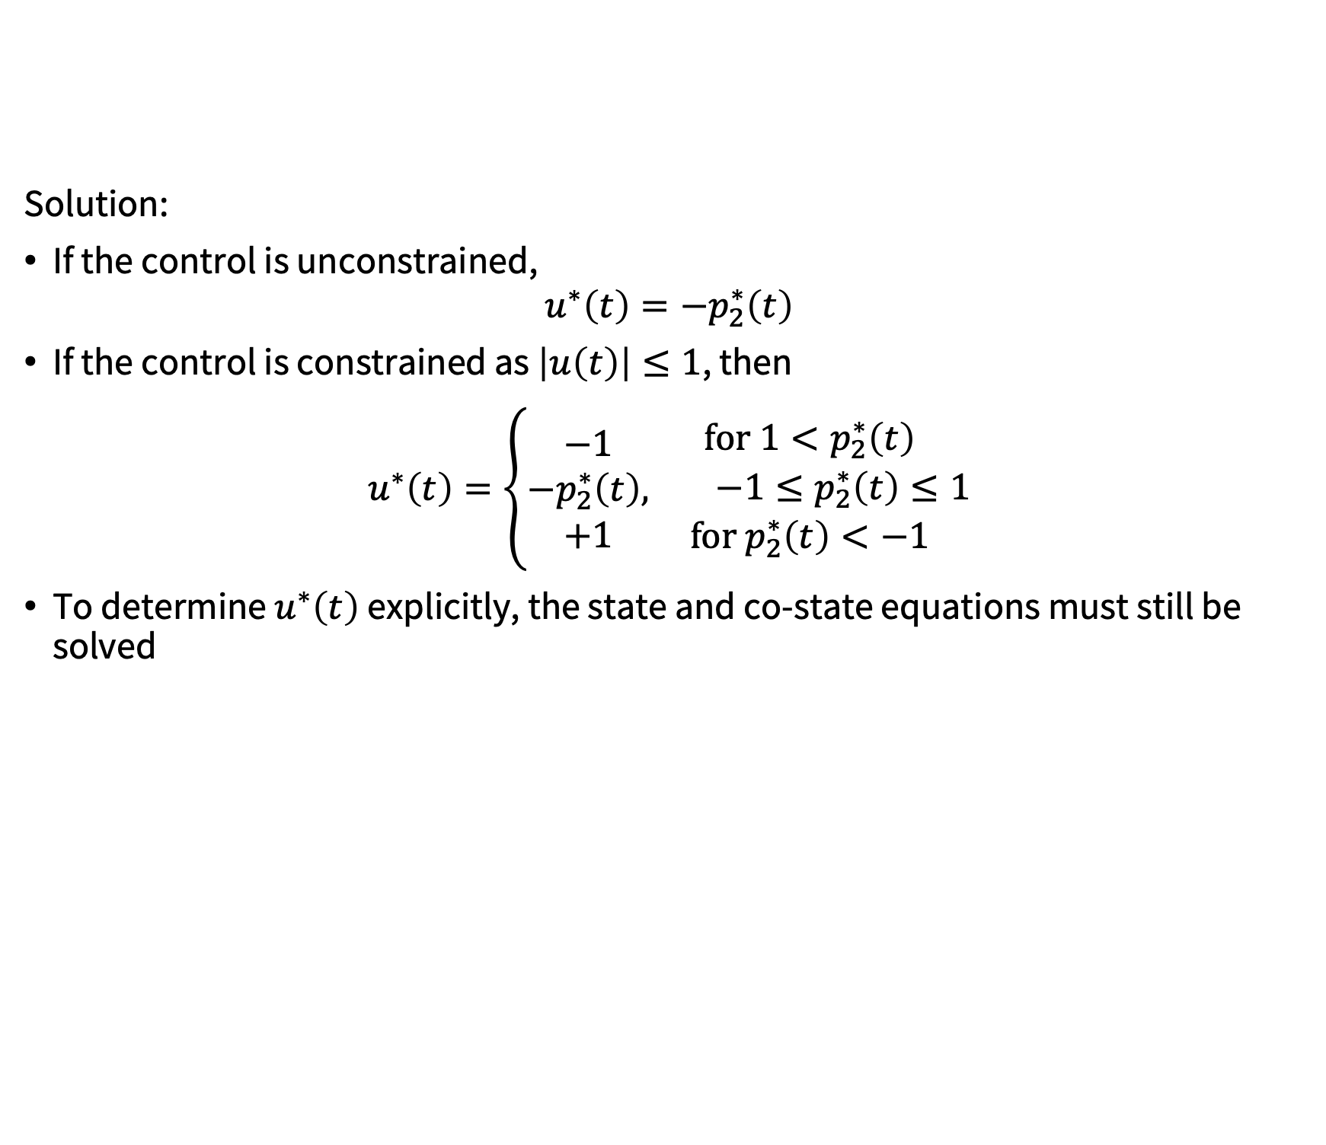
Pontryagin’s minimum principle
Solution:
If the control is unconstrained,
$$u^{∗}\left(t\right)=−p_{2}^{∗}\left(t\right)$$
If the control is constrained as $\left|u\left(t\right)\right|≤1$, then
$$u^{∗}\left(t\right)=\left\{\begin{aligned}−1 \\ −p_{2}^{∗}\left(t\right), \\ +1\end{aligned}\begin{aligned}for 1<p_{2}^{∗}\left(t\right) \\ −1≤p_{2}^{∗}\left(t\right)≤1 \\ {for p}_{2}^{∗}\left(t\right)<−1\end{aligned}\right.$$
To determine $u^{∗}\left(t\right)$ explicitly, the state and co-state equations must still be solved

Slide 12
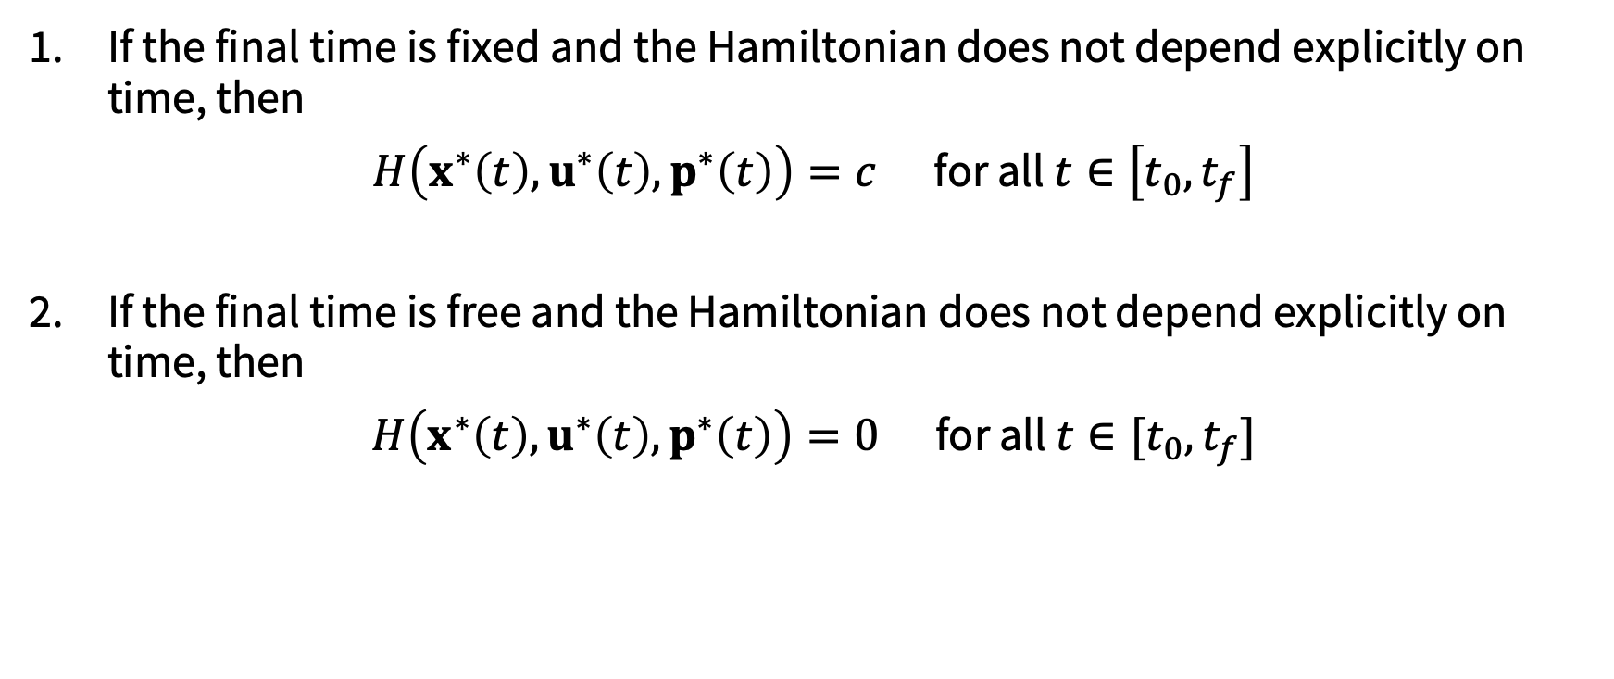
Additional necessary conditions
If the final time is fixed and the Hamiltonian does not depend explicitly on time, then
$H\left(x^{∗}\left(t\right), u^{∗}\left(t\right), p^{∗}\left(t\right)\right)=c$ for all $t∈\left[t_{0},t_{f}\right]$
If the final time is free and the Hamiltonian does not depend explicitly on time, then
$H\left(x^{∗}\left(t\right), u^{∗}\left(t\right), p^{∗}\left(t\right)\right)=0$ for all $t∈[t_{0},t_{f}]$

Slide 13
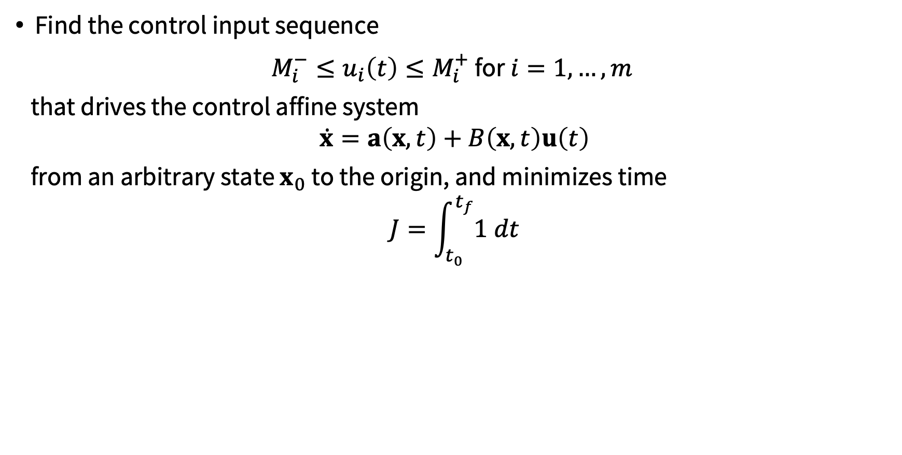
Minimum time problems
Find the control input sequence
$M_{i}^{−}≤u_{i}\left(t\right)≤M_{i}^{+}$ for $i=1, …, m$
that drives the control affine system
$$\dot{x}=a\left(x,t\right)+B\left(x,t\right)u\left(t\right)$$
from an arbitrary state $x_{0}$ to the origin, and minimizes time
$$J=\int_{t_{0}}^{t_{f}}{1 dt}$$

Slide 14
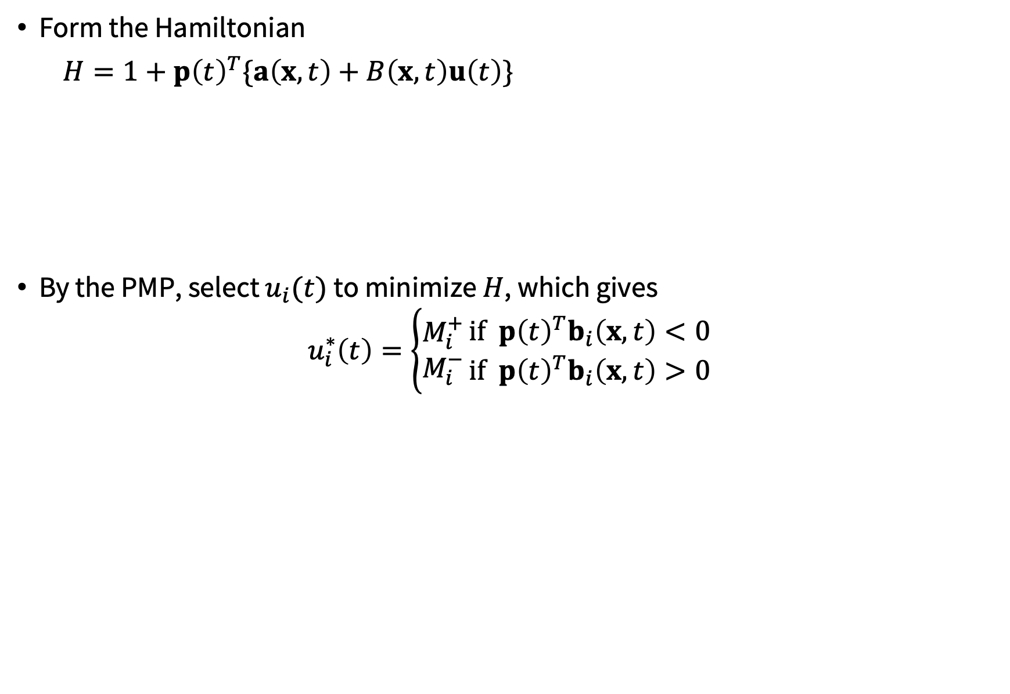
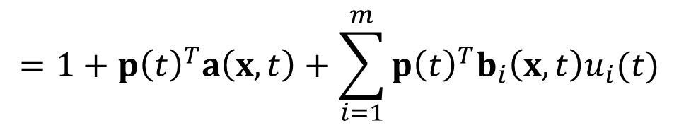
Minimum time problems
Form the Hamiltonian
$H=1+p{\left(t\right)}^{T}\{a\left(x,t\right)+B\left(x,t\right)u\left(t\right)\}$
By the PMP, select $u_{i}(t)$ to minimize $H$, which gives
$$u_{i}^{∗}\left(t\right)=\left\{\begin{aligned}M_{i}^{+} \\ M_{i}^{−}\end{aligned}\right.\begin{aligned}if p{\left(t\right)}^{T}b_{i}\left(x,t\right)<0 \\ if p{\left(t\right)}^{T}b_{i}\left(x,t\right)>0\end{aligned}$$
Side note: reminiscent of HJB? $p^{∗}\left(t\right)=∇_{x} J\left(x^{∗}\left(t\right), t\right)$ under certain technical assumptions (see Kirk Ch. 7)
$$=1+p{\left(t\right)}^{T}\{a\left(x,t\right)+[b_{1}\left(x,t\right){ b}_{2}\left(x,t\right)⋯b_{m}\left(x,t\right)]u\left(t\right)\}$$
$$=1+p{\left(t\right)}^{T}a\left(x,t\right)+\sum_{i=1}^{m}{p{\left(t\right)}^{T}b_{i}\left(x,t\right)u_{i}(t)}$$
“Bang-bang” control

Slide 15
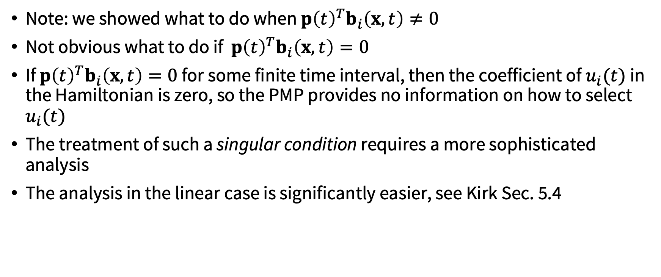
Minimum time problems
Note: we showed what to do when $p{\left(t\right)}^{T}b_{i}\left(x,t\right)≠0$
Not obvious what to do if $p{\left(t\right)}^{T}b_{i}\left(x,t\right)=0$
If $p{\left(t\right)}^{T}b_{i}\left(x,t\right)=0$ for some finite time interval, then the coefficient of $u_{i}(t)$ in the Hamiltonian is zero, so the PMP provides no information on how to select $u_{i}(t)$
The treatment of such a singular condition requires a more sophisticated analysis
The analysis in the linear case is significantly easier, see Kirk Sec. 5.4

Slide 16
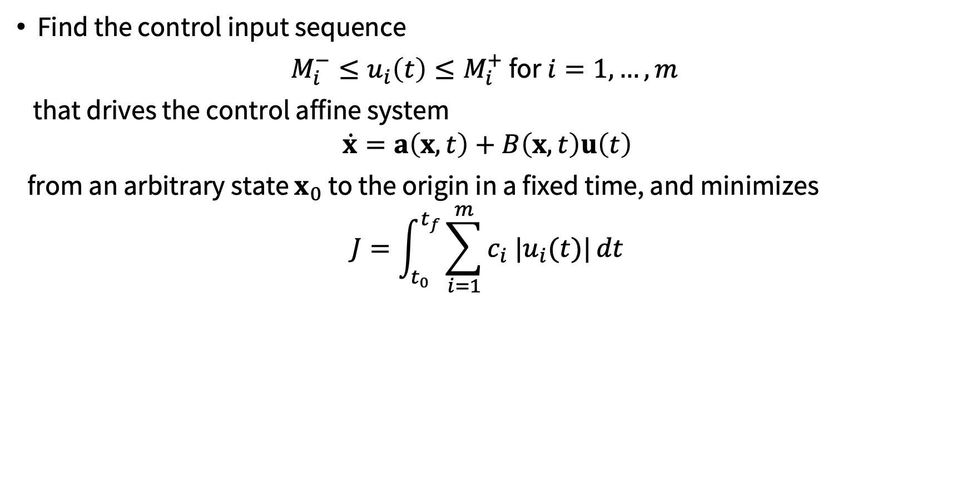
Minimum fuel problems
Find the control input sequence
$M_{i}^{−}≤u_{i}\left(t\right)≤M_{i}^{+}$ for $i=1, …, m$
that drives the control affine system
$$\dot{x}=a\left(x,t\right)+B\left(x,t\right)u\left(t\right)$$
from an arbitrary state $x_{0}$ to the origin in a fixed time, and minimizes
$$J=\int_{t_{0}}^{t_{f}}{\sum_{i=1}^{m}{c_{i} {|u}_{i}(t)|}dt}$$

Slide 17
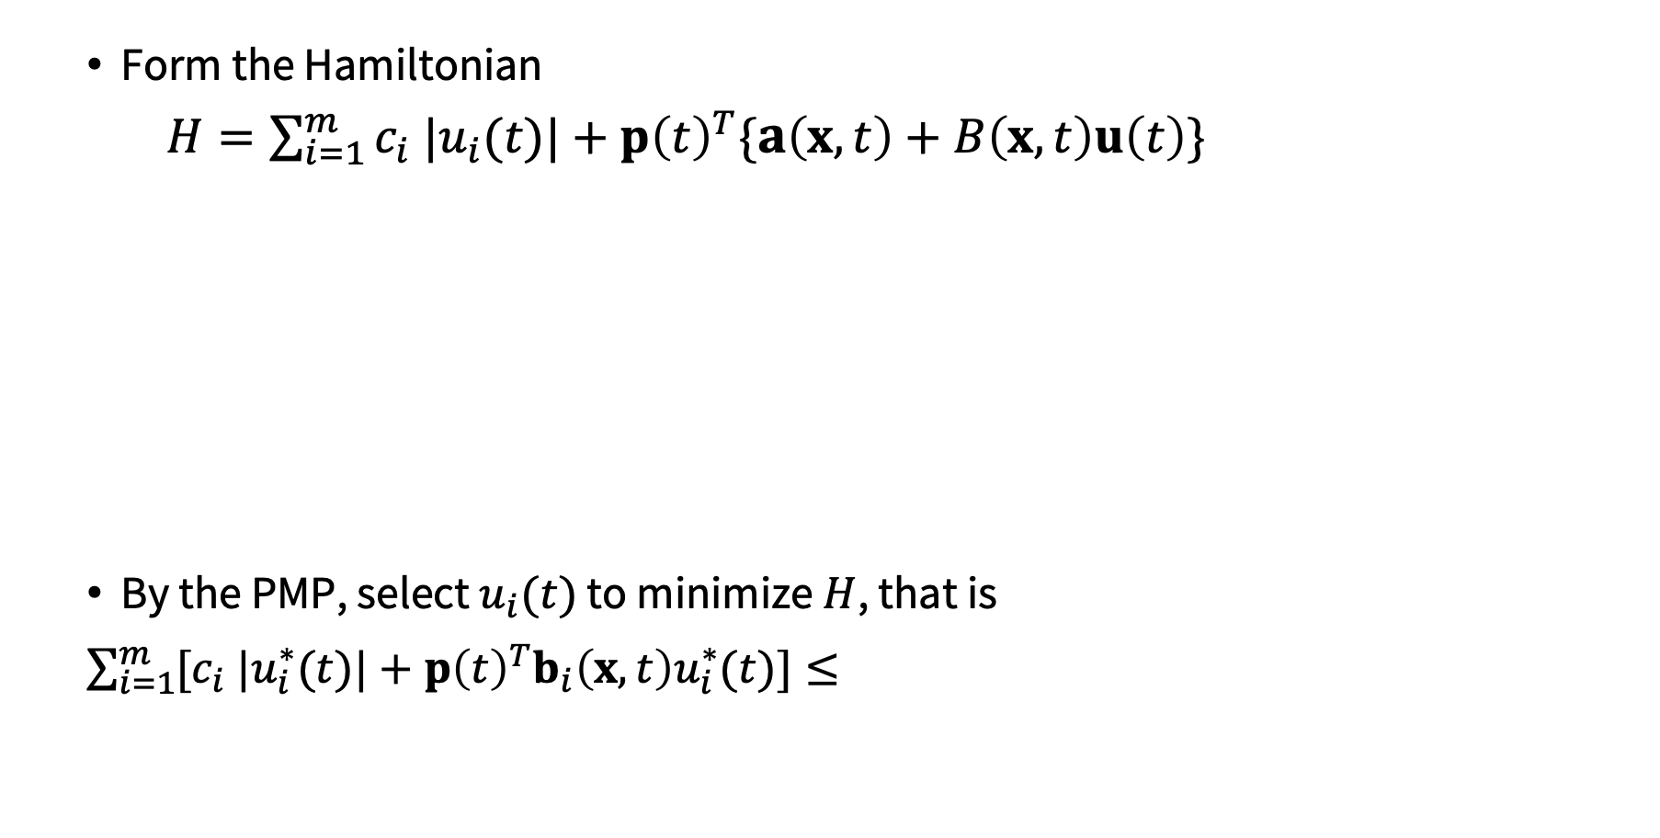
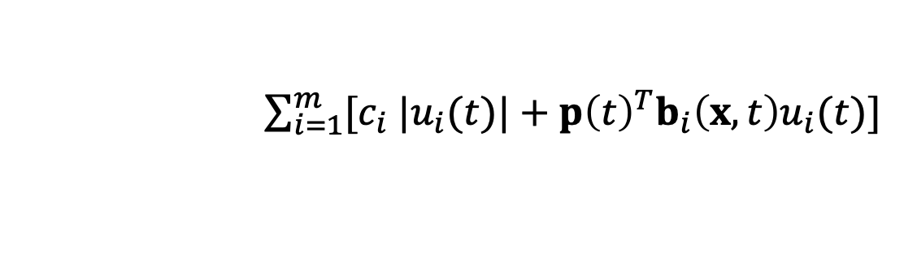
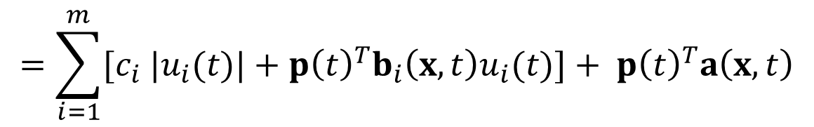
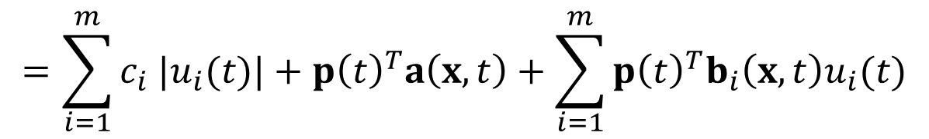
Minimum fuel problems
Form the Hamiltonian
$H=\sum_{i=1}^{m}{c_{i} {|u}_{i}(t)|}+p{\left(t\right)}^{T}\{a\left(x,t\right)+B\left(x,t\right)u\left(t\right)\}$
By the PMP, select $u_{i}(t)$ to minimize $H$, that is
$\sum_{i=1}^{m}{[c_{i} {|u}_{i}^{∗}(t)|}+p{\left(t\right)}^{T}b_{i}\left(x,t\right)u_{i}^{∗}(t)]≤$
$$=\sum_{i=1}^{m}{c_{i} {|u}_{i}(t)|}+p{\left(t\right)}^{T}a\left(x,t\right)+\sum_{i=1}^{m}{p{\left(t\right)}^{T}b_{i}\left(x,t\right)u_{i}(t)}$$
$$=\sum_{i=1}^{m}{[c_{i} {|u}_{i}(t)|}+p{\left(t\right)}^{T}b_{i}\left(x,t\right)u_{i}(t)]+ p{\left(t\right)}^{T}a\left(x,t\right)$$
$\sum_{i=1}^{m}{[c_{i} {|u}_{i}(t)|}+p{\left(t\right)}^{T}b_{i}\left(x,t\right)u_{i}(t)]$

Slide 18
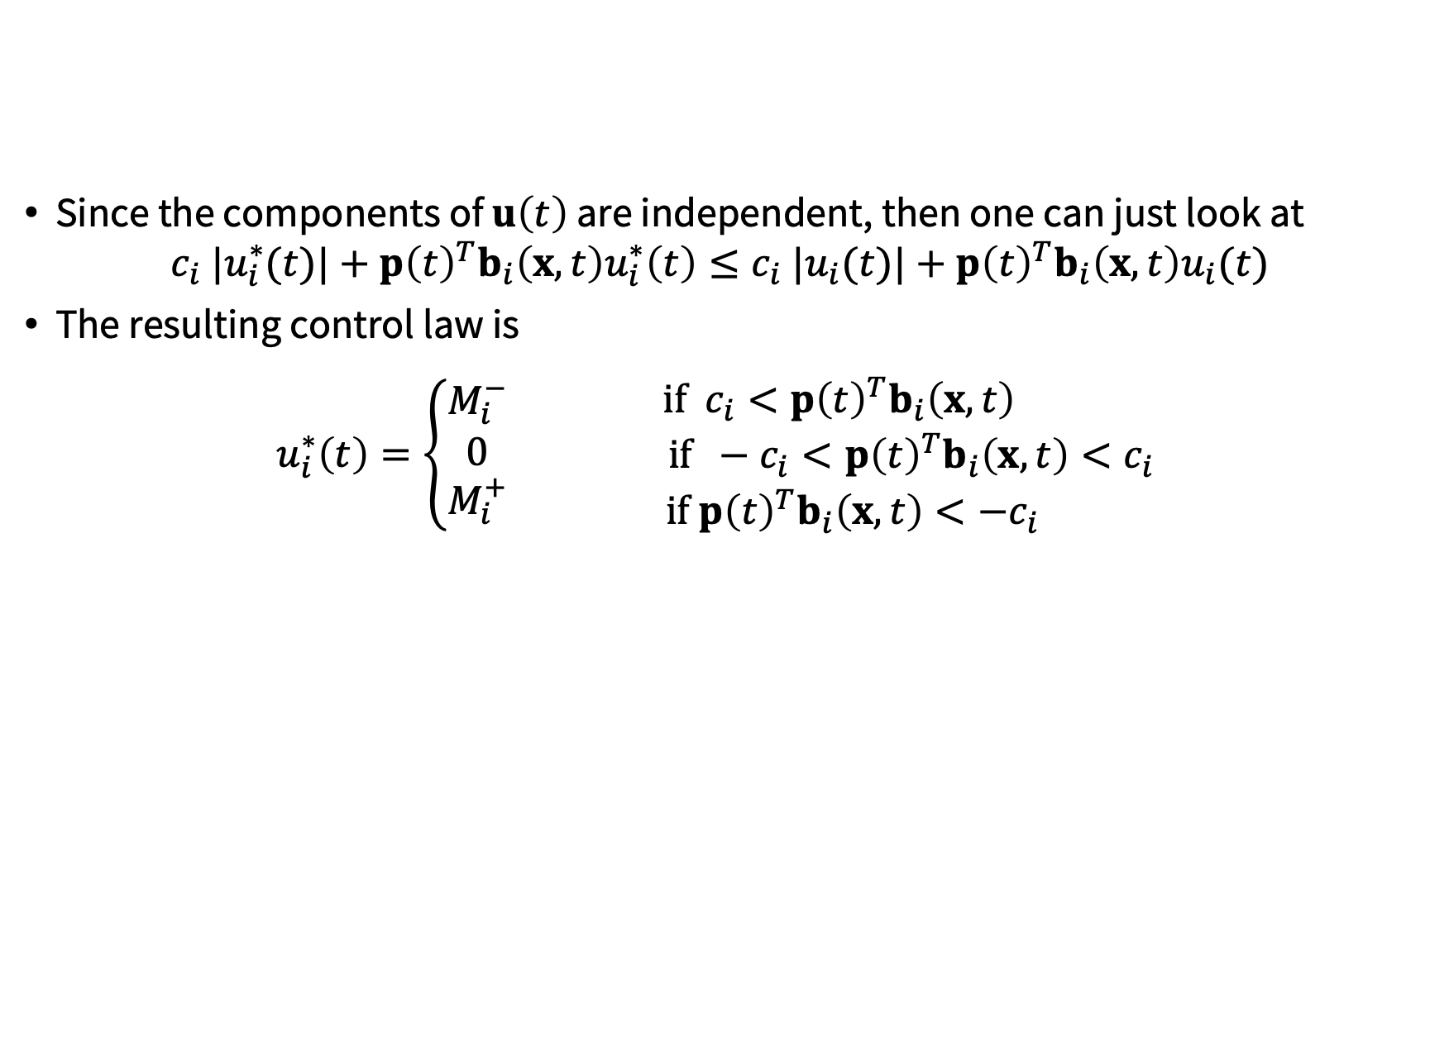
Minimum fuel problems
Since the components of $u\left(t\right)$ are independent, then one can just look at
$$c_{i} {|u}_{i}^{∗}(t)|+p{\left(t\right)}^{T}b_{i}\left(x,t\right)u_{i}^{∗}\left(t\right)≤c_{i} |u_{i}(t)|+p{\left(t\right)}^{T}b_{i}\left(x,t\right)u_{i}(t)$$
The resulting control law is
$$u_{i}^{∗}\left(t\right)=\left\{\begin{aligned}M_{i}^{−} \\ 0 \\ M_{i}^{+}\end{aligned}\right.\begin{aligned}if c_{i}<p{\left(t\right)}^{T}b_{i}\left(x,t\right) \\ if −c_{i}<p{\left(t\right)}^{T}b_{i}\left(x,t\right)<c_{i} \\ if p{\left(t\right)}^{T}b_{i}\left(x,t\right)<−c_{i}\end{aligned}$$
“Bang-off-bang” control

Slide 19
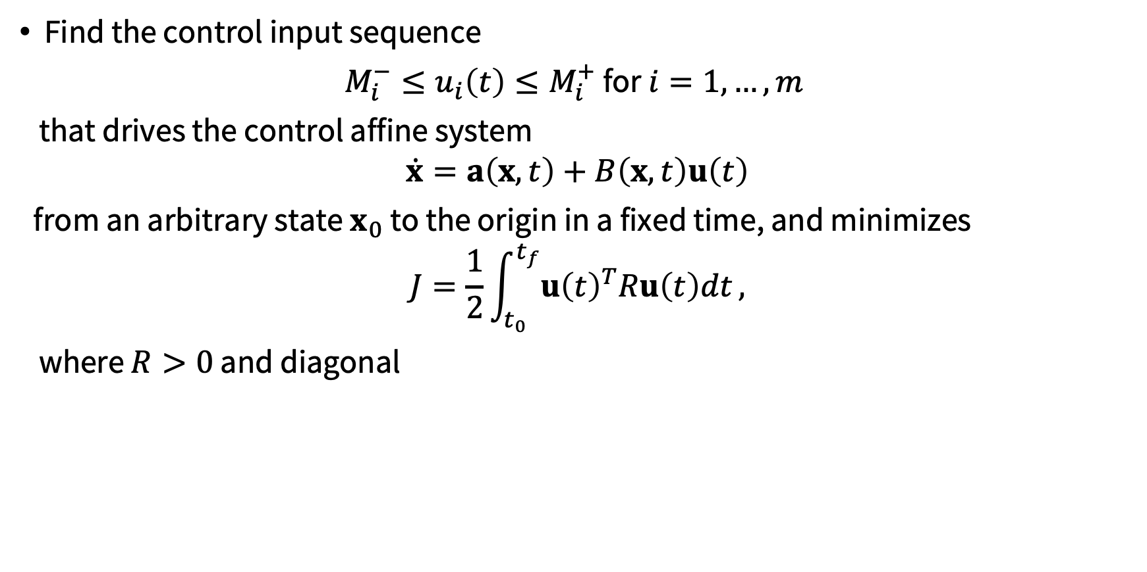
Minimum energy problems
Find the control input sequence
$M_{i}^{−}≤u_{i}\left(t\right)≤M_{i}^{+}$ for $i=1, …, m$
that drives the control affine system
$$\dot{x}=a\left(x,t\right)+B\left(x,t\right)u\left(t\right)$$
from an arbitrary state $x_{0}$ to the origin in a fixed time, and minimizes
$$J=\frac{1}{2}\int_{t_{0}}^{t_{f}}{u{\left(t\right)}^{T}Ru\left(t\right)dt},$$
where $R>0$ and diagonal

Slide 20
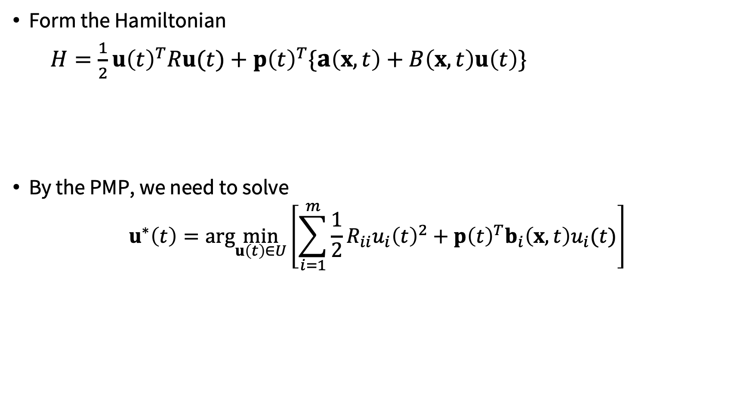
Minimum energy problems
Form the Hamiltonian
$H=\frac{1}{2}u{\left(t\right)}^{T}Ru(t)+p{\left(t\right)}^{T}\{a\left(x,t\right)+B\left(x,t\right)u\left(t\right)\}$
By the PMP, we need to solve
$$u^{∗}\left(t\right)=arg\min_{u\left(t\right)∈U}\left[\sum_{i=1}^{m}{\frac{1}{2}R_{ii}u_{i}{\left(t\right)}^{2}+p{\left(t\right)}^{T}b_{i}\left(x,t\right)u_{i}(t)}\right]$$
$=\frac{1}{2}u{\left(t\right)}^{T}Ru\left(t\right)+p{\left(t\right)}^{T}B\left(x,t\right)u\left(t\right)+$ $p{\left(t\right)}^{T}a\left(x,t\right)$

Slide 21
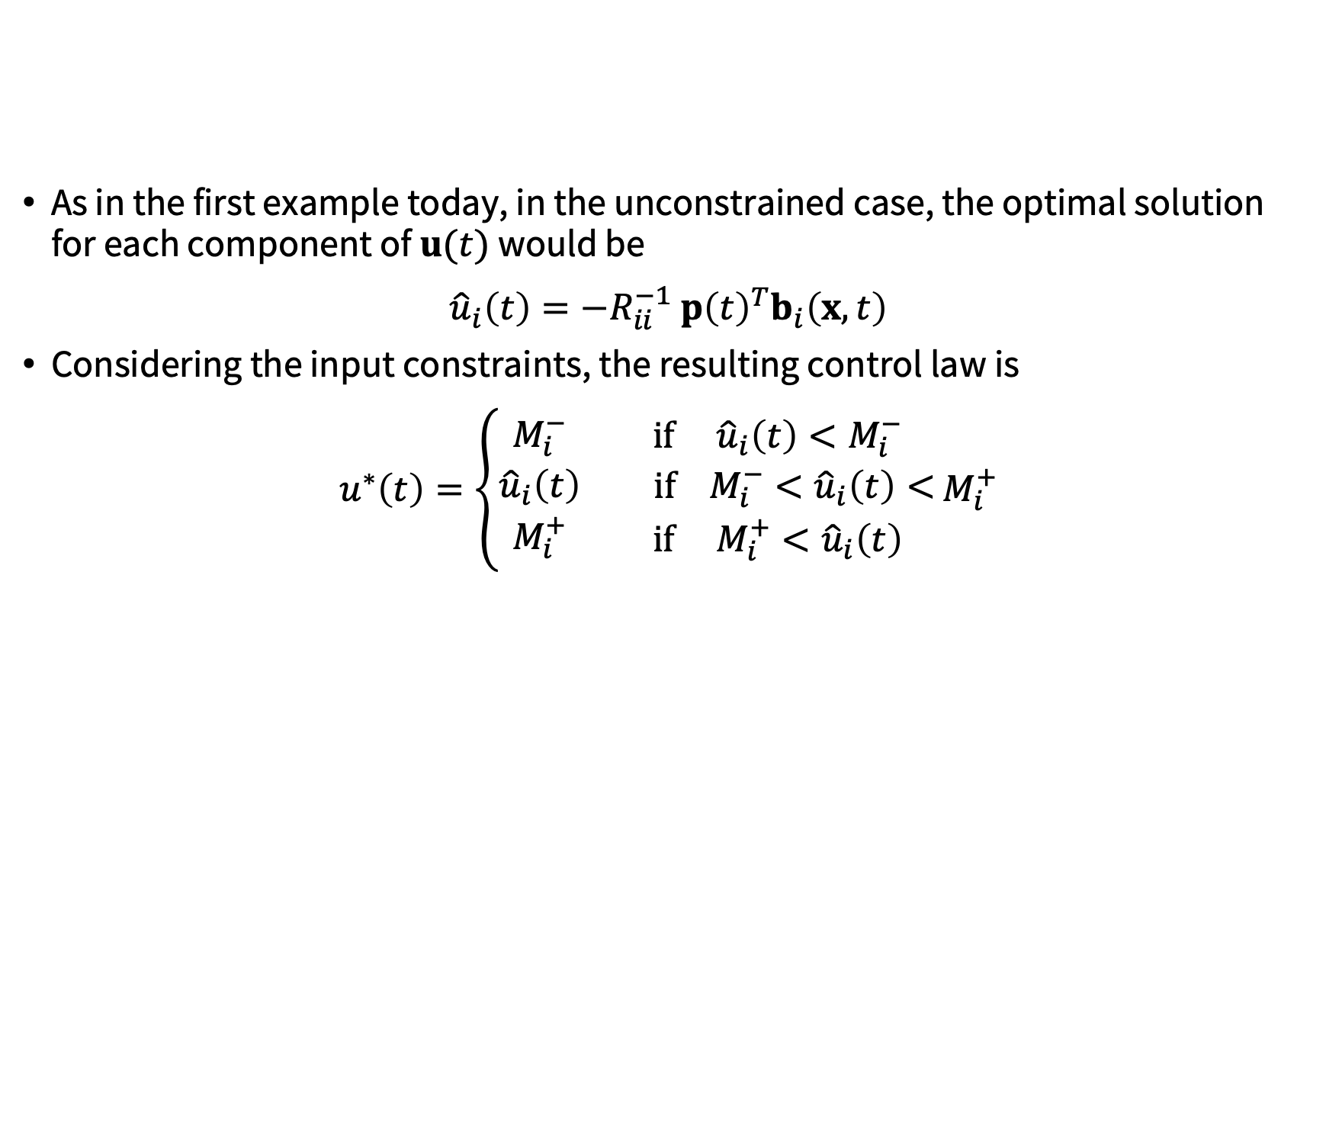
Minimum energy problems
As in the first example today, in the unconstrained case, the optimal solution for each component of $u(t)$ would be
${\hat{u}}_{i}\left(t\right)=−R_{ii}^{−1}$ $p{\left(t\right)}^{T}b_{i}\left(x,t\right)$
Considering the input constraints, the resulting control law is
$u^{∗}\left(t\right)=\left\{\begin{aligned}M_{i}^{−} \\ {\hat{u}}_{i}\left(t\right) \\ M_{i}^{+}\end{aligned}\right.\begin{aligned} if {\hat{u}}_{i}\left(t\right)<M_{i}^{−} \\ if M_{i}^{−}<{\hat{u}}_{i}\left(t\right)< \\ if{ M}_{i}^{+}<{\hat{u}}_{i}\left(t\right)\end{aligned}$ $M_{i}^{+}$
“Saturating” control

Slide 22
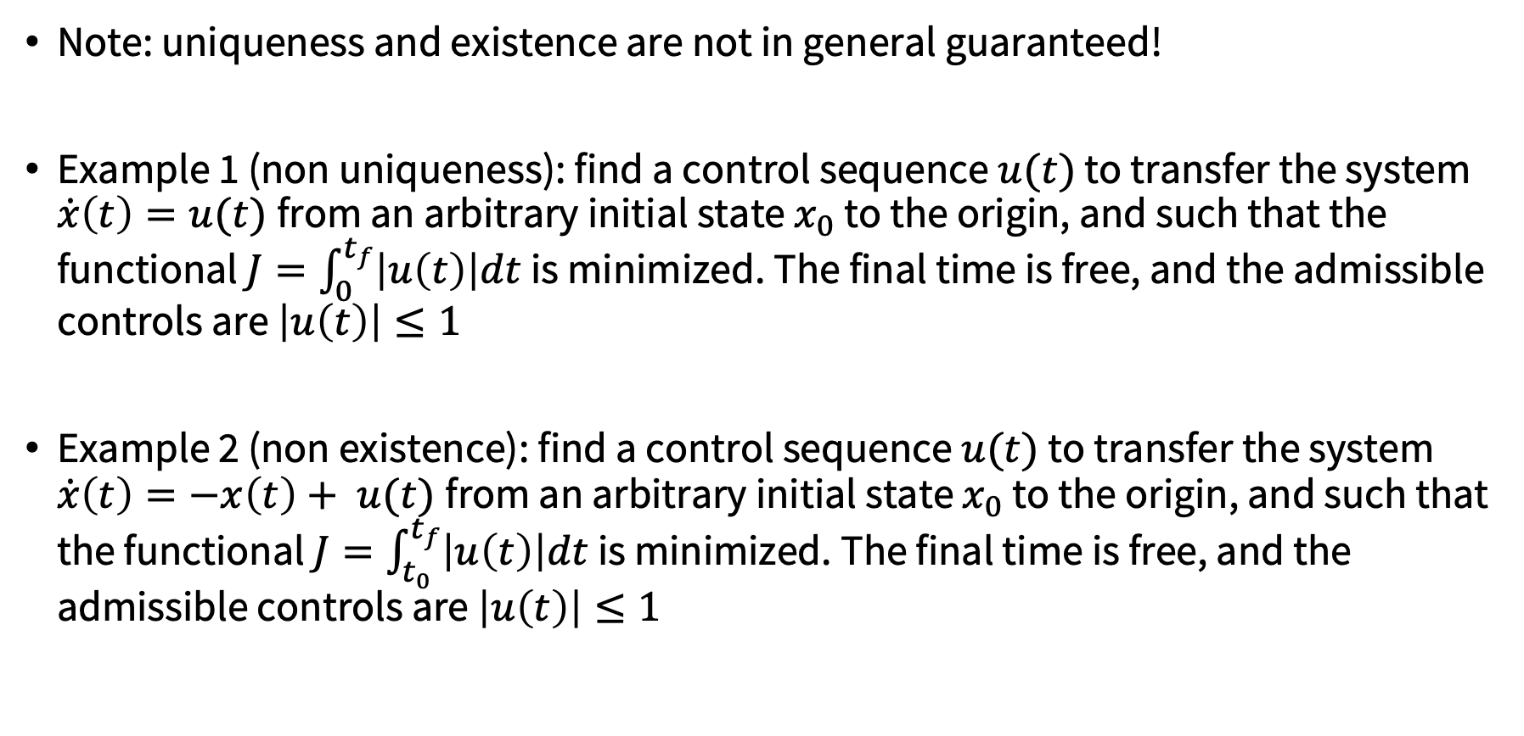
Uniqueness and existence
Note: uniqueness and existence are not in general guaranteed!
Example 1 (non uniqueness): find a control sequence $u(t)$ to transfer the system $\dot{x}\left(t\right)=u(t)$from an arbitrary initial state $x_{0}$ to the origin, and such that the functional $J=\int_{0}^{t_{f}}{\left|u\left(t\right)\right|dt}$ is minimized. The final time is free, and the admissible controls are $\left|u\left(t\right)\right|≤1$
Example 2 (non existence): find a control sequence $u(t)$ to transfer the system $\dot{x}\left(t\right)=−x\left(t\right)+ u(t)$from an arbitrary initial state $x_{0}$ to the origin, and such that the functional $J=\int_{t_{0}}^{t_{f}}{\left|u\left(t\right)\right|dt}$ is minimized. The final time is free, and the admissible controls are $\left|u\left(t\right)\right|≤1$

Slide 23
Computational methods
Until now, we derived necessary conditions for optimality and analytically studied a few special cases
We now focus on numerical techniques to solve two-point boundary value problems; popular methods:
Indirect shooting method
Indirect collocation method

Slide 24
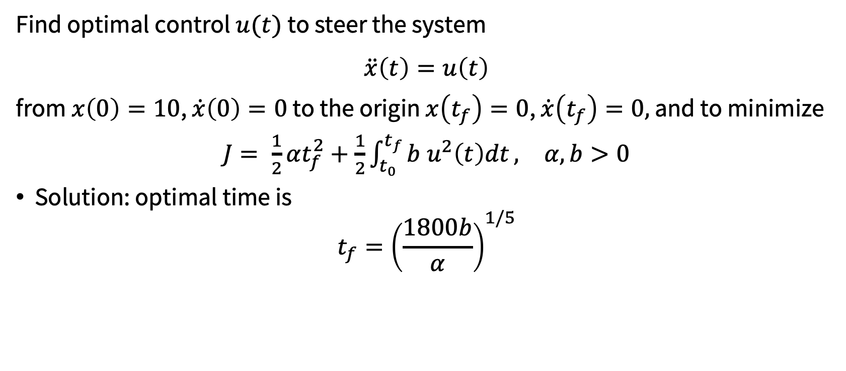
Let’s revisit our example…
Find optimal control $u(t)$ to steer the system
$$\ddot{x}\left(t\right)=u\left(t\right)$$
from $x\left(0\right)=10$, $\dot{x}\left(0\right)=0$ to the origin $x\left(t_{f}\right)=0$, $\dot{x}\left(t_{f}\right)=0,$ and to minimize
$J= \frac{1}{2}αt_{f}^{2}+\frac{1}{2}\int_{t_{0}}^{t_{f}}{b u^{2}\left(t\right)dt},$ $α, b>0$
Solution: optimal time is
$$t_{f}={\left(\frac{1800b}{α}\right)}^{1/5}$$

Slide 25
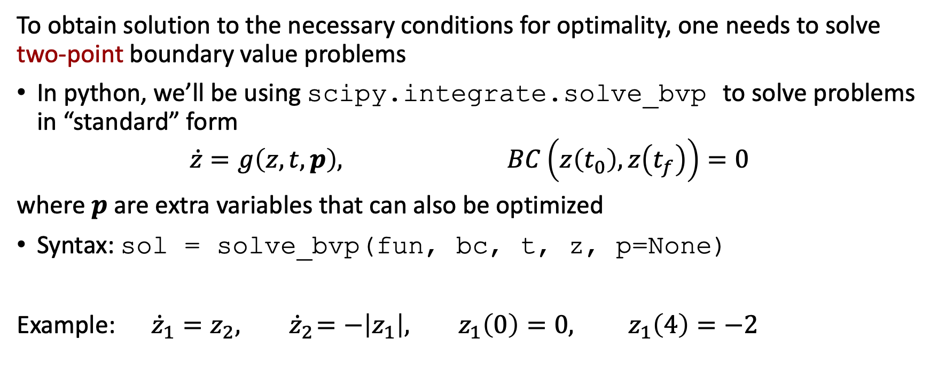
Indirect methods: practical aspects
To obtain solution to the necessary conditions for optimality, one needs to solve two-point boundary value problems
In python, we’ll be using scipy.integrate.solve_bvp to solve problems in “standard” form
$$\dot{z}=g\left(z, t, p\right), BC\left(z\left(t_{0}\right), z\left(t_{f}\right)\right)=0$$
where $p$ are extra variables that can also be optimized
Syntax: sol = solve_bvp(fun, bc, t, z, p=None)
Example: ${\dot{z}}_{1}=z_{2},{ \dot{z}}_{2}=−\left|z_{1}\right|, z_{1}\left(0\right)=0, z_{1}\left(4\right)=−2$
*solve_bvp uses a collocation formula (three-stage Lobatto)

Slide 26
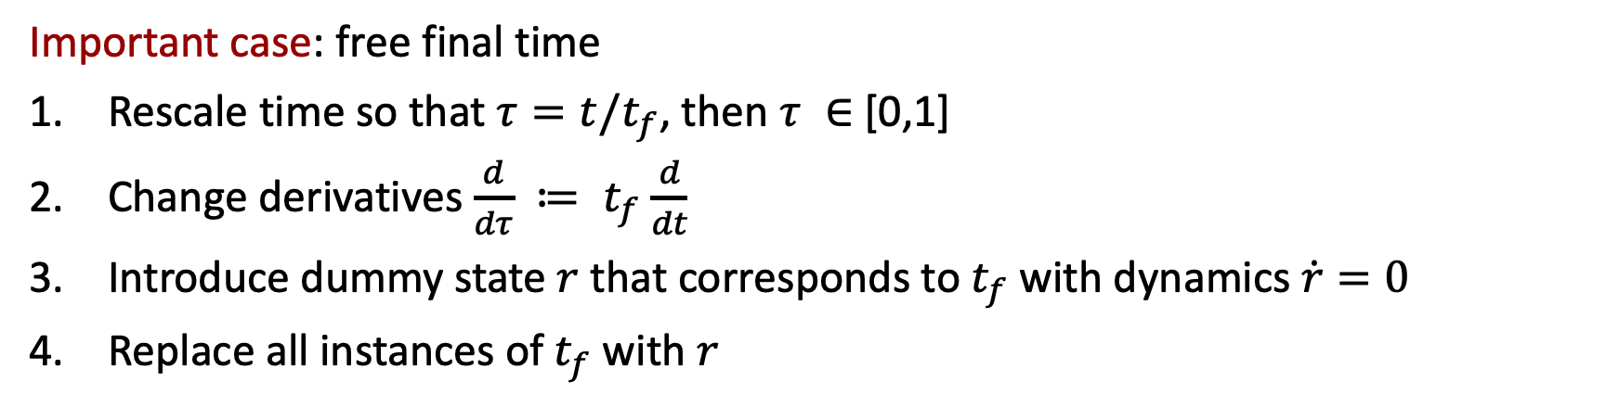
Extensions
What about problems whose necessary conditions to not fit directly the “standard” form (e.g., free end time problems)?
Handy tricks exist to convert problems into standard form:
Ascher, U., & Russell, R. D. (1981). Reformulation of boundary value problems into “standard” form. SIAM review, 23(2), 238-254.
Important case: free final time
Rescale time so that $τ=t/t_{f}$, then $τ ∈$ [0,1]
Change derivatives $\frac{d}{dτ} ≔ t_{f}$ $\frac{d}{dt}$
Introduce dummy state $r$ that corresponds to$t_{f}$ with dynamics $\dot{r}=0$
Replace all instances of$t_{f}$ with $r$

Slide 27

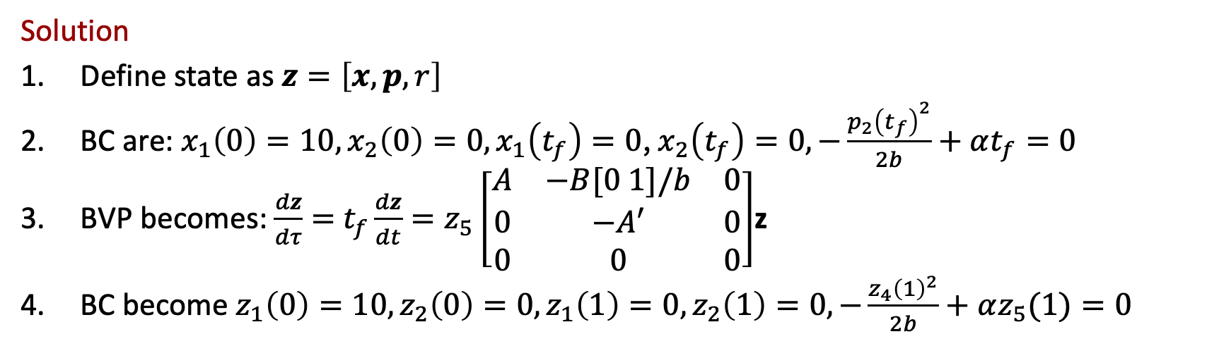
Example
Find optimal control $u(t)$ to steer the system $\ddot{x}\left(t\right)=u\left(t\right)$
from $x\left(0\right)=10$, $\dot{x}\left(0\right)=0$ to the origin $x\left(t_{f}\right)=0$, $\dot{x}\left(t_{f}\right)=0,$ and to minimize
$J= \frac{1}{2}αt_{f}^{2}+\frac{1}{2}\int_{t_{0}}^{t_{f}}{b u^{2}\left(t\right)dt},$ $α, b>0$
Solution
Define state as $z=\left[x, p, r\right]$
BC are: $x_{1}\left(0\right)=10, x_{2}\left(0\right)=0,x_{1}\left(t_{f}\right)=0$,${ x}_{2}\left(t_{f}\right)=0, −\frac{{p_{2}\left(t_{f}\right)}^{2}}{2b}+αt_{f}=0$
BVP becomes: $\frac{dz}{dτ}=$ $t_{f}\frac{dz}{dt}=z_{5}\left[\begin{matrix}A & −B[0 1]/b & 0 \\ 0 & −A′ & 0 \\ 0 & 0 & 0\end{matrix}\right]$z
BC become $z_{1}\left(0\right)=10,z_{2}\left(0\right)=0,z_{1}\left(1\right)=0,z_{2}\left(1\right)=0, −\frac{{z_{4}\left(1\right)}^{2}}{2b}+αz_{5}(1)=0$

Slide 28
Next time
Direct methods

