Slide 1
AA203 Optimal and Learning-based Control
Direct methods for optimal control, sequential convex programming (SCP)

Slide 2
Roadmap
Model-free RL
Control
Adaptive
optimal control
Model-based RL
Feedback control
Adaptive control
Optimal and learning control
Open-loop
MPC
Closed-loop
Indirect methods
Direct
methods
DP
HJB / HJI

Slide 3
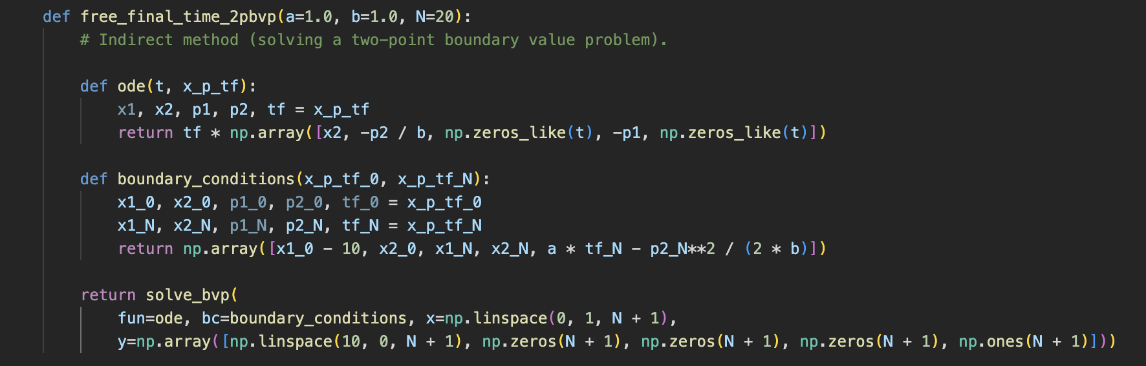
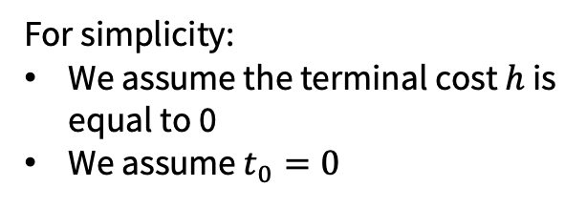

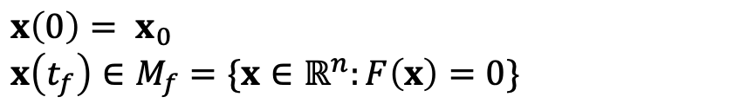

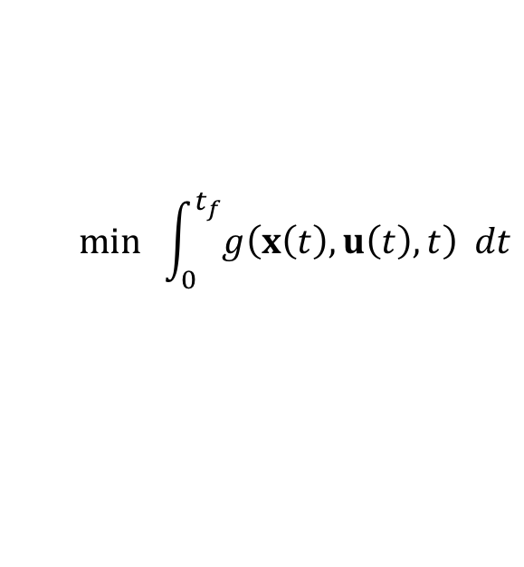
Optimal control problem
$$min \int_{0}^{t_{f}}{g\left(x\left(t\right),u\left(t\right),t\right) dt}$$
Indirect Methods:
Apply necessary conditions for optimality to (OCP)
Solve a two-point boundary value problem
$\dot{x}(t)=f\left(x\left(t\right),u\left(t\right),t\right)$, $t∈\text{[0, }t_{f}\text{]}$
(OCP)
$$x\left(0\right)= x_{0}$$
$$x\left(t_{f}\right)∈M_{f}=\{x∈ℝ^{n}:F\left(x\right)=0\}$$
$u\left(t\right)∈U⊆ℝ^{m}$, $t∈\text{[0, }t_{f}\text{]}$
For simplicity:
We assume the terminal cost $h$ is equal to 0
We assume $t_{0}=0$
Direct Methods:
Transcribe (OCP) into a nonlinear, constrained optimization problem
Solve the optimization problem via nonlinear programming

Slide 4
Direct methods
Resources:
Notes Chapter 5 and references therein, and also:
Rao A. V., “A survey of numerical methods for optimal control,” 2009.
Kelly, M., “An Introduction to Trajectory Optimization,” 2017.

Slide 5
Transcription methods
Optimization: what are the decision variables?
State and control parameterization methods
“Collocation”/“simultaneous”
Control parameterization methods
“Shooting”

Slide 6

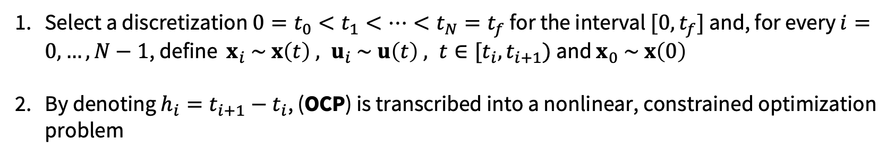
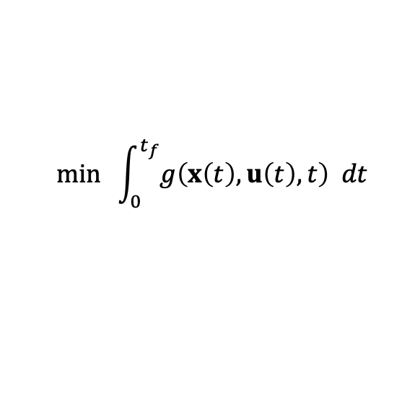
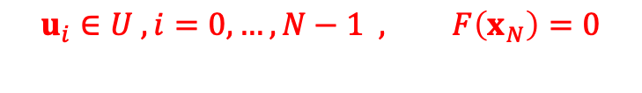
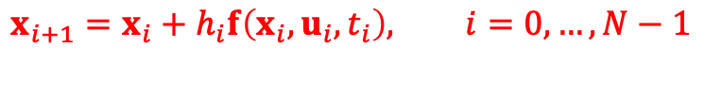

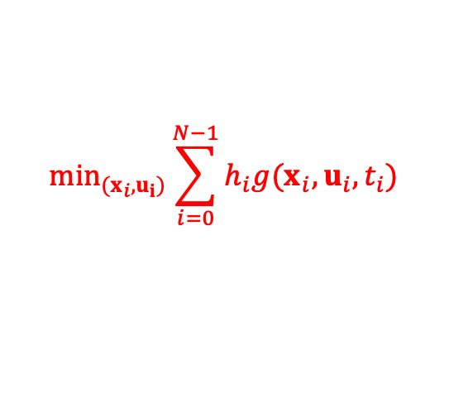
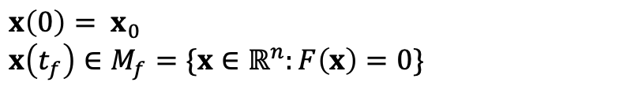
Transcription into nonlinear programming (state and control parametrization method)
$$min \int_{0}^{t_{f}}{g\left(x\left(t\right),u\left(t\right),t\right) dt}$$
$$\min_{(x_{i},u_{i})}\sum_{i=0}^{N−1}{h_{i}g(x_{i},u_{i},t_{i})}$$
$\dot{x}(t)=f\left(x\left(t\right),u\left(t\right),t\right)$, $t∈\text{[0, }t_{f}\text{]}$
(NLOP)
(OCP)
$$x\left(0\right)= x_{0}$$
$$x\left(t_{f}\right)∈M_{f}=\{x∈ℝ^{n}:F\left(x\right)=0\}$$
$$x_{i+1}=x_{i}+h_{i}f\left(x_{i},u_{i},t_{i}\right), i=0,…,N−1$$
$$u_{i}∈U , i=0,…,N−1 , F\left(x_{N}\right)=0$$
$u\left(t\right)∈U⊆ℝ^{m}$, $t∈\text{[0, }t_{f}\text{]}$
Forward Euler time discretization:
Select a discretization $0=t_{0}<t_{1}<…<t_{N}=t_{f}$ for the interval $[0,t_{f}]$ and, for every $i=0,…,N−1$, define $x_{i} \sim x\left(t\right) , u_{i} \sim u\left(t\right) , t∈[t_{i},t_{i+1})$ and $x_{0} \sim x\left(0\right)$
By denoting $h_{i}=t_{i+1}−t_{i}$, (OCP) is transcribed into a nonlinear, constrained optimization problem

Slide 7




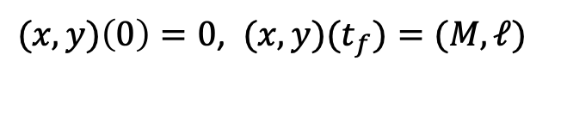

Illustrative example: Zermelo’s Problem
(OCP)
$$min \int_{0}^{t_{f}}{u{\left(t\right)}^{2} dt}$$
Current flow
$\dot{x}\left(t\right)=v cos\left(u\left(t\right)\right)+flow\left(y\left(t\right)\right),$t $∈$ [0, $t_{f}$]
$\dot{y}\left(t\right)=v sin\left(u\left(t\right)\right)$, t $∈$ [0, $t_{f}$]
$$v$$
$(x,y)\left(0\right)=0$, ${(x,y)(t}_{f})=(M,ℓ)$
$$u(t)$$
$\left|u\left(t\right)\right|≤u_{max}$, t $∈$ [0, $t_{f}$]

Slide 8

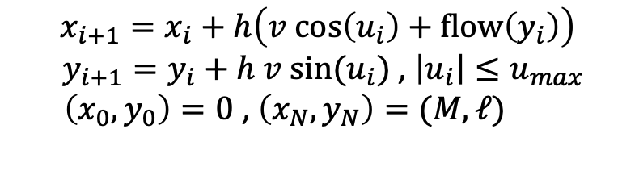
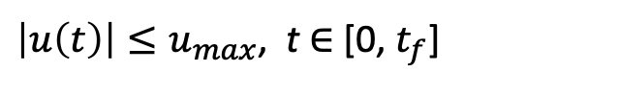
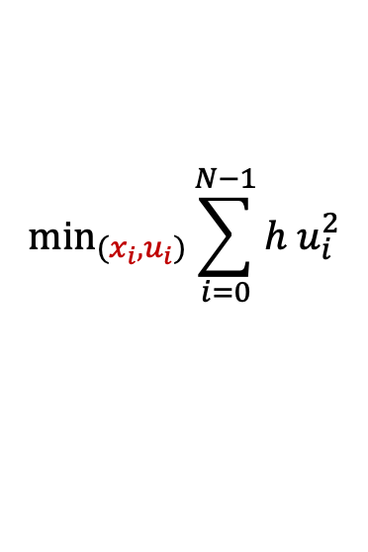
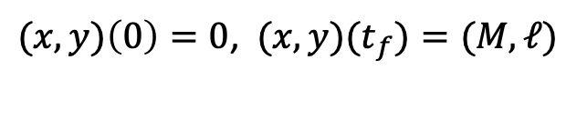

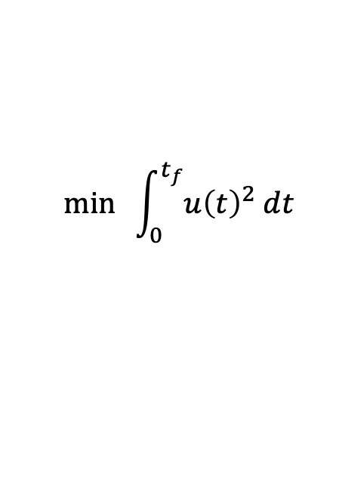
Example: Zermelo’s Problem (state and control parametrization method)
Transcribe optimal control problem into a non-linear program, and solve it via fmincon (MATLAB), scipy.optimize.minimize (python), etc.
$$min \int_{0}^{t_{f}}{u{\left(t\right)}^{2} dt}$$
$$\min_{(x_{i},u_{i})}\sum_{i=0}^{N−1}{h u_{i}^{2}}$$
(OCP)
(NLOP)
$\dot{x}\left(t\right)=v cos\left(u\left(t\right)\right)+flow\left(y\left(t\right)\right),$t $∈$ [0, $t_{f}$]
$\dot{y}\left(t\right)=v sin\left(u\left(t\right)\right)$, t $∈$ [0, $t_{f}$]
$$x_{i+1}=x_{i}+h\left(v cos\left(u_{i}\right)+flow\left(y_{i}\right)\right)$$
$y_{i+1}=y_{i}+h v sin(u_{i})$ , $\left|u_{i}\right|≤u_{max}$
$\left(x_{0},y_{0}\right)=0$ , $\left(x_{N},y_{N}\right)=(M,ℓ)$
$(x,y)\left(0\right)=0$, ${(x,y)(t}_{f})=(M,ℓ)$
$\left|u\left(t\right)\right|≤u_{max}$, t $∈$ [0, $t_{f}$]

Slide 9
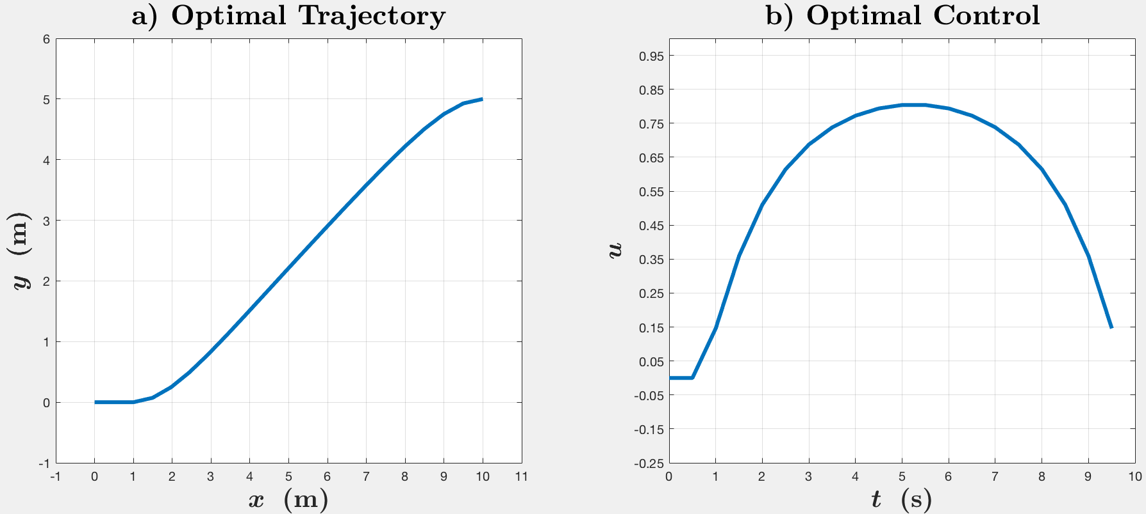
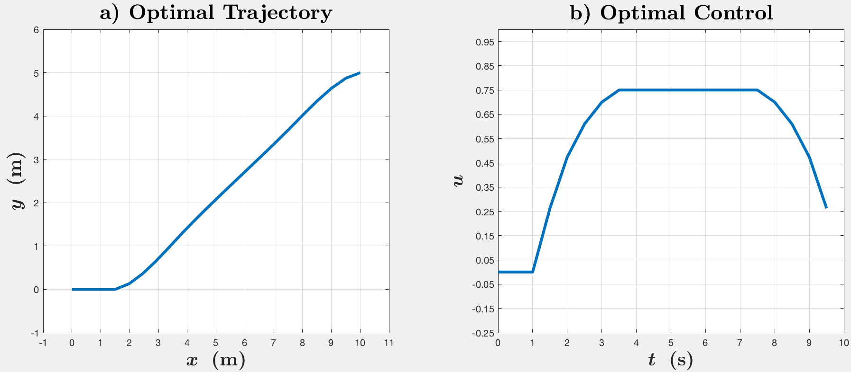

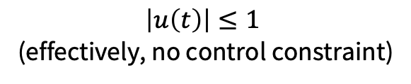
Results
$$\left|u\left(t\right)\right|≤1$$
(effectively, no control constraint)
$$\left|u\left(t\right)\right|≤0.75$$

Slide 10
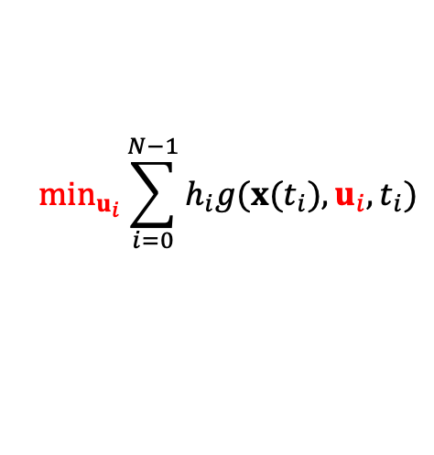
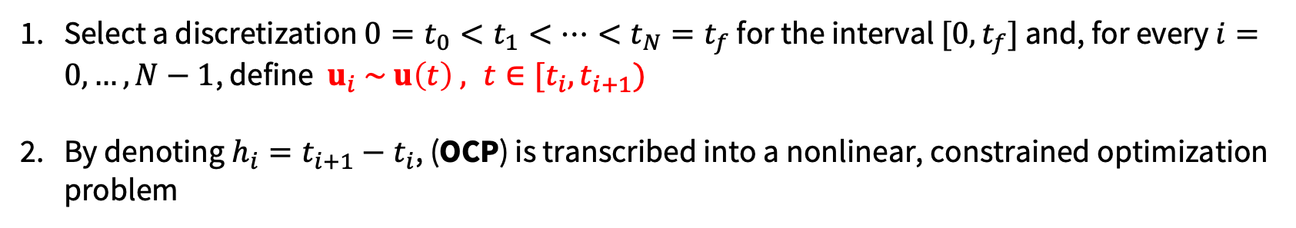

Transcription into nonlinear programming (control parametrization method)
$$min \int_{0}^{t_{f}}{g\left(x\left(t\right),u\left(t\right),t\right) dt}$$
$$\min_{u_{i}}\sum_{i=0}^{N−1}{h_{i}g(x(t_{i}),u_{i},t_{i})}$$
(NLOP-C)
$\dot{x}(t)=f\left(x\left(t\right),u\left(t\right),t\right)$, $t∈\text{[0, }t_{f}\text{]}$
$$u_{i}∈U , i=0,…,N−1 , F(x(t_{N}))=0$$
(OCP)
$$x\left(0\right)= x_{0}$$
$$x\left(t_{f}\right)∈M_{f}=\{x∈ℝ^{n}:F\left(x\right)=0\}$$
where each $x(t_{i})$ is recursively computed via
$u\left(t\right)∈U⊆ℝ^{m}$, $t∈\text{[0, }t_{f}\text{]}$
$$x(t_{i+1})=x(t_{i})+h_{i}f\left(x\left(t_{i}\right),u_{i},t_{i}\right), i=0,…,N−1$$
Time and control discretization:
Select a discretization $0=t_{0}<t_{1}<…<t_{N}=t_{f}$ for the interval $[0,t_{f}]$ and, for every $i=0,…,N−1$, define $u_{i} \sim u\left(t\right) , t∈[t_{i},t_{i+1})$
By denoting $h_{i}=t_{i+1}−t_{i}$, (OCP) is transcribed into a nonlinear, constrained optimization problem

Slide 11
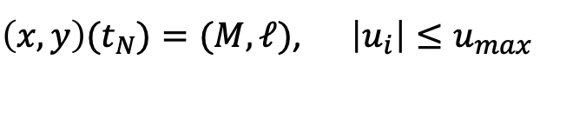


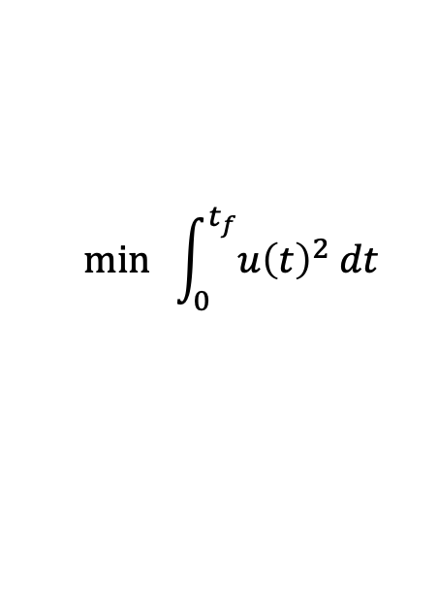

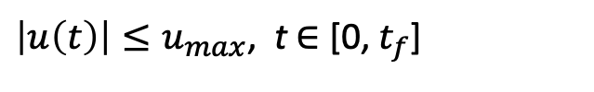
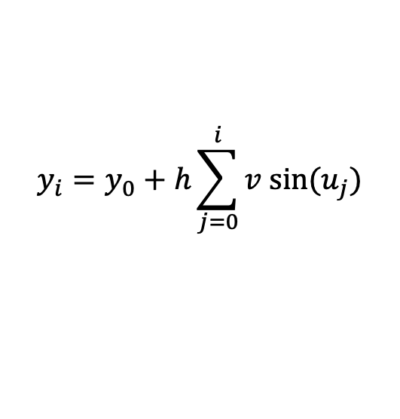
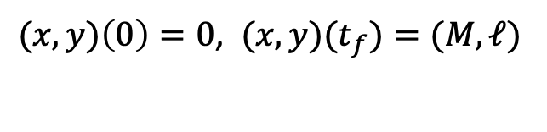
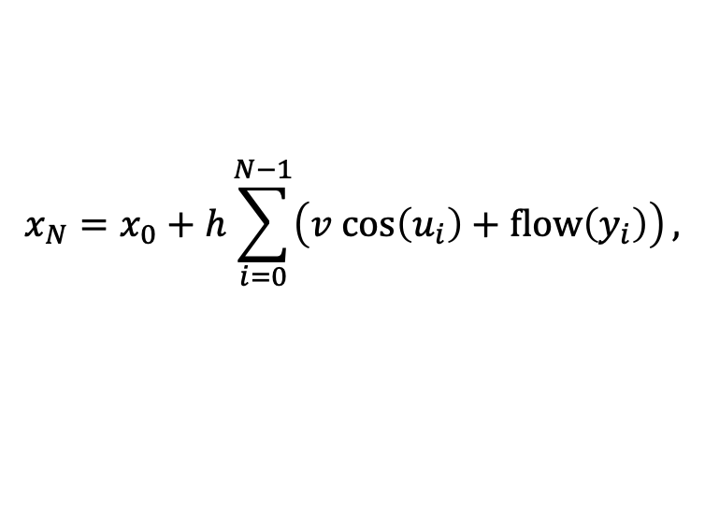
Example: Zermelo’s Problem (control parametrization method)
Transcribe optimal control problem into a non-linear program, and solve it via fmincon (MATLAB), scipy.optimize.minimize (python), etc.
$$\min_{u_{i}}\sum_{i=0}^{N−1}{h u_{i}^{2}}$$
$$min \int_{0}^{t_{f}}{u{\left(t\right)}^{2} dt}$$
(NLOP-C)
(OCP)
$\dot{x}\left(t\right)=v cos\left(u\left(t\right)\right)+flow\left(y\left(t\right)\right),$t $∈$ [0, $t_{f}$]
$\left(x,y\right)(t_{N})=(M,ℓ)$, $\left|u_{i}\right|≤u_{max}$
$\dot{y}\left(t\right)=v sin\left(u\left(t\right)\right)$, t $∈$ [0, $t_{f}$]
where, recursively:
$(x,y)\left(0\right)=0$, ${(x,y)(t}_{f})=(M,ℓ)$
$\left|u\left(t\right)\right|≤u_{max}$, t $∈$ [0, $t_{f}$]
$$x_{N}=x_{0}+h\sum_{i=0}^{N−1}{\left(v cos\left(u_{i}\right)+flow\left(y_{i}\right)\right)},$$
$$y_{i}=y_{0}+h\sum_{j=0}^{i}{v sin⁡(u_{j})}$$

Slide 12
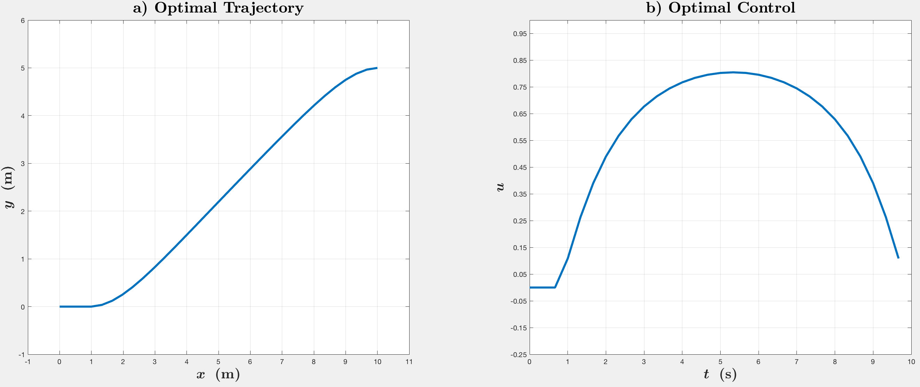
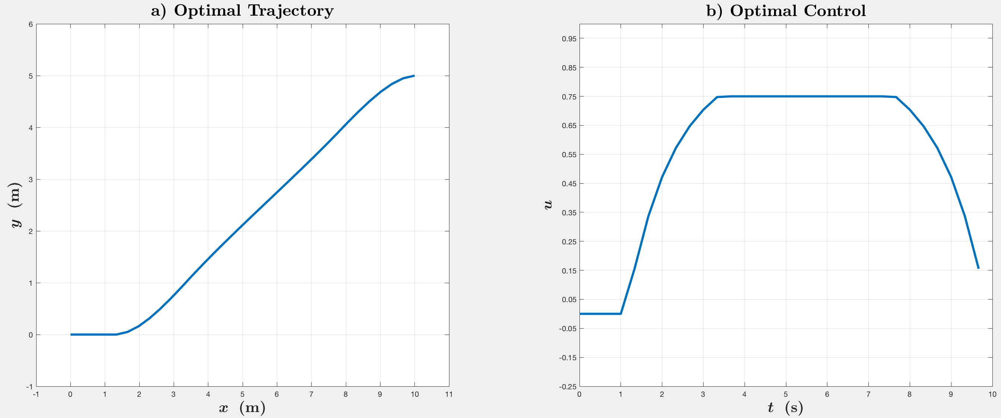

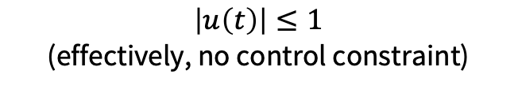
Results
$$\left|u\left(t\right)\right|≤1$$
(effectively, no control constraint)
$$\left|u\left(t\right)\right|≤0.75$$

Slide 13

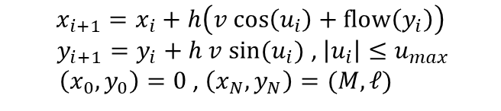

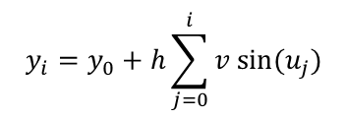


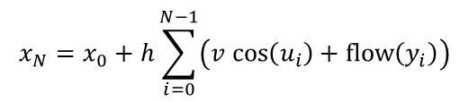


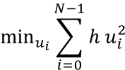
Example: Zermelo’s Problem
$$min \int_{0}^{t_{f}}{u{\left(t\right)}^{2} dt}$$
$$\min_{(x_{i},u_{i})}\sum_{i=0}^{N−1}{h u_{i}^{2}}$$
$\dot{x}\left(t\right)=v cos\left(u\left(t\right)\right)+flow\left(y\left(t\right)\right),$t $∈$ [0, $t_{f}$]
(NLOP)
(OCP)
$\dot{y}\left(t\right)=v sin\left(u\left(t\right)\right)$, t $∈$ [0, $t_{f}$]
$$x_{i+1}=x_{i}+h\left(v cos\left(u_{i}\right)+flow\left(y_{i}\right)\right)$$
$y_{i+1}=y_{i}+h v sin(u_{i})$ , $\left|u_{i}\right|≤u_{max}$
$\left(x_{0},y_{0}\right)=0$ , $\left(x_{N},y_{N}\right)=(M,ℓ)$
$(x,y)\left(0\right)=0$, ${(x,y)(t}_{f})=(M,ℓ)$
$\left|u\left(t\right)\right|≤u_{max}$, t $∈$ [0, $t_{f}$]
Direct Transcription
$$\min_{u_{i}}\sum_{i=0}^{N−1}{h u_{i}^{2}}$$
(NLOP-C)
$\left(x,y\right)(t_{N})=(M,ℓ)$, $\left|u_{i}\right|≤u_{max}$
where, recursively:
$$x_{N}=x_{0}+h\sum_{i=0}^{N−1}{\left(v cos\left(u_{i}\right)+flow\left(y_{i}\right)\right)}$$
$$y_{i}=y_{0}+h\sum_{j=0}^{i}{v sin⁡(u_{j})}$$
Direct Shooting

Slide 14
Transcription methods: extensions
Multiple shooting
Hybrid of simultaneous / (single) shooting methods
Alternative trajectory parameterizations
Euler integration (above): piecewise linear effective state trajectory (C⁰), zero-order hold control trajectory
Hermite-Simpson collocation (see Notes §5.2.1): piecewise cubic effective state trajectory (C¹), first-order hold control trajectory
Dynamics constraint is enforced at “collocation points”, exact form is derived by implicit integration
Pseudospectral methods: global polynomial basis functions (instead of piecewise polynomials)
Shooting methods: higher-order integration schemes (e.g., RK4)
Dynamics constraint is enforced by explicit integration

Slide 15
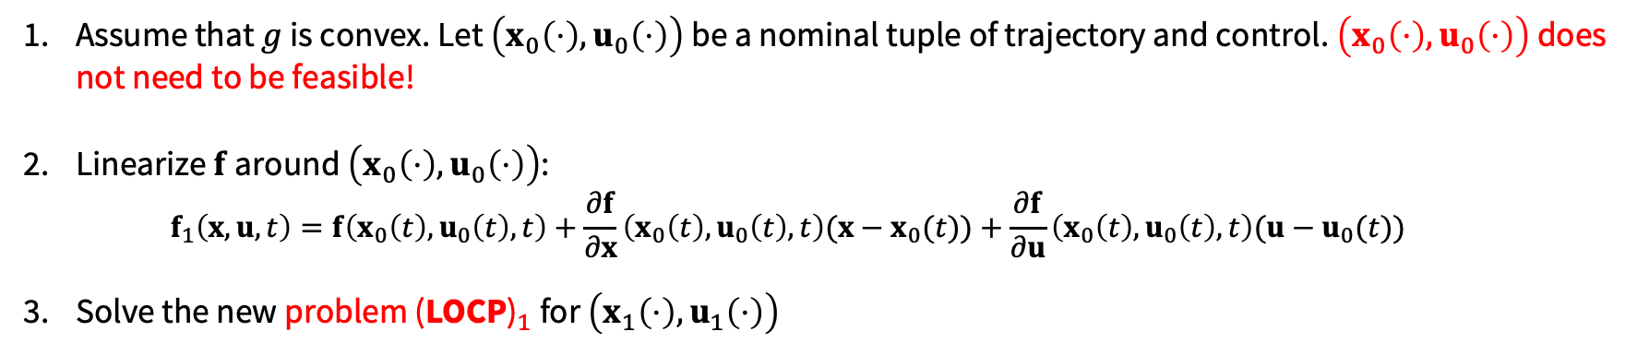





Sequential Convex Programming
$$min \int_{0}^{t_{f}}{g\left(x\left(t\right),u\left(t\right),t\right) dt}$$
$${\text{(}\text{LOCP}\text{)}}_{1}$$
$\dot{x}(t)=f_{1}\left(x\left(t\right),u\left(t\right),t\right)$, $t∈\text{[0, }t_{f}\text{]}$
$x\left(0\right)= x_{0}$, $x\left(t_{f}\right)=x_{f}$
$u\left(t\right)∈U⊆ℝ^{m}$, $t∈\text{[0, }t_{f}\text{]}$
The sources of nonconvexities are the dynamics and (possibly) the cost. Idea: linearize (and convexify) them around nominal trajectories!
Assume that $g$ is convex. Let $\left(x_{0}\left(⋅\right),u_{0}\left(⋅\right)\right)$ be a nominal tuple of trajectory and control. $\left(x_{0}\left(⋅\right),u_{0}\left(⋅\right)\right)$ does not need to be feasible!
Linearize $f$ around $\left(x_{0}\left(⋅\right),u_{0}\left(⋅\right)\right)$:
$$f_{1}\left(x,u,t\right)=f\left(x_{0}\left(t\right),u_{0}\left(t\right),t\right)+\frac{∂f}{∂x}\left(x_{0}\left(t\right),u_{0}\left(t\right),t\right)(x−x_{0}(t))+\frac{∂f}{∂u}\left(x_{0}\left(t\right),u_{0}\left(t\right),t\right)(u−u_{0}(t))$$
Solve the new problem ${\text{(}\text{LOCP}\text{)}}_{1}$ for $\left(x_{1}\left(⋅\right),u_{1}\left(⋅\right)\right)$

Slide 16
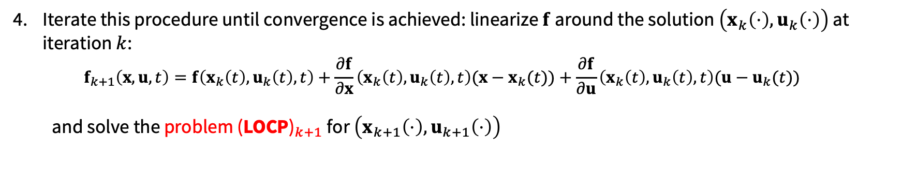




Sequential Convex Programming
$$min \int_{0}^{t_{f}}{g\left(x\left(t\right),u\left(t\right),t\right) dt}$$
$${\text{(}\text{LOCP}\text{)}}_{k+1}$$
$\dot{x}(t)=f_{k+1}\left(x\left(t\right),u\left(t\right),t\right)$, $t∈\text{[0, }t_{f}\text{]}$
$x\left(0\right)= x_{0}$, $x\left(t_{f}\right)=x_{f}$
$u\left(t\right)∈U⊆ℝ^{m}$, $t∈\text{[0, }t_{f}\text{]}$
The sources of nonconvexities are the dynamics and (possibly) the cost. Idea: linearize (and convexify) them around nominal trajectories!
Iterate this procedure until convergence is achieved: linearize $f$ around the solution $\left(x_{k}\left(⋅\right),u_{k}\left(⋅\right)\right)$ at iteration $k$:
$$f_{k+1}\left(x,u,t\right)=f\left(x_{k}\left(t\right),u_{k}\left(t\right),t\right)+\frac{∂f}{∂x}\left(x_{k}\left(t\right),u_{k}\left(t\right),t\right)(x−x_{k}(t))+\frac{∂f}{∂u}\left(x_{k}\left(t\right),u_{k}\left(t\right),t\right)(u−u_{k}(t))$$
and solve the problem ${\text{(}\text{LOCP}\text{)}}_{k+1}$ for $\left(x_{k+1}\left(⋅\right),u_{k+1}\left(⋅\right)\right)$

Slide 17
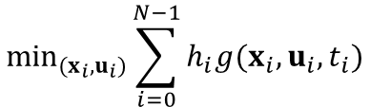
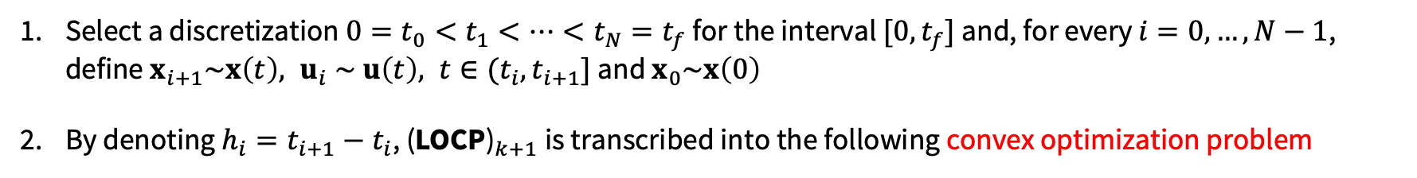




Sequential Convex Programming
$$min \int_{0}^{t_{f}}{g\left(x\left(t\right),u\left(t\right),t\right) dt}$$
$${\text{(}\text{LOCP}\text{)}}_{k+1}$$
$\dot{x}(t)=f_{k+1}\left(x\left(t\right),u\left(t\right),t\right)$, $t∈\text{[0, }t_{f}\text{]}$
$x\left(0\right)= x_{0}$, $x\left(t_{f}\right)=x_{f}$
$u\left(t\right)∈U⊆ℝ^{m}$, $t∈\text{[0, }t_{f}\text{]}$
Discretize and solve a convex problem at each iteration
Select a discretization $0=t_{0}<t_{1}<…<t_{N}=t_{f}$ for the interval $[0,t_{f}]$ and, for every $i=0,…,N−1$, define $x_{i+1}\sim x\left(t\right), u_{i} \sim u\left(t\right), t∈(t_{i},t_{i+1}]$ and $x_{0}\sim x\left(0\right)$
By denoting $h_{i}=t_{i+1}−t_{i}$, ${\text{(}\text{LOCP}\text{)}}_{k+1}$is transcribed into the following convex optimization problem
$$\min_{(x_{i},u_{i})}\sum_{i=0}^{N−1}{h_{i}g(x_{i},u_{i},t_{i})}$$
$${\text{(}\text{D}\text{LOCP}\text{)}}_{k+1}$$
$x_{i+1}=x_{i}+h_{i}f_{k+1}\left(x_{i},u_{i},t_{i}\right)$, $i=0,…,N−1$
$$u_{i}∈U , i=0,…,N−1, x_{N}=x_{f}$$

Slide 18
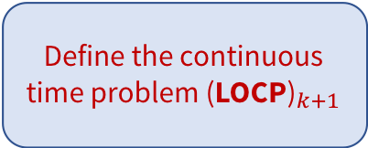
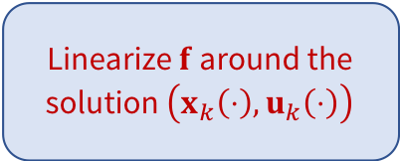
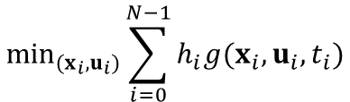
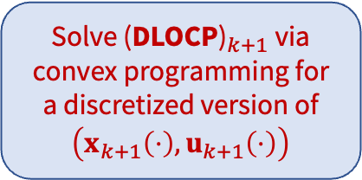


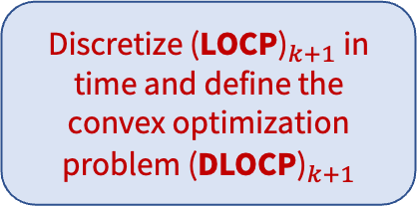
Sequential Convex Programming
$$min \int_{0}^{t_{f}}{g\left(x\left(t\right),u\left(t\right),t\right) dt}$$
$$\min_{(x_{i},u_{i})}\sum_{i=0}^{N−1}{h_{i}g(x_{i},u_{i},t_{i})}$$
$${\text{(}\text{D}\text{LOCP}\text{)}}_{k+1}$$
$${\text{(}\text{LOCP}\text{)}}_{k+1}$$
$\dot{x}(t)=f_{k+1}\left(x\left(t\right),u\left(t\right),t\right)$, $t∈\text{[0, }t_{f}\text{]}$
$x\left(0\right)= x_{0}$, $x\left(t_{f}\right)=x_{f}$
$x_{i+1}=x_{i}+h_{i}f_{k+1}\left(x_{i},u_{i},t_{i}\right)$, $i=0,…,N−1$
$u\left(t\right)∈U⊆ℝ^{m}$, $t∈\text{[0, }t_{f}\text{]}$
$$u_{i}∈U , i=0,…,N−1, x_{N}=x_{f}$$
SCP Methodology: at each iteration $k,$
Linearize $f$ around the solution $\left(x_{k}\left(⋅\right),u_{k}\left(⋅\right)\right)$
Define the continuous time problem ${\text{(}\text{LOCP}\text{)}}_{k+1}$
Solve ${\text{(}\text{DLOCP}\text{)}}_{k+1}$ via convex programming for a discretized version of $\left(x_{k+1}\left(⋅\right),u_{k+1}\left(⋅\right)\right)$
Discretize ${\text{(}\text{LOCP}\text{)}}_{k+1}$ in time and define the convex optimization problem ${\text{(}\text{DLOCP}\text{)}}_{k+1}$

Slide 19
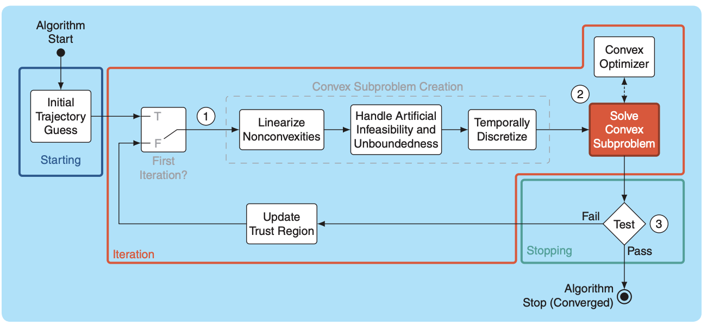
Sequential Convex Programming
For more info: D. Malyuta et al., "Convex Optimization for Trajectory Generation: A Tutorial on Generating Dynamically Feasible Trajectories Reliably and Efficiently," in IEEE Control Systems Magazine, vol. 42, no. 5, pp. 40-113, Oct. 2022.

Slide 20
Direct Methods in Practice
“As you begin to play with these algorithms on your own problems, you might feel like you're on an emotional roller-coaster.” – Russ Tedrake
Better initial guess trajectories (“warm-starting” the optimization, as seen in zermelo_simultaneous)
Cost function/constraint tuning (as seen in zermelo_scp)
Penalty methods; augmented Lagrangian-based solvers

Slide 21
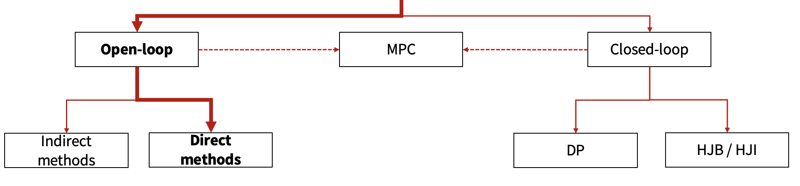
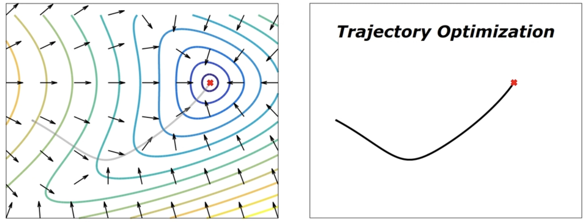
To wrap up…
Local vs Global solution
Less vs more compute
High- vs low-dimensional system

Slide 22
Next time
Dynamic programming
Discrete LQR

