Slide 1
AA203 Optimal and Learning-based Control
Dynamic programming, discrete LQR

Slide 2
Roadmap
Model-free RL
Control
Adaptive
optimal control
Model-based RL
Feedback control
Adaptive control
Optimal and learning control
Unconstrained
Constrained
Open-loop
MPC
Closed-loop
Indirect methods
Direct
methods
DP
HJB / HJI
LQR
iLQR
DDP
LQR
Reachability analysis
2

Slide 3
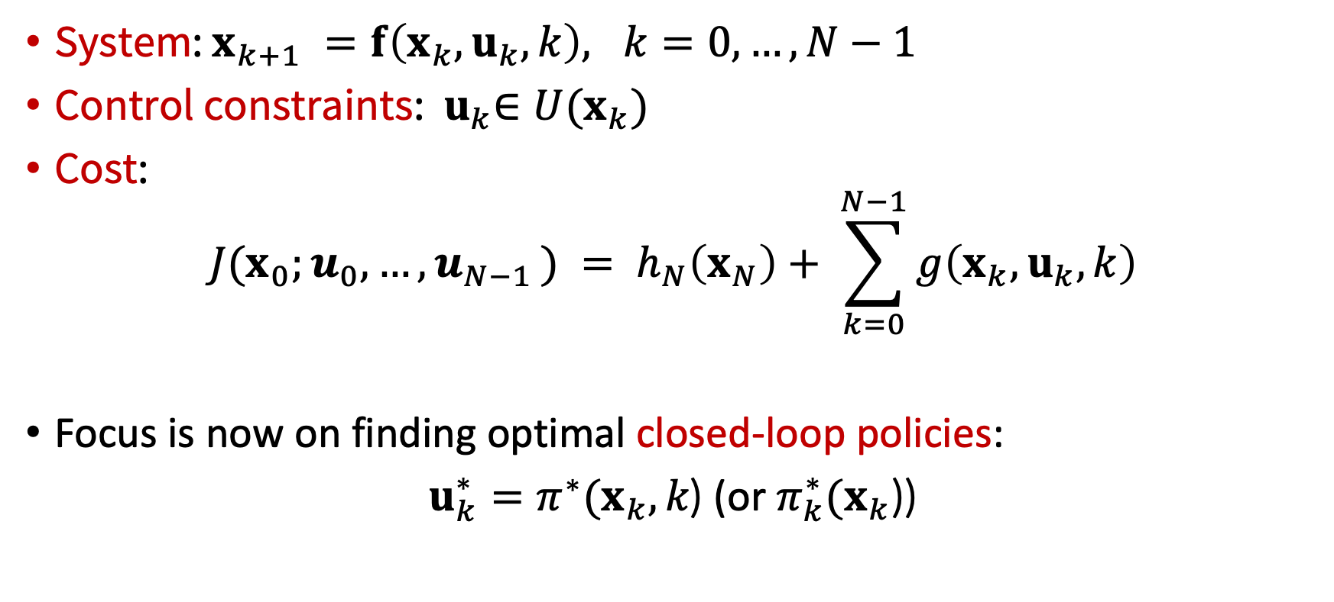
Basic problem – discrete-time setting
System: $x_{k+1} =f\left(x_{k}, u_{k},k\right), k=0, …, N−1$
Control constraints: ${ u}_{k}∈U(x_{k})$
Cost:
$$J{(x}_{0};u_{0},…, u_{N−1 }) = h_{N}\left(x_{N}\right)+ \sum_{k=0}^{N−1}{g\left(x_{k}, u_{k},k\right)}$$
Focus is now on finding optimal closed-loop policies:
$u_{k}^{∗}=π^{∗}(x_{k},k\text{)}$ (or $π_{k}^{∗}(x_{k}$))

Slide 4
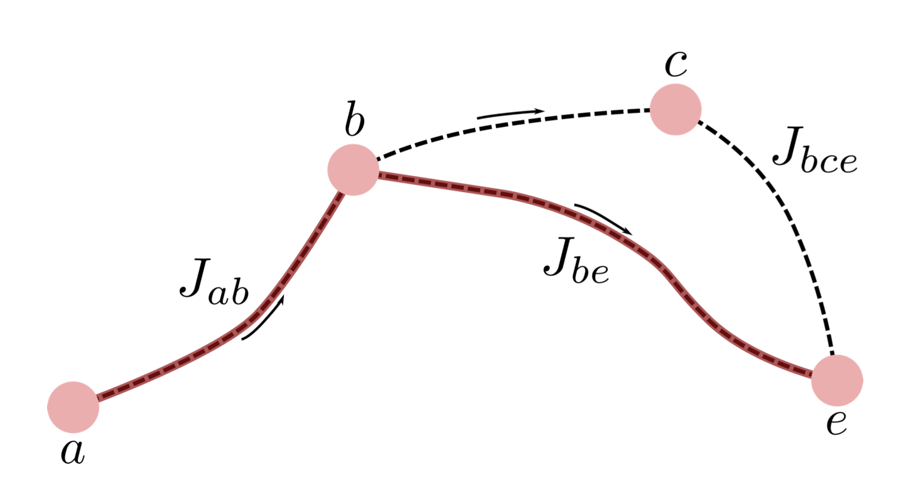
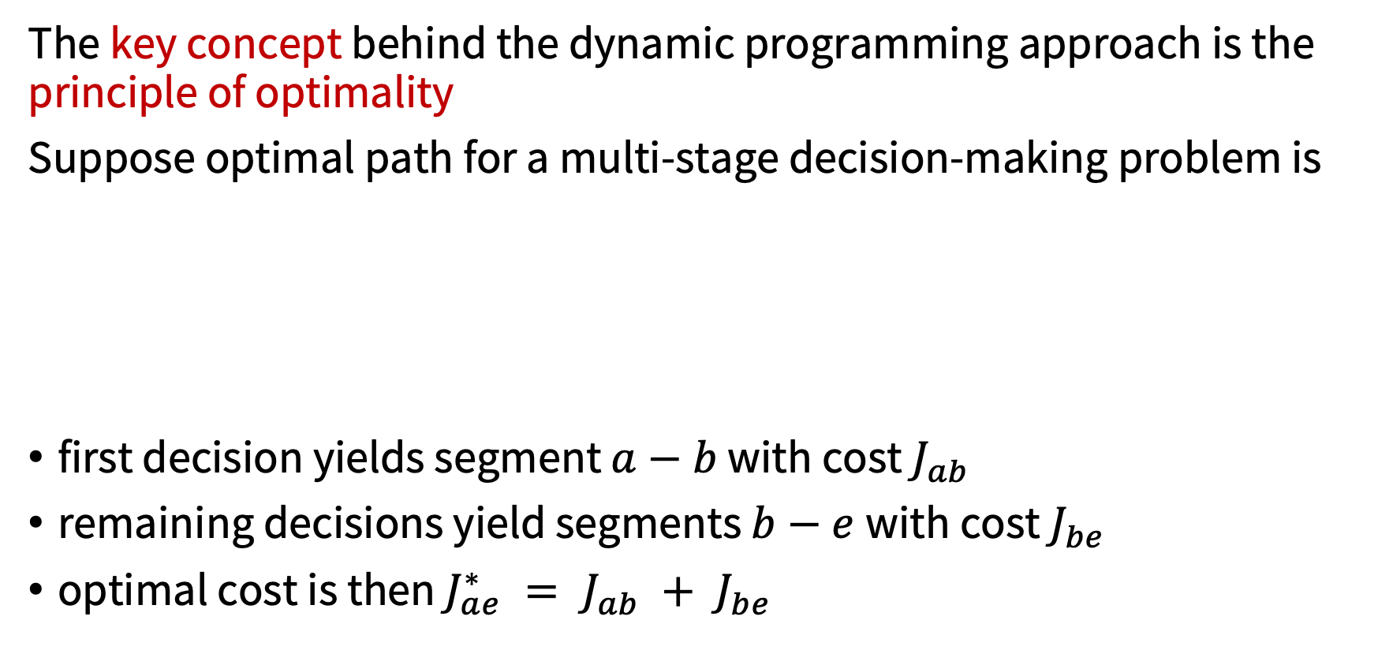
Principle of optimality
The key concept behind the dynamic programming approach is the principle of optimality
Suppose optimal path for a multi-stage decision-making problem is
first decision yields segment $a−b$ with cost $J_{ab}$
remaining decisions yield segments $b−e$with cost $J_{be}$
optimal cost is then $J_{ae}^{∗} = J_{ab} + J_{be}$

Slide 5
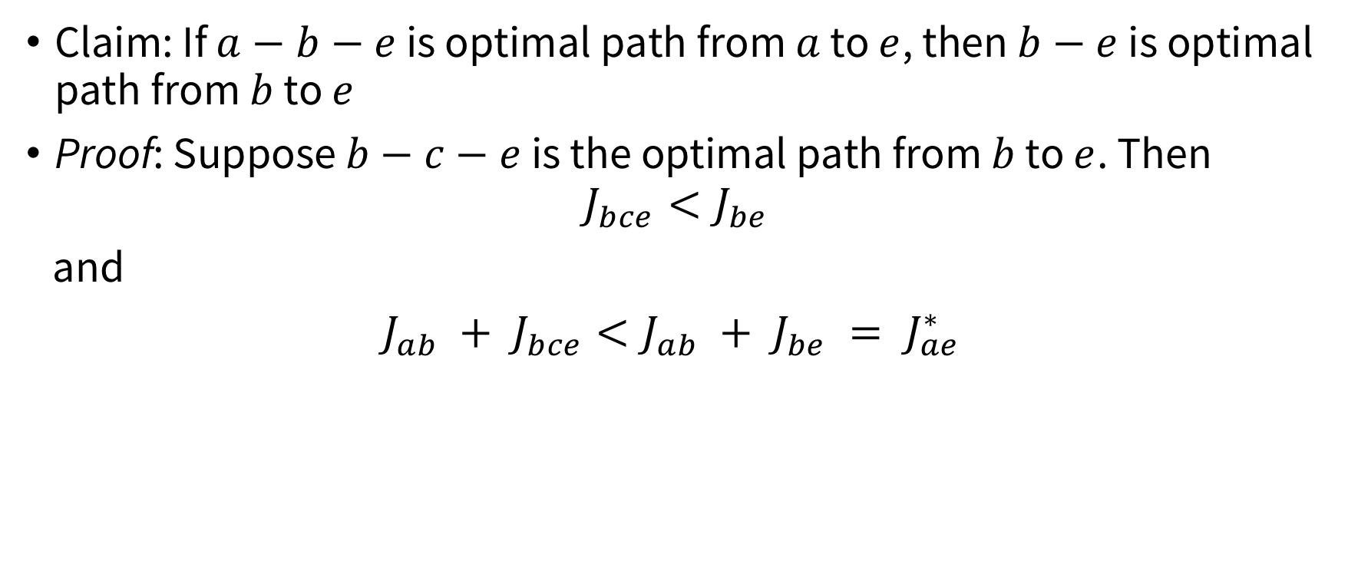
Principle of optimality
Claim: If $a−b−e$ is optimal path from $a$ to $e$, then $b−e$ is optimal path from $b$ to $e$
Proof: Suppose $b−c−e$ is the optimal path from $b$ to $e$. Then
$$J_{bce}<J_{be}$$
and
$J_{ab} + J_{bce}<J_{ab} + J_{be} = J_{ae}^{∗}$
Contradiction!

Slide 6
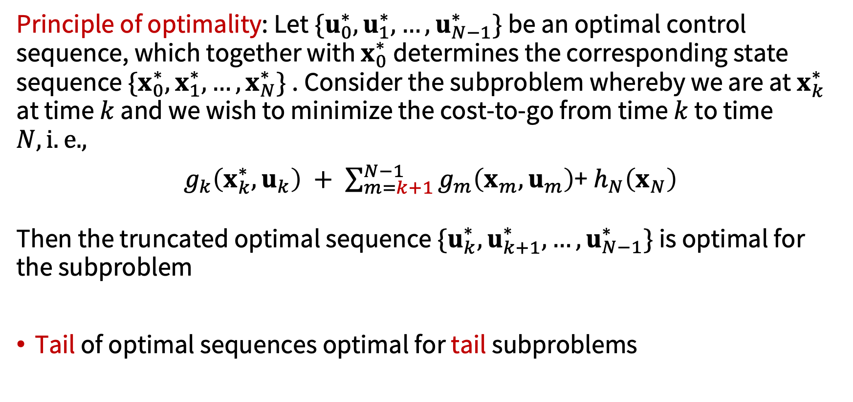
Principle of optimality
Principle of optimality: Let$\{u_{0}^{∗},u_{1}^{∗},…,u_{N−1}^{∗}\}$ be an optimal control sequence, which together with $x_{0}^{∗}$ determines the corresponding state sequence $\{x_{0}^{∗},x_{1}^{∗},…,x_{N}^{∗}\}$ . Consider the subproblem whereby we are at $x_{k}^{∗}$ at time $k$ and we wish to minimize the cost-to-go from time $k$ to time $N, i.e.,$
$g_{k}\left(x_{k}^{∗}, u_{k}\right) + \sum_{m=k+1}^{N−1}{g_{m}\left(x_{m}, u_{m}\right)}$+ $h_{N}\left(x_{N}\right)$
Then the truncated optimal sequence $\{u_{k}^{∗},u_{k+1}^{∗},…,u_{N−1}^{∗}\}$ is optimal for the subproblem
Tail of optimal sequences optimal for tail subproblems

Slide 7
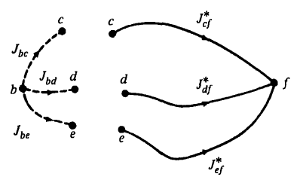
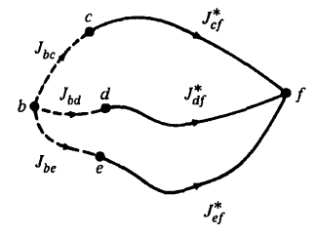
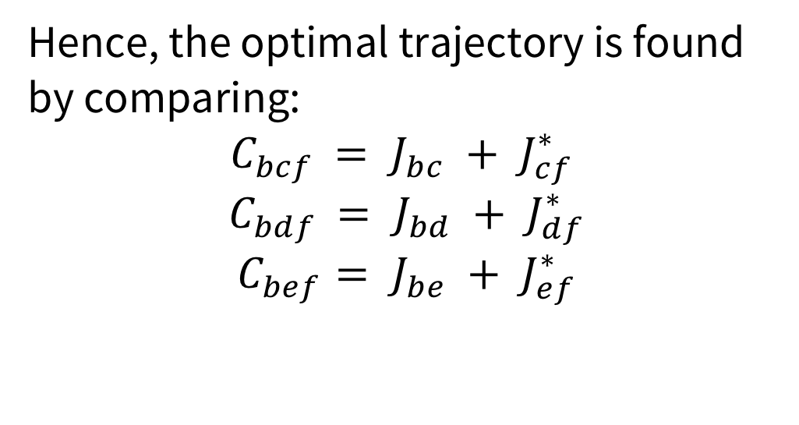
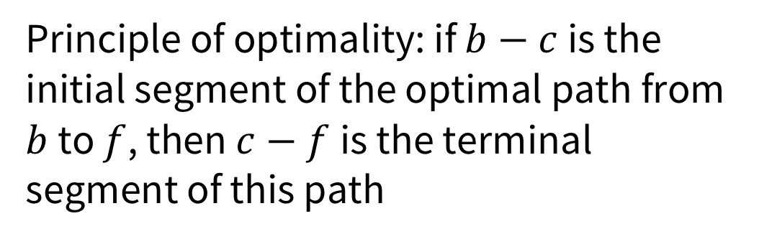
Applying the principle of optimality
Principle of optimality: if $b−c$ is the initial segment of the optimal path from $b$ to $f$, then $c−f$is the terminal segment of this path
Hence, the optimal trajectory is found by comparing:
$${ C}_{bcf} = J_{bc} + J_{cf}^{∗}$$
$${ C}_{bdf} = J_{bd} + J_{df}^{∗}$$
$$C_{bef}= J_{be} + J_{ef}^{∗}$$

Slide 8

Applying the principle of optimality
need only to compare the concatenations of immediate decisions and optimal decisions $→$ significant decrease in computation / possibilities
in practice: carry out this procedure backward in time

Slide 9
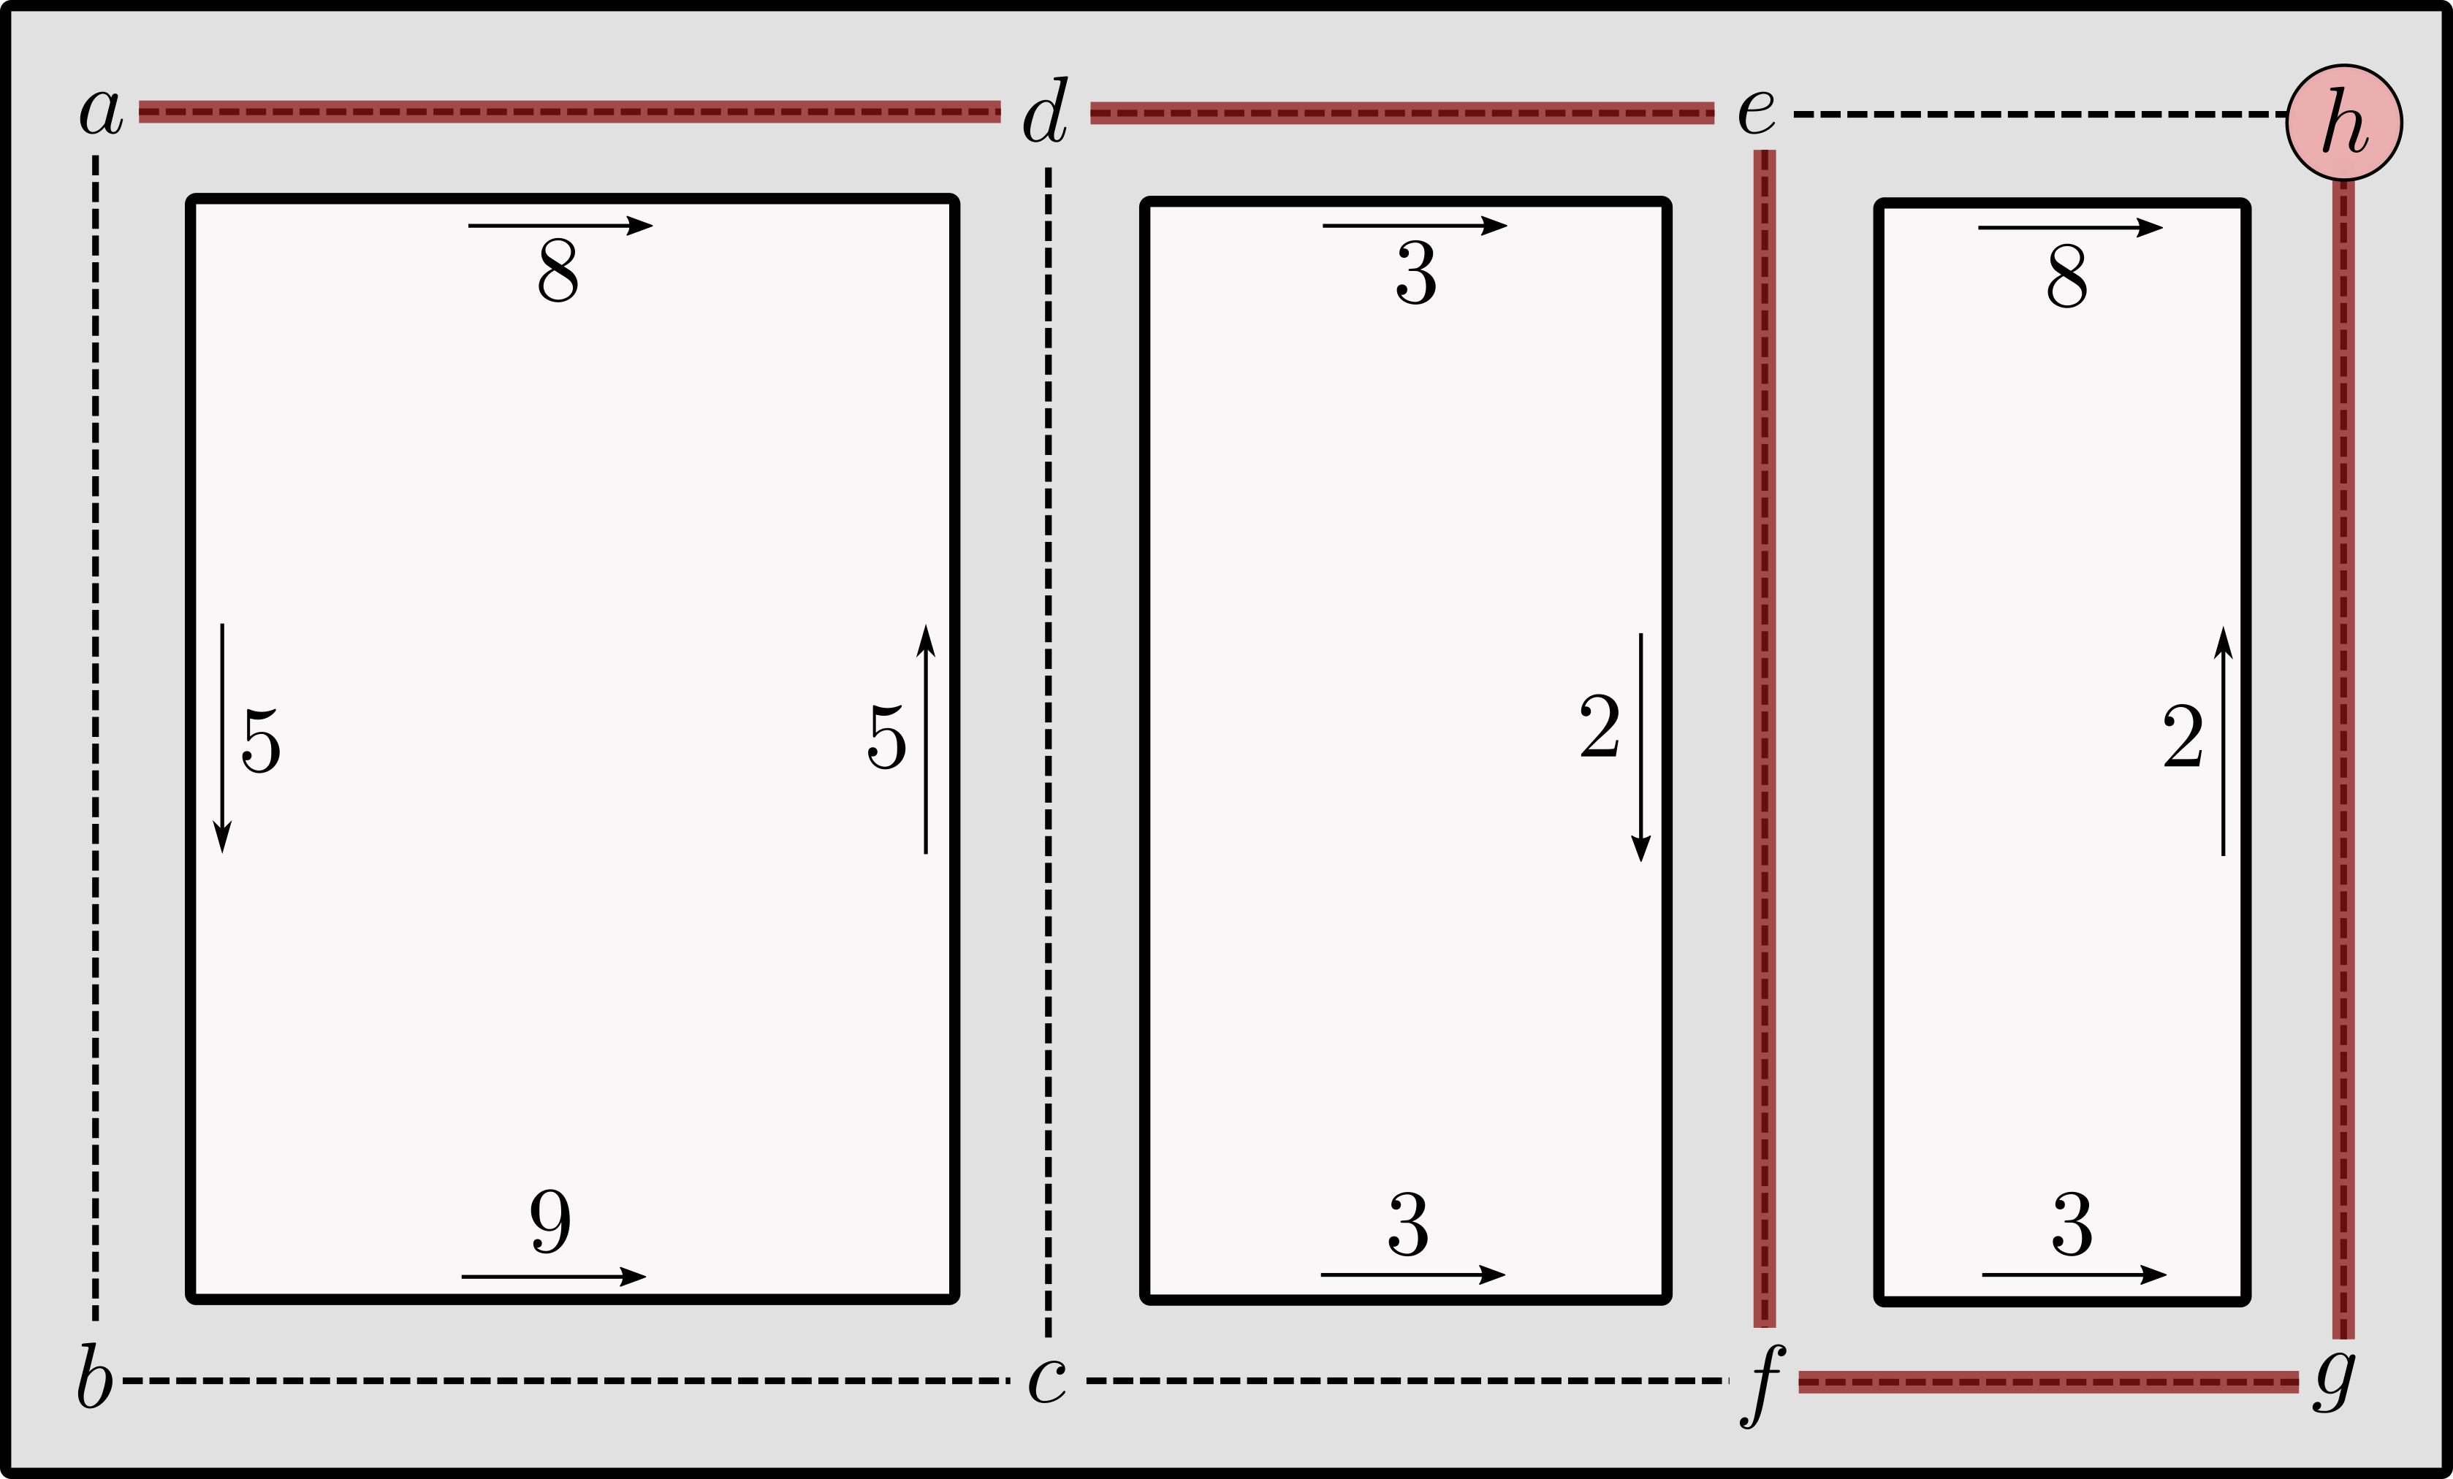
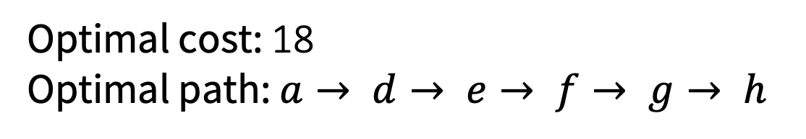
Example
Optimal cost: 18
Optimal path: $a→ d→ e→ f→ g→ h$

Slide 10
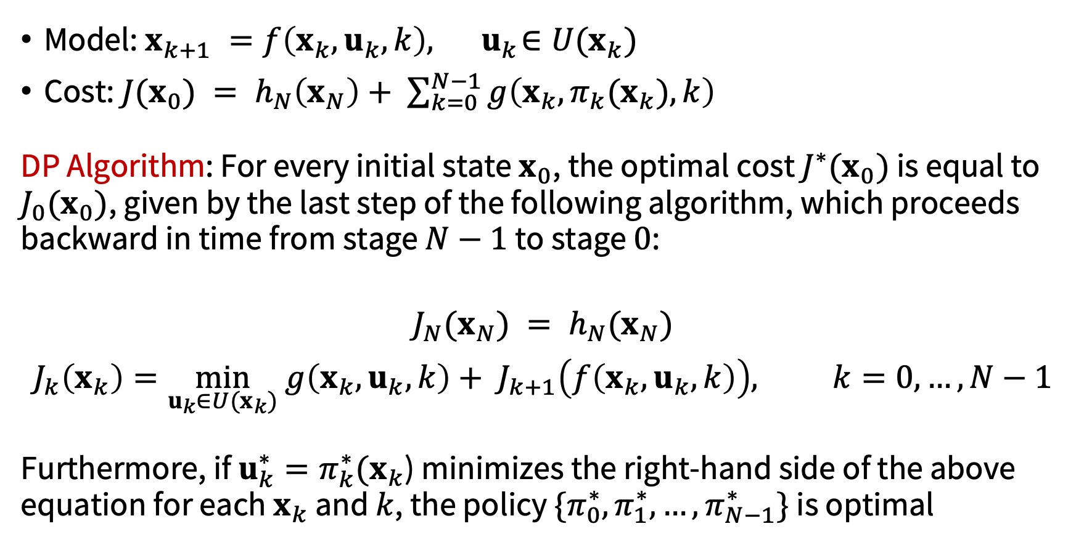
DP Algorithm
Model: $x_{k+1} =f\left(x_{k}, u_{k}, k\right),{ u}_{k}∈U(x_{k})$
Cost: $J{(x}_{0}) = h_{N}\left(x_{N}\right)+ \sum_{k=0}^{N−1}{g\left(x_{k}, {π_{k}(x}_{k}), k\right)}$
DP Algorithm: For every initial state $x_{0}$, the optimal cost $J^{∗}(x_{0})$ is equal to $J_{0}(x_{0})$, given by the last step of the following algorithm, which proceeds backward in time from stage $N−1$ to stage $0$:
$$J_{N}(x_{N}) = h_{N}(x_{N})$$
$$J_{k}\left(x_{k}\right)=\min_{u_{k}∈U(x_{k})} g\left(x_{k}, u_{k}, k\right)+ J_{k+1}\left(f\left(x_{k}, u_{k}, k\right)\right), k=0, …, N−1$$
Furthermore, if $u_{k}^{∗}=π_{k}^{∗}(x_{k}$) minimizes the right-hand side of the above equation for each $x_{k}$ and $k$, the policy $\{π_{0}^{∗},π_{1}^{∗},…,π_{N−1}^{∗}\}$ is optimal

Slide 11
Comments
discretization (from differential equations to difference equations)
quantization (from continuous to discrete state variables / controls)
global minimum
constraints, in general, simplify the numerical procedure
optimal control in closed-loop form
curse of dimensionality

Slide 12
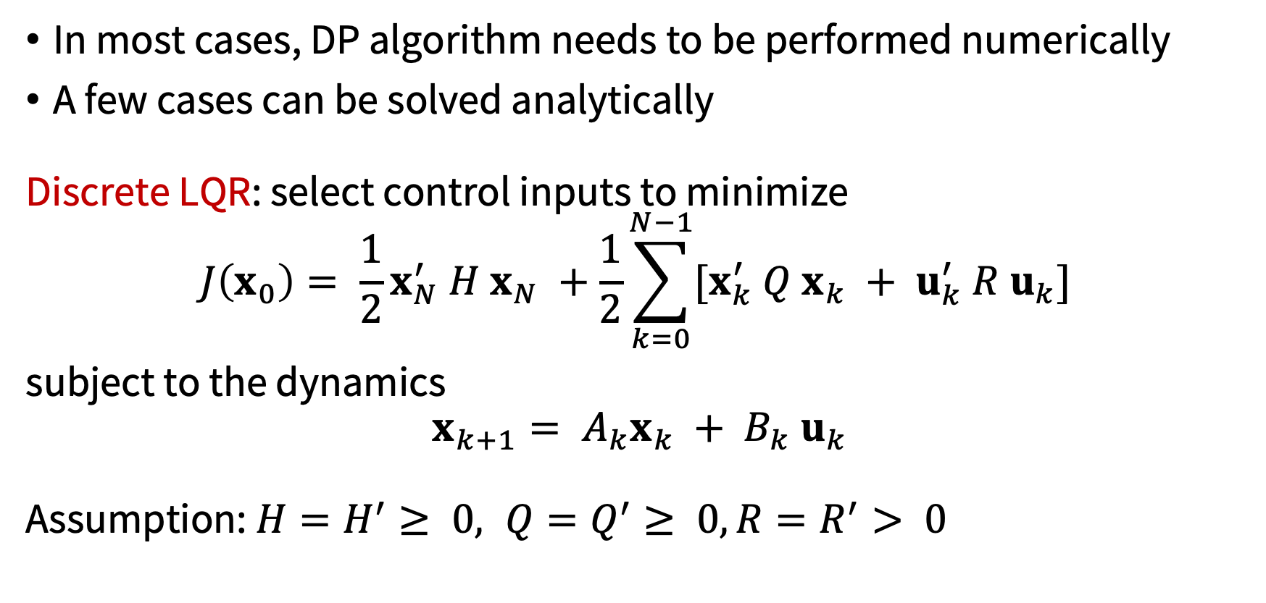
Example: discrete LQR
In most cases, DP algorithm needs to be performed numerically
A few cases can be solved analytically
Discrete LQR: select control inputs to minimize
$$J\left(x_{0}\right)= \frac{1}{2}x_{N}^{′} H x_{N} +\frac{1}{2}\sum_{k=0}^{N−1}{{[x}_{k}^{′} Q x_{k} + u_{k}^{′} R u_{k}] }$$
subject to the dynamics
$$x_{k+1}= A_{k}x_{k} + B_{k} u_{k}$$
Assumption: $H=H^{′}≥ 0, Q=Q^{′}≥ 0, R=R^{′}> 0$

Slide 13
Example: discrete LQR
First step:
Going backward

Slide 14
Example: discrete LQR
Taking derivative
and

Slide 15
DP for discrete LQR
Hence, the optimizer satisfies
so

Slide 16
DP for discrete LQR
Plugging in

Slide 17
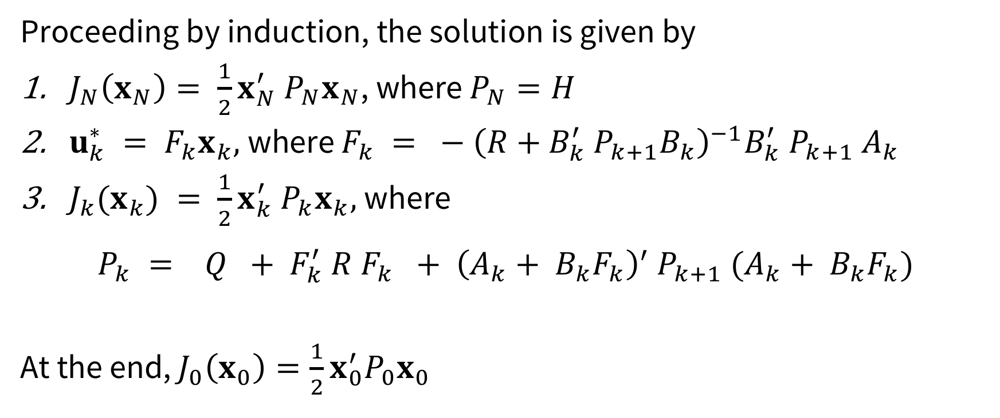
DP for discrete LQR
Proceeding by induction, the solution is given by
$J_{N}\left(x_{N}\right)= \frac{1}{2}x_{N}^{′} P_{N}x_{N}$, where $P_{N}=H$
$u_{k}^{∗} = F_{k}x_{k},$where $F_{k} = − {\left(R+B_{k}^{′} P_{k+1}B_{k}\right)}^{−1}B_{k}^{′} P_{k+1} A_{k}$
$J_{k}(x_{k}) = \frac{1}{2}x_{k}^{′} P_{k}x_{k},$where
$$P_{k} = Q + F_{k}^{′} R F_{k} + {\left(A_{k}+ B_{k}F_{k}\right)}^{′} P_{k+1} (A_{k}+ B_{k}F_{k})$$
At the end, $J_{0}\left(x_{0}\right)=\frac{1}{2}x_{0}^{′}P_{0}x_{0}$

Slide 18
Next time
Nonlinear LQR for tracking and trajectory generation

