Slide 1
AA203 Optimal and Learning-based Control
Nonlinearity: tracking LQR, iterative LQR, differential dynamic programming

Slide 2
Roadmap
Model-free RL
Control
Adaptive
optimal control
Model-based RL
Feedback control
Adaptive control
Optimal and learning control
Open-loop
MPC
Closed-loop
Indirect methods
Direct
methods
DP
HJB / HJI
LQR
iLQR
DDP

Slide 3
LQR-style algorithms for optimal control
Linear tracking problems
Nonlinear tracking problems
Using LQR techniques to solve nonlinear optimal control problems
Iterative LQR
Differential dynamic programming
Readings: notes Section 3.1, 3.2 and references therein

Slide 4
Recapping LQR
Minimize s.t.
Solved efficiently using dynamic programming by computing value function:
Result:

Slide 5
Recapping LQR
Can also generalize cost (adding linear/constant terms), and dynamics (adding affine term) Minimize subject to dynamics
➔

Slide 6
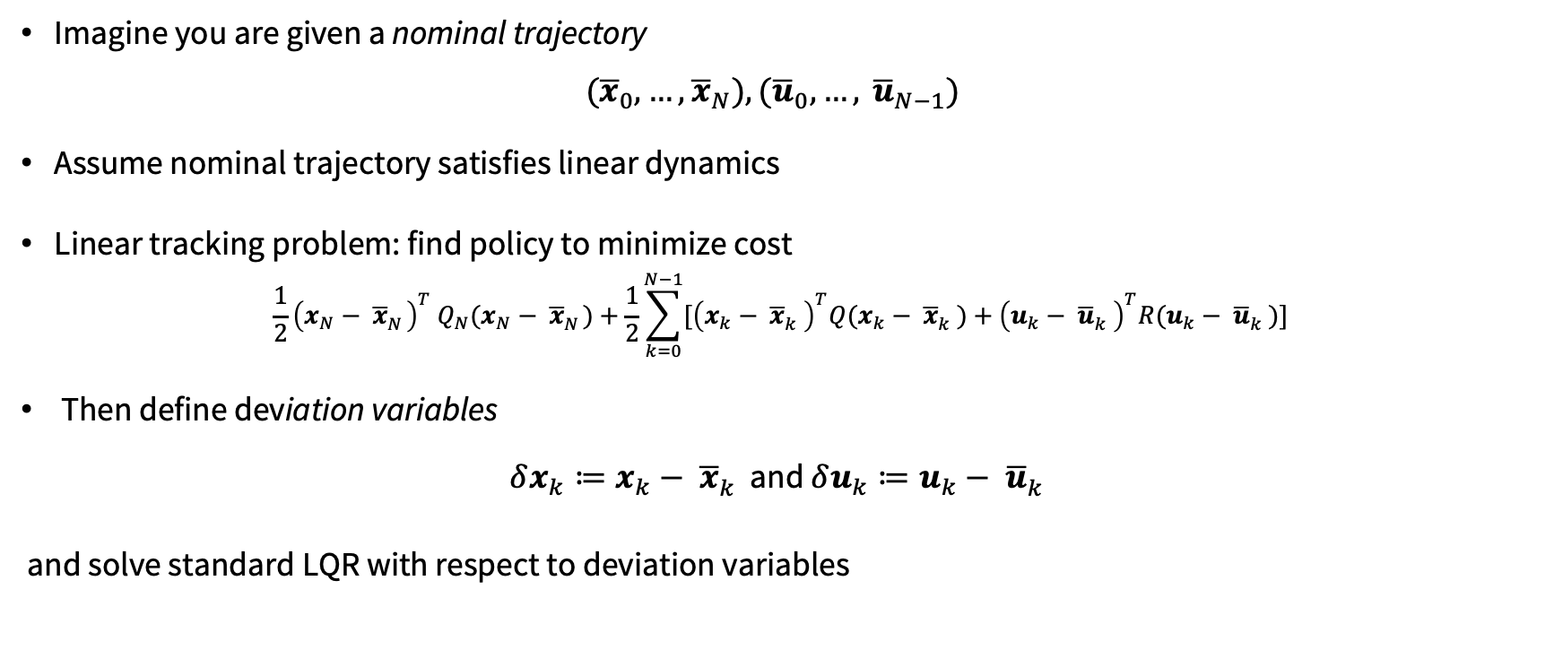
Linear tracking problems
Imagine you are given a nominal trajectory
${(\overline{x}}_{0},…,$ ${\overline{x}}_{N}), {(\overline{u}}_{0},…, {\overline{u}}_{N−1})$
Assume nominal trajectory satisfies linear dynamics
Linear tracking problem: find policy to minimize cost
$$\frac{1}{2}{\left(x_{N}− {\overline{x}}_{N}^{}\right)}^{T} Q_{N}(x_{N}− {\overline{x}}_{N}^{})+\frac{1}{2}\sum_{k=0}^{N−1}{[{\left(x_{k}− {\overline{x}}_{k}^{}\right)}^{T}Q(x_{k}− {\overline{x}}_{k}^{})+{\left(u_{k}− {\overline{u}}_{k}^{}\right)}^{T}R(u_{k}− {\overline{u}}_{k}^{})] }$$
Then define deviation variables
$δx_{k}≔x_{k}− {\overline{x}}_{k}^{}$ and ${δu_{k}≔u}_{k}− {\overline{u}}_{k}^{}$
and solve standard LQR with respect to deviation variables

Slide 7

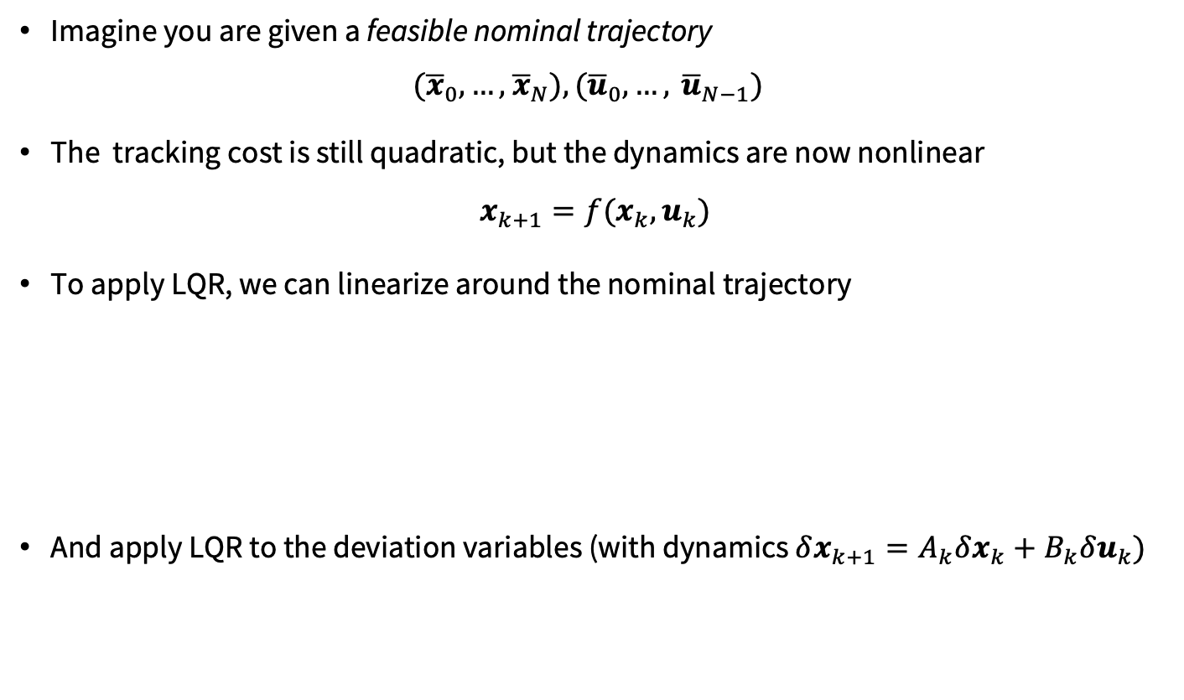



Nonlinear tracking problems
Imagine you are given a feasible nominal trajectory
${(\overline{x}}_{0},…,$ ${\overline{x}}_{N}), {(\overline{u}}_{0},…, {\overline{u}}_{N−1})$
The tracking cost is still quadratic, but the dynamics are now nonlinear
$$x_{k+1}=f(x_{k}, u_{k})$$
To apply LQR, we can linearize around the nominal trajectory
And apply LQR to the deviation variables (with dynamics $δx_{k+1}=A_{k}δx_{k}+B_{k}δu_{k})$
$$δx_{k}$$
$$δu_{k}$$
$$A_{k}$$
$$B_{k}$$

Slide 8
Nonlinear optimal control problem
Consider now nonlinear optimal control problem
Can we apply LQR-techniques to approximately solve it?

Slide 9

Iterative LQR
Imagine you are given a feasible nominal trajectory
${(\overline{x}}_{0},…,$ ${\overline{x}}_{N}), {(\overline{u}}_{0},…, {\overline{u}}_{N−1})$
Linearize the dynamics around feasible trajectory
And Taylor expand cost function around feasible trajectory

Slide 10

Iterative LQR
By optimizing over deviation variables (using results for LQR with cross-quadratic cost & affine dynamics), we obtain new solution:
{${\overline{x}}_{k}+δx_{k}^{∗}\}$ and {${\overline{u}}_{k}+δu_{k}^{∗}\}$
We can then re-linearize and Taylor expand around this new trajectory, and iterate!

Slide 11
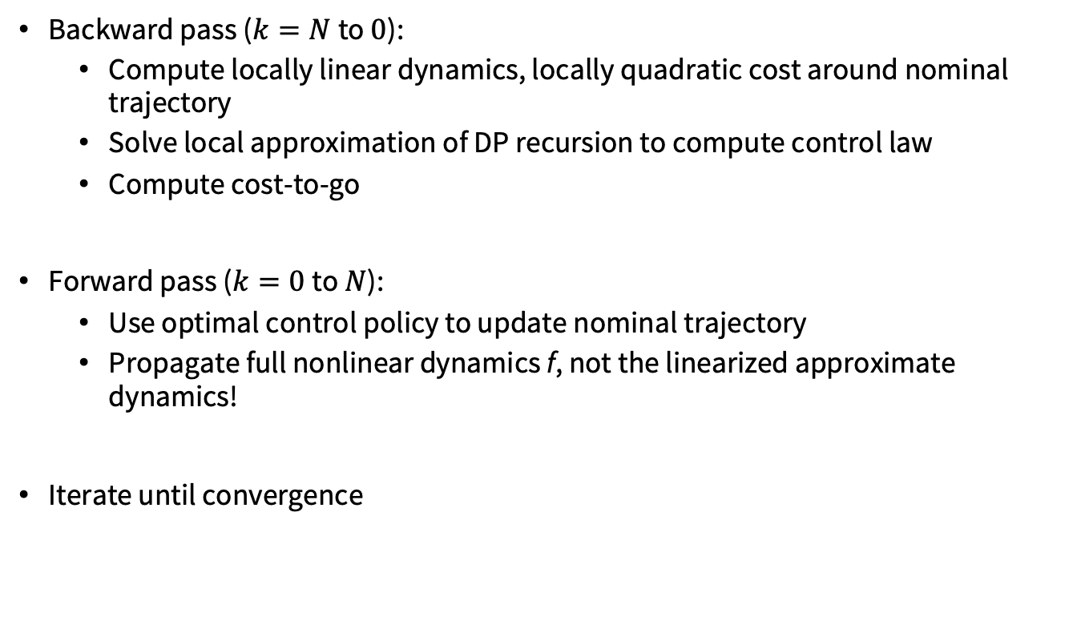
Iterative LQR
Backward pass ($k=N$to $0$):
Compute locally linear dynamics, locally quadratic cost around nominal trajectory
Solve local approximation of DP recursion to compute control law
Compute cost-to-go
Forward pass ($k=0$to $N$):
Use optimal control policy to update nominal trajectory
Propagate full nonlinear dynamics f, not the linearized approximate dynamics!
Iterate until convergence

Slide 12
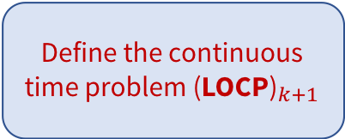
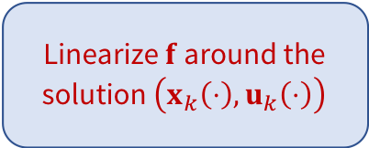
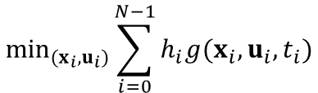

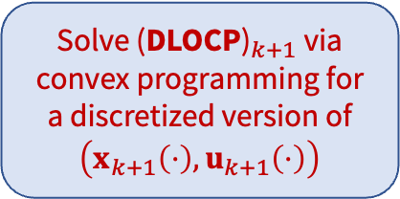




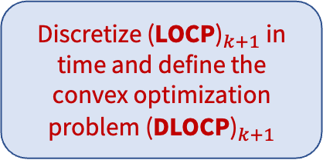
Connections between iLQR and SCP
$$min \int_{0}^{t_{f}}{g\left(x\left(t\right),u\left(t\right),t\right) dt}$$
$$\min_{(x_{i},u_{i})}\sum_{i=0}^{N−1}{h_{i}g(x_{i},u_{i},t_{i})}$$
$${\text{(}\text{D}\text{LOCP}\text{)}}_{k+1}$$
$${\text{(}\text{LOCP}\text{)}}_{k+1}$$
$\dot{x}(t)=f_{k+1}\left(x\left(t\right),u\left(t\right),t\right)$, $t∈\text{[0, }t_{f}\text{]}$
$x\left(0\right)= x_{0}$, $x\left(t_{f}\right)=x_{f}$
$x_{i+1}=x_{i}+h_{i}f_{k+1}\left(x_{i},u_{i},t_{i}\right)$, $i=0,…,N−1$
$u\left(t\right)∈U⊆ℝ^{m}$, $t∈\text{[0, }t_{f}\text{]}$
$$u_{i}∈U , i=0,…,N−1, x_{N}=x_{f}$$
SCP Methodology: at each iteration $k,$
Linearize $f$ around the solution $\left(x_{k}\left(⋅\right),u_{k}\left(⋅\right)\right)$
Define the continuous time problem ${\text{(}\text{LOCP}\text{)}}_{k+1}$
Solve ${\text{(}\text{DLOCP}\text{)}}_{k+1}$ via convex programming for a discretized version of $\left(x_{k+1}\left(⋅\right),u_{k+1}\left(⋅\right)\right)$
Discretize ${\text{(}\text{LOCP}\text{)}}_{k+1}$ in time and define the convex optimization problem ${\text{(}\text{DLOCP}\text{)}}_{k+1}$

Slide 13
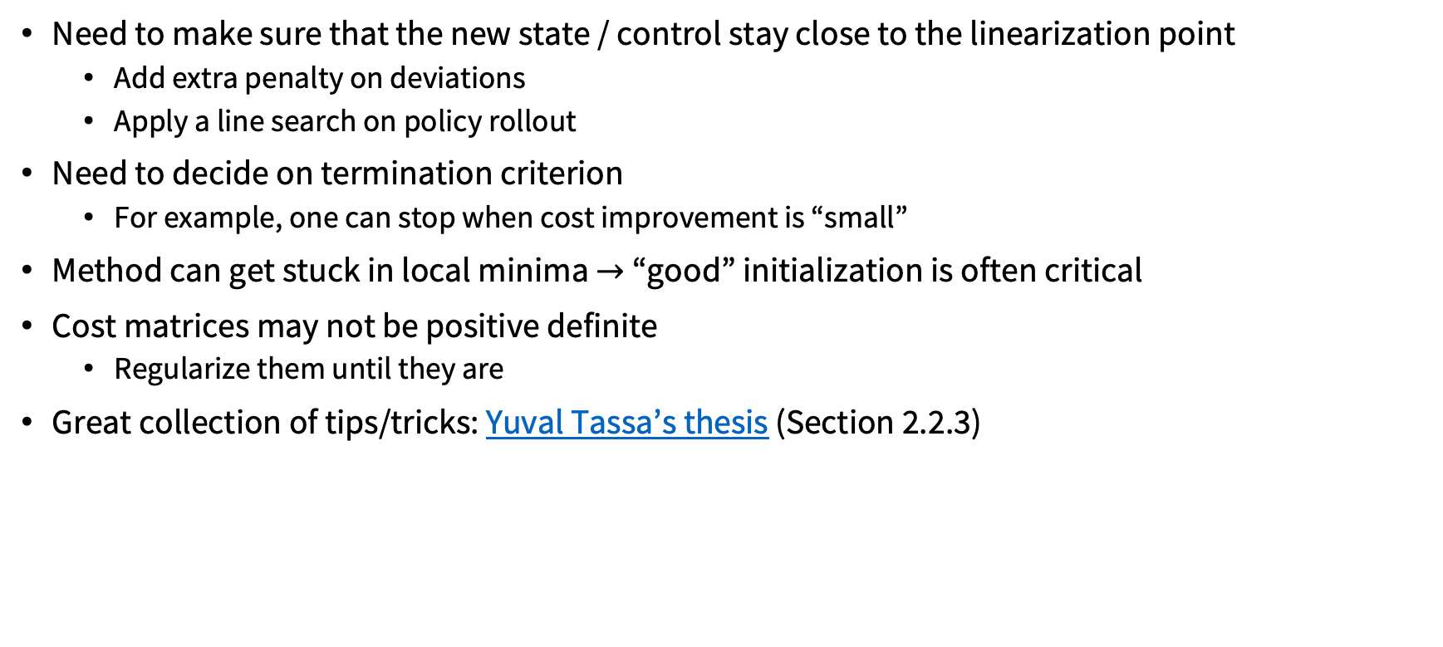
Algorithmic details
Need to make sure that the new state / control stay close to the linearization point
Add extra penalty on deviations
Apply a line search on policy rollout
Need to decide on termination criterion
For example, one can stop when cost improvement is “small”
Method can get stuck in local minima $→$ “good” initialization is often critical
Cost matrices may not be positive definite
Regularize them until they are
Great collection of tips/tricks: Yuval Tassa’s thesis (Section 2.2.3)

Slide 14
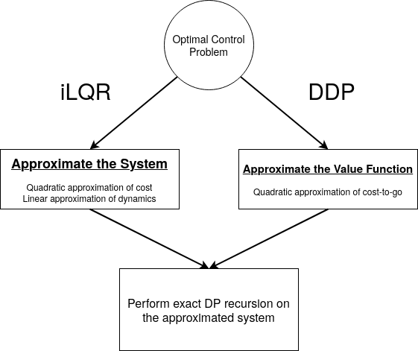
Differential Dynamic Programming (DDP)
iLQR first approximates dynamics and cost, then performs exact DP recursion
DDP instead approximates DP recursion directly

Slide 15
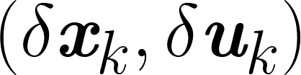
Differential Dynamic Programming (DDP)
In detail, consider the change in cost to go at timestep k under a perturbation
Using a 2nd order Taylor Expansion,

Slide 16
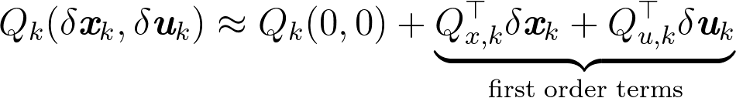
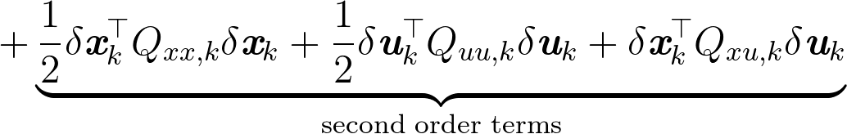
Differential Dynamic Programming (DDP)
The optimal control perturbation is
Expanding the approximation, one gets

Slide 17

Differential Dynamic Programming (DDP)
Apply conditions for optimality (gradient equal to zero):
As was the case with LQR, the optimal control has the form
Algorithm proceeds via same forward/backward passes as iLQR

Slide 18
iLQR vs. DDP
Quadratic approximations for the state-action value function (Q function):
DDP contains second-order dynamics derivatives compared to iLQR

Slide 19
Next time
Stochastic DP
Value Iteration, Policy Iteration

