Slide 1
AA203 Optimal and Learning-based Control
Stochastic DP, value iteration, policy iteration

Slide 2
Roadmap
Model-free RL
Control
Adaptive
optimal control
Model-based RL
Feedback control
Adaptive control
Optimal and learning control
Unconstrained
Constrained
Open-loop
MPC
Closed-loop
Indirect methods
Direct
methods
DP
HJB / HJI
LQR
iLQR
DDP
LQR
Reachability analysis
2

Slide 3
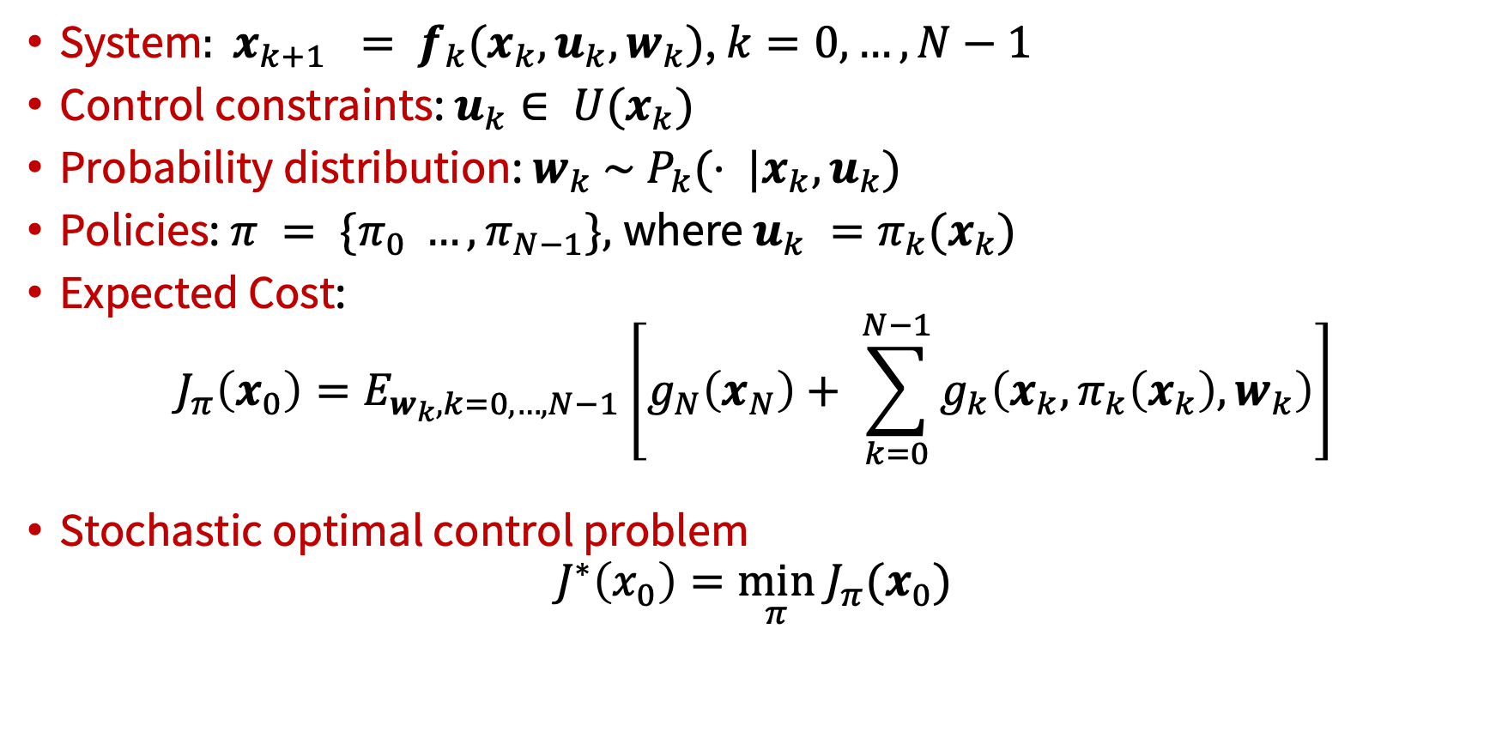
Stochastic optimal control problem: Markov Decision Problem (MDP)
System$: x_{k+1} = f_{k}(x_{k}, u_{k}, w_{k})$, $k=0, …, N−1$
Control constraints: $u_{k}∈ U(x_{k})$
Probability distribution: ${w_{k} \sim P}_{k}(⋅ |x_{k}, u_{k})$
Policies: $π = \{π_{0} …, π_{N−1}\},$where $u_{k} =π_{k}(x_{k})$
Expected Cost:
$$J_{π}\left(x_{0}\right)=E_{w_{k},k=0, …, N−1}\left[g_{N}\left(x_{N}\right)+ \sum_{k=0}^{N−1}{g_{k}\left(x_{k}, π_{k}\left(x_{k}\right), w_{k}\right)}\right]$$
Stochastic optimal control problem
$$J^{∗}\left(x_{0}\right)=\min_{π} J_{π}(x_{0})$$

Slide 4
Key points
Discrete-time model
Markovian model
Objective: find optimal closed-loop policy
Additive cost (central assumption)
Risk-neutral formulation

Slide 5
Key points
Discrete-time model
Markovian model
Objective: find optimal closed-loop policy
Additive cost (central assumption)
Risk-neutral formulation
Other communities use different notation: Powell, W. B. AI, OR and control theory: A Rosetta Stone for stochastic optimization. Princeton University, 2012.

Slide 6
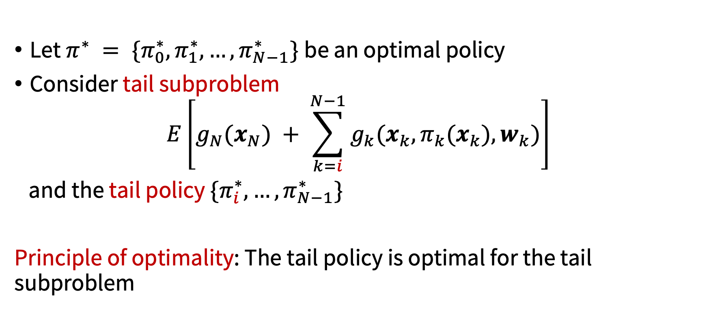
Principle of optimality
Let $π^{∗} = \{π_{0}^{∗}, π_{1}^{∗}, …, π_{N−1}^{∗}\}$be an optimal policy
Consider tail subproblem
$$E\left[g_{N}(x_{N}) + \sum_{k=i}^{N−1}{g_{k}(x_{k}, π_{k}(x_{k}), w_{k})}\right]$$
and the tail policy $\{π_{i}^{∗}, …, π_{N−1}^{∗}\}$
Principle of optimality: The tail policy is optimal for the tail subproblem

Slide 7
The DP algorithm (stochastic case)
Intuition
DP first solves ALL tail subproblems at the final stage
At generic step, it solves ALL tail subproblems of a given time length, using solution of tail subproblems of shorter length

Slide 8
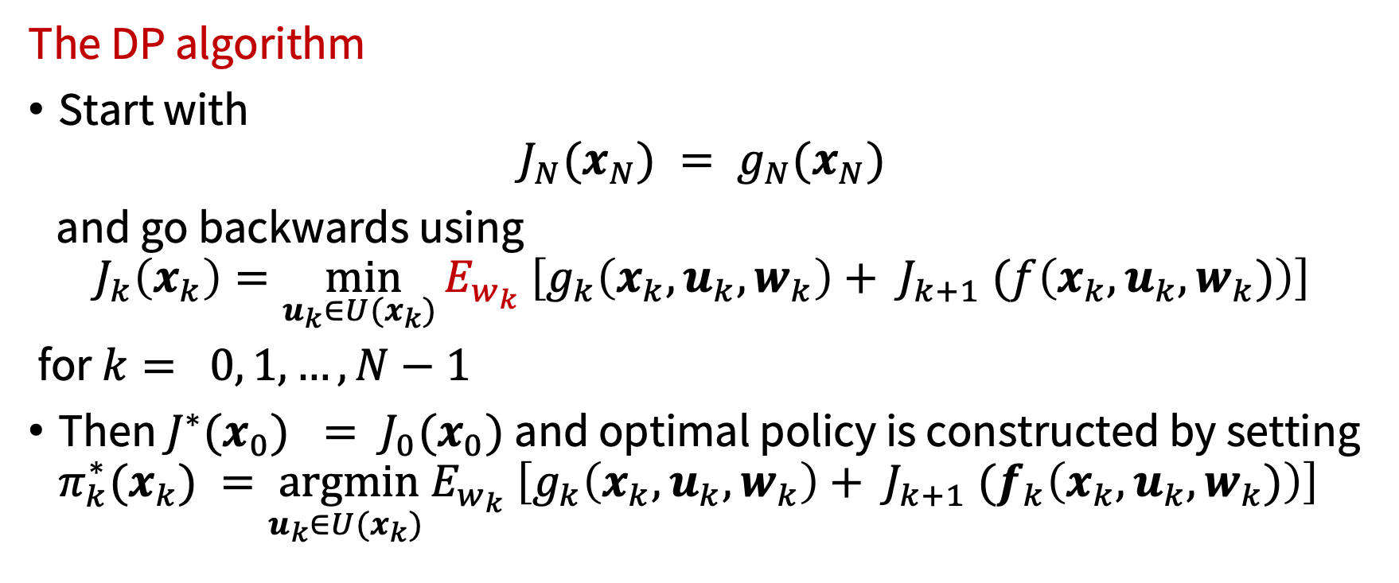
The DP algorithm (stochastic case)
The DP algorithm
Start with
$$J_{N}(x_{N}) = g_{N}(x_{N})$$
and go backwards using
$$J_{k}\left(x_{k}\right)=\min_{u_{k}∈U(x_{k}) }E_{w_{k}} \left[g_{k}\left(x_{k}, u_{k}, w_{k}\right)+ J_{k+1} (f\left(x_{k}, u_{k}, w_{k})\right)\right]$$
for $k= 0, 1, …, N−1$
Then $J^{∗}(x_{0}) = J_{0}(x_{0})$and optimal policy is constructed by setting $π_{k}^{∗}(x_{k}) =\underset{u_{k}∈U(x_{k}) }{argmin}E_{w_{k}} \left[g_{k}\left(x_{k}, u_{k}, w_{k}\right)+ J_{k+1} (f_{k}\left(x_{k}, u_{k}, w_{k})\right)\right]$

Slide 9

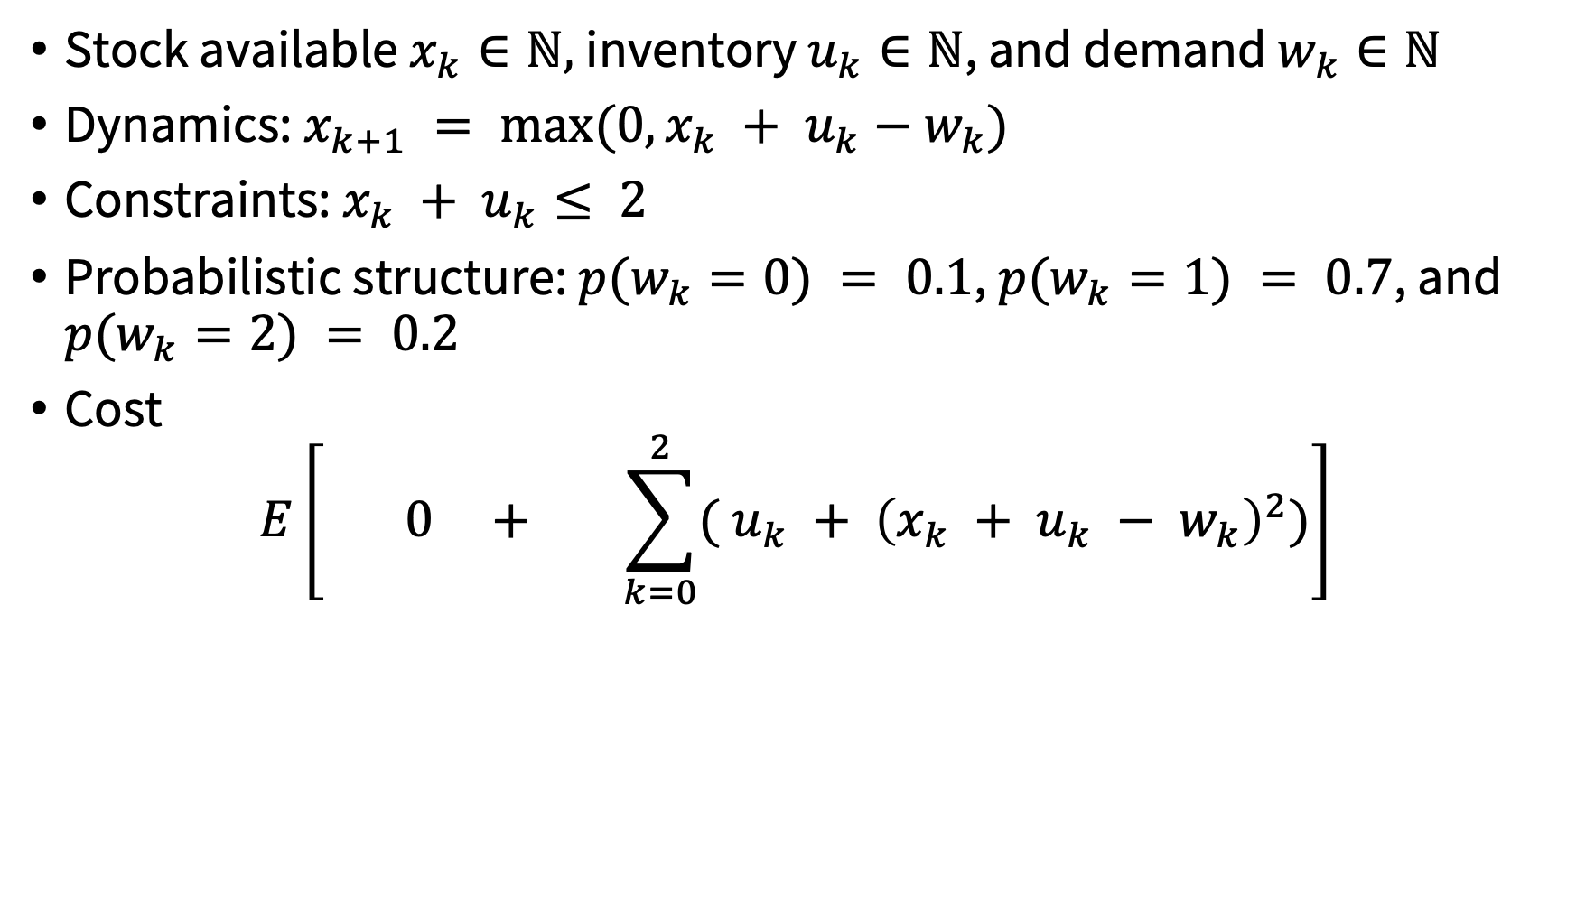

Example: Inventory Control Problem
Stock available $x_{k}∈ℕ,$inventory $u_{k}∈ℕ$, and demand $w_{k}∈ℕ$
Dynamics: $x_{k+1} = max(0, x_{k} + u_{k}−w_{k})$
Constraints: $x_{k} + u_{k}≤ 2$
Probabilistic structure: $p(w_{k}=0) = 0.1$, $p(w_{k}=1) = 0.7$, and $p(w_{k}=2) = 0.2$
Cost
$$E\left[ 0 + \sum_{k=0}^{2}{( u_{k} + {\left(x_{k} + u_{k} − w_{k}\right)}^{2})}\right]$$
$$g_{3}( x_{3})$$
$$g_{k}( x_{k}, u_{k}, w_{k})$$

Slide 10
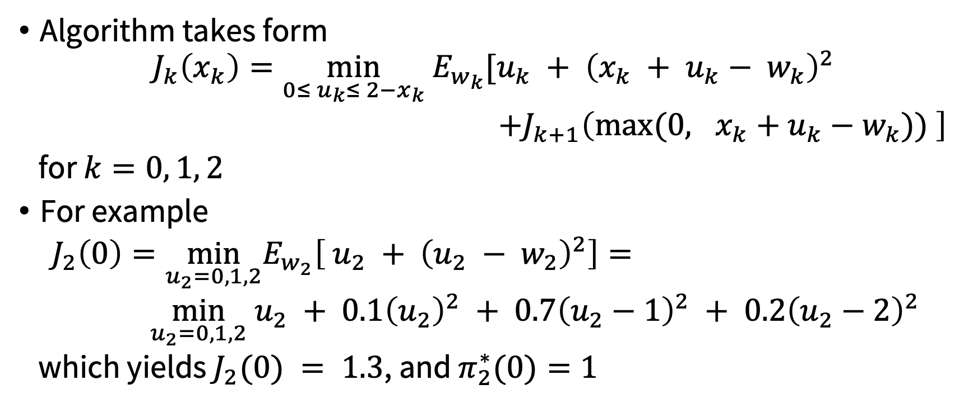
Example: Inventory Control Problem
Algorithm takes form
$$J_{k}\left(x_{k}\right)={\min_{0≤ u_{k}≤ 2−x_{k}} E}_{w_{k}}[u_{k} + {\left(x_{k} + u_{k}− w_{k}\right)}^{2}$$
$+J_{k+1}\left(\max{(0, x_{k}+u_{k}−w_{k})) }\right]$
for $k=0, 1, 2$
For example
$J_{2}\left(0\right)=\min_{u_{2}=0,1,2}E_{w_{2}}\left[ u_{2} + {\left(u_{2} − w_{2}\right)}^{2}\right]=$
$\min_{u_{2}=0,1,2} u_{2} + 0.1{\left(u_{2}\right)}^{2} + 0.7{\left(u_{2}−1\right)}^{2} + 0.2{\left(u_{2}−2\right)}^{2}$
which yields $J_{2}(0) = 1.3$, and $π_{2}^{∗}(0)=1$

Slide 11

Example: Inventory Control Problem
Final solution:
$J_{0}(0) = 3.7$,
$J_{0}(1) = 2.7$, and
$J_{0}(2) = 2.818$
(see this spreadsheet)

Slide 12
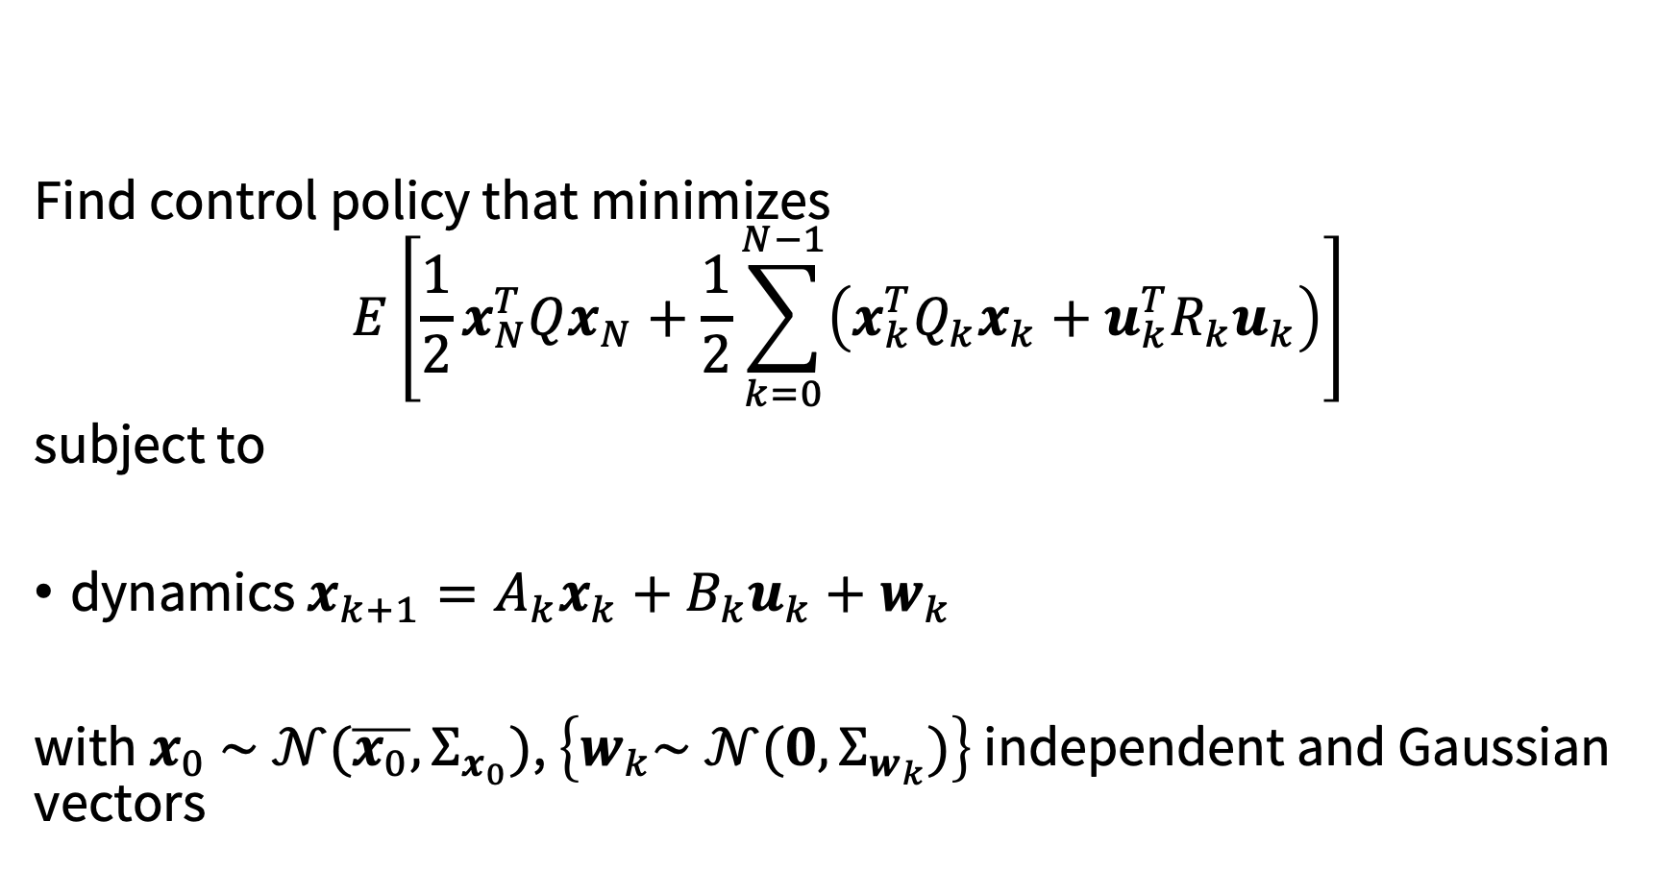
Stochastic LQR
Find control policy that minimizes
$$E\left[{\frac{1}{2}x}_{N}^{T}Qx_{N}+\frac{1}{2}\sum_{k=0}^{N−1}{\left(x_{k}^{T}Q_{k}x_{k}+u_{k}^{T}R_{k}u_{k}\right)}\right]$$
subject to
dynamics $x_{k+1}=A_{k}x_{k}+B_{k}u_{k}+w_{k}$
with $x_{0} \sim 𝒩(\overline{x_{0}},Σ_{x_{0}})$, $\left\{w_{k}\sim 𝒩(0,Σ_{w_{k}})\right\}$ independent and Gaussian vectors

Slide 13
Stochastic LQR
As before, let’s suppose (possibly up to an additive constant). Then:

Slide 14
Stochastic LQR
As before, let’s suppose . Then:
➔ optimal policy is the same as in the deterministic case; cost-to-go is increased by some constant related to magnitude of noise

Slide 15
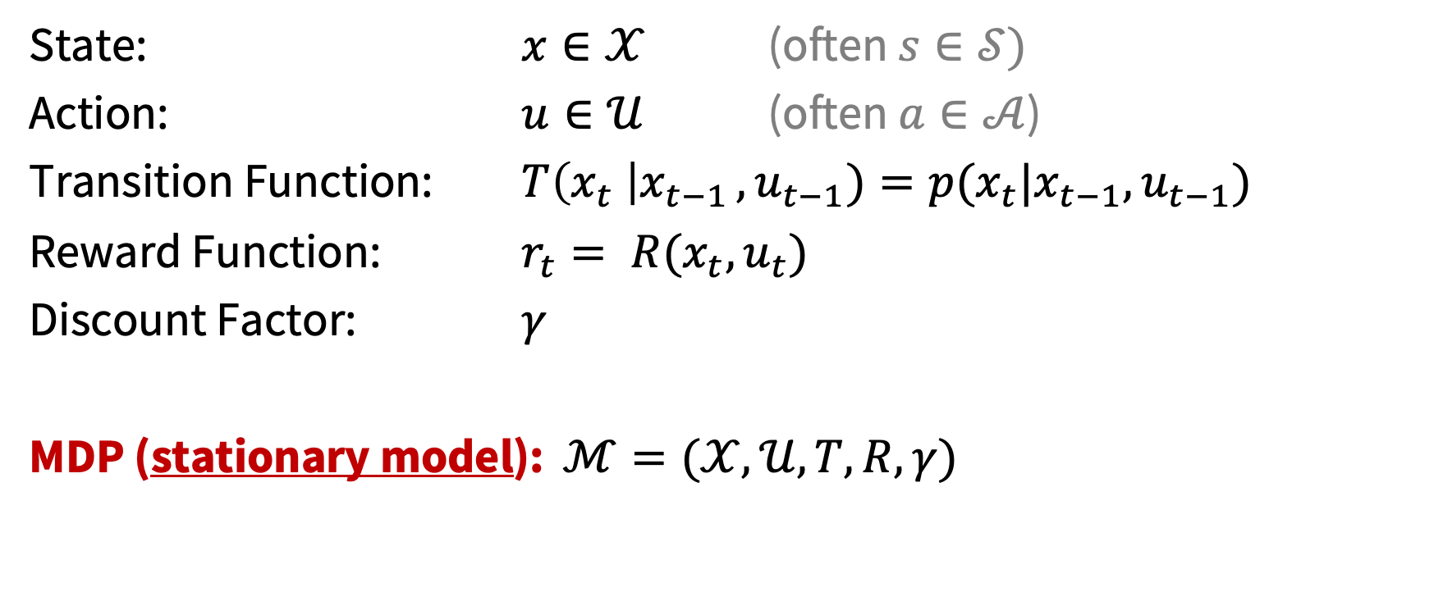
Infinite Horizon MDPs
State: $x∈𝒳$ (often $s∈𝒮)$
Action: $u∈𝒰$ (often $a∈𝒜$)
Transition Function: $T\left(x_{t} \right|x_{t−1 },u_{t−1})=p(x_{t}|x_{t−1},u_{t−1})$
Reward Function: $r_{t}= R(x_{t}, u_{t})$
Discount Factor: $γ$
MDP (stationary model): $ℳ=(𝒳,𝒰,T,R,γ)$

Slide 16
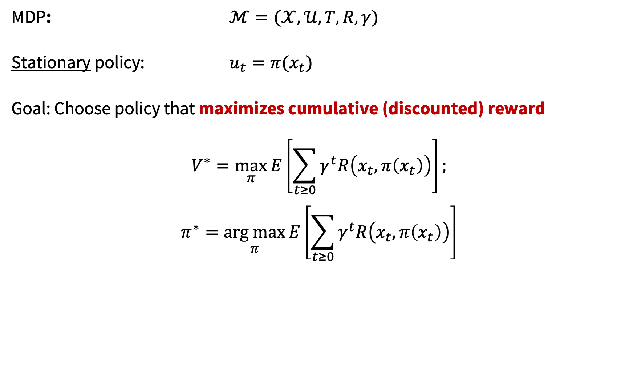
Infinite Horizon MDPs
MDP: $ℳ=(𝒳,𝒰,T,R,γ)$
Stationary policy: $u_{t}=π(x_{t})$
Goal: Choose policy that maximizes cumulative (discounted) reward
$$V^{∗}=\max_{π}{E\left[\sum_{t≥0}{γ^{t}R\left(x_{t},π\left(x_{t}\right)\right)}\right]};$$
$$π^{∗}=\underset{π}{arg max}{E\left[\sum_{t≥0}{γ^{t}R\left(x_{t},π\left(x_{t}\right)\right)}\right]}$$

Slide 17
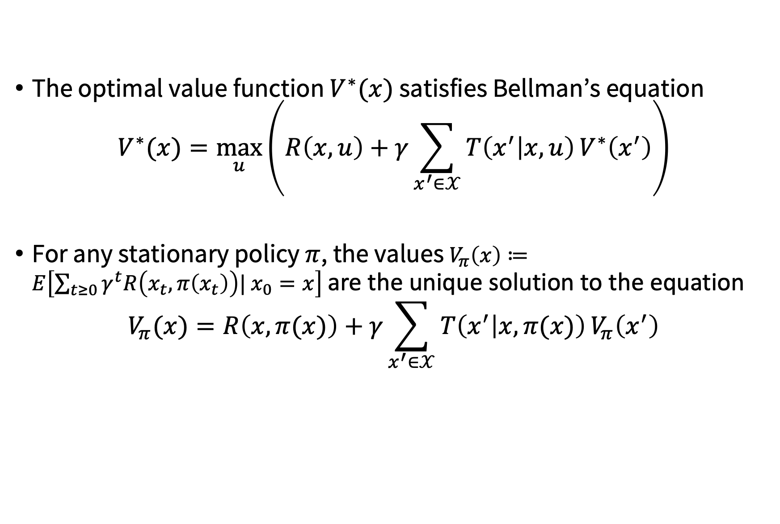
Infinite Horizon MDPs
The optimal value function $V^{∗}(x)$ satisfies Bellman’s equation
$$V^{∗}(x)=\max_{u}\left(R\left(x,u\right)+γ\sum_{x^{′}∈𝒳}{T\left(x^{′} | x,u\right)}V^{∗}\left(x^{′}\right)\right)$$
For any stationary policy $π$, the values $V_{π}\left(x\right)≔E\left[\sum_{t≥0}{γ^{t}R\left(x_{t},π\left(x_{t}\right)\right)| x_{0}=x}\right]$ are the unique solution to the equation
$$V_{π}(x)=R\left(x,π(x)\right)+γ\sum_{x^{′}∈𝒳}{T\left(x^{′} | x,π(x)\right)}V_{π}\left(x^{′}\right)$$

Slide 18
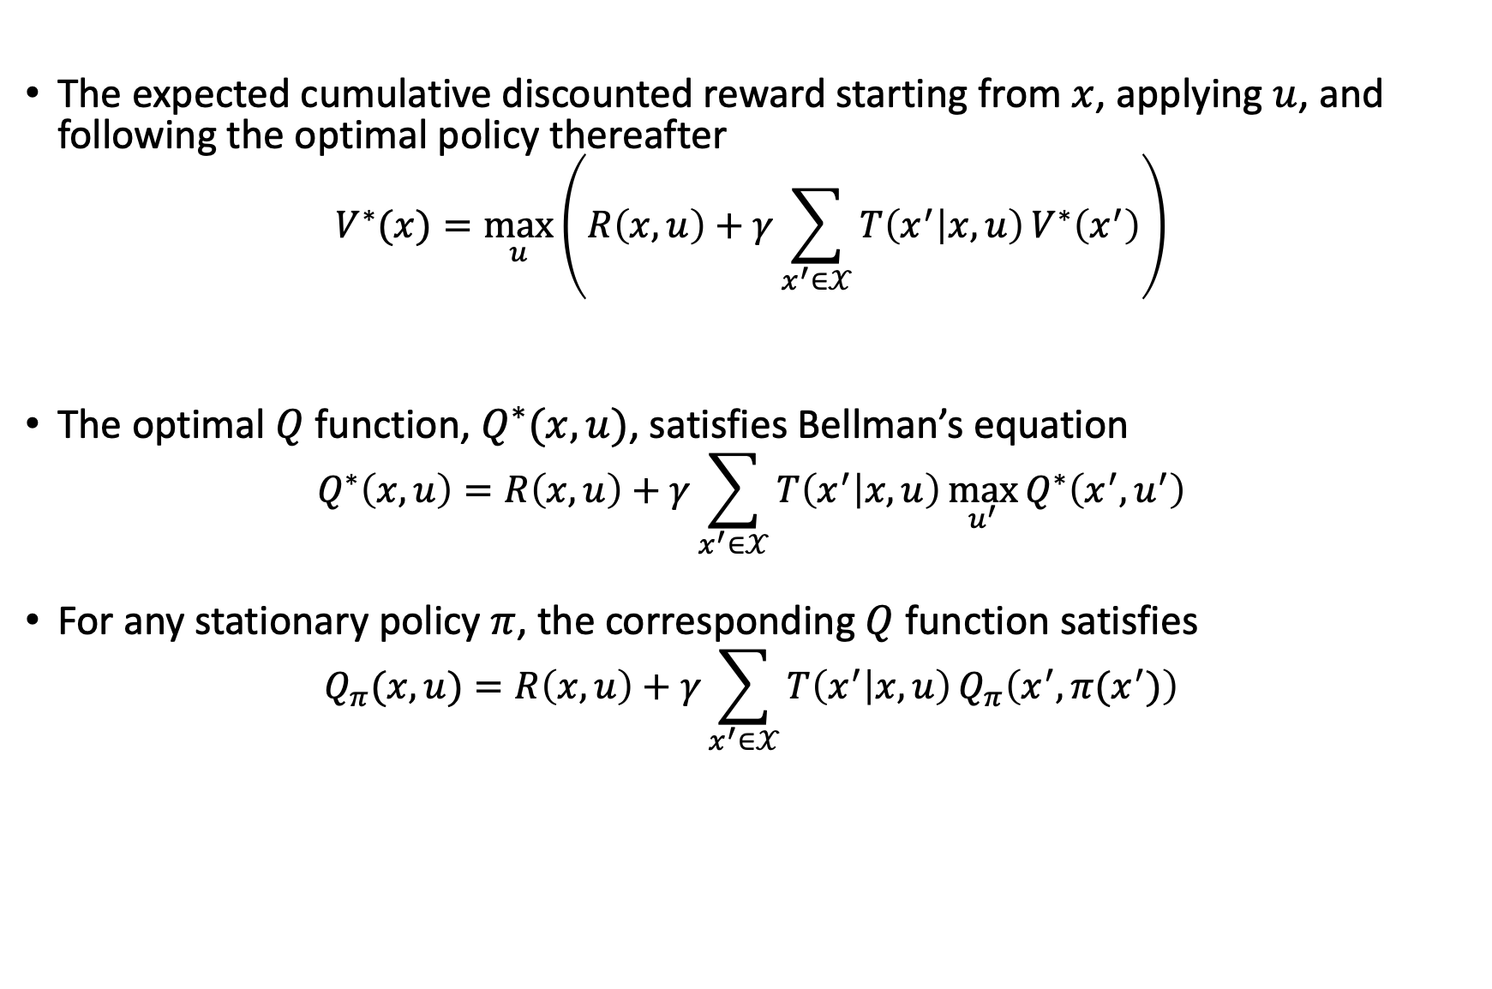

State-action value functions (Q functions)
The expected cumulative discounted reward starting from $x$, applying $u$, and following the optimal policy thereafter
$$V^{∗}(x)=\max_{u}\left(R\left(x,u\right)+γ\sum_{x^{′}∈𝒳}{T\left(x^{′} | x,u\right)}V^{∗}\left(x^{′}\right)\right)$$
The optimal $Q$ function, $Q^{∗}(x,u)$, satisfies Bellman’s equation
$$Q^{∗}\left(x,u\right)=R\left(x,u\right)+γ\sum_{x^{′}∈𝒳}{T\left(x^{′} | x,u\right)}\max_{u^{′}}{Q^{∗}\left(x^{′},u^{′}\right)}$$
For any stationary policy $π$, the corresponding $Q$ function satisfies
$$Q_{π}(x,u)=R\left(x,u\right)+γ\sum_{x^{′}∈𝒳}{T\left(x^{′} | x,u\right)}Q_{π}\left(x^{′},π(x^{′})\right)$$
$$Q^{∗}(x,u)$$

Slide 19
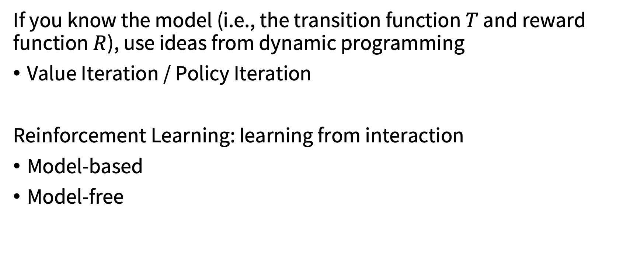
Solving infinite-horizon MDPs
If you know the model (i.e., the transition function $T$ and reward function $R$), use ideas from dynamic programming
Value Iteration / Policy Iteration
Reinforcement Learning: learning from interaction
Model-based
Model-free

Slide 20
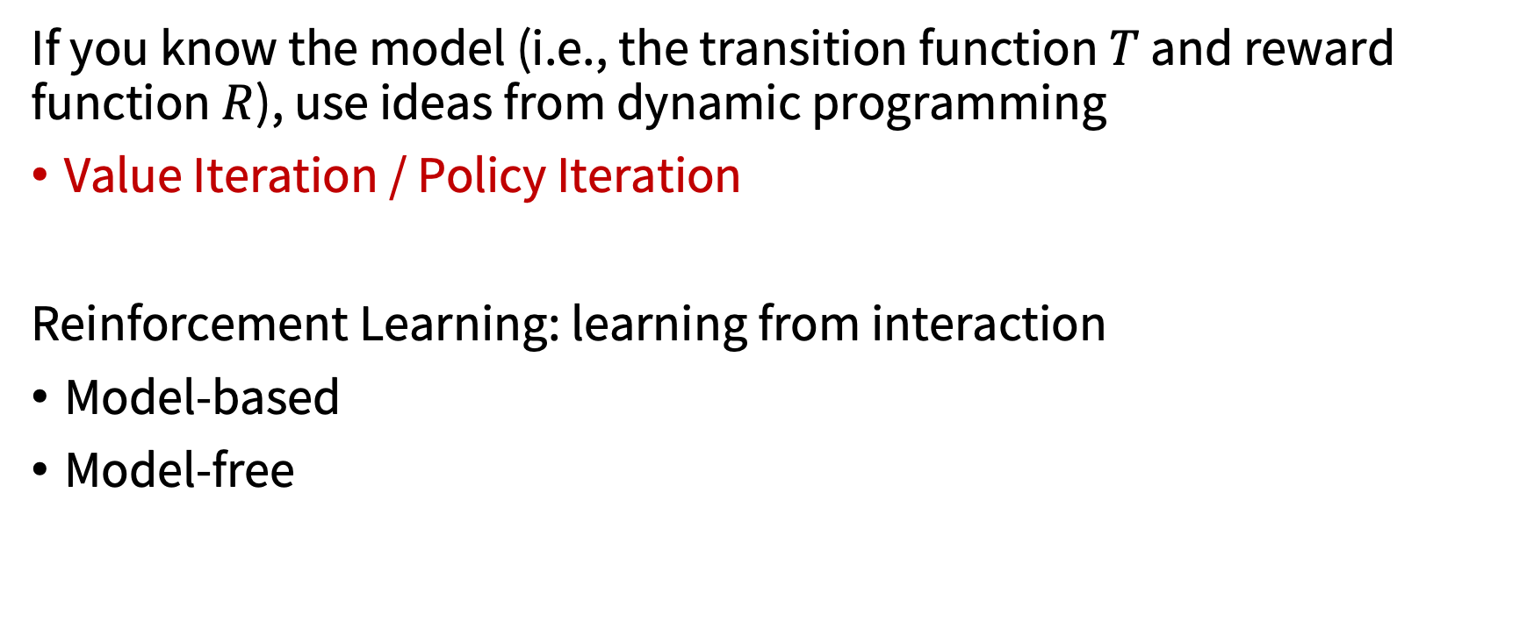
Solving infinite-horizon MDPs
If you know the model (i.e., the transition function $T$ and reward function $R$), use ideas from dynamic programming
Value Iteration / Policy Iteration
Reinforcement Learning: learning from interaction
Model-based
Model-free

Slide 21
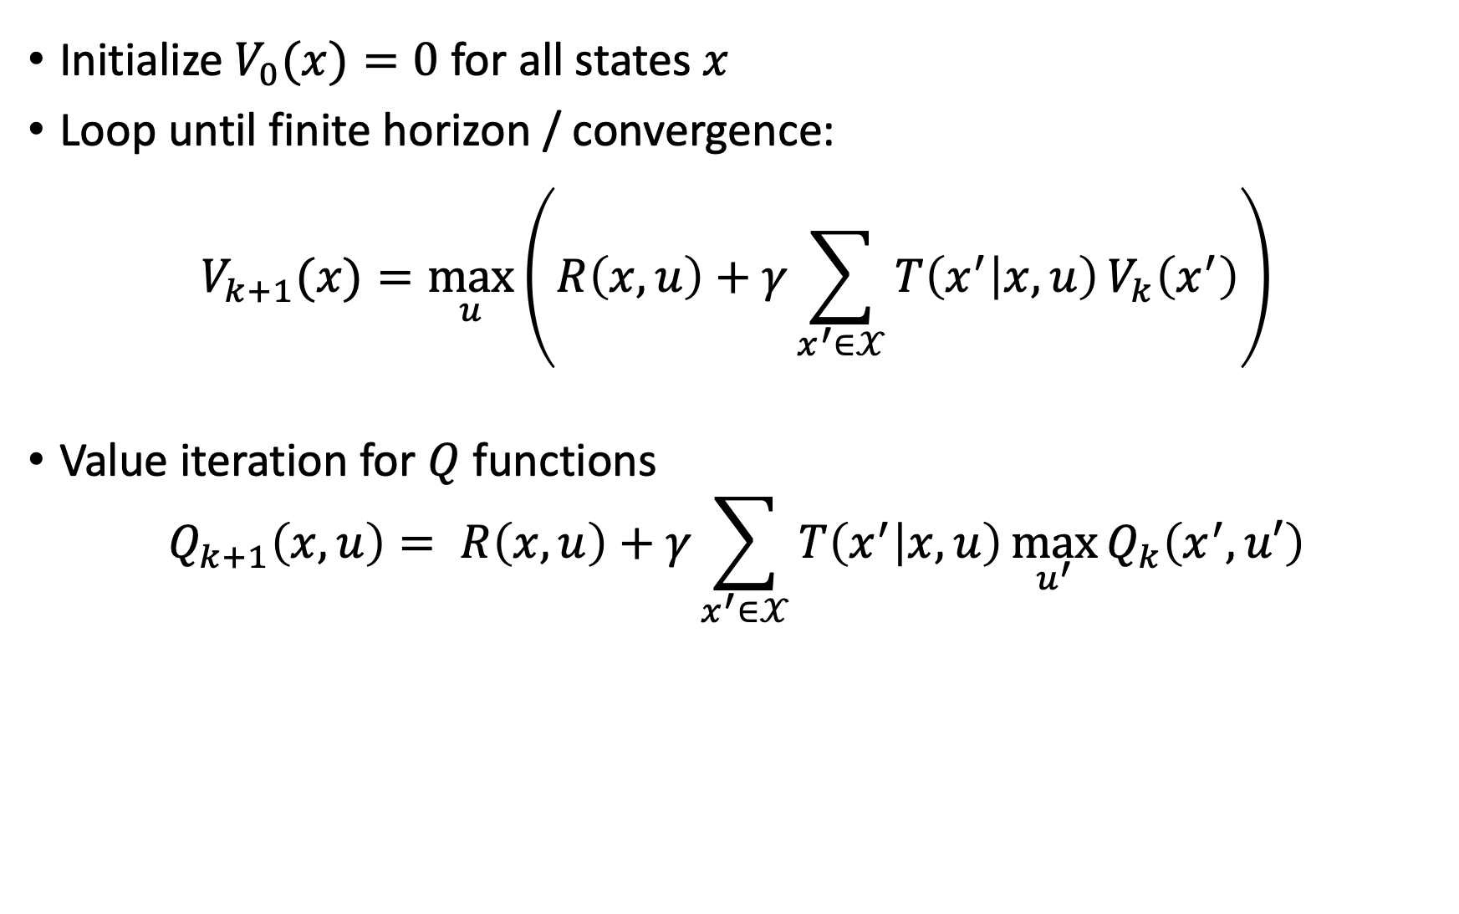
Value Iteration
Initialize $V_{0}(x)=0$ for all states $x$
Loop until finite horizon / convergence:
$$V_{k+1}(x)=\max_{u}\left(R\left(x,u\right)+γ\sum_{x^{′}∈𝒳}{T\left(x^{′} | x,u\right)}V_{k}\left(x^{′}\right)\right)$$
Value iteration for $Q$ functions
$$Q_{k+1}\left(x,u\right)= R\left(x,u\right)+γ\sum_{x^{′}∈𝒳}{T\left(x^{′} | x,u\right)}\max_{u^{′}}{Q_{k}\left(x^{′},u′\right)}$$

Slide 22
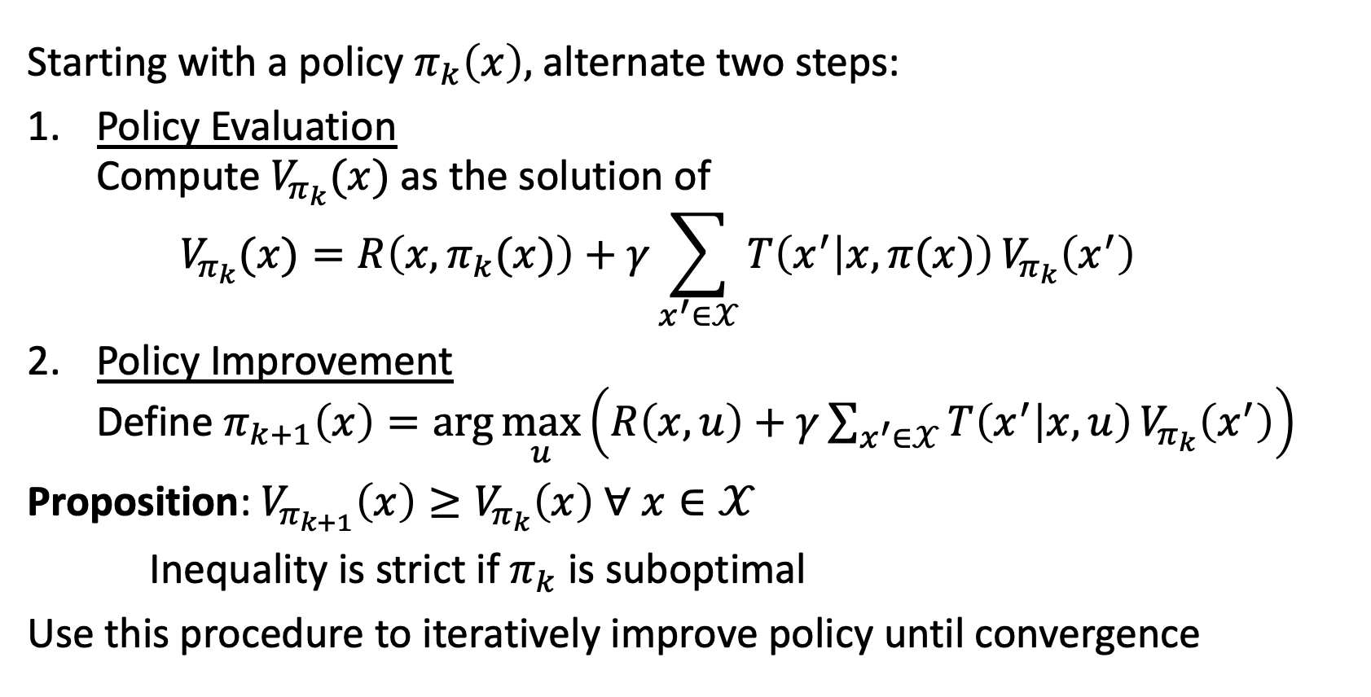
Policy Iteration
Starting with a policy $π_{k}\left(x\right),$ alternate two steps:
Policy Evaluation Compute $V_{π_{k}}(x)$ as the solution of $V_{π_{k}}(x)=R\left(x,π_{k}(x)\right)+γ\sum_{x^{′}∈𝒳}{T\left(x^{′} | x,π(x)\right)}V_{π_{k}}\left(x^{′}\right)$
Policy Improvement Define $π_{k+1}\left(x\right)=\arg{\max_{u}}\left(R\left(x,u\right)+γ\sum_{x^{′}∈𝒳}{T\left(x^{′} | x,u\right)}V_{π_{k}}\left(x^{′}\right)\right)$
Proposition: $V_{π_{k+1}}\left(x\right)≥V_{π_{k}}\left(x\right) ∀ x∈𝒳$
Inequality is strict if $π_{k}$ is suboptimal
Use this procedure to iteratively improve policy until convergence

Slide 23
Recap
Value Iteration
Estimate optimal value function
Compute optimal policy from optimal value function
Policy Iteration
Start with random policy
Iteratively improve it until convergence to optimal policy
Requires model of MDP to work!

Slide 24
Next time
HJB, HJI, and reachability analysis

