Slide 1
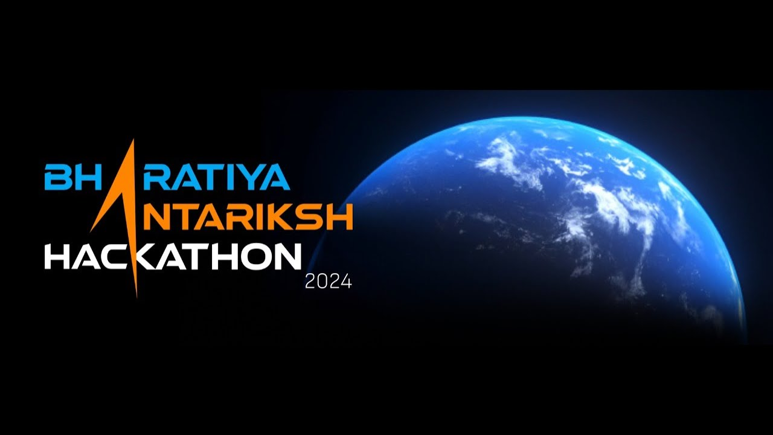
Name of the team: Cosmic Titans
Team members details: 1. Rajdeep Choudhury (From Amity University)
2. Poran Dip Boruah (From Assam Engineering College)
3. Jitu Pegu (From Dhemaji Engineering College)
4. Dikshyan Chakraborty (From Lovely Professional University)

Slide 2
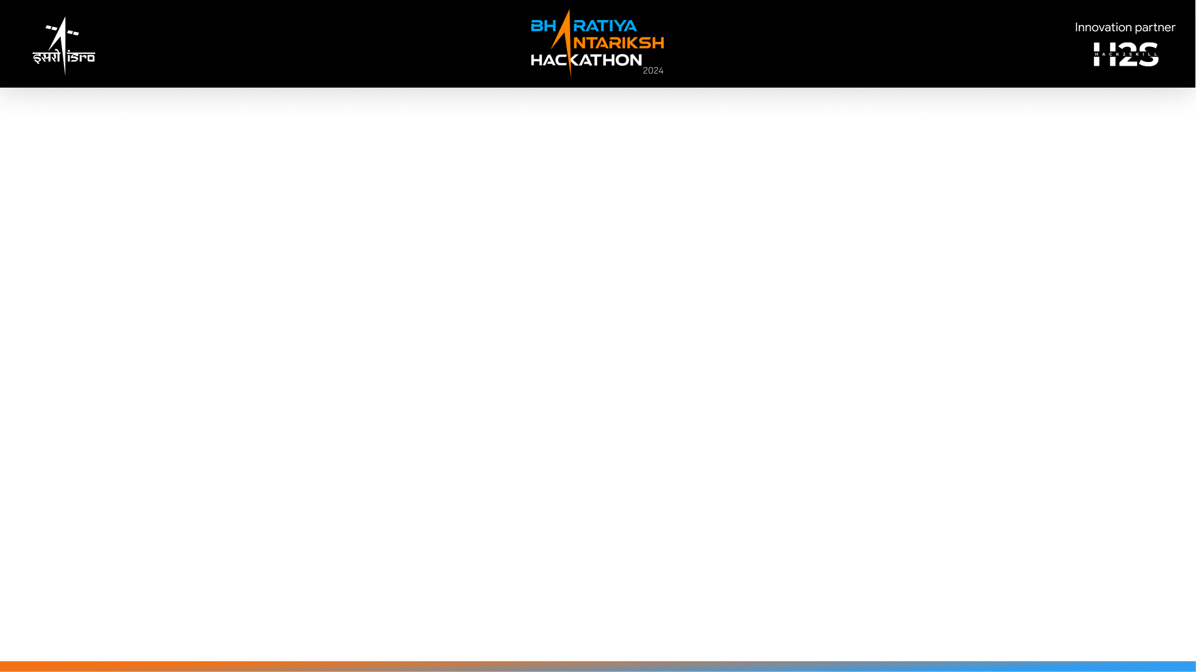
Detailed solution and Approach
Our team has chosen the problem statement 11: Luner surface image simulation and visualization. We use python programming language for this topic. We utilize python libraries like NumPy for numerical computations, Matplotlib for basic plotting and more advanced libraries like VTK for 3D rendering. To obtain high resolution topographic data of the Luner surface we used the data of
NASA’s Lunar Reconnaissance Orbiter(LRO) mission and other publicly available dataset.
We create a mesh grip that represents the Luner surface. This can be done by using NumPy’s mesh grid function, which will create a grid of x, y coordinates based on the topographical data.
To enhance realism, we implement lighting models to stimulate sunlight and shadows on the Luner surface.

Slide 3
Tools and Technology used
To create a lunar surface simulation and visualization, you will need a variety of tools and technologies. Here's a detailed list:
For programming language:
We will use python programming language.
2. Data handling:
We will use NumPy for numerical operations and handling large data efficiency.
3. Visualization:
We will use Matplotlib for creating static, Plotly for web-based visualization and VTK (The Visualization Toolkit) for 3D simulation and image processing.
4. Development environment:
We will use PyCharm for a more robust development environment.
Data source:
USGS (United States Geological Survey) and NASA’s PDS(Planetary Data System).

Slide 4
Opportunity should be explained the following
1. How different is it from any of the other existing ideas?
-> By using our program, we can get more accurate data more than other existing ideas.
2. How will it be able to solve the problem?
-> Since it can provide accurate data, so it can help in upcoming Luner projects going on in ISRO and also help to know more about Moon surface.
3. USP of the proposed solution.
-> 1. Modular Design: Design with a modular approach, making it easy to extend and use for research and educational purpose.
2. Machine Learning Integration: Offers optional integration with machine learning for predictive modelling and advanced simulations.
3. User friendly development and deployment.

Slide 5
Proposed architecture/User diagram
Data Acquisition
Source: NASA’s PDS,USGS
Programming Language
Python
Tools: NumPy, PIL
Simulation
NumPy
User Interface
PyCharm
Visualization
Tools: Matplotlib, Plotly,
VKT

Slide 6
List of features offered by the solution
The features are:
1. High resolution data integration.
2. Realistic terrain simulation.
3. Interactive and immersive visualization.
4. User friendly development and testing.
5. Use as an education and research tools.

Slide 7
Process flow diagram
Data Acquisition
Source: NASA’s PDS,USGS
Programming Language
Python
Tools: NumPy, PIL
Simulation
NumPy
User Interface
PyCharm
Visualization
Tools: Matplotlib, Plotly,
VKT

Slide 8
Solution brief
Creating a Luner surface simulation and visualization system involves collecting high resolution data, processing it for accuracy, stimulating realistic terrain features and providing interactive visualization. This solution leverages various Python libraries and tools to achieve these goals efficiently.
Key Components:
To create a lunar surface simulation and visualization, you will need a variety of tools and technologies. Here's a detailed list:
For programming language:
We will use python programming language.
2. Data handling:
We will use NumPy for numerical operations and handling large data efficiency.

Slide 9
3. Visualization:
We will use Matplotlib for creating static, Plotly for web-based visualization and VTK (The Visualization Toolkit) for 3D simulation and image processing.
4. Development environment:
We will use PyCharm for a more robust development environment.
Data source:
USGS (United States Geological Survey) and NASA’s PDS(Planetary Data System).
By combining high-fidelity data, advanced processing techniques, realistic simulations and interactive visualizations, this solution provides a comprehensive and user friendly tool for exploring and studying the Luner surface.

Slide 10
