Slide 1

Seasonal Agriculture Performance Analysis
Vennapusa Purushotham Reddy
Tadipatri Engineeing College
AICTE STU ID : STU688225a65b9121753359782

Slide 2

PROBLEM STATEMENT
Agricultural activities are influenced by seasonal variations in environmental conditions, farming practices, resource availability and market conditions.
As a result, agricultural performance may differ from one season to another. However, raw agricultural data does not clearly explain how agricultural performance changes across seasons or what patterns can be observed in different seasonal conditions.
The problem is to analyze the given agricultural dataset and investigate seasonal differences in agricultural performance by identifying meaningful patterns, trends, relationships and variations within the available data.

Slide 3
Project Description
Agricultural activities are influenced by seasonal variations in environmental conditions, farming practices, resource availability and market conditions.
As a result, agricultural performance may differ from one season to another.
However, raw agricultural data does not clearly explain how agricultural performance changes across seasons or what patterns can be observed in different seasonal conditions.
The problem is to analyze the given agricultural dataset and investigate seasonal differences in agricultural performance by identifying meaningful patterns, trends, relationships and variations within the available data.

Slide 4

WHO ARE THE END USERS?
Farmers: For crop selection, irrigation, and seasonal planning.
Agricultural Planners: To compare seasonal and regional performance.
Agricultural Researchers: To study crop, soil, weather, and resource patterns.
Government & Agriculture Departments: For data-based agricultural planning.
Farm Management Teams: To analyze costs, revenue, profit, and resource efficiency.

Slide 5

Technology Used
  Python
  Pandas for data cleaning and analysis
  NumPy for numerical operations
  Matplotlib for data visualization
  Seaborn for statistical visualizations J
  upyter Notebook / Google Colab for analysis
  CSV Dataset for storing and processing agricultural data
  GitHub for project repository and version sharing

Slide 6
RESULTS
Insights and Visualizations
Visualization | Brief Finding
Seasonal Yield | Kharif had the highest yield: 5.63 t/ha
Seasonal Profit | Kharif was most profitable; Zaid showed a loss
Crop Profitability | Sugarcane & Chilli were the top profitable crops
Irrigation vs Yield | Drip irrigation recorded 6.58 t/ha average yield
Rainfall vs Yield | Very weak linear relationship (r ≈ 0.031)
Correlation Analysis | Water efficiency and yield showed a strong relationship (r = 0.913)

Slide 7
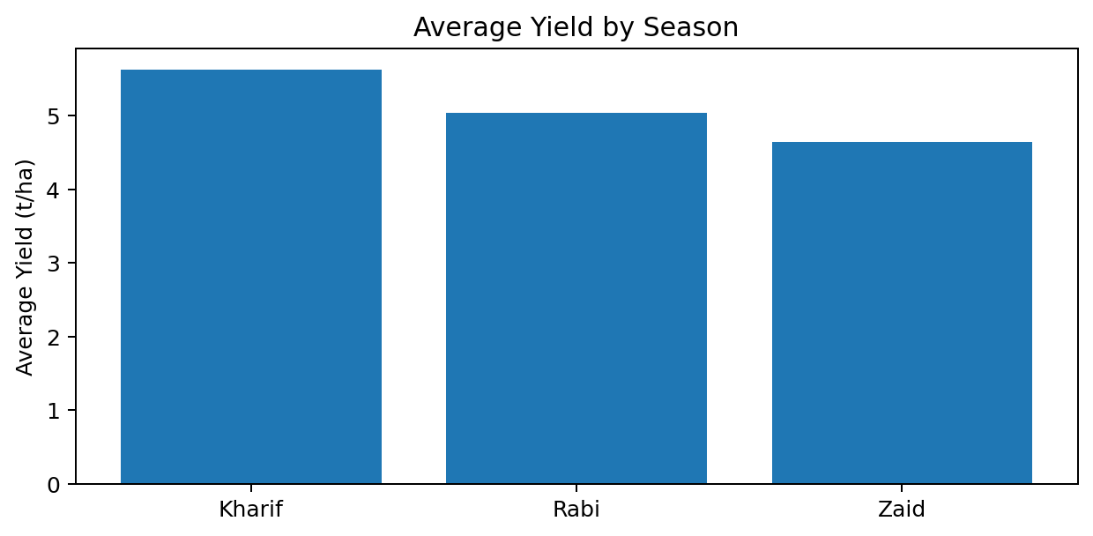
Seasonal Yield Comparison
Kharif recorded the highest average yield at 5.63 t/ha.
Rabi averaged 5.04 t/ha, while Zaid averaged 4.64 t/ha.
The result shows a clear difference in average productivity across seasons.

Slide 8
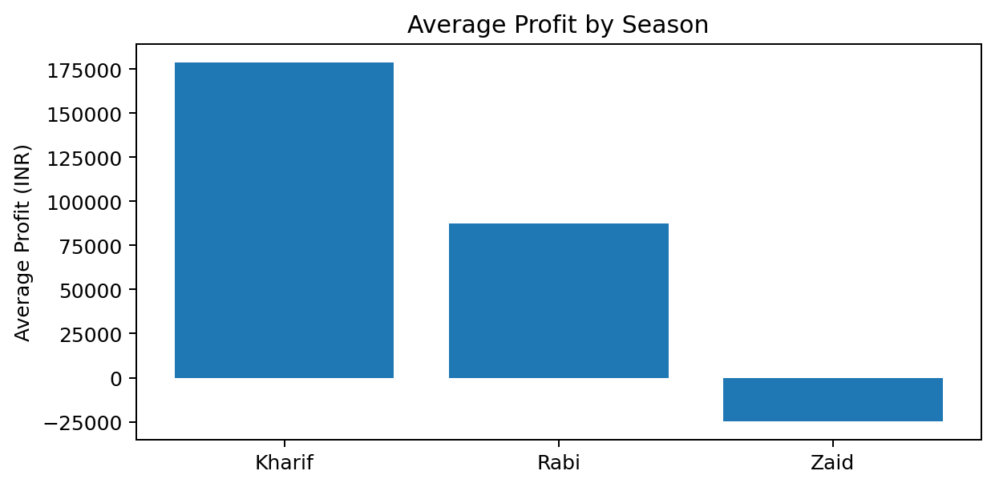
Seasonal Profit Comparison
Kharif had the highest average profit at ₹1,78,914.65.
Rabi recorded ₹87,689.47 average profit.
Zaid recorded an average loss of ₹24,804.82.

Slide 9
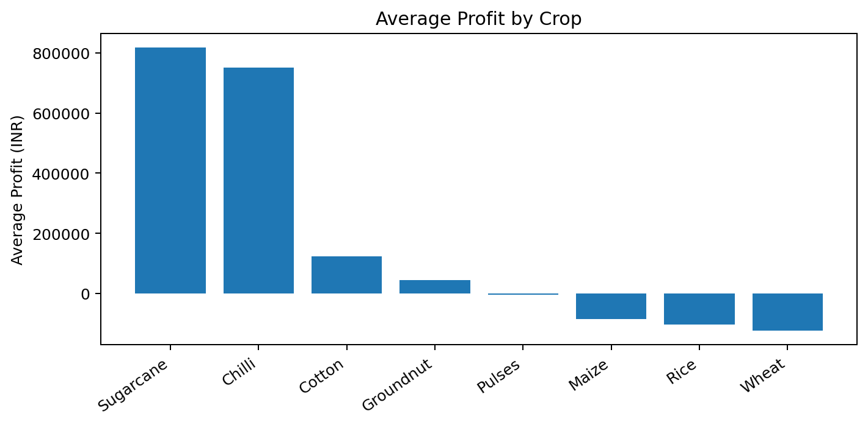
Crop-wise Profitability
Sugarcane had the highest average profit at ₹8,17,187.99.
Chilli followed with ₹7,50,878.34.
Rice, Wheat and Maize showed negative average profit in the analyzed data.

Slide 10
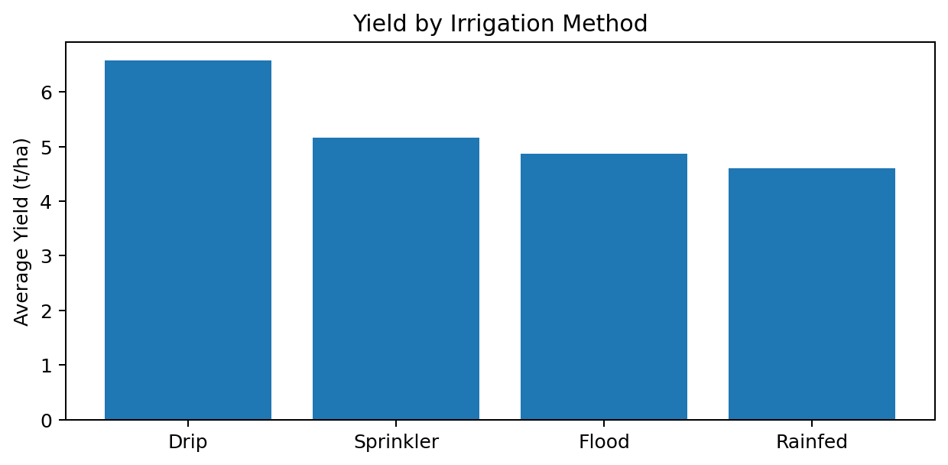
Irrigation and Yield
Drip irrigation recorded the highest average yield at 6.58 t/ha.
Its average profit was ₹2,19,626.
Rainfed showed the highest water-efficiency value, but its yield and profit were lower than Drip.

Slide 11
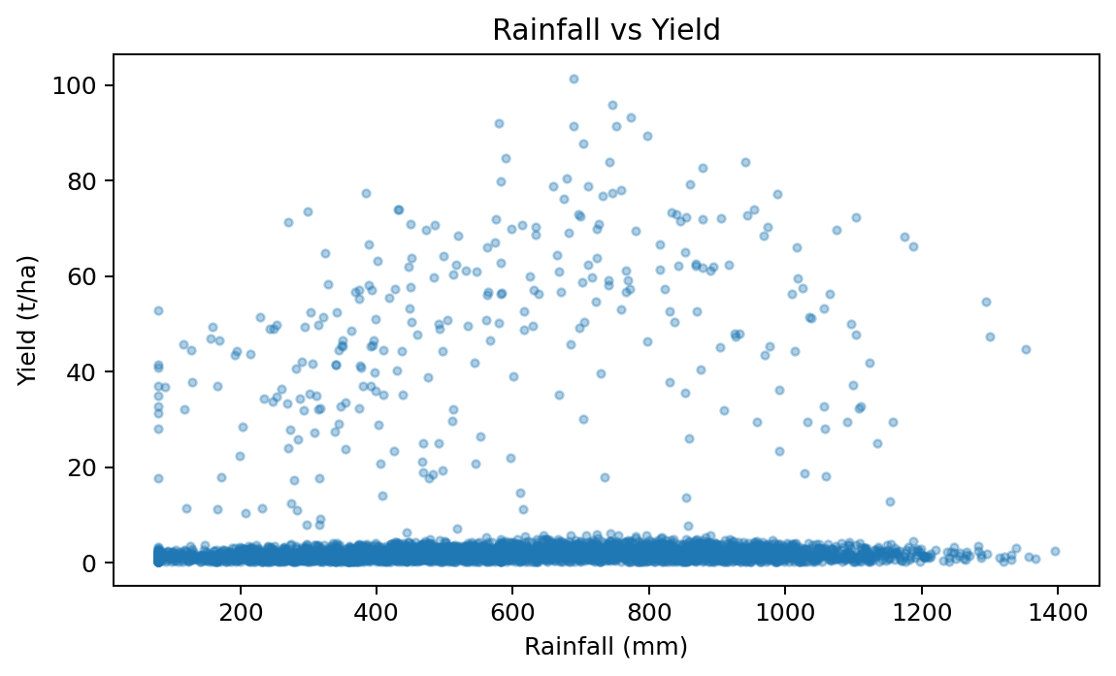
Environmental Relationship: Rainfall and Yield
Rainfall was examined against yield to understand environmental relationships.
The correlation between rainfall and yield was weak at about 0.031.
This suggests rainfall alone does not explain yield differences in this dataset.

Slide 12
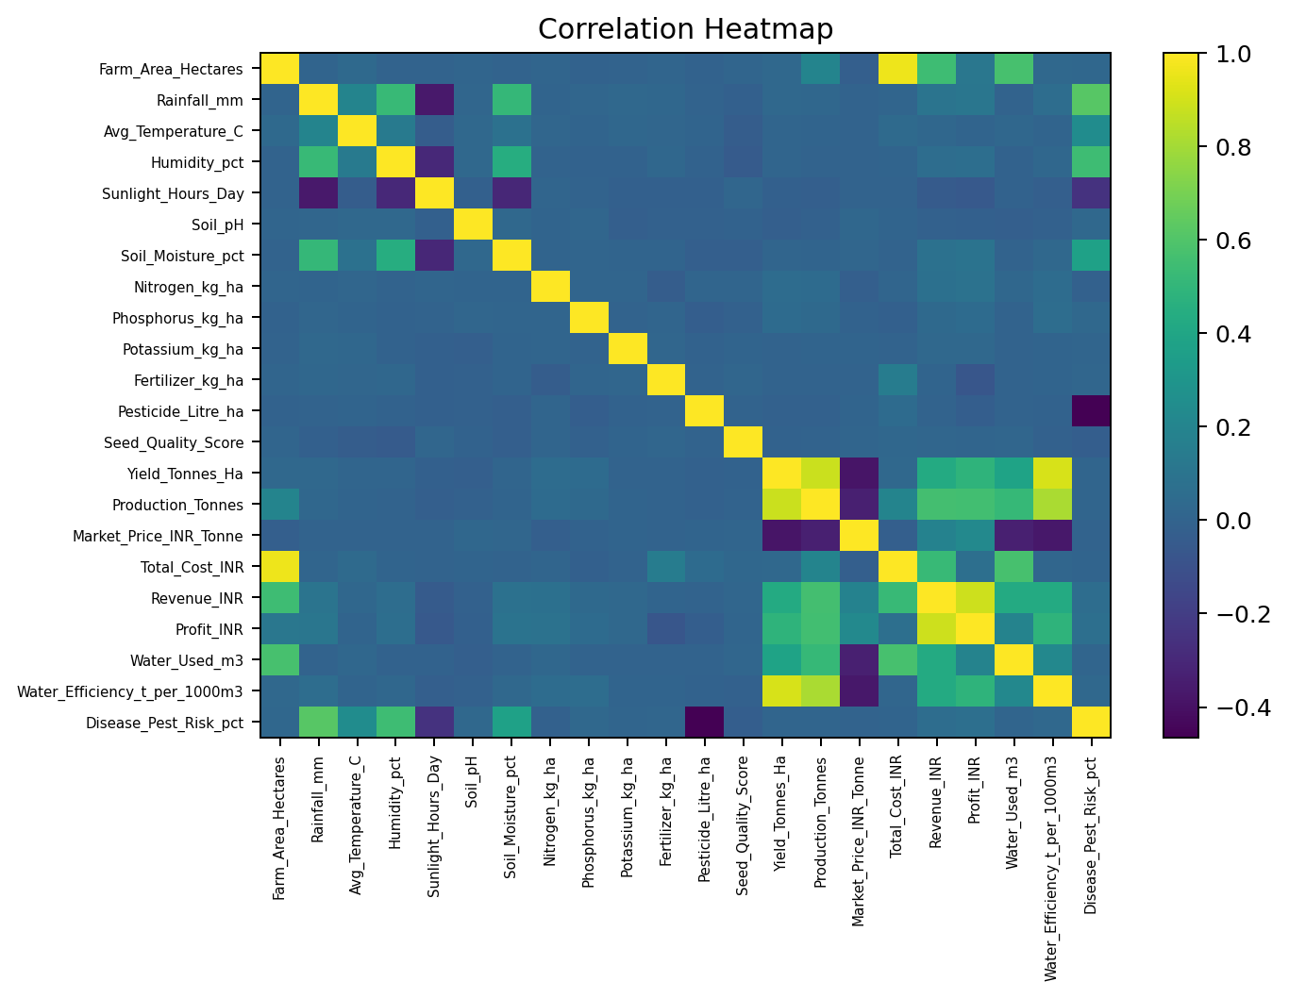
Correlation Analysis
Water efficiency had a strong positive correlation with yield: 0.913.
Production also had a strong relationship with yield: 0.883.
Revenue showed a strong positive relationship with profit: 0.887.
Correlation indicates association, not direct causation.

Slide 13
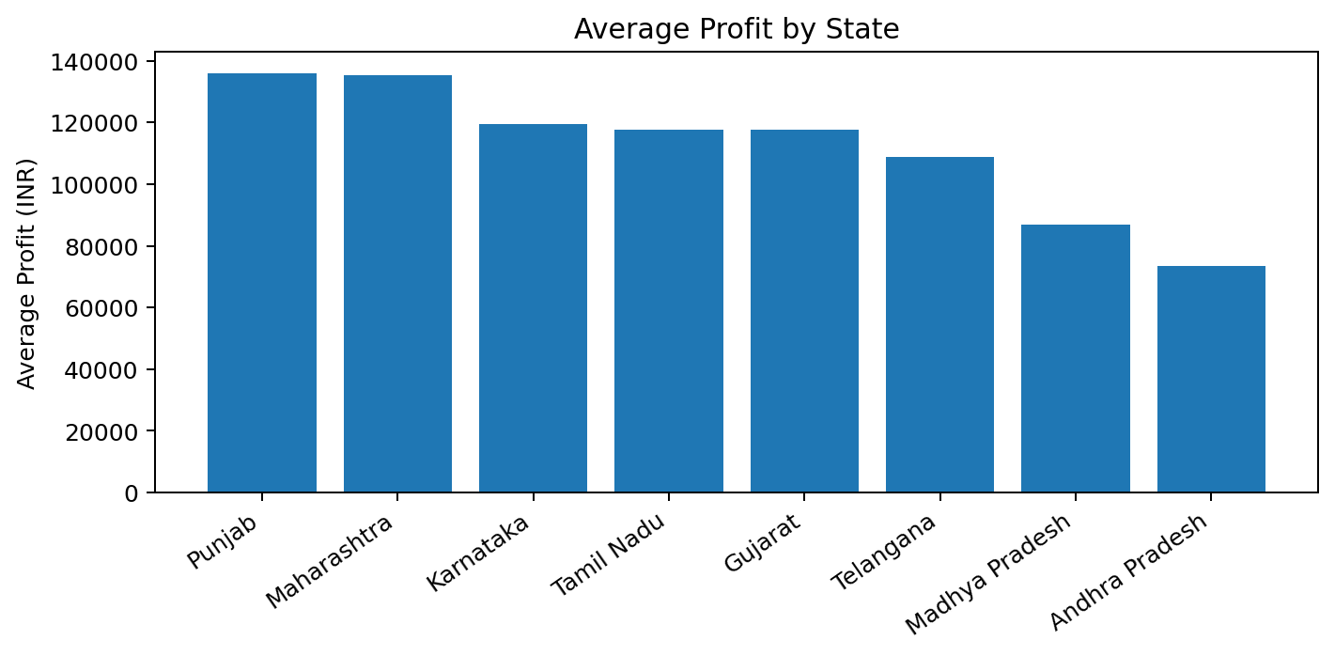
Regional Profit Comparison
The dataset includes 8 states and 10 districts.
Regional averages were compared to identify differences in profitability.
This view can help identify locations that deserve further investigation.

Slide 14
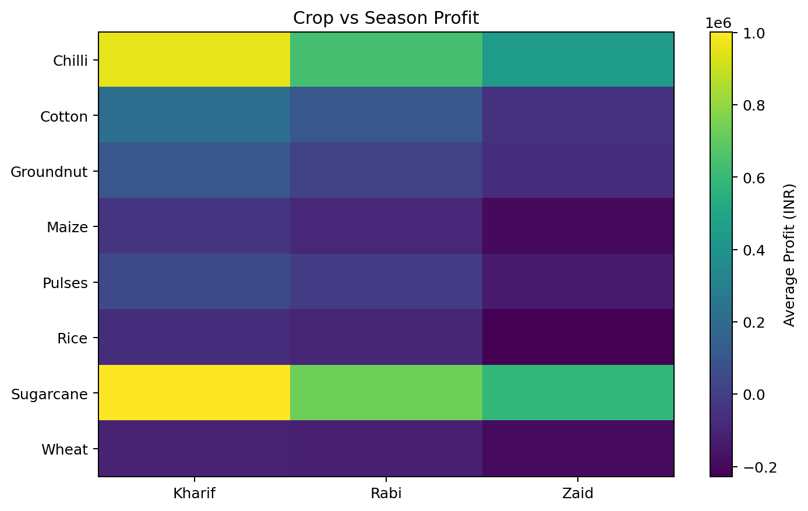
Crop and Season Profit Pattern
Sugarcane and Chilli were consistently among the strongest profit-generating crop groups.
Sugarcane + Kharif was the highest-profit crop-season combination in the analysis.
Crop performance changes across seasons, so crop selection should consider season as well.

Slide 15
RESULTS
Overview:
1. Seasonal Performance
Kharif recorded the highest average yield (5.63 t/ha) and profit (₹1.79 lakh).
Zaid performed weakest, with 4.64 t/ha yield and an average loss of ₹24,805.
2. Crop Profitability
Sugarcane (₹8.17 lakh) and Chilli (₹7.51 lakh) had the highest average profits.
Rice, Wheat and Maize showed negative average profit in the analyzed dataset.
3. Irrigation Performance
Drip irrigation recorded the highest average yield at 6.58 t/ha.
Rainfed farming had the highest calculated water efficiency at 7.56 t/1000 m³.
4. Water Efficiency
Water efficiency showed a very strong positive relationship with yield (r = 0.913).
This indicates that better water utilization was strongly associated with higher yield in the dataset.
5. Environmental Factors
Rainfall and yield showed a very weak linear relationship (r ≈ 0.031).
Other environmental and farm conditions may contribute to yield variation.

Slide 16
RESULTS
6. Economic Relationships
Revenue and profit had a strong positive relationship (r = 0.887).
Production also showed a positive relationship with yield (r = 0.883).
7. Agricultural Inputs
Fertilizer quantity showed almost no linear relationship with yield (r ≈ 0.000).
Seed quality also showed a very weak relationship with yield (r ≈ -0.007).
8. Pest & Disease Risk
Kharif had the highest average disease/pest risk at 54.47%.
This suggests that higher-performing seasons may still require stronger pest monitoring.
9. Crop-Season Pattern
Sugarcane + Kharif had the highest average profit (₹10.01 lakh).
Chilli + Kharif followed with approximately ₹9.54 lakh average profit.
10. Regional Analysis
Profitability varied across regions, showing that agricultural performance was not uniform.
Regional and crop-season differences should be considered before making broader decisions.

Slide 17
Future scope
Predictive Analysis: Develop models to predict crop yield, profit, and seasonal performance using historical data.
Weather Integration: Include real-time weather data such as rainfall, temperature, and humidity for better planning.
Crop Recommendation: Build a system that recommends suitable crops based on soil, season, weather, and expected profitability.
Smart Irrigation: Use IoT sensors to monitor soil moisture and optimize water usage.
Disease Detection: Add machine-learning-based crop disease and pest detection.
Real-Time Dashboard: Develop an interactive dashboard for farmers and agricultural departments to monitor performance.
Market Price Prediction: Analyze and predict future crop prices to support better selling decisions.
Larger Dataset: Include more years, regions, crops, and farm-level data for more reliable analysis.

Slide 18
GitHub Link
https://github.com/porasalex/Seasonal-Agriculture-Performance-Analysis.git

Slide 19

VOIS Course completion certificate -
Course name- Data Visualization

Slide 20
Thank you
THE – END
.
.

