Slide 1
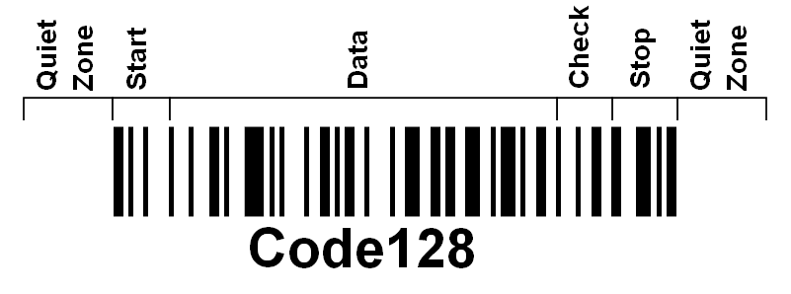


Barcodes
Quite Zone: | The blank spaces before and after the barcode. They help the barcode reader to distinguish the barcode from other markings.
Start: | Identifies the beginning of the barcode.
Data: | Besides hold information, there are also special function characters that may be encoded within the DATA for various purposes.
Check: | The check character is used to verify integrity of the data as a whole and must be calculated as part of both the barcode printing and reading process.
Stop: | The STOP character ends the barcode and has a value of 106 for all three Code Sets.
Quiz
Notes:
EE, BYU
https://www.precisionid.com/code-128-faq/

Slide 2
BARCODES
Quiet Zone –
Start –
Data –
Check –
Stop –
Explain how to find out the ASCII sequence in binary. By counting either 0’s or 1’s

