Slide 1
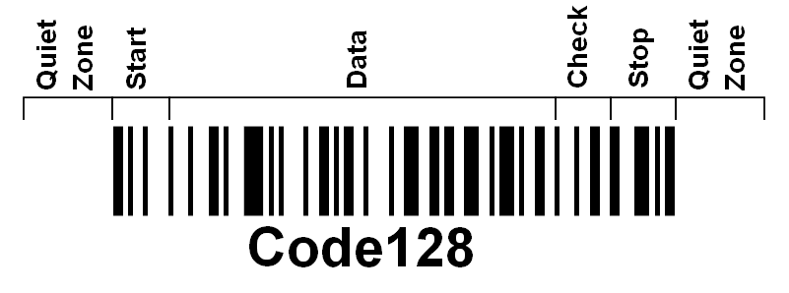
BARCODES
Quiet Zone –
Start –
Data –
Check –
Stop –
Explain how to find out the ASCII sequence in binary. By counting either 0’s or 1’s

