Slide 1
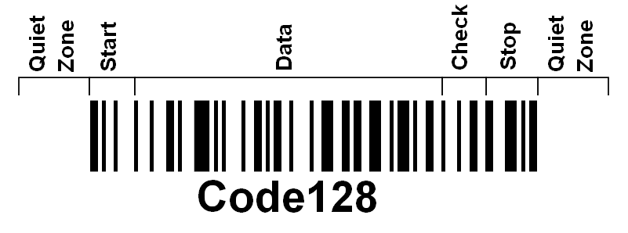


Barcodes
Quite Zone: | The blank spaces before and after the barcode. They help the barcode reader distinguish the barcode from other markings.
Start: | Identifies the beginning of the barcode. It always holds the same value
Data: | This is where the information is stored, usually a string of characters, though it also may include special function characters that may be encoded within the DATA for various purposes.
Check: | The check character is used to verify integrity of the data as a whole and must be calculated as part of both the barcode printing and reading process.
Stop: | The STOP character ends the barcode and has a value of 106.
Quiz
There are 4 sizes of bars within the barcode each size encodes a number of 1’s or 0’s the smallest including only 1 value while the biggest is 4 values. If a bar is black it is a 1, if it is white it encodes a 0. TIP: only account for the values in the data section of the barcode.
Notes:
EE, BYU
https://www.precisionid.com/code-128-faq/
https://www.barcodefactory.com/code128-barcode-generator
https://github.com/porcupineparty/PointOfSale
https://www.youtube.com/watch?v=dpdzkgHecQ4

Slide 2
BARCODES
Quiet Zone –
Start –
Data –
Check –
Stop –
Explain how to find out the ASCII sequence in binary. By counting either 0’s or 1’s

